Slide 1

First Order Nonlinear ODEs
P M V Subbarao
Professor
Mechanical Engineering Department
I I T Delhi
Understanding of Non-linear Nature of Thermofluid Properties….

Slide 2

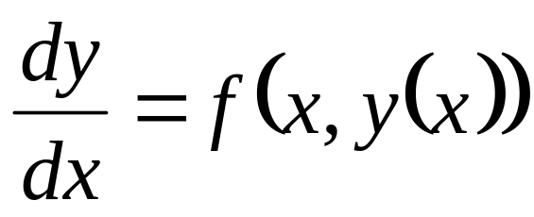
General First Order ODEs : Definition
The first-order linear differential equation (on the unknown y is
where f(x,y(x)) is given or known and this called as source function.
The equation is nonlinear if the source function f is not linear on its second argument,

Slide 3
First Order Nonlinear Ordinary Differential Equations
Generally do not have closed-form solutions.
Great mathematicians of 17th and 18th century studied very few selected non-linear FO-ODEs to develop implicit solution methodologies.
Out of many NL FO-ODEs, there is only one case in which a solution may be explicitly obtained.
These are called as Exact Equations.

Slide 4
Classification of NL FO-ODE
A major classification of NL FO-ODE is based on autonomy of the equation.
Autonomous NL FO-ODEs.
Nonautonomous NL FO-ODEs.

Slide 5
Newton’s Study on Nonlinear Thermofluid Systems
In 1701, Newton published (in Latin and anonymously) in the Phil. Trans. of the Royal Society a short article (Scala graduum Caloris).
He did not write any formula but expressed verbally his cooling law:
The excess of the degrees of the heat … were in geometrical progression when the times are in an arithmetical progression.
if equal time of cooling be taken, the degrees of heat will be in geometrical proportion.

Slide 6
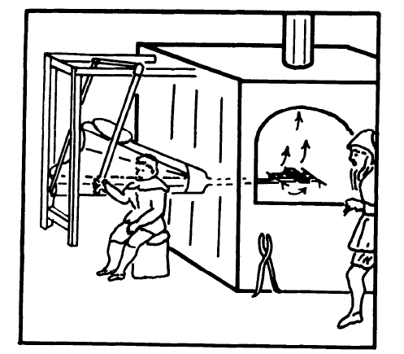
A plausible 'wind tunnel' for Newton's cooling experiments.

Slide 7
Measurements made by Sir Newton
Started putting on thick piece hot (almost soft) particles of several metals, and other fusible bodies.
The time of its cooling was marked, till all the particles were hardened.
The time of cooling of the iron was marked, till equal to the heat of the human body.

Slide 8
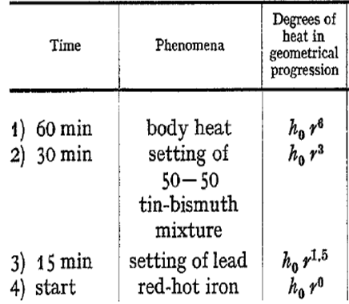
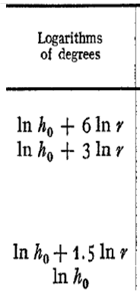
Table of Observations from Newton’s Experiment

Slide 9
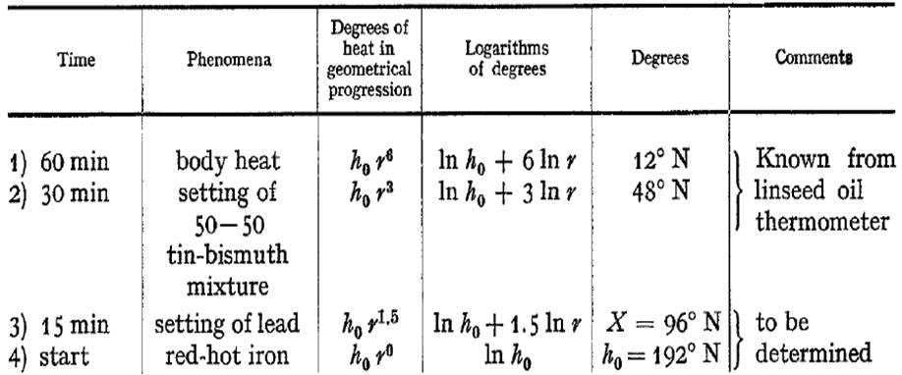
Table of Observations from Newton’s Experiment & Anlaysis

Slide 10
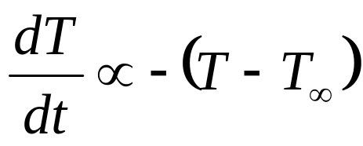
Modern Definition :
Newton’s Law of Cooling
Newton’s Law of Cooling states:
if an hot object is placed in a room, it will cool until it reaches room temperature. More precisely, it states that the rate of change of the object is negatively proportional to the difference between the current temperature and the room temperature.
If T is the temperature and T∞ is the constant room temperature,

Slide 11
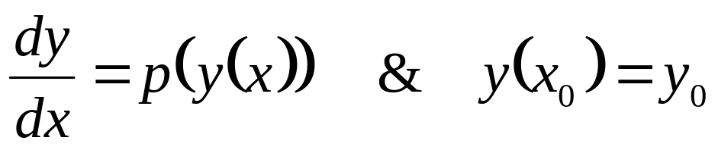
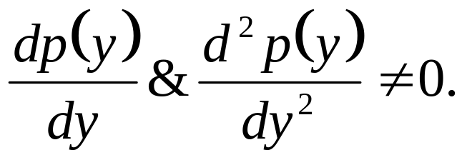
Autonomous Differential Equation
An autonomous differential equation is an ordinary differential equations which does not explicitly depend on the independent variable.
When the independent variable is time, they are also called time-invariant systems.
An important property of autonomous ODEs, is that the solution mapping depends only on increment of independent variable, but not separately on the variable.
An autonomous, nonlinear, first-order differential equation has the following form:
where

Slide 12
The Guess and Check method
Guess and check is a method, in which any function that satisfies the autonomous equation is found.
It doesn't matter what method is used to find the function.
The task is to prove that it is a solution.
The way to guess is to use your knowledge and intuition to find a function whose derivative behaves in the required way.

Slide 13
Guess An Autonomous NL FO-ODE

Slide 14
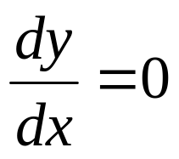
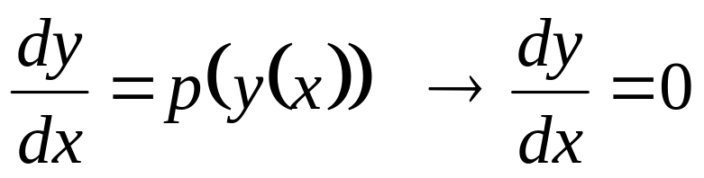
Equilibrium of Autonomous Systems
An equilibrium solution is a constant solution, y=C.
Equilibrium solutions of autonomous differential equations can be found by setting
Every autonomous system tends to move towards equilibrium.

Slide 15
Classification of Equilibrium States
Equilibrium solutions are then classified based on the behavior of solutions near the equilibrium solution.
The three types of equilibrium solutions are:
Stable: An equilibrium solution is called stable (or asymptotically stable), if you were to move the initial condition slightly above or below the equilibrium solution, then the solution would return to the equilibrium solution in the long run x→∞.
Unstable: An equilibrium solution is called unstable, if you were to move the initial condition slightly above or below the equilibrium solution, then the solution would move away from the equilibrium, never to return.

Slide 16
Classification of Equilibrium States
Semi-Stable: An equilibrium solution called semi-stable, if the behavior depends on if you moved slightly above or below.
One direction would act like a stable solution, and return you to the equilibrium solution, while the other would act like an unstable solution, and move you away.

Slide 17
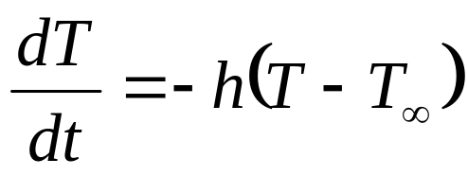
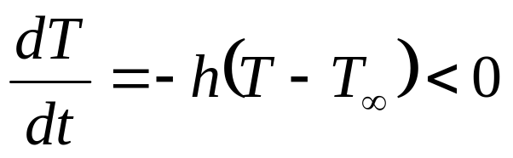
Newtons Law of Cooling & Stability
Newton’s Law of Cooling:
T=T∞ is the equilibrium solution.
Lets see what happen if we change the temperature to be slightly warmer and slightly cooler than room temperature.
If an object is slightly warmer than room temperature, T >T∞
Thus the object would cool until it reached room temperature again.
The equilibrium solution is stable.

Slide 18
Equilibrium State of A Thermofluid System
Autonomous nature of thermofluid systems showed many derived properties.
A Property of a System can be determined if and only if the system is in Equilibrium.

Slide 19
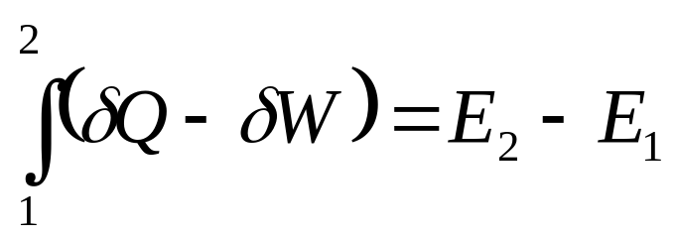
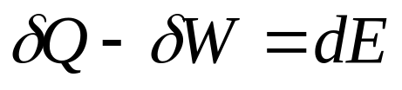
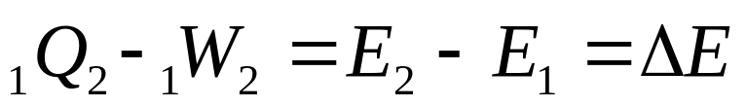
First law for a Control Mass during a Process
The change in energy of a system during a change of state is numerically equal to the algebraic sum of heat transfer during the process and the work transfer during the process.
Remarks:
Only change of energy has been defined.
Zero Energy has to be expressed with respect to some arbitrary reference!
Q and W must be measured in same units.

Slide 20
Autonomous Nature of Internal Energy of Poly-atomic Gas
Internal energy of a gas is due to microscopic kinetic energy of molecules.
An absolute temperature can be used as an independent property of an ideal gas deciding the amount of internal energy.
In reality, the internal energy is an autonomous property of an ideal gas.
This is more true for poly-atomic ideal gas.
Mathematically, this can be defined as:

Slide 21
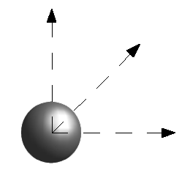
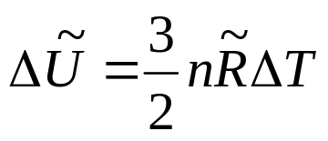
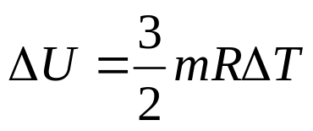
Internal (Microscopic) Energy : Monatomic Ideal Gas
For an ideal monatomic gas, this is just the translational kinetic energy of the linear motion of the "hard sphere" type atoms.
For a monatomic ideal gas this change in internal energy is given by :

Slide 22
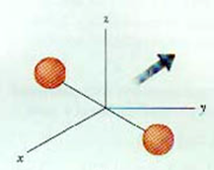
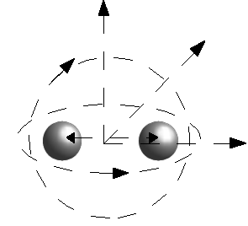
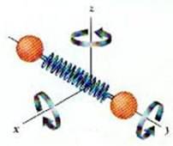
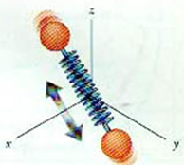
Internal (Microscopic) Energy : Diatomic Ideal Gas
For polyatomic gases there is rotational and vibrational kinetic energy as well.

Slide 23
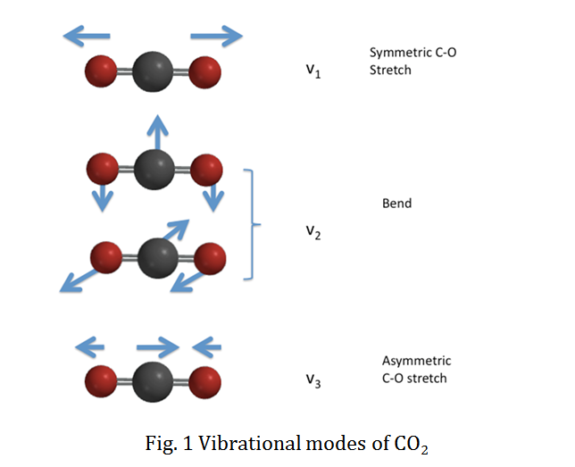
Internal (Microscopic) Energy : Polyatomic Ideal Gas

Slide 24
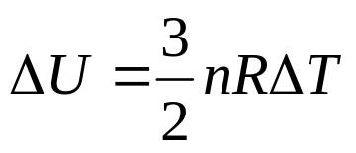
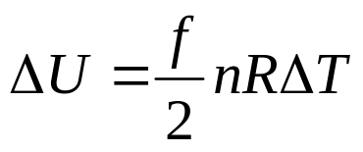
Internal Energy of an Ideal Gas
Internal energy in general includes both kinetic energy and potential energy associated with the molecular motion.
But the potential energy is associated with intermolecular forces which are presumed to be zero in an ideal gas.
Therefore the internal energy of an ideal gas is entirely kinetic energy.
For a monoatomic ideal gas this change in internal energy is given by
If rotation and vibrational kinetic energies are involved (polyatomic molecules) then
f : Number of degrees of freedom of a molecule

Slide 25
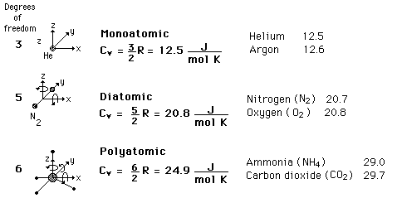
CV Specific Heats of Ideal Gases
Experimental results

Slide 26
Gas
Constant Volume Heat Capacity
C_{V}(J/mol K)
C_{V}/R
Ar
12.5
1.50
He
12.5
1.50
CO
20.7
2.49
H2
20.4
2.45
HCl
21.4
2.57
N₂
20.6
2.49
NO
20.9
2.51
O₂
21.1
2.54
Cl₂
24.8
2.98
CO₂
28.2
3.40
CS₂
40.9
4.92
H₂S
25.4
3.06
N₂O
28.5
3.42
SO₂
31.3
3.76

Slide 27
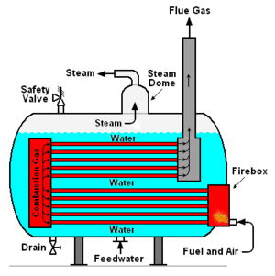
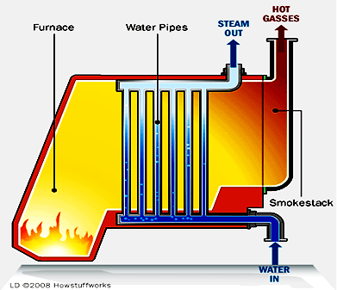
The issue of Increasing unit Temperature of A Pure Substance

