Slide 1

First Order Inhomogeneous ODEs to Study Thermofluids
P M V Subbarao
Professor
Mechanical Engineering Department
I I T Delhi
Understanding of A Single DoF Systems Driven by External Drivers….

Slide 2

Three Selected problems fit for FO-ODE
Development of a design model for thermometers.
Development of Travel model for minute particles in a fluid : Principle of Momentum Transfer.
Development of primitive models for Space Vehicles: Principles of Chemical Reaction & Momentum Transfer.

Slide 3
Important Applications of Particle Movement in A Field
What is the effect of gravity on the movement of a monocyte in blood?
How does sedimentation vary with the size of the sediment particles?
How rapidly do enzyme-coated beads move in a bioreactor?
What electric field is required to move a charged particle in electrophoresis?
What g force is required to centrifuge cells in a given amount of time?

Slide 4
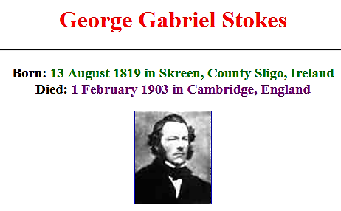

Slide 5
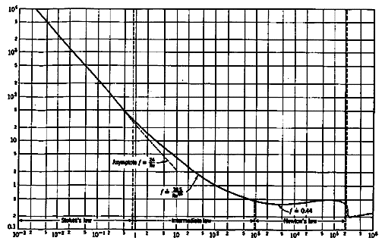
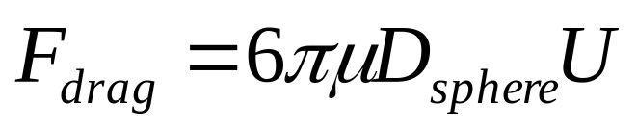
Stokes Flow
In a remarkable 1851 scientific paper, Sir G. G. Stokes first derived the basic formula for the drag of a sphere.
Derived a simple formula for drag using above velocity field.
C_{D}
Re
The formula is strictly valid only for Re << 1 but agrees with experiment up to about Re = 1.

Slide 6
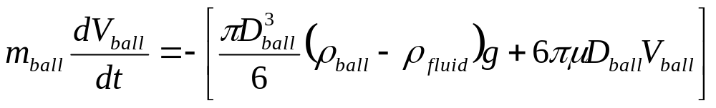
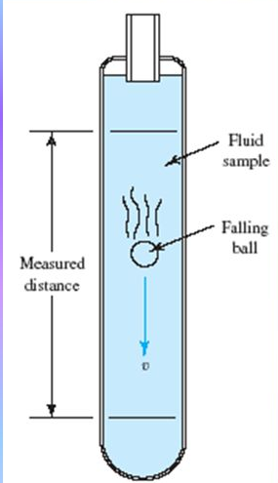

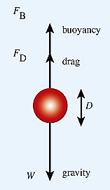
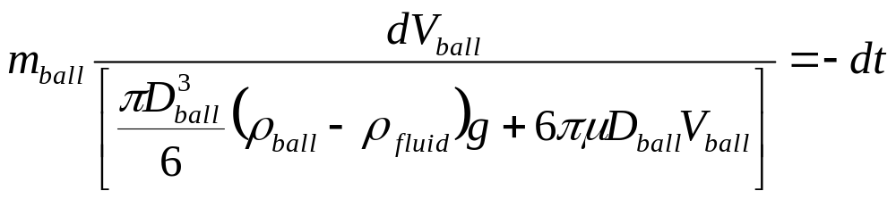
Instantaneous Velocity of A Settling Particle
Initial condition: ball stats from rest:
Separate the variables:

Slide 7
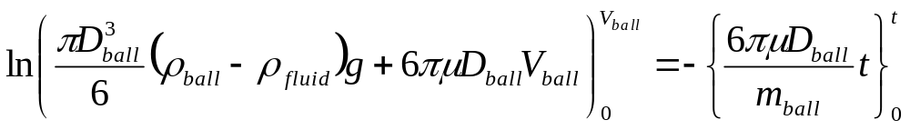
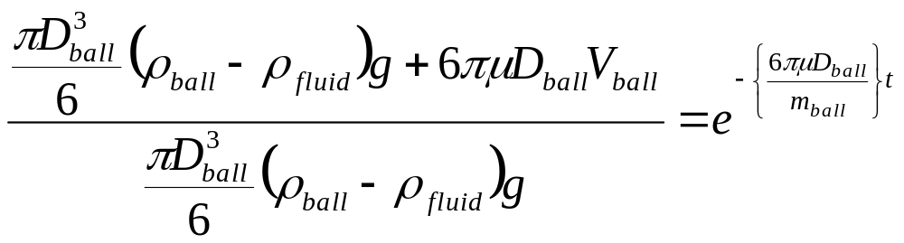
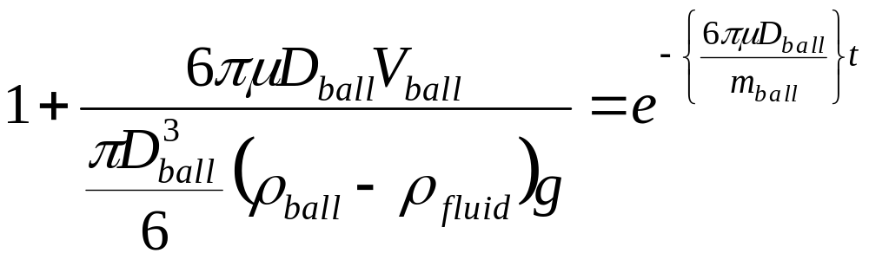
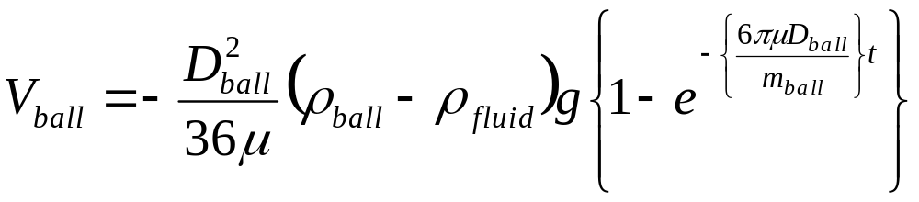
Velocity of SettlingParticle

Slide 8
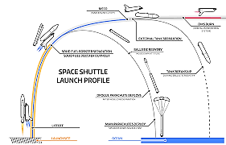
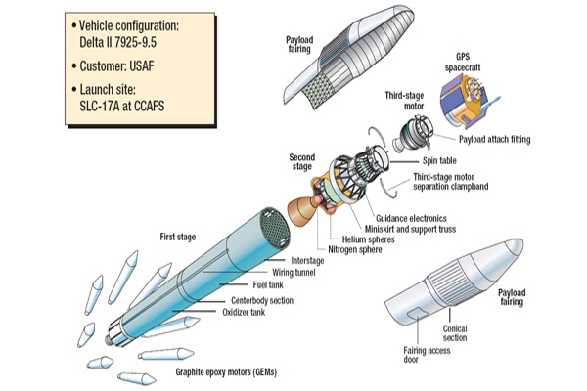
A Travel into Space…..
Generation of Cheapest Solutions thru Simple ODEs….

Slide 9
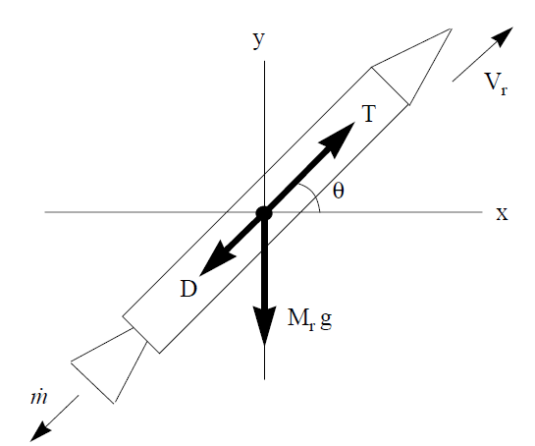
Basic Forces Acting on A Rocket
T = Rocket thrust
D = Rocket Dynamic Drag
V_{r} = Velocity of rocket
m_{ejects} = Mass flow rate of ejects
m_{r}= Mass of the rocket

Slide 10
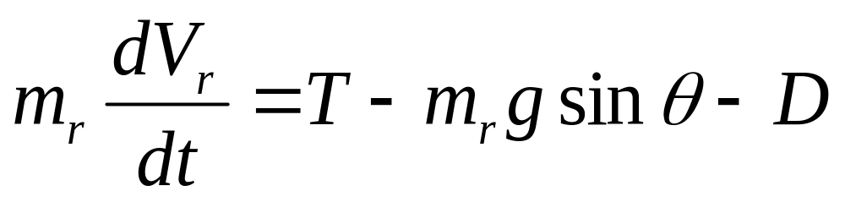
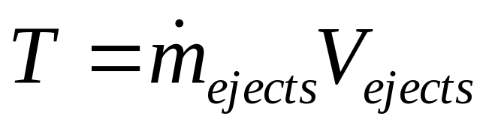
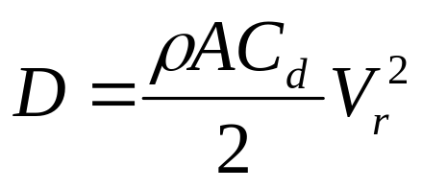
MOMENTUM BALANCE FOR A ROCKET
Rocket mass X Acceleration = Thrust – Drag -gravity effect
Drag

Slide 11

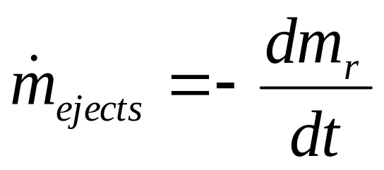
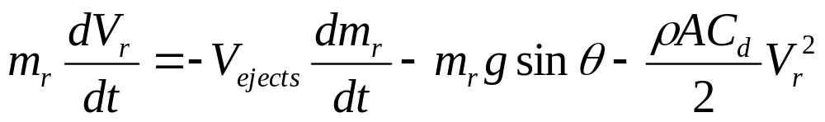
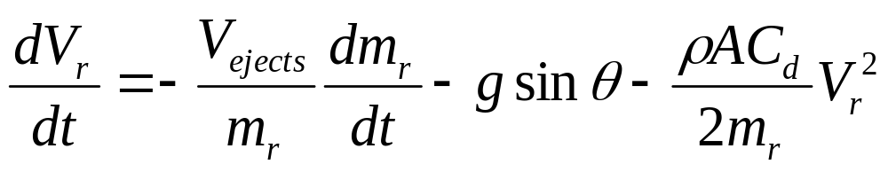
Force Balance on A Rocket
Conservation of mass:

Slide 12
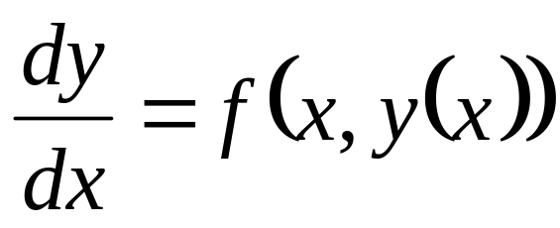
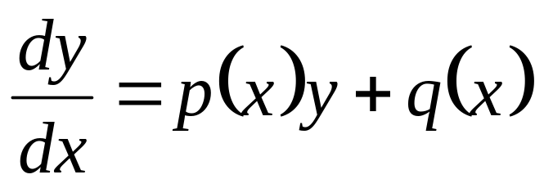
First Order ODEs : Definition
The first-order linear differential equation (on the unknown y is
where f(x,y(x)) is given or known and this called as source function.
The equation is linear iff the source function f is linear on its second argument,
The linear equation has constant coefficients if both p(x) and q(x) are constants.
Otherwise the equation has variable coefficients.

Slide 13
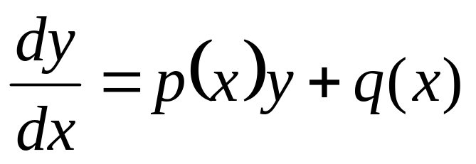
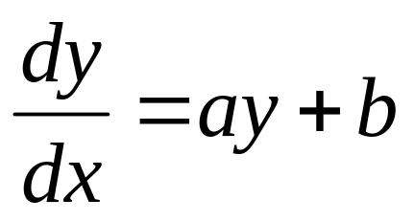
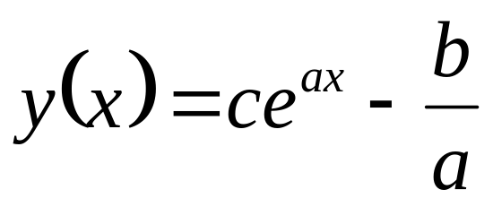
Theory of Solution for Linear FO-ODEs with Constant Variables
Theorem CV-FO-ODE
The linear differential equation
with p(x) = a≠ 0, and q(x) =b, where a & b are constants.
This has infinitely many solutions,
Above equation is called the general solution of the differential equation.

Slide 14
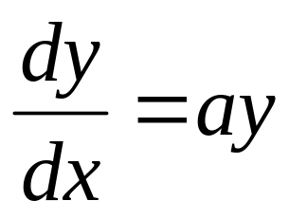
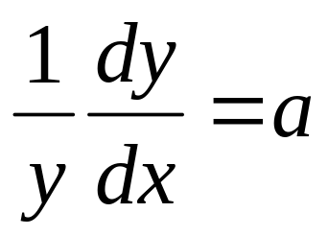
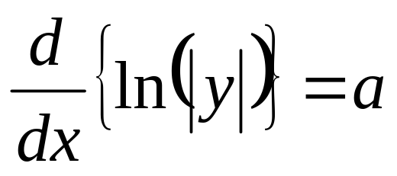
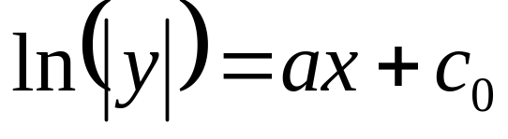
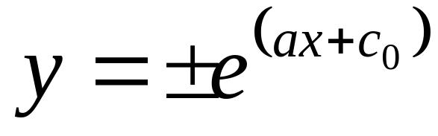
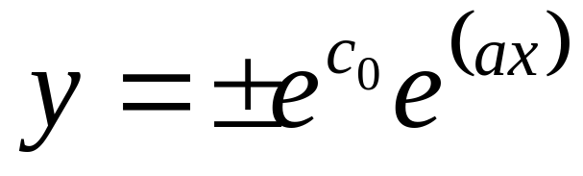
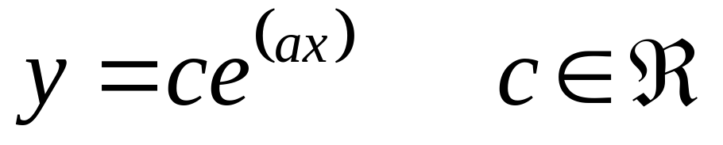
Proof of Theorem : CV-FO-ODE
Case -1 : b = 0
Where c₀∈ℜ is an arbitrary integration constant.
Compute the exponential on both sides;

Slide 15
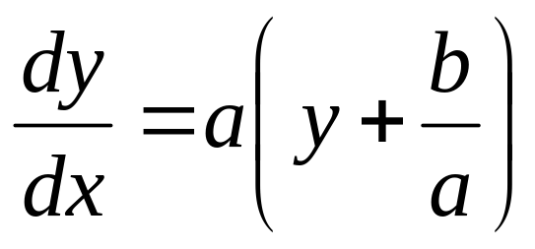
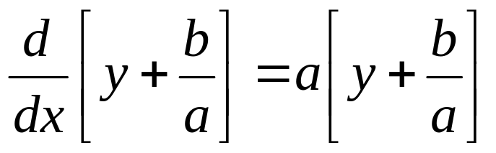
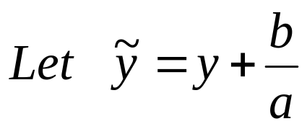
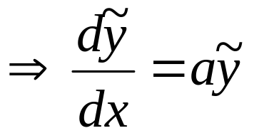
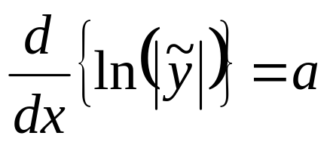
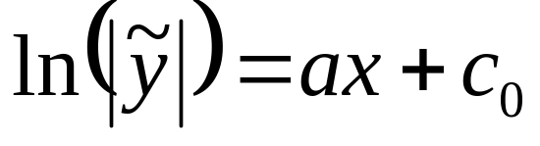
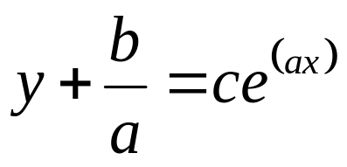
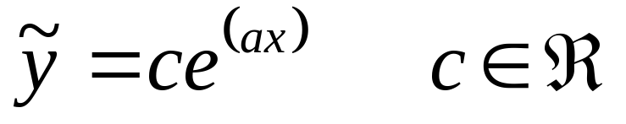
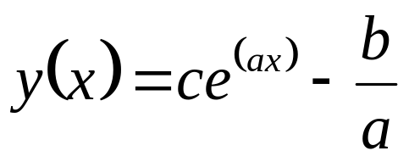
Proof of Theorem : CV-FO-ODE
Case -2 : b ≠0
Where c₀∈ℜ is an arbitrary integration constant.
Compute the exponential on both sides;

Slide 16
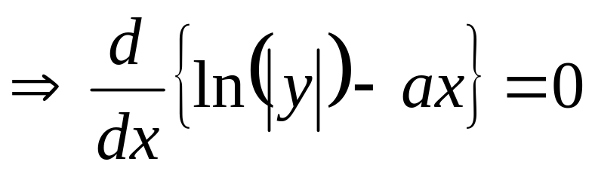
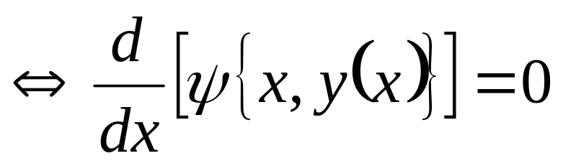
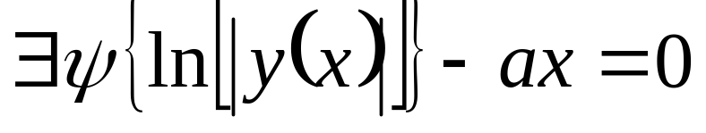
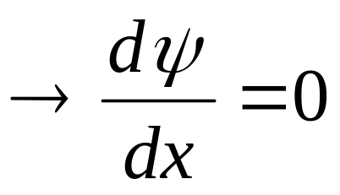
Remark
The FO-ODE is solved by transforming it into a total derivative.
Let us highlight this fact in the calculation,
The function ψ(x) is called a potential function.
This is how the original differential equation gets transformed into a total derivative,

Slide 17
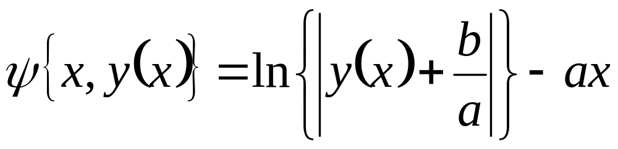
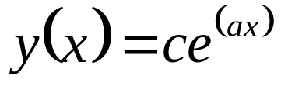
The Potential Function
The potential function is
This is known as conservative thermofluid system/field.

Slide 18
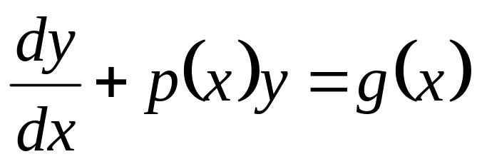
Linear FO-ODE with Variable Coefficient
Linear equations with constant coefficient are simpler to solve than variable coefficient ones.
The Theorem used before cannot be generalized in a simple way to all linear equations with variable coefficients.
There is another way to solve linear equations with both constant and variable coefficients.
This is known as integrating factor method.
Start from a Linear VC-FO-ODE

Slide 19
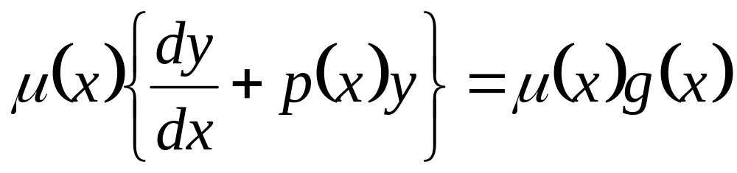
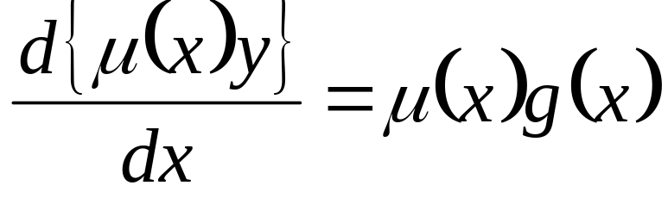

Theory of Solution for Linear FO-ODEs
A linear first order linear ODE can be solved using the integrating factor method.
The equation may be multiplied by the “Integrating Factor”, μ(x).
Multiply the original ODE with an integrating factor μ(x).
The IF is defined so that the equation becomes equivalent to:

Slide 20


The Solution in terms of IF
Where by integrating both sides with respect to x, gives:
Above equation is easily integrated using μ (x0) = μ0 and y(x0) = y0:

Slide 21

The Finale
It remains to determine μ(x).

Slide 22





The Integrating Factor
Above equation is separable:
It can be integrated to
it is customary to assign μ(x0)) = 1.

Slide 23


The Final Solution to Linear Inhomogeneous ODE
The Integrating Factor

