Slide 1
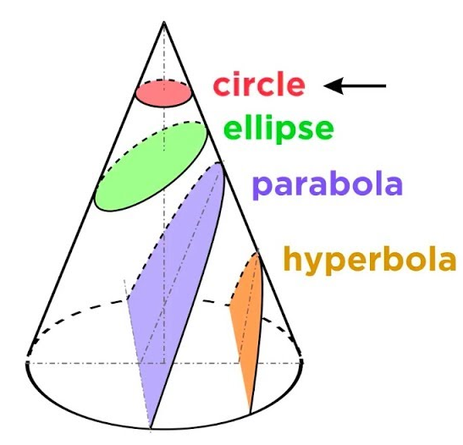

Analysis of Hyperbolic SO-PDES
P M V Subbarao
Professor
Mechanical Engineering Department
I I T Delhi
Uncontrolled Evolution of Thermofluid Systems…..

Slide 2

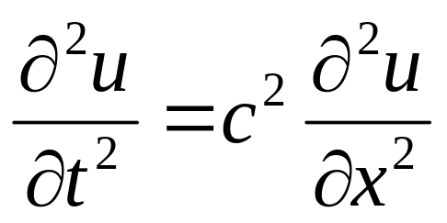
SO-Hyperbolic PDEs : Definition
Like Parabolic equations, which describes a temporal evolution of a process, hyperbolic evolution equations describe processes that are evolving in time.
For such an equation the initial state of the system is part of the auxiliary data for a well-posed problem.
The archetypal hyperbolic evolution equation is the Wave Equation.
The one dimensional Wave Equation is:
where c is the velocity of the wave.

Slide 3
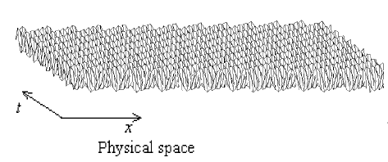
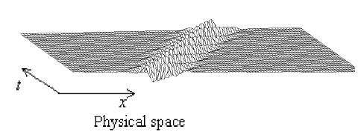
Physical space representation of a uniform wave train and a wave packet
Uniform Wave Train in Fluid Medium
A Wave Packet in Fluid Medium

Slide 4
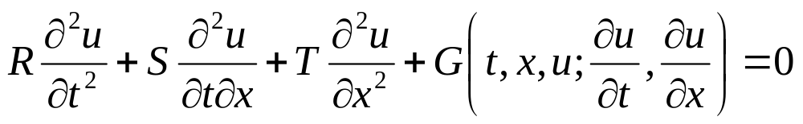
Geometric Interpretation of A Linear Hyperbolic SO-PDE
General Second Order Linear SO-PDE
The Wave Equation is:
R = 1; S = 0 & T = -c²

Slide 5
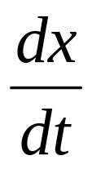
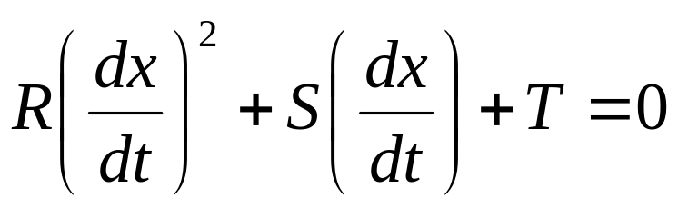
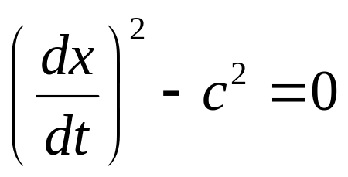
Characteristics of the Surface Defined by A Linear SO-PDE
The slope of characteristic curve is:
Theorem for Linear SO-PDE: The equation for the slope of the characteristic curve is
R = 1; S = 0 & T = -c²

Slide 6
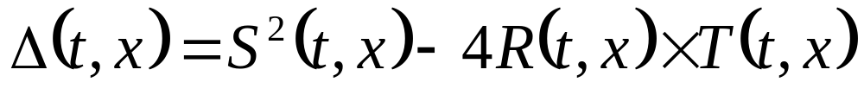
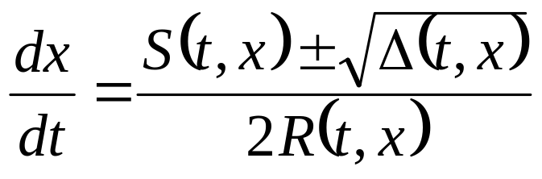
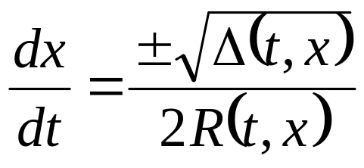
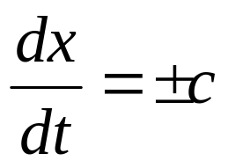
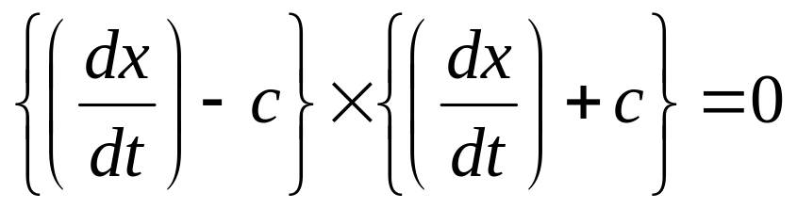
Discriminant of A Linear SO-PDE
The nature of a Linear SO-PDE is distinguished by the relative magnitude of coefficients of higher order differentials.
Define discriminant of a Linear SO-PDE as:
R = 1; S = 0 & T = -c²

Slide 7
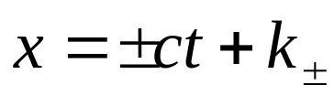
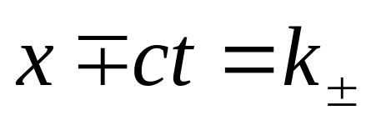
Direct Method of Solving H-SO-PDE
Equations of Characteristic lines:
The two families of characteristics are described as waves travelling in opposite direction at speed c.

Slide 8
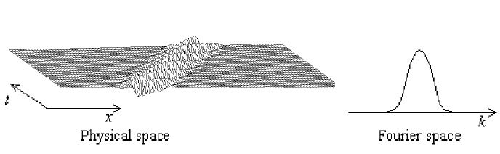
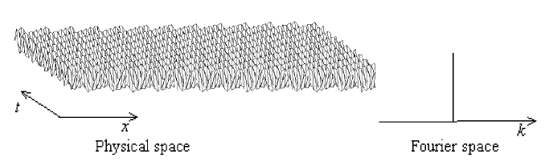
Fourier's View of Waves
A Wave Packet in Fluid Medium
Uniform Wave Train in Fluid Medium

Slide 9
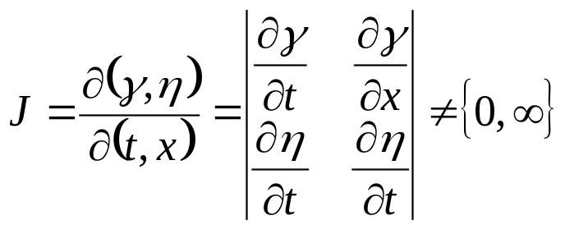


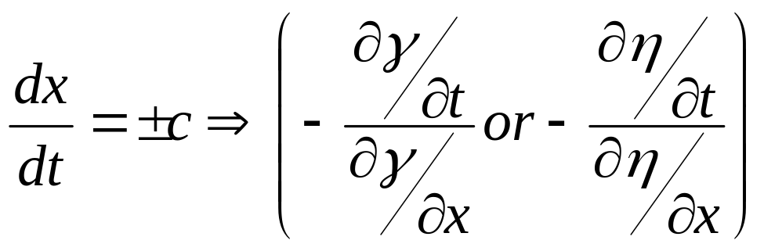
Transformation from Physical to Characteristic Space
Consider the coordinate transform (x; y) →(γ; η) where and are such that the Jacobian,
A hyperbolic equation has its own transformation fucntions, which are invertible and one-to-one.

Slide 10
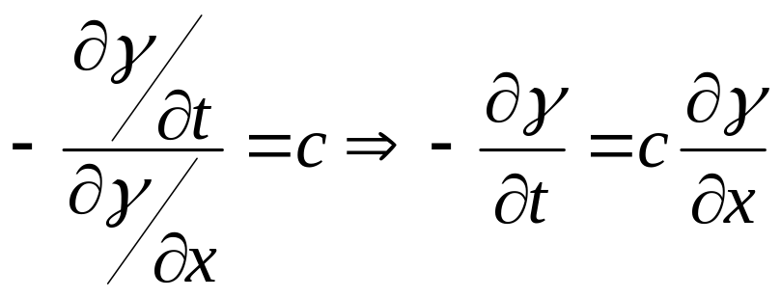
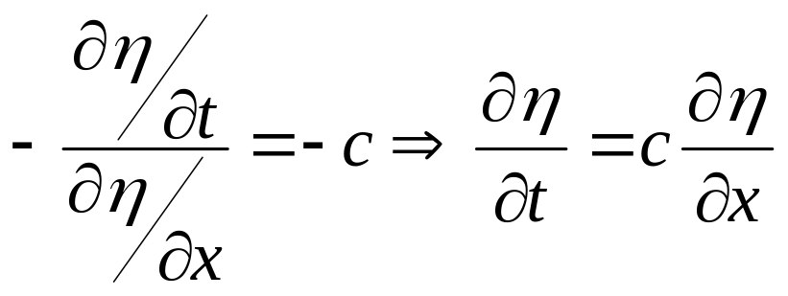
Transformation Varaibles

Slide 11
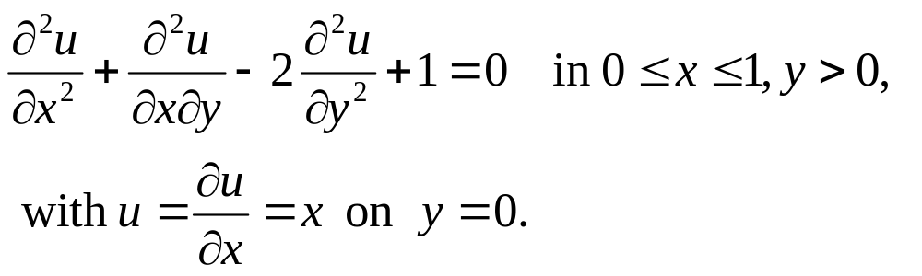
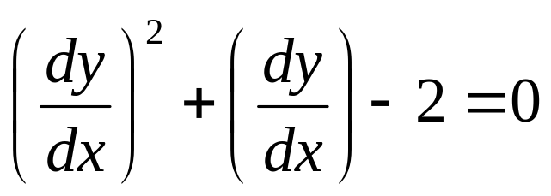
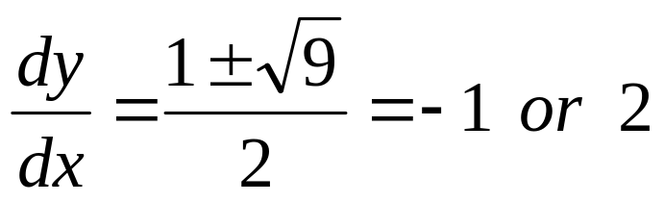
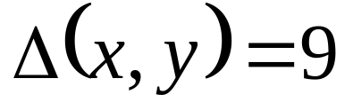
Example: Direct Solution of Wave Equation
Solve
R = 1; S = 1 & T = -2
Theorem for Linear SO-PDE: The equation for the slope of the characteristic curve is

Slide 12
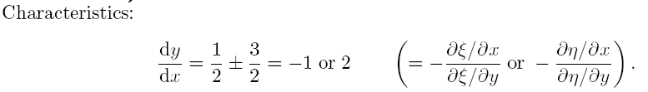

Characteristic Equations

Slide 13
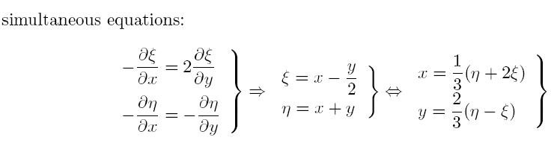





Generation of Simultaneous Equations

Slide 14
Generation of Simultaneous Equations

Slide 15
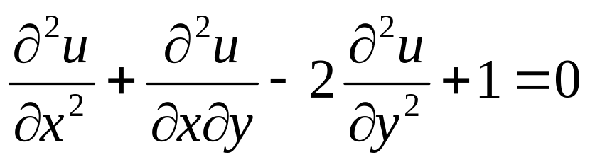

Transformation of Original Equations

Slide 16

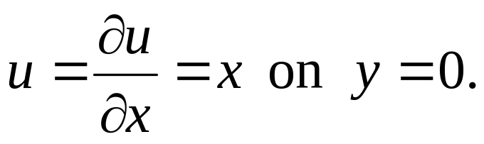
General Solution of Canonical Farm
General solution is given by
where f and g are arbitrary functions.
These are to be found by applying initial conditions.

Slide 17


Use of Dirichlet Conditions

Slide 18




Use of Neumann Conditions
Also, using the relation

Slide 19



Generation of Solution
after integration
where k is a constant.
Solving two equation simultaneously gives

Slide 20



Generation of Full Solution
So, full solution is
check this solution

Slide 21
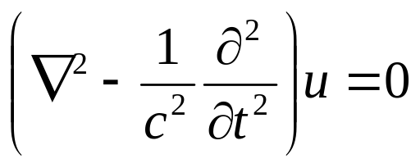
Analytical Solution of the Wave Equation
An elegant solution to the wave equation goes back to Jean-Baptiste le Rond d'Alembert (1717 - 1783).
He introduced an operator known as the wave operator or d'Alembertian.
The wave equation is then expressed simply as
To find the general solution in one spatial dimensions, new coordinates are introduced via the transformation

Slide 22
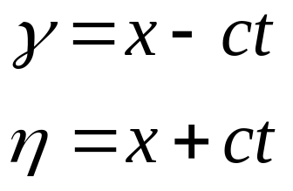
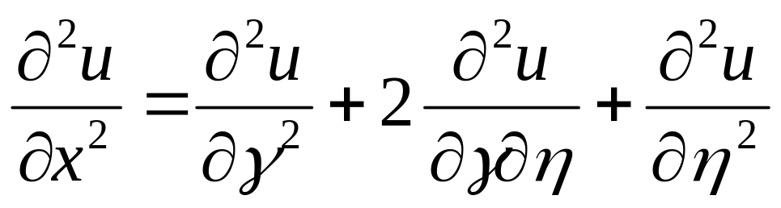
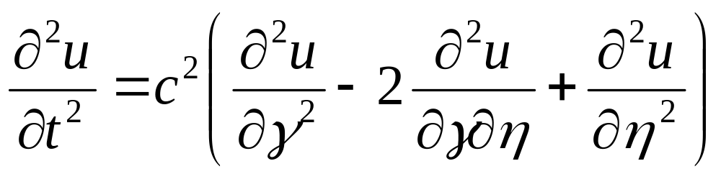
Transformation of Wave Equation
Define new co-ordinates:
Therefore

Slide 23
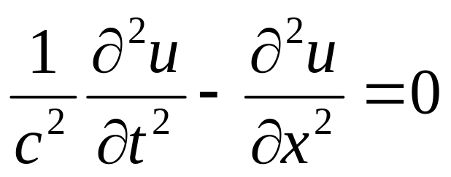
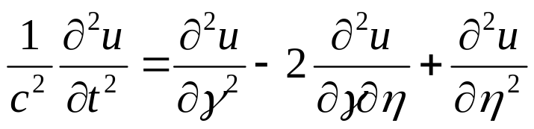
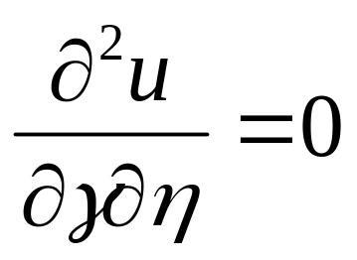
Transformation of Wave Equation

Slide 24
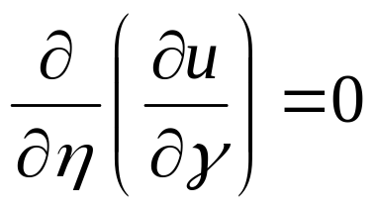
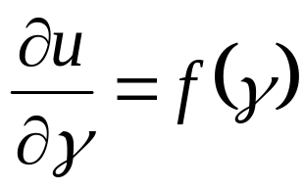
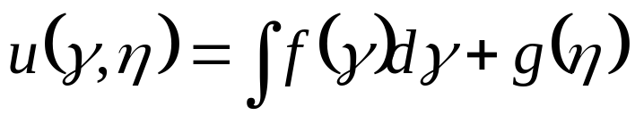
Integration of Transformed Wave Equation
This can now be easily integrated.
On first integration.
where f (γ) is some arbitrary function of γ .
Integrating with respect to η, gives the general solution

Slide 25
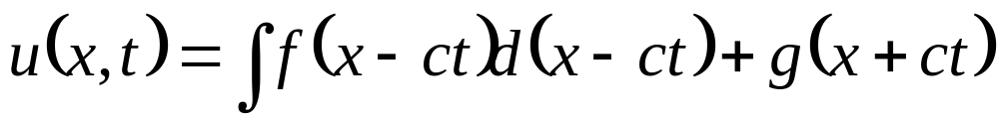
Solution in Original Co-ordinate System
The general solution of the wave equation is the sum of two counter-propagating waves.
This allows us to solve the initial value problem in a general way.
Let u(x; 0) = φ(x) and ∂u/∂t (x; 0)=ψ(x) be the initial conditions.

Slide 26
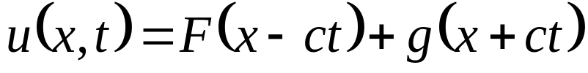
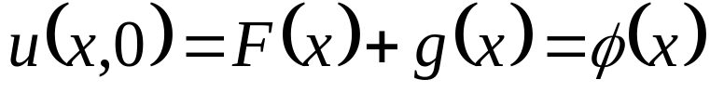
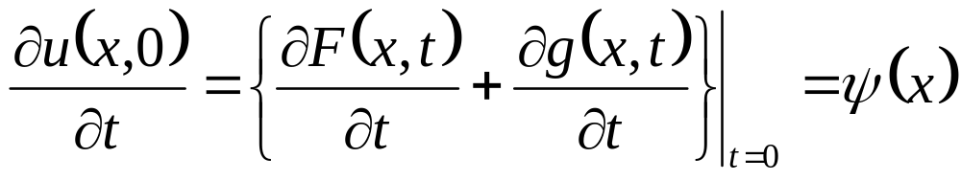
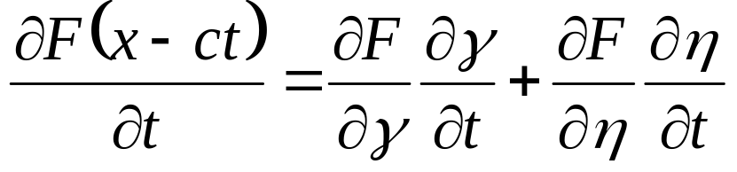
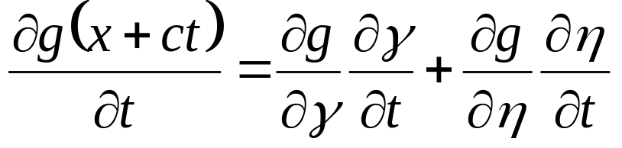
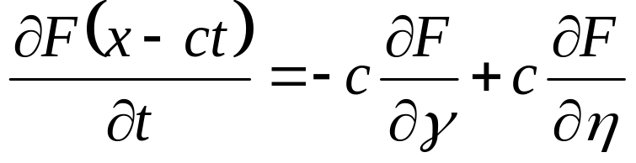
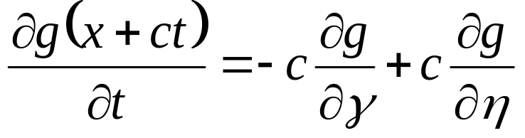
The Initial Value Problem
The general solution to the wave equation is
First Initial Condition:
Second Initial Condition:

Slide 27
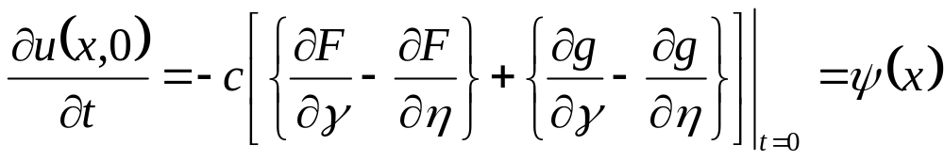
The Second Initial Condition

Slide 28
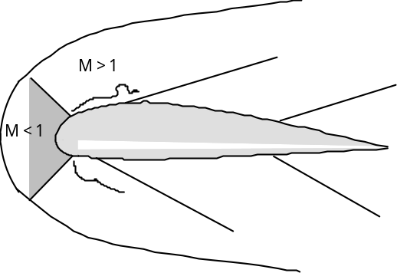
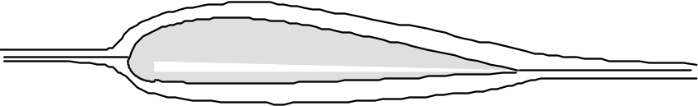


Design of Wings for Planes
• Subsonic Wing in Supersonic Flow
• Subsonic Wing in Subsonic Flow
• Supersonic Wing in Supersonic Flow
• Supersonic Wing in Subsonic Flow
• Wings that work well sub-sonically generally
Don’t work well supersonically, and vice-versa

Slide 29



Design of Wings for Hypersonic Planes

Slide 30

Equivalent 2-D Flow on Swept Wing
• Freestream Mach number resolved into 3 components
i) vertical to wing …
ii) in plane of wing, but tangent to leading edge
iii) in plane of wing, but normal to leading edge

Slide 31


Revised Mathematical Analysis
• Consider flow expansion around an infinitesimal corner

Slide 32



Look for A New Framework

Slide 33

Characteristic Lines
• Supersonic “compatibility” equations
• Apply along “characteristic lines” in flow field

Slide 34

Basic principle of Methods of Characteristics

Slide 35
“Method of Characteristics”
• Basic principle of Methods of Characteristics
-- If supersonic flow properties are known at two points in a flow field,
-- There is one and only one set of properties compatible* with these at a third point,
-- Determined by the intersection of characteristics, or mach waves, from the two original points.

Slide 36

Physical Meaning of Characteristic Lines
• Schlieren Photo of Supersonic nozzle flow with roughened wall

