Slide 1

Analysis of Parabolic SO-PDES
P M V Subbarao
Professor
Mechanical Engineering Department
I I T Delhi
A Mathematical Framework to Connect Time & Entropy…..

Slide 2

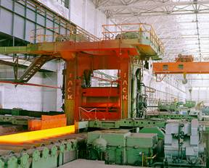
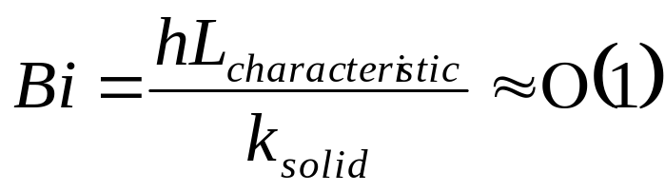
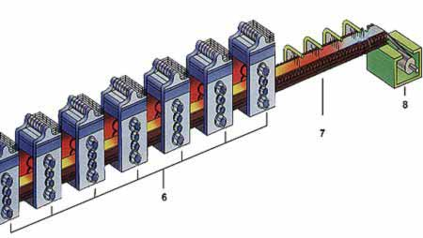
Motivation: Hot Rolling of Steel Sheets
The Solution of Heat Conduction Equations !!!

Slide 3
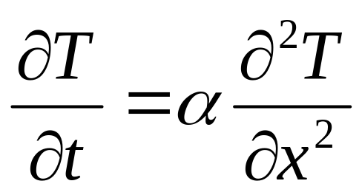
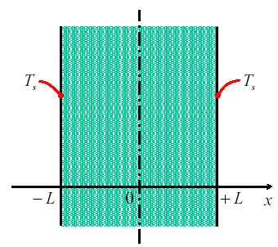
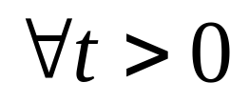
One Dimensional Transient Conduction
Governing Differential Equation:
Initial Condition:
T(x,o)= T₀
Boundary Conditions:
T(±L,t)=T_{s} ≠T∞

Slide 4


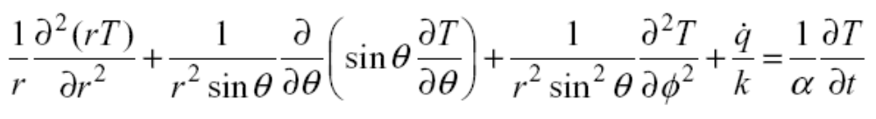
General Form of Fourier’s Heat Equation
Cartesian coordinates:
Cylindrical coordinates:
Spherical coordinates:

Slide 5
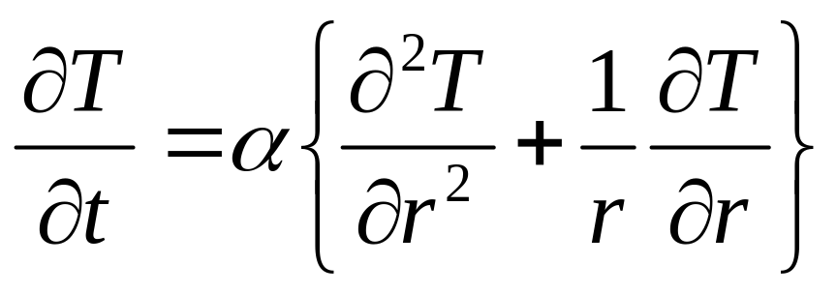
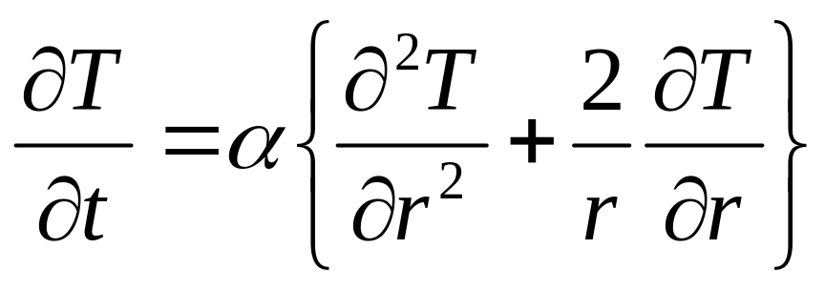
One Dimensional Fourier’s Equations
Constant thermal conductivity & No heat generation:
Cartesian coordinates:
Cylindrical coordinates:
Spherical coordinates:

Slide 6
Primitive Variables & derived Variables
Characteristic Space Dimension : L or r_{o}
Characterisitc Time Dimension : ?
Characteristic Temperature Variables:
Initial Temperature : T₀
Far Field Fluid Temperature : T∞
Characterisitc Medium Property : α

Slide 7
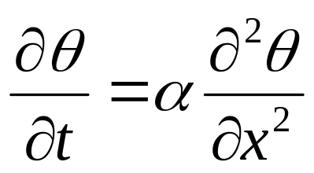
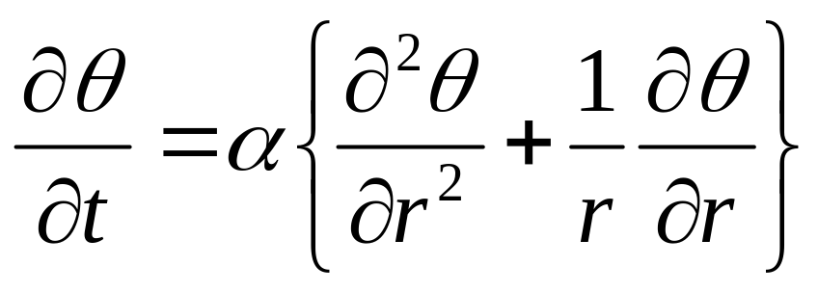
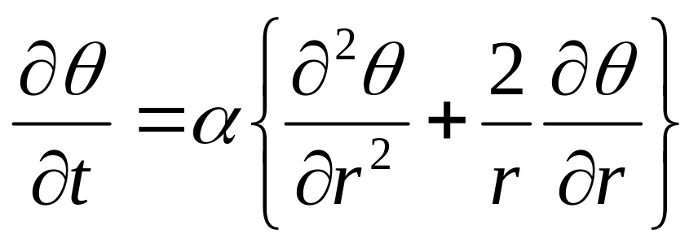
Extent of Solution Domain
Highest Measure of Excess Temperature : θ₀ =|T₀ -T∞|
Instantaneous local Excess temperature: θ = |T -T∞|
Cartesian coordinates:
Cylindrical coordinates:
Spherical coordinates:

Slide 8
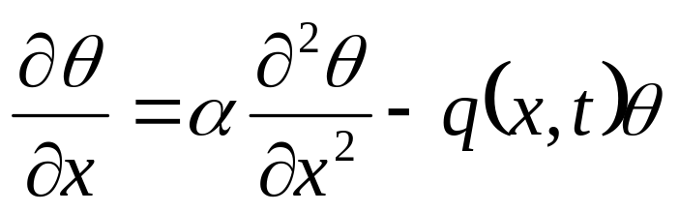
One-dimensional Reaction-Diffusion Equation
Governing Differential Equation:
considered on Ω := (-b; b) ×(0;τ) is obtained.
The potential q ∈C[-b, b] may be complex valued.
The completeness of the system is with respect to the uniform norm in the closed rectangle Ω.

Slide 9
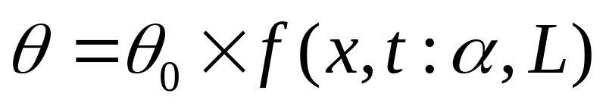
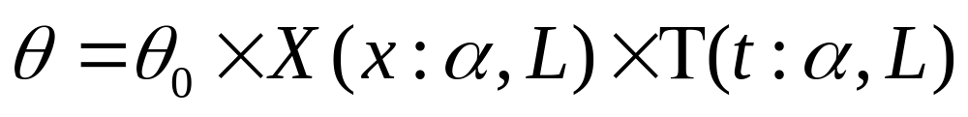
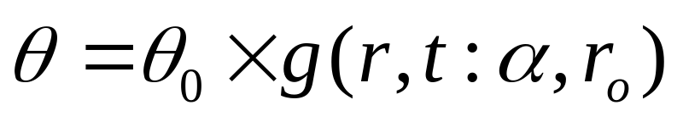
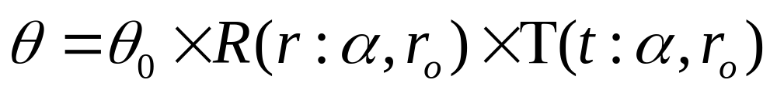
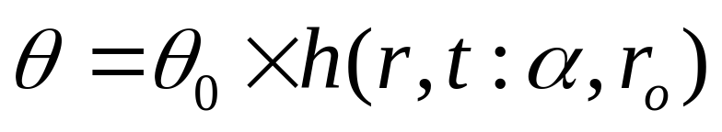
Nature of Solution : Fourier′s Vision
Cartesian coordinates:
Cylindrical coordinates:
Spherical coordinates:

Slide 10
One Dimensional Transient Conduction
Governing Differential Equation:
Initial Condition:
T(x,0)= T₀
Boundary Conditions:
T(±L,t)=T_{s} ≠T∞

Slide 11
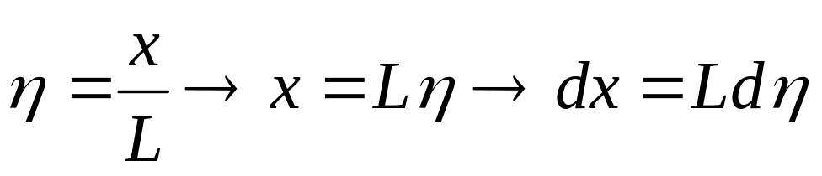
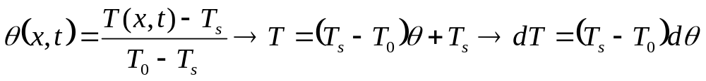
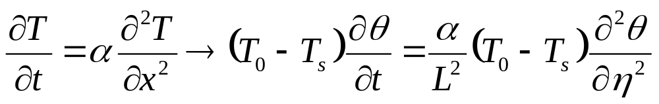
Non-dimensionalization of GDE
Define a Non dimensional variable for the x-coordinate
Define a Non dimensional variable for the temperature:
Substitute Dimensionless variables into GDE:

Slide 12
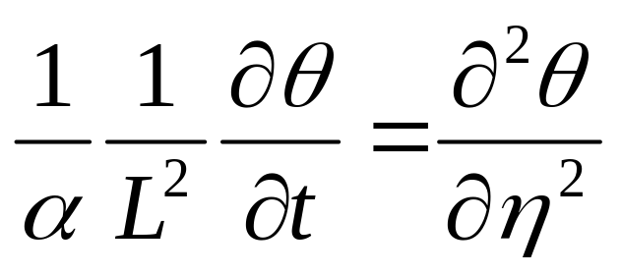
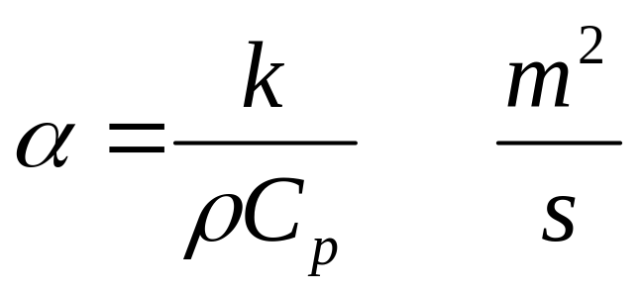
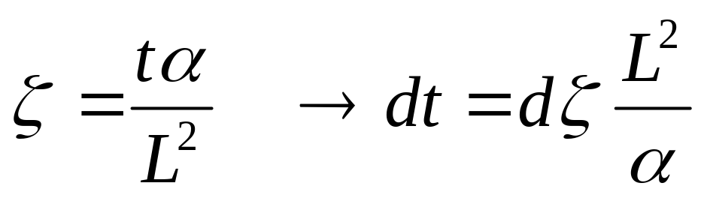
Non-dimensional Time
Define thermal diffusivity:
Define non dimensional variable for time

Slide 13
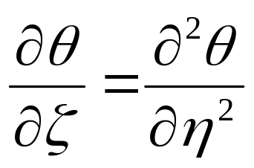
A Pure Dimensionless GDE
Initial condition: q(h,0) = 1
Boundary conditions: q(±1,z) = 0
At any time Temperature profile will be symmetric about x-axis.
Solution in positive or negative direction of x is sufficient.

Slide 14
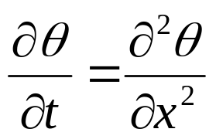
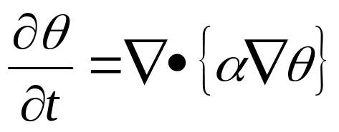
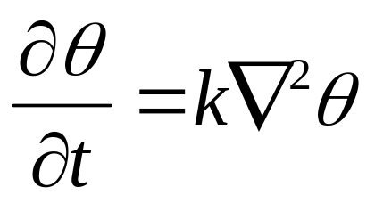
SO-Parabolic PDEs : Definition & Properties
Unlike elliptic equations, which describes a steady state, parabolic (and hyperbolic) evolution equations describe processes that are evolving in time.
For such an equation the initial state of the system is part of the auxiliary data for a well-posed problem.
The archetypal parabolic evolution equation is the Heat conduction or Diffusion equation.
The one dimensional Heat Equation is:
or more generally, for k > 0,
For constant k > 0,

Slide 15
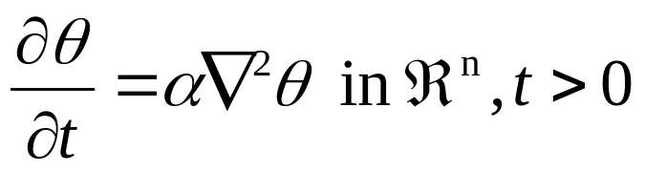
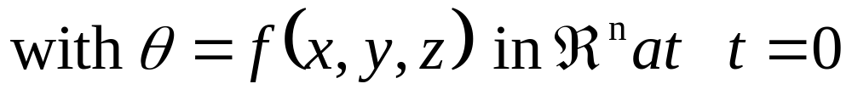
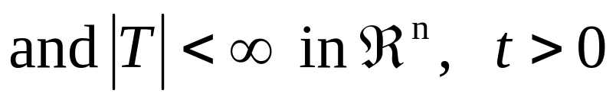
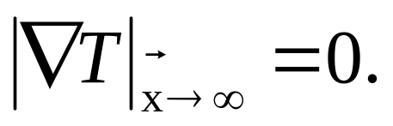
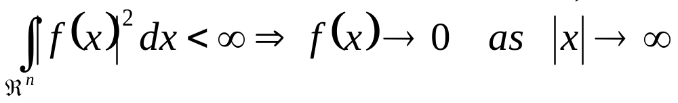
Well-Posed Cauchy Problem
(Initial Value Problem)
Consider α > 0,
It is required that the solution T(x,y,z; t) is bounded in ℜ^{n} for all t.
In particular it is also assumed that the boundedness of the smooth function T at infinity gives;
More conditions imposed on f(x).

Slide 16
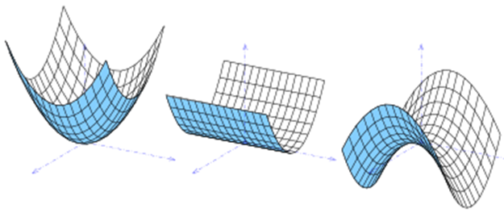
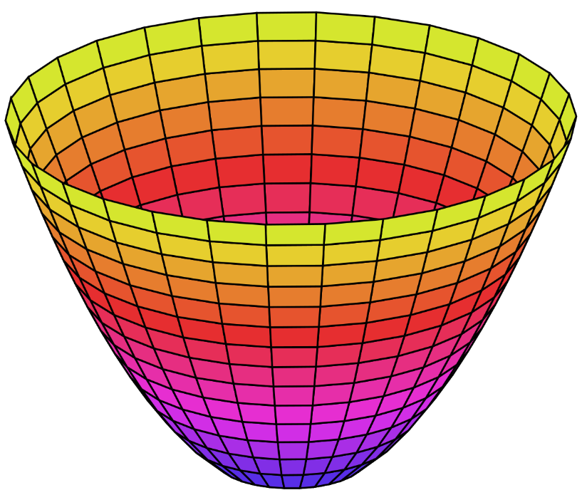
Profile of Parabolic Solution Surface

Slide 17
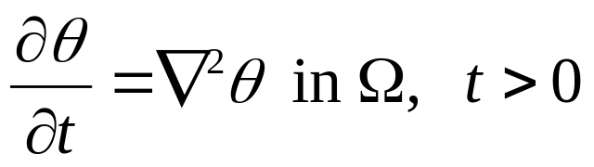
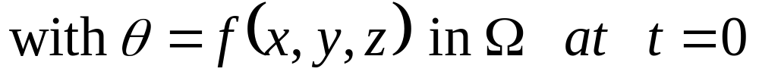
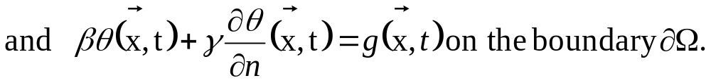
Well-Posed Initial-Boundary Value Problem
Consider an open bounded region Ω of ℜ^{n} and k > 0;
Consider an open bounded region Ω of ℜ^{n} and k > 0;
γ= 0 gives the Dirichlet problem.
β = 0 gives the Neumann problem.
γ and β ≠ 0 gives the Robin or radiation problem.
The problem can also have mixed boundary conditions.
If Ω is not bounded (half-plane), then additional behaviour at infinity condition may be needed.

Slide 18
Temporal Irreversibility of the Heat Equation
Consider a parabolic thermofluid system for which the initial conditions are unknown.
However, few conditions on the solution at other than initial time are made available.
The resulting problem is known as not well-posed.
Though the total number of auxiliary conditions is same as a well posed problem.
These are called as backward heat equations.
In 1-D it is an ill-posed problem.

Slide 19
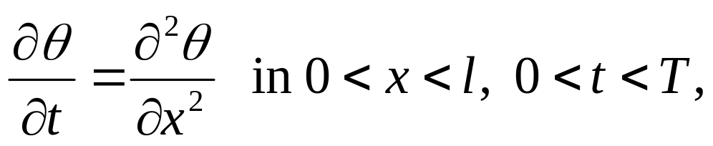
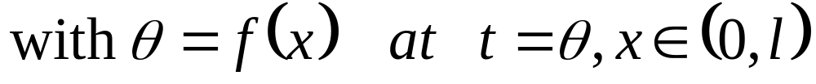
The backward heat equations
The objective is to find previous states T(x; t) for t < τ.
We know the value of final evolved state f(x).
This will not have solution for any arbitrary f(x).
Even when a the solution exists for any arbitrary f(x), it does not depend continuously on the data.

Slide 20
The Irreversibility
Backward heat equation is irreversible in the mathematical sense that forward time is distinguishable from backward time.
It models physical processes irreversible in the sense of the Second Law of Thermodynamics.

Slide 21
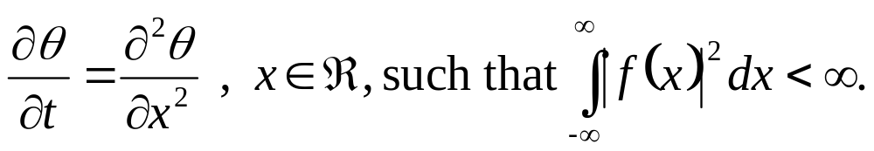
Uniqueness of Solution
The 1-D initial value problem
has a unique solution.

Slide 22
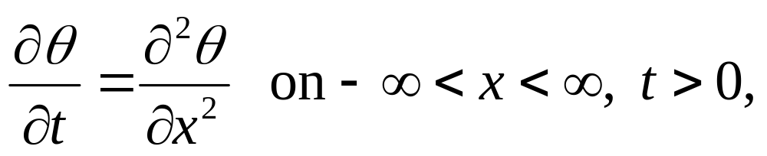
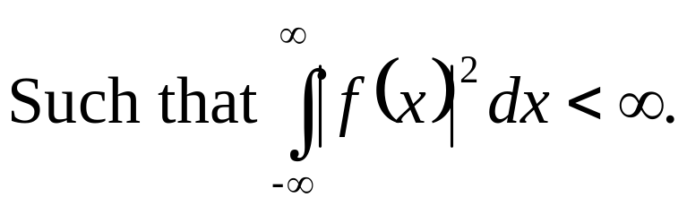
Fundamental Solution of the Heat Equation
Consider the 1-D Cauchy problem,

Slide 23
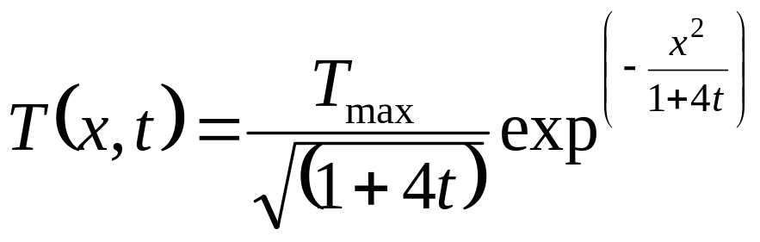
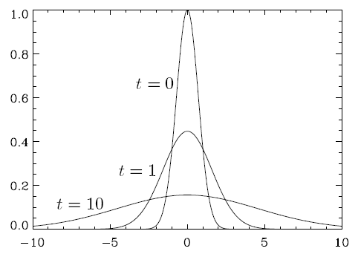
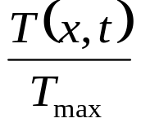

Fundamental Solution of the Heat Equation
Possible Model:

Slide 24
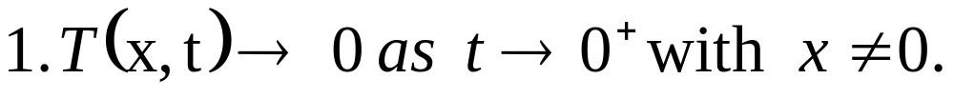
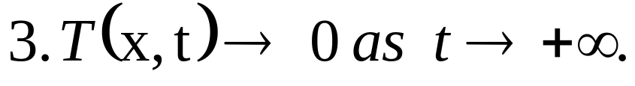
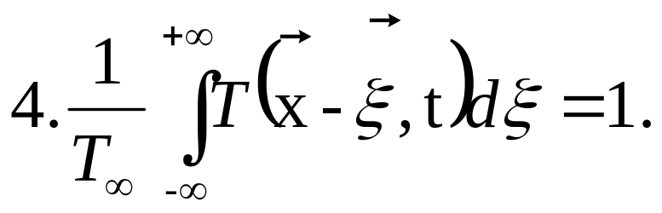
Properties of the Fundamental Solution to SO-PPDE
The function T(x; t) is solution (positive) of the heat equation for t > 0 and has a singularity only at x = 0; t = 0.

Slide 25
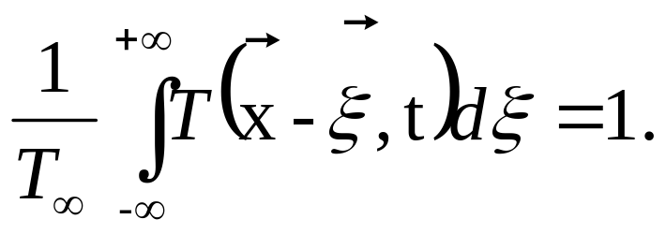
The Temporal Behaviour of PPDE Solution
At any time t > 0 (no matter how small), the solution to the initial value problem for the heat equation at an arbitrary point x depends on all of the initial data:
The data propagate with an infinite speed.
As a consequence, the problem is well posed only if behaviour-at-infinity conditions are imposed.
However, the influence of the initial state dies out very rapidly with the distance.

Slide 26

Behaviour of PPDE Solution at large time
Suppose that the initial data have a compact support.
The initial data decays to zero sufficiently quickly as | x | →∞.
The solution of the heat equation on spatial scales behaves to follow laws of nature.
After a long period of evolution the influence of initial data is large in special scale, x.
There exists an order x²/t ∼ O(1)
The initial data ξ²/t ∼ O(ε)
Where ε << 1.
Finally the solution for large times

Slide 27



Similarity Solution
The Parabolic partial differential equations, like the heat equation, the solution depends on a certain grouping of the independent variables.
There is no explicit independency among the independent variables.
Consider the heat equation in 1-D
Introduce the dimensionless similarity variable
Then, the heat equation reduces to an ODE

Slide 28


Simplified Fourier Problem
Initial condition: q(h,0) = 1
1
Boundary conditions: q(1,z) = 0
0
1
h

Slide 29




Fourier’s Separation of Variables

Slide 30




Slide 31



The boundary conditions are
which requires B = 0
Then apply the boundary conditions at the other end
which requires cosλ = 0

Slide 32



The solution corresponding to the n-th eigenvalue is
The general solution is the sum over all n’s
The constants A_{n} are determined from the initial conditions

Slide 33


Slide 34


Slide 35


Slide 36

Relationship between the Biot number and the temperature profile.

Slide 37



Systems with Negligible Surface Resistance
Homeotherm is an organism, such as a mammal or bird, having a body temperature that is constant and largely independent of the temperature of its surroundings.

Slide 38

Biot Number of Small Birds

Slide 39

Biot Number of Big Birds

Slide 40


Very Large Characteristic Dimension

Slide 41

Very Large Characteristic Dimension
The United States detonated an atomic bomb over Nagasaki on August 9, 1945. The bombings of Nagasaki and Hiroshima immediately killed between 100,000 and 200,000 people and the only instances nuclear weapons have been used in war.

Slide 42

The semi-infinite solid
Governing Differential Equation:
Boundary conditions
x = 0 :T = T_{s}
As x → ∞ :T → T₀
Initial condition
t = 0 :T = T₀

Slide 43




Notice that there is no natural length-scale in the problem.
Indeed, the only variables are T, x, t, and α.

Slide 44




Transform the derivatives :

Slide 45





Slide 46





Slide 47




Slide 48





Slide 49

η

Slide 50



