Slide 1

Solution to More Thermo-Mechanical Problems using Laplace Equations
P M V Subbarao
Professor
Mechanical Engineering Department
I I T Delhi
A Rosetta Stone of Thermofluids …..

Slide 2

Summary
All the three types of equations can be reduced to canonical forms.
The Hyperbolic equations reduce to wave equation.
The parabolic equations reduce to the heat equation.
The Laplace's equation models the canonical form of elliptic equations.
Thus, the wave, heat and Laplace's equations serve as canonical models for all second order constant coefficient PDEs.
We will spend the rest of this course studying the solutions to the Laplace, heat and wave equations.

Slide 3
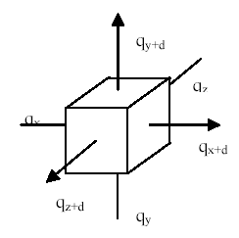
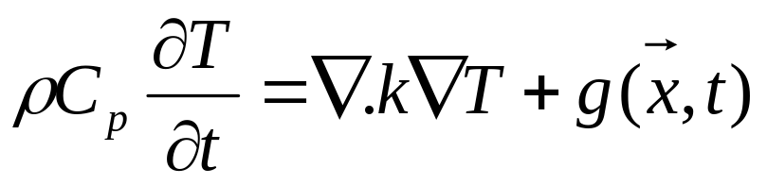
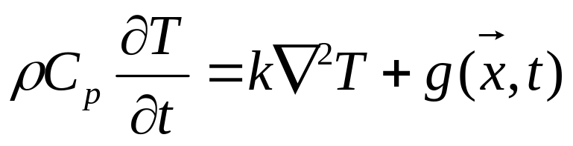
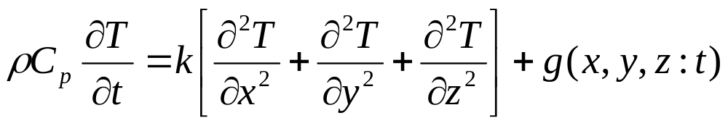
Heat Conduction in a Cube/Cuboid
General Conduction equation with heat generation.
For an isotropic and homogeneous material:

Slide 4
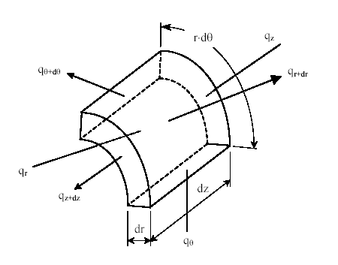
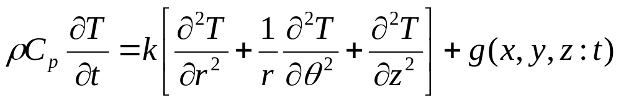
General conduction equation based on Polar Cylindrical Coordinates

Slide 5
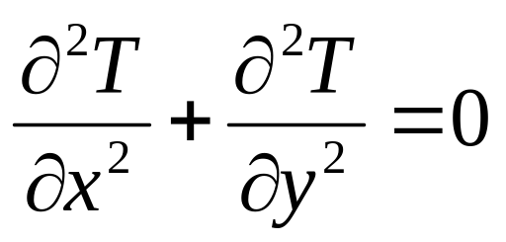
Laplace Equation : Steady Conduction in A Rectangular Plate
H
Boundary conditions:
x = 0 & 0 < y < H : T(0,y)= f₀(y)
x = W & 0 < y < H : T(W,y)= f_{H}(y)
y = 0 & 0 < x < W : T(x,o)= g₀(x)
y = H & 0 < x < W : T(x,H)= g_{W}(x)
y
0
W
x

Slide 6
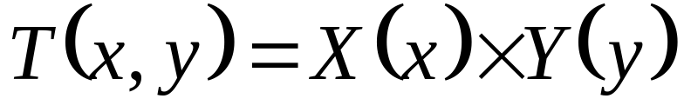
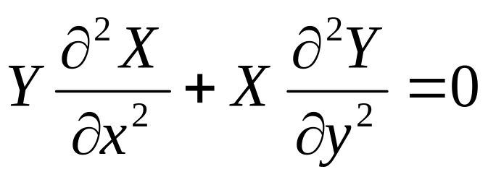
Method of Separation of Variables
Solutions to Laplace (partial) differential equations can be obtained using the technique known as separation of variables.
In separation of variables, it is assumed that the solution is of the separated form
Substitute this relation into the governing relation given by

Slide 7
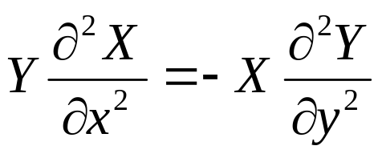
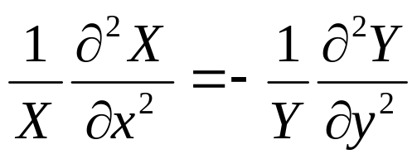
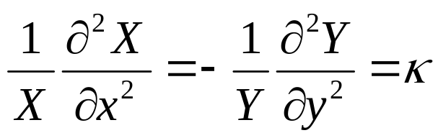
Validity of Separation of Variables Method
If possible, move the x-terms to one side and the y-terms to the other.
If not possible, then this method will not work.
Correspondingly, it is said that the partial differential equation is not separable.
Once separated, the two sides of the equation must be constant : κ

Slide 8
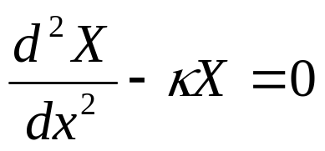
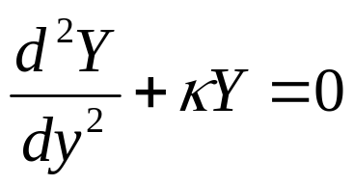
Generation of Simultaneous Linear ODEs
X is function of only x and Y is function of only y.
The form of solution of above depends on the sign and value of κ.
The only way that the correct form can be found is by an application of the boundary conditions.
Three possibilities will be considered:

Slide 9
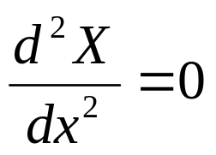
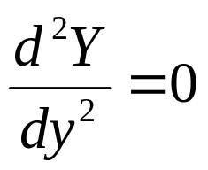
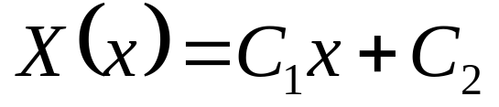
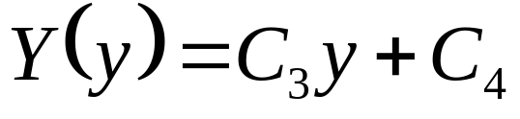
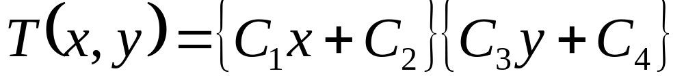
First Possibility
κ = 0
Integrating above equations twice will give
The product of above equations should provide a solution to the Laplace equation:
Linear variation of temperature in both x and y directions.

Slide 10
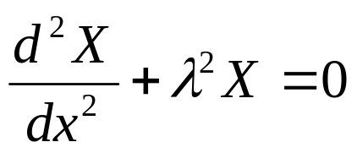
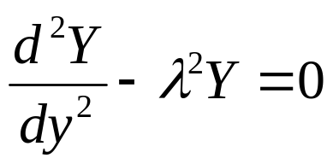
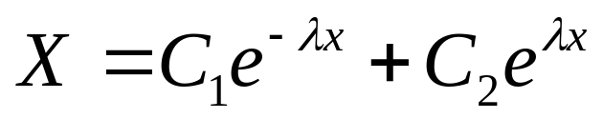
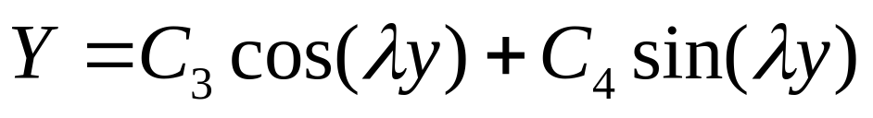
Second Possibility
κ < 0 & κ=-λ²
Integration of above ODEs gives:
&
Solution to the Laplace equation is:
Asymptotic variation in x direction and harmonic variation
in y direction

Slide 11
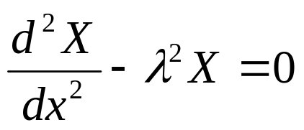
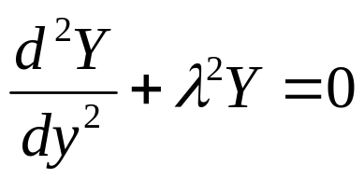
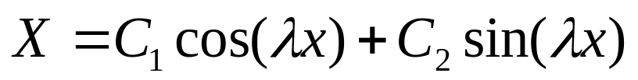
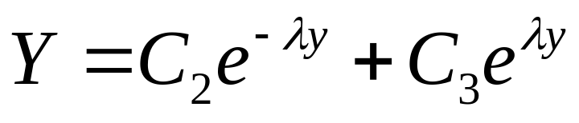
Third Possibility
κ > 0 & κ= λ²
Integration of above ODEs gives:
&
Solution to the Laplace equation is:
Harmonic variation in x direction and asymptotic variation
in y direction.

Slide 12

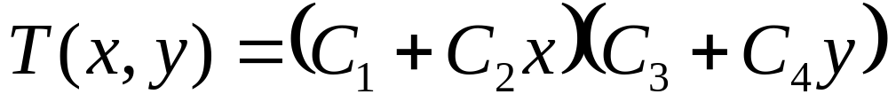


Summary of Possible Solutions

Slide 13
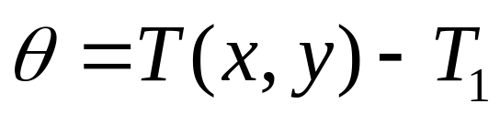
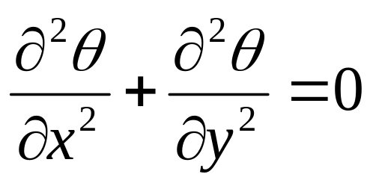
Steady conduction in a rectangular plate
2D SPACE – All Dirichlet Boundary Conditions
q = C
Define:
T = T₂
H
T = T₁
T = T₁
Laplace Equation is:
q = 0
q = 0
y
0
W
x
T = T₁
q = 0

Slide 14
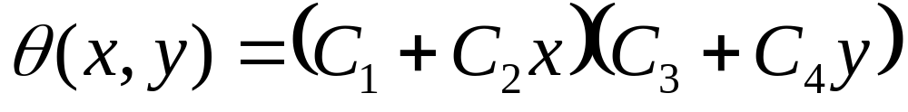
l²=0 Solution

Slide 15
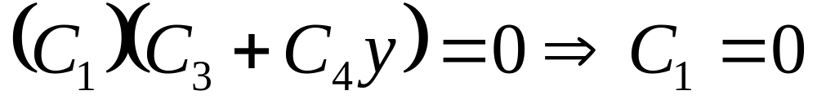
Feasibility of Solution
The solution corresponds to l²=0, is not a valid solution for this set of Boundary Conditions!

Slide 16
l² < 0 or l² > 0 Solutions
OR
l² > 0 is a possible solution !
q = C
H
q = 0
q = 0
y
0
x
W
q = 0

Slide 17
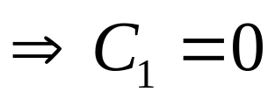

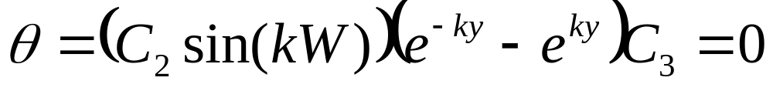
Final Solution : l² > 0 : x - Boundary Conditions
Substituting x - boundary conditions :

Slide 18

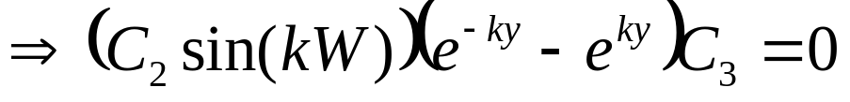
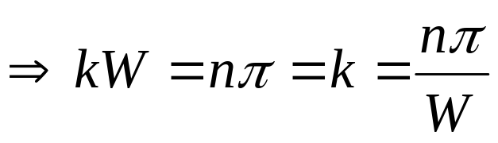

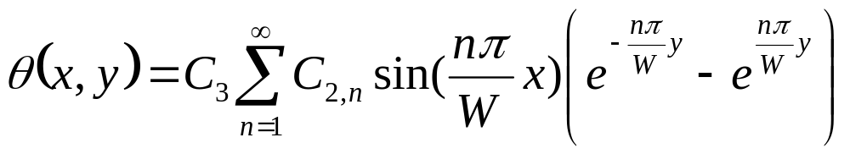
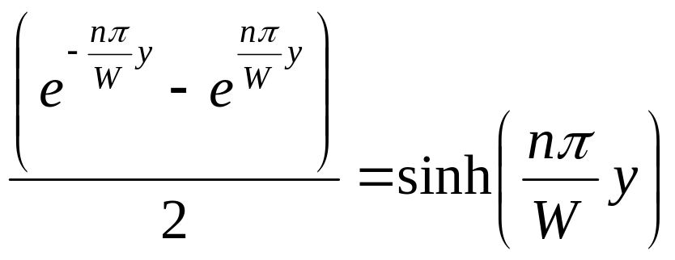
Final Solution : l² > 0 : y - Boundary Conditions
Where n is an integer.
Solution domain is a superset of geometric domain !!!
Recognizing that

Slide 19
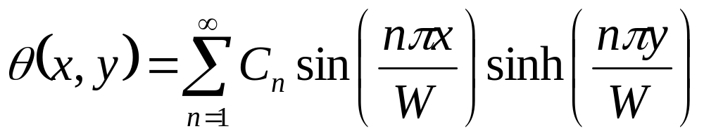
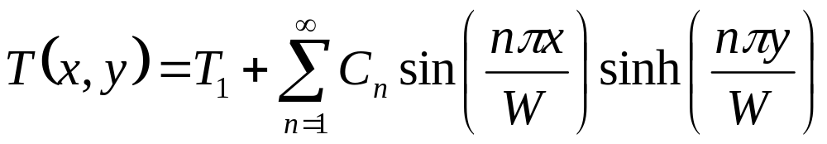
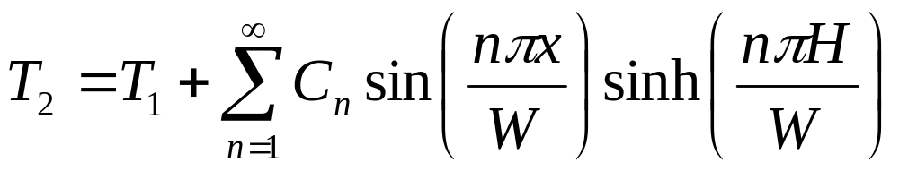
Series Solution
where the constants have been combined and represented by C_{n}
Using the final boundary condition:

Slide 20
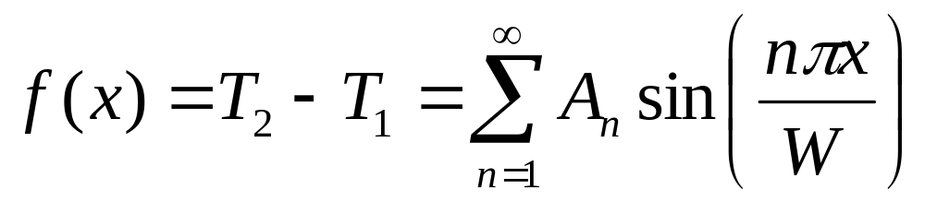
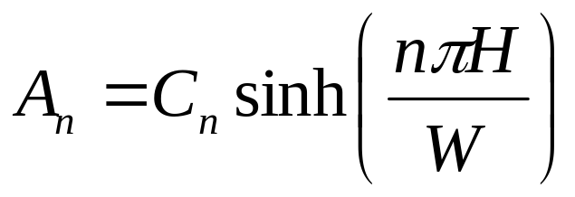
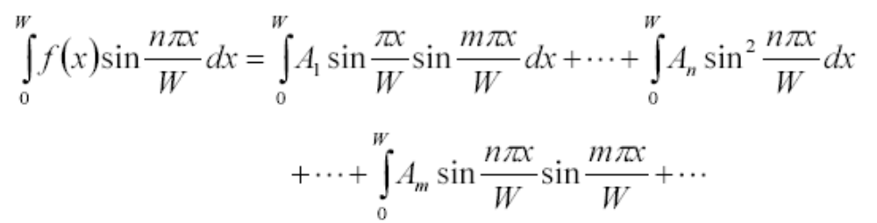
Series Expansion of Boundary Condition
Construction of a Fourier series expansion of the boundary values is facilitated by rewriting previous equation as:
where
Multiply f(x) by sin(mpx/W) and integrate to obtain

Slide 21
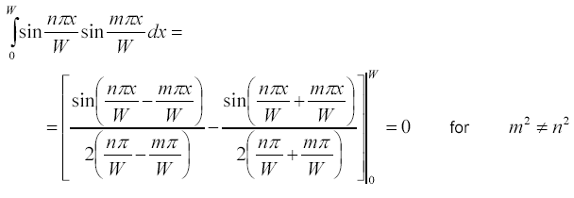

Substituting these Fourier integrals in to solution gives:

Slide 22


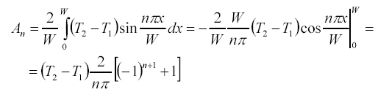
And hence
Substituting f(x) = T₂ - T₁ into above equation gives:

Slide 23

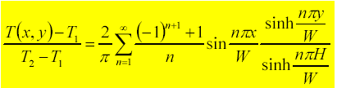
Computation of Coefficient
Therefore

Slide 24
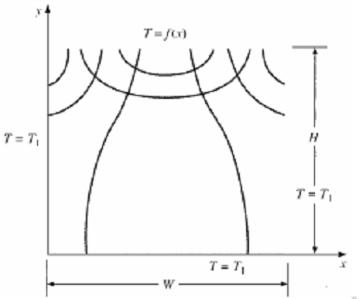
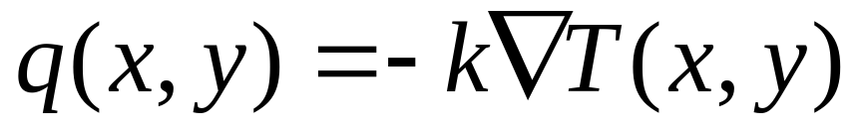
Computation of Isotherms & Heat Flux Lines
Isotherms and heat flow lines are
Orthogonal to each other!

Slide 25
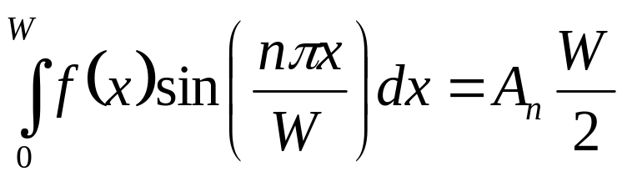



Linearly Varying Temperature B.C.
q = Cx
H
q = 0
q = 0
y
0
x
W

Slide 26
Laplace Equations & Principle of Superposition : Laplace Equation

Slide 27

True 2D Problems : Steady Conduction in Plate
Boundary conditions:
x = 0 & 0 < y < H : T(0,y)= 0
x = W & 0 < y < H : T(W,y)= f₁(y)
y = 0 & 0 < x < W : T(x,0)= 0
y = H & 0 < x < W : T(x,H)= f₂(x)

Slide 28


Principle of Superposition
Let
The Temperatures are determined by
Boundary conditions:
x = 0 & 0 < y < H : α (0,y)= 0
x = W & 0 < y < H : α (W,y)= 0
y = 0 & 0 < x < W : α (x,0)= 0
y = H & 0 < x < W : α (x,H)= f₂(x)
x = 0 & 0 < y < H : β (0,y)= 0
x = W & 0 < y < H : β (W,y)= f₁(y)
y = 0 & 0 < x < W : β (x,0)= 0
y = H & 0 < x < W : β (x,H)= 0

Slide 29





General Solutions : α Function
Unused Boundary conditions:
y = H & 0 < x < W : α (x,H)= f₂(x)

Slide 30




General Solutions : β Function
Unused Boundary conditions:
x = W & 0 < y < H : β (W,y)= f₁(y))

Slide 31

True 2D Problems : Steady Conduction in Plate
Boundary conditions:
x = 0 & 0 < y < H : T(0,y)= 0
x = W & 0 < y < H : T(W,y)= f₁(y)
y = 0 & 0 < x < W : T(x,0)= 0
y = H & 0 < x < W : T(x,H)= f₂(x)

Slide 32




Simple Harmonic Functions as Solutions
Unused Boundary condition-1:
x = W & 0 < y < H : T(W,y)= sinπy
H
W

Slide 33



Simple Harmonic Functions as Solutions
H
Unused Boundary condition -2:
y = H & 0 < x < W : T(x,H)= sinπx
W

Slide 34

Non-homogeneous Boundary Conditions for 2D Laplace Equation
Method of Superposition:
Decomposes the real problem
y
h
,
T
∞
Example:
Problem with 4 NHBC is decomposed into 4 problems each having one NHBC
′
q
′
W
g
(
y
)
o
PDE
L
x
0
f
(
x
)

Slide 35
The Solution
y
h
,
T
y
h
,
0
∞
=
q
′
′
W
g
(
y
)
q
′
′
W
0
o
o
0
L
x
0
L
x
f
(
x
)
0
y
y
h
,
0
y
h
,
0
h
,
T
∞
+
+
T
T
3
T
2
4
W
g
(
y
)
W
0
W
0
L
L
L
0
0
x
0
f
(
x
)
x
0
0
x

Slide 36


Friction Welding of Two Solid Cylinders
Radial and Axial Conduction in a Cylinder
Two solid cylinders are pressed coaxially with a force F and rotated in opposite directions.
Coefficient of friction is
r
h
,
T
∞
h
,
T
∞
r
ω
o
0
z
ω
L
L
h
,
T
h
,
T
∞
Convection at the outer surfaces.
∞
How to Achieve the Strong Weld?

Slide 37






Governing PDE in Cylindrical Coordinates
Boundary conditions
or
finite

Slide 38







Separation of Variables
Selecting the sign of the as positive.

Slide 39



The SO-ODE for Radial Distribution of Temperature
∴ The General form of Bessel equation is
This is a Bessel equation with m²=0
Solution to Bessel’s ODE

Slide 40

The SO-ODE for Axial Distribution of Temperature
Complete solution

Slide 41


Application of Boundary Conditions
Boundary condition:1
or
finite

Slide 42






Boundary Condition - 2
Define

Slide 43


Boundary Condition - 3

Slide 44

The Series Solution for Temperature

Slide 45




Boundary Condition - 4
Orthogonality Condition
and
are orthogonal with respect to
Applying orthogonality gives the values of a_{j}

Slide 46


Computation of Coefficients

Slide 47

The Final Equation for Temperature Disribution
r
h
,
T
∞
h
,
T
∞
r
ω
o
0
z
ω
L
L
h
,
T
h
,
T
∞
∞

Slide 48

The fuel fabrication process

Slide 49


Fuel Rod Cluster

Slide 50



Non-homogeneous Laplace Equations
Example : Thermal Analysis of Nuclear Rods
r
Solid cylinder generates
T
r
a
′
′
o
q
′
′
0
′
heat at a rate
q
′
One end is at
0
z
while the other is insulated.
T
L
o
Fig. 3.6
Cylindrical surface is at
Find the steady state temperature distribution.

Slide 51

Formulation of Problem
Important Observations
• Energy generation leads to
NHDE
r
T
r
a
′
′
o
q
′
′
0
′
q
′
z
0
T
L
• Define
to make
o
Fig. 3.6
BC at surface homogeneous
• Use cylindrical coordinates

Slide 52




Non-homogeneous Laplace Equation
Boundary conditions
r
T
r
a
′
′
o
q
′
′
0
′
q
′
(1)
0
z
finite
T
L
(2)
o
Fig. 3.6
(3)
(4)

Slide 53




Solution to

Slide 54



The Solution
    Let:
Split above equation: Let

Slide 55



Therefore
• Guideline for splitting PDE and BC:
should be governed by HPDE and three HBC.
Let
take care of the NH terms in PDE and BC

Slide 56




BC (1)
finite
(c-1)
BC (2)
(c-2)
BC (3)
Let
(c-3)

Slide 57




Thus
(d-1)
BC (4)
Let
(c-4)
Thus
(d-2)
Solution to (d)

Slide 58




(e)
(i) Assumed Product Solution
(f)
(f) into (c), separating variables
(g)
(h)

Slide 59





Selecting the sign of the
terms
(i)
(j)
  For
(k)

Slide 60






(l)
(iii) Solutions to the ODE
(m)
(j) is a Bessel equation with
(n)

Slide 61




Solution to (k) and (l)
(o)
(p)
Complete Solution:
(q)
(iv) Application of Boundary Conditions
BC (c-1) to (n) and (p)

Slide 62









BC (c-4) to (m) and (o)
BC (c-3) to (m) and (o)
Equation for
or
(r)
With
The solutions to
become

Slide 63






(s)
BC (d-1) and (d-2)
and
(t)
BC (c-2)
(u)

Slide 64









(v) Orthogonality
are solutions to equation (i).
Comparing (i) with eq. (3.5a) shows that it is a Sturm-
Liouville equation with
and
Eq. (3.6) gives
and
2 HBC at
and
are orthogonal
with respect to

Slide 65




Evaluating the integrals and solving for
(v)

Slide 66






Solution to
(w)
(5) Checking
Dimensional check: Units of
and of
in
solution (s) are in °C
Limiting check:
and

