Slide 1

Second Order-Partial Differential Equations
P M V Subbarao
Professor
Mechanical Engineering Department
I I T Delhi
Important and Unavoiable Thermofluid Applications Geneted SO-PDEs…..

Slide 2

Introductory Remarks
There is no general theory known for solving all partial differential equations …..
Abstract mathematicians never realized this branch of mathematics.
As the variety of phenomena modelled by such equations, research focuses on particular PDEs that are important for theory or applications.
Mathematicians only studied those PDEs which are catergorized according to application.

Slide 3
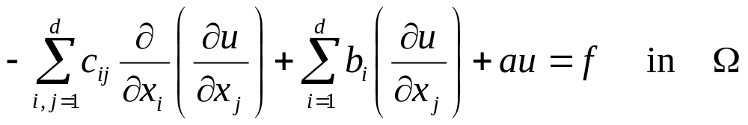
Second Order – Partial DEs
A general and perhaps more conventional form of a scalar linear second-order equation in d number of different variables u = (x₁, . . . , x_{n}) is:
If all the coefficients are independent of the space variable x, the equation is with constant coefficients.
In general, for all derivatives to exist, the solution and the coefficients have to satisfy regularity requirements (???).
These requirements can be slightly reduced when the equation is formulated in a weak sense.
Note also that additional conditions need to be prescribed in order to ensure the existence and the uniqueness of the solution.

Slide 4
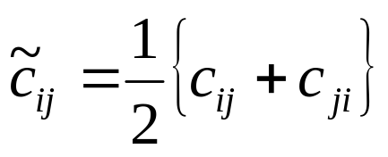
Second Order – Partial Des : Remarks-1
For any twice continuous function u, it is possible to symmetrize the coefficients of the matrix [C] = c_{ij} by writing:
and modifying the other coefficients accordingly to preserve the original form of the equation.

Slide 5
Second Order – Partial Des : Definition
Consider a second-order partial differential equation of above form with a symmetric coefficient matrix C(x); then the equation is said to be
1. elliptic at x ∈Ω, if C(x) is positive definite, i.e., if for all v≠ 0 ∈ ℜ^{d} , v^{t}Cv > 0.
2. parabolic at x ∈Ω, if C(x) is positive semidefinite v^{t}Cv ≥ 0, for all v≠ 0 ∈ ℜ^{d} and not positive definite and the rank of C(x), b(x), a(x) is equal to d.
3. hyperbolic at x ∈Ω, if C(x) has one negative and (n−1) positive eigenvalues.
By extension, an equation will be called elliptic, parabolic or hyperbolic in the open set Ω if it is elliptic, parabolic or hyperbolic everywhere in Ω.

Slide 6
Second Order – Partial Des : Remark 2
This classification implies that the equation is not invariant if it is multiplied by −1.
In this respect, the equation −Δu = f is elliptic in ℜ^{d}. (since its coefficient matrix is positive definite).
However, the equation -Δu = -f has an unknown type (as its coefficient matrix is negative definite).
To overcome this problem, it is common to multiply the equation by (−1) so that the previous definition applies to this equation.
However, the character of the equation is not altered by a change of variables.

Slide 7
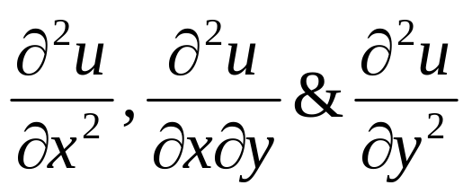
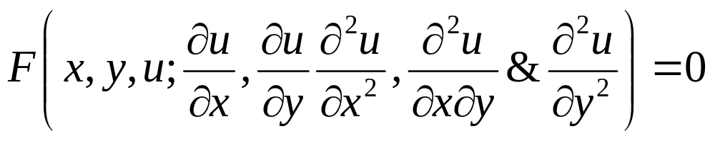
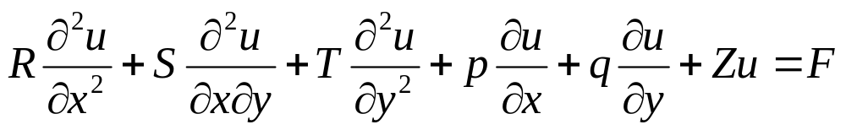
Second Order – Partial Des: Remark 3
An equation is said to be of order two, if it involves at least one of the differential operators
Thus the general form of a second order Partial differential equation is
The most general linear partial differential equation of order two in two independent variables x and y with variable coefficients is of the form
where 𝑅, 𝑆, 𝑇, 𝑃, 𝑄, 𝑍, 𝐹 are functions of 𝑥 and 𝑦 only and not all 𝑅, 𝑆, 𝑇 are zero.

Slide 8
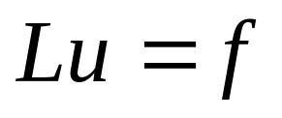
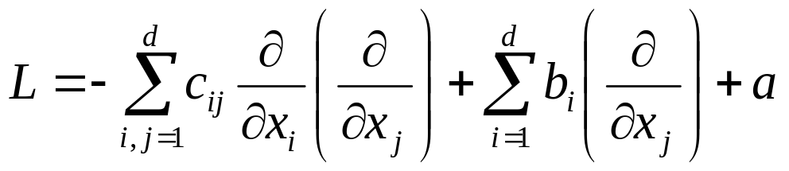
Second Order – Partial Des: Remark 4
In practice, we make a distinction between time-dependent and time-independent PDEs.
Often, elliptic equations are time-independent equations.
Notation. Elliptic partial differential equations can be written in a more concise form:
where L denotes the second-order elliptic differential operator defined according to previous equation as:

Slide 9
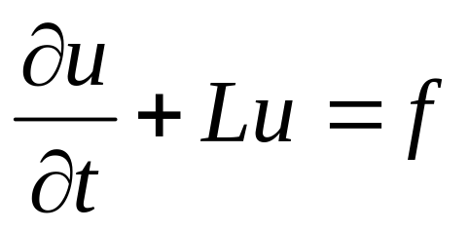
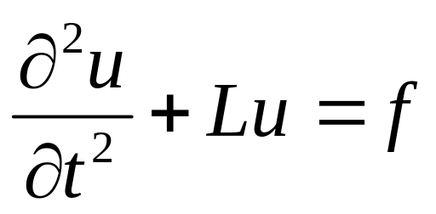
Second Order – Partial DEs: Remark 4
As many PDE are commonly used in physics, one of the independent variables represents the time t.
For example, given an elliptic differential operator L, the operator form of a parabolic equation is:
and a second-order hyperbolic equation is then:

Slide 10
Second Order – Partial DEs: Boundary Conditions
In general, in the mathematical models, additional information on the boundary of the domain are supplied with the PDE.
These information are known as initial or final conditions (with respect to the time dimension).
As boundary conditions (with respect to the space dimension).
Notice here the fundamental difference between ordinary differential equations (ODE) and partial differential equations.
The general solution of an ODE contains constants (values) while the general solution of a PDE contains arbitrary functions.

Slide 11
Second Order – Partial DEs: Boundary Conditions
As we will learn soon, the equation is not sufficient to ensure the unicity of the solution u.
Additional information is needed on the boundary Ω or on a portion Γ of the boundary of Ω.
Such data is called a boundary condition.
Hence, the partial differential equation together with a set of additional restraints is called a boundary value problem.

Slide 12
Second Order – Partial DEs: Boundary Conditions
If the boundary condition gives a value to the domain: ∀ x ∈ Γ, u(x) is fixed, then it is a Dirichlet boundary condition.
If the boundary condition gives a value to the normal derivative of the problem: ∀ x ∈ Γ ∂u(x)/ ∂ν =(∇u•ν) is fixed, then it is a Neumann boundary condition.
Mixed boundary conditions indicate that different boundary conditions are used on different parts of the domain boundary.
Robin (Newton) boundary conditions is another frequently used type of boundary conditions.
It involves a (linear) combination of function values (Dirichlet) and normal derivatives (Neumann).

Slide 13
Hadamard concept of well-posed problem
The notion of well-posedness, due to J. Hadamard (1865-1963), is related to the requirements that can be expected from solving a partial differential equation.
Definition (Hadamard’s well-posedness):
A given problem for a partial differential equation is said to be well-posed if:
(1) a solution exists,
(2) the solution is unique,
(3) the solution depends continuously on the given data (in some reasonable topology).
Otherwise it is ill-posed.

Slide 14
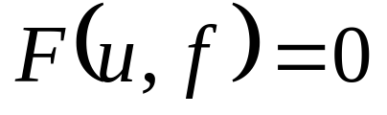
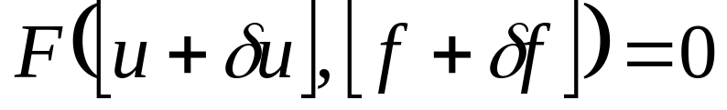
The notion of continuous dependence on the data
The notion of continuous dependence on the data indicates that the solution should not have to change much if the data are slightly perturbated.
This requirement is important because in applications, the boundary data are usually obtained through measurements and may be noisy.
Hence, small measurement errors should not affect dramatically the solution.
Suppose our problem is of the general form: find a solution u such that
Now, if we denote by δf a small perturbation on the data and by δ u the modification in the solution that occurred because of this perturbation, such that

Slide 15
The notion of continuous dependence on the data
Now, if we denote by δf a small perturbation on the data and by δ u the modification in the solution that occurred because of this perturbation, such that
then,
This concept of perturbation generated a new definition at the beginning of the century.

Slide 16
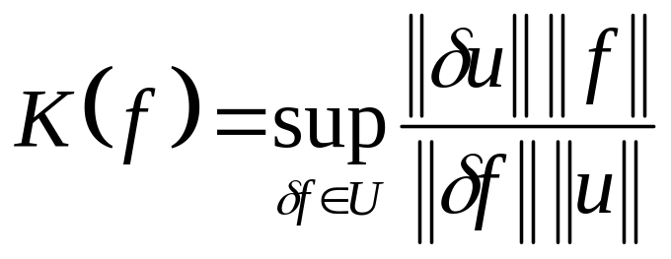
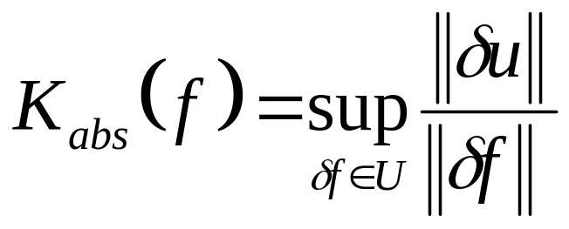
The notion of continuous dependence on the data : Definition : Quarteroni et al., 2000
Following above reference, let us consider the relative condition number associated with problem F(u, f) = 0:
where U is a neighborhood of the origin and represents the set of admissible perturbations on the data for which the problem F(u + δu, f + δf) = 0 is still relevant.
Whenever f = 0 or u = 0, we consider the absolute condition number, given by

Slide 17
The ill-conditioned SO-PDE
Above problem is called ill-conditioned when K(f) is ”big” for any admissible given function f .
The meaning of big may change depending on the problem considered.
Remark: Notice that the notion of well-posedness of a problem and its property of being wellconditioned is independent from the numerical method used to solve it.
Even in the case where the condition number may be infinite, the problem may be well-posed.
Usually, it can be reformulated into an equivalent problem with a finite condition number.

Slide 18
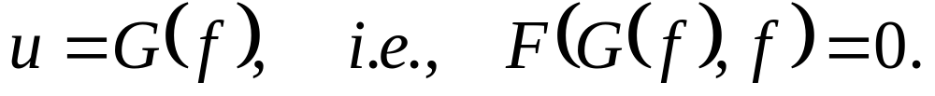
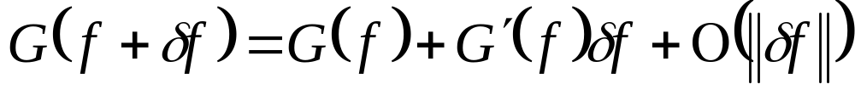
The ill-conditioned SO-PDE
If above problem has a unique solution, then there exists a resolvent mapping G between the sets of the data and the solutions, such that
Hence, problem
yields u + δu = G(f + δ f).
If the mapping G is differentiable in f, G : ℜ^{n} → ℜ^{m} , G′(f) will denote the Jacobian matrix of G evaluated at f, we can write

Slide 19
The Closure
The concept of well-posed problem is obviously of great importance is practical applications.
Indeed, if a problem is well-posed, it is reasonable to attempt to compute an accurate approximation of the exact solution (here unique) as long as the data are suitably approximated.
However, there are examples with incorrect boundary conditions may jeopardize the well-posedness nature of a problem.

Slide 20
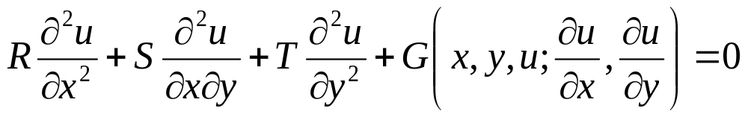
Geometric Interpretation of A Linear SO-PDE
Combine the lower order terms and rewrite the previous equation in the following form
Think geometrically.
Identify the solution u(x, y) with its graph,
This is a surface in xyu-space defined by u = f(x, y).
Geometric Interpretation:
If f(x, y, u) =0 is a solution of this equation, then this function describes the solution surface, or integral surface.
The shape of this surface is distinguished by the relative magnitude of coefficients of higher order differentials.

Slide 21
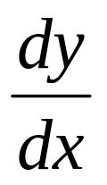
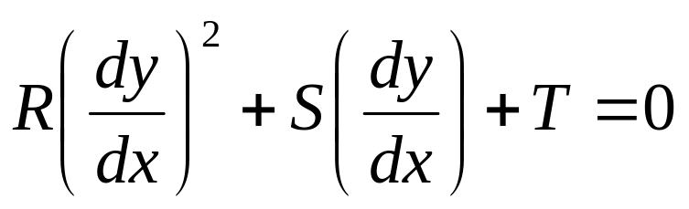
Characteristics of the Surface Defined by A Linear SO-PDE
The slope of characteristic curve is:
Theorem for Linear SO-PDE: The equation for the slope of the characteristic curve is
As the above is a quadratic equation, it has 2, 1, or 0 real solutions, depending on the sign of the discriminant.

Slide 22
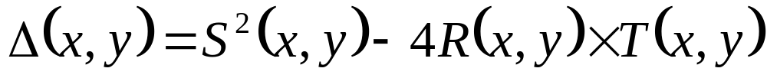
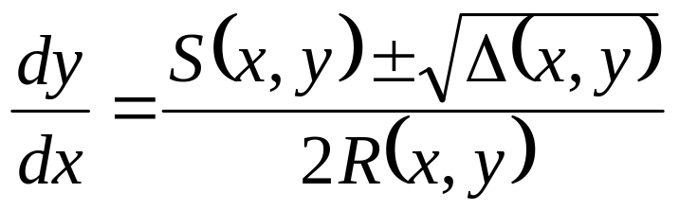
Discriminant of A Linear SO-PDE
The nature of a Linear SO-PDE is distinguished by the relative magnitude of coefficients of higher order differentials.
Define discriminant of a Linear SO-PDE as:

Slide 23
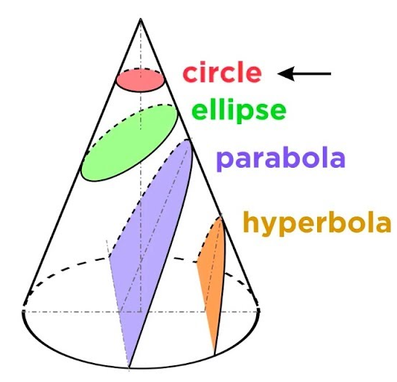
Classification of second order linear PDEs
The classification of second order linear PDEs is given by the following definitions.
Definition 1: At the point (x₀; y₀) the second order linear PDE is called
Hyperbolic, if Δ(x₀; y₀) > 0
Parabolic, if Δ(x₀; y₀) = 0
Elliptic, if Δ(x₀; y₀) < 0
Notice that in general a second order equation may be of one type at a specific point, and of another type at some other point.

Slide 24
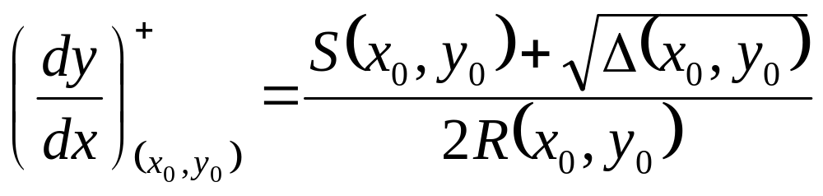
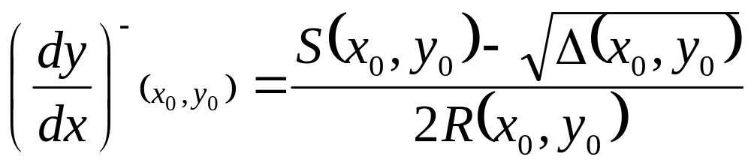
Hyperbolic Linear SO-PD Equations
If the discriminant Δ > 0, then there are two distinct families of characteristic curves.

Slide 25
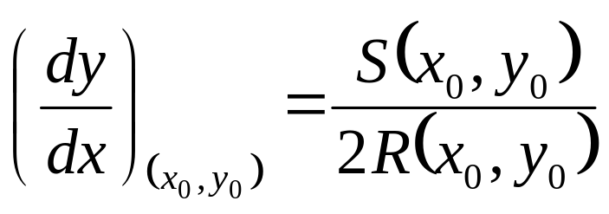
Parabolic Linear SO-PD Equations
For parabolic equations Δ= B²-4AC = 0.
There is only one family of characteristic curves.

Slide 26
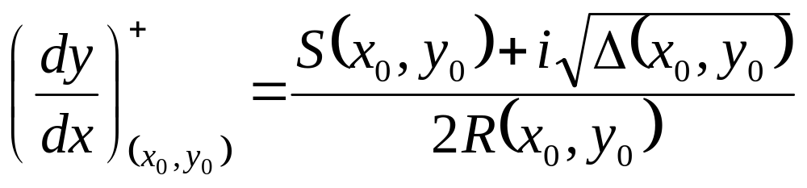

Elliptic Linear SO Equations
Elliptic equations are due to Δ = B²-4AC < 0.
There are two complex conjugate solutions.

Slide 27
Summary
All the three types of equations can be reduced to canonical forms.
The Hyperbolic equations reduce to wave equation.
The parabolic equations reduce to the heat equation.
The Laplace's equation models the canonical form of elliptic equations.
Thus, the wave, heat and Laplace's equations serve as canonical models for all second order constant coefficient PDEs.
We will spend the rest of this course studying the solutions to the Laplace, heat and wave equations.

