Slide 1

Non-linear Wave Equations : A Source of Inspiration for Unending Space Travel
P M V Subbarao
Professor
Mechanical Engineering Department
I I T Delhi
Explore Secrets of fast Flying Objects…..
A Flying Machine is Always Competing with Some Invisible Speed…..

Slide 2

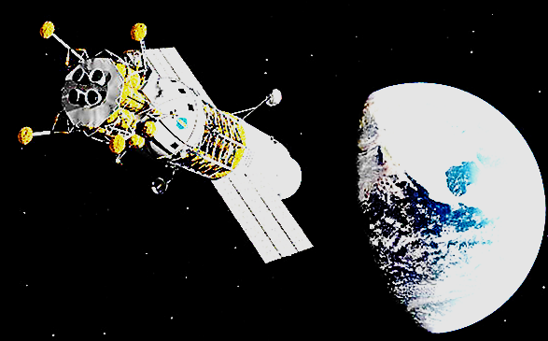
An Universal Method of Flying Fast
Sky is the Limit

Slide 3
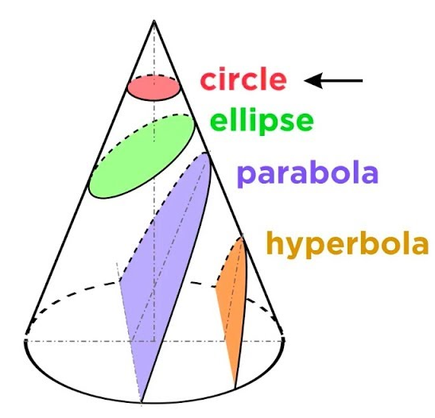
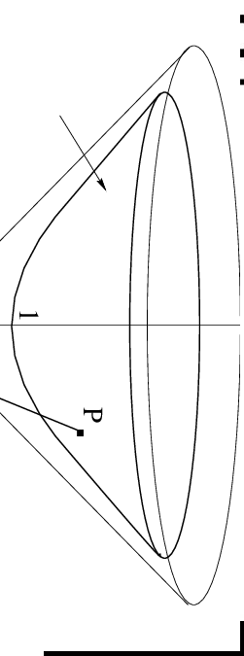
Domain of Interest

Slide 4
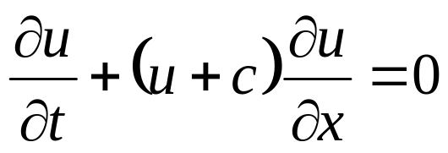
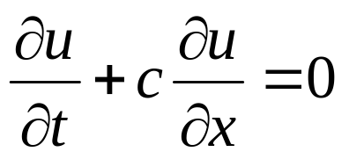
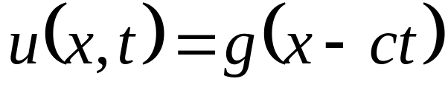
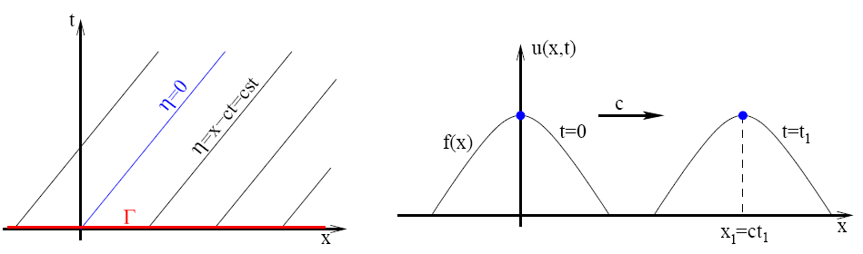
FO- Wave Equation
Consider the equation
with u(0; x) = f(x); where c is some positive constant.
If u is small (i.e. u² << c), then the equation approximate to the linear wave equation.
with u(0; x) = f(x).
This is known as Linear wave equation or advection equation.
The general solution is
where g is an arbitrary function

Slide 5
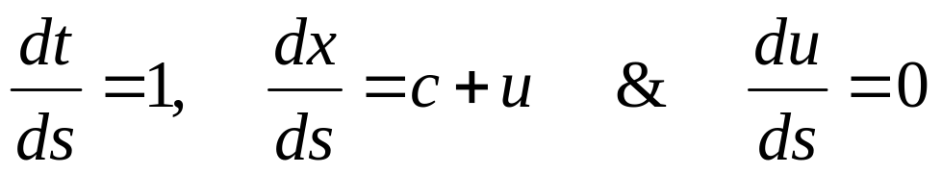
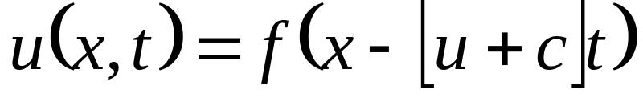
The Nonlinear Waves Equation
The nonlinear equation,
the characteristic and compatibility equations are defined by
Apply the initial condition u(x; 0) = f(x) to find the solution of non-linear wave equation as
This is similar to the linear wave, but now the “wave speed” involves u.

Slide 6
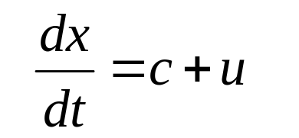
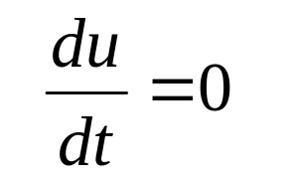
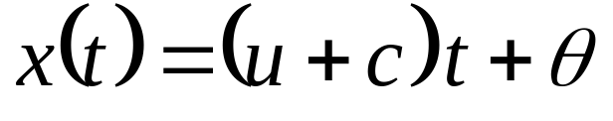
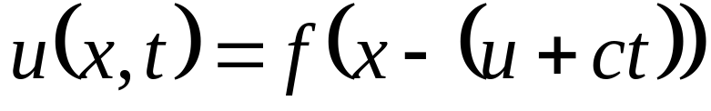
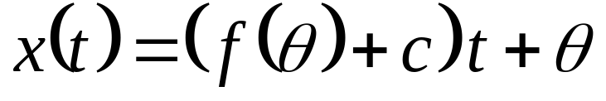
Analysis of Characteristic Curves for NL-FO-ODE
The combination of characteristic equations is described by
Integrate above to get straight lines as solution as,
∴The equation of characteristic curves, expressed in terms of a parameter, θ , is

Slide 7
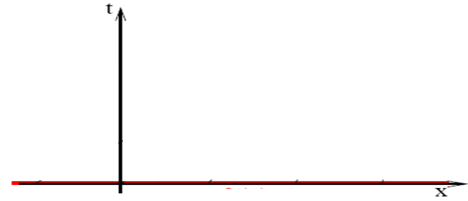
Evolution of Characteristic Curves
The slope of the characteristics, varies from one line to another.
u=f(θ) & x-[f(θ)+c]t=θ
x=θ. t=0
Two successive curves (lines) can intersect each other?!?!.
This may happen after some time.

Slide 8
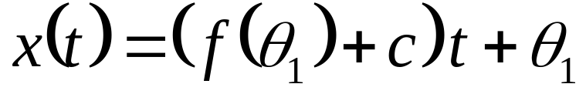
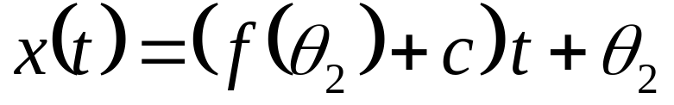
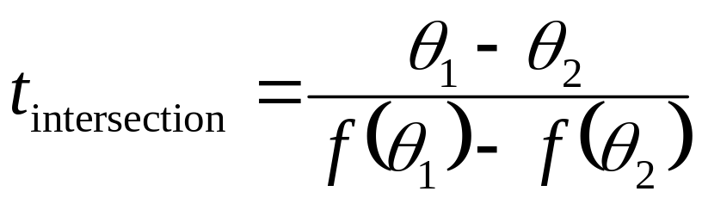
Intersection of Characteristic Curves
Consider two crossing characteristics expressed in terms of θ₁ and θ₂.
These correspond to initial values given at x =θ₁ and x=θ₂.
These characteristics
intersect at the time
x=θ₂. t=0
x=θ₁. t=0

Slide 9
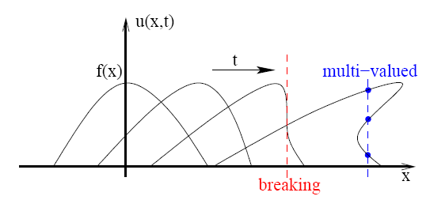
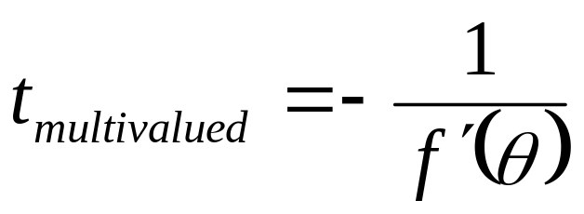
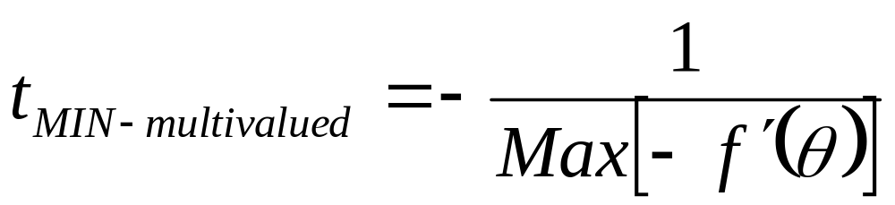
Positive Value of Intersection Time
If the intersection time is positive, it will be in the region of solution or it will be experienced.
At this point, the value of u is influenced by two curves and hence will not be single valued.
This is known as the solution breaks down.
By letting θ₂ → θ₁ , it can be seen that the characteristics intersect at
The minimum time for which the solution becomes multi-valued is

Slide 10
Multivalued Wave Fields
The solution is single valued (i.e. is physical) only for 0 < t < t_{min}.
Hence, when f′(θ) < 0, it can be expected that the solution to exist only for a finite time.
In physical terms, the equation considered is purely advective.
In real waves, these are known as shock waves.
Large values of density, temperature and pressure are formed.
Here the diffusive terms become vitally important.

Slide 11

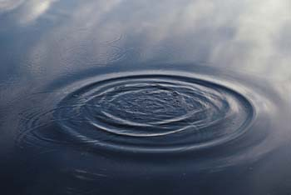
Effect of Travelling Disturbance in A Fluid Medium
• If the object is traveling significantly slower than sonic velocity (u<<c), then pressure waves travel out uniformly similar to waves on the surface of a pond.
If u < c
u

Slide 12
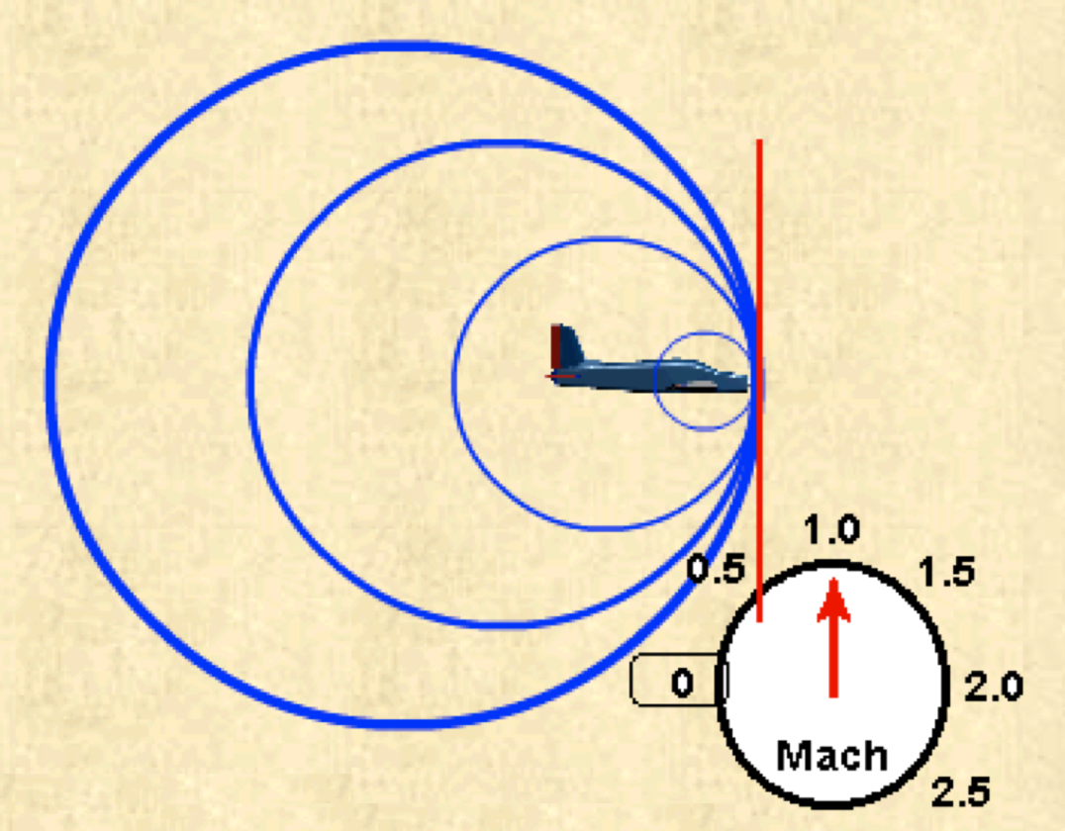
Moving Disturbance In A Fluid
• As the object approaches the speed of sound, it begins to catch up with the pressure waves and creates an infinitesimally weak flow discontinuity just ahead of the aircraft

Slide 13
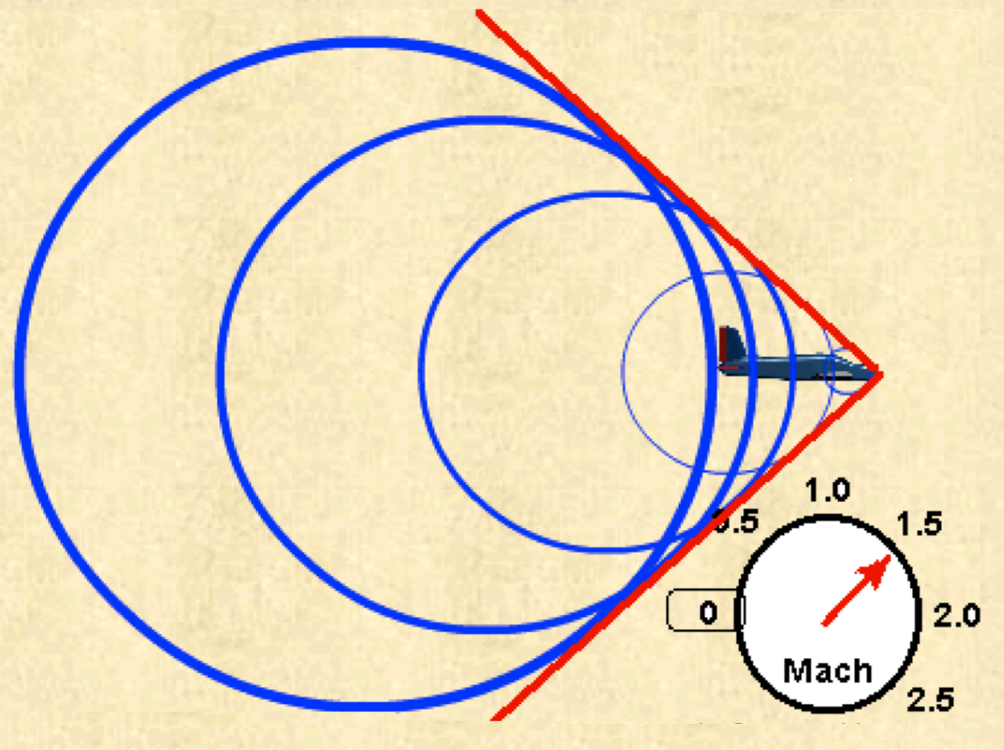
Moving Disturbance In A Fluid
• As the vehicle breaks the speed of sound, the infinitesimally weak Shock waves begin to add up along a “Mach Line” and form a strong pressure wave with highly compressed air, called a shockwave.

Slide 14
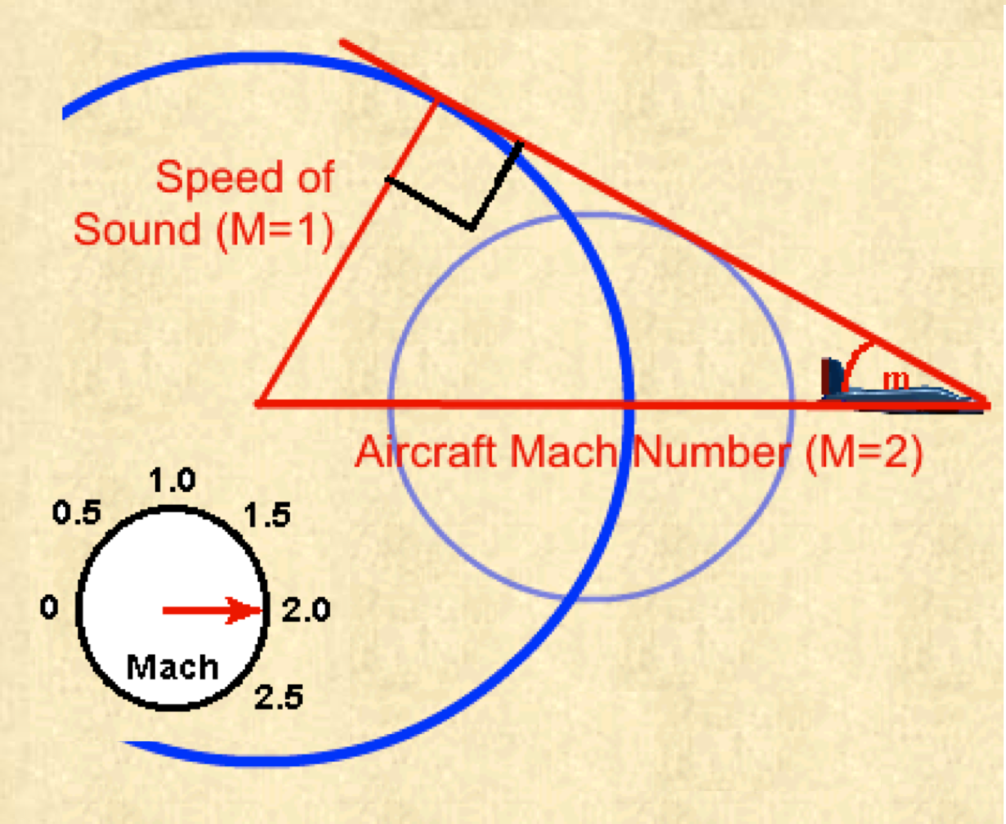

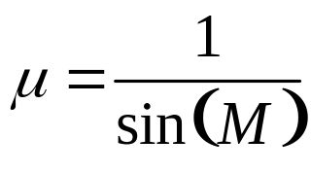

Mach’s Cone
• As Mach number increases, the strength of the Cone increases and the Angle of the shockwave becomes increasingly severe
• Mach Angle

Slide 15
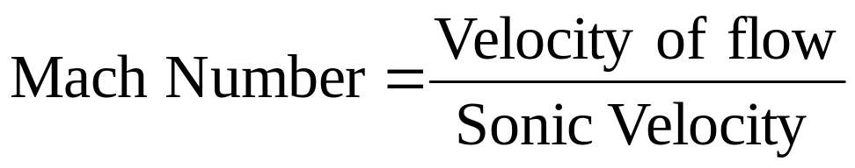
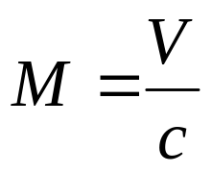

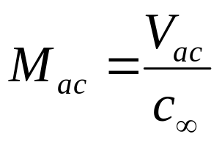
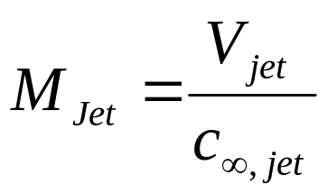
Mach Number : A True Measure of High Speed Systems
Mach number of a flight
Mach number of a Jet

Slide 16
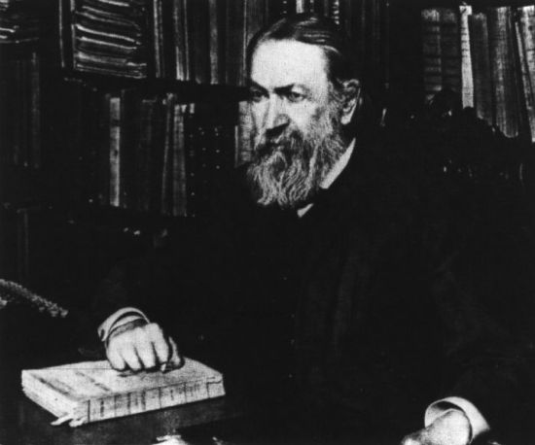
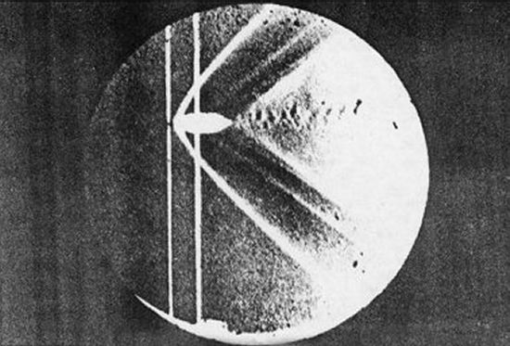
Mach’s experiments
Mach was actually the first person in history to develop a method for visualizing the flow passing over an object at supersonic speeds.
He was also the first to understand the fundamental principles that govern supersonic flow and their impact on aerodynamics.
"Photographische Fixierung der durch Projektile in der Luft eingeleiten Vorgange" that he presented to the Academy of Sciences in Vienna in 1887.
Ernst Mach's photo of a bullet in supersonic flight

Slide 17
Mach’s Witness of Shock
Not only was Mach was able to make the invisible shock waves visible, but it is even more amazing that he was able to photograph the phenomenon.
His experiments required split-second timing in an age before computers or electronics were available.
Mach's shadowgraph technique and a related method called Schlieren photography are still widely used to observe supersonic flow fields even today.
Yet Mach's contributions to supersonic aerodynamics were not limited to experimental methods alone.
He was the first person to note the sudden and discontinuous changes in the behavior of an airflow when the ratio V/c goes from being less than 1 to greater than 1.

Slide 18
Moving Disturbance of Finite Size in a Fluid
• Mach’s thought experiments are limited to infinitesimally small object.
What is minimum size of the object, which will follow Mach’s cone?
Later experience proved following:
As mach number becomes very large for a given size of the object, the Mach wave becomes a shock wave and gets bent so severely that it lies right against the vehicle;
Resulting flow field referred to as a shock layer.

Slide 19
Two Extreme Flyers
Flying of point or zero degree conical object at high speeds : Leads to derivation Speed of Sound.
Flying of a bluff body at high speeds : generation of A discontinuity.

Slide 20
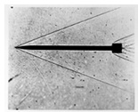
Weak Shock Due to Hypersonic Sleek flyers
One does find in some of the ancient writings of India some descriptions of advanced scientific thinking which seemed anachronistic to the age from which they come."
- Charles Berlitz - Mysteries from Forgotten Worlds.

Slide 21
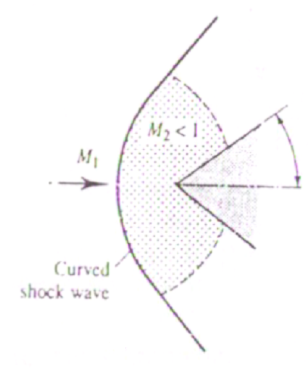
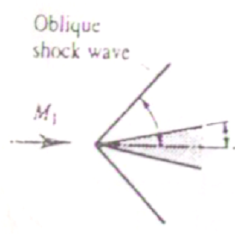
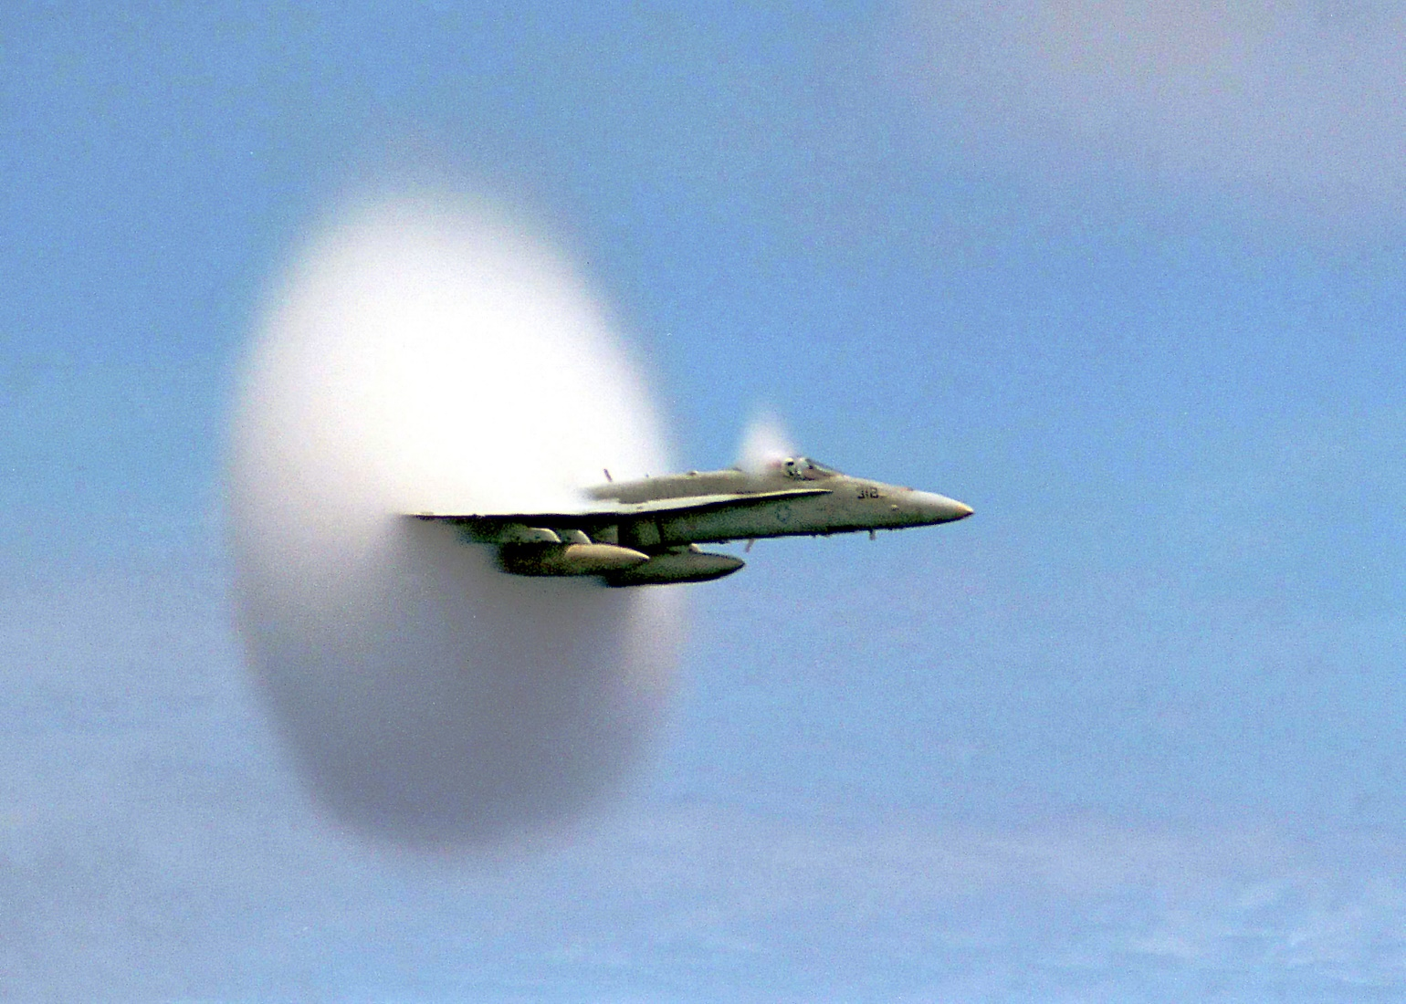
High Angle Flying Objects
Sleek Bodies at supersonic Speeds
Bluff Bodies at supersonic Speeds
The second Extreme of Gad Dynamic Actions

Slide 22
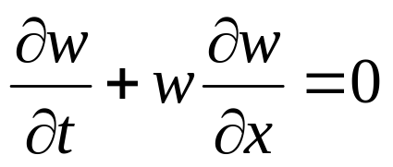
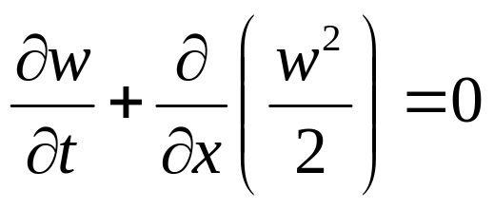
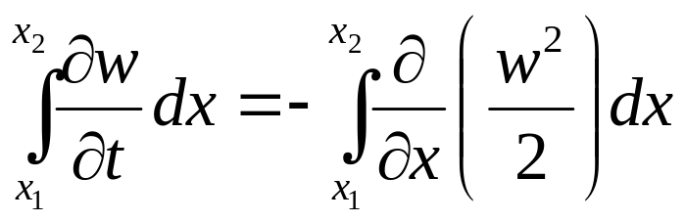
Weak Solutions
When wave breaking occurs (multi-valued solutions), the assumptions made for derivation of FO-PDE are not valid.
Consider again the nonlinear wave equation,
Substitute w(x; t) = u(x; t) + c; hence the PDE becomes the inviscid Burger's equation
or equivalently in a conservative form
This is called as a weak solution of this problem

Slide 23
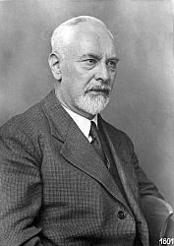
Prandtl Theory
The first theories about supersonic shock waves and flow came from Prandtl and Theodore Meyer, one of his students, in 1908.
Four decades before the first supersonic aircraft.
He didn’t continue working on this theory till the 1920s.
Adolf Buseman worked with Prandtl to developed a method for designing a supersonic nozzle in 1929.
Ludwig Prandtl

Slide 24
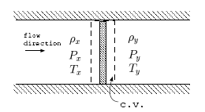
Prandtl – Meyer Analysis of A Shock
A control volume for this analysis is shown, and the gas flows from left to right.
The control volume is having a very narrow width.
No chemical reactions.
There is no friction or heat loss across this CV.
No work transfer is possible as this is so narrow.
The increase of the entropy is fundamental to any thing that happens in this world.

Slide 25
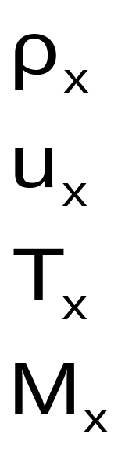
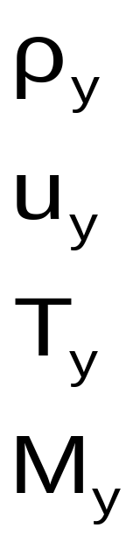
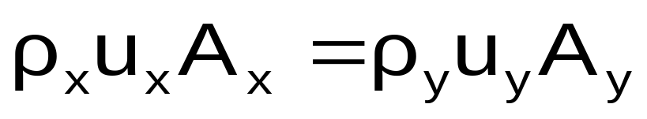
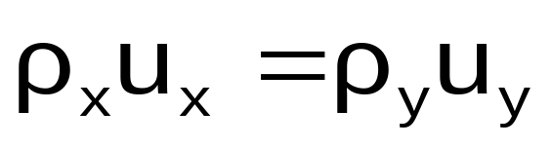
Conservation of Mass
Conservation of mass:
The area of the disturbance is not varying in flow direction.
Conservation of momentum: The momentum is the quantity that remains constant because there are no external forces.

Slide 26
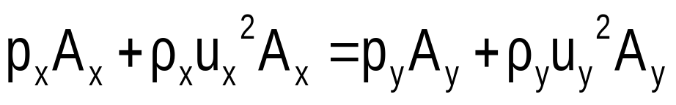
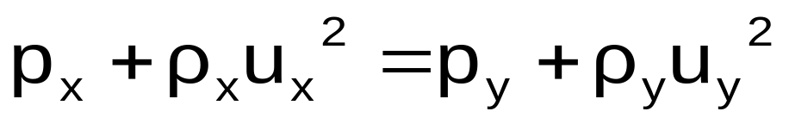
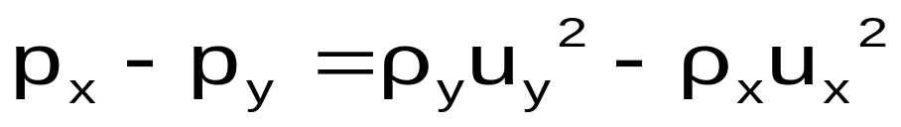
Conservation of Momentum
The area of the disturbance is constant.

Slide 27
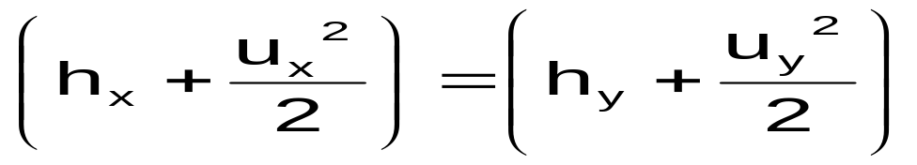
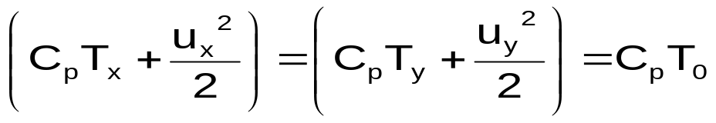

Conservation of Energy
For calorically perfect gas:
The equation of state for perfect gas reads

Slide 28




Summary of Equations
Conservation of mass :
Conservation of momentum :
Conservation of Energy :
The equation of state for perfect gas :

Slide 29



Machization of Conservation Equations

Slide 30



Roots of Machized Conservartion Equation
Reversible flow : No entropy generation between x & y,

Slide 31



The Dangerous Ghost
Shows existence of an Irreversibility between x & y,
The Existence of Normal Shock !!!!
This equation relates the downstream Mach number to the upstream Mach Number across a Normal Shock.
It can be used to derive pressure ratio, the temperature ratio, and density ratio across a Normal Shock.

Slide 32



An Ultimate Measure for Possibility of a Fantasy
Shock is possible only in supersonic flows
Infeasible
M

Slide 33


The weak solution
Effectively, the weak solution that evolves will be a piecewise smooth function with a discontinuity, the shock wave, that propagates with shock speed.
The form of the shock will be the discontinuity

