Slide 1

Quasi-Linear FO-Partial Differential Equations
P M V Subbarao
Professor
Mechanical Engineering Department
I I T Delhi
Mathematics for Space Travel thru Thermofluids Processes …..

Slide 2

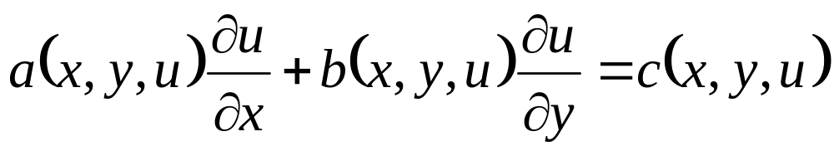
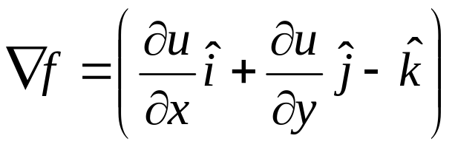
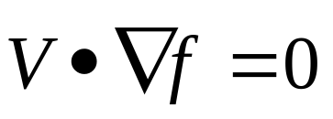
Vector Nature of Non-linear FO-PDEs
Consider a general non-linear partial differential equation in two independent variables,
Using vector calculus that the normal to the integral surface f(x,y,u) is given by the gradient function.
Now consider the vector of coefficients given in original PDE.
By using vector calculus the original Non-linear PDE is written as:

Slide 3
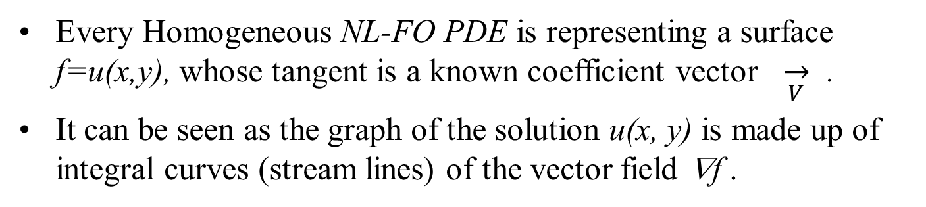
Geometrical Interpretation of Quasi-linear A FO-PDE
Given NL-FO PDE :
Every Homogeneous NL-FO PDE is representing a surface f=u(x,y), whose tangent is a known coefficient vector $\overset{→}{V}$ .
It can be seen as the graph of the solution u(x, y) is made up of integral curves (stream lines) of the vector field ∇f .
Clue: The graph of the solution to the PDE is constructed by finding the stream lines of ∇f that pass through the initial curve.
This is equivalent to solving a system of ODEs!
Geometrically, coefficient vector defines a direction field,
This is called as the characteristic field.

Slide 4
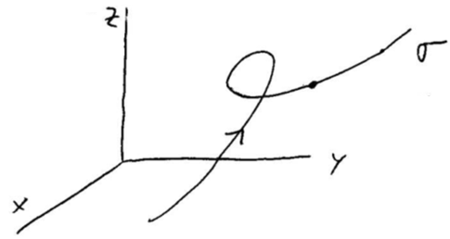
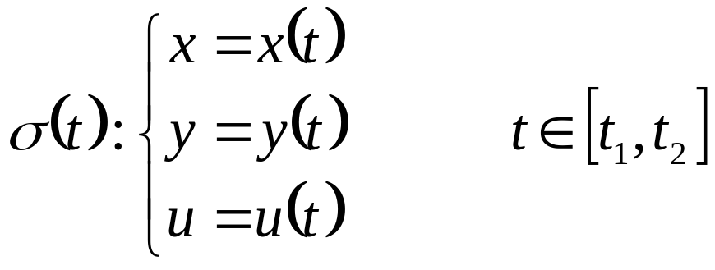
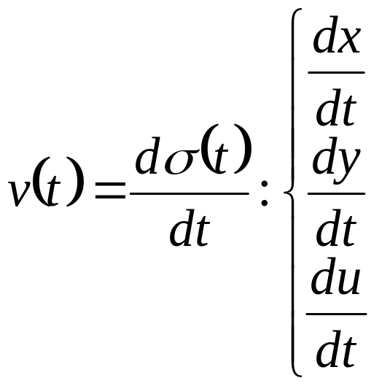
Space Curve & The Method of Characteristics
Parameterize the initial space curve using intrinsic geometry
Γ =σ(t).
The tangent to the curve is then

Slide 5
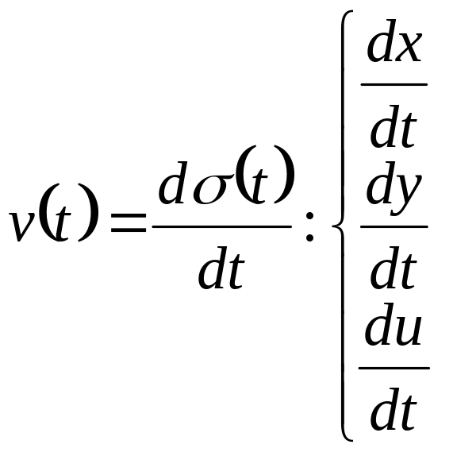
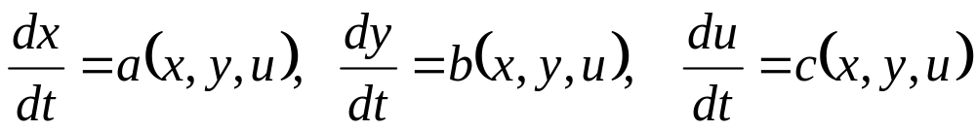
The Space Curve in QL- FO-ODE
Equate above equations to get the parametric form of the characteristic curves as

Slide 6
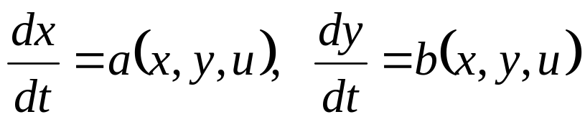
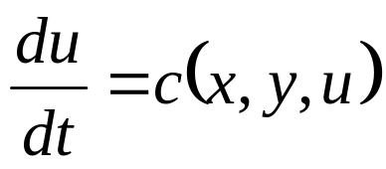
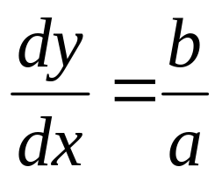
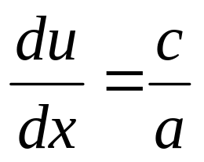
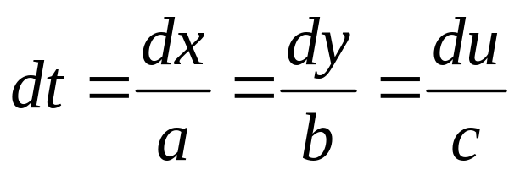
Characteristic & Compatibility Equations
These are called as characteristic equations of given QL-FO-ODE.
is called as compatibility equations of given QL-FO-ODE.
with a(x, y,u) ≠ 0 characteristic equations give
Compatibility condition becomes
All of these relations can be summarized in the form

Slide 7
How do we use these Characteristic & Compatibility Equations to solve quasi-linear partial differential equations?

Slide 8
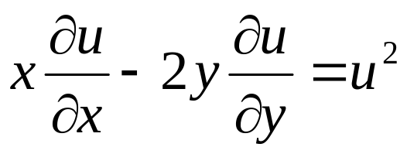
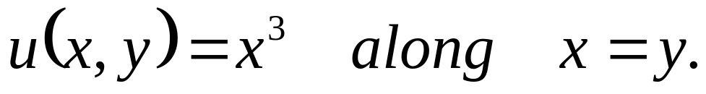
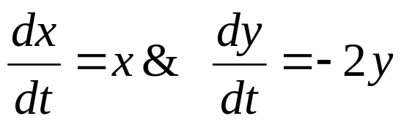
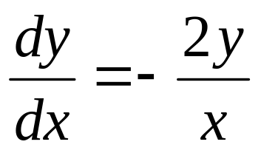
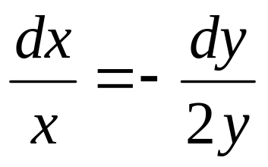
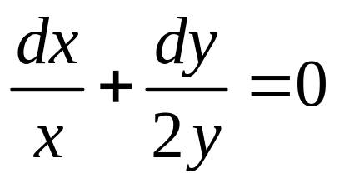
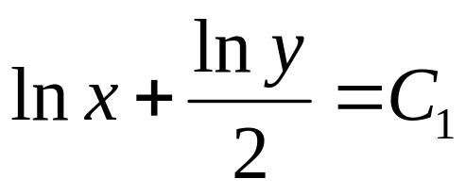
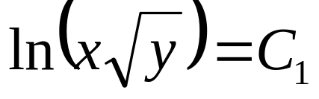
Example
Find the solution to
with initial space curve
Characteristic equations are :
or
What is the shape of these characteristic curves ?

Slide 9
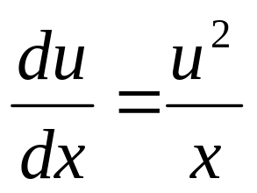
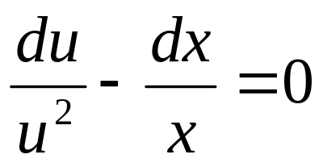
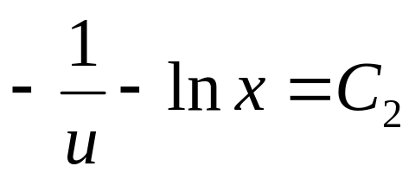
Solution
Compatibility conditions along these curves are
with

Slide 10
In Search of A General Solution
with
The goal is to find the general solution to the differential equation.
Since u = f(x, y), the integration “constant” is not really a constant, but is constant with respect to x.
It is in fact an arbitrary constant function.
In fact, this can be viewed it as a function of C₁, the constant of integration in the characteristic equation.

Slide 11
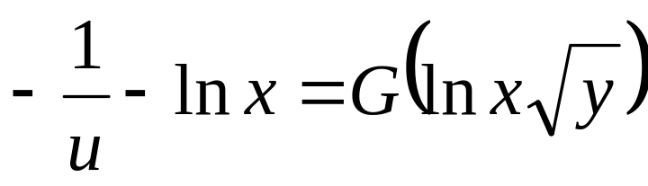
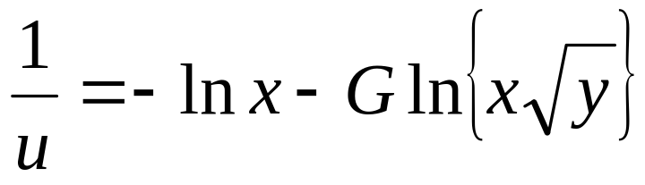
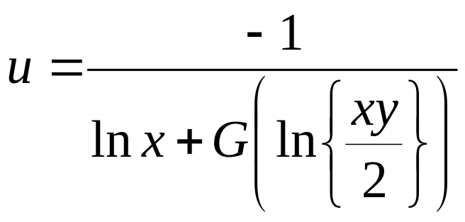
The General Solution
Hence, let C₂ = G(C₁), G is an arbitrary function.
Since
The general solution of the given Partial differential equation can be written as
This is a general solution to the partial differential equation

Slide 12
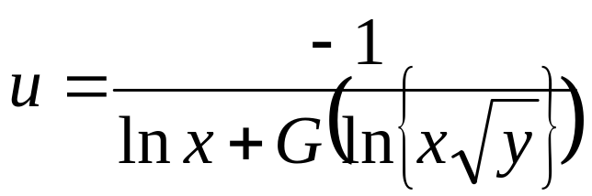
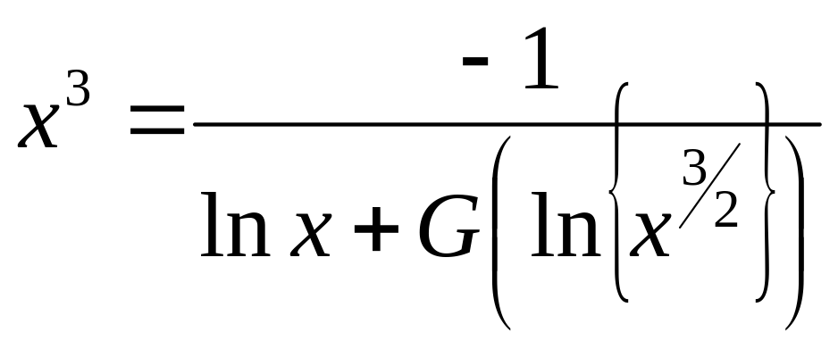
The Specific Solution
The general solution:
The side condition

Slide 13
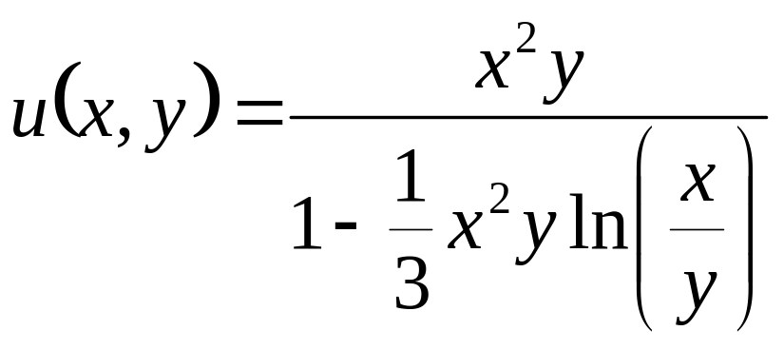
The Final Solution
Better & Engineering understanding of characteristic curves ?!?!?!??!

Slide 14
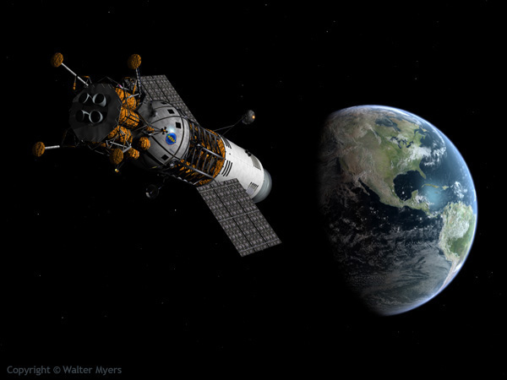
An Universal Method of Flying Fast
Sky is the Limit

Slide 15
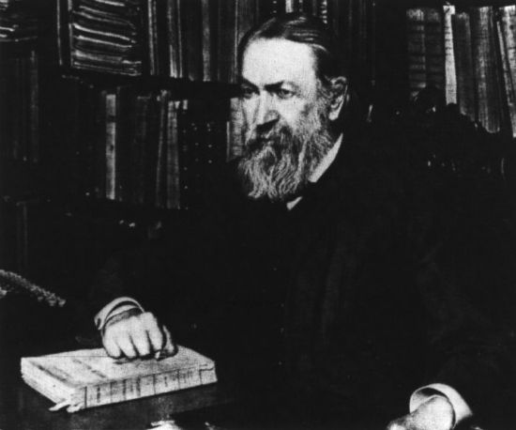
Engineering Understanding of Characteristic Field by Ernst Waldfried Josef Wenzel Mach
By 1885, the Buddha of Science initiated the art of understanding the basic characteristics of high speed flow.
He proposed that one of the most important variables affecting aerodynamic behavior is the speed of the air flow over a body (V) relative to the speed of sound (c).
Mach was the first physicist to recognize that dependency.
He was also the first to note the sudden and discontinuous changes in the behavior of an airflow when the ratio V/c goes from being less than 1 to greater than 1.
Ernst Mach (1838-1916)

Slide 16
1940-50’s Flying Story
Cruising at High Altitudes ?!?!?!
Aircrafts were trying to approach high altitudes for a better fuel economy.
This led to numerous crashes for unknown reasons.
Geoffrey Raoul de Havilland Jr. was a British test pilot, the English aviation pioneer and aircraft designer.
On 11 April 1939, de Havilland and John Cunningham narrowly escaped with their lives during a spin test of a new flight.
He made the first flight of the Vampire on 20 September 1943, making him the third British test pilot to conduct the maiden flight of a jet-powered aircraft.
De Havilland was awarded the OBE in the King's birthday honours in 1945.

Slide 17
The Sacrifice
De Havilland died on the evening of 27 September 1946 whilst carrying out high-speed tests in the de Havilland DH 108 TG306.
The aircraft had undergone severe and violent longitudinal oscillations prior to break-up.
This caused de Havilland's head to strike the cockpit canopy with great force.
Another pilot who flew the DH 108, Capt. Eric "Winkle" Brown, suggested that a factor in de Havilland's death was his height.
Brown suffered similar oscillations during a test flight but, because of his shorter stature, they did not cause his head to contact the cockpit hood.

Slide 18
Sound must be Made Difficult to Understand
The people had recognized for several hundred years that sound is a variation of pressure.
The ears sense the variations by frequency and magnitude which are transferred to the brain which translates to voice.
A fast flying aircraft is competing in any way with this sound?
If so, it raises the question: what is the speed of the disturbance generated by the fast flying aircraft.

Slide 19
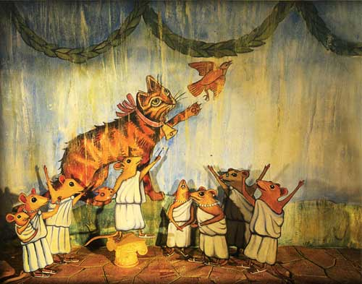
Bell The Cat : A Story for Kids

Slide 20
Engineering Understanding of Accoustics
The fact that the engineer knows about the acoustics is great but it is not enough for today's sophisticated industry.
A cat is pursuing a mouse and the mouse escape and hide in the hole.
Suddenly, the mouse hear a barking dog and a cat yelling.
The mouse go out to investigate, and cat is catching the mouse.
The mouse ask the cat I thought I hear a dog.
The cat reply, yes you right.
My teacher was right, one language is not enough today.

Slide 21
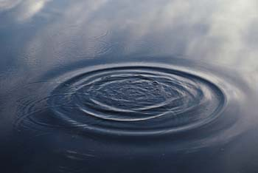
Effect of Disturbance in A Fluid Medium
• As an object moves through a fluid medium it creates pressure waves.
• Pressure waves travel out at the speed of sound which in term depends on fluid properties and temperature.
• If the object is traveling significantly slower than sonic velocity, then pressure waves travel out uniformly similar to waves on the surface of a pond.

Slide 22
Wave Equations
Wave phenomena are ubiquitous in nature.
They include water waves, sound waves, etc.
They are found to be an alternative and better description of particles,.
Waves travel with constant or with the speed depends strongly on the wave length.
Partial differential equations (PDEs) govern the waves.
Schrödinger equation for quantum wave functions, a quite simple set of PDEs are well known and extremely accurate.

Slide 23
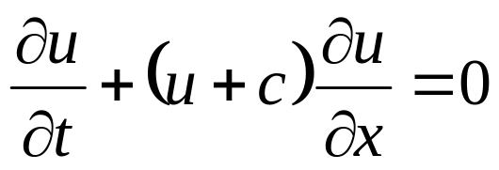
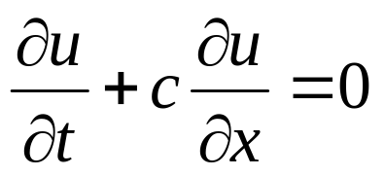
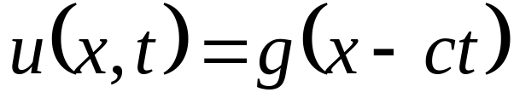
FO- Wave Equation
Consider the equation
with u(0; x) = f(x); where c is some positive constant.
If u is small (i.e. u² << u), then the equation approximate to the linear wave equation.
with u(0; x) = f(x).
This is known as Linear wave equation or advection equation.
The general solution is
where g is an arbitrary function
The function g is determined by the initial conditions.

Slide 24
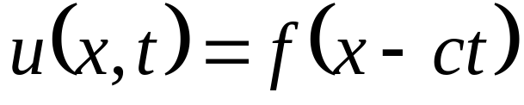
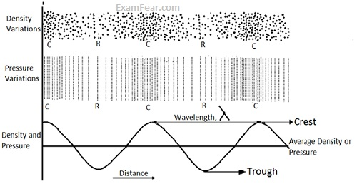
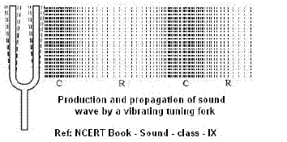
Solution of FO Linear Waver Equation/Advection Equation
The general solution is
Apply the initial condition u(x; 0) = f(x) to find the solution of linear wave equation as
This represents a wave (unchanging shape) propagating with constant wave speed c.

Slide 25
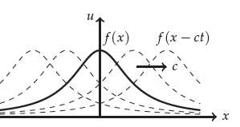
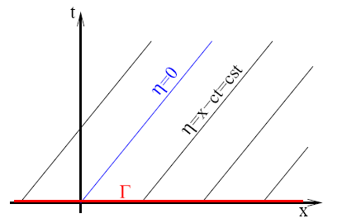
Travelling Waves
It is understood that u(x, t) = f (x- ct) indicates that the solution is a wave moving in one direction.
f (x) is the shape of the initial function.
This is known as a traveling wave.
A typical traveling wave is shown as
Characteristic Curves

