Slide 1

FO-Partial Differential Equations
P M V Subbarao
Professor
Mechanical Engineering Department
I I T Delhi
Emanation from the application of the laws of nature to systems…..
…..

Slide 2

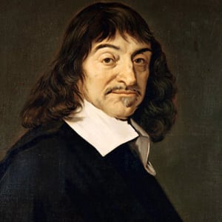
René Descartes Biography
Academic, Philosopher, Mathematician, Scientist (1596–1650)
Descartes added theology and medicine to his studies.
Descartes believed that all truths were ultimately linked.
He introduced Cartesian geometry.

Slide 3
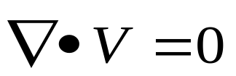
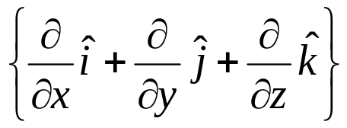

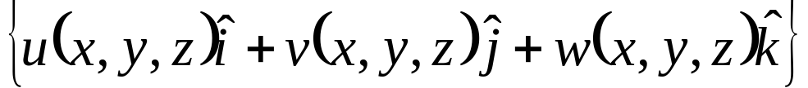
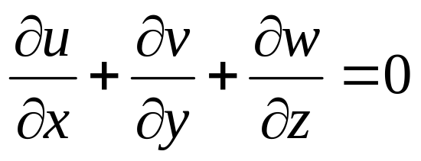
FO PDEs and Simple Fields in Thermofluids
Solenoidal Field
A simple first order PDE !!!
Real engineering fields are more complex and hence demand more comprehensive PDEs to study the same.

Slide 4
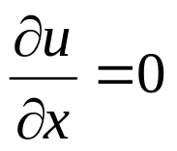

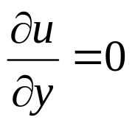
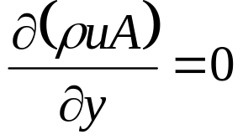

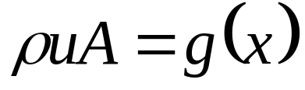
Geometrical Interpretation of FO-PDEs
Consider simple FO-PDE:
General solution in D =ℜ²
f is an arbitrary C1 function.
Consider another simple FO-PDE:
General solution in D =ℜ²
g is an arbitrary C1 function.

Slide 5
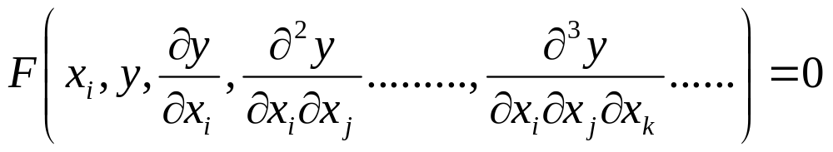

What is a Partial Differential Equation?
A partial differential equation for a function y of the independent variables x₁, x₂, . . . ,x_{n} (n > 1) is a relation of the form
y = f(x₁,x₂ . . . , x_{n}) is said to be a solution of above, when this function, satisfies the PDE identically within a given domain of the independent variables x₁,x₂,…..x_{n}.

Slide 6
Classification of PDEs
Above PDE is said to be linear if F depends linearly on the unknown function y and all its derivatives.
The coefficients of a linear PDE may still depend on the independent variables.
If they don’t, the PDE is called as a linear equation with constant coefficients.
If the function F is linear in the highest derivatives only, the PDE is said to be quasi-linear.
Otherwise the equation is nonlinear.
An equation is said to be of n^{th} order if the highest derivative which occurs is of order n.

Slide 7
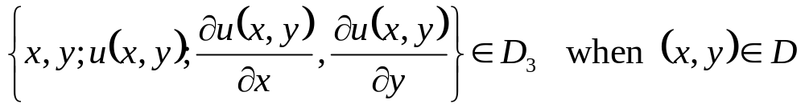
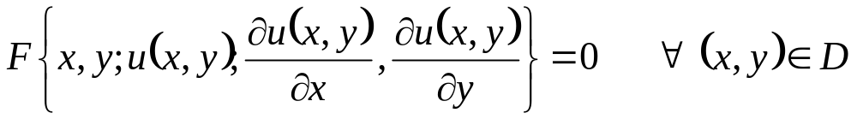
PDE: A Classical (genuine) Solution
A solution u(x,y) is called as classical solution iff
u is defined on a domain D ⊂ ℜ²
u ∈ C¹(D)
Otherwise, u(x,y) is a generalized or weak solution.

Slide 8
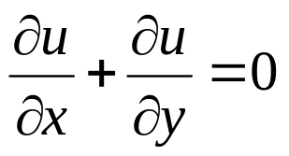
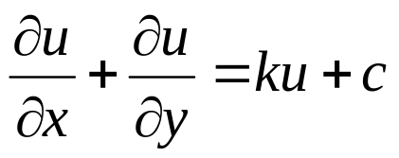
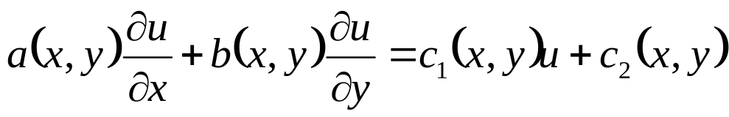
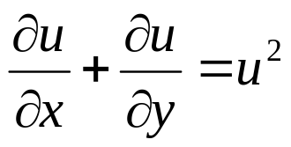
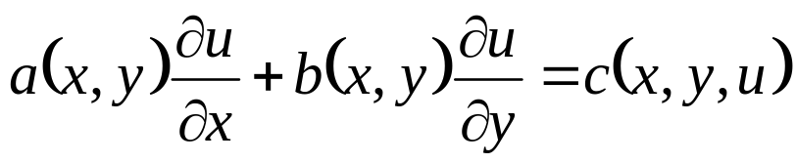
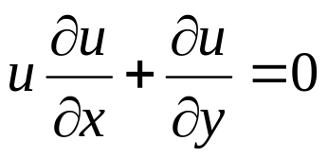
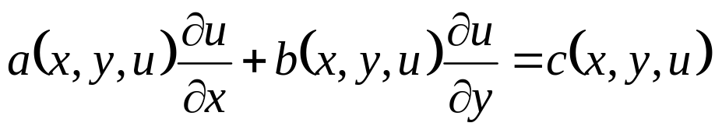
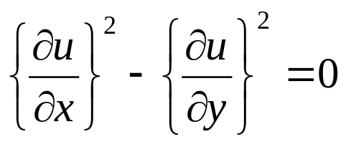
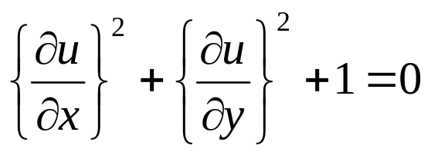
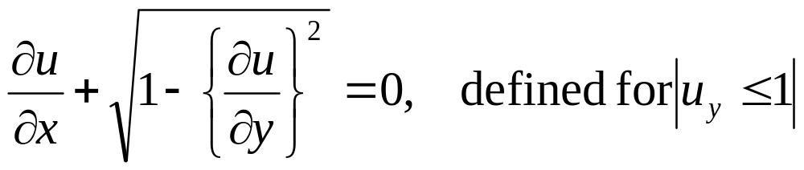
Examples of FO-PDEs
Linear FO-PDE:
Generic Form
Semi-linear FO-PDE:
Quasi-linear FO-PDE:
Nonlinear FO-PDE:

Slide 9
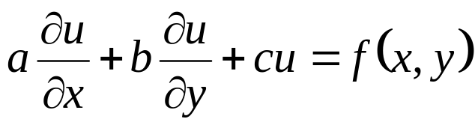
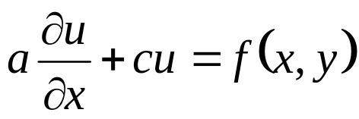
Solutions of Linear Constant Coefficient FO-PDEs
The linear first order constant coefficient partial differential equation
a, b, and c constants with a² + b² > 0.
Solution : case 1: b=0
This is viewed as a first order linear (ordinary) differential equation with y as a parameter.
The solution of such equations can be obtained using an integrating factor.

Slide 10
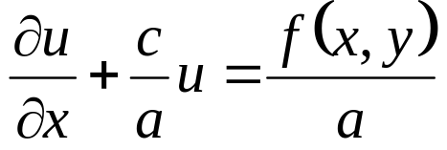
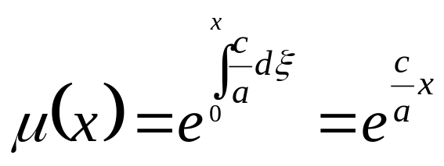
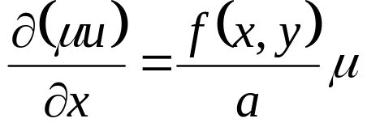
Solution of Linear FO-PDE with CC: case 1
First rewrite the equation as
Introduce the integrating factor
the differential equation can be written as
Integrate above equation and solve for u(x, y).

Slide 11
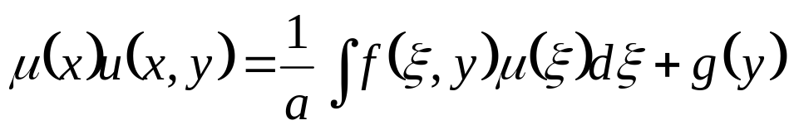
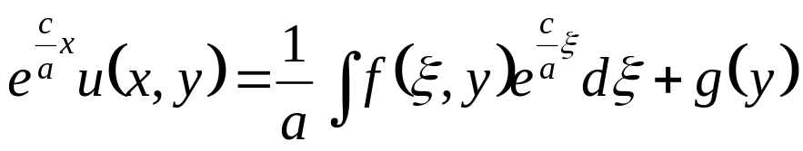
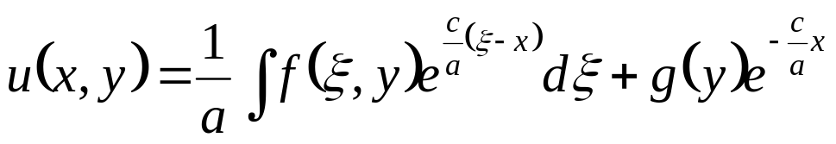
Integration of Linear FO-PDE with CC: case 1
Here g(y) is an arbitrary function of y.

Slide 12
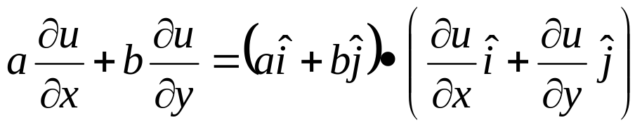

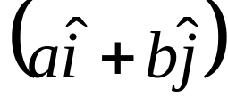
Solution of Linear FO-PDE with CC: case 2
Second case b≠0.
Find a transformation, which would eliminate one of the derivative terms.
This transformation will reduce this problem to the case 1.
The transformation fuction can be obtained using vector calculus
Interpret a part of left side as vector product.
This term is nothing but a directional derivative of u(x, y) in the direction of

Slide 13
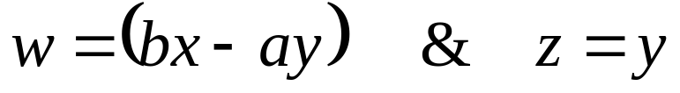
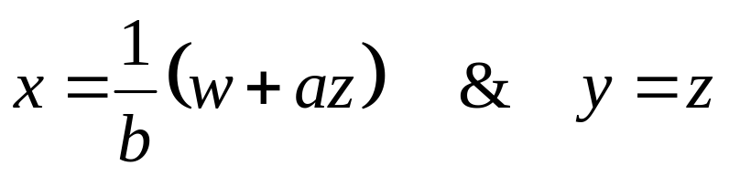
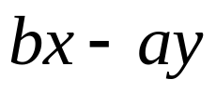
Development of Transformation Function
Identify a transformation, which can translate the given FO-PDE as a derivative involving only one direction
The preferred direction is along Coefficient Vector
but not in a directional orthogonal to .
Consider a transformation
y
This transformation is invertible.
x

Slide 14
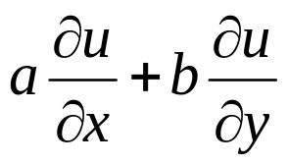
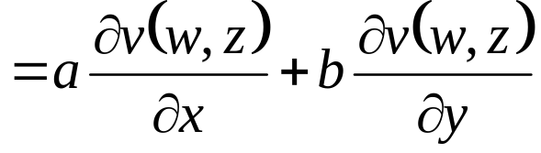
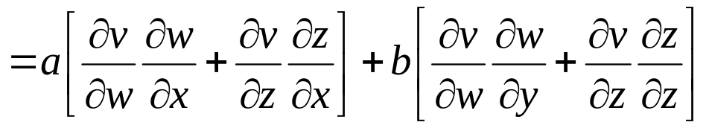
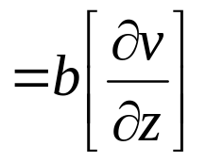
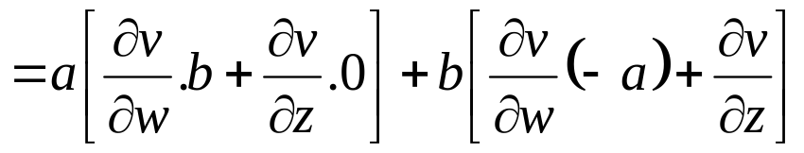
FO-PDE in Transformed Plane
The Original linear FO-PDE:
Selected transformation plane:
Compute transform of the derivative terms.
Let u(x, y) = v(w, z).
Then, the sum of partial derivatives is

Slide 15
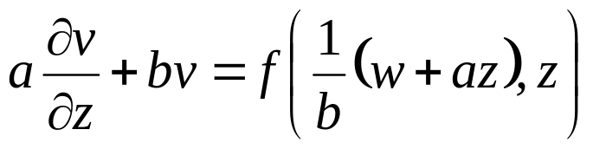
The Transformed FO-PDE
The Original linear FO-PDE:
Therefore, the partial differential equation becomes
This is now in the same form as in the first case and can be solved using an integrating factor.

Slide 16
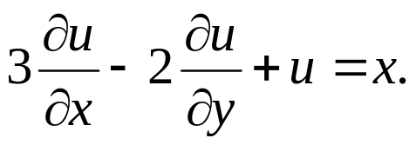
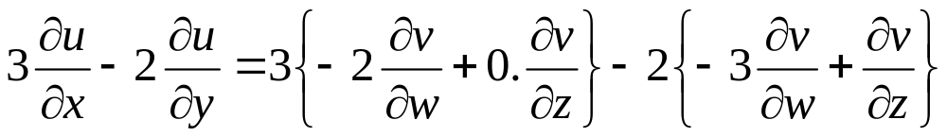
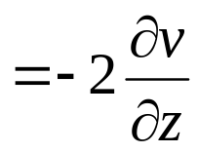
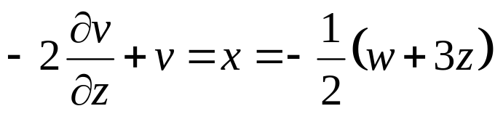
Example
Find the general solution of the equation
First, we transform the equation into new coordinates.
Then
The new partial differential equation for v(w, z) is

Slide 17
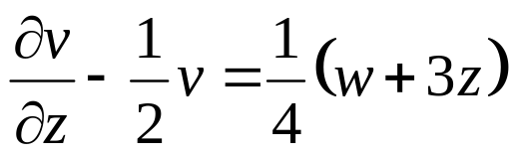
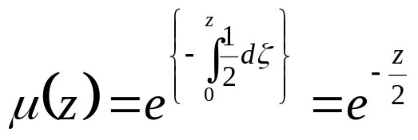
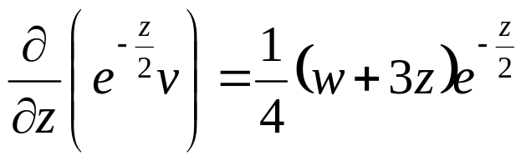
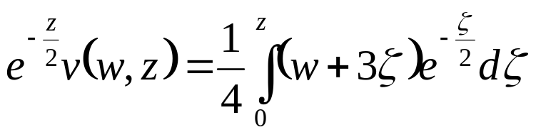
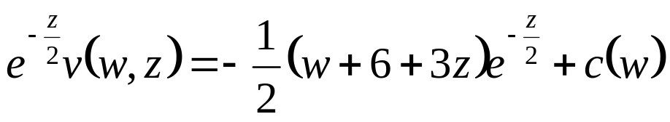
Example
Rewriting this equation,
we identify the integrating factor
Using this integrating factor, we can solve the differential equation for v(w, z).

Slide 18


Example

Slide 19

Linear First Order) PDEs
A PDE of the form
is called a (first order) linear PDE (in two variables).
It is called homogeneous if C0 ≡ 0

Slide 20

Nonlinear FO PDEs
Consider a general non-silinear partial differential equation in two independent variables,
Think geometrically.
Identify the solution u(x, y) with its graph,
This is a surface in xyz-space defined by z = u(x, y).
Geometric Interpretation:
If f(x, y, u) =0 is a solution of this equation, then this function describes the solution surface, or integral surface.
The initial data along the γ curve generates a space curve Γ.
Γ must lie on the graph and its also called as the initial curve of the solution.
Hence a non-linear FO PDE is known as quasi-linear PDE.

Slide 21

The Central Idea
The objective of a Quasi-linear FO PDE is to build the remainder of the graph as a collection of additional space curves that “emanate from”

Slide 22




Application of Vector Calculus
Using vector calculus that the normal to the integral surface f(x,y,u) is given by the gradient function.
Now consider the vector of coefficients given in original PDE.
The dot product of coefficient vector with the gradient is :
This is the left hand side of the partial differential equation.

Slide 23
Quasilinear FO-PDE as Vector Equation
∇f is normal to the surface of coefficient vector.
And hence, coefficient vector is tangent to the surface.
It can be seen as the graph of the solution u(x, y) is made up of integral curves (stream lines) of the vector field ∇f .
Moral: The graph of the solution to the PDE is constructed by finding the stream lines of ∇f that pass through the initial curve.
This is equivalent to solving a system of ODEs!
Geometrically, coefficient vector defines a direction field,
This is called as the characteristic field.

