Slide 1

Laplacian Operator : A Mathematical Key to Thermofluids
P M V Subbarao
Professor
Mechanical Engineering Department
I I T Delhi
A Beautiful Cipher to tie pure mathematics to any branch of physics your heart might desire ….

Slide 2

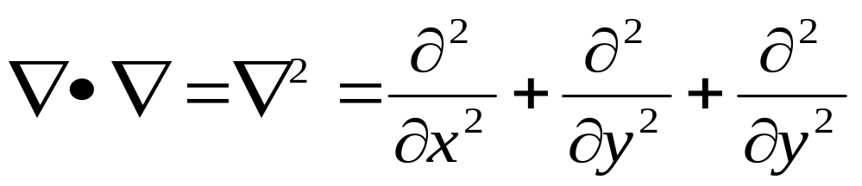
Laplacian of A scalar field
The Laplacian is a scalar operator.
If it is applied to a scalar field, it generates a scalar field.
The Laplacian operator is defined as:
The equation ∇²f = 0 is called Laplace’s equation.
In 1799, Laplace proved that the solar system was stable over astronomical timescales.
This is an important equation in thermofluids.

Slide 3



The Laplacian Operator
In Cartesian Coordinates
In Cylindrical Coordinates
In Spherical Coordinates

Slide 4
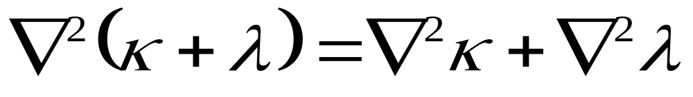
Laplacian of Multiple Scalar fields
If a field may be written as an addition of two scalar functions, then:
If a field may be written as a product of two scalar functions, then:

Slide 5
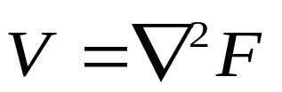
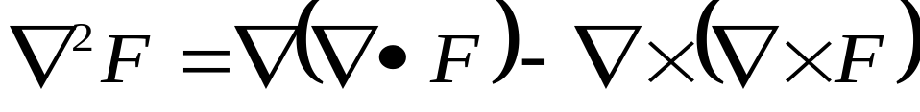
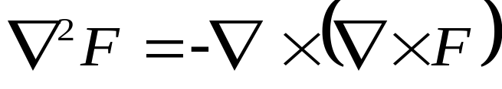
The Laplacian of Vector Fields
If the scalar Laplacian operator is applied to a vector field, it acts on each component in turn and generates a vector field.
In electromagnetic theory, in particular, one often finds ∇² operator acting on a vector field
A class of functions, known as “Harmonic Functions” satisfy what is known as the Laplacian equation
Solenoidal-rotational Vector Fields….

Slide 6
Geometric Theory of Thermofluids
The non-linear character of differential equations governing thermo-fluid dynamic problems created considerable difficulties to find out exact solutions.
Mathematicians with engineering skill developed many interesting devices
One such device is the Geometric theory of surfaces and curves in fluid flow theory.
Eugenio Beltrami (16 November 1835 – 18 February 1900) was an Italian mathematician notable for his work concerning differential geometry and mathematical physics.

Slide 7
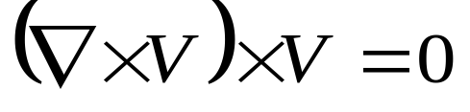
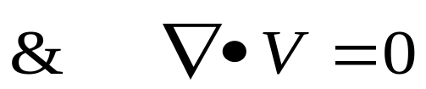
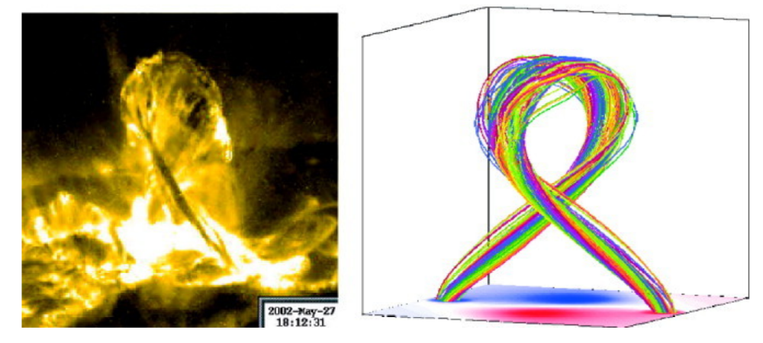
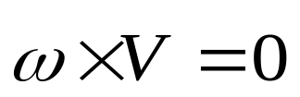
BELTRAMI FIELDS
A three-dimensional vector field V is said Beltrami if
A Beltrami field is characterized by the fact that the vorticity vector is collinear with velocity through out the field.
Beltrami fields are known as force-free fields.
The ”surface” of the sun (called the photosphere) shows Beltrami behaviour.
Reconstruction of the three-dimensional field above the photosphere is possible using Beltrami model.

Slide 8
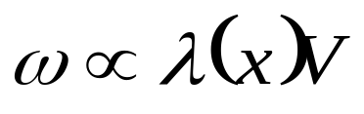
Classification of Approximate Nature of Beltrami Field
From a mathematical viewpoint, above equation can be roughly rewritten in the form
where λ(x) is a scalar function which varies in general with position
Potential fields λ ≡ 0 is an irrotational field, also known as potential field.
Linear Beltrami fields: they are characterized by a constant λ.
Non-linear Beltrami fields: they corresponds to a variable function λ(.)

Slide 9
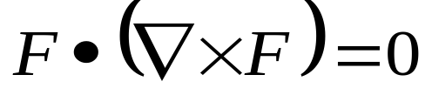
Complex Lamellar Field
A complex-lamellar field is a three-dimensional vector field whose streamlines are intersect orthogonally to vortex lines.
Complex-lamellar fields are characterized by the fact that there exists a family of surfaces orthogonal to the stream lines.
Irrotational field is a subset of complex-lamellar flows.
This is a special class of flow fields, where streamlines are steady in a accelerating flow.

Slide 10
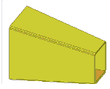
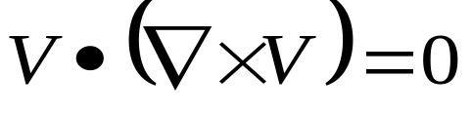
Creation of Uniform Flow Through A Diverging Duct

Slide 11
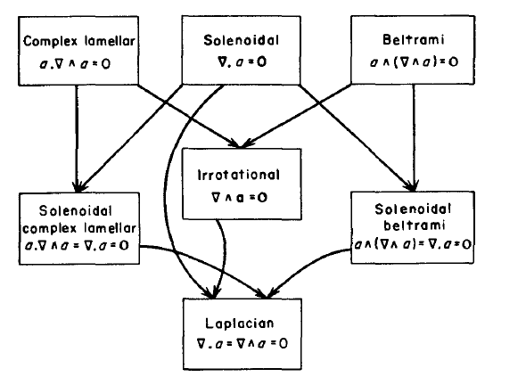
Vectorially Described Thermofluid Fields

Slide 12
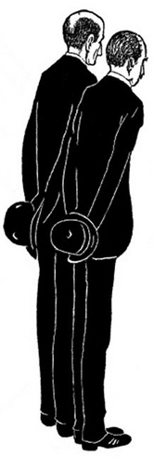
The Strange Natural Geniuses : The Wright Brothers
Wilbur Wright on Their Flying Experiments
"There is no sport equal to that which aviators enjoy while being carried through the air on great white wings.
More than anything else the sensation is one of perfect peace mingled with an excitement that strains every nerve to the utmost if you can conceive of such a combination

Slide 13

The Strange Natural Geniuses : The Wright Brothers
Wilbur Wright on Their Flying Experiments
"I am an enthusiast, but not a crank in the sense that I have some pet theories as to the proper construction of a flying machine.
I wish to avail myself of all that is already known and then, if possible, add my mite to help on the future worker who will attain final success.“

Slide 14
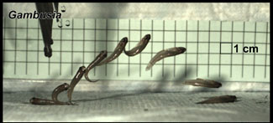
The term “potential theory” arises from the fact that, in 19th century physics, the fundamental forces of nature were believed to be derived from potentials which satisfied
Laplace’s equation.

Slide 15
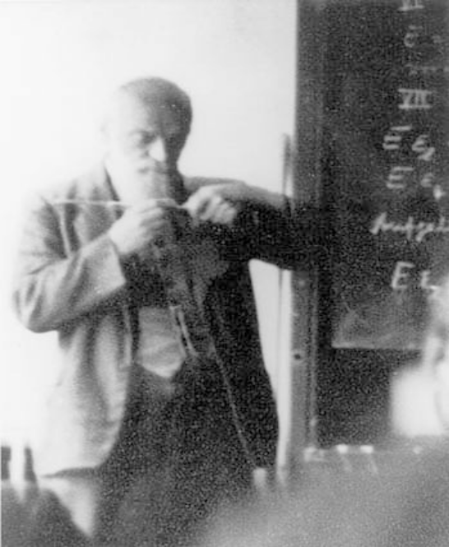
Paul Richard Heinrich Blasius, 1911
Paul Richard Heinrich Blasius was born on 9 August 1883 in Berlin.
He studied at the universities of Marburg and Gottingen from 1902 to 1906.
He joined as a scientific collaborator and research assistant with Ludwig Prandtl from 1908 at the hydraulics laboratory of Berlin technical University.
He was one of the first students of Prandtl who provided a mathematical basis for boundary-layer drag.
He also showed as early as 1911 that the resistance to flow through smooth pipes could be expressed in terms of the Reynolds number for both laminar and turbulent flow.
He developed another Powerful theorem in 1911.

Slide 16
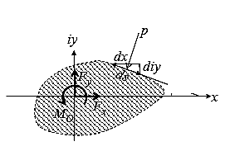
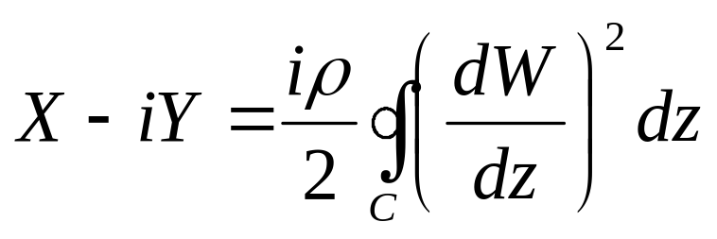
The Theorem of Blasius
Let a steady uniform flow past a fixed two-dimensional body with bounding contour C be a harmonic flow with velocity potential w(z).
Then, if no external body forces are present, the force (X, Y ) exerted by the fluid on the body is given by

Slide 17
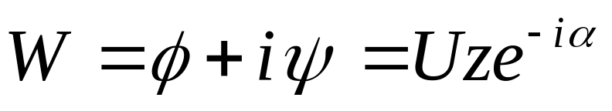
THE UNIFORM FLOW :A Trivial Solution to Laplacian
The first and simplest example is that of a uniform flow with velocity U directed along an arbitrary axis.
In this case the complex potential is

Slide 18
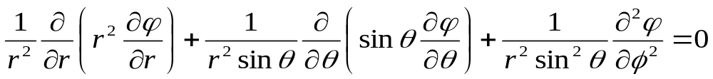
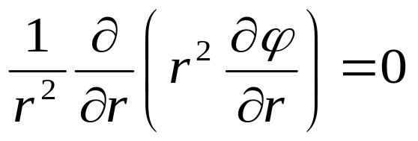
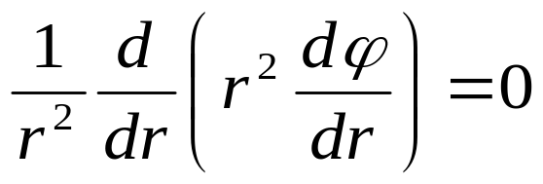
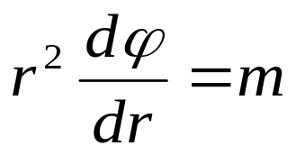
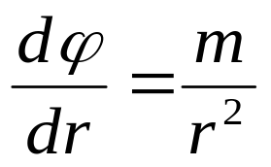
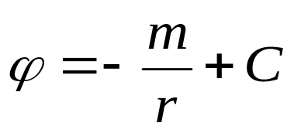
Elementary Potential Flows of First Kind
Consider a Laplacian flow field in Spherical Coordinate system:
One dimensional Laplacian flow in Spherical Coordinate system:
where m and C are integration constants.

Slide 19
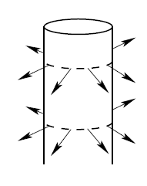
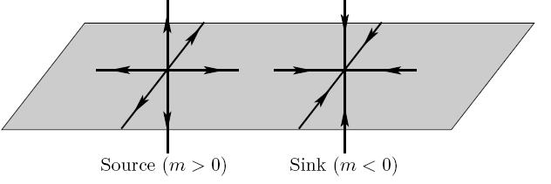
Application in Hydrodynamics
This potential is considered as velocity potential, it produces the three-dimensional radial velocity.
m is called as fluid strength.
If m > 0 this is called as a source or sink, if m < 0.
By convention the constant m = Q/4π where Q is the flow rate or volume flux.

Slide 20
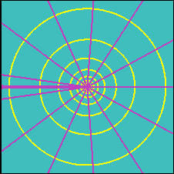
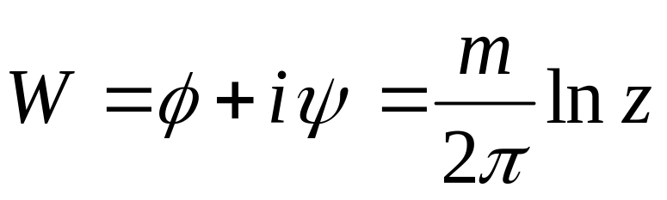
Diagnosis of Source/Sink Function
Iso φ lines
Iso ψ lines
The flow field is uniquely determined upon deriving the complex potential W with respect to z.

Slide 21
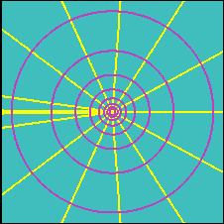
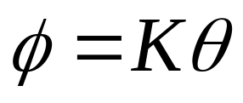
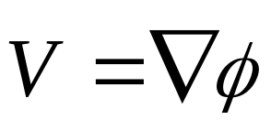
Engineering of Potential Flows of Second Kind
Iso φ lines
Iso ψ lines
Is a solution to Laplace’s equation in plane polar coordinates.
What is the structure of vector field?

Slide 22
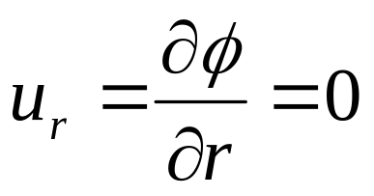
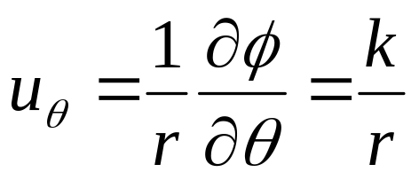
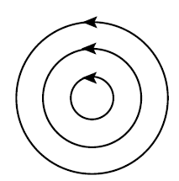
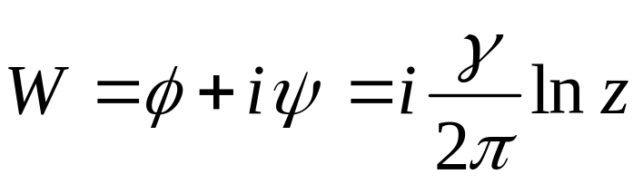
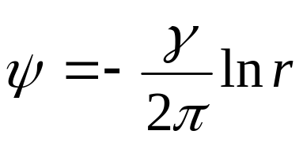
Vector Field due to Potential Flows of Second Kind
In polar co-ordinates:
This is the case of a vortex, the flow field is purely tangential.
the complex potential W with respect to z.

Slide 23
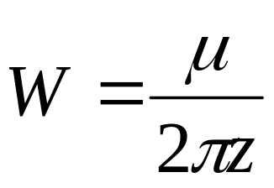
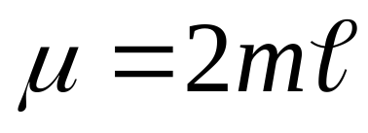
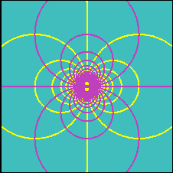
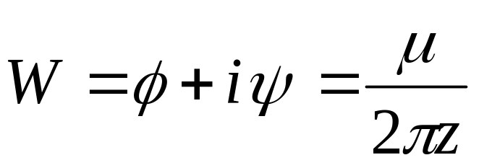
THE DOUBLET
Consider a source-sink pair with strengths ±m, located at (∓ℓ/2, 0).
Let the separation distance ℓ approach zero, while simultaneously increasing the source and sink strengths such that the product κ × ℓ remains constant.
The resulting flow is a doublet with strength, μ

Slide 24
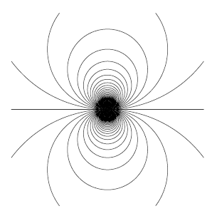

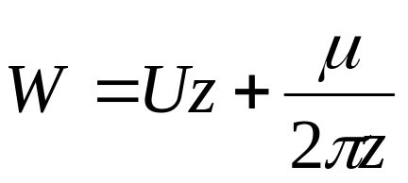
Uniform Flow Past A Doublet : Perturbation of Uniform Flow
The superposition of a doublet and a uniform flow gives the complex potential
+
ψ- Streamines – Uniform Flow
ψ- Streamlines-Doublet

Slide 25
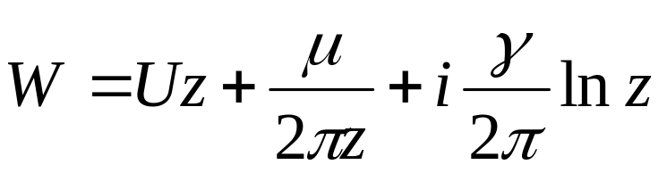
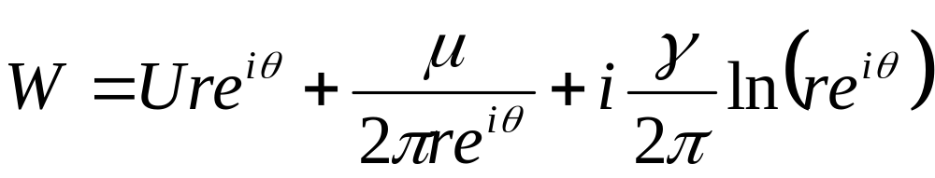
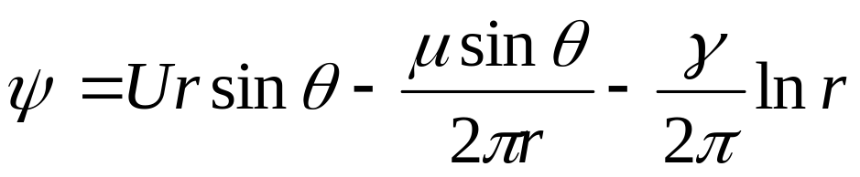
Uniform Flow Past A Doublet with Vortex
The superposition of a doublet and a uniform flow gives the complex potential

Slide 26
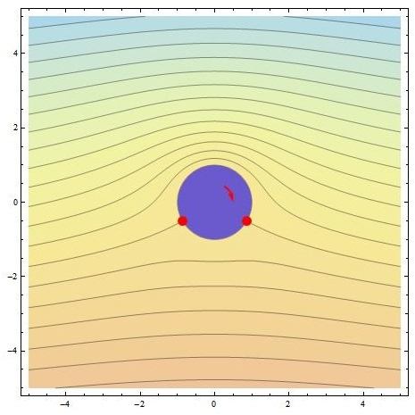
Visualization of Multilevel Interaction Function

Slide 27
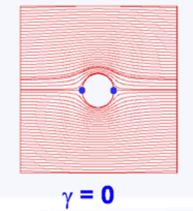
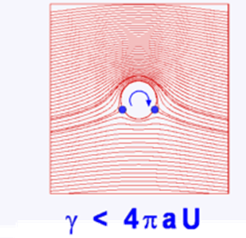






The Non-living Genius : Lifting Machine

Slide 28






Computation of Velocity Field
The radial and tangential velocities are given by:
On the surface of the cylinder (r=R):

Slide 29


Angle of Attack
Unbelievable Flying Objects

Slide 30



Computation of Surface Pressure Field
Find the pressure field over the surface of the cylinder from Bernoulli’s equation:

Slide 31


Computation of Lift
Lift per unit span, (i.e. per unit distance normal to the plane of the paper) is given by:
On the surface of the cylinder, x = R Cosθ.
Thus, dx = -Rsinθdθ.
The above integrals may be thought of as integrals with respect to θ.
For the lower surface, θ varies between π and 2π.
For the upper surface, θ varies between π and 0.

Slide 32
The Kutta – Joukowski Lift Theorem
This is an important result.
It says that clockwise vortices will produce positive lift that is proportional to γ and the free stream speed with direction 90 degrees from the stream direction rotating opposite to the circulation.
Kutta and Joukowski generalized this result to lifting flow over any general body.
This Equation is known as the Kutta-Joukowski theorem.

Slide 33

Spindle Rotors take the Place of Wings
Flettner (1924) used rotating cylinder to produce forward motion.

Slide 34


Change In Perspective on Imagination
Consider hallow Cylinder in Polar Coordinates
Polar to Cartesian Mapping
New Object in Cartesian
Coordinates

Slide 35





The Art of Transformation/Mapping

Slide 36

Transformation for Inventing a True Flyer
A large amount of airfoil theory has been developed by distorting flow around a cylinder to get flow around an airfoil.
The essential feature of the distortion is that the potential flow being distorted ends up also as potential flow.

Slide 37



Jowkowski Transformation
The most common Conformal transformation is the Jowkowski transformation which is given by
C is real and >0
The inverse of transformations is:

Slide 38



The Outcome

Slide 39
Translationary Transformations
If the circle is centered in (0, 0) and the circle maps into the segment between and lying on the x axis;
If the circle is centered in (ξ_{c} ,0), the circle maps in an airfoil that is symmetric with respect to the ξ axis;
If the circle is centered in (0, η_{c} ), the circle maps into a curved segment;
If the circle is centered in and ( ξ_{c} , η_{c} ), the circle maps in an asymmetric airfoil.

Slide 40






Flow Over An Airfoil

Slide 41









Mapping for flow Past An Airfoil
R
ζ_{c}
U

Slide 42




Non-rotating Bodies to Generate Lift
R
ζ_{c}
The lift on an airfoil varies as the sine of the angle of attack or, for small angles, linearly with angle of attack
The primary (and almost exclusive) influence of camber in controlling the zero lift angle of attack -β
The lift curve slope at zero angle of attack is 2π for a flat plate, and increases weakly with increasing thickness and camber

Slide 43


Obtaining the Pressure Distribution
R
ζ_{c}
Choose a set of points on the circle
For these points determine
Velocity on the circle

Slide 44





Quantification & Control of Lift
Lift per unit length
In order to increase camber and thickness of airfoil :
If R = C = c/4, it is called as thin airfoil

Slide 45
Closing Remarks on Jowkowski Method
One of the troubles with conformal mapping methods is that parameters such as ξ_{c} and η_{c} (ζ_{c}=ξ_{c}+i η _{c}) are not so easily related to the airfoil shape.
Thus, if we want to analyze a particular airfoil, we must iteratively find values that produce the desired section.
A technique for doing this was developed by Theodorsen.
Another technique involves superposition of fundamental solutions of the governing differential equations.
This method is called thin airfoil theory.

