Slide 1

Basics of Nonlinear SO-ODE
P M V Subbarao
Professor
Mechanical Engineering Department
I I T Delhi
Embedment of Multiple Thermofluid Processes in One System……

Slide 2

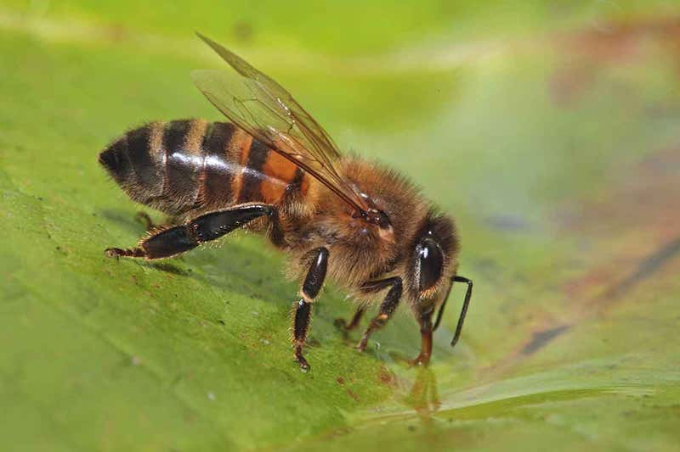
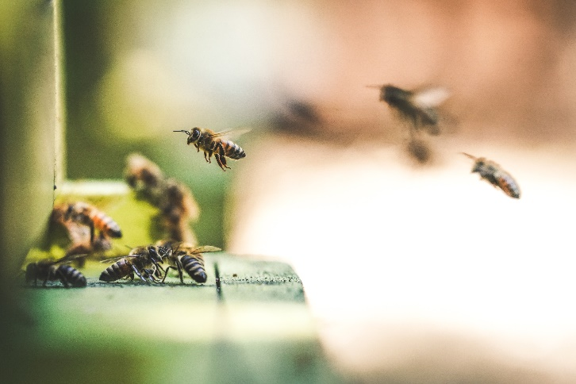
Low Energy Comfort thru Team Work
Everyone knows that bees collect nectar from flowers.
A group of bees also harvest water.
Forager bees take it back to the hive and pass it by mouth to the hive bees, who spreads the droplets on the honeycomb.
Other busy bees are on duty nearby, fanning the water with their wings to make it cool the hive.
Teamwork at its very best using non-linear Thermofluid systems!

Slide 3

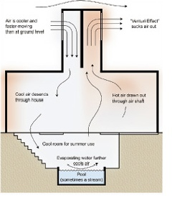
An ancient Idea for Better Living
Wind-catcher (Bagdir)

Slide 4
Need for Solving Nonlinear SO-ODEs
Sustainable and eco-friendly industrial thermofluid systems can only be developed by modelling as nonlinear second order ODEs.
The differential equations obtained via multiple physical laws are often nonlinear.
Nonlinear differential equations are difficult to solve.
Several of NL-SO-ODEs do not admit analytical solutions and their solutions need to be approximated.

Slide 5
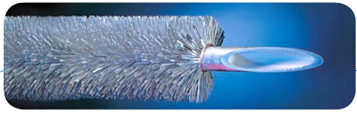
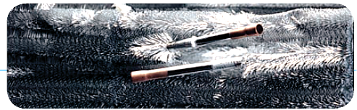
Feather Finned Evaporators for Compact Air conditioners

Slide 6
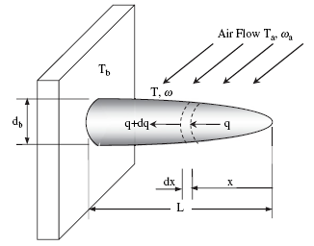
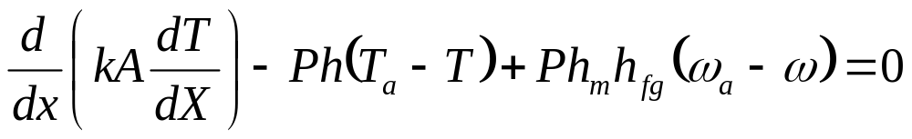
Heat Transfer in Wet Fins
Cooling and dehumidifying fins for Air-conditioning
Hot and humid air flow
T_{a} & ω_{a}

Slide 7
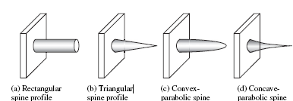

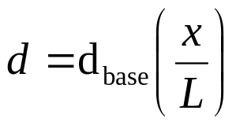
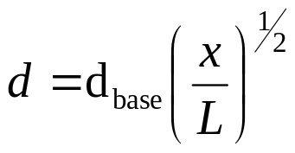
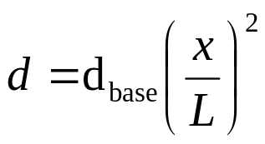
Schematic of different spine fin profiles

Slide 8


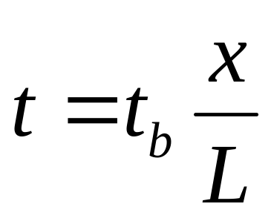
Schematic of different longitudinal fin profiles
Rectangular Profile Fin
Triangular Profile Fin
Local Semi Fin thickness

Slide 9

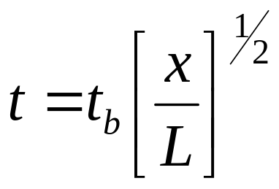

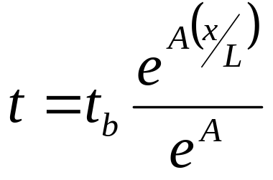
Schematic of different longitudinal fin profiles
Convex Profile Fin
Local Semi Fin thickness
Exponential Profile Fins
Local Semi Fin thickness
A > 0
A < 0

Slide 10
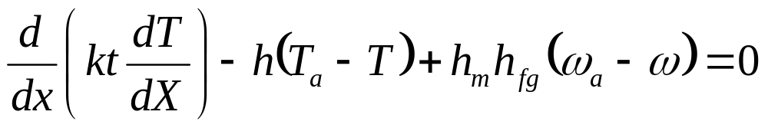
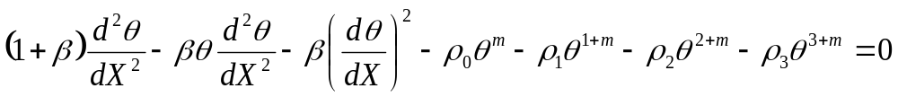
Governing ODE for Heat Transfer from Rectangular Wet Fins
The governing equation of longitudinal thin fins per unit width subjected to moisture condensation on the fin surface can be written as follows

Slide 11
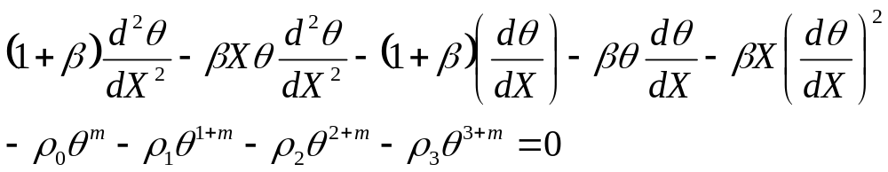
Governing ODE for Heat Transfer from Triangular Wet Fins
Local Semi Fin thickness

Slide 12
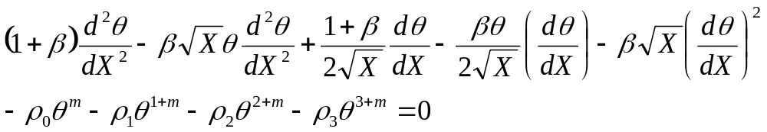
Governing ODE for Heat Transfer from Convex Profile Wet Fins
Local Semi Fin thickness

Slide 13
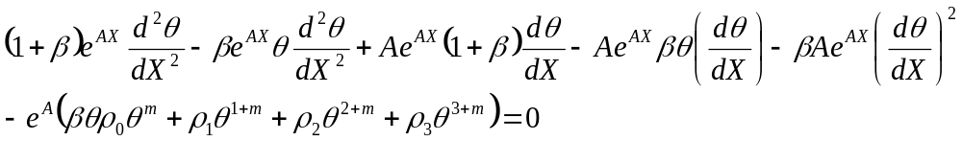
Governing ODE for Heat Transfer from Exponential Profile Wet Fins
Exponential Profile Fins
Local Semi Fin thickness
A > 0
A < 0

Slide 14
Classical Methods to solve NL-ODEs
Many classical methods have been proposed to find exact or approximated solutions of these nonlinear differential equations.
The Lyapunov approach.
The direct integration method
The multiscale expansion technics
The harmonic balance method
The fractional homotopy analysis transform method
The differential transform method (DTM).
The DTM is a semi-exact method, based on the k^{th} order derivative of state variables around the initial time t₀ or space x₀.
This does not need linearization.
This has been used in recent years for solving eco-friendly and sustainable nonlinear thermofluid systems.

Slide 15
Topics for Course Project
The Lyapunov approach.
The direct integration method
The multiscale expansion technics
The harmonic balance method
The fractional homotopy analysis transform method.
A group of not more than two is allowed.
Collect at least 5 international journal papers published after 2010.
No two groups can have more than two same papers.
A group which collect all the research papers different from other groups will get 10% bonus marks.
Use original statements and uniform symbols used in lectures.
Graphs can directly take from papers.

Slide 16
Introduction to DTM
The differential transformation method (DTM) is a (relatively) new method for solving differential equations.
The DTM has more systematically been used “to solve differential equations” in the second half of the 90’s
This is based on Taylor series.
The DTM is presented as “an extended Taylor series method”.
The series solution is different from the traditional Taylor (or power) series method.

Slide 17
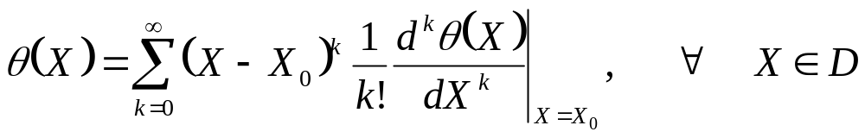
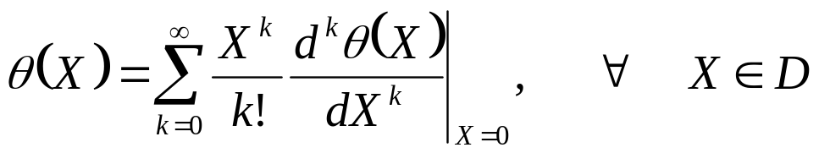
Recapitulation of Fundamentals : Differential Transform Method
The function θ(X) is analytic in a domain D.
Here X = X₀ represents any point in the domain.
The function θ(X) can be represented by a power series centered at X₀.
Then, the Taylor series expansion of θ(X) has the following form:
In particular, for X₀=0, above Equation becomes
This is known as the Maclaurin series of θ(X).

Slide 18
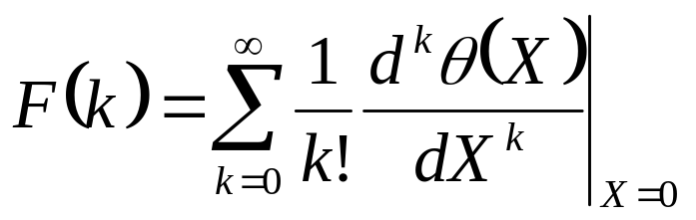
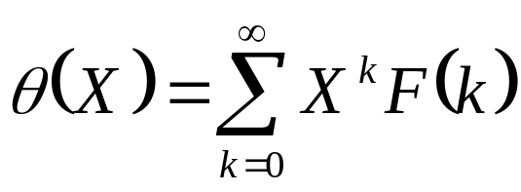
The DTM Theorem
The differential transformation operator for the function θ(X) can be defined as
where F(k) is the transformed function of the original function θ(X).
The differential spectrum of F(k) must lie within the interval X ∈ [0; 1].
Finally, the differential
inverse transform of F(k) is
Clearly, the DTM converts a function into the Taylor series expansion.
Above is an infinite series and thus, for higher accuracy, more terms should be retained.
To use the definition of DTM , the transformed functions need many fundamental theorems.

Slide 19
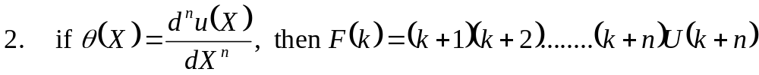
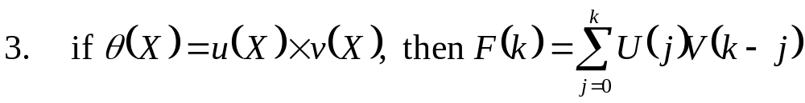
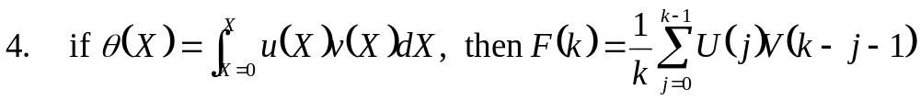
Theorems 1 - 4 for DTM
If θ(X) = a u(X) ± b v(X), then F (k) = aU(k) ±bV (k), where a and b are any arbitrary constants.

Slide 20
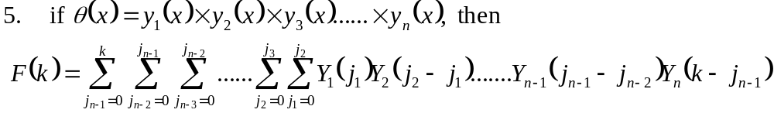
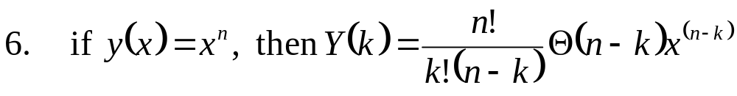
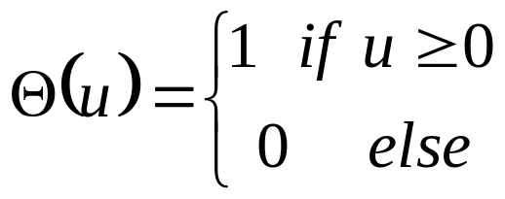
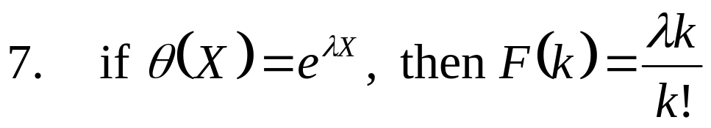
Theorems 5 -- 7 for DTM
where Θ is the step function,
where λ is any arbitrary constant.

Slide 21
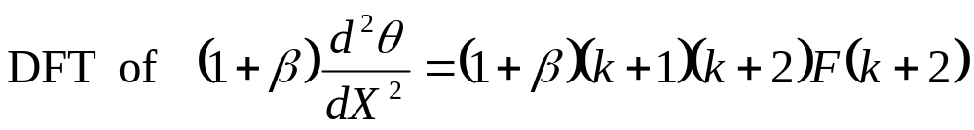
Transformation of the given NL-SO-ODE: First Term
Perform DFT using the theorems related to DFT on the original NL-SO-ODEs valid for various fins.
Consider Rectangular profile fin

Slide 22
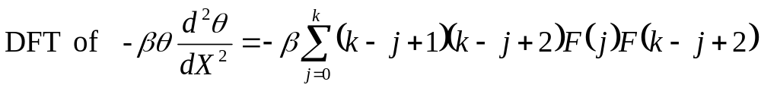
Transformation of the given NL-SO-ODE: Second Term
Invoke theorems 2 &3

Slide 23
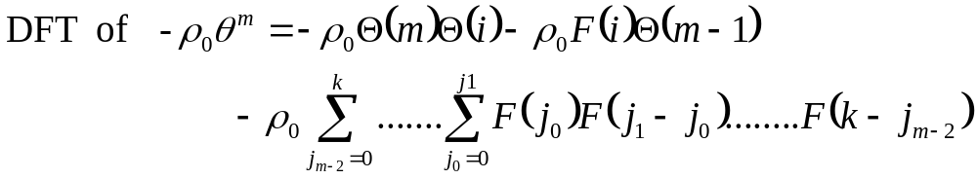
Transformation of the given NL-SO-ODE: thrid Term
Invoke theorem 6

Slide 24
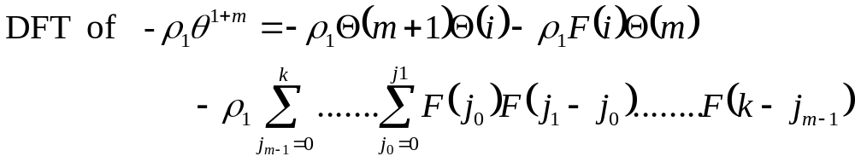
Solution from the differential transformation method
Invoke theorem 6

Slide 25
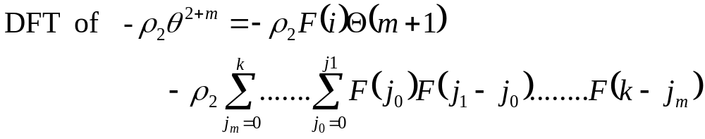
Solution from the differential transformation method
Invoke theorem 6

Slide 26
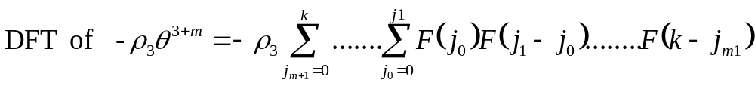
Solution from the differential transformation method
Invoke theorem 6

Slide 27
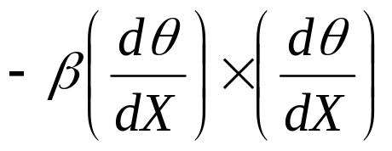
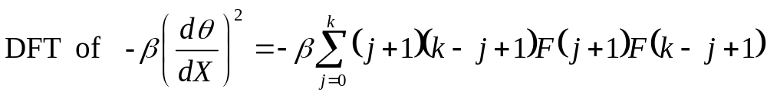
Solution from the differential transformation method
Invoke theorem ?

Slide 28
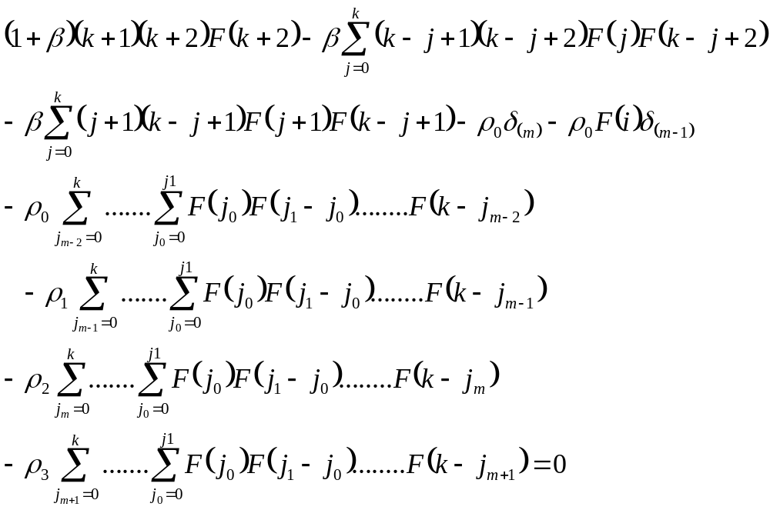
DT of NL-SO-ODE
The original NL-SO-ODE for wet rectangular Fin:
The Differential Transform of NL-SO-ODE for wet rectangular Fin:

Slide 29
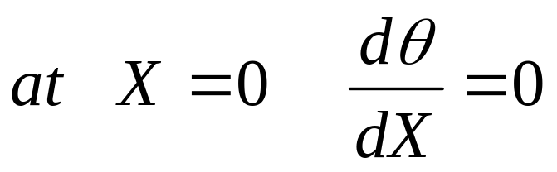

Computation of F(1)
The following boundary condition is known at the tip of the rectangular fin:
The differential transformation operator for the function θ(X)

Slide 30
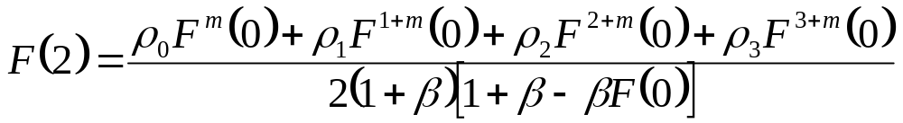
The Second DT Term
The DT terms F(k) for all k can be calculated from DT of SO-ODE.
This yields the following:

Slide 31
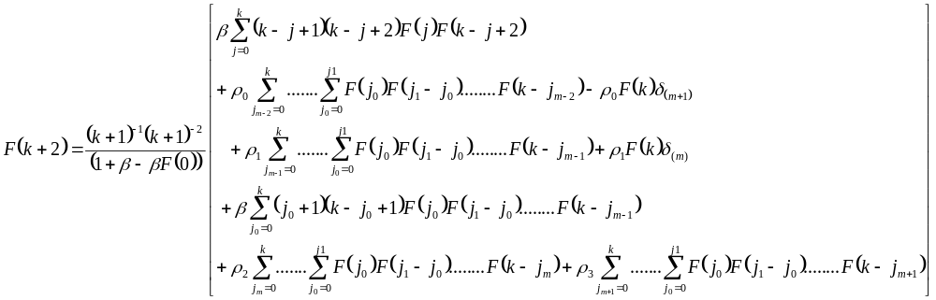
DT terms from 3rd to (k+2)^{th} …..
From the above analytic continuations, substituting above Equations for F(2) and all F(k+2) into
This operation gives a closed-form expression for the temperature profile.

Slide 32

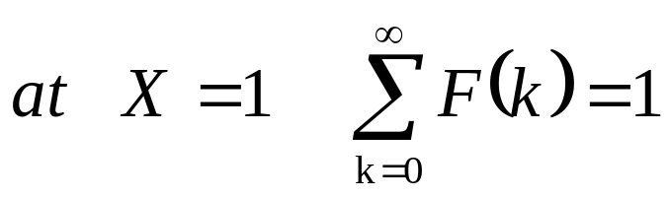
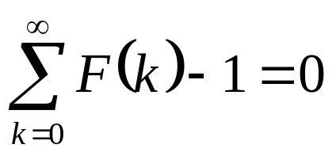
Computation of F(0)
The base boundary condition is useful to obtain the initial value of F(0).
DTT of BCs:
Substitute as many F(k) term as demanded by the accuracy of an application.
Solve the resulting via the Newton Raphson iterative method gives the final value of F(0).

Slide 33
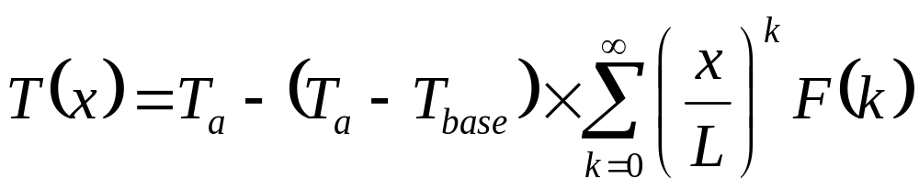
Computation of Fin temperature Profile
Once F(k) is known for all k, one can readily obtain a series solution to local fin temperature.

Slide 34
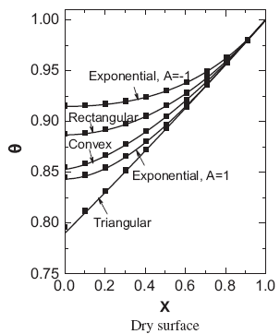
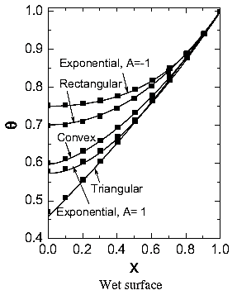

Temperature Profiles of Dry and Wet Fins

Slide 35

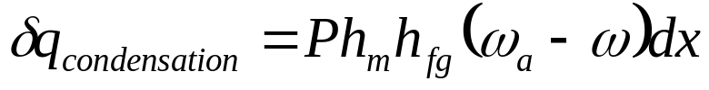
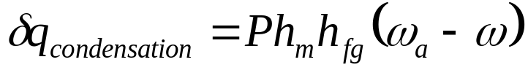
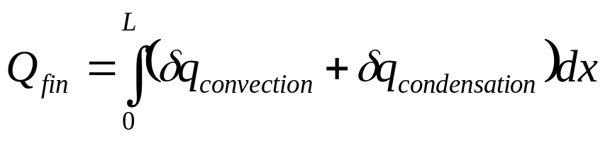

Calculation of the heat transfer rate per unit width
The integral approach is used to compute cooling capacity of each fin.

Slide 36



Fin Cooling Capacity as a function of Bi

Slide 37


Solutions of A special Second Order
Non-linear Ordinary Differential Equation
Let u(t) be a function satisfying the linear homogeneous differential equation
There must be certain non-linear ordinary differential equations have solutions expressed in terms of u and any other arbitrary function.
One such class of NL-SO-ODE is expressed as
where μ and n are constants;
p(t) and q(t) are known functions and f(t) ≠ 0, otherwise arbitrary.

Slide 38






An Example of Special NL-SO-ODE
Consider a NL-SO-ODE
u(t) is the solution of
L-SO-ODE:
∴The solution of
N L-SO-ODE:

Slide 39
Analytic Solution For Heat Transfer from Triangular Wet Fins
Local Semi Fin thickness

Slide 40
Indian References
Analytic solution for heat transfer of wet fins on account of all nonlinearity effects, Balaram Kundu a,b, Kwan-Soo Lee a, Energy 41 (2012) 354--367.
Solutions of some classes of second order non-linear ordinary differential equations, P. V. Ranganathan, Int. J. .Non-Linear Mechanics, Vol. 23. No. 5 6. pp. 421--429, 1988.

Slide 41


Definition of Traditional (or raw) Taylor series method
The Taylor series method expresses the solution of a differential equation as a power series expansion about the initial location x₀:
in which the derivatives
are such that the ODE is satisfied
order by order in powers of (x − x0).
As consequence, the Taylor coefficients of the expansion
are completely determined once the initial parameter x0 is fixed.

Slide 42


General procedure : The Differential Transform Method
The DTM is a formalized Taylor transformation.
Consider the image Y_{k} of y(x) defined as:
γ(x) is an auxiliary function and named as the kernel corresponding to y(x).
Mk is called the weighting factor.
y(x) is recovered through an inverse series transform:

Slide 43



Theorems 1 - 4 for DTM
If y(x) = ay₁(x) ± by₂(x), then Y (k) = aY₁(k) ± bY₂(k), where a and b are any arbitrary constants.

Slide 44

Theorems 5 & 6 for DTM
where Θ is the step function,
and x₀ the initial value of x.

Slide 45



Theorems 6 – 10 for DTM
where λ is any arbitrary constant.
where w and α are constants.

