Slide 1

Family of Sturm-Liouville Problems
P M V Subbarao
Professor
Mechanical Engineering Department
I I T Delhi
Orthogonal Series Functions as Ansaz to Thermo-fluid Problems

Slide 2

Sturm-Liouville Theory
Mathematicians have studied Sturm-Liouville problems for over 200 years.
Highly developed theory and remains an active area of interest.
Major results:
A complete “spectral theory” for problems where [a; b] is finite.
A satisfying but complex theory for singular problems.
Value:
Solutions to separable PDEs,
major advances in spectral theory,
various applications in thermofluids.

Slide 3
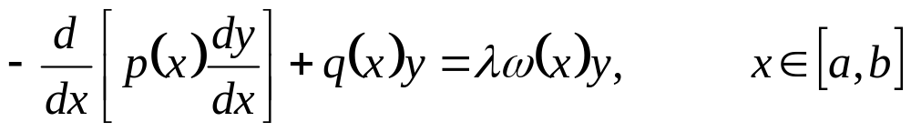
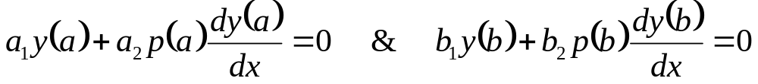
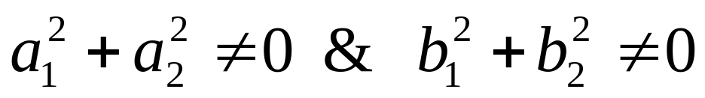
Sturm-Liouville Boundary Value Problem
A SL-BVP
with p, q and ω are specified such that p(x) > 0 and ω(x) ≥ 0
∀ x ∈[a,b].
where
is also called as a SL-EVP, if there exists a non-trivial solution for any λ= μ, where μ is a complex number.
Such a value μ is called an eigenvalue and the corresponding non-trivial solutions y(.; μ) are called Eigen functions.

Slide 4
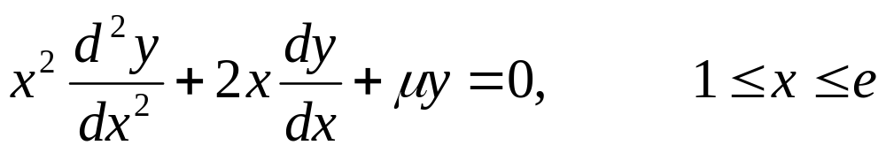
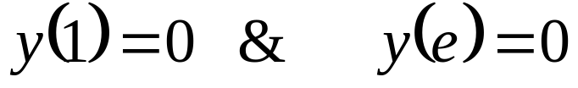
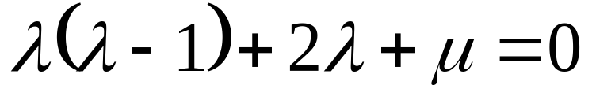
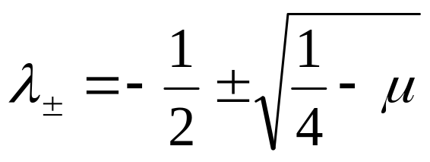
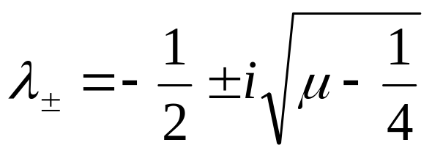
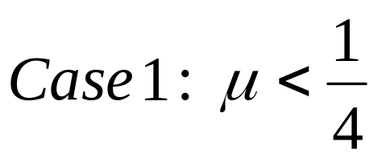
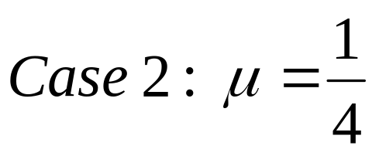
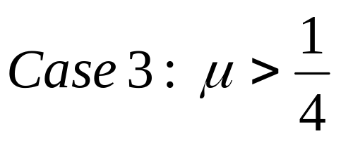
Example: Euler like SL-BVP
Solve
With boundary conditions
Solution: Take Ansaz as x^{λ}. The characteristic equation is
Solutions:
Three different cases are possible:

Slide 5
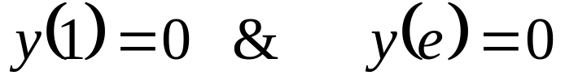
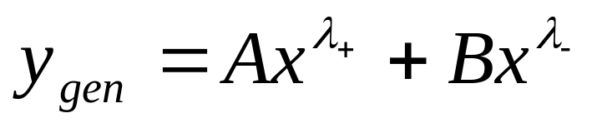
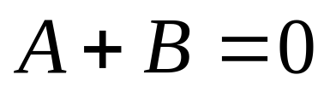
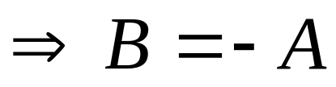
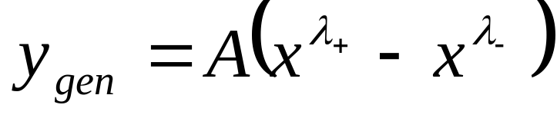
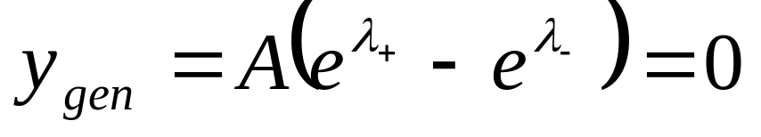
Example: Euler like SL-BVP : case 1
Solve
With boundary conditions
Solution:

Slide 6
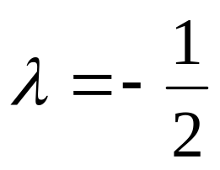
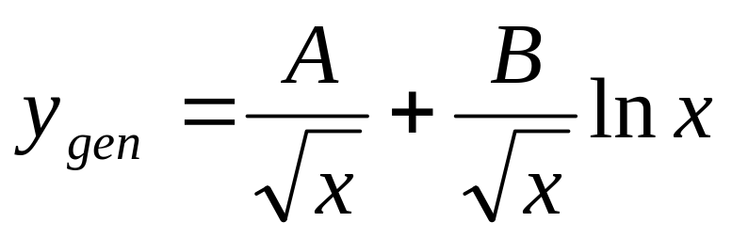
Example: Euler like SL-BVP : Case 2
Solve
With boundary conditions
Now we get a double root
Solution:

Slide 7
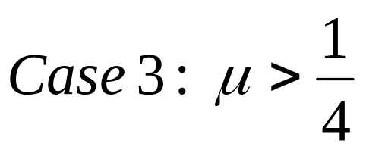
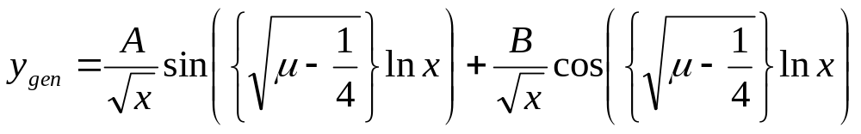
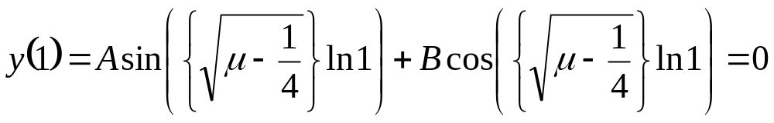
Example: Euler like SL-BVP : Case 3
Solve
With boundary conditions
The two complex roots
Solution:

Slide 8
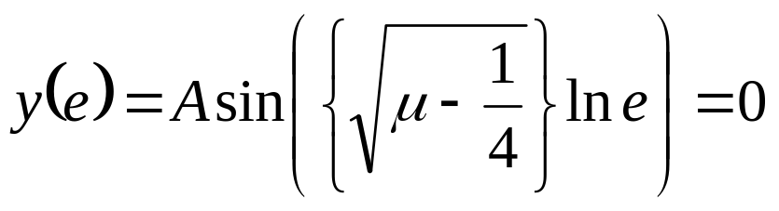
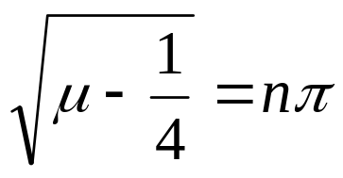
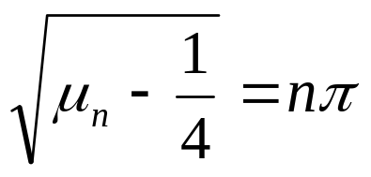
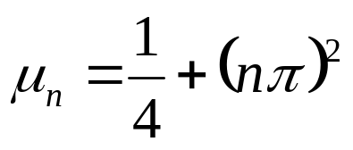
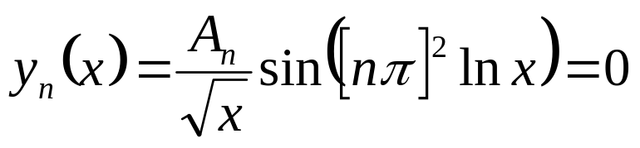
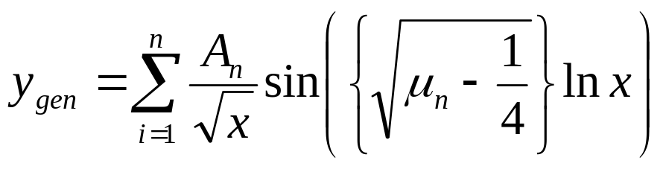
Series as Solution to SLP
Hence μ must satisfy
for some positive integer n.
This generates the eigenvalues
The corresponding Eigen functions

Slide 9
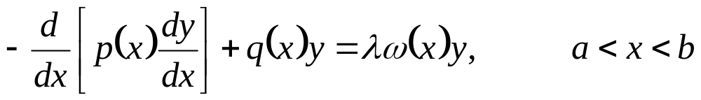
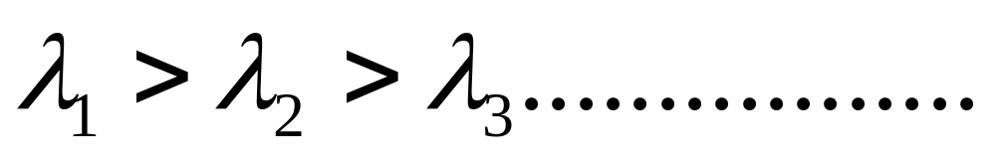
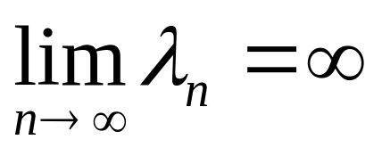
Theorem 1
A nonzero function y that solves the Sturm-Liouville problem
Boundary conditions:
Theorem 1: The eigenvalues form an increasing sequence of real numbers
with
The eigen function y_{n} corresponding to λn is unique and has exactly (n−1) zeros in the interval a < x < b.
Daileda

Slide 10
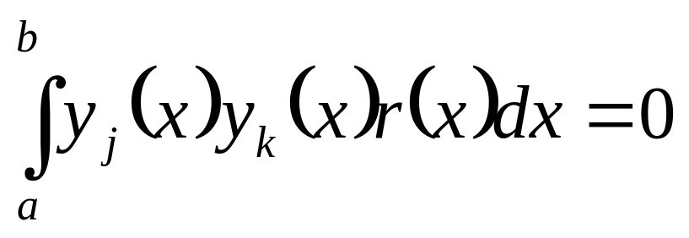
Theorem 2 : Identification of Ancestral Mother
A nonzero function y that solves the Sturm-Liouville problem
Boundary conditions:
Generalized Fourier Series
Theorem 2: Suppose that y_{j} and y_{k} are eigen functions corresponding to distinct eigenvalues λ_{j} and λ_{k} . Then y_{j} and y_{k} are orthogonal on [a, b] with respect to the weight function ω(x) = r (x).
That is

Slide 11
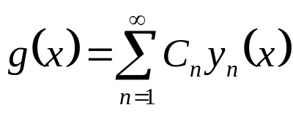
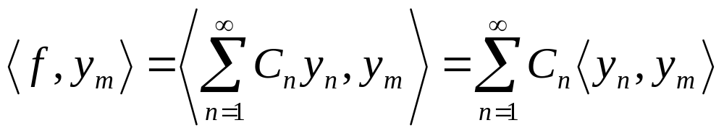
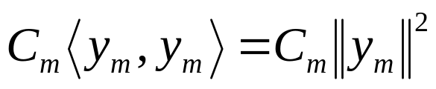
The Mother of Generalized Fourier Series
SLT can generalize the concept of Fourier series from the usual trigonometric basis functions.
SLT identifies Fourier series as an orthonormal series consisting of Eigen functions to a special Sturm-Liouville problem.
Assume that we have an infinite linear combination
where y_{n} is orthogonal to y_{m} for n ≠ m.
Then the inner product of f and y_{m}

Slide 12
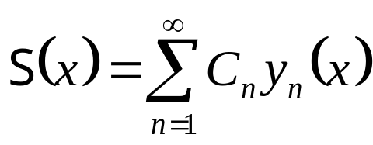
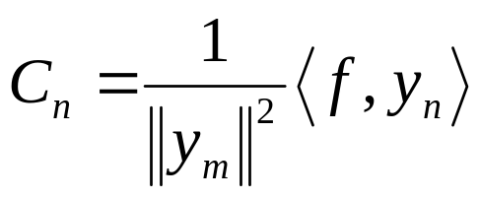
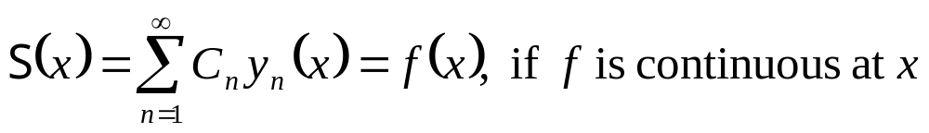
Real Thermofluid Problems/Sources as A Series Functions
Let f be an arbitrary function (source) on [0, l].
A generalized Fourier series for f is identified as
where
are the generalized Fourier coefficients.
Let y₁,y₂, . . . be a set of orthogonal Eigen functions of a regular Sturm-Liouville problem, and let f be a piece-wise smooth function in [0, l].
Then, for each x in [0, l] ∃

Slide 13
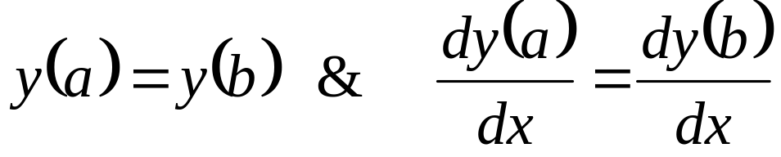
Classification of SL-EVPs
An SL-EVP is called a regular SL-EVP, if p > 0 and r > 0 on [a, b].
An SL-EVP is called a singular SL-EVP, if
  (i) p > 0 on (a, b) and p(a) = 0 = p(b), and
  (ii) r ≥ 0 on [a, b].
An SL-EVP is called a periodic SL-EVP, if p(a) = p(b), p > 0 and r > 0 on [a, b], p, q, r are continuous functions on [a, b], coupled with boundary conditions

Slide 14
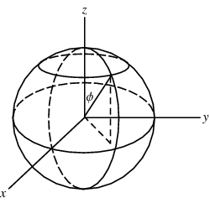
The Legendre Equation
Legendre published work on celestial mechanics with a paper, ”Recherches sur la figure des planets” in 1784 which contains the Legendre polynomials.
The Spherical Laplace equation describes the gravitational potential of a planet or star.
The Legendre equation appears for a variable related to the polar angle in the spherical coordinate system.
Legendre equation appears in problems of heat conduction when solving the Laplace equation in spherical coordinates by the separation of variables method.

Slide 15
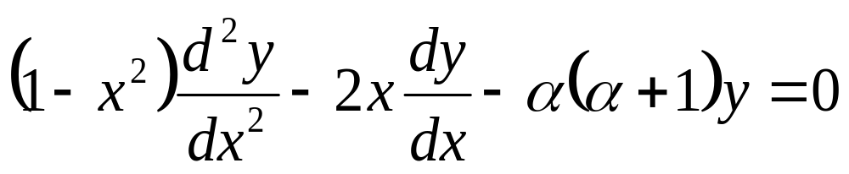
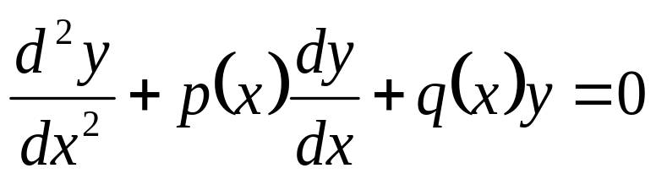
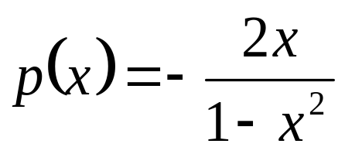
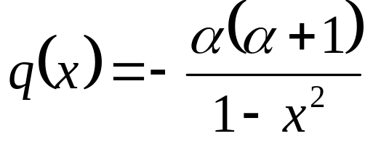
The Legendre L-SO Differential Equation
This equation arises in many problems in physics, specially in boundary value problems in spherical system:
where α is a constant.
We write this equation as
Hence x = 0 is an ordinary point for.
Clearly p(x) and q(x) are analytic at the origin and have radius of convergence R = 1.

Slide 16
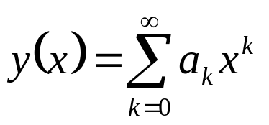
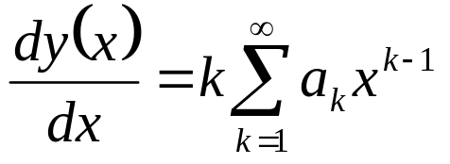
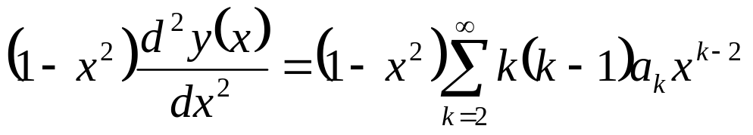
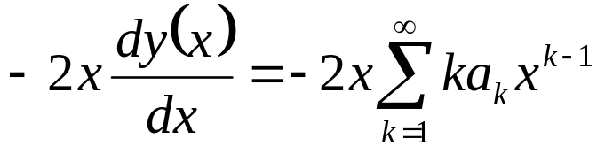
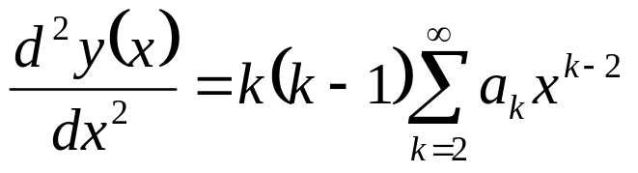
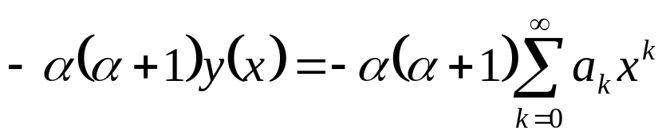
The Legendre Equation
The obvious Ansaz is:

Slide 17


Addition of Four Special Series Functions
The Legendre equation says that the addition of the four equations above must be zero,
Therefore, every term in that sum must vanish

Slide 18


The Recurrence Formula for Coefficient
This is the recurrence relation for the coefficients a_{k}.
The recurrence relation becomes

Slide 19




More Algebra to get an Informative Recurrence Formula for Coefficient

Slide 20






Practice to Get An Unified Recurrence Formula

Slide 21


The two Independent Elementary Solutions to LE
The fundamental solutions are

Slide 22
Legendre Functions
The functions y₁& y₂ are called Legendre functions.
For a non integer value of the constant α these functions cannot be written in terms of elementary functions.
But when α is an integer, one of these series terminate and becomes a polynomial.
The case α being a nonnegative integer is specially relevant in physics.
For α even the function y₁ becomes a polynomial while y₂ remains an infinite series.
For α odd the function y₂ becomes a polynomial while the y₁ remains an infinite series.

Slide 23


The Legendre polynomials
The Legendre polynomials are proportional to these polynomials.
The proportionality factor for each polynomial is chosen so that the Legendre polynomials have unit lengh in a particular chosen inner product.
The first four polynomials are

Slide 24

The Bessel Equation
The Bessel equation appears when the Laplace equation is solved in cylindrical coordinates.
The Bessel equation appears for the radial variable in the cylindrical coordinate system.
The equation is named after Friedrich Bessel, a German astronomer.
Bessel first obtained the equation when he was studying star motions.
But the equation first appeared in Daniel Bernoulli's studies of oscillations of a hanging chain.

Slide 25



Finned Engine Cylinder

Slide 26


Geometrical Design of Finned Cylinder

Slide 27








Heat Transfer in Finned Cylinders
Circumferential fin of rectangular profile

Slide 28

Solution of Bessel Equation using Frobenius method
m is any real nonnegative constant, using the Frobenius method centered at x₀=0.
x₀ = 0 is a regular singular point of the equation.
Write the equation in the standard form
use the Frobenius method centered at x₀= 0 to solve the series solution.

Slide 29


The Unified Recurrence Formula for Coefficients
Get the solution y_{α}
The ratio test shows that this power series converges for all x > 0.
When a₀ = 1 the corresponding solution is usually called in the literature as J_{α}

Slide 30


The Bessel Functions

Slide 31


Radial Conduction Equation
Define
Radial conduction equation :
The appropriate boundary conditions:

Slide 32

Radial Temperature Distribution
The equation for the temperature excess becomes

Slide 33


Heat Dissipation Capacity of Cylinder with Radial fins
The heat flow through a fin is given by the heat flow at the base of a fin and can be expressed as
The total heat flow from a fin array is the sum of heat flow from the fin body and the heat flow from the base surface without fin and can be written as

Slide 34

Base Temperature
The temperature difference between a fin base and the
fluid (θ_{B}) due to total heat flow rate at the fin base can
be expressed as

Slide 35



Development of Compact Finned Cylinder
The heat flow through the base is
The ideal heat flow
Fin Efficiency

Slide 36

Efficiency of Circumferential Fins

Slide 37


Chebyshev’s Differential Equation

