Slide 1

Orthogonal Series Functions as Solutions to Special Linear SO-ODE
P M V Subbarao
Professor
Mechanical Engineering Department
I I T Delhi
In Tune with Digital Computing & Complex Geometries……

Slide 2

Taylor's Series Vs Fourier Series
Taylor series are:
Local in nature. Taylor series are computed using an infinite number of derivatives at one point.
Taylor series decompose a function by representing it as a fixed combination of derivatives.
Taylor series are invertable only in the neighborhood of a point. Note: You cannot, in general, recover the entire function from a Taylor series.
The basis functions in Fourier Series are orthogonal !!!
Fourier series are:
Global in nature. Fourier series are computed using an integral over one period.
Fourier series decompose a function by representing it as a linear combination of basis functions (sine and cosine).
Fourier series are invertible.

Slide 3
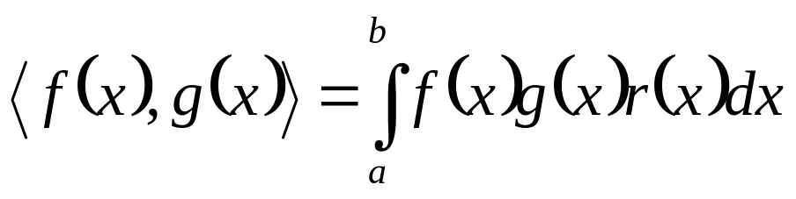
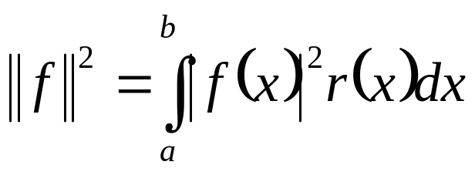
Orthogonal Series : Inner Product and Norm
The value of scalar product of two vectors will determine, whether these vectors are orthogonal or not.
A generalized definition of scalar product of any two functions is defined as an inner product.
Consider a Function Space consisting of functions f (x) and g(x) defined on the interval [a, b] (for some a, b > 0) together with a positive weight-function r(x).
The generalized concept of scalar product (inner product) is expressed as:
Similarly the norm is defined as:

Slide 4
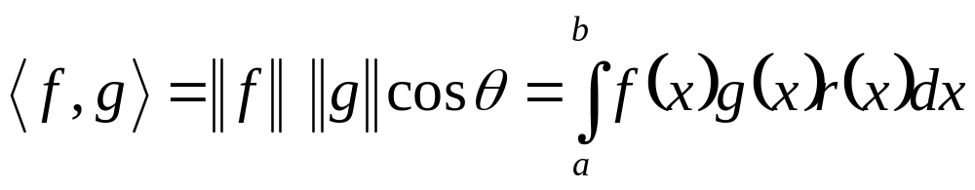
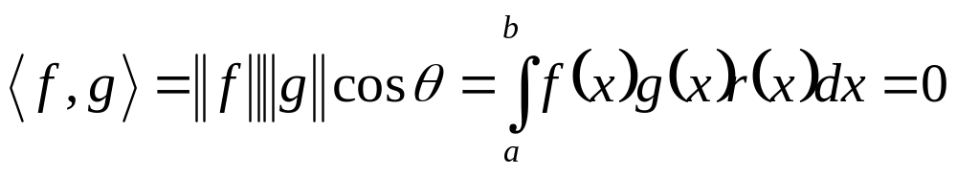
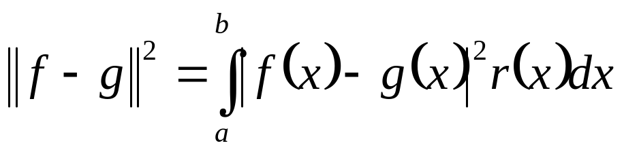
Inner Product as A Measure of Angle between A Pair of Functions
The angle between these functions is defined as:
Functions f and g are orthogonal on [a, b] with respect to the weight r if
The inner product and orthogonality depend on the choice of a, b and r.
If orthogonality is achieved with r(x) ≡ 1, these definitions reduce to the “ordinary orthogonal functions”.
The distance between these functions is defined as:

Slide 5
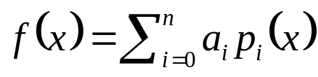
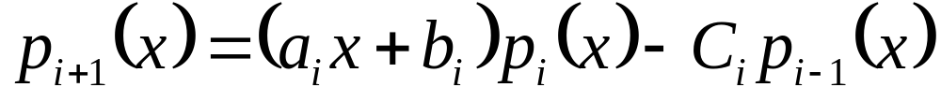
Properties of Orthogonal Polynomials
All sets of orthogonal polynomials have a number of fascinating properties.
Any polynomial f(x) of degree n can be expanded in terms of {p₁, p₂, …..p_{n}}.
∃ coefficients, a_{i} such that
Given an orthogonal set of polynomials, {p₁, p₂, …..p_{n}}, each polynomial p_{k}(x) is orthogonal to any polynomial of degree < k.
Any orthogonal set of polynomials {p₁(x), p₂(x), …..p_{n} (x)}, has a recurrence formula that relates any three consecutive polynomials in the sequence.
∃ a relation;
a, b and c depend on i

Slide 6
Properties of Orthogonal Polynomials
Above relation is called as recurrence formula and this is used to calculate higher order coefficients.
Each polynomial in {p₁(x), p₂(x), …..p_{n} (x)} is has all n of its roots real distinct and strictly within the interval of orthogonaly i.e., not on its ends.
This is an extremely unusual property.
It is particularly important when solving the classes of polynomials that arise in thermofluid solutions.
The roots of n^{th} degree polynomial, p_{n}(x), lie strictly inside the roots of (n+1)^{th} degree polynomial, p_{n+1}(x).

Slide 7
The field of orthogonal polynomials was developed in the late 19th century and many of the sets of orthogonal polynomials described arose from descriptions of special physical problems
Adrien-Marie Legendre published on celestial mechanics in 1784 which contains the Legendre polynomials.
Bessel introduced Bessel function in 1817 in his study of a problem of Kepler of determining the motion of three bodies moving under mutual gravitation.

Slide 8
The Greatest Academic Friendship
The devoted friendship between CHARLES-FRANCOIS STURM and JOSEPH LIOUVILLE began in the early 1830's.
STURM and LIOUVILLE wrote only one joint paper on the theory called after them, several remarks in their works bear witness to their collaboration.
They always praise each other's achievements and even cover up each other's mistakes.
They discussed each other's papers before their publication with the result that in some cases an elaboration of a certain discovery was published before the discovery itself.

Slide 9
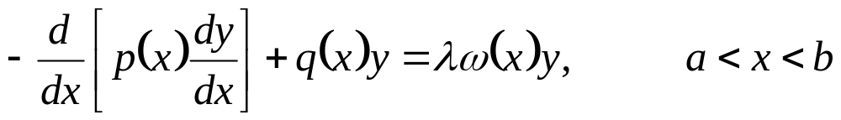
Sturm-Liouville Problems
A Sturm-Liouville problem consists of
A Sturm-Liouville equation on an interval
together with Boundary conditions, i.e. specified behavior of y at x = a and x = b.
Assume than p, dp/dx, q and ω are continuous such that p(x) > 0 and ω(x) ≥ 0 ∀ x ∈(a,b).
is known as spectral parameter.
According to the general theory of second order linear ODEs, this guarantees that solutions to above equation exist.

Slide 10
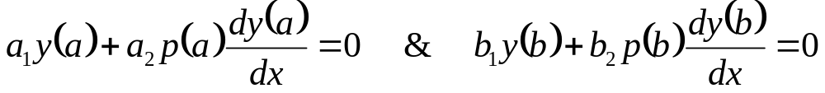
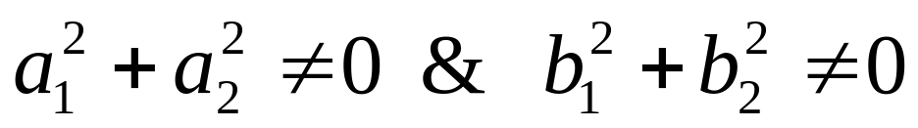
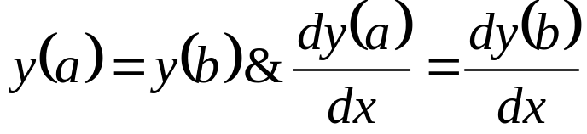
Regular Sturm-Liouville Problem
A regular Sturm-Liouville problem has the form
Boundary conditions:
where
These boundary conditions are called separated boundary conditions.
If p(x) or r(x) is 0 in some endpoint we say that it is singular SLP.
A SLP is called periodic if p > 0, r > 0 and p, q and r are continuous functions on [a, b]; along with the special BC:

Slide 11
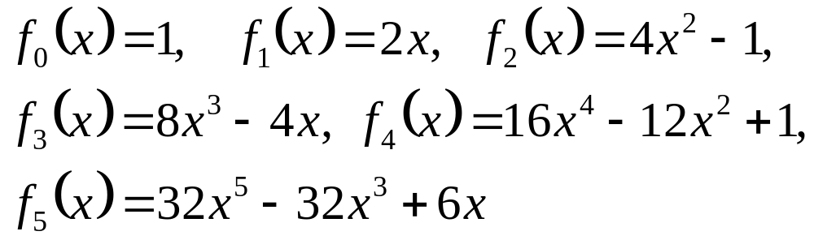
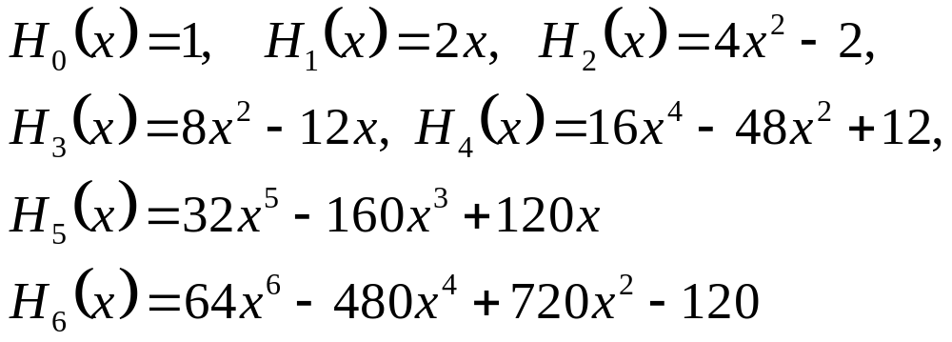
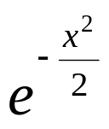
Examples of Orthogonal Series
The functions f_{n}(x) = sin(nx) (n = 1, 2, . . .) are pairwise orthogonal on [0, π] relative to the weight function r(x) ≡ 1.
The functions
are pairwise orthogonal on [−1, 1] relative to the weight function r(x) = SQRT(1 − x²).
They are examples of Chebyshev polynomials of the second kind.
Hermite polynomial
weight function

Slide 12
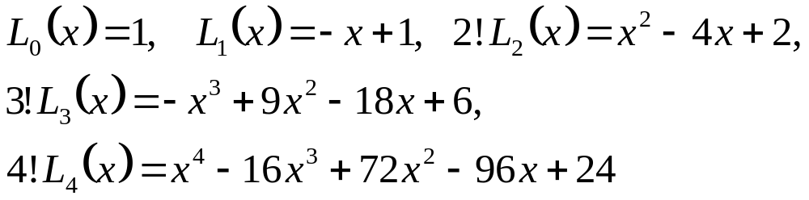
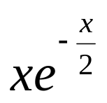
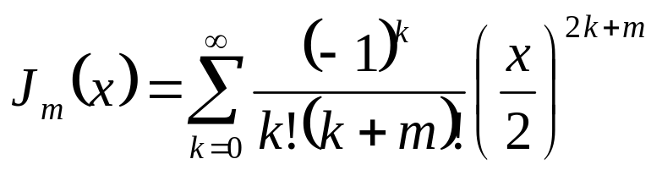
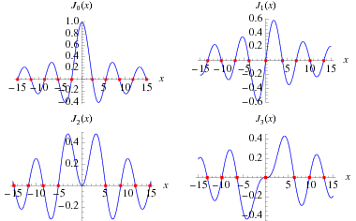
Examples of Orthogonal Series
Lagurre polynomial
weight function
Let J_{m} be the Bessel function of the first kind of order m.
Any set of functions f_{n}(x) = J_{m}(α_{mn}x/a) with α_{mn} denote its n^{th} positive zero. are pairwise orthogonal on [0, a] with respect to the weight function w(x) = x.

Slide 13
First Few Roots of J_{m}(x)
 | J₀ | J₁ | J₂ | J₃ | J₄ | J₅
1 | 2.4048 | 3.8317 | 5.1356 | 6.3802 | 7.5883 | 8.7715
2 | 5.5201 | 7.0156 | 8.4172 | 9.7610 | 11.0647 | 12.3386
3 | 8.6537 | 10.1735 | 11.6198 | 13.0152 | 14.3725 | 15.7002
4 | 11.7915 | 13.3237 | 14.7960 | 16.2235 | 17.6160 | 18.9801
5 | 14.9309 | 16.4706 | 17.9598 | 19.4094 | 20.8269 | 22.2178

Slide 14
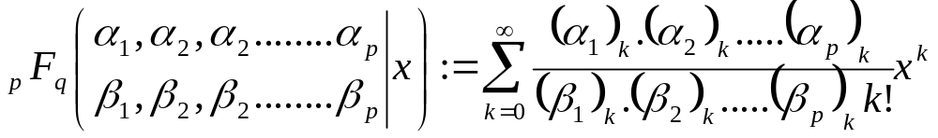
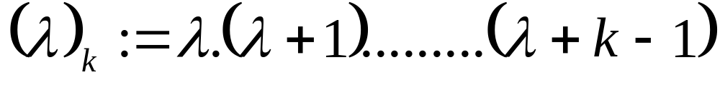
Hypergeometric Series
A generalized hypergeometric series _{p}F_{q} is defined by
where (λ)k denotes the Pochammer symbol

Slide 15
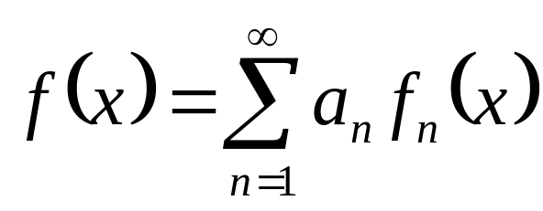
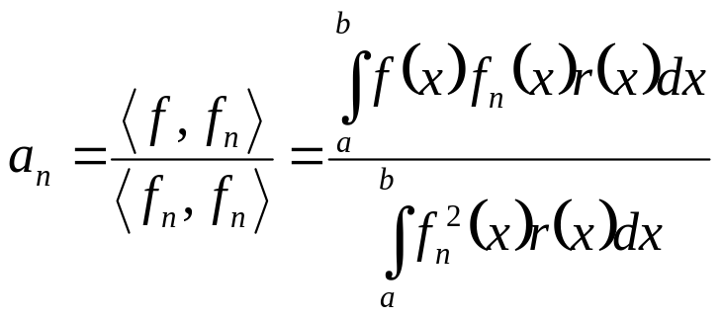
Theorem : Orthogonal Series Expansions
Suppose that {f₁, f₂, f₃, . . .} is an orthogonal set of functions on [a, b] with respect to the weight function r.
The piecewise continuous function f on [a, b] is generated as
then the coefficients a_{n} are given by
The series expansion above is called a generalized Fourier series for f .
an are the generalized Fourier coefficients.
Regular Sturm-Liouville Problems are generators of Orthogonal series.

Slide 16
Sturm-Liouville DE : A Mother of Orthogonal Series
A nonzero function y that solves the Sturm-Liouville problem
Boundary conditions:
is found to be an Eigen function, and the corresponding value of λ is called its eigenvalue.
The eigenvalues of a Sturm-Liouville problem are the values of λ for which nonzero solutions exist.

Slide 17
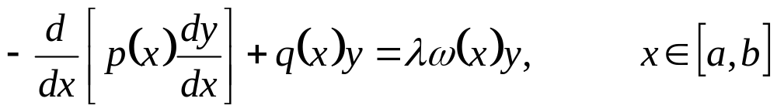
Sturm-Liouville Boundary Value Problem
A SL-BVP
with p, q and ω are specified such that p(x) > 0 and ω(x) ≥ 0
∀ x ∈[a,b].
where
is called as a SL-EVP, if there exists a non-trivial solution for any λ= μ, where μ is a complex number.
Such a value μ is called an eigenvalue and the corresponding non-trivial solutions y(.; μ) are called Eigen functions.

Slide 18
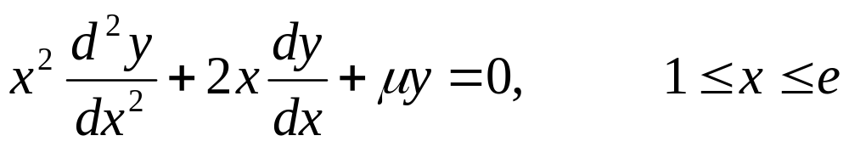
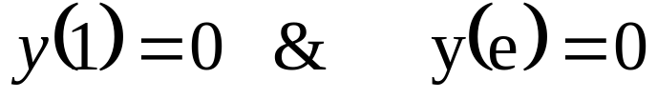
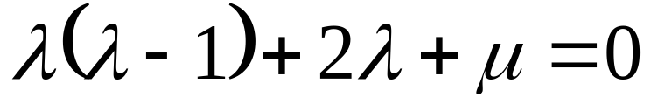
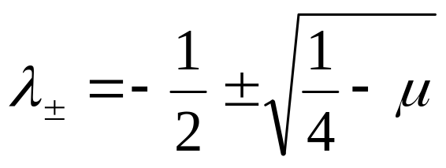
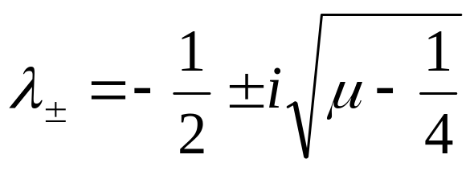
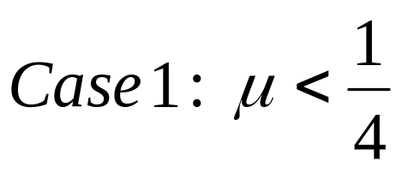
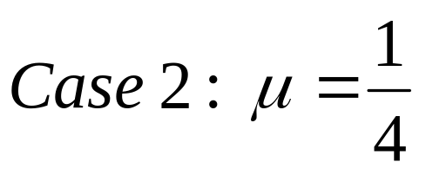
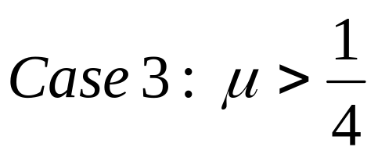
Example: Euler like SL-BVP
Solve
With boundary conditions
Solution: Take Ansaz as x^{λ}. The characteristic equation is
Solutions:
Three different cases are possible:

