Slide 1

Designated Series Functions as Solutions to Special Linear SO-ODE
P M V Subbarao
Professor
Mechanical Engineering Department
I I T Delhi
In Tune with Digital Computing……

Slide 2

Taylor's Expansion
1715 - Taylor's Expansion:
Taylor’s Theorem. If f is a function continuous and n times differentiable in an interval [x₀, x₀ + h], then there exists some point in this interval, denoted by x₀ + λh for some λ ∈ [0, 1], such that:

Slide 3
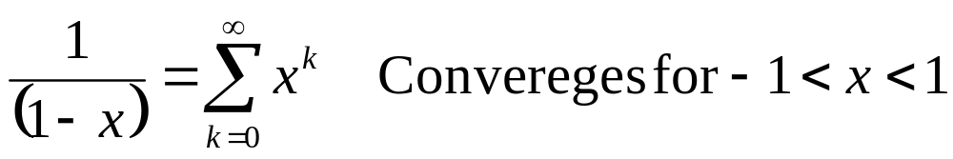
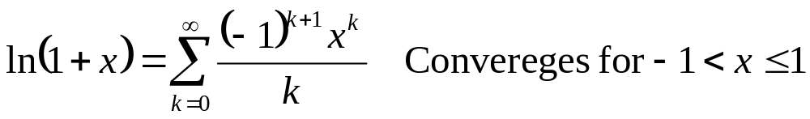
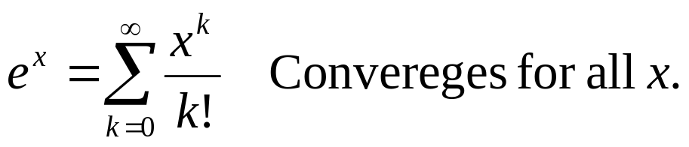
Maclaurin Series : 1742
These series are named after the Scottish mathematician Colin Maclaurin.
Maclaurin series is the expansion of Taylor series about 0.
Therefore, Maclaurin series are special case of ‘Taylor Series’.
Key Maclaurin series used in Applications:
Geometric Series:
Log Series:
Exponential Series:

Slide 4
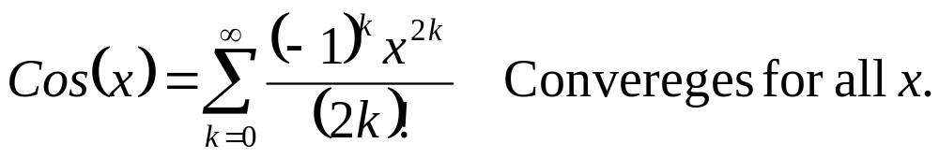
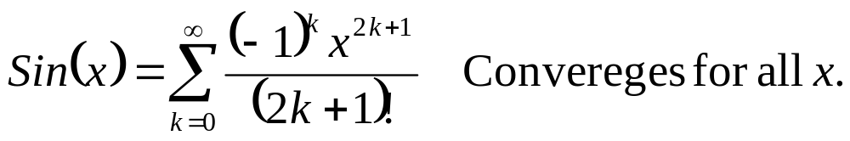
Maclaurin Series
Cosine Series:
Sine Series:
Linearity and Power Series. The set of all power series convergent for |x| < R form a vector space under function addition and scalar multiplication.
This means:
1. The sum of two power series is a power series.
2. A scalar multiple of a power series is a power series.
3. The zero power series is the zero function: all coefficients are zero.
4. The negative of a power series is (-1) times the power series.

Slide 5
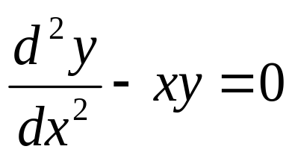
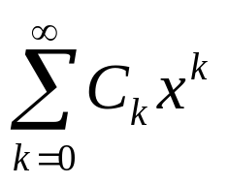
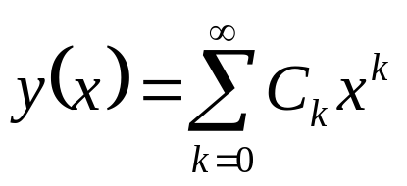
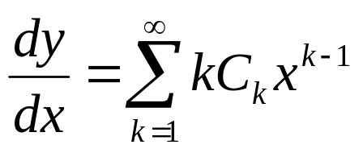
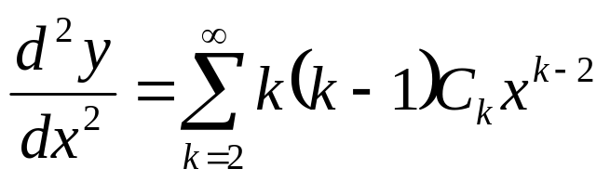
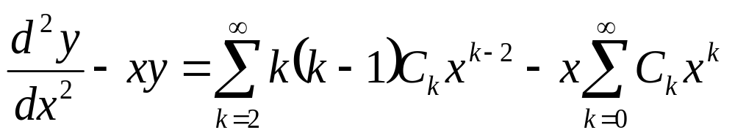
Airy's airfoil equation & Power Series Solution
One of the famous example of SO-ODE with VC is Airy's Equation
Maclaurin series is the first choice for Ansaz

Slide 6
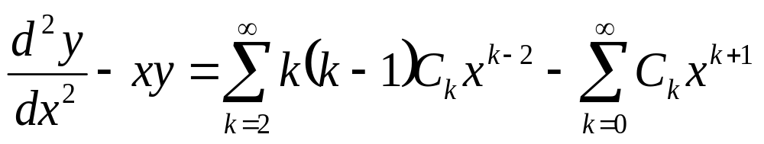
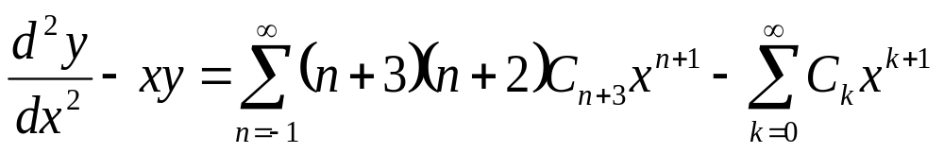
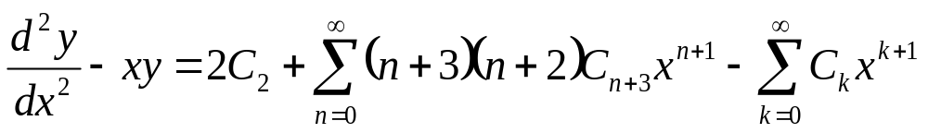
Airy's airfoil equation & Power Series Solution
Let us introduce the new variable k = n+3.

Slide 7
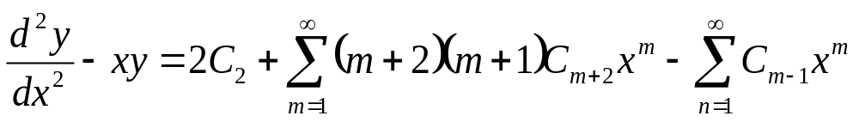
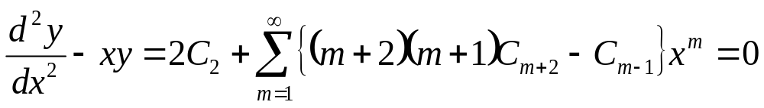
Airy's airfoil equation & Power Series Solution
As LHS = 0 = RHS and the power series for the zero function has zero coefficients.
All coefficients in the series LHS must be zero.
This implies the relations

Slide 8

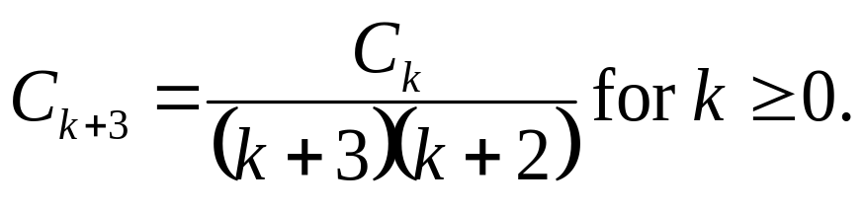
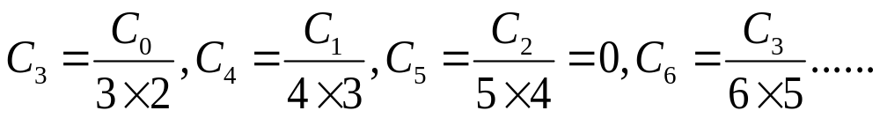
Airy's airfoil equation & Power Series Solution
Replace m by k + 1.
Get a Recurrence Formula!!!
Authenticity of the method !?!?!?

Slide 9
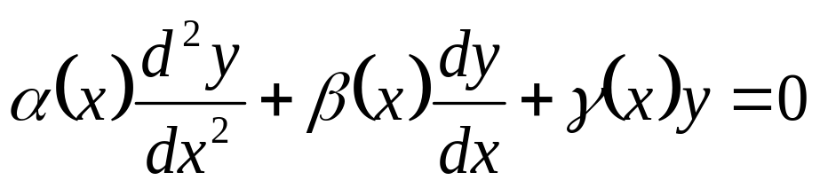
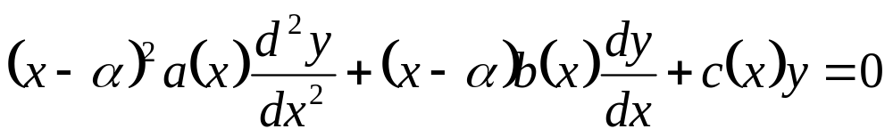
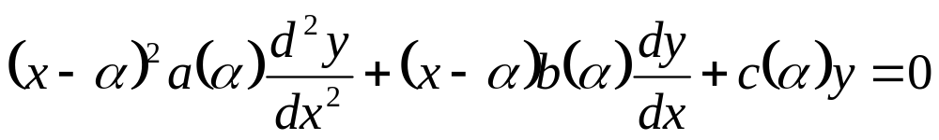
The Method of Frobenius: by the mathematician Ferdinand Georg Frobenius, 1890
Consider a Linear SO-ODE of the form
At any regular singular point x=α, above SO-ODE is modified as:
where a(x), b(x) and c(x) are polynomials with a(α) ≠ 0.
An approximate SO-ODE can be obtained if the coefficients a(x), b(x), and c(x) are evaluated at x≈α.
This is similar to Eulers Equidimensional Equation!!!

Slide 10
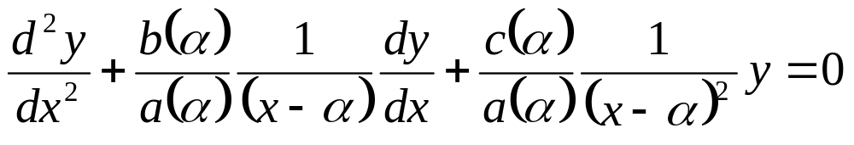
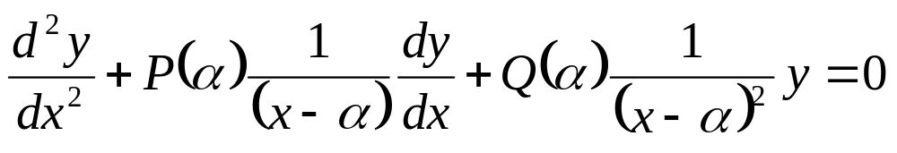
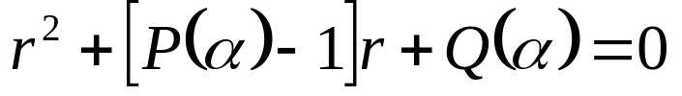
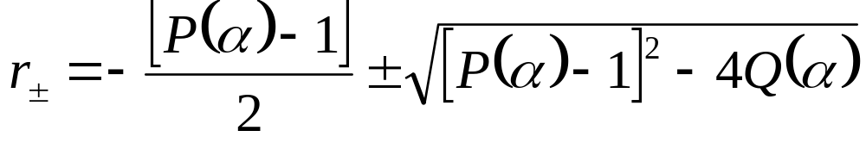
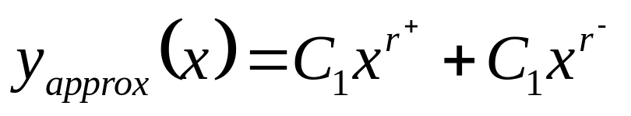
Standard Form of Approximated EEE
A valid Ansaz for x>α is (x-α)^{r}.
Substitution of Ansaz generates an Indicial Equation
Above solution is not a valid solution for the original ODE.

Slide 11
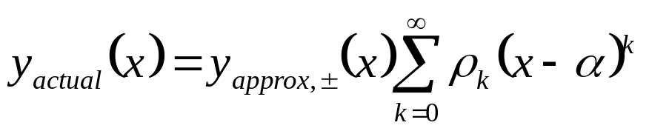
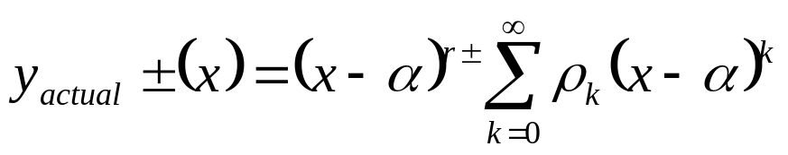
A New form of Solution
The function y_{approx}(x) will not in general be a solution to the ODE, but it is expected that y_{approx}(x) will be close to would be solution.
Accordingly, the solution to the ODE is in the form
This is called a Frobenius series invented in ~1890 by the mathematician Ferdinand Georg Frobenius.
Theorem: The method of Frobenius series yields at least one solution to
as a product of (x-α)^{r} and a power series.

Slide 12
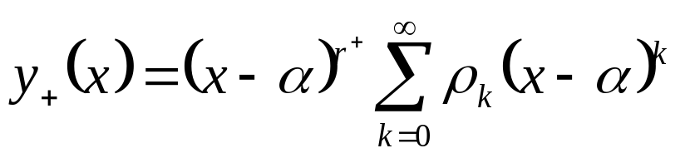
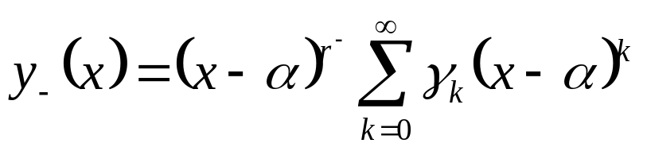
Theorem for Real Roots -1
If r⁺ & r⁻ are two independent roots of the indicial equation and (r⁺-r⁻) is not zero or a positive integer, then there are two linearly independent solutions y₊ and y₋ of Linear SO-ODE are of the form
Where series functions are analytic at x = α with radius of convergence R and ρ₀≠0 and γ₀≠0.

Slide 13
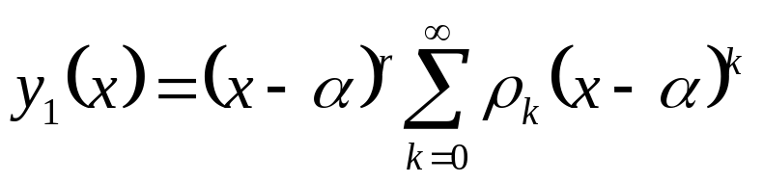
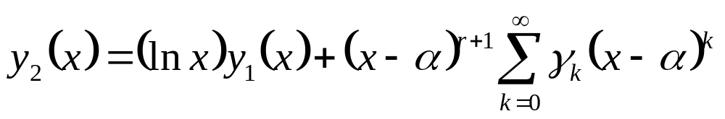
Theorem for Equal Roots - 2
If r⁺ & r⁻ are two dependent roots of the indicial equation r⁺ =r= r⁻, then there are two linearly independent solutions y₁ and y₂ of Linear SO-ODE are of the form
Where series functions are analytic at x = α with radius of convergence R and ρ₀≠0.

Slide 14
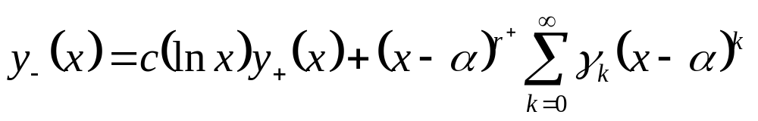
Theorem for Real Roots -3
If r⁺ & r⁻ are two independent roots of the indicial equation and (r⁺-r⁻) is a positive integer, then there are two linearly independent solutions y₊ and y₋ of Linear SO-ODE are of the form
Where series functions are analytic at x = α with radius of convergence R and ρ₀≠0 and γ₀≠0.
It may happen that c = 0.

Slide 15
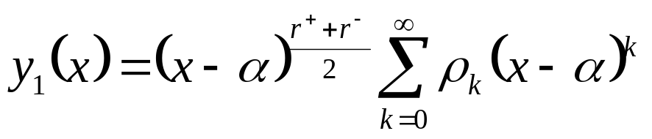
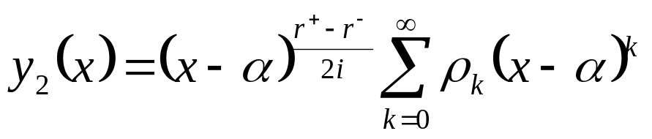
Theorem for Imaginary Roots -4
If r⁺ & r⁻ are two independent imaginary roots of the indicial equation, then generate new real roots same as before.
The two linearly independent solutions y₁ and y₂ of Linear SO-ODE are of the form
Where series functions are analytic at x = α with radius of convergence R and ρ₀≠0 and γ₀≠0.
It may happen that c = 0.

Slide 16
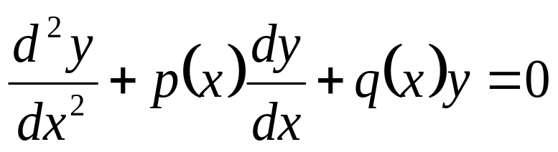
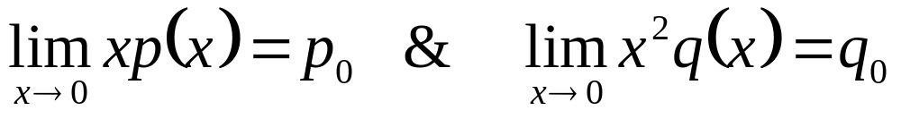
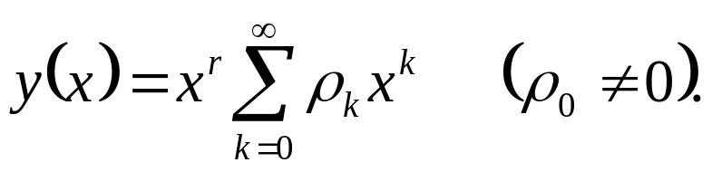
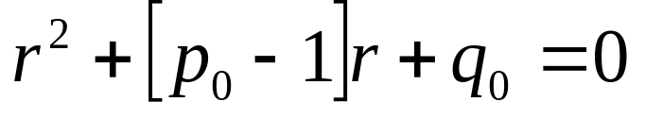
Modern Description of Method of Frobenius
For simplicity, we consider a second order linear ODE with a regular singular point at x0 = 0.
Suppose that at least one of p(x) or q(x) is not analytic at x = 0, but that both of xp(x) and x²q(x) are analytic. i.e.,
then there is a solution to
(x > 0) of the form
where r is a root of the indicial equation

Slide 17
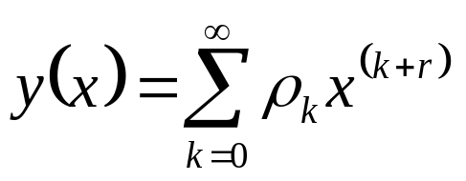
Summary of Frobenius Method
Look for a solution y of the form
Introduce this power series expansion into the differential equation.
Find the indicial equation for the exponent r.
Find the larger solution (root) of the indicial equation.
Find a recurrence relation for the coefficients ρ_{k}.
Introduce the larger root r⁺ into the recurrence relation for the coefficients ρ_{k}.
Only then, solve this later recurrence relation for the coefficients ρ_{k}.
This an authentic procedure to find the solution y_{gen}.

Slide 18
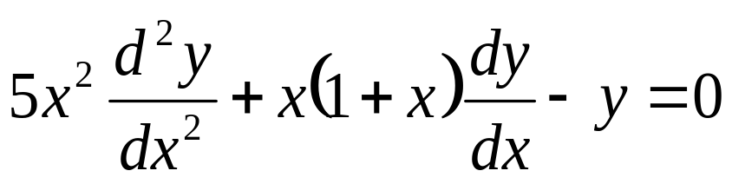
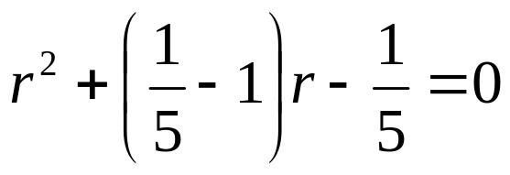
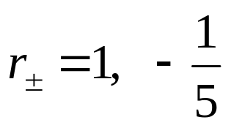
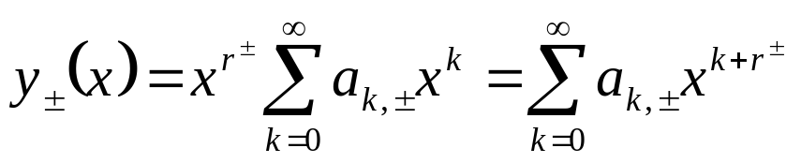
Examples
Find a solution of
in terms of the Frobenius series.
x = 0 is a regular singular point
Feel that α = 0, we have a(α) = 5, b(α) = 1, and c(α) = -1.
Hence the Ansaz for approximate EEE is x^{r} and the indicial equation is
and its solutions are
The proposed Frobenius series solution is

Slide 19
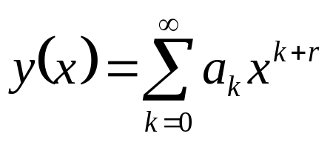
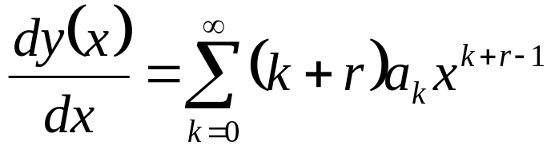
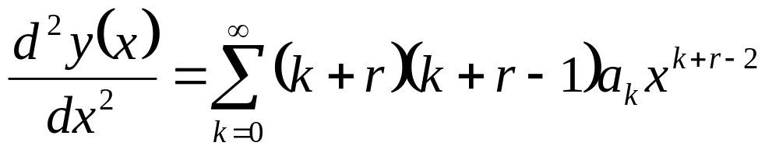
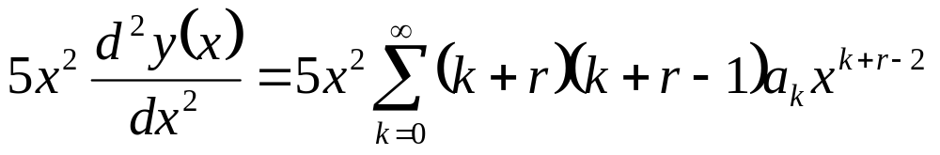
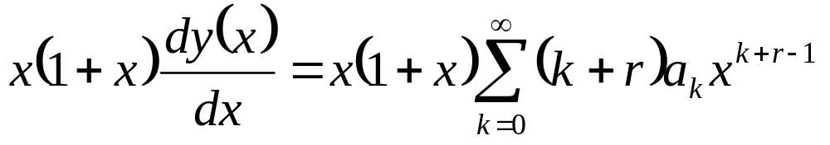
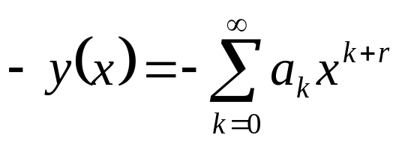
The proposed Frobenius series in the given SO-ODE

Slide 20




The proposed Frobenius series in the given SO-ODE

Slide 21


More Algebra to Evaluate the Coefficients
This basically means that the constant a₀ can have arbitrary value!!??!!
Or is there any constraint on a₀ induced by the conditions on the coefficients of the other powers of x ???

Slide 22


More Algebra to Obtain the Coefficients
Let us introduce the new variable n = k+1.

Slide 23


The Recurrence Formula for Coefficient
For all value of n ≥1

Slide 24






A Unified Recurrence Formula for Coefficient

Slide 25




The Final Solution

