Slide 1

Series Solutions to Linear SO-ODE
P M V Subbarao
Professor
Mechanical Engineering Department
I I T Delhi
Solutions More General than the Elementary Functions from Calculus

Slide 2

Solvable Linear SO-ODEs
By the middle of the eighteen century people realized that the methods to solve linear SO-ODEs reached a dead end.
One reason was the lack of functions to write the solutions of differential equations.
People even started to think of differential equations as sources to find new functions.
Fourier’s solution to heat equation as a trigonometric series ignited the minds of Mathematicians of 19th Century.
19th century mathematicians started to use general power series expansions to find solutions of many new differential equations.
Convergent power series define functions far more general than the elementary functions from calculus.

Slide 3
Analytical Theory of Heat by
JOSEPH FOURIER :1822
Primary causes are unknown to us; but are subject to simple and constant laws.
These may be discovered by observation only…
The study of “Primary Causes” is the object of natural philosophy.
I have deduced these laws from prolonged study and attentive comparison of the facts known up to this time.
All these facts I have observed afresh in the course of several years with the most exact instruments that have hitherto been used.
Profound study of nature is the most fertile source of mathematical discoveries.
CHAPTER III. PROPAGATION OF HEAT IN AN INFINITE RECTANGULAR SOLID

Slide 4
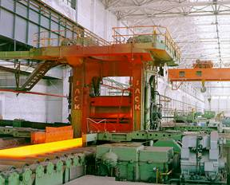
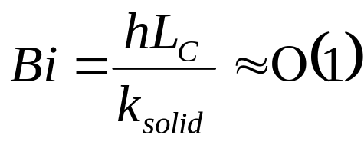
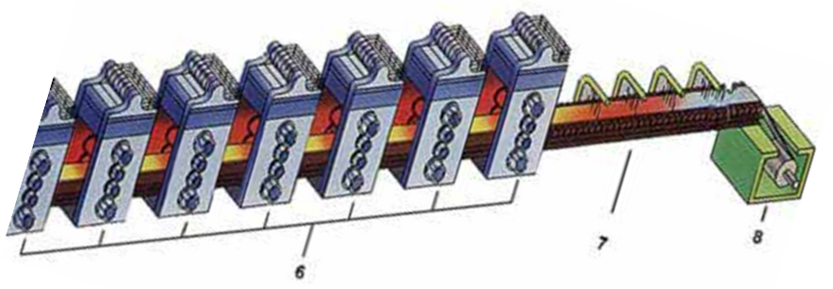
Current Industrial Application of Fourier Solution
Iron, pure | 73 W/m.K
Iron, wrought | 59 W/m.K
Wrought Carbon Steel | 59 W/m.K
Stainless Steel | 12—45 W/m.K

Slide 5
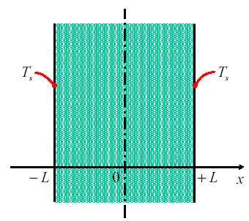
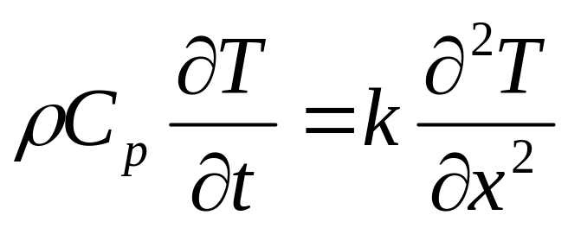
One Dimensional Transient Conduction
Governing Differential Equation:
Initial Condition:
T(x,o)= T₀
Boundary Conditions:
T(± L, t)=T_{s}

Slide 6
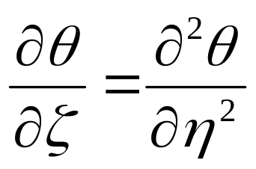
A Pure Dimensionless Partial Differential Equation
Initial condition: q(h,0) = 1
Boundary conditions: q(±1,z) = 0
At any time Temperature profile will be symmetric about x-axis. Solution in positive or negative direction of x is sufficient.

Slide 7
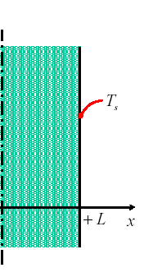
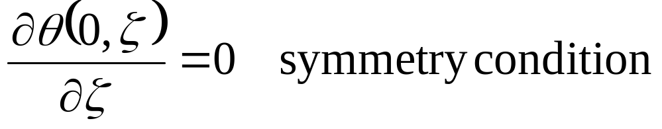
The Partial Differential Equation
Initial condition: q(h,0) = 1
1
Boundary conditions: q(1,z) = 0
0
1
h

Slide 8
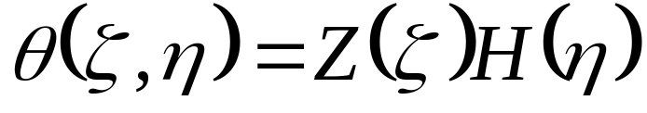
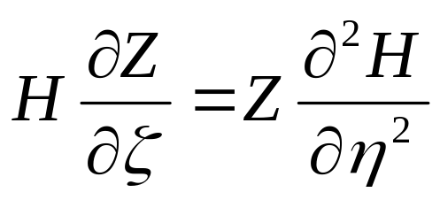
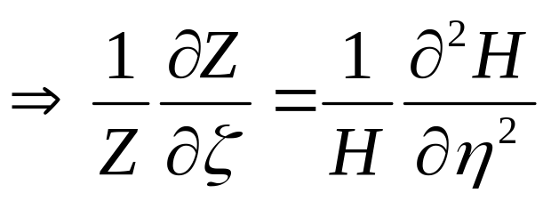
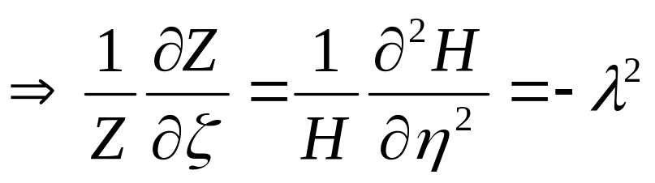
The Art of Separation of Variables
Let

Slide 9
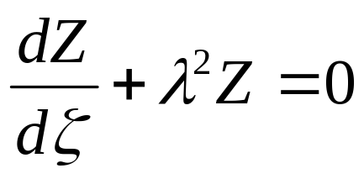
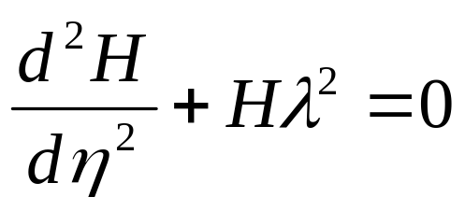
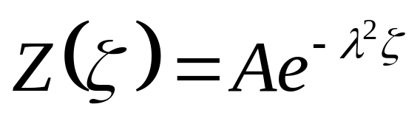
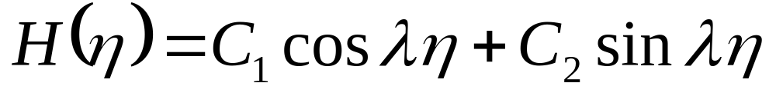
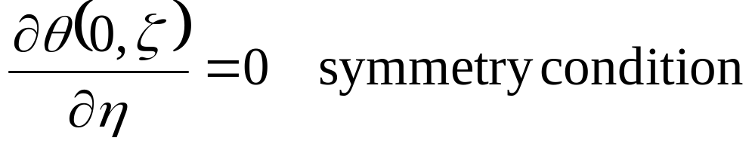
A pair of ODEs
Boundary conditions: q(1,z) = 0
Boundary conditions: q(1,z) = 0

Slide 10
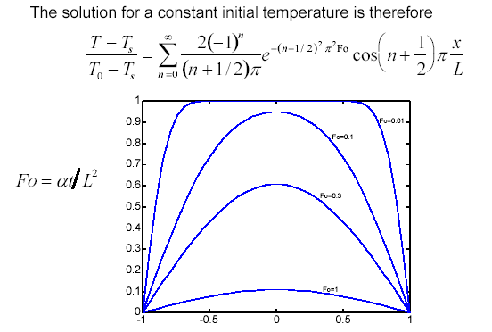
Trigonometric Series Solution by Fourier

Slide 11
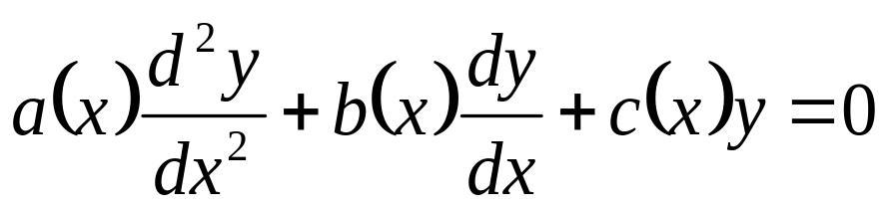
The Hypothesis
The form of a solution to a linear SO-ODE can be an infinite series, if the function & variable Coefficients of ODE are analytic at the point of interest.
where a, b, and c are polynomials.
Domain of Validity????
Valid for all x ∈ Ɽ ?!?!?!

Slide 12
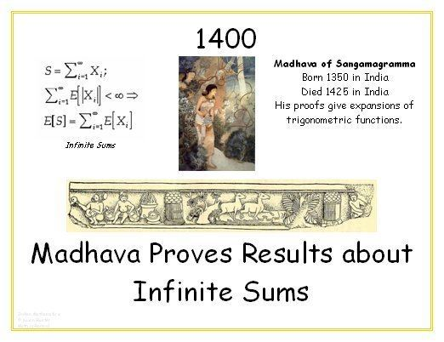
Introduction to Infinite Series
Zeno's paradox :The Greek philosopher Zeno considered the problem of summing an infinite series to achieve a finite result, but rejected it as an impossibility.
Later, Aristotle proposed a philosophical resolution of the paradox, but the mathematical content was unresolved.
Archimedes's method of exhaustion provided an infinite number of progressive subdivisions could be performed to achieve a finite result.
In the 14th century, Madhava of Sangamagrama found a number of special cases of the Taylor series.

Slide 13
Formalization of Series Form of Functions
The Kerala School of Astronomy and Mathematics further expanded his works with various series expansions and rational approximations until the 16th century.
In 1715, a general method for constructing these series for all functions for which they exist was finally provided by Brook Taylor, after whom the series are now named.
Taylor's Expansion:
Taylor’s Theorem. If f is a function continuous and n times differentiable in an interval [x₀, x₀ + h], then there exists some point in this interval, denoted by x₀ + λh for some λ ∈ [0, 1], such that:
f is a so-called analytic function

Slide 14
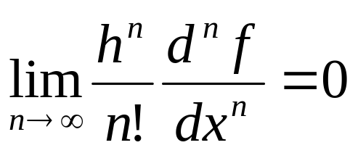
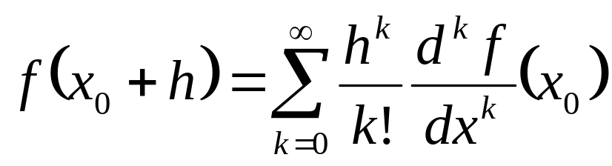
An Infinite-Order Taylor Series
If f is a so-called analytic function of which the derivatives of all orders exist, then one may consider increasing the value of n indefinitely.
Thus, if the condition holds that
which is to say that the terms of the series converge to zero as their order increases.
Then an infinite-order Taylor-series expansion is available in the form of

Slide 15
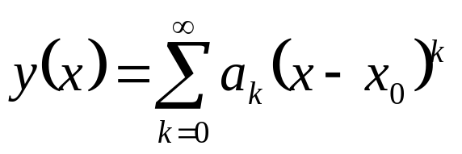
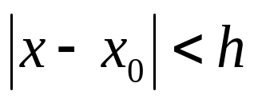
Power Series Definition : Analytic Function
A function y is analytic on an interval (x₀ - h, x₀+ h) iff it can be written as the power series expansion below.
Above series is convergent for

Slide 16
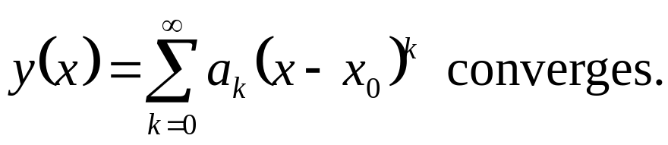
Definition : Convergence of A Power Series
The power series
converges in absolute value iff the series
Remark: If a series converges in absolute value, it converges.
The converse is not true.

Slide 17
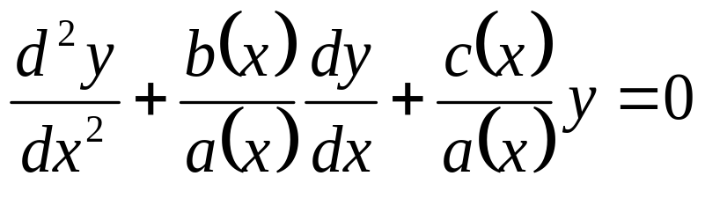
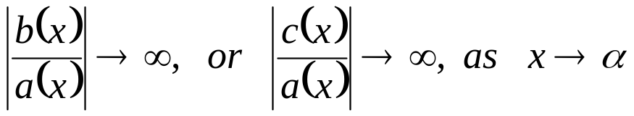
Fitness test-1 Power Series Solutions:
Special Properties of SO-ODEs
Consider the differential equation
where a, b, and c are polynomials, or equivalently,
A point x = α is called a singular point of above ODE, if
Any point x=β is called as an ordinary point of ODE, at which the functions p(x) and q(x) are continuous.

Slide 18
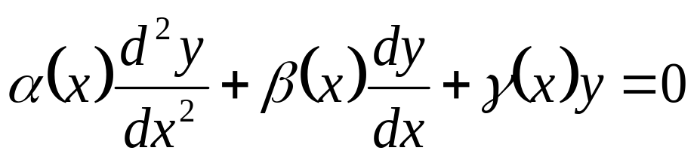
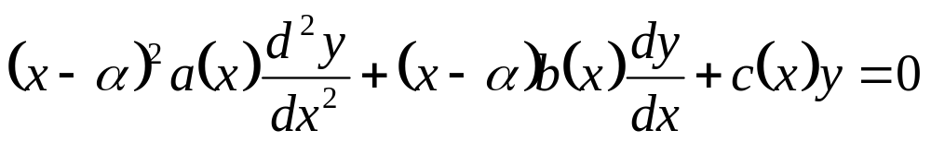
Fitness test-2 Power Series Solutions:
Special Properties of SO-ODEs
A singular point x = α is called a regular singular point of the above equation if it can be written as
where a(x), b(x) and c(x) are polynomials with a(α) ≠ 0.
A singular point that is not a regular singular point is called a irregular singular point.

Slide 19
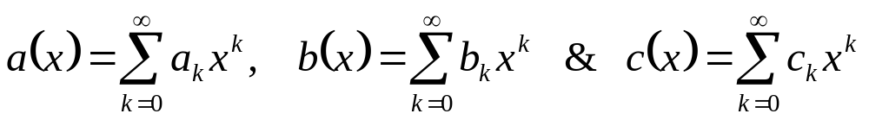
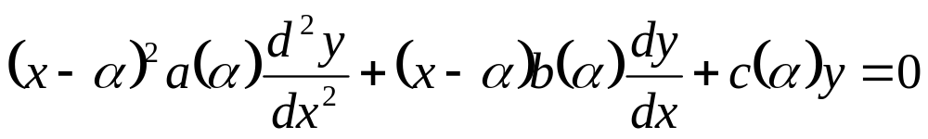
The Method of Frobenius : by the mathematician Ferdinand Georg Frobenius, 1890
Consider a Linear SO-ODE of the form
where a(x), b(x) and c(x) are polynomials with a(α) ≠ 0. Also .x = α is a regular singular point.
An approximate SO-ODE can be obtained if the coefficients a(x), b(x), and c(x) are evaluated at x≈α.
This is similar to Eulers Equidimensional Equation!!!

Slide 20
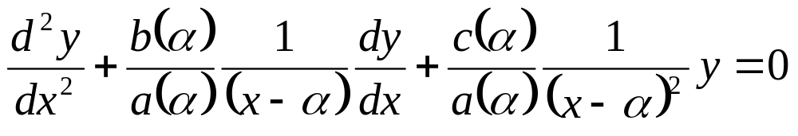
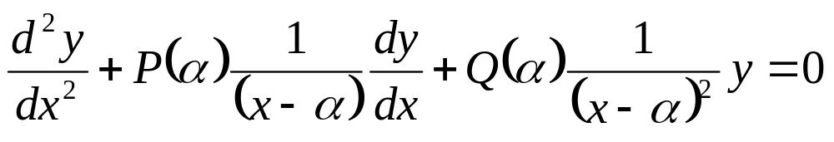
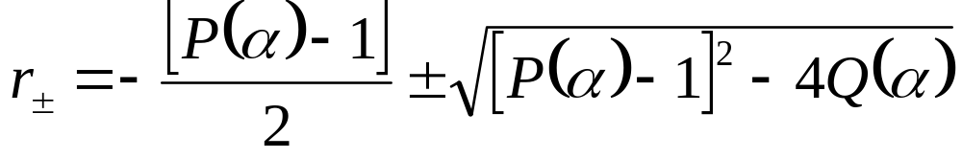
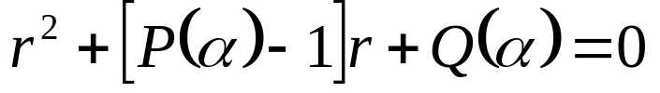
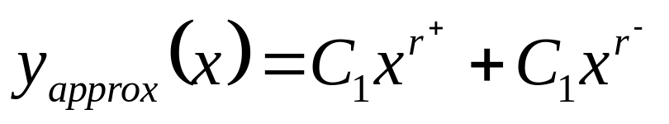
Standard Form of Approximate EEE
A valid Ansaz for x>α is (x-α)^{r}.
Substitution Ansaz generates an Indicial Equation
Above solution is not a valid for the original ODE.

Slide 21
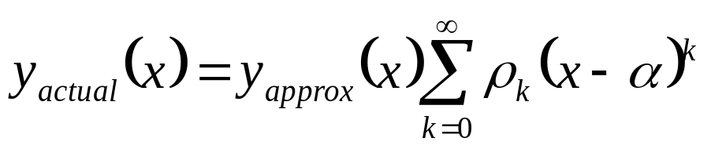
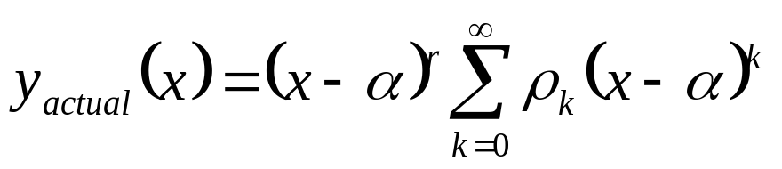
A New form of Solution
The function y_{approx}(x) will not in general be a solution to the ODE, but it is expected that y_{approx}(x) will be close to being a solution.
Accordingly, the solution to the ODE is in the form
This is called a Frobenius series invented in ~1890 by the mathematician Ferdinand Georg Frobenius.
Theorem . The method of Frobenius series yields at least one solution to
as a product of (x-α)^{r} and a power series.

