Slide 1

The Variation of Parameters Method
P M V Subbarao
Professor
Mechanical Engineering Department
I I T Delhi
A General Method to Solve Non-Homogeneous Linear SO-ODEs ….

Slide 2

The Variation of Parameters Method
This method provides a general way to find a particular solution y_{p} to a nonhomogeneous linear SO-ODE, L(y) = f.
The variation of parameters method also works for second order linear equations having variable coefficients and continuous but otherwise arbitrary sources.
When the source is more complicated, one usually turns to the variation of parameters method.
The Concept:
Develop a formula to compute y_{p} in terms of any pair of fundamental solutions to the homogeneous equation L(y) = 0.

Slide 3
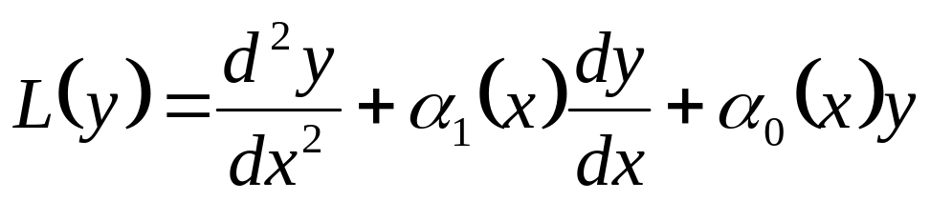
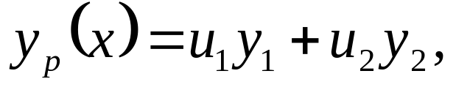
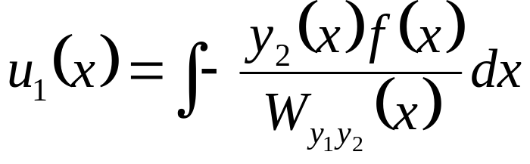
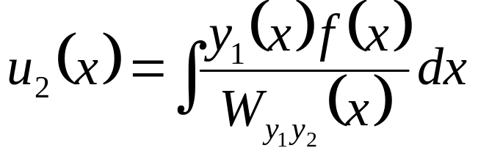
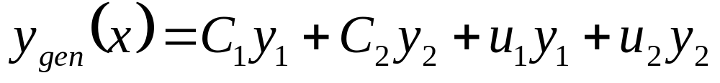
Theorem : Variation of Parameters
A particular solution to the equation L(y)=f (x), with
and α₁, α₀, f are continuous functions of x only, is given by
where y₁ and y₂ are fundamental solutions of the homogeneous equation L(y) = 0 and the functions u₁ and u₂ are defined by
where W_{y1y2} is the Wronskian of y₁ and y₂.
∴The complete solution of L(y)=f is:

Slide 4
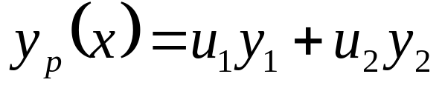
Basis for Theorem: Variation of Parameters
The basis for this theorem is a generalization of the reduction order method.
The formula for y_{p} is obtained by generalization of the reduction order method.
Write y_{p} in terms of both fundamental solutions y₁, y₂ of the homogeneous equation,
Substitute y_{p} in the equation L(y_{p}) = f .
Develop an equation relating u₁ and u₂.
We need to find u₁ and u₂, but there is only one equation available to solve, L(y_{p}) = f.
∴ The problem to find for u₁, u₂ cannot have a unique solution.
There is a need to develop a second equation along with L(y_{p}) = f.

Slide 5
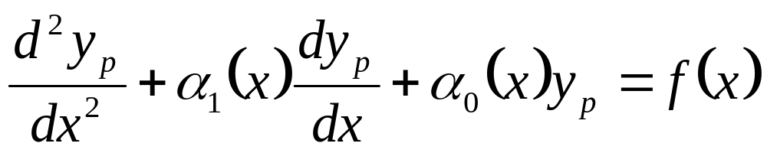
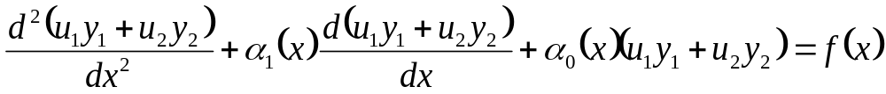
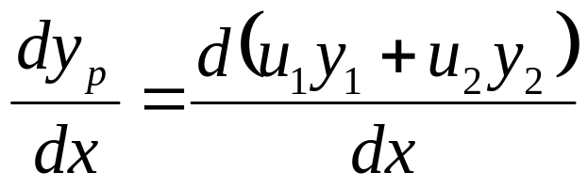
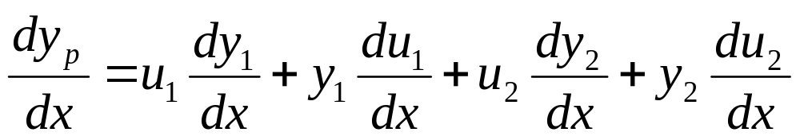
A Search for An Ansaz as Second Equation
: Step -1
Motivated by the reduction of order method an ansaz is selected for y_{p} as:

Slide 6
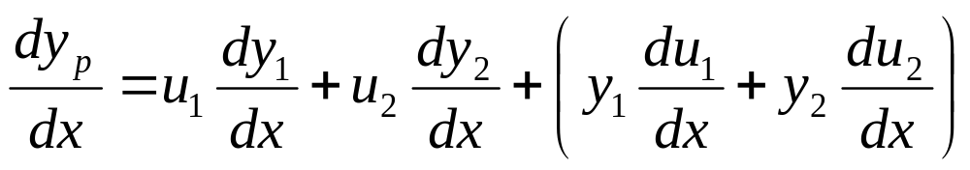
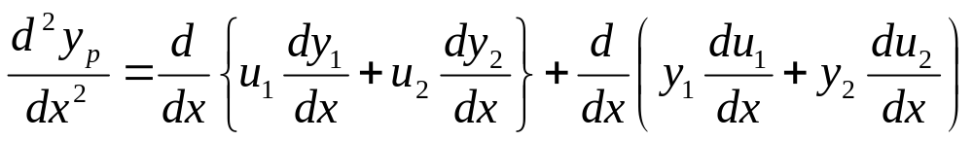
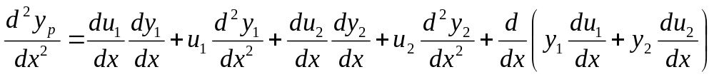
A Search for An Ansaz as Second Equation
: Step 2

Slide 7
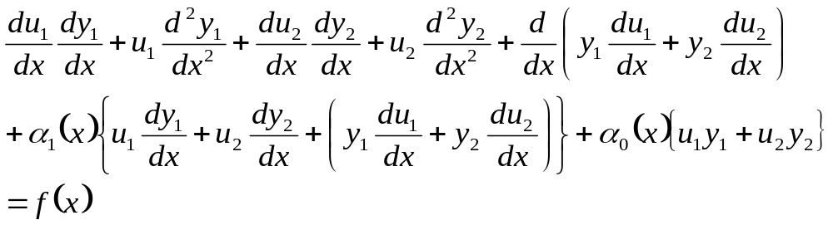
A Search for An Ansaz as Second Equation
: Step 3

Slide 8

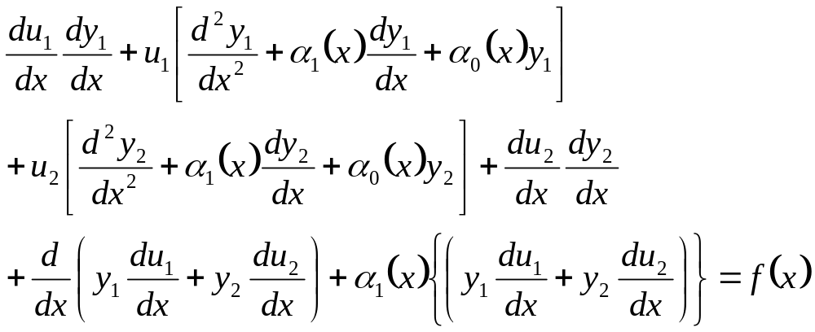
A Search for An Ansaz as Second Equation
:Step 4

Slide 9
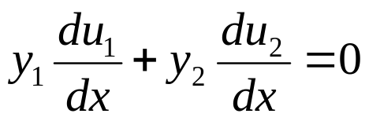
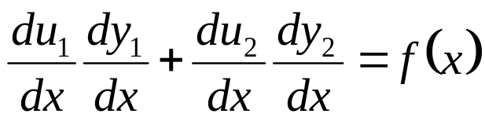
A Search for An Ansaz as Second Equation
: The culmination
A truly educational guess for second equation (Ansaz) is
This is a 2×2 algebraic linear system for the unknowns u₁ and u₂.
It is hard to overstate the importance of the word “algebraic” in the previous sentence.

Slide 10
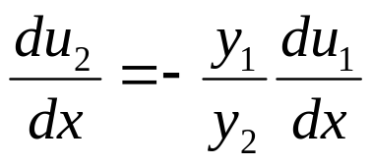
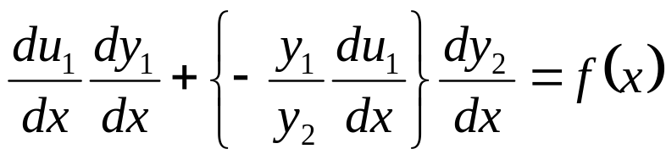
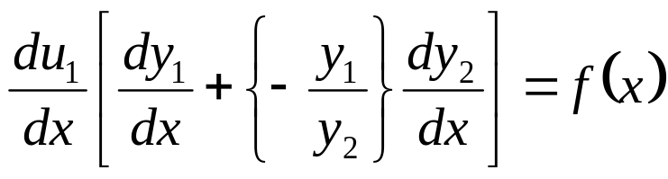
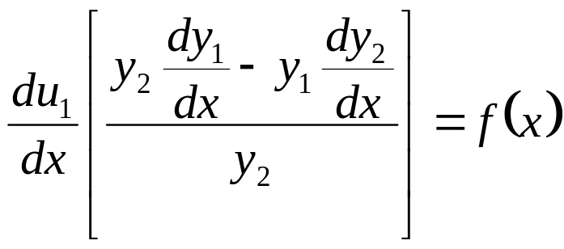
A 2×2 algebraic linear system
Compute u₂ from the first equation given above
Introduce it in the second equation

Slide 11
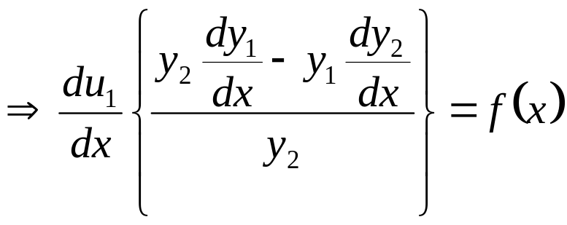
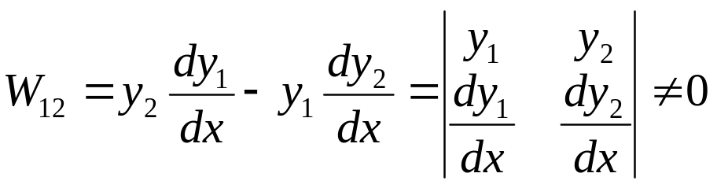
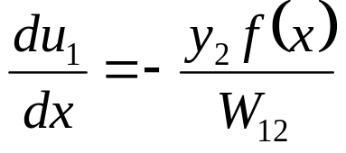
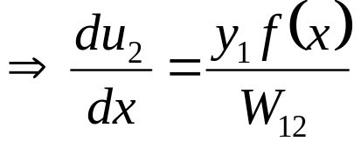
Introduction of The Wronskian
Recall the definition of Wronskian of two functions y₁ & y₂:
Remark: The integration constants in the expressions for u₁, u₂ are always chosen to be zero.

Slide 12
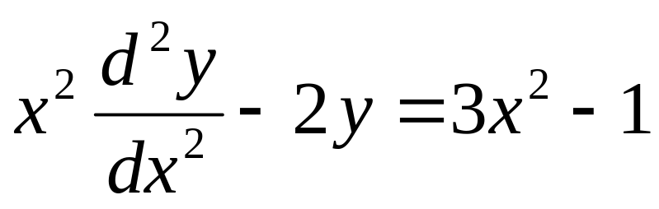
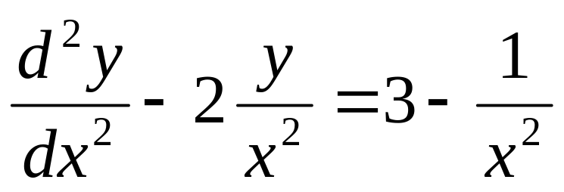
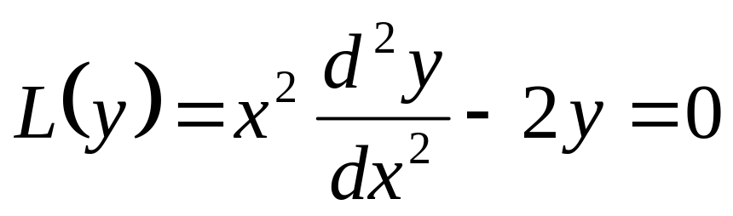
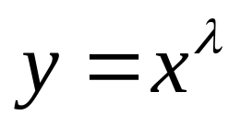
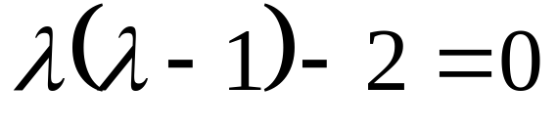
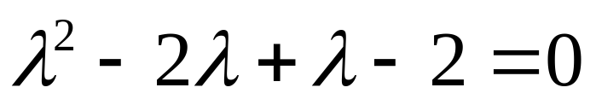
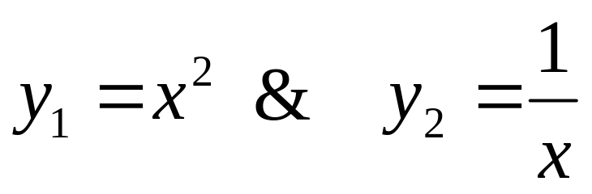
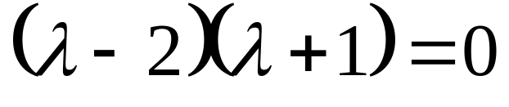
Example : EEE
Find the general solution of the nonhomogeneous equation
Let initial trial solution (Ansaz)

Slide 13
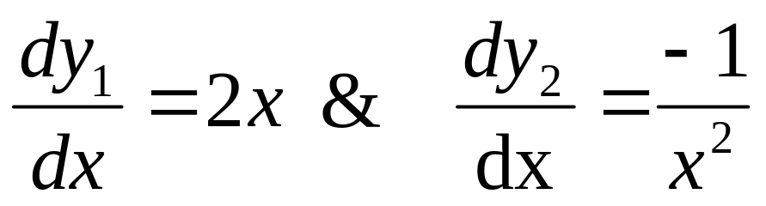
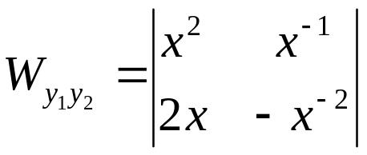
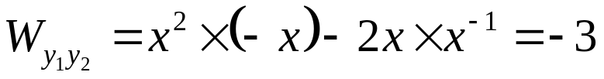
Wronskian of the fundamental solutions y₁, y₂,

Slide 14
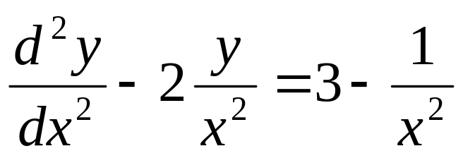
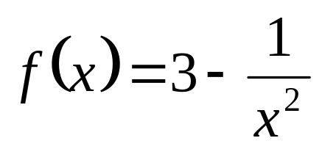
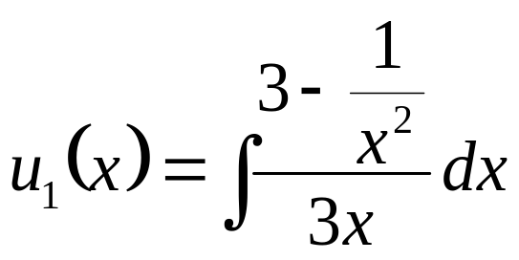
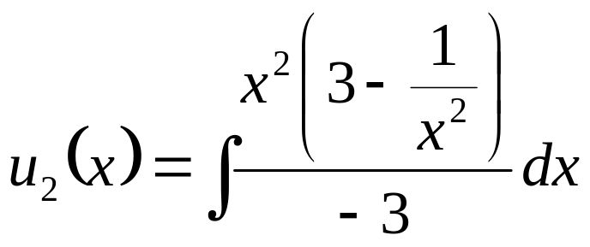
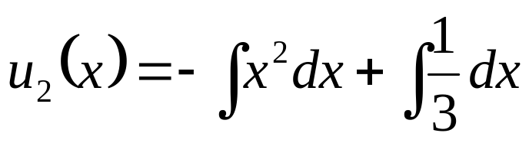
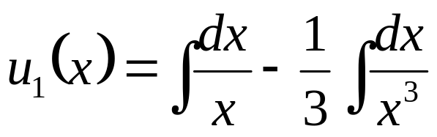
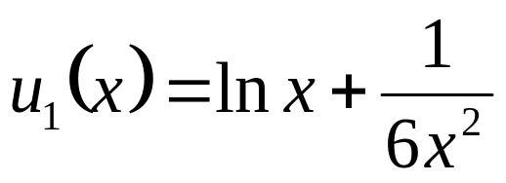
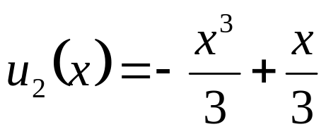
The Particular Solution

Slide 15
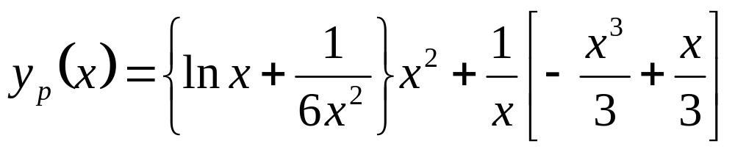
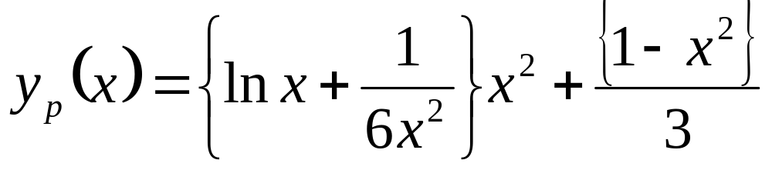
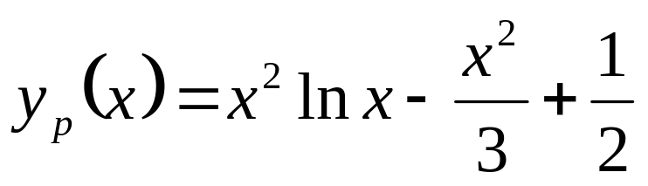
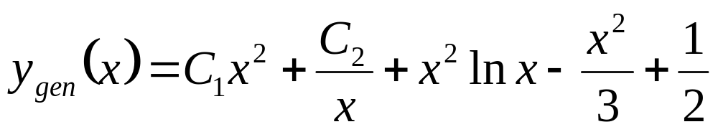
The Final General Solution
A particular solution to the nonhomogeneous equation above is

Slide 16
Profound study of nature is the source of mathematical discoveries.
Jean-Baptiste Joseph Fourier
Applications of Linear SO-ODE with VC

Slide 17


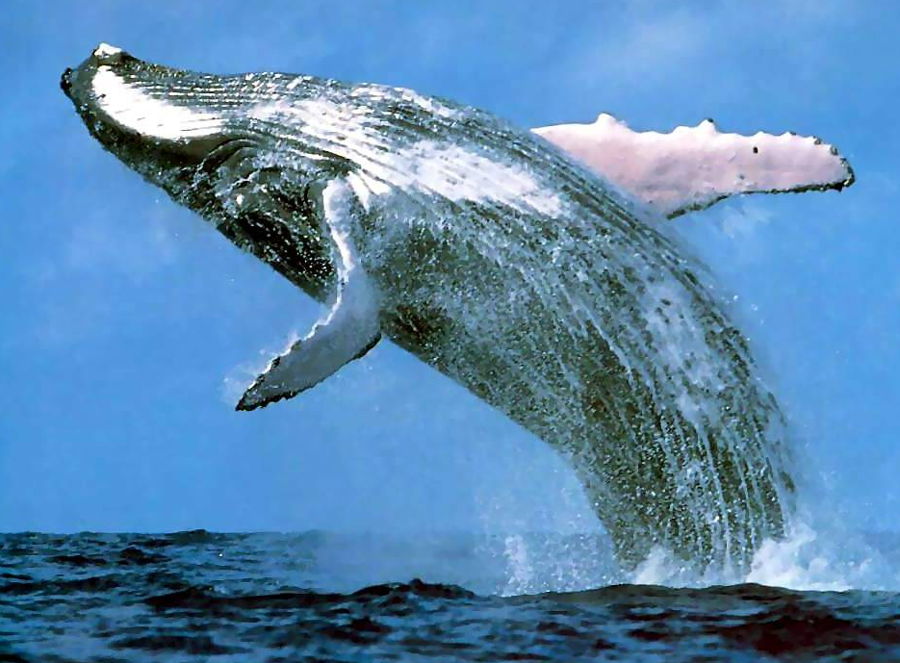
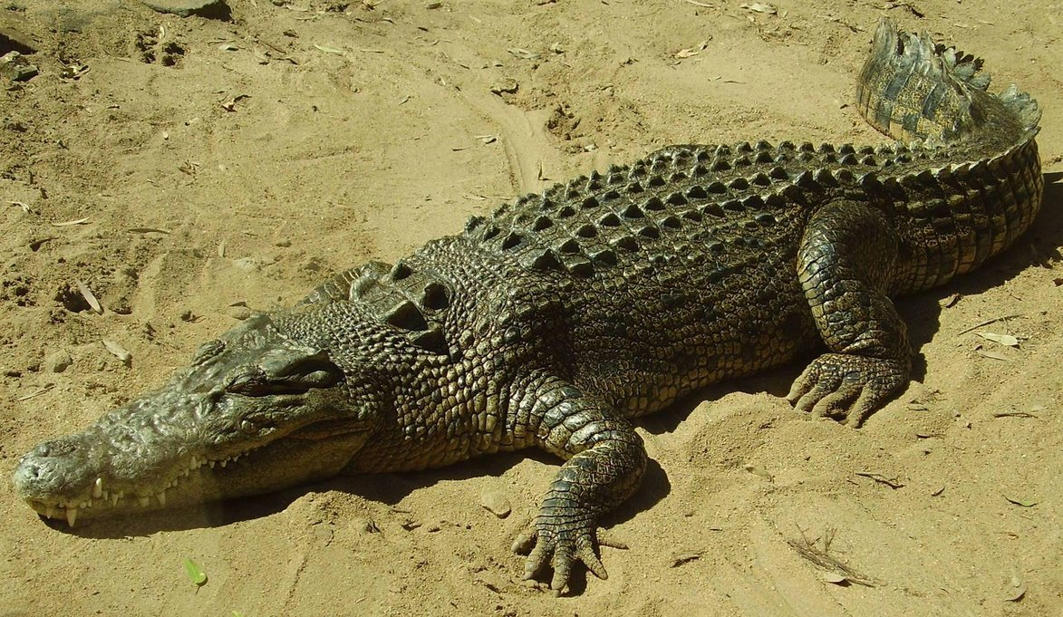
An Evolution to Perfection of Heat Transfer is Sustainable

Slide 18

The Bare Pentium 4 Processor

Slide 19

Heat Sinks for Pentium 4

Slide 20

Pentium 4 While Performing

Slide 21

Innovative Fin Designs

Slide 22

Basic Geometry Fins & Shapes
Longitudinal
Pins
Radial

Slide 23
Salient Geometric Features of A Fin
profile
PROFILE AREA
cross-section
CROSS-SECTION AREA

Slide 24



Slender Fins
Δx
thickness
x

Slide 25
Gardner-Murray Analysis : Assumptions
Steady state one dimensional conduction Model.
No Heat sources or sinks within the fin .
Thermal conductivity constant and uniform in all directions.
Heat transfer coefficient constant and uniform over fin faces.
Surrounding temperature constant and uniform.
Base temperature constant and uniform over fin base.
Fin width much smaller than fin height.
No heat flow from fin tip.
No bond resistance between fin base and prime surface.
Heat flow off fin proportional to temperature excess.

Slide 26



Steady One-dimensional Conduction through Fins
Q_{conv}
Q_{x}
Q_{x+dx}
Conservation of Energy:

Slide 27



Second Order ODE with CC Model for A Slender Fin
For a constant cross section area:
Define m, the fin design parameter:

Slide 28




Homogenization of ODE
Define:
At the base of the fin:

Slide 29


The Second Boundary Condition : Tip of A Fin

Slide 30


The Second Boundary Condition : Tip of A Fin

Slide 31


Linear Second order ODE with Constant Coefficients : Real Roots
This equation has two linearly independent solutions functions.
The general solution is the linear combination of those two independent functions.
Each solution function θ and its second derivative must be constant multiple of each other.
Therefore, the general solution function of the differential equation above is:

Slide 32





Hypothetical Fin Problem
At the base of the fin:
Infinitely long fin:
Logic from Mathematics shows that C₁ = 0 !

Slide 33
Assignment 2
Submit a research report on:
Most popular boundary conditions for slender fins.
Solutions for above conditions.
Relative merits and demerits.
Date of Submission: 26th September 2018.
Original Reports will be given highest marks.
All copied will be given zero marks.

Slide 34




Material Savings through Variable CS Fins

Slide 35






Longitudinal fin of triangular profile
The differential equation for temperature excess :
L
q_{b}
x
b
x=b
x=a=0

Slide 36


Longitudinal fin of concave parabolic profile
The differential equation for temperature excess is an
L
x
q_{b}
b
Euler equation
x=b
x=a=0

Slide 37


Mathematical Fins

Slide 38



Hot Rolling of Steel Sheets
Iron, pure | 73 W/m.K
Iron, wrought | 59 W/m.K
Wrought Carbon Steel | 59 W/m.K
Stainless Steel | 12—45 W/m.K

