Slide 1

Study of Non-Homogeneous Linear SO-ODEs
P M V Subbarao
Professor
Mechanical Engineering Department
I I T Delhi
Sources Drive the Systems and Generate More Appliances….

Slide 2

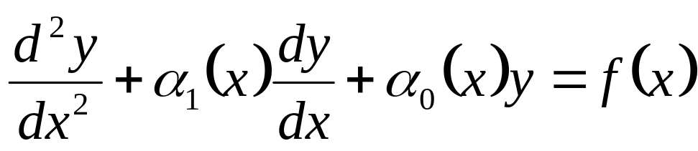
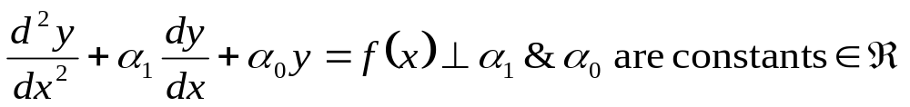
Anatomy of Nonhomogeneous linear SO-ODE
Consider a general linear second order nonhomogeneous ODE.
Linear Operator, L(y)
Source Function
Let us consider most popular and simple thermofluid Model

Slide 3
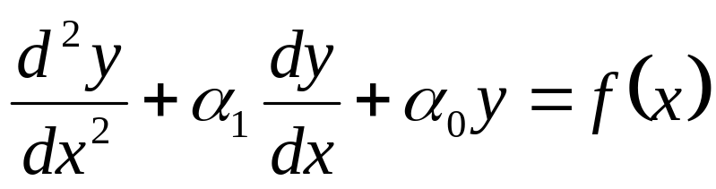
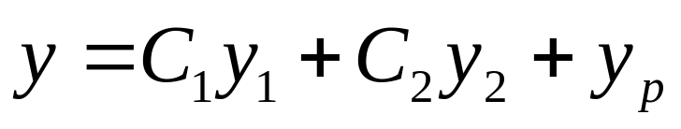
Nonhomogeneous Equations Linear Second Order ODE
Theorem:
Every solution y of the nonhomogeneous CC-SO-ODE
where α₁ and α₀ are constants ∈ℜ .
is given by
y_{p} is the particular solution.
One of the method to find such particular solution is known as the undetermined coefficients method.

Slide 4
Methods to Compute Particular Solution
There are mainly two different ways to compute the particular solution of a nonhomogeneous equation.
The undetermined coefficients method.
This method only works for constant coefficients of linear operator.
The variation of parameters method.
The variation of parameters method also works for variable coefficients of linear operators.

Slide 5
The Undetermined Coefficients Method : Part -1
This method works only for linear operators L(y) with constant coefficients and for simple source functions f.
The Method:
Find fundamental solutions y₁, y₂ of the homogeneous equation L(y) = 0.
Given the source functions f, guess the solutions y_{p}.
For few source functions, educated guesses are constructed by trial and error.
The associated guessed solutions are collected from additional laws of nature.

Slide 6
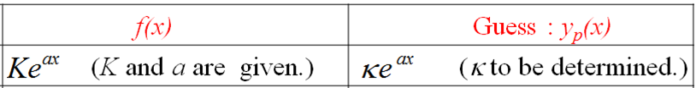
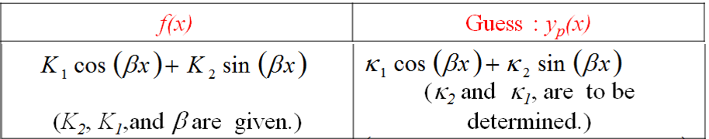
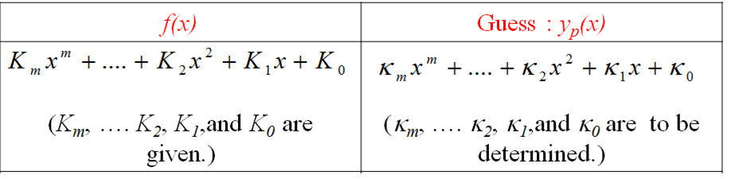
Simple Source Functions – Natural Guesses

Slide 7
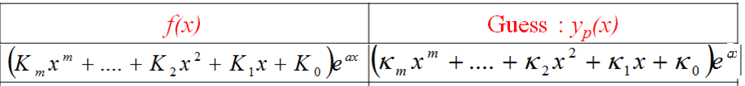
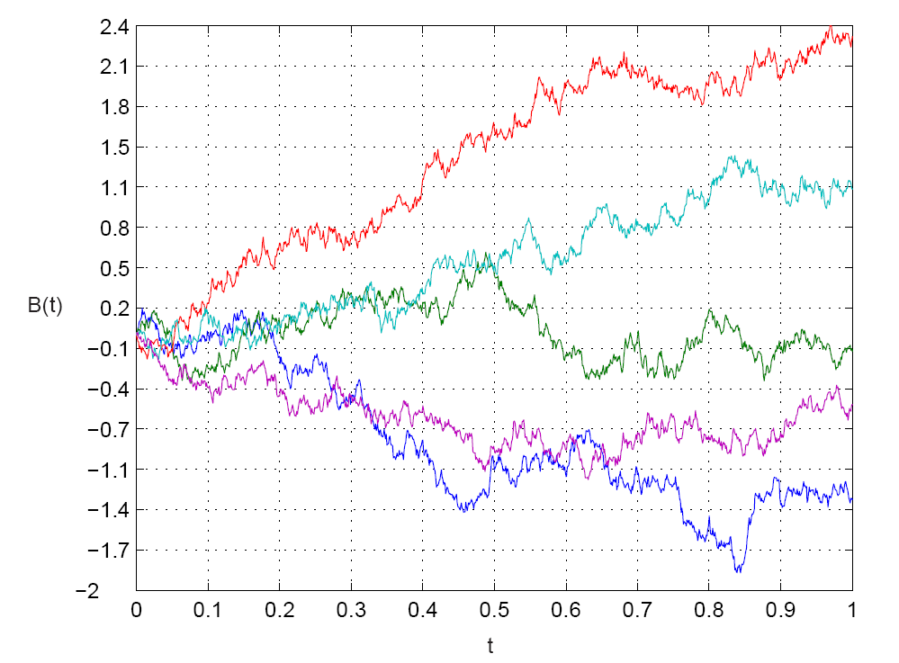
Simple Source Functions – Hybrid - 1

Slide 8

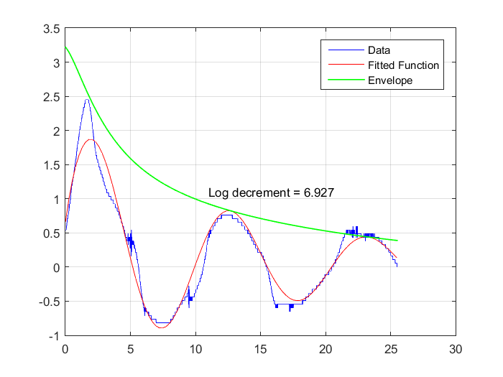
Simple Source Functions – Hybrid -2

Slide 9
How to Solve Systems with Baroque Source Functions ???

Slide 10
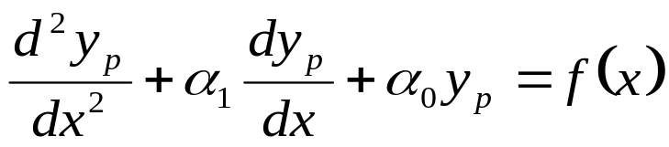
The Undetermined Coefficients Method – Part 2
Find the undetermined constants κ₁, κ_{2,} κ_{3 ….} in the function y_{p} using the equation L( y_{p}) = f.
If the function y_{p} given by the table satisfies L(y_{p}) = 0, then change the guess to xy_{p}.
If xy_{p} satisfies L(xy_{p}) = 0 as well, then change the guess to x²y_{p}.
Find the undetermined constants κ in the function y_{p} using the equation L( ξ) = f, where ξ is y_{p}, or xy_{p} or x²y_{p}.
This is the undetermined coefficients method.

Slide 11
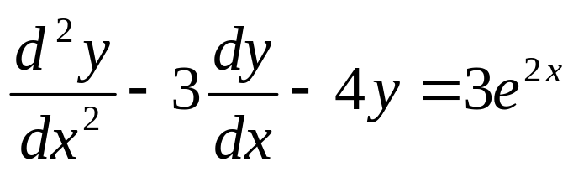
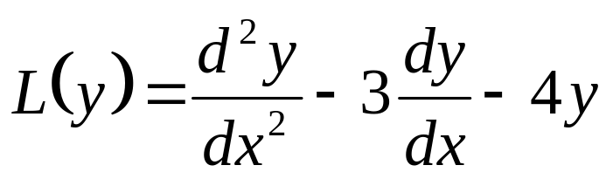
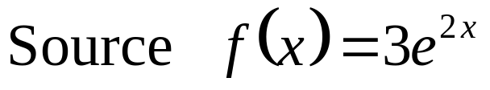
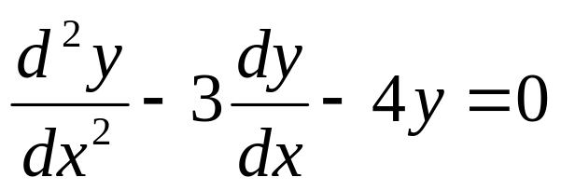
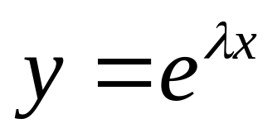
Example - 1
Find the complete solution to the nonhomogeneous equation
The operator:
Consider the operator to find the fundamental solutions
Substitute the Ansatz:

Slide 12
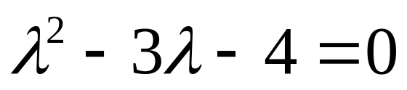
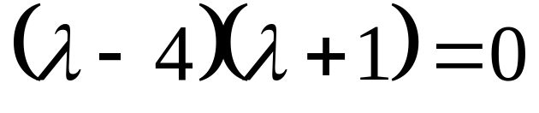
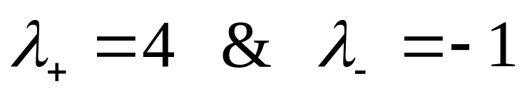
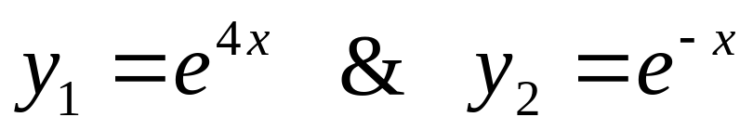
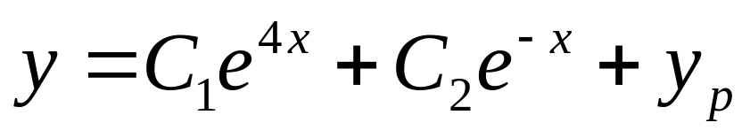
Example – 1 : Characteristic Equation
The Characteristic Equation :

Slide 13
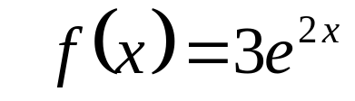
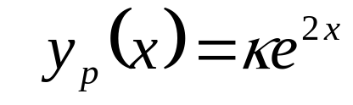
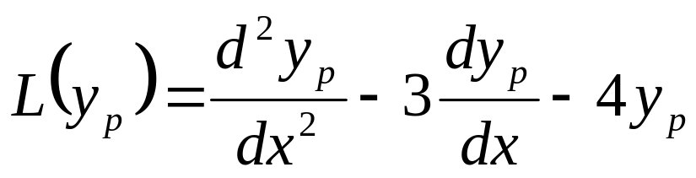
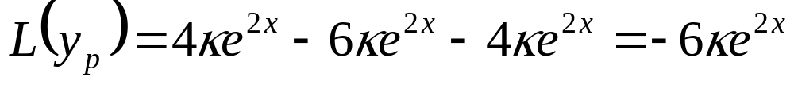
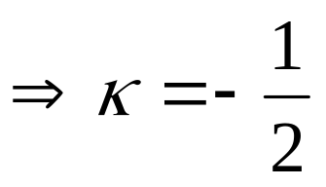
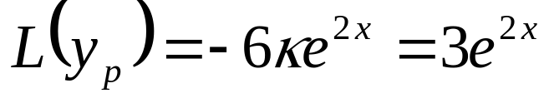
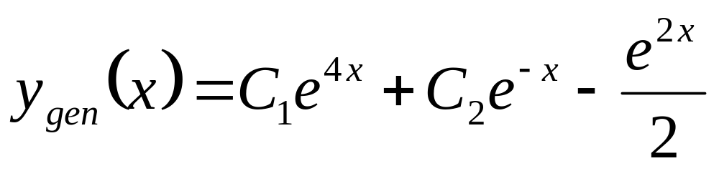
Example 1 : Particular Solution
For a given source function
The guess for particular solution is

Slide 14

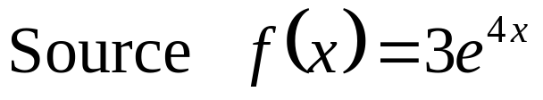
Example - 2
Find all solutions to the nonhomogeneous equation
The operator:

Slide 15
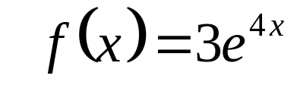
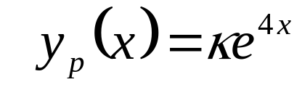
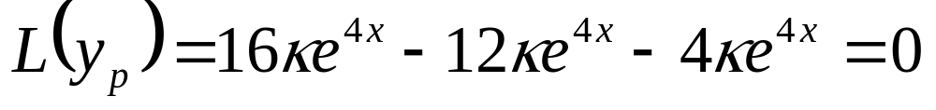
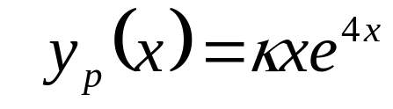
Example 2 : Particular Solution
For a source function
The guess for particular solution is
∴The first guess is wrong.
The second guess for particular solution is

Slide 16
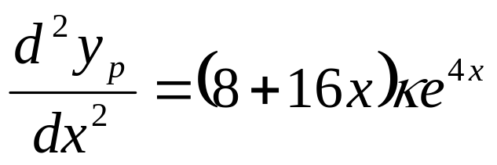
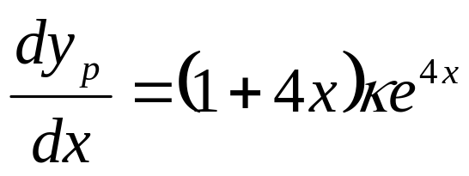
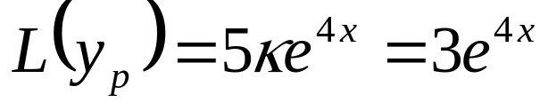
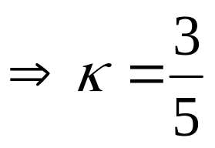
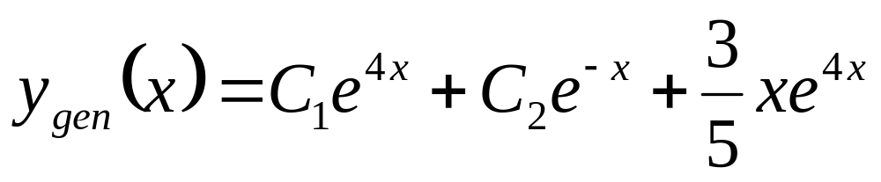
Example 2 : Second Trial

Slide 17
Popular use of Linear SO-ODE with CC in Thermofluids
Design and development of Accurate Instrumentation in Fluid mechanics & Heat Transfer……
Also useful in many other instruments in general engineering…..

Slide 18
The Shocking News in The New York Times
1 million to 10 million years they might be able to make a plane that would fly ?!?!?!
People had dreamed of flying for many years.
The United States Army was trying to develop an airplane in 1903, but the plane wouldn't fly.
The New York Times wrote that maybe in
1 million to 10 million years they might be able to make a plane that would fly.
Only eight days later two men were successful in flying the first manned plane.
Controlled, powered flight had seemed impossible until Orville Wright took off on the 17th December 1903.
They were Wilbur Wright and his younger brother, Orville.

Slide 19
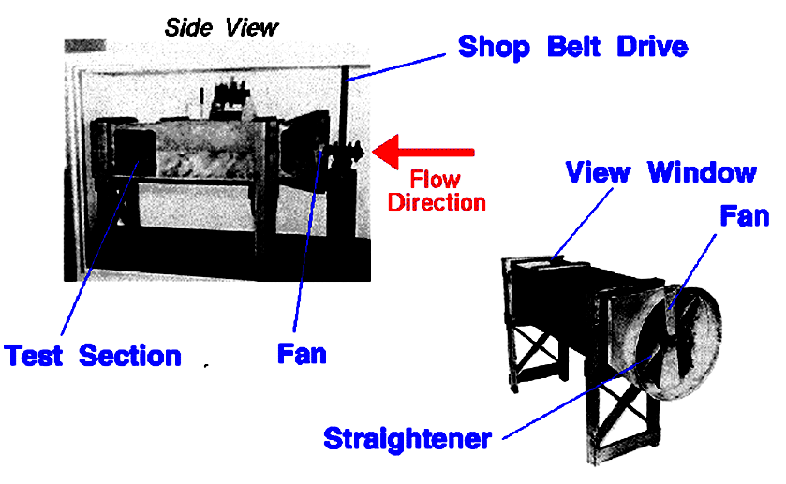
Wind Tunnel : An artificial Thermodynamic System to Study Flow Past Miniature Wings

Slide 20

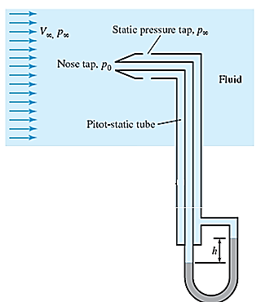
Wright Brother’s Art of Learning Aerodynamics
At the end of their 1901 wind tunnel tests, the Wright brothers had the most detailed data in the world for the design of aircraft wings.
In 1902, they returned to Kitty Hawk with a new aircraft based on their new data.
This aircraft performed much better than the 1901 aircraft and lead directly to the successful 1903 flyer.
Results of the wind tunnel tests were also used in the design of their propellers.

Slide 21
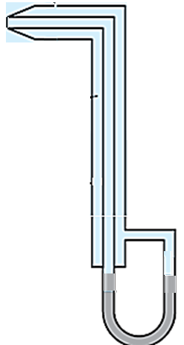
Formulation of ODE for Design of Pitot-Static Tube Manometer : Assumptions

Slide 22
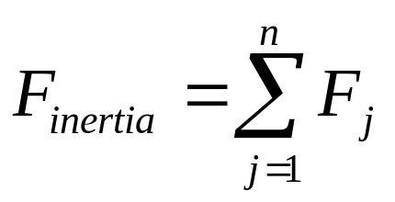
Formulation of ODE for Design of Pitot-Static Tube Manometer : Assumptions
Assume that the probe is initially in the equilibrium position.
The pressure difference Δp is suddenly applied across it.
The fluid column will move during time t > 0.
Newton’s Second Law of Motion

Slide 23
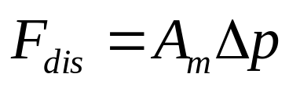
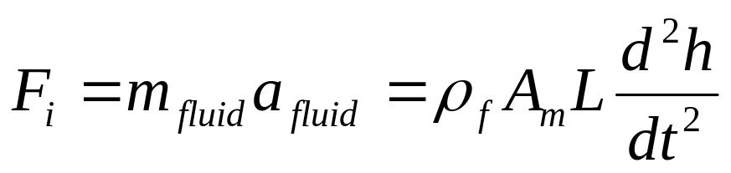
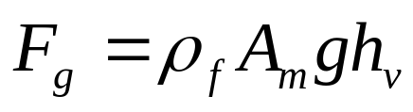
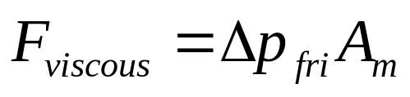
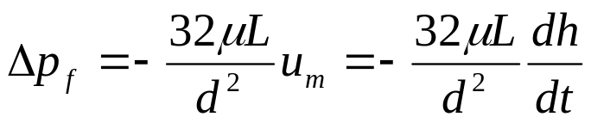
The forces that are acting on the length L of the fluid
Force disturbing the equilibrium
Inertial Force
Forces opposing the change:
a. Weight of column of fluid
b. Fluid friction due to viscosity of the fluid :
The velocity of the fluid column is expected to be small and the laminar assumption is thus valid.
The viscous force opposing the motion is calculated based on the assumption of fully developed Hagen-Poiseuelle flow.
The frictional pressure drop

Slide 24
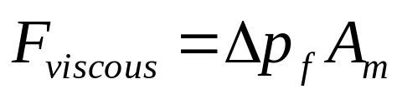
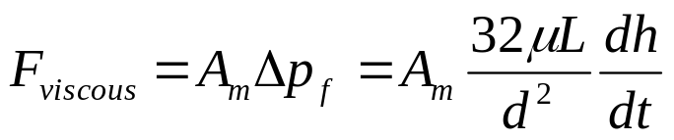
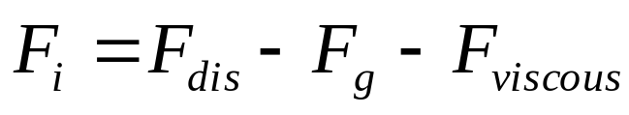


The forces that are acting on the length L of the fluid
Newton’s Law of Motion

Slide 25



A Second Order ODE

Slide 26







A Second Order ODE with constant coefficients
Primary design criteria: ???

Slide 27


Formulation of ODE for Design of Pitot-Static Tube Manometer : Assumptions

Slide 28




Engineering Definitions of Constant Coefficients
Engineering form of ODE:
The Natural Frequency:

Slide 29






Damping : Music
The Art of Non Discriminant Music Instrument:
The dimensionless damping ratio:

Slide 30






Engineered ODE with CC
t

Slide 31


General Response of A Manometer Column
Under damped Pitot-Static Tube Manometer:
ζ=0
t
ζ=0.5
t

Slide 32

Control of Signal Stability
ζ=0.707
t
ζ=1.0
t

Slide 33





Over Damped System (ζ >1)
h(t)
t

Slide 34

Response of Pitot tube to step input

Slide 35

Time Constant of a Pitot Tube as a Function of Radius and Length
L=2m
L=1m
L=0.5m

Slide 36


Measurement of Turbulent Flows

Slide 37





Newton’s Law for Measurement of Turbulent Flows
The temperature of Electrically heated wire placed in fluid flow is a function of flow velocity
For a constant voltage across wire:

Slide 38




Micro Hotwire in A Flow
1.0
How to make sure that the entire wire be at same steady state temperature???
A hot-wire uses an electrically heated 5 µm diameter tungsten filament with a length of 1 mm.
0.5
Very low value of time constant of the wire will lead to faster steady state of the wire.
0.0

Slide 39
The Major Design Challenge
How to make sure that the entire wire be at same steady state temperature???

Slide 40

Thermal model for Design of a Hotwire Probe
The x-coordinate for the sensor is shown from the center of the wire.

Slide 41






Energy Balance for An infinitesimal Element @ SS
Heat generated + Heat in by conduction = Heat leaving by conduction + Heat loss by convection

Slide 42




ODE for Steady State Temperature of A Hot wire

Slide 43




Roots of Characteristic Equation

Slide 44



General Solution for Hotwire Temperature
Boundary Conditions:

Slide 45



Design of Hotwire with Uniform SS Temperature

