Slide 1
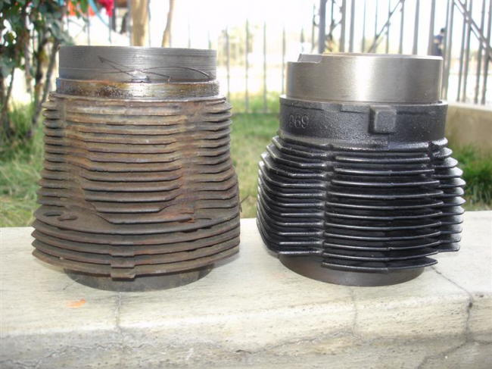
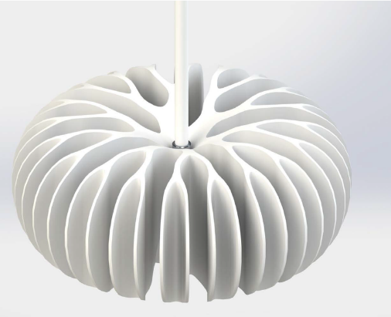

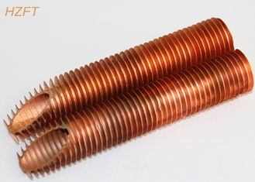
Study of Denominated Linear SO-ODEs
P M V Subbarao
Professor
Mechanical Engineering Department
I I T Delhi
Models Highly Useful for Design of Complex Geometry Devices….

Slide 2

Why Denominated Linear SO-ODEs
Second order linear equations with variable coefficients are in general more difficult to solve than equations with constant coefficients.
Great mathematicians invented solutions for SO-ODEs with specific functions as variable coefficients.
These are:
The Euler Equidimensional Equation (Cauchy –Euler equation).
Family of Sturm-Liouville Differential Equations.

Slide 3
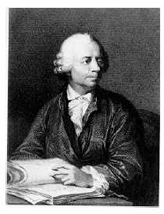
Leonhard Euler
Leonhard Euler (1707-1783) was arguably the greatest mathematician of the eighteenth century.
One of the most prolific of all time; his publication list of 886 papers and books fill about 90 volumes.
Remarkably, much of this output dates from the last two decades of his life, when he was totally blind.
Euler's prolific output caused a tremendous problem of backlog.
The St. Petersburg Academy continued publishing his work posthumously for more than 30 years.

Slide 4
Euler′s Deeper Influence on the Teaching of Mathematics
Leonhard Euler was not a teacher.
He had a deeper influence on the teaching of mathematics than any other mathematican or mathematics teacher.
His skills of teaching mathematics is seen in his three special treatises.
Introductio in Analysin Infinitorum, 1748.
Institutiones Calculi Differentialis, 1755.
Institutiones Calculi Integralis (1768-1794).
All the elementary and advanced calculus textbooks published since 1748, are copies of copies of …… Euler.

Slide 5
Euler Equidimensional Equation
Euler’s inventions were so extensive that many 20th Century mathematicians tried to avoid confusion by naming these inventions after the person who first studied them after Euler.
This equation is also called Cauchy Equidimensional Equation, Cauchy Equation, Cauchy-Euler Equation.
The Euler Equidimensional Equation is a special equation.
The ideas, used to solve second order linear equations with constant coefficients were developed by analyizing Eulers solution to EEE.

Slide 6
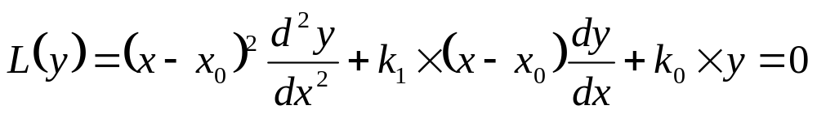
Euler Equidimensional Equation
The Euler Equidimensional Equation for the unknown y with singular point at x₀ ∈ℜ is given by the equation
where k₁ and k₀ are non-dimensional constants.

Slide 7
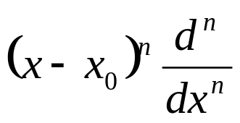
The concept of Equidimensional Nature
The equation is called equidimensional because if the variable x has any physical dimensions, then the terms with
For any nonnegative integer n, all terms are actually dimensionless.
Euler introduced a genious Approach.
The exponential functions y(x) = e^{λx} are not valid Ansaz to the EEE.
It is simple to show that there is no constant λ such that the exponential is solution.

Slide 8
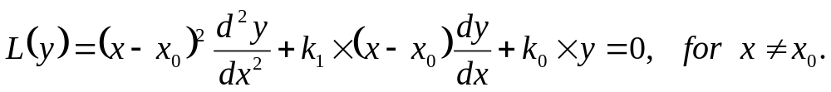
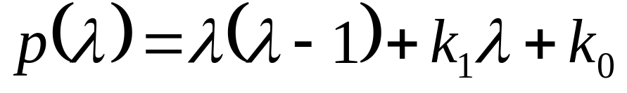
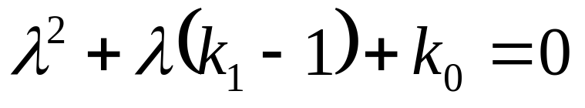
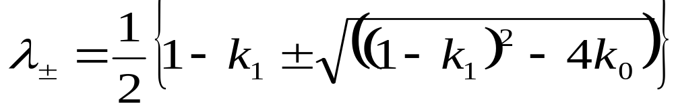
Original Method of Solution
Consider the Euler Equidimensional Equation
where k₁, k₀ and x₀ are real constants.
Euler thought an inverse of Method of Characteristics.
Invented a quadratic equation for which λ± roots are influenced by k₁ & k₀ .

Slide 9
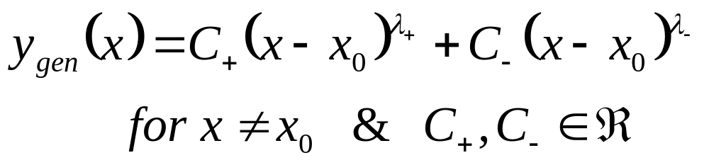
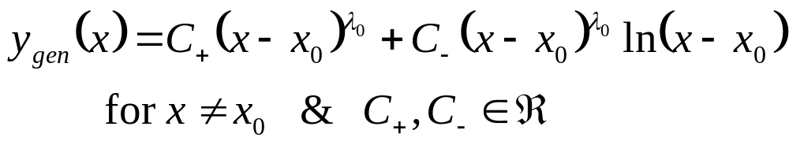
General Solution to Euler Equation
If λ₊ ≠λ₋, real or complex, then the general solution of Euler Equation is given by
If λ₊ = λ₋=λ₀, ∈ℜ, then the general solution of Euler Equation is given by

Slide 10
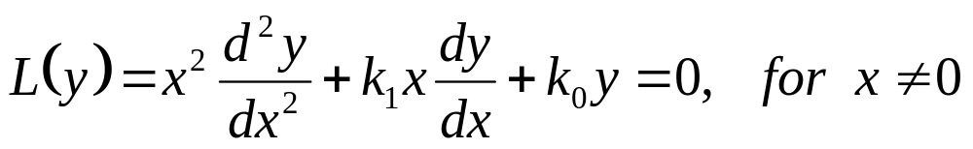
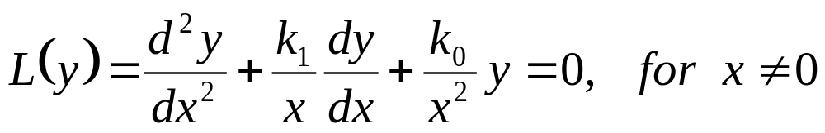
Second Generation Solution to EEE
Simplified form of EEE is developed by equating x₀ = 0.
The general case x₀ ≠ 0 follows this case.
or, in standard form
Its hard to think of some likely candidates for particular solutions of above Equation.
A simple power law function is a natural ansatz for above ODE.
An educated guess for the solution is y = x^{λ}, where λ is a constant to be determined.

Slide 11
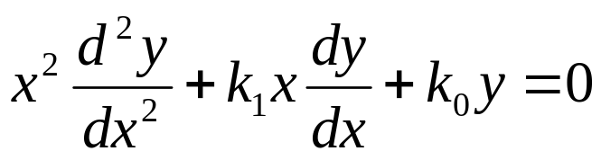
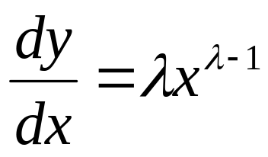
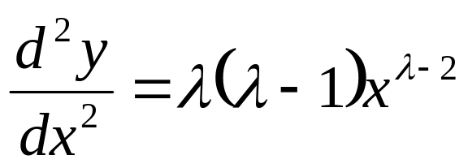
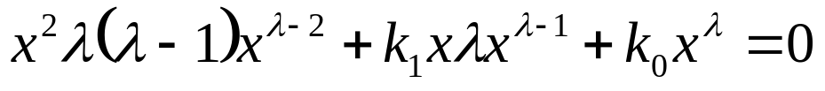
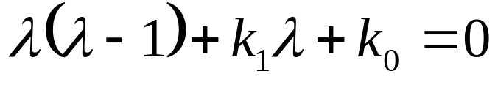
Euler Characteristic Polynomial
For the time being, let us consider only the case of x > 0.
Start with the trial solution y = x^{λ}
This polynomial is sometimes called the Euler Characteristic Polynomial.

Slide 12
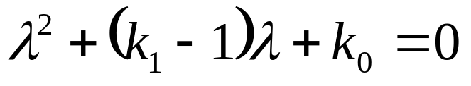
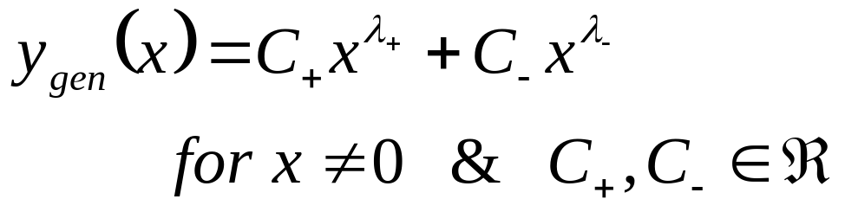
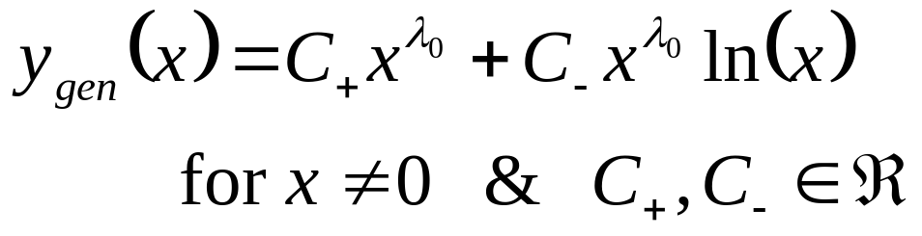
Roots of Euler Characteristic Polynomial
If λ₊ ≠λ₋, real or complex, then the general solution of Euler Equation is given by
If λ₊ = λ₋ = λ₀ ∈ℜ, then the general solution of Euler Equation is given by

Slide 13
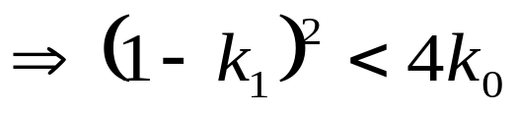
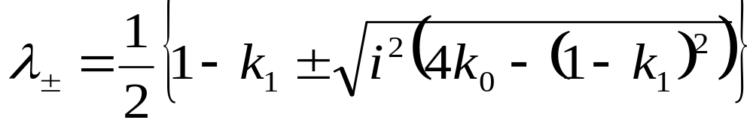
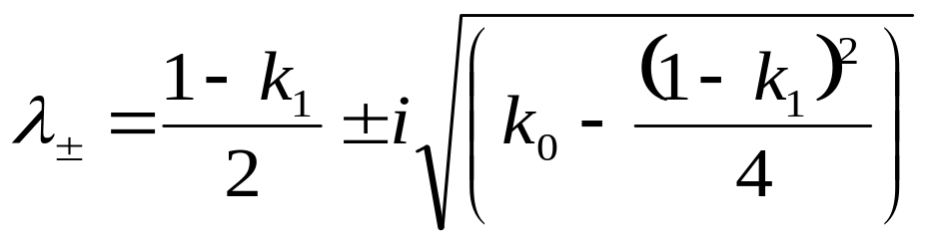
Solution to Euler Equation with Complex Roots
If λ₊ ≠λ₋, complex, then the general solution of Euler Equation is given by

Slide 14

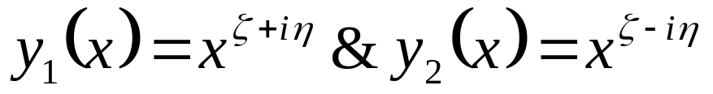
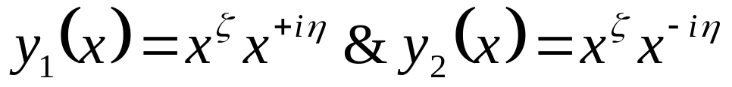
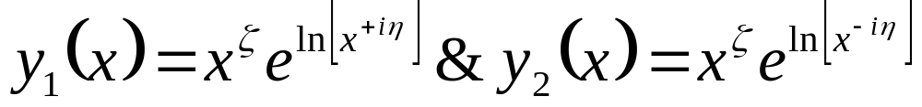
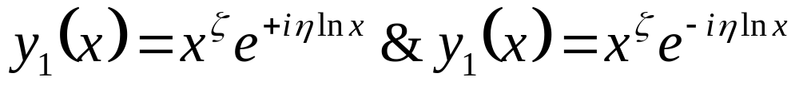
Eulers Analysis of Solution with Complex Roots

Slide 15
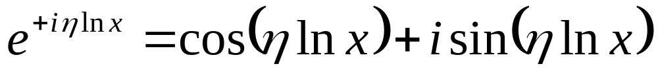
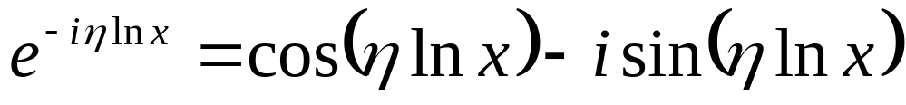
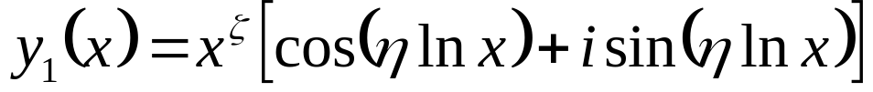
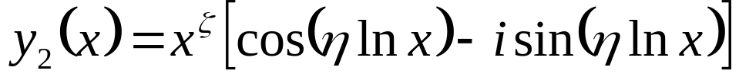
The General Solution of EEE
Euler formula for complex exponentials

Slide 16
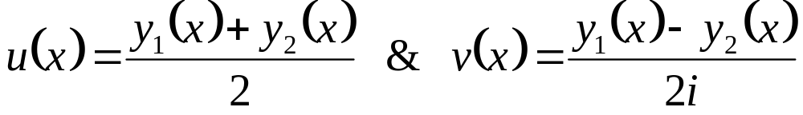
Real Solution to EEE with Complex Roots
“Filter out” all functions containing coefficients with an imaginary part.
Collect the real parts that satisfy the given differential equation, keeping only those whose coefficients are real numbers.
A pair of real valued, linearly independent solutions can be generated using linear combinations
Their Wronskian is NEVER ZERO
It is easy to verify that both u and v satisfy the EEE.

Slide 17
Reals Solution to EEE
If λ₊ ≠λ₋, real , then the general solution of Euler Equation is given by
If λ₊ = λ₋ = λ₀ ∈ℜ, then the general solution of Euler Equation is given by
If λ₊ ≠λ₋, complex, then the general solution of Euler Equation is given by

Slide 18
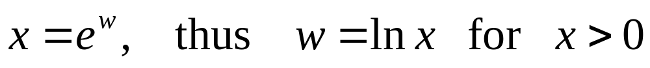
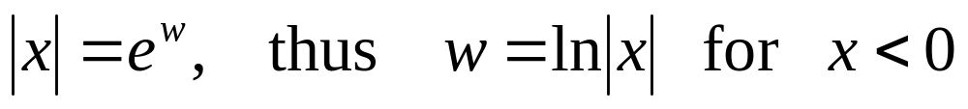
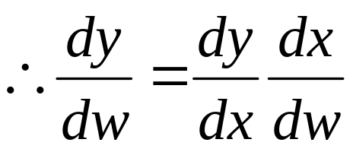
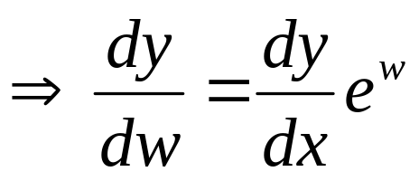
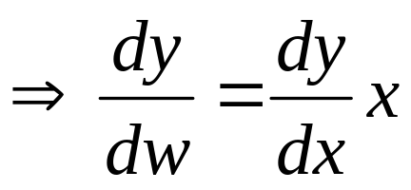
Solution to EEE by “Change of Variables Method”
The Euler equation can also be solved by a Change of Variables Method.
This approach seeks to convert an Euler equation into one with constant coefficients.
Define

Slide 19
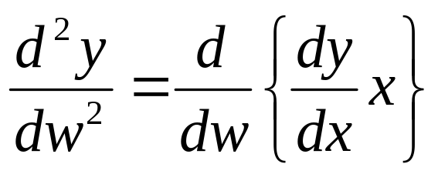
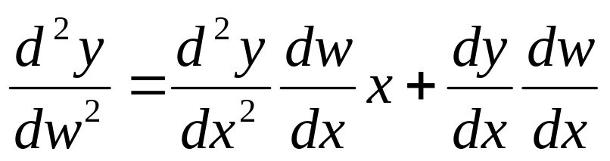
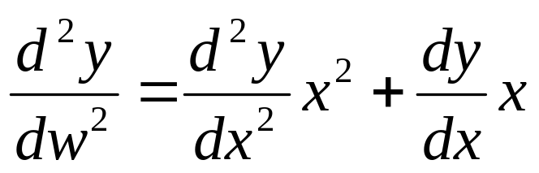
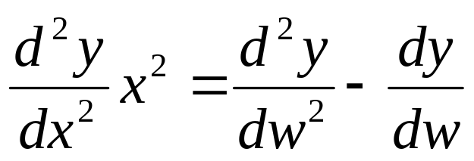
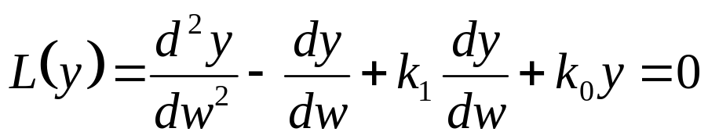
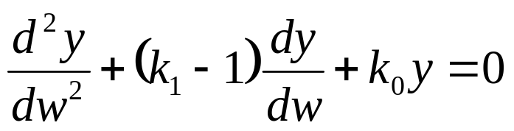
Transformed EEE

Slide 20
In a thermodynamic Persepctive
Every ODE is A Model for Specific thermofluid system…..
What drives a system to perform????

Slide 21
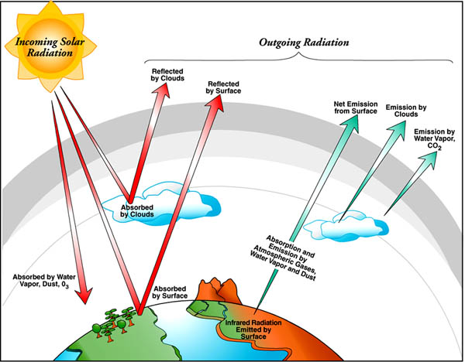
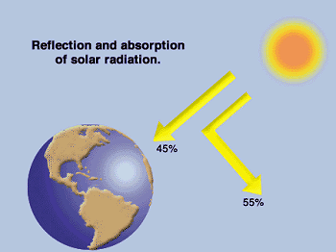
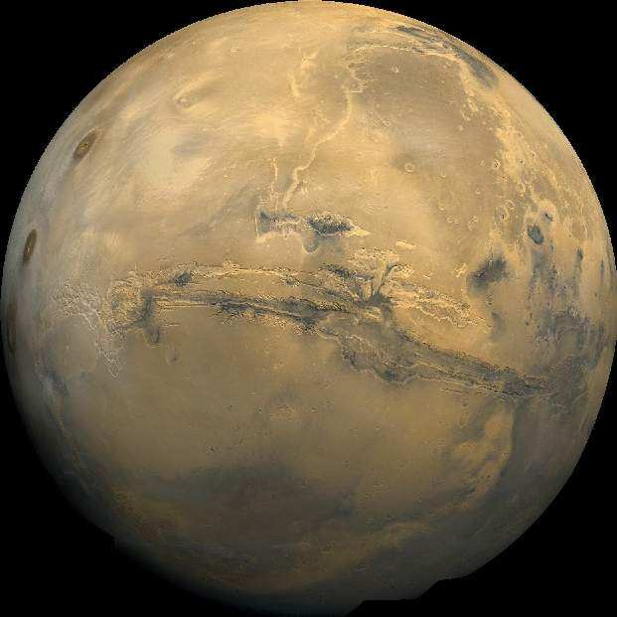
The flow of energy from a source to a sink through an intermediate system orders that system.
The Law of Source & System in Thermofluids
Morowitz [1992]

Slide 22
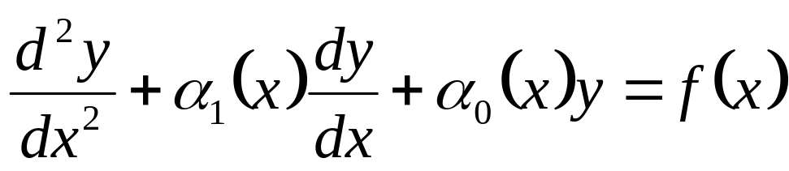
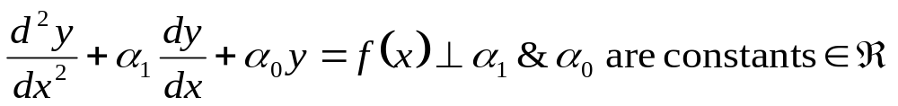
Anatomy of Nonhomogeneous linear SO-ODE
Consider a general linear second order nonhomogeneous ODE.
Linear Operator, L(y)
Source Function
Let us consider most popular and simple thermofluid Model

Slide 23
Solutions of Nonhomogeneous SO-ODE with CC
All solutions of a CC homogeneous equation can be obtained from only two solutions that are linearly independent, called fundamental solutions.
Every other solution is a linear combination of these two.
This result is not longer true for nonhomogeneous equations.
Addition of a fixed function translates the solutions of the homogeneous equation as the solutions of the nonhomogeneous equation.
The fixed function is an additional solution and it is called a particular solution of the nonhomogeneous equation.

Slide 24


Nonhomogeneous Equations Linear Second Order ODE
Theorem:
Every solution y of the nonhomogeneous CC-SO-ODE
where α₁ and α₀ are constants ∈ℜ .
is given by
y_{p} is the particular solution.
One of the method to find such particular solution is known as the undetermined coefficients method.

Slide 25
Methods to Compute Particular Solution
There are mainly two different ways to compute the particular solution of a nonhomogeneous equation.
The undetermined coefficients method.
This method only works for constant coefficients of linear operator.
The variation of parameters method.
The variation of parameters method also works for variable coefficients of linear operators.

Slide 26
The Undetermined Coefficients Method : Part -1
This method works only for linear operators L(y) with constant coefficients and for simple source functions f.
The Method:
Find fundamental solutions y₁, y₂ of the homogeneous equation L(y) = 0.
Given the source functions f, guess the solutions y_{p}.
For few source functions, educated guesses are constructed by trial and error.
The associated guessed solutions are collected from additional laws of nature.

Slide 27

Simple Source Functions – Natural Guess -1
“Humanity stands ... before a great problem of finding new raw materials and new sources of energy that shall never become exhausted. In the meantime we must not waste what we have, but must leave as much as possible for coming generations.”
― Svante Arrhenius

Slide 28

Simple Source Functions – Natural Guess - 2
de:hino::smin yattha: de:he:
kauma:ram yauvanam jara: |
thattha: de:ha:nthara pra:pthihi
dhi:ras thathra na muhyathi ||2.13
parithra:na:ya sa:dhu:na:m
vina:sa:ya cha dushkrutha:m |
dharma samsthapana:rttha:ya
sambhava:mi yuge yuge || 4.8

Slide 29


Simple Source Functions – Approximation of Complexities - 1
Muhammad ibn Musa Al-Khwarizmi is one of the greatest scientific minds of the medieval period and a most important Muslim mathematician who was justly called the 'father of algebra'.

Slide 30


Simple Source Functions – Hybrid - 1

Slide 31


Simple Source Functions – Hybrid -2

