Slide 1

Second Order Linear ODEs
P M V Subbarao
Professor
Mechanical Engineering Department
I I T Delhi
Understanding of Higher Order Physics in Thermofluids ….

Slide 2

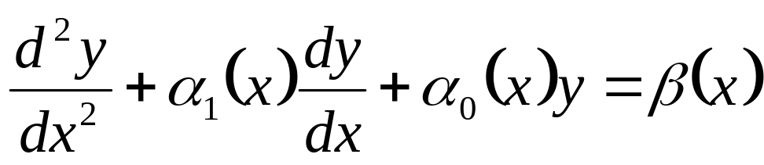
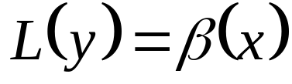
General Form of A Linear SO-ODEs
A General linear SO-ODEs is written as:
can be written as

Slide 3
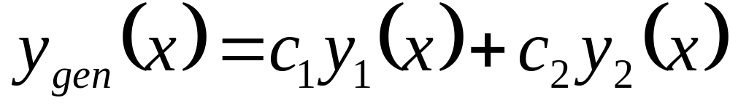
General Solution of A Linear Homogeneous SO-ODE
If y₁ and y₂ are linearly independent solutions of the equation L(y) = 0 on an interval I ⊂ R,
then there are unique constants c₁, c₂ such that every solution y of the differential equation L(y) = 0 on I can be written as a linear combination

Slide 4
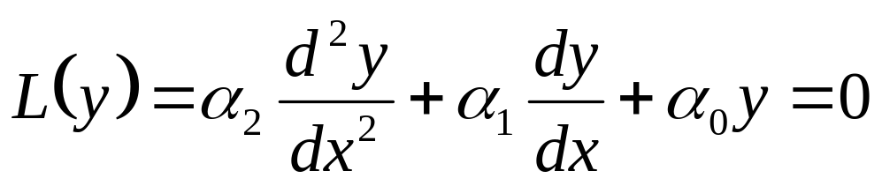
Linear SO-ODE with CC
This equation is called as homogeneous second order ODE with constant coefficients.
Method of Characteristic (Auxiliary) Equation is most suitable method to find solution to Linear SO-ODE with CC.

Slide 5
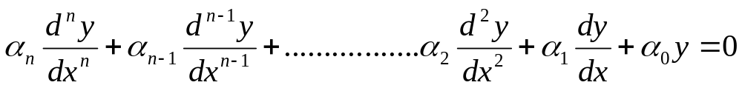
Linear (Constant Coefficient) Homogeneous ODEs of n^{th} Order
Theorem: Ordinary, linear, constant coefficient, homogeneous differential equations with dependent variable y and independent variable x have solutions of the form y = ce^{λx} where c is a nonzero constant.
Ordinary, linear, constant coefficient, homogeneous differential equations of any order have exponential solutions.

Slide 6
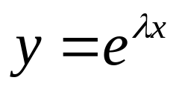
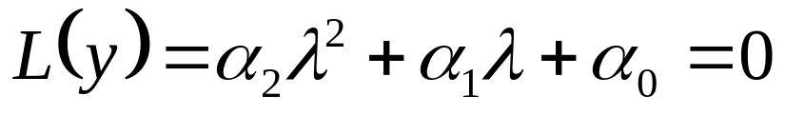
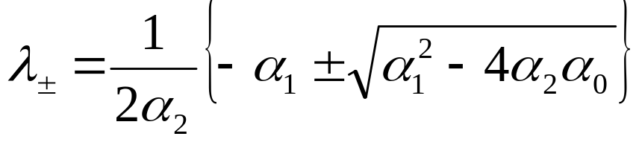
Linear (Constant Coefficient) Homogeneous ODEs of Second Order
If
is an ansatz, then
This ansatz has thus converted a differential equation into an algebraic equation.
This is called as Characteristic Equation
The possible pairs of solutions of the characteristic equation are given by

Slide 7
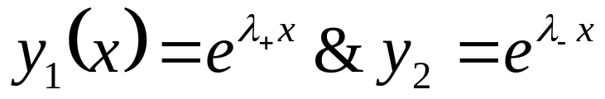
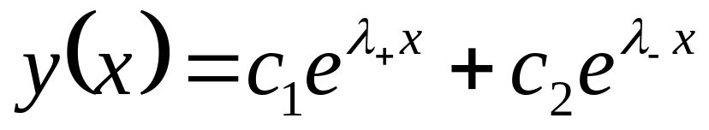
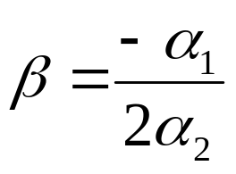
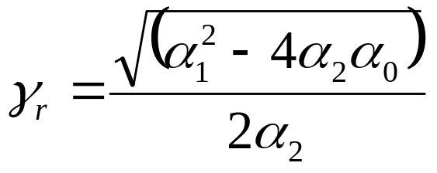

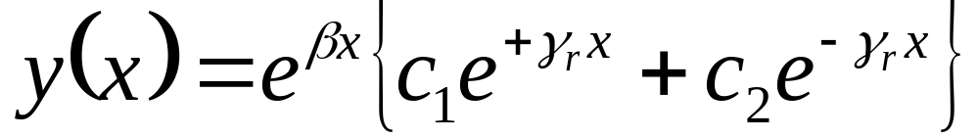
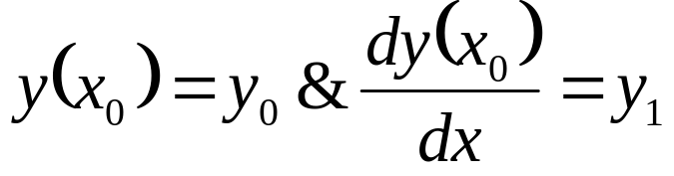
Solution of Linear SO-ODE with CC :
& Real Roots
α₁² > 4α₂α₀ : λ₊ ≠ λ₋ are real and distinct roots.
Two independent solutions are:
The general solution to can be written as a linear superposition of the two solutions; that is,
The unknown constants c₁ and c₂ can be determined by the given initial conditions.

Slide 8
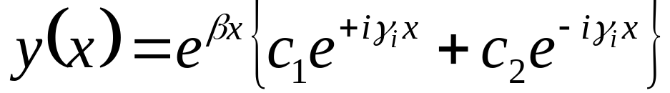
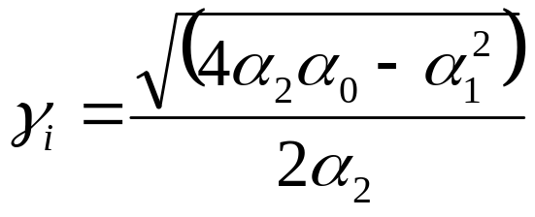
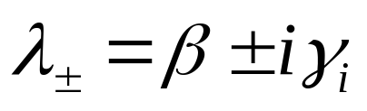
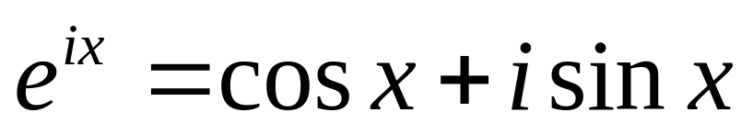
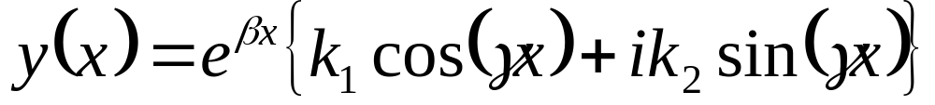
Solution of Linear SO-ODE with CC :
& Complex Conjugate Roots
α₁² < 4α₂α₀ : λ₊ ≠ λ₋ are complex and distinct roots.
The solution is:
The “our jewel”
The unknown constants k₁ and k₂ can be determined by the given initial conditions.

Slide 9
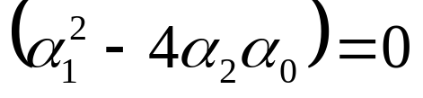
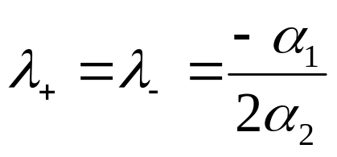
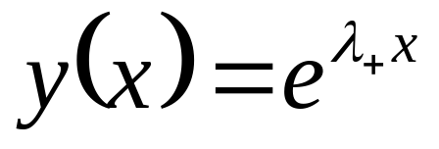
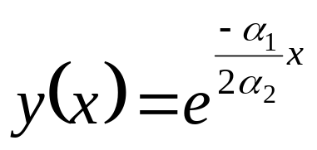
Repeated roots
The degenerate root is then given by
yielding only a single solution to the ode:
To satisfy two initial conditions, a second independent solution must be found separately.
One such method is Reduction of order.

Slide 10
The Reduction of Order Method for Linear SO-ODE with CC
Characteristic method generated only one solution to Linear SO-ODE with CC.
The second solution must be chosen to be not proportional to the known (first) solution.
The Reduction of Order Method transforms the original SO-ODE into two simultaneous FO-ODEs using the first solution as a seeding.
ROM proposes an independent second solution, but using the first solution.
A first solution is essential to use ROM.
How to establish independency of two known solutions????

Slide 11
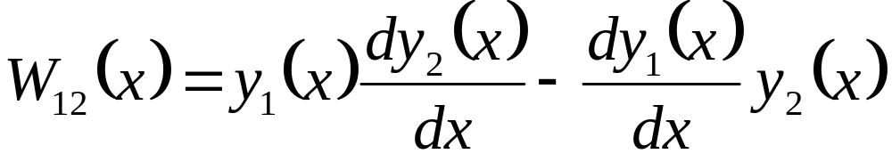
The Wronskian Function
The function, W, is called the Wronskian to honor the polish scientist Josef Wronski, who first introduced this function in 1821.
The Wronskian of the differentiable solutions y₁ & y₂ is the defined as
This function provides an important information about the linear dependency of two functions y₁, y₂.

Slide 12
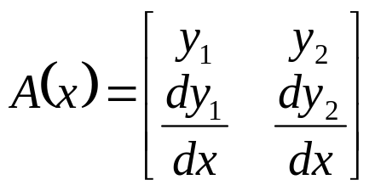
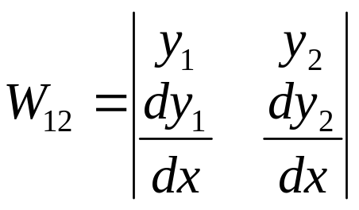
The Wronskian Matrix
Introduce the matrix valued function
The Wronskian can be written using the determinant of that 2 × 2 matrix,
If y₁ and y₂ are linearly dependent on I ∈ℜ , then W₁₂= 0 on I.
If the Wronskian W(x0) ≠ 0 at a point x₀ ∈ I, then the functions y1, y2 defined on I are linearly independent.
If y1, y2 are fundamental independent solutions of L(y) = 0 on I ∈ℜ, then W12(x) ≠ 0 on I.

Slide 13
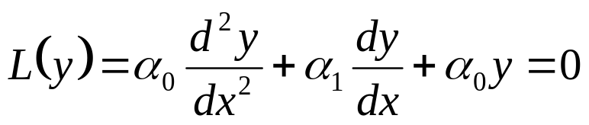
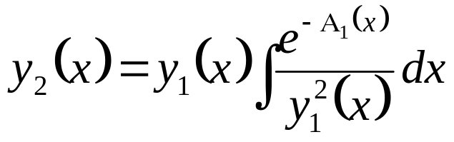
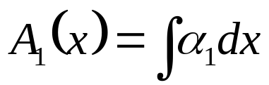
First Theorem for Linear-SO-ODE with CC
If a nonzero function y₁ is a solution to
where α₁ and α₂ are constants, then a second solution not proportional to y₁ is
where

Slide 14
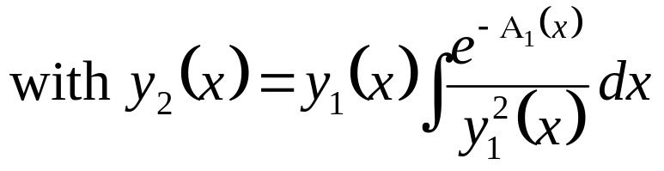
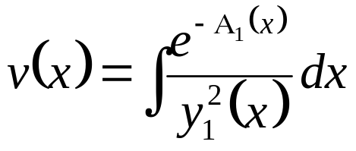
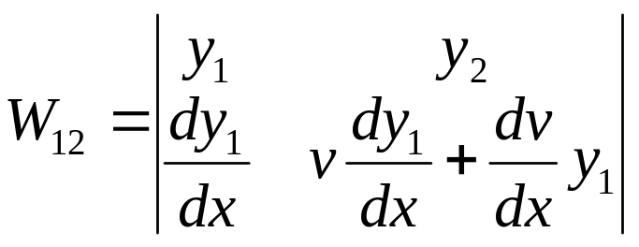
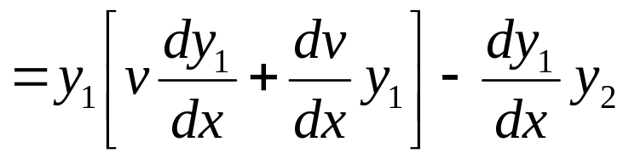
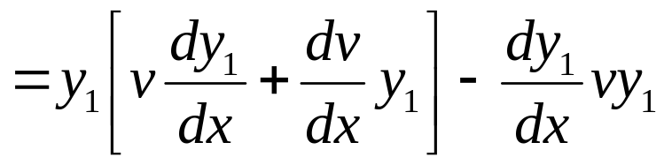
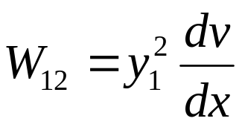
Independency Test
The functions y₁ is known.
Compute Wronskian,
The Test:
Let
This is a nonzero function, therefore the functions y1 and y2 = vy1 are linearly independent.

Slide 15
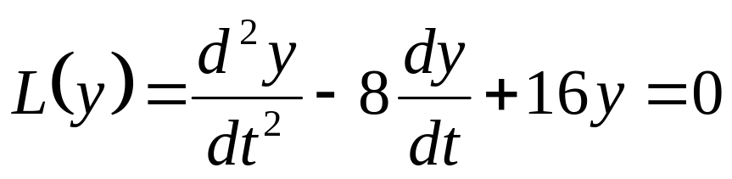
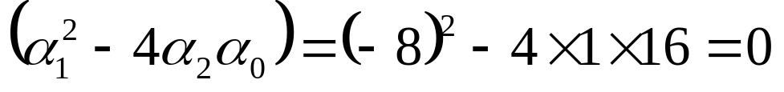

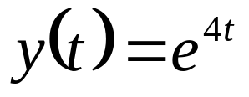
Example
Find the solution of
Yielding only a single solution to the ode:

Slide 16
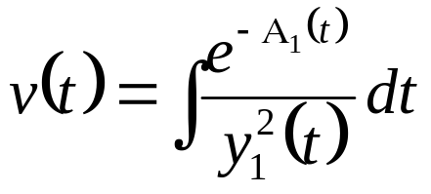
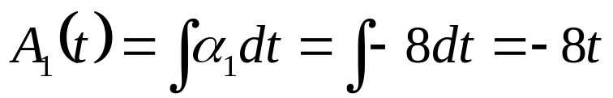
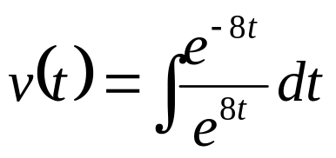
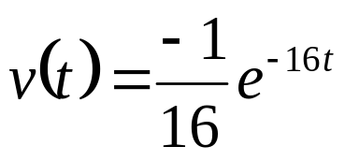
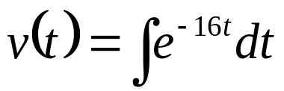
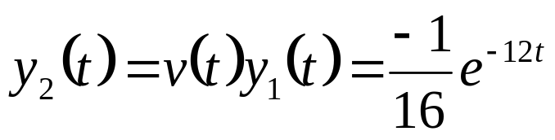
Example
Use the reduction order method to find a second solution y₂ to the differential equation
knowing that y₁(t) = e^{4t} is a solution.
We are looking for a solution of the form y₂(t) = v(t)e^{4t}.
Where

Slide 17
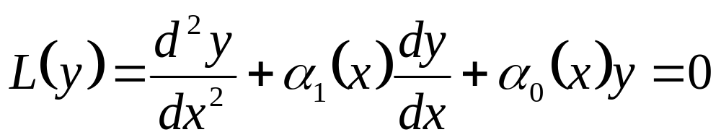
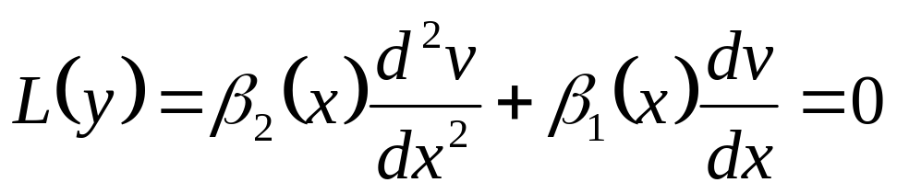
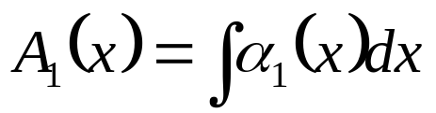
Modern use of Reduction of Order Method
Given one non-trivial solution y₁=f(x) to
Set y₂(x) = v(x)f(x) for some unknown v(x) and substitute into differential equation.
This will generate a second order differential equation with zero coefficient of v(x) term.
Use the Integrating Factor Method to get v(x).
Substitute v(x) back into y₂(x) = v(x)f(x) to get the second linearly independent solution.
where

Slide 18
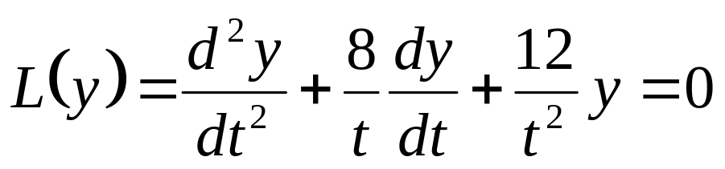
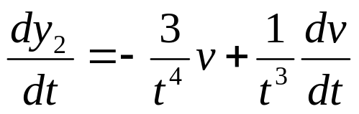
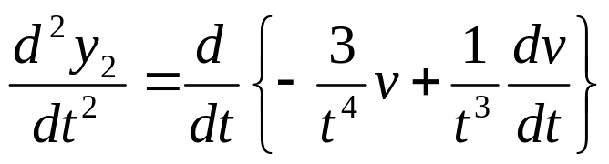

Example
Use the reduction order method to find a second solution y₂ to the differential equation
knowing that y₁(t) = 1/t³ is a solution.
We are looking for a solution of the form y₂(t) = v(t)/t³.
This implies that

Slide 19





Slide 20











Slide 21
Extension of The ROM to Solve Linear SO-ODE with Variable Coefficients
Sometimes a solution to a second order differential equation can be obtained solving two first order equations, one after the other.
This solution method reduces the order of the SO-ODEs.
Mainly the Reduction of Order Method is used in solving FOUR types of Linear SO-ODEs.
In the first case, one solution to a second order, linear, homogeneous, differential equation must be known by any other method.
The second and third cases are usually called Special SO-ODEs.
The fourth case is called the Conservation of the Energy Equation.

Slide 22
Special SO-ODEs
A SO-ODE is called as special when
either the function, or
its first derivative, or
the independent variable does not appear explicitly in the equation.
In all these cases the SO-ODE can be transformed into a first order equation in terms of a new function.
The transformation to get the new function is different in each case.
In a nut-shell, the method is to solve a new first order equation and transform back to solve another first order equation to get the required function.

Slide 23

Definition of Special Second Order Equations.
A SO-ODE in the unknown function y is an equation
where the function f : ℜ³ → ℜ is given.
The equation is linear if function f is linear in both arguments y and dy/dx.
The SO-ODE given above is special if one of the following conditions hold:
(a) d²y/dx²= f(x; dy/dx), the function y does not appear explicitly in the equation;
(b) d²y/dx²= f(y; dy/dx), the variable x does not appear explicitly in the equation.

Slide 24



Theorem for SO-ODE with no y Function
If a second order differential equation has the form
then
Generates a first order equation

Slide 25





Theorem for SO-ODE with no x Function
If a second order differential equation has the form
is defined as a pure initial value problem, i.e.,
This initial value problem is said to have an invertible solution y, iff ∃ a function

Slide 26

Conservation SO-ODE
This case is known as Conservation of the (Mechanical ) Energy.
This is another special SO-ODE such that both the variable x and the function dy/dx do not appear explicitly in the equation.
This case is important in Newtonian mechanics.
For that reason this equation is written in a slightly modified form.
where y is the displacement of a particle and m is a constant.
It turns out that solutions to the differential equation above have a particular property:
∃ a function of dy/dt (velocity, v) and y, called the energy of the system, that remains conserved during the motion.

Slide 27



Theorem for Conservation of Energy SO-ODE
Consider a particle with positive mass m and position y function of time t) which is a solution of Newton's second law of motion
with initial conditions y(t₀) = y₀ and dy/dt (@ t₀) = v₀.
Where f(y) is the force acting on the particle at the position y.
Then, the position function y satisfies
Where E₀ is fixed by the initial conditions.
and ψ(y) is the potential of the force f - the negative of the primitive of f, that is

