Slide 1

Second Order ODEs
P M V Subbarao
Professor
Mechanical Engineering Department
I I T Delhi
Understanding of Higher Order Physics & Complex Geometries in Thermofluids ….

Slide 2



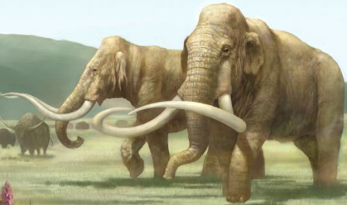
A True Design Reason behind Geometry of Natural Systems…..
African Elephant
Indian Elephant
Mammoths

Slide 3
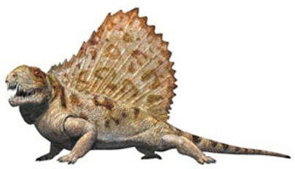
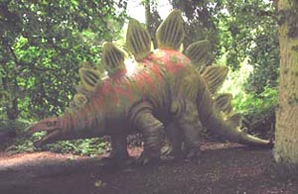
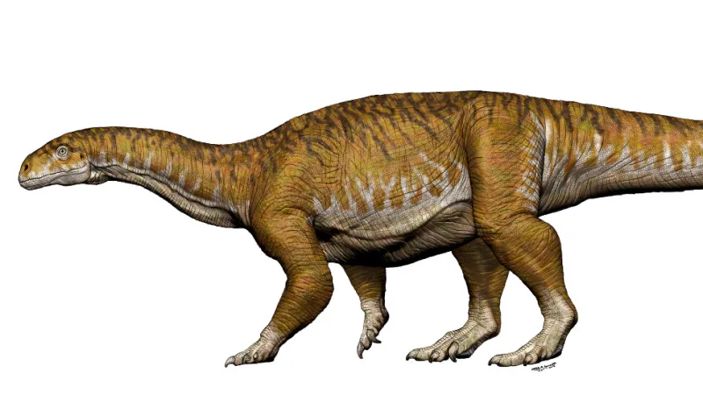

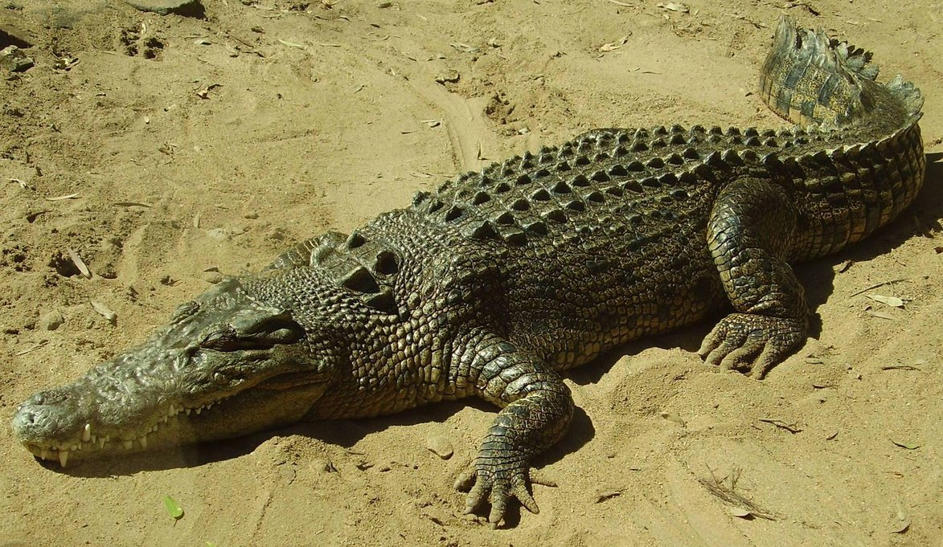
An Evolution to Perfect Heat Transfer is Essential for Sustainability

Slide 4

The Bare Pentium 4 Processor

Slide 5
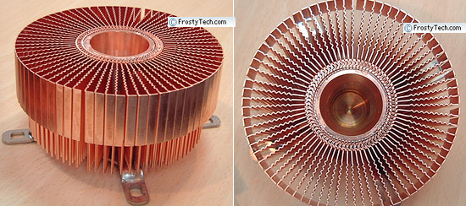
Heat Sinks for Pentium 4

Slide 6
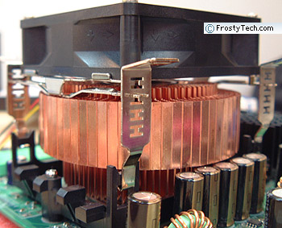
Pentium 4 While Performing

Slide 7
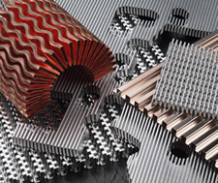
Innovative Fin Designs

Slide 8
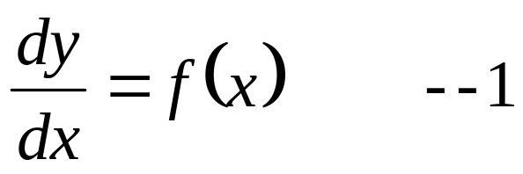
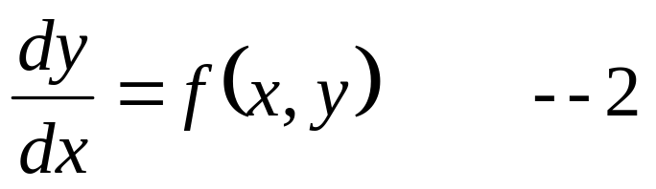
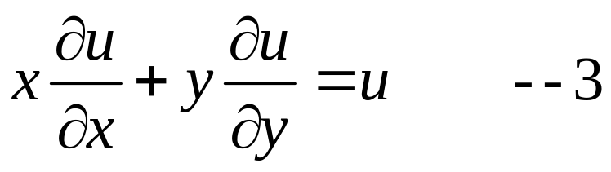
Newton as A Mathematician
The search for general methods of integrating differential equations began when Isaac Newton classified first order differential equations into three classes:

Slide 9
Origin of Second Order ODEs
Newton's second law of motion, ma = f, has generated the first second order ODE, "Principia Mathematica Philosophiae Naturalis (1686)“.
This due to the fact that the acceleration is the second time derivative of the particle position function.
Second order ODEs are more difficult to solve than first order ODEs.
Leonhard Euler worked on a special class of second order ODEs, Miscellanea Berolinensia, 1743.
Great mathematicians invented solutions for SO-ODEs.
These are: The Euler equidimensional Equation, Sturm-Liouville Differential Equations, Bessel Differential Equation, Legendre’s Differential equation, Chebyshev’s differential equation.
Most of these included second space derivatives.

Slide 10
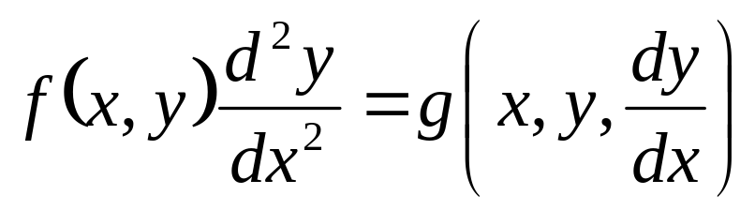
Present Definition of Second Order ODE
A general second order differential equation for the function y is
where f & g are given functions on the interval I ⊂ Ɽ.

Slide 11
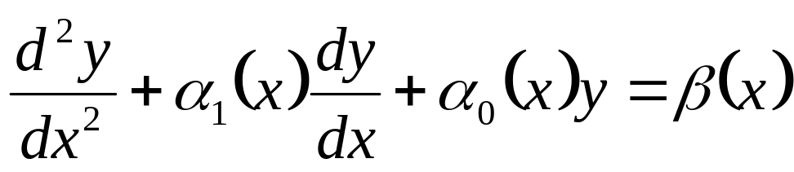
Definition of Second Order Linear ODE
A second order linear differential equation for the function y is
where α₁, α₀, β are given functions on the interval I ⊂ Ɽ.
The above ODE;
is homogeneous iff the source β(x) = 0 for all x ∈ Ɽ;
has constant coefficients iff α₁ and α₀ are constants;
has variable coefficients iff either α₁ or α₀ is not constant.

Slide 12
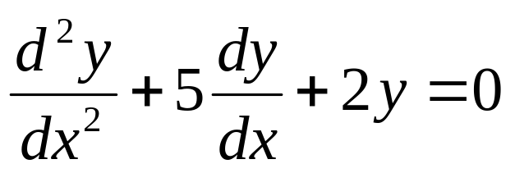
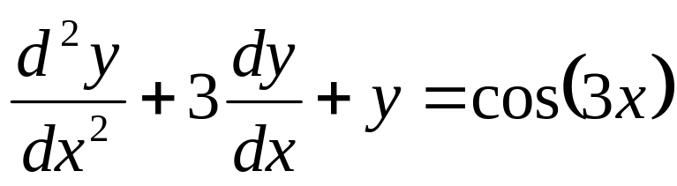
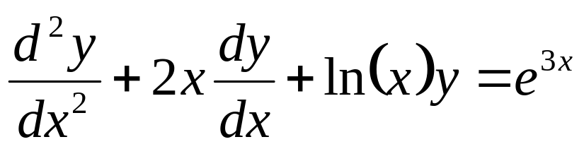
General Examples of Linear Second Order ODEs
A second order, linear, homogeneous, constant coefficients equation is
A second order, linear, nonhomogeneous, constant coefficients, equation is
A second order, linear, nonhomogeneous, variable coefficients equation is

Slide 13
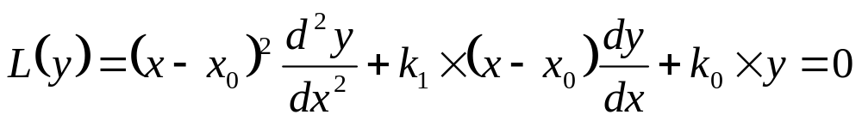
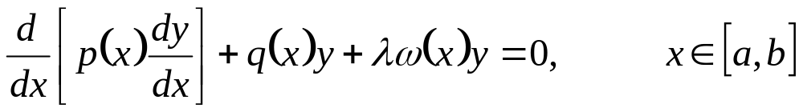
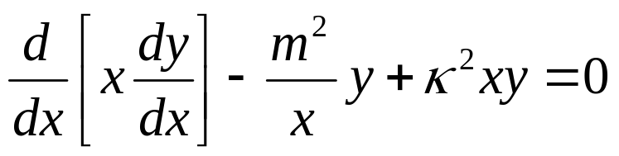
Special Linear Second Order ODEs with Variable Coefficients
The Euler equidimensional equation for the unknown y with singular point at x₀ ∈ℜ is given by the equation
where k₁ and k₀ are constants.
A Sturm-Liouville equation is a second order linear differential equation that can be written in the form
∴ The Bessel equation is

Slide 14
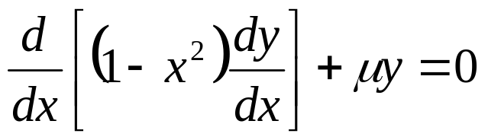
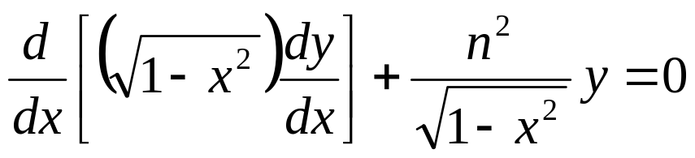
Special Linear Second Order ODEs with Variable Coefficients
The Legendre’s differential equation is
The Chebyshev’s differential equation is

Slide 15
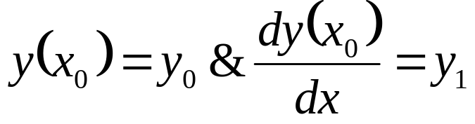
The Second Order Initial Value Problem
A second order linear ODE is said to be a pure Initial value problem iff
If the functions α₁, α₀, β are continuous on a closed interval I ⊂ Ɽ.
The constant x₀ ∈ I, and y₀, y₁ ∈ Ɽ are arbitrary constants,
then there is a unique solution y, defined on I, to the above initial value problem.

Slide 16
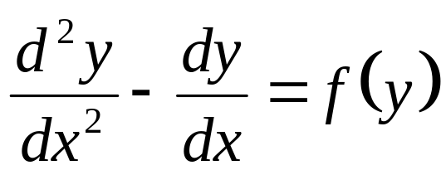
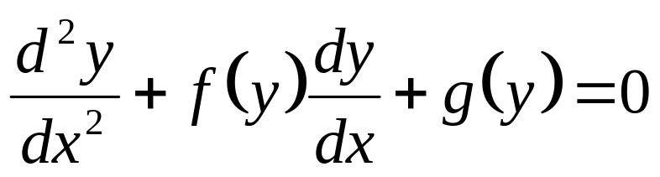
Definition of Second Order Non-linear ODE : type 1
Non-linear second order ODEs of type 1 are differential equation for the function y is
An autonomous Non-linear second order ODEs of type 1:
Lienard equation :

Slide 17
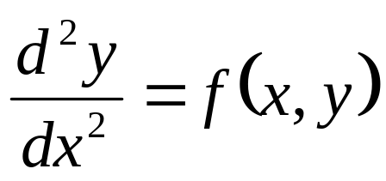
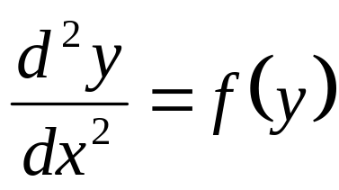
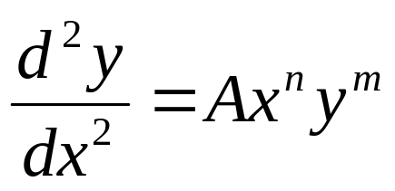
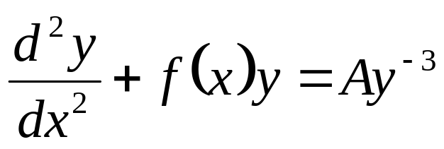
Definition of Second Order Non-linear ODE : type 2
Non-linear second order ODEs of type 1 are differential equation for the function y is
An autonomous Non-linear second order ODEs of type 1:
Emden--Fowler equation :
Ermakov (Yermakov) equation:

Slide 18
Basic Theories for SO-ODEs
Basic understanding of SO-ODEs is possible only by studying Linear ODEs.

Slide 19
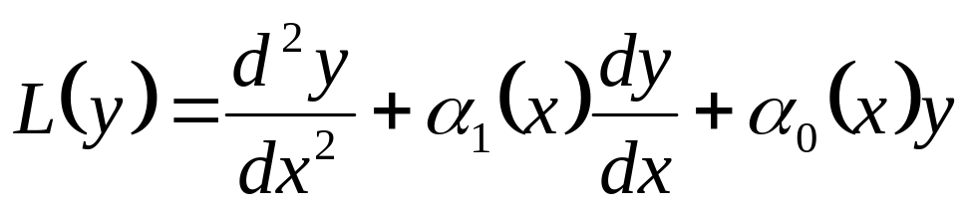
The Homogeneous part of Linear SO-ODEs
A focus on homogeneous part of Linear SO-ODE helps in identification of deeper properties of its solutions.
Only homogeneous equations is considered in this study.
A shorter new notation is introduced to write differential equations.
Given two functions α₁ and α₀, a new function L is introduced to act on a function y.

Slide 20
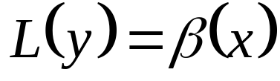
A Shorter Notation for Linear SO-ODE
The function L is called an operator.
This is done to emphasize that L is a function that acts on other functions, instead of acting on numbers.
The operator L above is also called a differential operator, since L(y) contains derivatives of y.
These operators are useful to write differential equations in a compact notation, since
can be written as

Slide 21
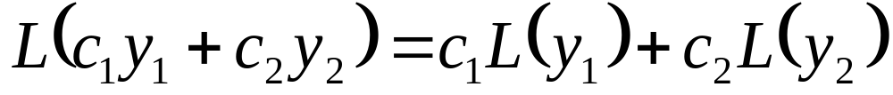
The First Property of Homogeneous Linear SO-ODEs
An operator L is a linear operator iff for every pair of functions y₁, y₂ and constants c₁, c₂ holds

Slide 22
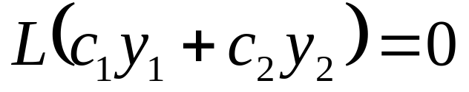
Homogeneous Linear SO-ODEs : Principle of Superposition
If L is a linear operator and y₁, y₂ are solutions of the homogeneous equations L(y₁) = 0, L(y₂) = 0, then for every constants c₁, c₂ holds
Remark: This result is not true for nonhomogeneous equations.

Slide 23
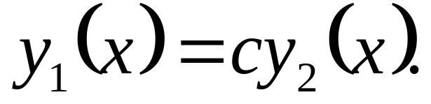
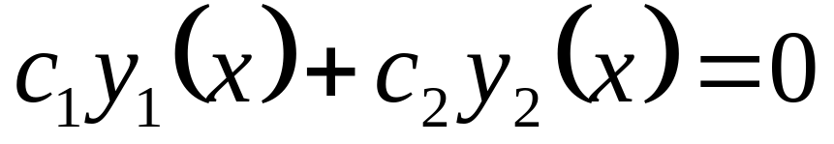
Properties of Homogeneous Linear SO-ODEs
Two functions y₁, y₂ are called linearly dependent iff they are proportional.
or
Otherwise, the functions y₁, y₂ are linearly independent.

Slide 24
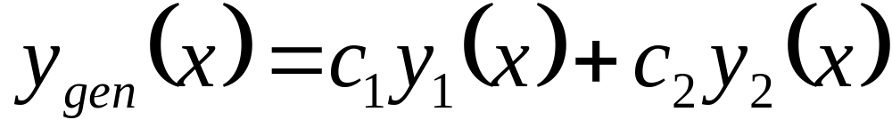
General Solution of A Linear Homogeneous SO-ODE
If y₁ and y₂ are linearly independent solutions of the equation L(y) = 0 on an interval I ⊂ R, then there are unique constants c₁, c₂ such that every solution y of the differential equation L(y) = 0 on I can be written as a linear combination

Slide 25
Methods For Finding Two Linearly Independent Solutions
Characteristic (Auxiliary) Equation ( only for Constant Coefficients)
Reduction of order
Cauchy-Euler (Variable Coefficients)

Slide 26
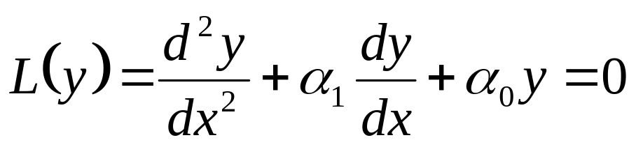
Characteristic Equation Method
This method is used only when the coefficients α₁ and α₀ are real constants.
This equation is called as homogeneous second order ODE with constant coefficients.
It’s not hard to think of some likely candidates for particular solutions of above Equation.
Because of the superior differential properties of the exponential function, this becomes a natural ansatz.
An educated guess, for the form of the solution is y = e^{λx}, where λ is a constant to be determined.

Slide 27
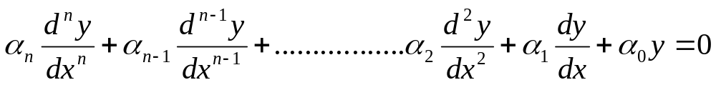
Linear (Constant Coefficient) Homogeneous ODEs of n^{th} Order
Theorem: Ordinary, linear, constant coefficient, homogeneous differential equations with dependent variable y and independent variable x have solutions of the form y = ce^{λx} where c is a nonzero constant.
Ordinary, linear, constant coefficient, homogeneous differential equations of any order have exponential solutions.

Slide 28
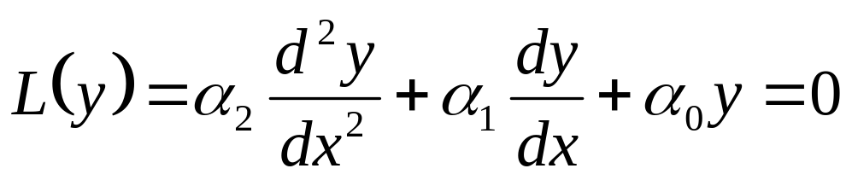
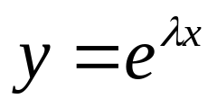
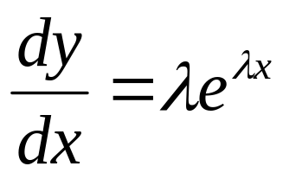
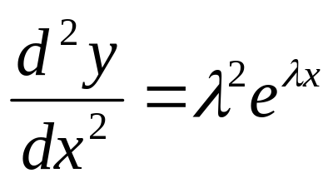
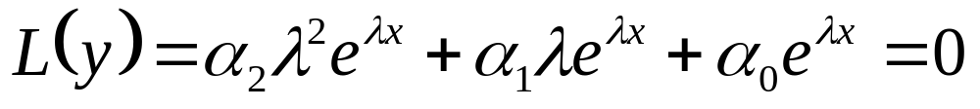
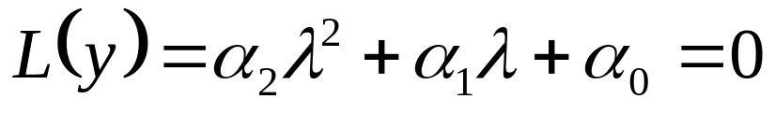
Linear (Constant Coefficient) Homogeneous ODEs of Second Order Order
If
is an ansatz, then
&
Substitute these in Operator.
Our ansatz has thus converted a differential equation into an algebraic equation.
This is called as Characteristic Equation

Slide 29
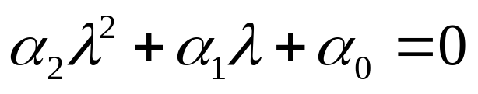
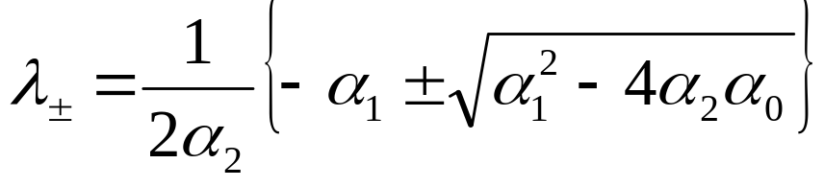
Roots of Characteristic Equation
Using the quadratic formula, the two solutions of the characteristic equation are given by
There are three cases to consider:
(1) if α₁² -4α₂ α₀ > 0, then the two roots are distinct and real;
(2) if α₁² -4α₂ α₀ < 0, then the two roots are distinct and complex conjugates of each other;
(3) if α₁² -4α₂ α₀ = 0, then the two roots are degenerate and there is only one real root.
All these three cases must be studied in the context of thermofluids.

Slide 30
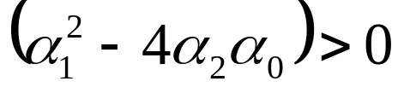
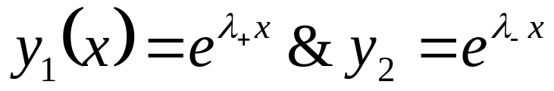
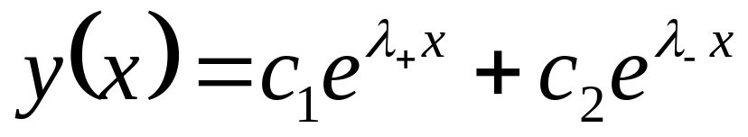
Real & Distinct roots
Both the roots are real for
λ₊ ≠ λ₋ are real and distinct roots.
Two independent solutions are:
The general solution to can be written as a linear superposition of the two solutions; that is,
The unknown constants c₁ and c₂ can be determined by the given initial conditions.

Slide 31
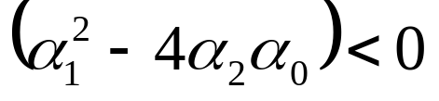
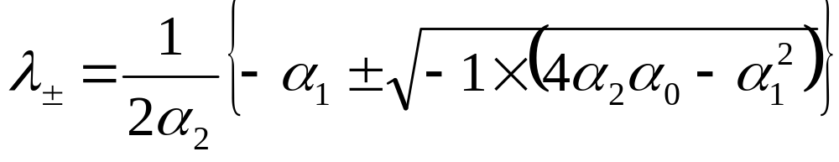






Complex Conjugate, Distinct roots
λ₊ ≠ λ₋ are complex conjugate roots for

Slide 32

Euler’s Trigonometric Formula
The central mathematical fact that is of engineering interest in this context is generally called “Euler's formula”.
Euler's formula is ubiquitous in mathematics, physics, and engineering.
The physicist Richard Feynman called the equation "our jewel" and "the most remarkable formula in mathematics".
Around 1740 Euler turned his attention to the exponential function in place of logarithms and obtained the formula used today that is named after him.
It was published in 1748, obtained by comparing the series expansions of the exponential and trigonometric expressions.

Slide 33



Eulerization of Complex conjugate, distinct roots
Euler Formulae:
The unknown constants k₁ and k₂ can be determined by the given initial conditions.

Slide 34




Repeated roots
The degenerate root is then given by
yielding only a single solution to the ode:
To satisfy two initial conditions, a second independent solution must be found separately.
One such method is Reduction of order.

