Slide 1

Analytical Solutions to Detailed Thermal Modeling of Chip Packages
P M V Subbarao
Professor & Head
Mechanical Engineering Department
Analytical Expression for True Temperature Distributions

Slide 2


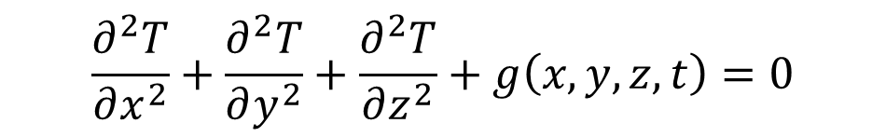
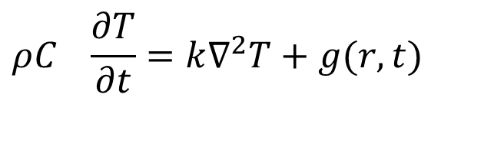
3D Conduction Model for A Chip package
For an isotropic and homogeneous material thermal conductivity is a scalar.
$$ρC_{}\frac{∂T}{∂t}=k∇^{2}T+g(r,t)$$
Convection cooling at the surface of chip package can establish steady-state heat conduction governed by :
$$k∇^{2}T+g\left(r,t\right)=0$$
In cartesian Coordinate system:
$$\frac{∂^{2}T}{∂x^{2}}+\frac{∂^{2}T}{∂y^{2}}+\frac{∂^{2}T}{∂z^{2}}+g\left(x,y,z,t\right)=0$$
Standard analytical solutions are available for 3D steady conduction with no heat generation only !!!

Slide 3
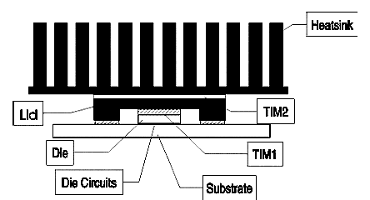
Schematic cross-sectional view of a flip-chip package
A general flip-chip package in a computer hardware system is considered herein, containing a silicon die with multiple nonuniformly distributed areal heat sources

Slide 4
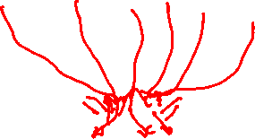
Schematic cross-sectional view of a flip-chip package
A heatsink is attached to the lid of this package via a thermal interface material (TIM2).
The heat developed in the package travels “up ward” through the die-lid interface material (TIM1), lid, TIM2 and sink and is then transferred to the air flowing through the heatsink fins via forced convection.

Slide 5
Schematic cross-sectional view of a flip-chip package
In reality, some of the heat dissipated by the die also travels ‘downward’ through the substrate and electrical interconnects into the motherboard.
The proportion of energy transferred this way is generally small.

Slide 6
Schematic cross-sectional view of a flip-chip package
At the heatsink level, a detailed analysis of the flow and temperature fields in the heat transfer problem described requires the solution of the incompressible nonlinear Navier Stokes equations.
As no analytic solutions to these flow equations exist, commonly adopted approaches for attempting a solution are based on finite-difference or finite element methods.

Slide 7
Schematic cross-sectional view of a flip-chip package
In the context of the package, the mode of heat transfer from the areal heat sources to the heatsink is conduction.
since there is practically no airflow interior to the package.
This provides the motivation for a rigorous treatment of the heat transfer in the package interior using basic principles of Fourier heat conduction.
Reference Paper: IEEE TRANSACTIONS ON COMPONENTS AND PACKAGINGTECHNOLOGIES,VOL.31,NO.2,JUNE2008 461 A Fourier Series-Based Analytical Solution for Three-Dimensional Conjugate Heat Transfer Problems in Microprocessor Cooling Sai Ankireddi and Stanley Pecavar.

Slide 8
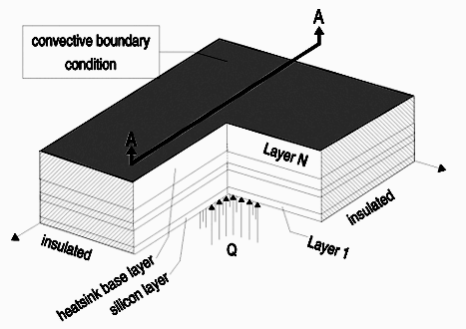
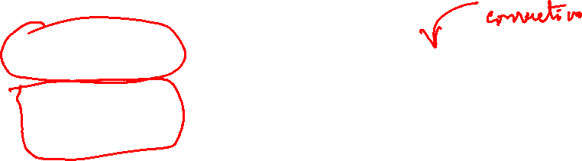
The Model for Conduction Heat Transfer
The model for the heat transfer analysis in the package interior consists of a general multilayer stack of
silicon,
TIM1 (and its contact resistances),
lid,
TIM2 (and its contact resistances) and
the heatsink base

Slide 9
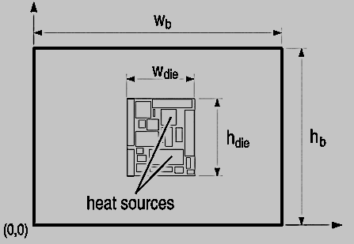
The Model for Conduction Heat Transfer
The plan dimensions of all the layers in the stack are illustrated in second figure.
The multiple die sources are all concentrated at the “bottom” of the stack in a rectangular region of dimensions.
This is the region corresponding to the die size

Slide 10
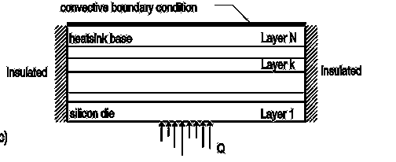
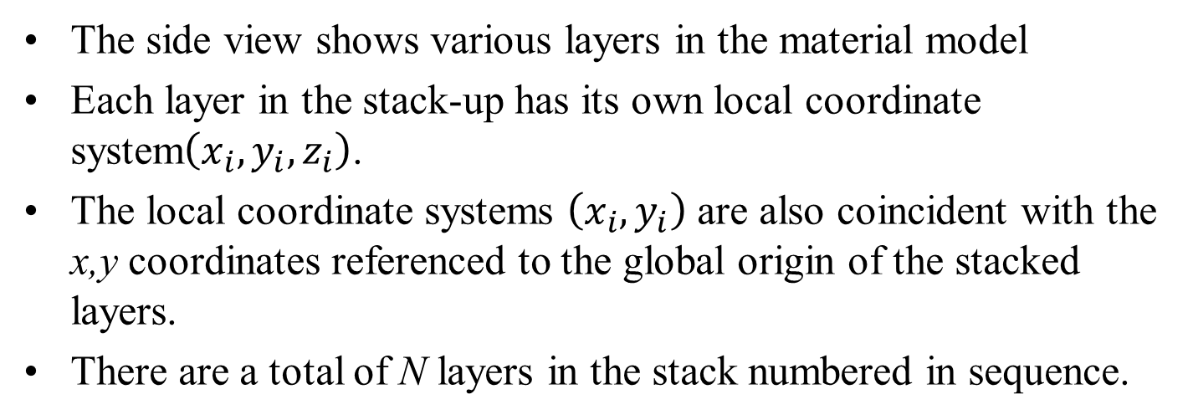
The Model for Conduction Heat Transfer
The side view shows various layers in the material model
Each layer in the stack-up has its own local coordinate system$\left(x_{i},y_{i},z_{i}\right)$.
The local coordinate systems $\left(x_{i},y_{i}\right)$are also coincident with the x,y coordinates referenced to the global origin of the stacked layers.
There are a total of N layers in the stack numbered in sequence.

Slide 11
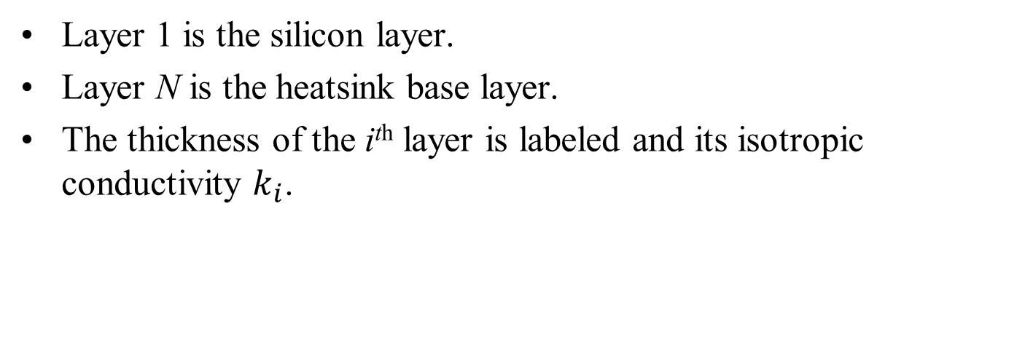
The Model for Conduction Heat Transfer
Layer 1 is the silicon layer.
Layer N is the heatsink base layer.
The thickness of the i^{th} layer is labeled and its isotropic conductivity $k_{i}$.

Slide 12

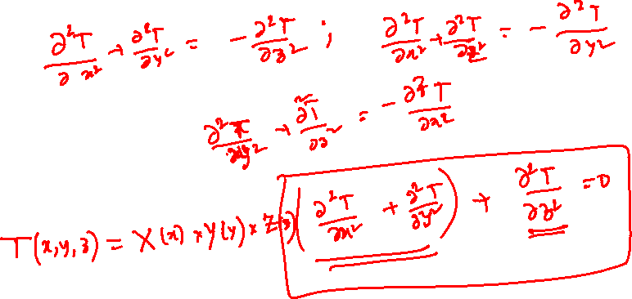
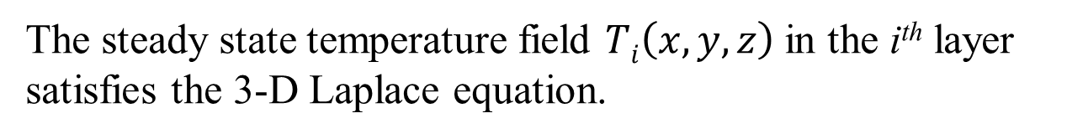
General Solution of A Steady State 3D Conduction Model without Heat generation
The steady state temperature field $Ti\left(x,y,z\right)$in the i^{th} layer satisfies the 3-D Laplace equation.
$$\frac{∂^{2}T_{i}}{∂x^{2}}+\frac{∂^{2}T_{i}}{∂y^{2}}+\frac{∂^{2}T_{i}}{∂z^{2}}=0$$

Slide 13
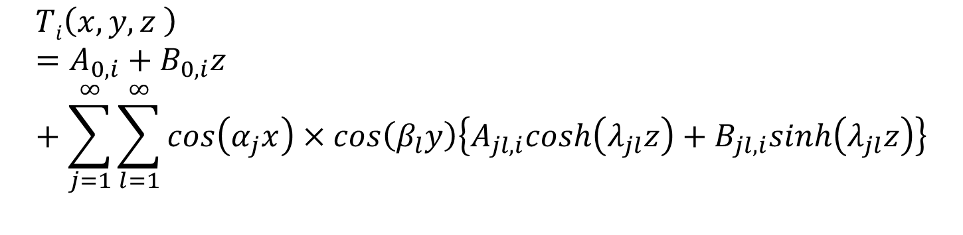
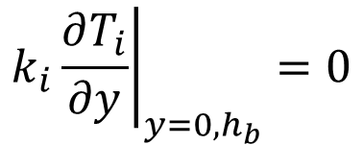
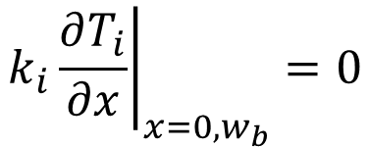


General Solution of A Steady State 3D Conduction Model without Heat generation
$$\frac{∂^{2}T}{∂x^{2}}+\frac{∂^{2}T}{∂y^{2}}+\frac{∂^{2}T}{∂z^{2}}=0$$
$$Ti\left(x,y,z \right)=A_{0,i}+B_{0,i}z+\sum_{j=1}^{∞}{\sum_{l=1}^{∞}{cos\left(α_{j}x\right)}×cos\left(β_{l}y\right)\left\{A_{jl,i}cosh\left(λ_{jl}z\right)+B_{jl,i}sinh\left(λ_{jl}z\right)\right\}}$$
It is noted an identical condition satisfied as:
$$λ_{jl}^{2}=α_{j}^{2}+β_{l}^{2}$$
Edge Boundary Conditions:
$$k_{i}{\left.\frac{∂T_{i}}{∂x}\right|}_{x=0,w_{b}}=0$$
It is assumed that the ends of the layer are insulated, i.e.
$$k_{i}{\left.\frac{∂T_{i}}{∂y}\right|}_{y=0,h_{b}}=0$$

Slide 14
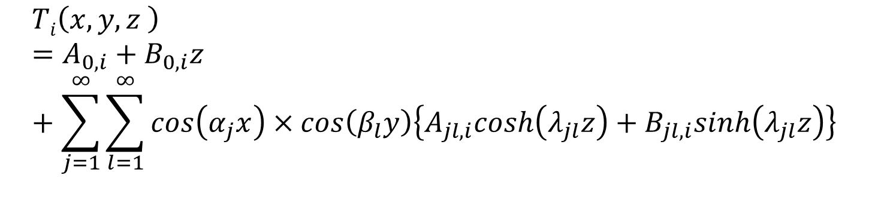
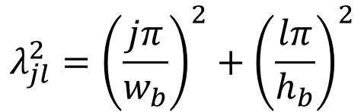
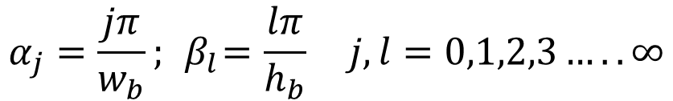
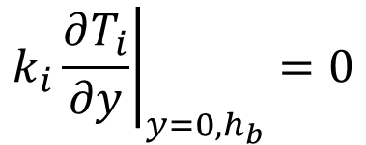
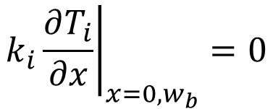
General Solution of A Steady State 3D Conduction Model without Heat generation
$$Ti\left(x,y,z \right)=A_{0,i}+B_{0,i}z+\sum_{j=1}^{∞}{\sum_{l=1}^{∞}{cos\left(α_{j}x\right)}×cos\left(β_{l}y\right)\left\{A_{jl,i}cosh\left(λ_{jl}z\right)+B_{jl,i}sinh\left(λ_{jl}z\right)\right\}}$$
$$k_{i}{\left.\frac{∂T_{i}}{∂x}\right|}_{x=0,w_{b}}=0$$
$$k_{i}{\left.\frac{∂T_{i}}{∂y}\right|}_{y=0,h_{b}}=0$$
Edge Boundary Conditions:
Applying these boundary conditions to solution it can be readily shown that
$$α_{j}=\frac{jπ}{w_{b}};{ β}_{l}=\frac{lπ}{h_{b}} j,l=0,1,2,3…..∞$$
$$λ_{jl}^{2}={\left(\frac{jπ}{w_{b}}\right)}^{2}+{\left(\frac{lπ}{h_{b}}\right)}^{2}$$

