Slide 1


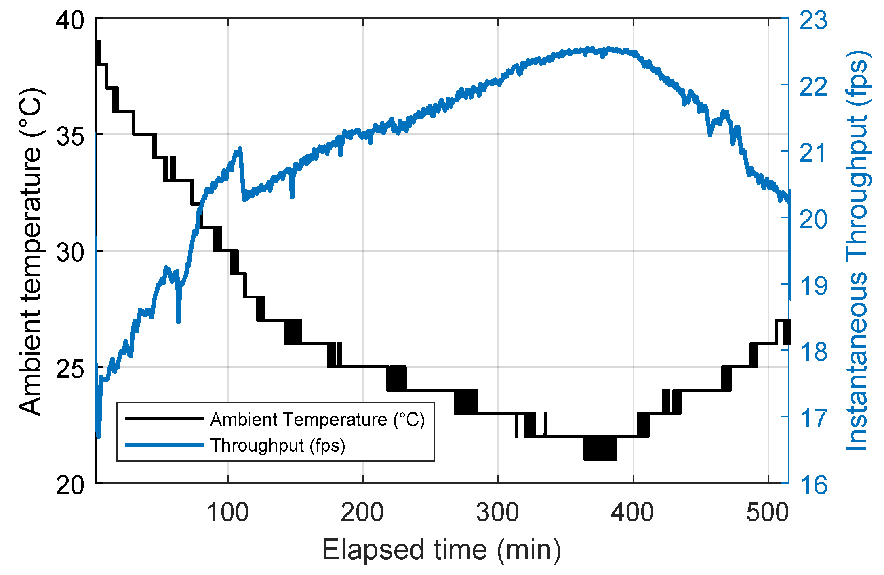
Methodology of Deriving Compact Thermal Models For Chips
P M V Subbarao
Professor
Mechanical Engineering Department
An Essential Step to Create Temperature Aware Design of Chips….

Slide 2

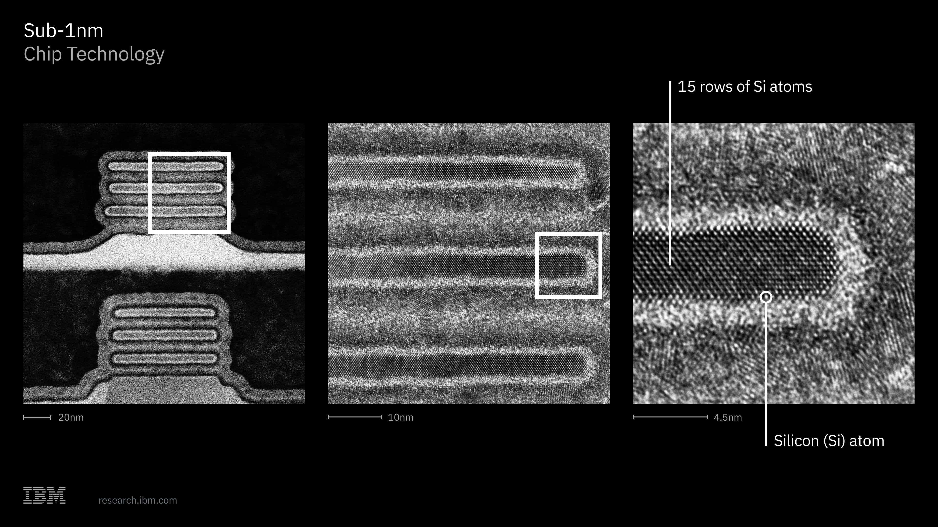
TEMPERATURE AWARE DESIGN
In sub-100nm technologies, early accurate design estimation is key to high-level design convergence.
The design should ensure careful consideration of deep submicron effects, namely, power, performance, reliability, etc.
Temperature plays an important role in early accurate estimations of power, performance and reliability.
Thermal effects are influenced by placement and routing.
Putting two hot blocks adjacent to each other will exacerbate the hot spots.
Alternately, surrounding a hot block by several colder blocks will actually help in cooling down the hot spot.

Slide 3
TEMPERATURE AWARE DESIGN
Temperature should thus be included in the cost function in order to achieve optimal placement and routing in sub-100nm.
Temperature can also affect manufacturability in terms of packaging and choices of process if the design is thermally limited.
Temperature profiles are needed at both functional-block level and standard-cell level during the chip design flow.

Slide 4
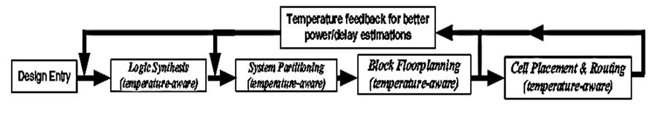
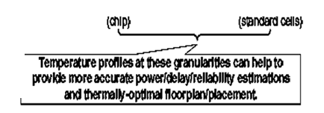

Chip Design Flow

Slide 5
Importance of Temperature Estimation
Early in the design flow, it is very important to be able to estimate temperature at different granularities and at different design stages, especially.
The estimated temperature can then be used to perform power, performance, and reliability analyses, together with placement, packaging design, etc.
Decisions use temperature as a guideline.
This awareness is intrinsically thermally optimized and free from thermal limitations.
This type of design methodology is called as temperature aware design.

Slide 6
Importance of Temperature Estimation
The idea of temperature-aware design is unique.
Operating temperature is properly considered during the entire design flow instead of being determined only after the fact at the end of the design flow.
The first key element for a temperature-ware design methodology is a thermal model to estimate operating temperatures.

Slide 7
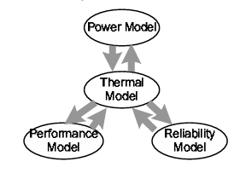
A THERMAL MODEL
A thermal model helps to close the loop for accurate, performance and reliability estimations.

Slide 8
A THERMAL MODEL
The power model first provides estimated power to the thermal model.

Slide 9
A THERMAL MODEL
The thermal model in turn provides estimated temperature to the power model, and so on.

Slide 10
A THERMAL MODEL
After a few iterations, both power and temperature estimations are completed.
At that point, temperature aware power estimation is achieved.

Slide 11
A THERMAL MODEL
Similarly, temperature-aware performance and reliability estimations can also be achieved

Slide 12
Chip Package
The final step in creating a semiconductor device is integrated circuit packaging.
This involves encasing the semiconductor material block (on which a given functional circuit is fabricated) in a protective case to protect it from physical harm and corrosion.
There are many types of IC packages, each having unique dimensions, mounting styles, and pin counts.
Most commonly used packaging methods are enumerated here.

Slide 13
Types of Chip Packages
Dual In-Line Package (DIP)
  Small Outline Package (SOP)
  Thin Small Outline Package (TSOP)
  Quad Flat Package (QFP)
  Quad Flat Package-Extended (QFP-EP)
  Quad Flat No-leads (QFN)
Ball Grid Array (BGA)
  Micro Ball Grid Array (µBGA)
  Ceramic Ball Grid Array (CBGA)
  Plastic Ball Grid Array (PBGA)
  Fine-Pitch Ball Grid Array (FBGA)

Slide 14
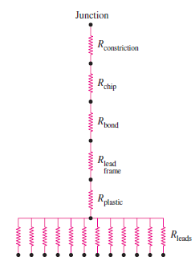
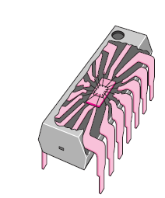
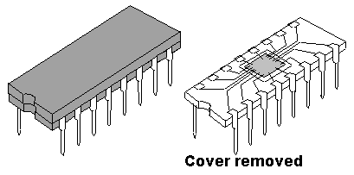
Dual-in-line Package (DIP) Vs CTM
It is the most common through-hole IC package used in circuits, especially hobby projects.
This IC has two parallel rows of pins extending perpendicularly out of a rectangular plastic housing.
The overall dimensions of a DIP package depend on its pin count.
The most common pin counts are four, six, eight, fourteen, eighteen, twenty, twenty-eight, and forty pins.
The pins on a DIP IC are spaced 2.54mm apart, which is a standard spacing.

Slide 15
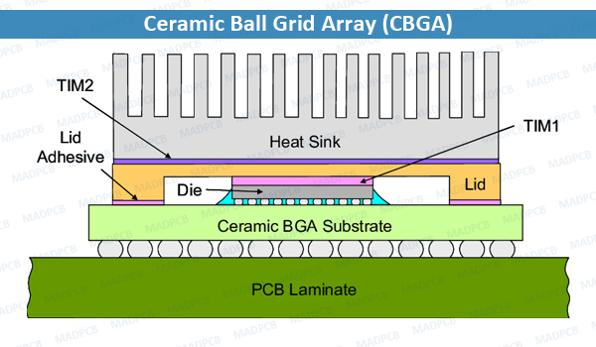
Ceramic Ball Grid Array Package
A CBGA package (Ceramic Ball Grid Array) is a high-density chip carrier that uses a multi-layer ceramic substrate.
Also used an array of high-melting-point solder balls (typically 90% lead / 10% tin) on its base for electrical connection to a printed circuit board.

Slide 16
CBGA package
Ceramic Ball Grid Array (CBGA) is a square-shaped or rectangular ceramic package that uses solder balls for external electrical connection instead of leads.
These solder balls are arranged in a grid or array at the bottom of the ceramic package body, hence the name “ceramic ball grid array”.
Actually, the CBGA is just one of several types of the BGA package.

Slide 17
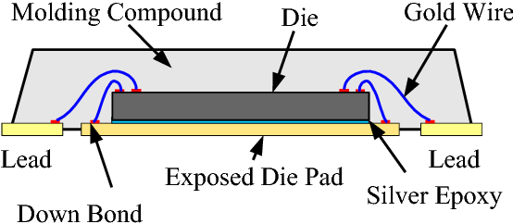
Quad Flat Package No-lead (QFN-NL) Package
A Quad Flat No-lead (QFN) package is a surface-mount integrated circuit package. Instead of extending pins or legs from its sides.
It uses flat metal pads located on the bottom perimeter and a central exposed thermal pad to connect directly to a printed circuit board

Slide 18
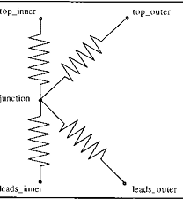

Package Vs CTM : CBGA

Slide 19
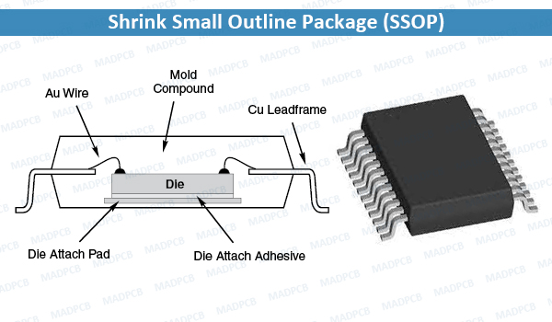
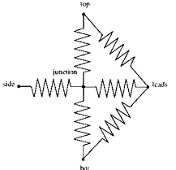
Package Vs CTM : SSOP

Slide 20
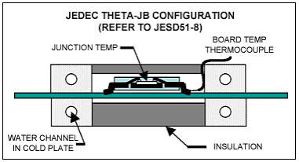
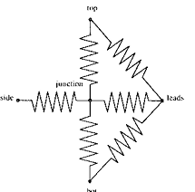
Package Vs CTM : TQFP

Slide 21
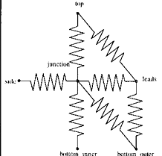
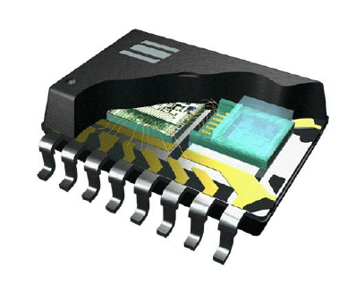
Package Vs CTM : CDIP

Slide 22
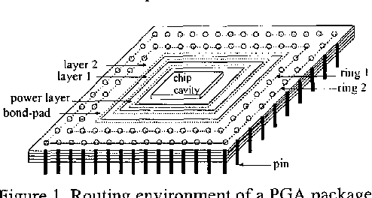
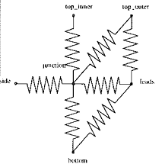
Package Vs CTM : CPGA

Slide 23
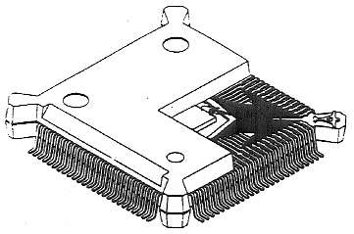
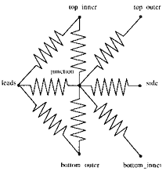
Package Vs CTM : PQFP

Slide 24
Development of CTM
The method consists of the following steps.
1) Creation of a “full” model of an electronic device.
A set of boundary conditions, representing those conditions which a device may encounter in practice, is imposed on all faces where significant heat transfer could occur.
The junction temperature and heat flow rate through each side is then calculated using the full model for each combination of these boundary conditions.
The junction temperatures, heat flow rates and corresponding boundary conditions thus obtained are implemented in a user-defined cost function.

Slide 25
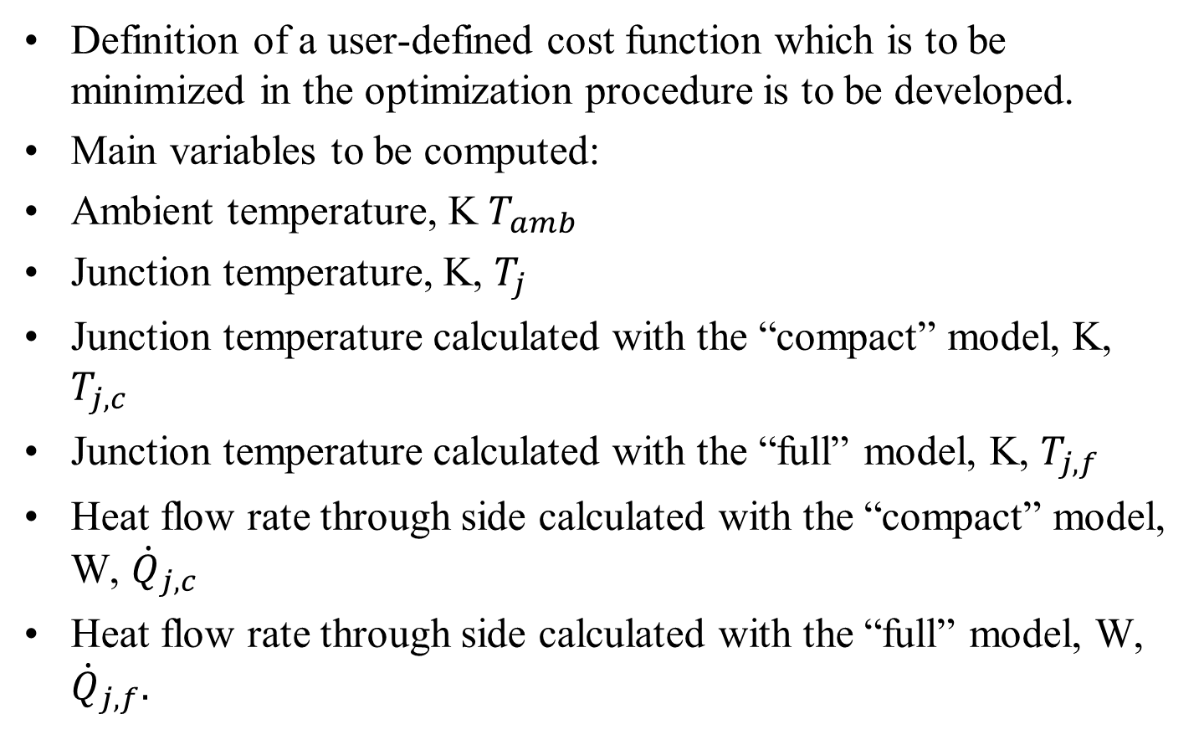
Cost function for Selection of Optimal CTM
Definition of a user-defined cost function which is to be minimized in the optimization procedure is to be developed.
Main variables to be computed:
Ambient temperature, K $T_{amb}$
Junction temperature, K, $T_{j}$
Junction temperature calculated with the “compact” model, K, $T_{j,c}$
Junction temperature calculated with the “full” model, K, $T_{j,f}$
Heat flow rate through side calculated with the “compact” model, W, ${\dot{Q}}_{j,c}$
Heat flow rate through side calculated with the “full” model, W, ${\dot{Q}}_{j,f}.$

Slide 26
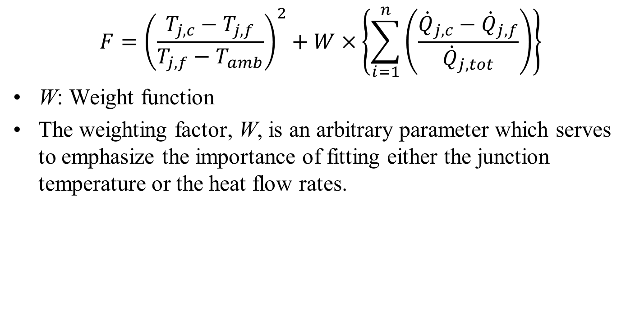
Cost function for Selection of Optimal CTM
$$F={\left(\frac{T_{j,c}−T_{j,f}}{T_{j,f}−T_{amb}}\right)}^{2}+W×\left\{\sum_{i=1}^{n}{\left(\frac{{\dot{Q}}_{j,c}−{\dot{Q}}_{j,f}}{{\dot{Q}}_{j,tot}}\right)}\right\}$$
W: Weight function
The weighting factor, W, is an arbitrary parameter which serves to emphasize the importance of fitting either the junction temperature or the heat flow rates.

