Slide 1

Principles for Creation of Compact Thermal Models
P M V Subbarao
Professor
Mechanical Engineering Department
Novel ways of thermal characterization With International Standards….

Slide 2

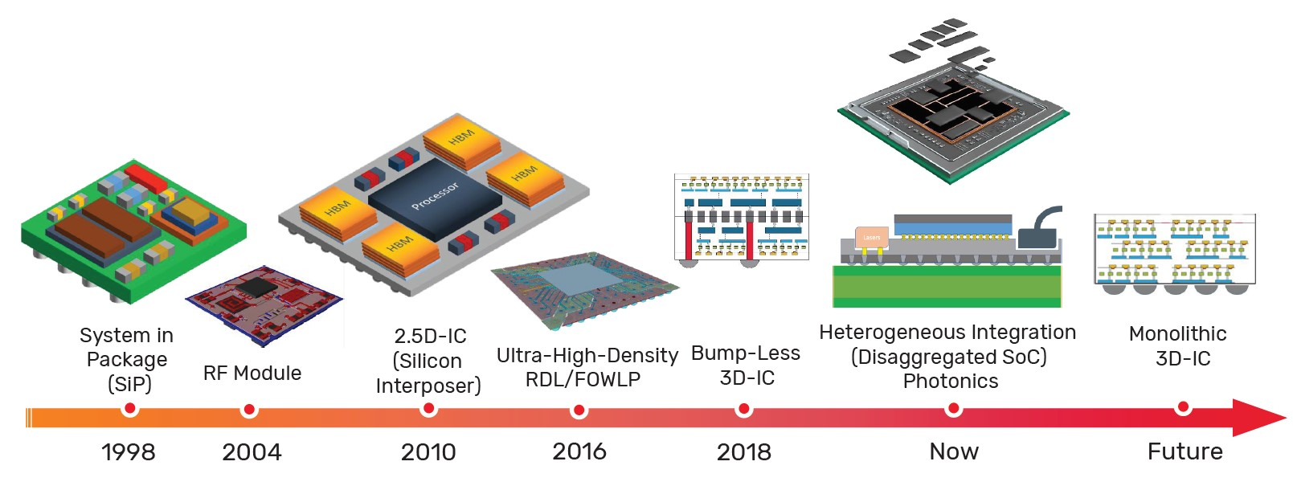
Need for Compact Resistance Model

Slide 3


Slide 4
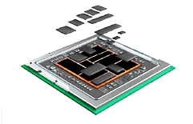
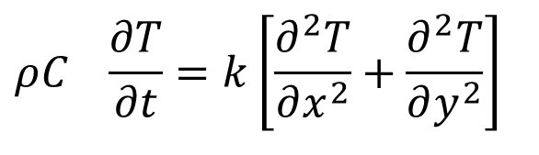
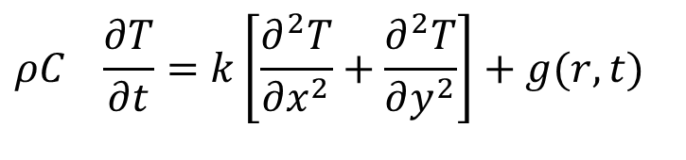
Need for Compact Resistance Model
$$ρC_{}\frac{∂T}{∂t}=k\left[\frac{∂^{2}T}{∂x^{2}}+\frac{∂^{2}T}{∂y^{2}}\right]$$
$$ρC_{}\frac{∂T}{∂t}=k\left[\frac{∂^{2}T}{∂x^{2}}+\frac{∂^{2}T}{∂y^{2}}\right]+g(r,t)$$

Slide 5
Compact Thermal Model
Quick ascertainment of the thermal performance of new processors is essential to reduce design-cycle time and physical prototyping at the earliest possible stage of the design process.
First time in 1990s, some European industries began to realized the need for an accurate prediction of the temperatures of critical electronic parts at the package, board, and system levels.
It was also realized that the prediction was seriously hampered by a lack of reliable, standardized input data that characterize the thermal behavior of these parts.
Many European projects were started with an aim for the creation and experimental calibration of thermal models for a range of electronic parts.

Slide 6
Compact Thermal Model
The ultimate goal of these projects was to get component manufacturers to supply calibrated compact thermal models(CTMs) of their parts to endusers.
Initially, experimental techniques used to calibrate the detailed thermal conduction models of the parts and the methods to generate compact models.
Compact thermal modeling (CTM) focuses on the question of
how to acquire sufficiently accurate thermal data of electronic components?
for the prediction of the thermal behavior of electronic board and systems without relying on detailed models.

Slide 7
Compact Thermal Model
Compact thermal models generally use some form of electrical component analog for thermal parameters.
These electrical analogs do not look anything like the mechanical components they represent.
Compact thermal models are not as accurate as a detailed thermal model, but they are computationally very efficient (i.e. fast) and the tools required are more readily available (e.g. spreadsheets, Mathcad, etc).
Compact thermal models are analogous to an electrical engineer’s lumped parameter model.

Slide 8
Important parameters in Two Resistor Model
Junction temperature
Junction temperature is the highest temperature of the actual semiconductor in an electronic device.
Case temperature
The temperature of the outside of a semiconductor device’s case. It is normally measured on the top of the case.
Ambient temperature
The temperature of the air that surrounds an electronic part. It often measured a defined distance away from a printed circuit board.

Slide 9
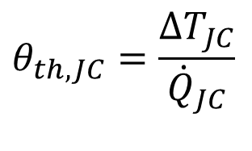
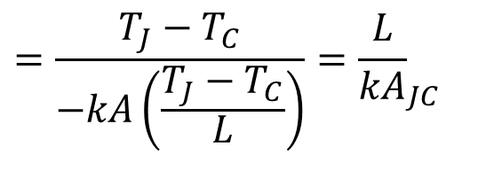
Thermal Resistance in THERMAL
CHARACTERIZATION OF A CHIP PACKAGE
For conduction heat transfer from junction to Case:
$$θ_{th,JC}=\frac{{∆T}_{JC}}{{\dot{Q}}_{JC}}$$
$$=\frac{T_{J}−T_{C}}{−kA\left(\frac{T_{J}−T_{C}}{L}\right)}={\frac{L}{kA}}_{JC}$$
What exactly is the junction temperature?
Can this temperature be measured?
If not, which temperature is measured?
Is this temperature representative for reliability analyses?
What exactly is the case temperature?
Can this temperature be unambiguously defined?
Is it possible to measure such a defined temperature?

Slide 10
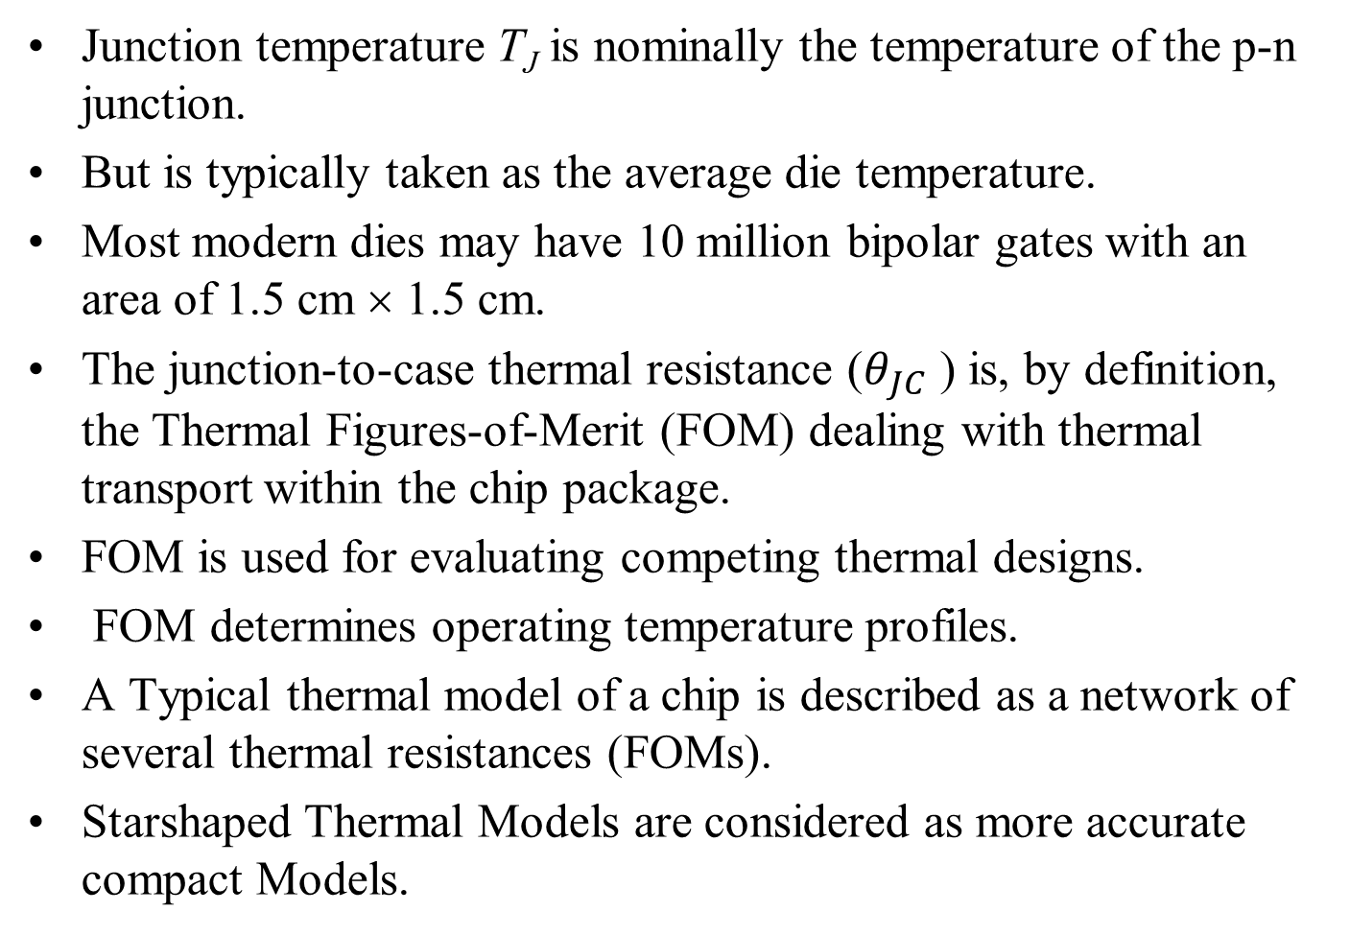
The Junction Temperature
Junction temperature T_{J} is nominally the temperature of the p-n junction.
But is typically taken as the average die temperature.
Most modern dies may have 10 million bipolar gates with an area of 1.5 cm × 1.5 cm.
The junction-to-case thermal resistance ($θ_{JC}$ ) is, by definition, the Thermal Figures-of-Merit (FOM) dealing with thermal transport within the chip package.
FOM is used for evaluating competing thermal designs.
FOM determines operating temperature profiles.
A Typical thermal model of a chip is described as a network of several thermal resistances (FOMs).
Starshaped Thermal Models are considered as more accurate compact Models.

Slide 11
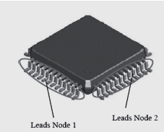
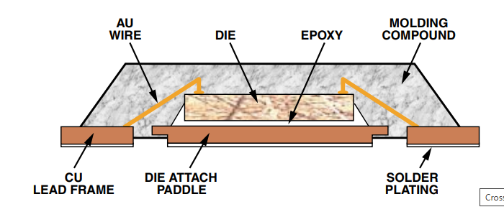
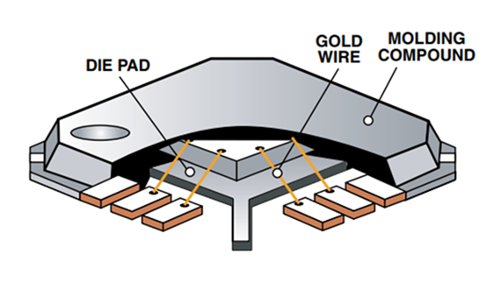
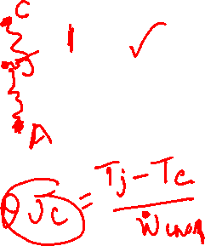
Compact Thermal Models for a Leaded Chip

Slide 12
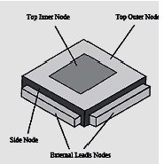
Compact Thermal Models for a Leaded Chip
Equivalent Thermal Material Model

Slide 13
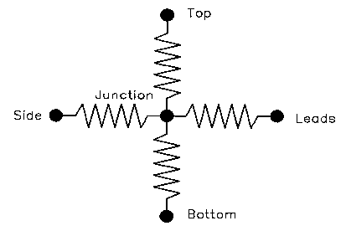
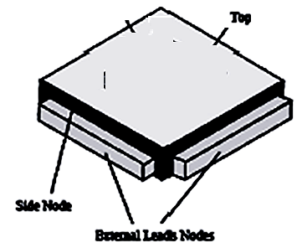
Star-Shaped Thermal Resistor Networks
Bar-Cohen et al. represented the mono-chip packages, by a star-shaped network.
In SSN thermal resistors radiate from the junction node to nodes on the surface and to the node for the leads.
A simple network is shown as:

Slide 14
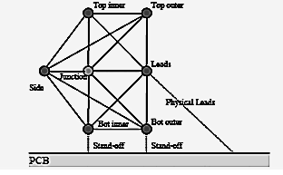
Compact Models of a Leaded Package

Slide 15
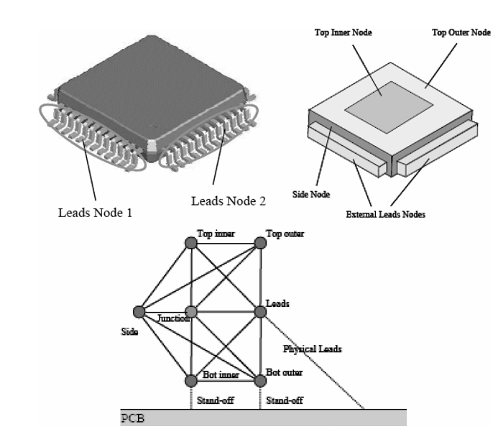
Compact Models of a Leaded Package

Slide 16
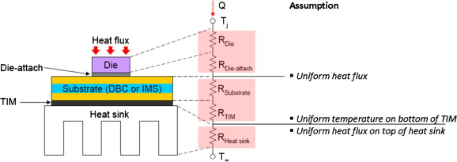
Compact Thermal Models: Case 1

Slide 17
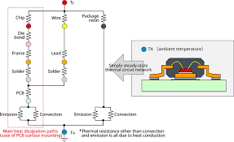
Compact Thermal Models: Case 2

Slide 18
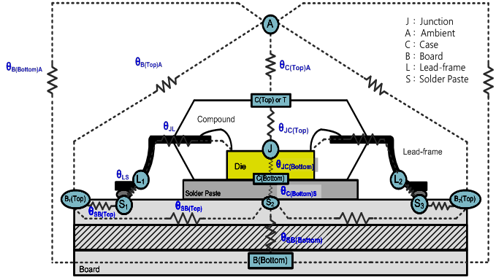
Compact Thermal Models: Case 3

Slide 19
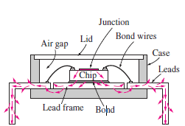
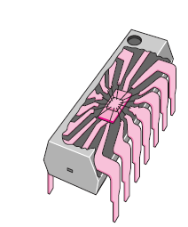
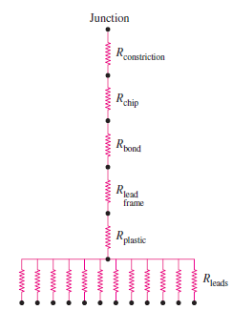
Package Level Thermal Management of DIP Electronic Processor
Is this description complete?
If not complete, is it comprehensive?
Total Thermal Resistance of an electronic chip:
$R_{total}=R_{constriction}$+ $R_{chip}$+ $R_{bond}$+ $R_{lead−frame}+R_{plastic}+R_{leads}$

Slide 20
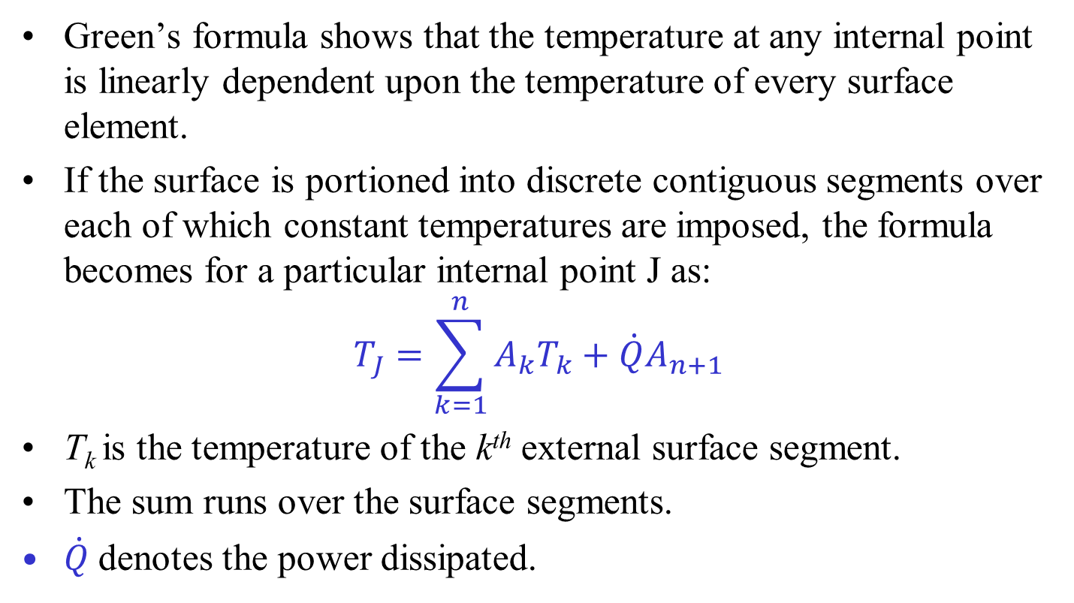
Green’s formula for an interior point
: Heat Conduction Equation
Green’s formula shows that the temperature at any internal point is linearly dependent upon the temperature of every surface element.
If the surface is portioned into discrete contiguous segments over each of which constant temperatures are imposed, the formula becomes for a particular internal point J as:
$$T_{J}=\sum_{k=1}^{n}{A_{k}T_{k}}+\dot{Q}A_{n+1}$$
T_{k} is the temperature of the k^{th} external surface segment.
The sum runs over the surface segments.
$\dot{Q}$denotes the power dissipated.

Slide 21
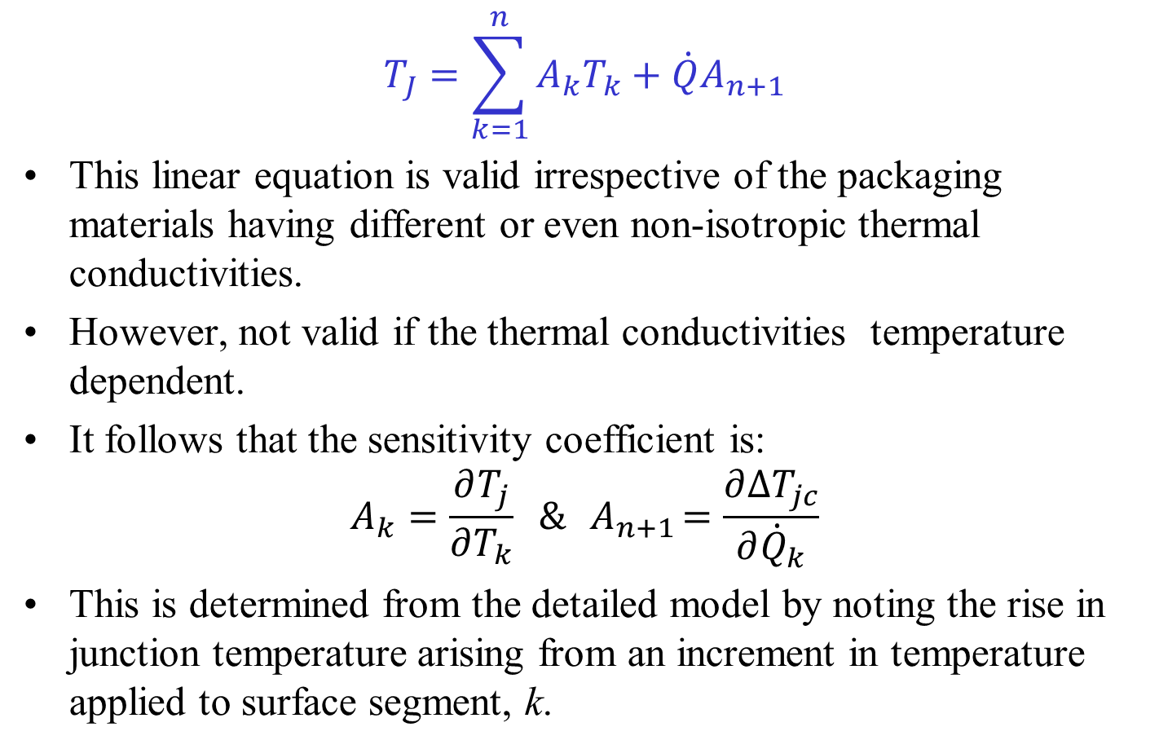
Green’s formula for an interior point
: Heat Conduction Equation
$$T_{J}=\sum_{k=1}^{n}{A_{k}T_{k}}+\dot{Q}A_{n+1}$$
This linear equation is valid irrespective of the packaging materials having different or even non-isotropic thermal conductivities.
However, not valid if the thermal conductivities temperature dependent.
It follows that the sensitivity coefficient is:
$$A_{k}=\frac{∂T_{j}}{∂T_{k}} \&{ A}_{n+1}=\frac{∂∆T_{jc}}{∂{\dot{Q}}_{k}}$$
This is determined from the detailed model by noting the rise in junction temperature arising from an increment in temperature applied to surface segment, k.

Slide 22
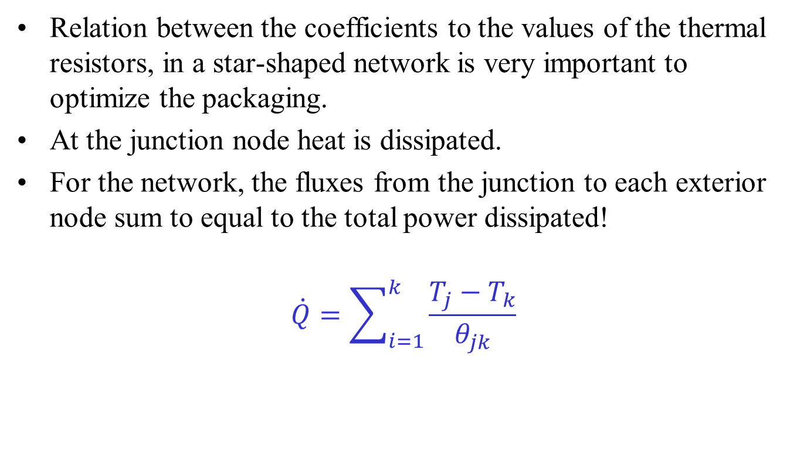
Factors Influencing the Sensitivity Coefficients
Relation between the coefficients to the values of the thermal resistors, in a star-shaped network is very important to optimize the packaging.
At the junction node heat is dissipated.
For the network, the fluxes from the junction to each exterior node sum to equal to the total power dissipated!
$$\dot{Q}=\sum_{i=1}^{k}{\frac{T_{j}−T_{k}}{θ_{jk}}}$$

Slide 23
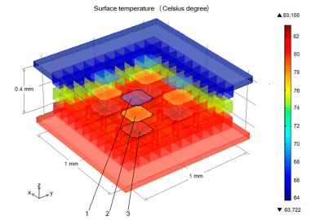
A Methodology to Develop Compact Thermal Models
Creation of a calibrated detailed model of an electronic device.
This “full” or detailed model can be made using any CHT package.
A generating set of combinations of boundary conditions is imposed on all faces where significant heat transfer occurs.
The junction temperature and heat flow rate through each side and/or node temperatures are then calculated, using the detailed model for all boundary conditions.
Definition of the “compact model” layout.
Definition of an objective function, to be minimized in the optimization procedure.

Slide 24
A Methodology to Develop Compact Thermal Models
The optimization Process.
By varying the parameters of the CTM, the user-specified cost function is minimized.
Evaluation of the accuracy of the model.
The best approach is to use a test set that is independent of the generating set.
When the results are within a specified accuracy range, a compact model that is “independent” of the imposed boundary conditions is obtained.
Make the compact model available for dissemination in neutral file format for use by board and system level vendors.

