Slide 1

Diffusion of Heat Generated in A Chip: Conduction Analysis
P M V Subbarao
Professor
Mechanical Engineering Department
Means to Diffuse out the Heat to Surface….
Fourier’s Clue to Reach Newtons Solution…

Slide 2

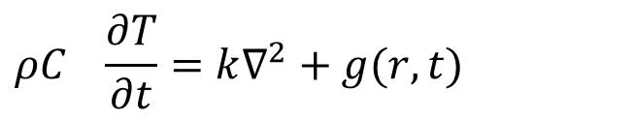


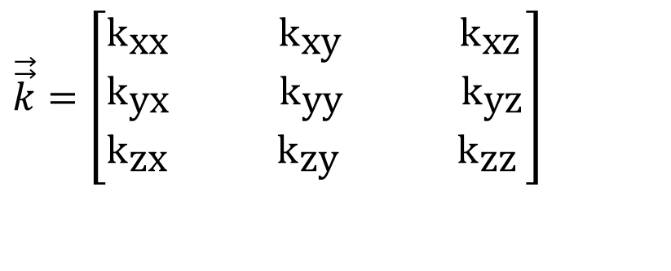
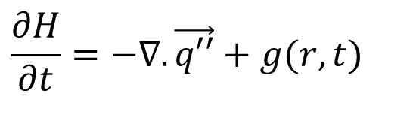
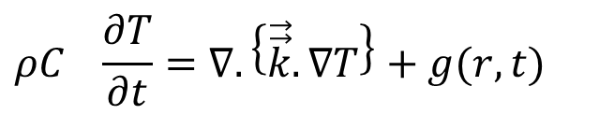
Fourier’s Constitutive Equation for an Electronic Processor
$$\frac{∂H}{∂t}=−∇.\vec{q′′}+g(r,t)$$
$$\vec{q′′}=−k∇T$$
$$\vec{q′′}=−\vec{\vec{k}}•∇T$$
$$\vec{\vec{k}}=\left[\begin{aligned}&k_{\text{xx}} {\text{k}}_{\text{xy}} {\text{k}}_{\text{xz}} \\ &k_{\text{yx}} {\text{k}}_{\text{yy}} {\text{k}}_{\text{yz}} \\ &k_{\text{zx}} {\text{k}}_{\text{zy}} {\text{k}}_{\text{zz}}\end{aligned}\right]$$
The General Fourier Conduction Equation
$$ρC_{}\frac{∂T}{∂t}=∇.\left\{\vec{\vec{k}}.∇T\right\}+g(r,t)$$
For a homogeneous and isotropic material:
$$ρC_{}\frac{∂T}{∂t}=k∇^{2}+g(r,t)$$

Slide 3
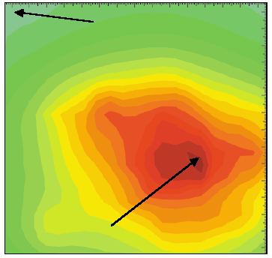
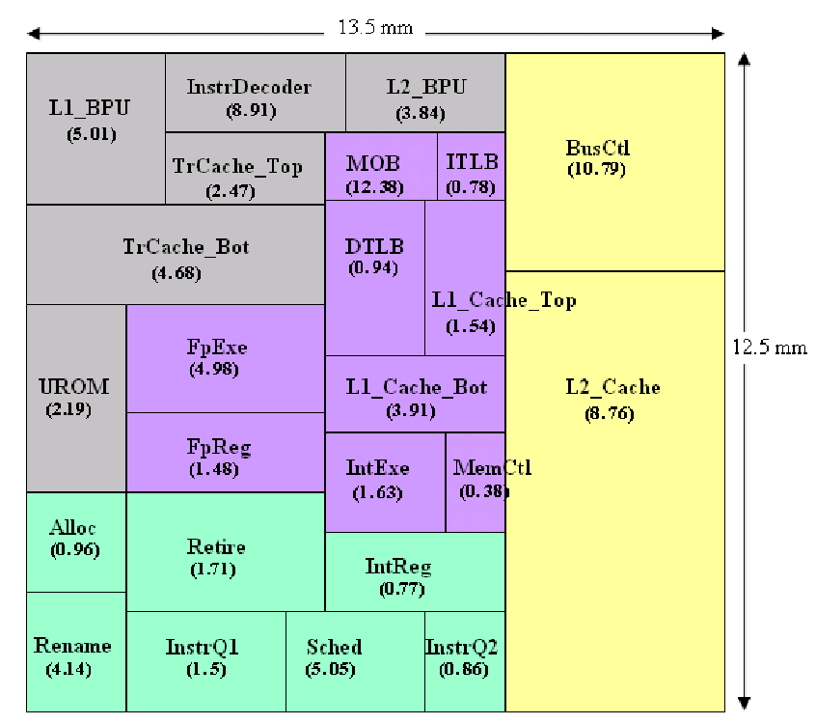
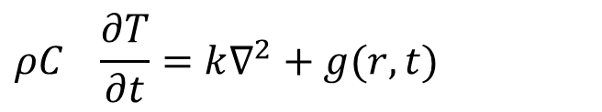
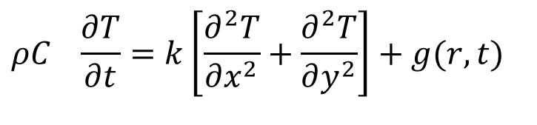
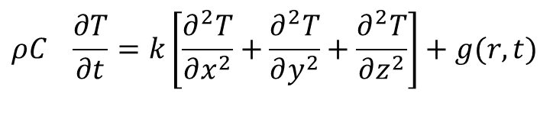
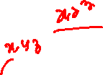
Fourier’s Constitutive Equation for an Electronic Processor Die : Cartesian System
For a homogeneous and isotropic material:
$$ρC_{}\frac{∂T}{∂t}=k∇^{2}+g(r,t)$$
$$ρC_{}\frac{∂T}{∂t}=k\left[\frac{∂^{2}T}{∂x^{2}}+\frac{∂^{2}T}{∂y^{2}}+\frac{∂^{2}T}{∂z^{2}}\right]+g(r,t)$$
$$ρC_{}\frac{∂T}{∂t}=k\left[\frac{∂^{2}T}{∂x^{2}}+\frac{∂^{2}T}{∂y^{2}}\right]+g(r,t)$$
Thermal conductivity: 148 W/(m·K) at 300 K.
Specific heat capacity: 700 J/(kg·K)).
Density: 2329 kg/m³
Four Boundary Conditions are required to solve above equation.

Slide 4

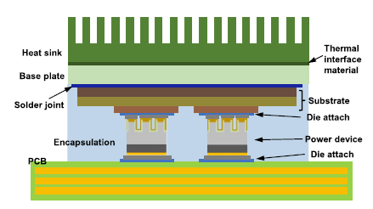
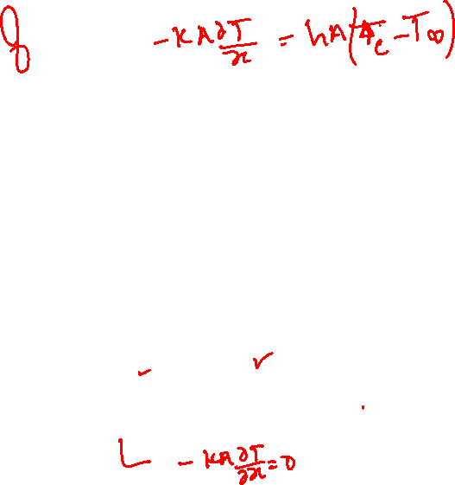
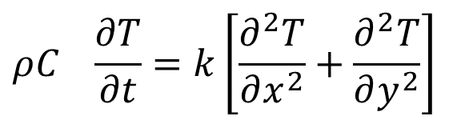
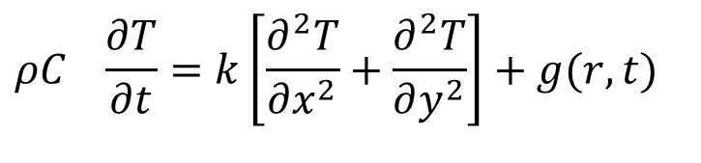
Thermal Management View of A Chip
$$ρC_{}\frac{∂T}{∂t}=k\left[\frac{∂^{2}T}{∂x^{2}}+\frac{∂^{2}T}{∂y^{2}}\right]$$
$$ρC_{}\frac{∂T}{∂t}=k\left[\frac{∂^{2}T}{∂x^{2}}+\frac{∂^{2}T}{∂y^{2}}\right]+g(r,t)$$

Slide 5
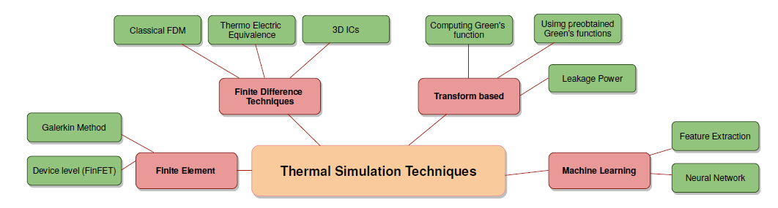
Taxonomy of solutions

Slide 6
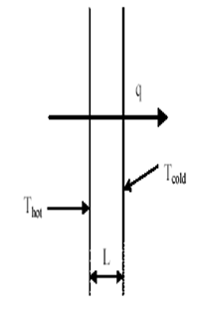

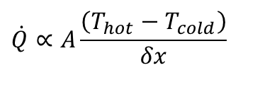
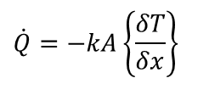
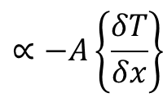

Fourier’s law of Heat Conduction : 1822
The rate of heat transfer through a solid layer is proportional to:
The temperatures difference between the left (hot) and right (cold) surfaces increase,
The wall surface area increases,
The wall thickness reduces,
$$\dot{Q}$$
$$\dot{Q}∝A\frac{\left(T_{hot}−T_{cold}\right)}{δx}$$
$$∝−A\left\{\frac{δT}{δx}\right\}$$
$$\dot{Q}=−kA\left\{\frac{δT}{δx}\right\}$$
$$δx$$
This is called as Fourier Law of Conduction
A Constitutive Relation !

Slide 7
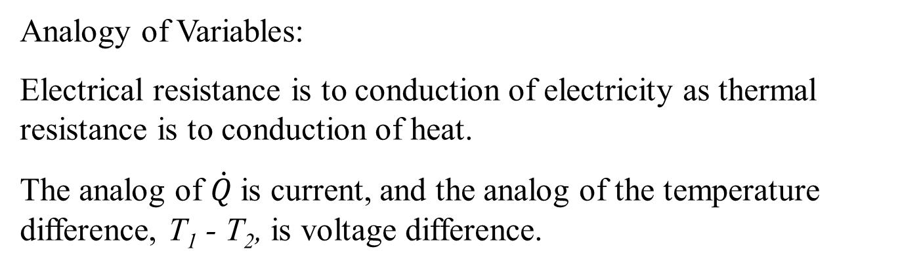
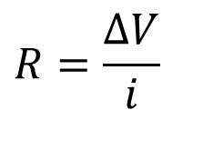
Electrical Circuit Theory of Heat Transfer
Valid at Steady State operation:
There is an analogy between heat flow by conduction (Fourier’s law) and the flow of an electrical current (Ohm’s law).
A resistance is defined as the ratio of a driving potential to a corresponding transfer rate.
$$R=\frac{ΔV}{i}$$
Analogy of Variables:
Electrical resistance is to conduction of electricity as thermal resistance is to conduction of heat.
The analog of $\dot{Q}$ is current, and the analog of the temperature difference, T₁ - T₂, is voltage difference.

Slide 8
Validity of Electrical Circuit Theory of Heat Transfer
The notion of “Thermal Resistance” is deeply rooted in the vocabulary of the thermal management.
Th physical difference between heat flow and current flow is that an electrical current itself dissipates heat.
It is erroneous to conclude that there is any practical analogy between electrical and thermal resistance.
An insulator in electrical terms is about 20 orders of magnitude less conductive a conductor, while, in thermal terms, the difference between an “insulator” and a “conductor” is only about three orders of magnitude.
The entire range of thermal conductivity is then equivalent to the difference in electrical conductivity of high-doped and low-doped silicon.
The corresponding physical properties of thermal conductivity and electrical conductivity conspire to make the behavior of heat flow quite unlike the flow of electricity in normal situations.

Slide 9
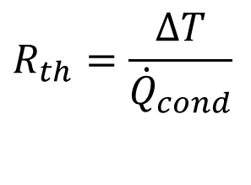
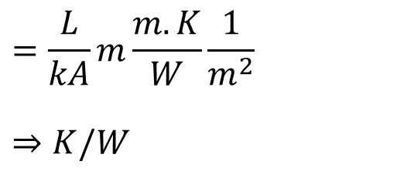
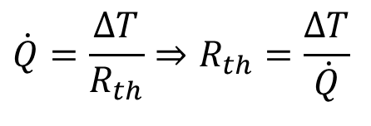
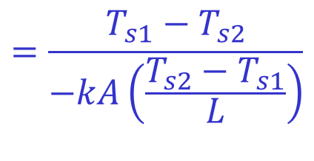
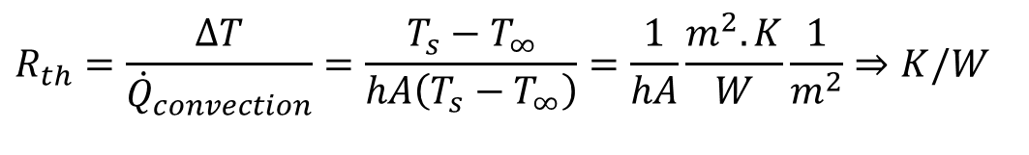
Thermal Resistance
From this perspective the slab is a pure resistance to heat transfer, and we can define
$$\dot{Q}=\frac{ΔT}{R_{th}}⇒R_{th}=\frac{ΔT}{\dot{Q}}$$
For conduction heat transfer:
$$=\frac{T_{s1}−T_{s2}}{−kA\left(\frac{T_{s2}−T_{s1}}{L}\right)}$$
$$=\frac{L}{kA}m\frac{m.K}{W}\frac{1}{m^{2}}$$
$$⇒K/W$$
$$R_{th}=\frac{ΔT}{{\dot{Q}}_{cond}}$$
Similarly for convection:
$$Thermal Managment denotes Rth as θ$$
$$R_{th}=\frac{ΔT}{{\dot{Q}}_{convection}}=\frac{T_{s}−T_{∞}}{hA\left(T_{s}−T_{∞}\right)}=\frac{1}{hA}\frac{m^{2}.K}{W}\frac{1}{m^{2}}⇒K/W$$

Slide 10
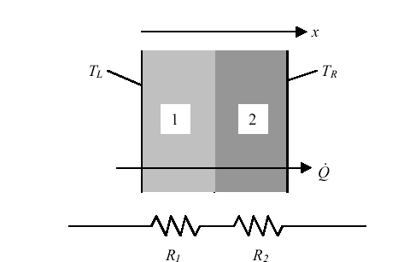
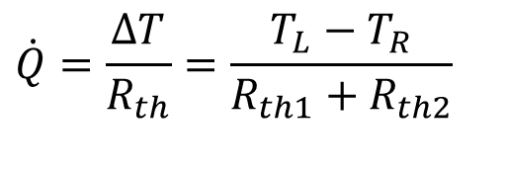
Thermal Layers in A Processors
The concept of a thermal resistance circuit allows ready analysis of problems such as a composite layers (composite planar heat transfer surface).
In the composite slab, the heat flux is constant with x.
The resistances are in series and sum to R_{th} = R_{th1} + R_{th2}.
If T_{L} is the temperature at the left, and T_{R} is the temperature at the right, the heat transfer rate is given by
$$\dot{Q}=\frac{ΔT}{R_{th}}=\frac{T_{L}−T_{R}}{R_{th1}+R_{th2}}$$

Slide 11
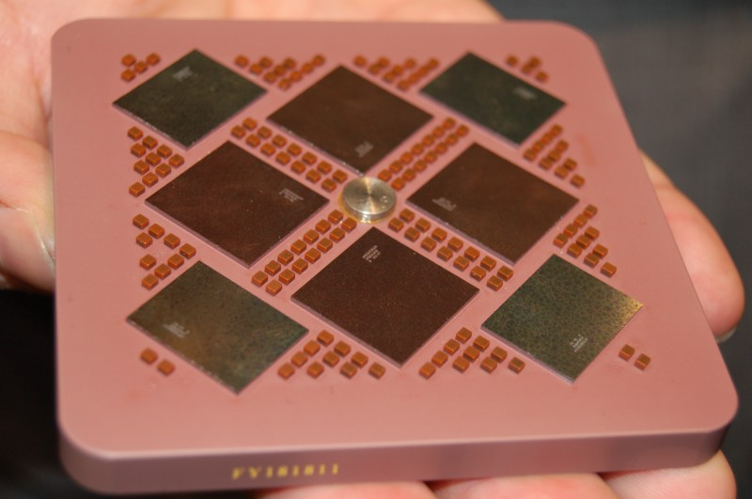
Compact Thermal Models for Chips
For a mono-chip package a compact model is a thermal resistor network containing no more than ten layers.
The concept of compact model is coined by DELPHI for ease of design of electronic equipment.
Suppliers can develop several applications without any information about the operating environments.
Rosten, H.I., Lasance, C.J.M., Parry, J.D.: The world of thermal charaterization according to DELPHI—part I: Background to DELPHI. IEEE Trans Components Packaging Technol 20(4), 384–391, December (1997)

Slide 12
Two-Resistor Compact Thermal Models for A Chip
The Two-Resistor compact model is the simplest and most intuitive of compact models.
TRCTM occupies an important place in the spectrum of compact models' methodologies.
Two-Resistor model are attractive features that allow for its rapid implementation in a wide range of simulation environments in industry.
The two-resistor model definition describes the thermal behavior of the chip package itself and its interconnection to the environment.
The environmental conditions themselves are not a part of the model and must be specified by the user in terms of boundary conditions for the relevant application.

Slide 13
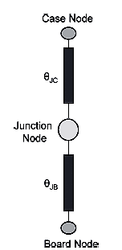
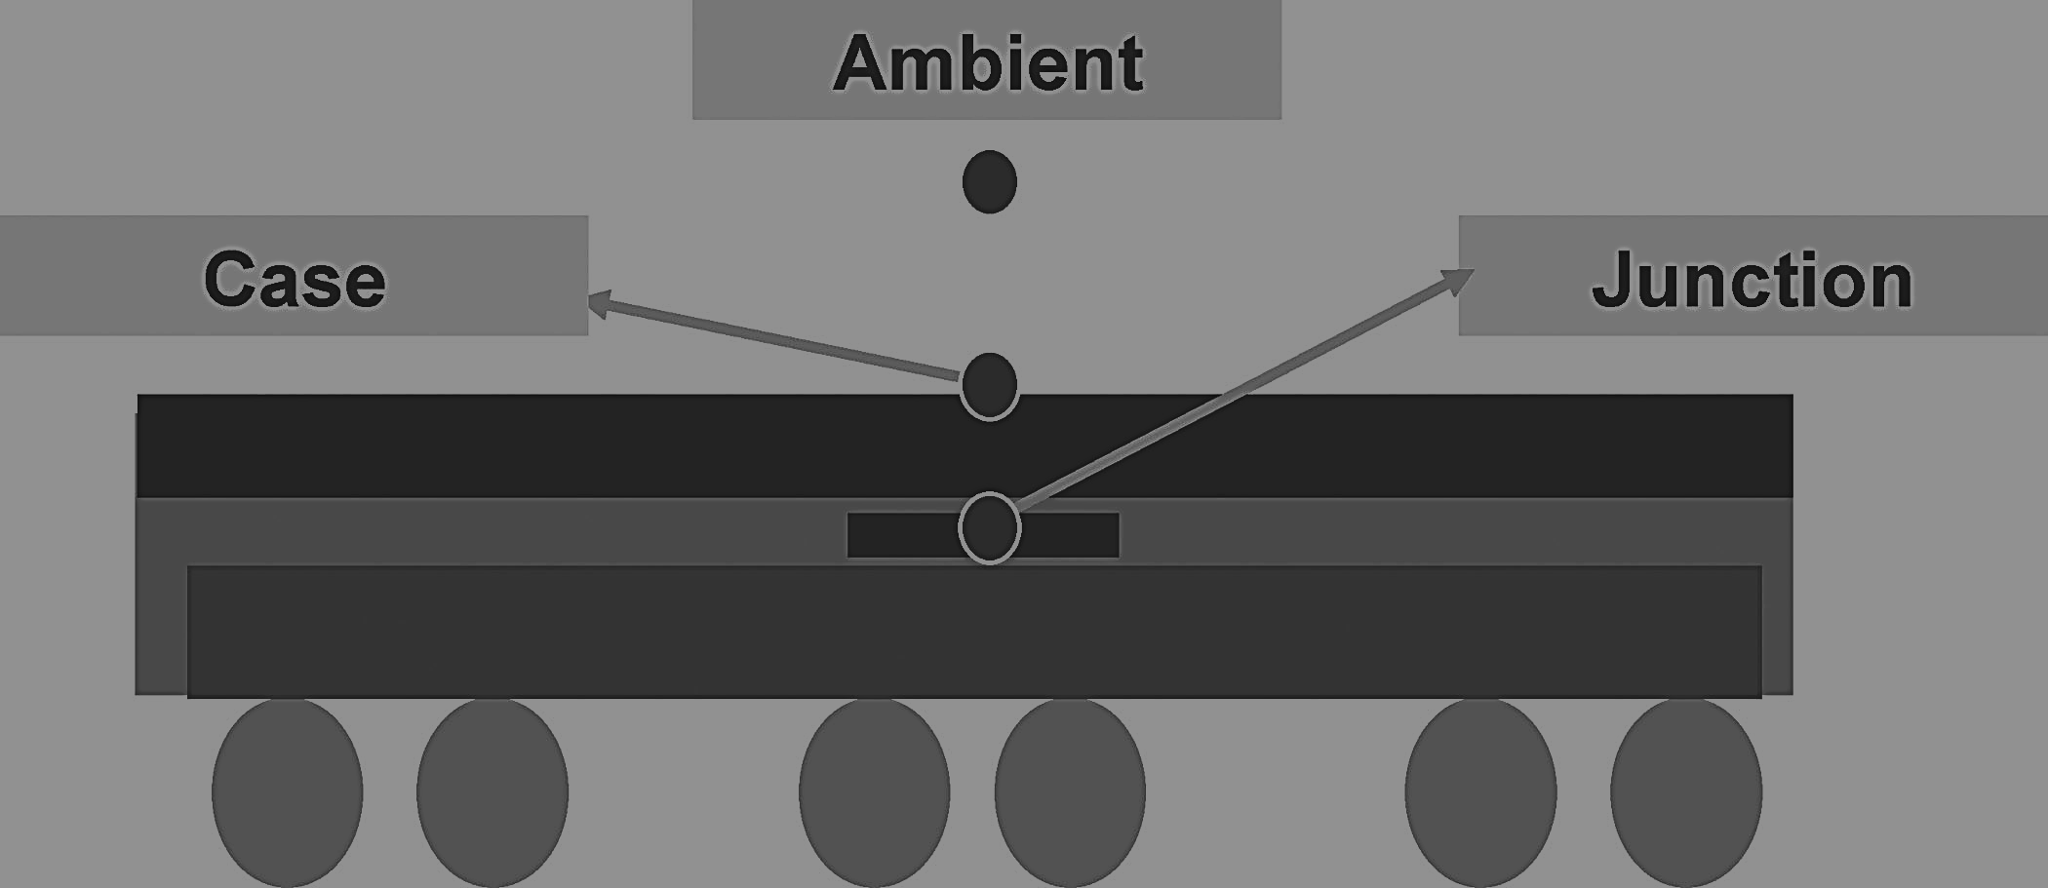
Two-Resistor Compact Thermal Models for A Chip
The 2-Resistor Model consists of three nodes.
Board

Slide 14
Two-Resistor Compact Thermal Models for A Chip
The 2-Resistor Model consists of three nodes.
These are connected together by two thermal resistors, being the known (measured/estimated) values of the Junction-to-Board and Junction-to-Case resistances.
The heating power (${\dot{W}}_{elec−chip}$) is applied at the Junction node.
The Board node is considered to be in perfect thermal contact with the local environment immediately below the PCB.
The Case node is considered to be in direct thermal contact with the local environment immediately above the top of the package.

Slide 15
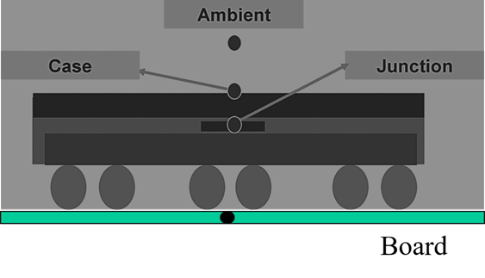
Compact Thermal Models for A Chip
$$θ_{th,JC}=\frac{{∆T}_{JC}}{{\dot{Q}}_{JC}}$$
$$=\frac{T_{J}−T_{C}}{−kA\left(\frac{T_{J}−T_{C}}{L}\right)}={\frac{L}{kA}}_{JC}$$

Slide 16




Two-Resistor Compact Thermal Models for A Chip
${\dot{W}}_{elec}={\dot{Q}}_{JC}$+ ${\dot{Q}}_{JB}$
$$θ_{th,JC}=\frac{{∆T}_{JC}}{{\dot{Q}}_{JC}}$$
$$θ_{th,JB}=\frac{{∆T}_{JB}}{{\dot{Q}}_{JB}}$$

Slide 17
Two-Resistor Compact Thermal Models for A Chip
∴There are only two paths for the heat to leave the Junction node and flow into the environment—through the Case node and through the Board node.
No heat flow through the sides is accounted for.
International standards are required to measure/estimate these resistances.
No heat flow through the sides is accounted for.
It should be kept in mind that the Two-Resistor model requires the need for understanding the application in which the package is to be used

Slide 18
Remarks on 2-R Model
The Two-Resistor model can be used during the design process at various stages.
During the initial stage of the design, it can be used in back-of-the-envelope calculations to assess the possible bounds of the package behavior.
As the design progresses,
the model can be used in more detailed simulation tools that either directly support such a model,
or provide the basic building blocks from which the model can be built.
The simulation tool could be in either of the following classes:
A thermal network calculator or
A three-dimensional simulation tool.

Slide 19
2-R Model with Variable Environments
The environmental conditions for the relevant application must be applied at the Top and Base surfaces.
For a single package placed on a PCB in an airflow environment,
the equivalent thermal resistance network diagram of the package and environment could is drawn as

Slide 20
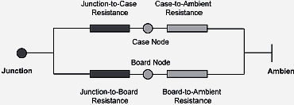
2-R Model with Variable Environments
$$θ_{th,JC}+θ_{th,CA}=\frac{{∆T}_{JA}}{{\dot{Q}}_{JC}}$$
$$θ_{th,JB}+θ_{th,BA}=\frac{{∆T}_{JA}}{{\dot{Q}}_{JB}}$$
${\dot{W}}_{elec}={\dot{Q}}_{JC}$+ ${\dot{Q}}_{JB}$

