Slide 1

Chip Level Thermal Management
P M V Subbarao
Professor
Mechanical Engineering Department
Manage the Computing Die Subjected Heat Generated by Irreversible Computing….

Slide 2

Chip Level Thermal Management
Please Pack me Safely & Cool Me ….

Slide 3


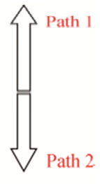
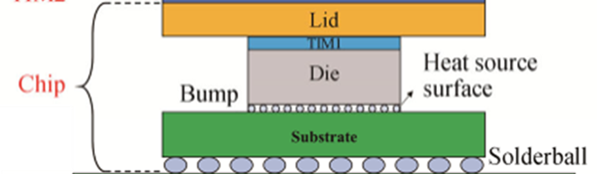
Thermal Management View of A Chip
Newton’s
Secondary Cooling Path
Fourier’s
Primary Heat Transfer Path
Convection decides the Steady State Conditions of A Processor.

Slide 4
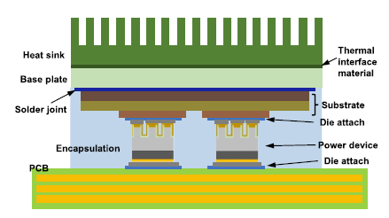
Thermal Management View of A Chip
Newton’s
Secondary Cooling Path
A junction-side (or top-side) cooling package

Slide 5
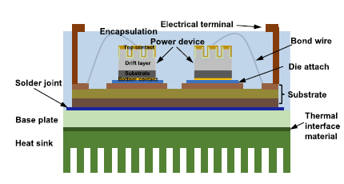
Thermal Management View of A Chip
Newton’s
Secondary Cooling Path
A Bottom-side cooling package

Slide 6
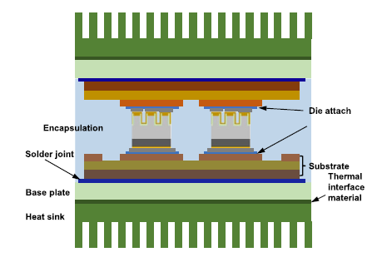
Thermal Management View of A Chip
Newton’s
Secondary Cooling Path
Newton’s
Secondary Cooling Path
A double-side cooling package

Slide 7
The Die Saviour Concept
This work is
“the mathematical principles of Natural philosophy”
Based on the phenomena of motions to investigate the forces of nature.
These forces demonstrate the other phenomena.
when asked once about how this scientist gained his insight into the problems of nature, replied
“By constantly thinking unto them.”
In analogy with Euclid’s Geometric Progression (300 B.C.), Napier’s Logarithms (1614)
The Newton’s Law of Cooling (1701)

Slide 8
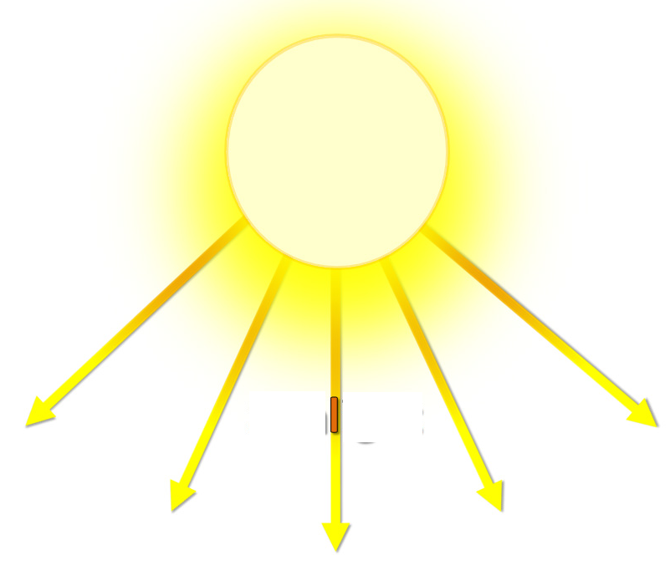
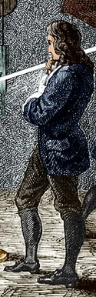

Another Newton’s Experience
Natural Philosophy!

Slide 9

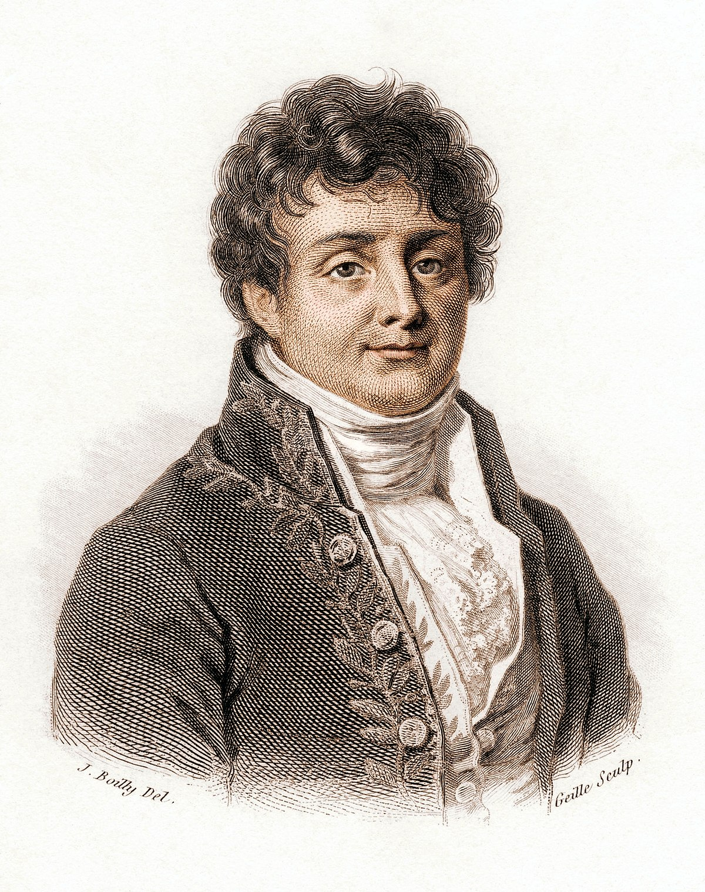
Fourier's Interpretation of Newton’s Experience

Slide 10
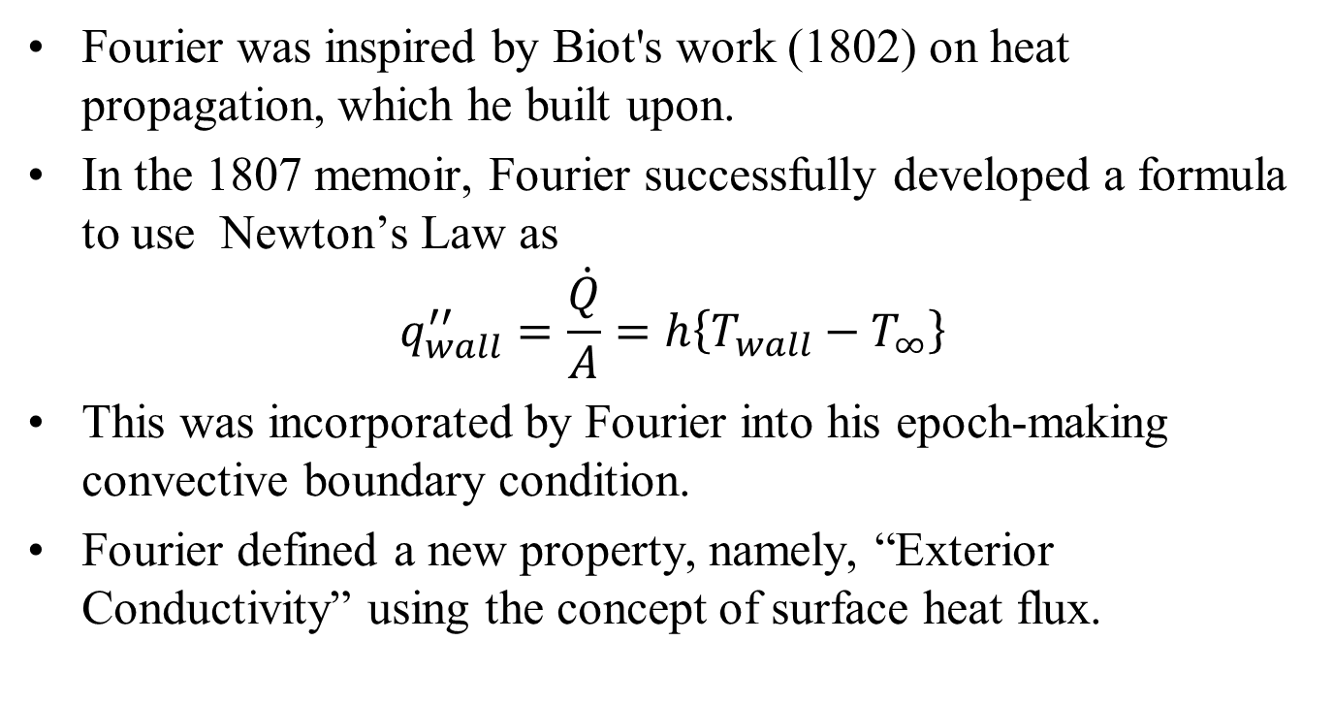
From Newton (1701) to Fourier (1822)
Fourier was inspired by Biot's work (1802) on heat propagation, which he built upon.
In the 1807 memoir, Fourier successfully developed a formula to use Newton’s Law as
$$q_{wall}^{′′}=\frac{\dot{Q}}{A}=h\left\{T_{wall}−T_{∞}\right\}$$
This was incorporated by Fourier into his epoch-making convective boundary condition.
Fourier defined a new property, namely, “Exterior Conductivity” using the concept of surface heat flux.

Slide 11
Newtons Law of Cooling by Fourier
Fourier practically completed the modern heat conduction theory using Newton’s law of cooling.
In Fourier’s heat conduction theory, the unsteady term of his equation and the resulting exponential term involving time in analytical solution represents Newton’s legacy.
In the analytical solution of unsteady heat conduction problem involving a solid sphere, Newton’s cooling problem results when the Biot number is very small.
Therefore, Fourier presented the exact analytical solution of Newton’s cooling problem.

Slide 12
19th Century Fourier’s Energy Balance Equation
The energy conservation equation is a differential statement of the thermal energy balance in a body under study.
The thermal energy content E (J) of a material body can change only if energy is removed/added through its bounding surface or energy is generated or absorbed within the body.
Consider a small volume element V inside a material undergoing heat conduction processes.
The rate of change of thermal energy E of a Control Mass at a point inside the volume, V is
$$\frac{1}{V}\frac{∂E}{∂t}$$

Slide 13
20th Century Thermal Energy Balance Equation for A Control Mass
$$\frac{1}{V}\frac{∂E}{∂t}=\frac{∂Η}{∂t}$$
where enthalpy Η of the material (J/m³) is the amount of thermal energy per unit volume E/V .
From thermodynamics, the following relationship expresses the accumulated enthalpy in a material resulting from increasing its temperature from T₁ to T₂,
$$Η=\int_{T_{1}}^{T_{2}}{ρC_{p}dT}$$
More complex Η - T relationships are also important.

Slide 14
The Rate of Change in Energy of A Control Mass
$$Η=\int_{T_{1}}^{T_{2}}{ρC_{p}dT}$$
Introducing the above Η - T relationship, the rate of change of thermal energy gives:
$$\frac{∂Η}{∂t}=ρC_{p}\frac{∂T}{∂t}$$
Fourier identified that the rate of changed of thermal energy of a control mass is a reaction.
The action is “net outflow of thermal energy” through the bounding surface A of volume V is given by
$$−\iint_{A}{\vec{q′′}.\hat{n}dA}$$
Fourier’s Original Invention is: What causes above action???
$$−\iint_{A}{q′′.\hat{n}dA}=−\iiint_{V}{∇.\vec{q′′}dV}$$
Using divergence theorem :

Slide 15
Additional Action (Energy) Term by Fourier
$$−\iiint_{V}{∇.\vec{q′′}dV}$$
Where, $\vec{q′′}$is the heat flux vector representing the amount of energy crossing through a unit boundary area per unit time (J/m²s).
Heat Generation: A medium through which heat is conducted may involve the conversion of electrical, nuclear or chemical energy into thermal energy.
Often absorption of radiation such as solar energy or gamma rays is modeled as heat generation.
The heat generation is a volumetric phenomenon.
The rate of internal heat generation/absorption at a point in the body (J/m³s) is assumed given as $g\left\{\vec{r};t\right\}$.

Slide 16
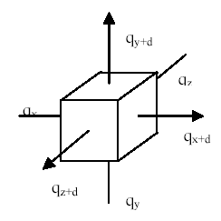
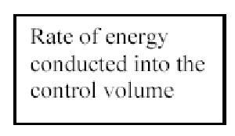
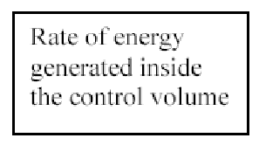


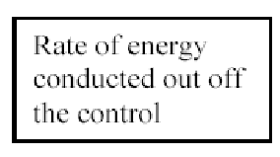
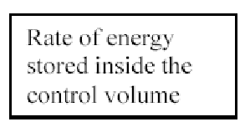
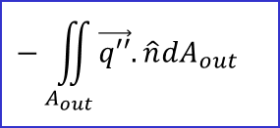
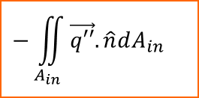
The Thermal Energy Balance Equation by Fourier
Consider an active Functional Block
$$\iiint_{V}{g(\vec{r},t)dV}$$
$$−\iint_{A_{in}}{\vec{q′′}.\hat{n}dA_{in}}$$
$$\iiint_{V}{\frac{∂H}{∂t}dV}$$
$$−\iint_{A_{out}}{\vec{q′′}.\hat{n}dA_{out}}$$

Slide 17
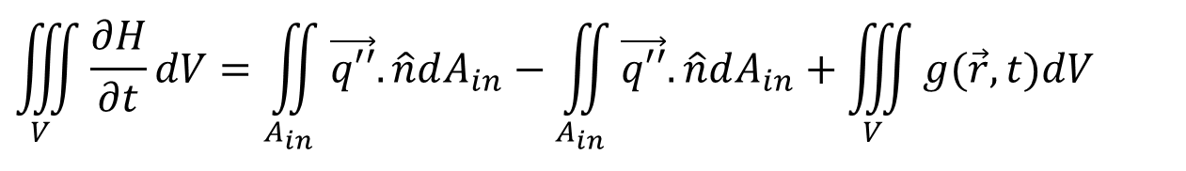
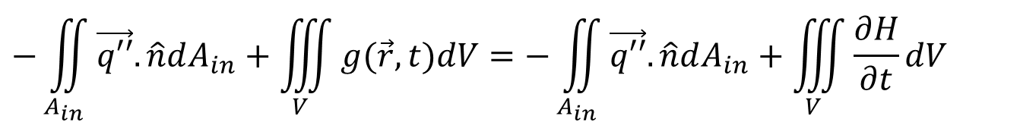
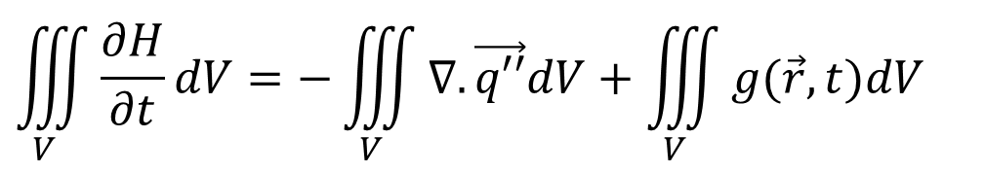
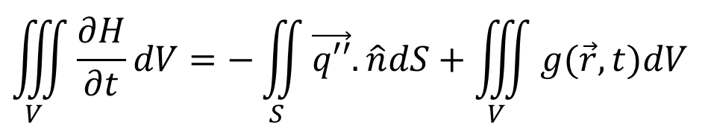
The Thermal Energy Balance Equation
$$−\iint_{A_{in}}{\vec{q′′}.\hat{n}dA_{in}}+\iiint_{V}{g(\vec{r},t)dV}=−\iint_{A_{in}}{\vec{q′′}.\hat{n}dA_{in}}+\iiint_{V}{\frac{∂H}{∂t}dV}$$
$$\iiint_{V}{\frac{∂H}{∂t}dV}=\iint_{A_{in}}{\vec{q′′}.\hat{n}dA_{in}}−\iint_{A_{in}}{\vec{q′′}.\hat{n}dA_{in}}+\iiint_{V}{g(\vec{r},t)dV}$$
$$\iiint_{V}{\frac{∂H}{∂t}dV}=−\iint_{S}{\vec{q′′}.\hat{n}dS}+\iiint_{V}{g(\vec{r},t)dV}$$
Using Gauss Divergence Theorem:
$$\iiint_{V}{\frac{∂H}{∂t}dV}=−\iiint_{V}{∇.\vec{q′′}dV}+\iiint_{V}{g(\vec{r},t)dV}$$

Slide 18
The Fourier Conduction Equation
$$\iiint_{V}{\frac{∂H}{∂t}dV}=−\iiint_{V}{∇.q′′dV}+\iiint_{V}{g(\vec{r},t)dV}$$
However, since the integrals are equal the arguments are also equal, and the most general form of the differential thermal energy balance equation is
$$\frac{∂H}{∂t}=−∇.q′′+g(\vec{r},t)$$
This is called the differential thermal energy balance equation.
∴ Newton’s law of cooling is an essential boundary condition for an Electronic Processor (Control Mass).

Slide 19
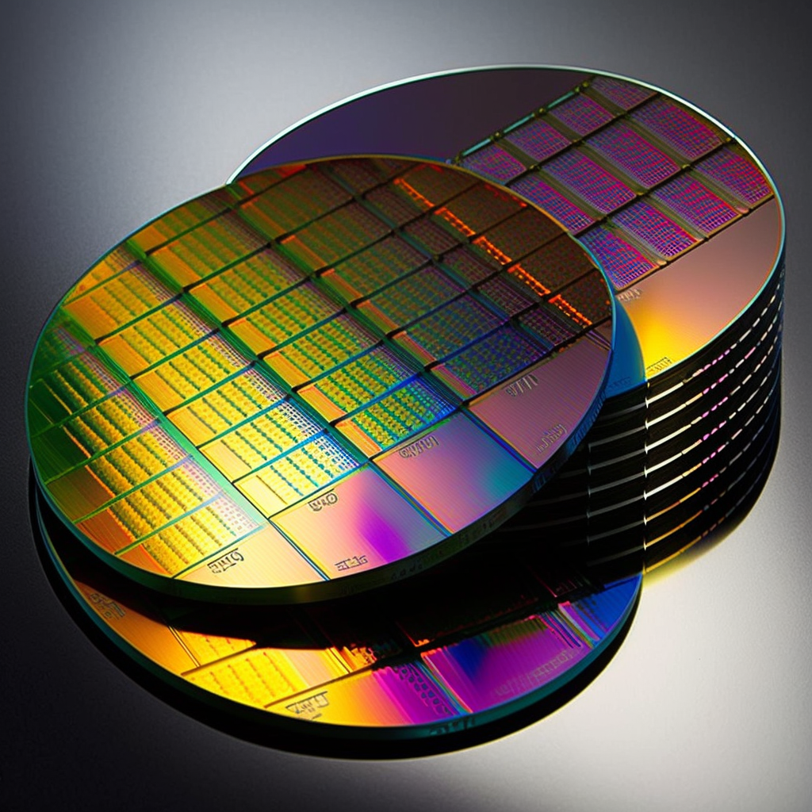

Fourier’s Constitutive Equation for the Heat Flux
$$\frac{∂H}{∂t}=−∇.q′′+g(\vec{r},t)$$
Thickness of a selected functional block is much smaller than other two dimensions:
Wafers used in VLSI fabrication are typically between 100 and 300 millimeters in diameter and between 0.01 and 1 millimeter thick.
The most common size used in the industry is 300mm, although smaller sizes, such as 200mm and 150mm are still used in some applications.
$$∆y≈∆z≫∆x$$

Slide 20
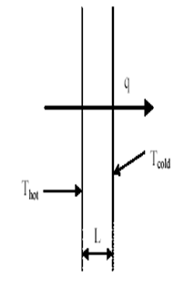
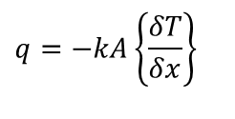
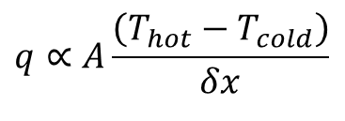
Fourier’s law of Heat Conduction : 1822
The rate of heat transfer through the wall is proportional to:
The temperatures difference between the left (hot) and right (cold) surfaces increase,
The wall surface area increases,
The wall thickness reduces,
A Constitutive Relation
$$q∝A\frac{\left(T_{hot}−T_{cold}\right)}{δx}$$
$$∝−A\left\{\frac{δT}{δx}\right\}$$
$$q=−kA\left\{\frac{δT}{δx}\right\}$$
$$δx$$
This is called as Fourier Law of Conduction

Slide 21
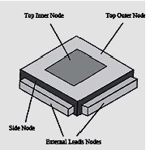
Local Heat Flux during Conduction
Local Heat flux in a slab along x-direction:
$$q_{x}′′= −k\lim_{δx→0}\left\{\frac{\left(T_{cold}(x+δx)−T_{hot}(x)\right)}{\left(x+δx\right)−x}\right\}$$
$$q_{x}′′= −k\left\{\frac{dT}{dx}\right\}$$
$$\vec{q^{′′}}= −k∇T$$

Slide 22


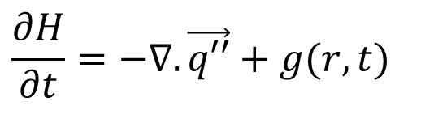
Fourier’s Constitutive Equation for an Electronic Processor
$$\frac{∂H}{∂t}=−∇.\vec{q′′}+g(r,t)$$
$$\vec{q′′}=−k∇T$$
$$\vec{q′′}=−\vec{\vec{k}}•∇T$$
$$\vec{\vec{k}}=\left[\begin{aligned}&k_{\text{xx}} {\text{k}}_{\text{xy}} {\text{k}}_{\text{xz}} \\ &k_{\text{yx}} {\text{k}}_{\text{yy}} {\text{k}}_{\text{yz}} \\ &k_{\text{zx}} {\text{k}}_{\text{zy}} {\text{k}}_{\text{zz}}\end{aligned}\right]$$
The General Fourier Conduction Equation
$$ρC_{}\frac{∂T}{∂t}=∇.\left\{\vec{\vec{k}}.∇T\right\}+g(r,t)$$

