Slide 1

Thermodynamics of Computing Process
P M V Subbarao
Professor
Mechanical Engineering Department
Irreversible Issues in Computation and Electronic Devices

Slide 2

Energetic Issues of ICTs
Bennet and Landauer have shown that there exists a minimum amount of energy required to perform any computation.
The ultimate limit on the minimum energy per switching is set at k_{B}T ln2.
It is approximately 10⁻²¹J at room temperature, called as the Shannon-von Neumann-Landauer (SNL) limit.
Computing machines inevitably involve devices which perform logical functions that do not have a single-valued inverse.
This logical irreversibility is associated with physical irreversibility.
Generates a minimal heat generation, per machine cycle, typically of the order of k_{B}T for each irreversible function.

Slide 3
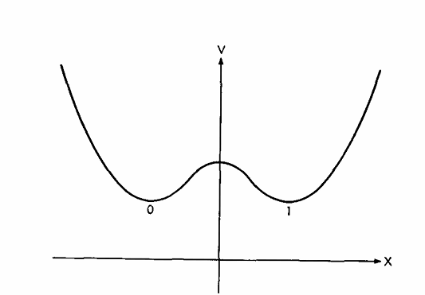
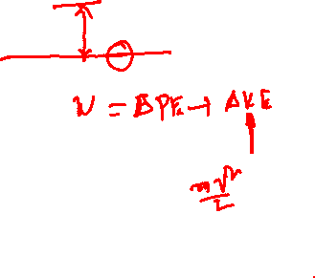
Physical Irreversibility Due to Logical Irreversibility
Consider A
Any programing logic to change 0 to 1 is physically interpreted as:
Bistable potential well.
0 and 1 are two equilibrium positions of this well.

Slide 4
Energetic Issues of ICTs
This dissipation serves the purpose of standardizing signals and making them independent of their exact logical history.
Even erasing information decreases the overall entropy of the system and this cannot be done without dissipating heat of at least k_{B}T ln2 Joule per bit erased.
Therefore, ideal computation is also thermodynamically irreversible!

Slide 5
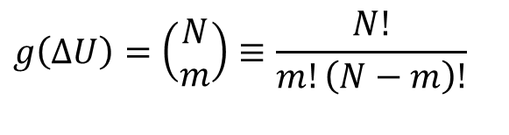

Computational or Information Entropy
For a given value of change in energy of a die (ΔU), there are numerous permutations of bits that yield m ones and (N - m) zeros.
If each of these g(ΔU) permutation states is equally likely, one can define the entropy as
$$S\left(ΔU\right)=\ln\left\{g\left(ΔU\right)\right\}$$
Where g(ΔU) is named as a degeneracy function.
Using simple probability
$$g\left(ΔU\right)=\left(\begin{matrix}N \\ m\end{matrix}\right)≡\frac{N!}{m!\left(N−m\right)!}$$

Slide 6

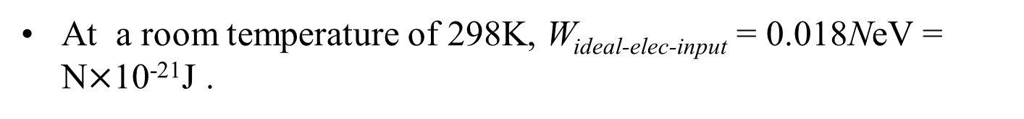
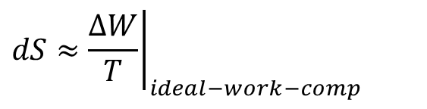
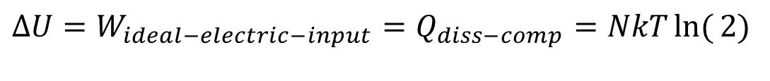

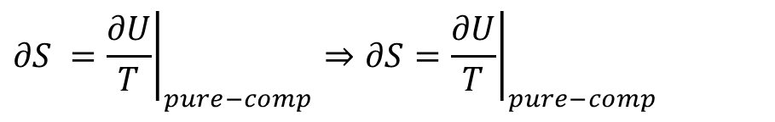
Extension of Boltzmann theory :Energy consumption by An Ideal Electronic Device
Ideal electrical work to be consumed for N bits of computation is:
$$∆U=W_{ideal−electric−input}=Q_{diss−comp}=NkT\ln{(}2)$$
At a room temperature of 298K, W_{ideal-elec-input} = 0.018NeV = N$×$10⁻²¹J .
A closed system executing a process is governed by:
For a constant volume device:
$$TdS=dU+pdV$$
$$∂S ={\left.\frac{∂U}{T}\right|}_{pure−comp}⇒∂S={\left.\frac{∂U}{T}\right|}_{pure−comp}$$
$$dS≈{\left.\frac{∆W}{T}\right|}_{ideal−work−comp}$$
For a solid system:
$$dU=CdT=NkT\ln{(}2)$$
Ideal Electronic Devices can almost work as Adiabatic systems and require no cooling!!!

Slide 7
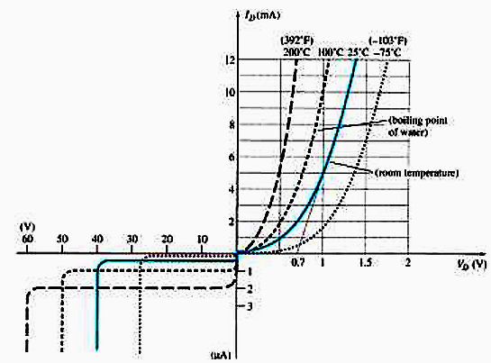

Extension of Boltzmann Theory
Ideal electrical work to be consumed for a bit of computation is:
$$W_{electric−input}=Q_{diss}=kT\ln{(}2)$$
At a room temperature of 298K, W_{ideal-input} = 0.018eV = 10⁻²¹J
Why more energy is consumed at higher device temperatures?
Any excess energy must be dissipated and leads to Entropy Generation…

Slide 8
Physical & Logical Irreversibility
A device logically irreversible if the output of a device does not uniquely define the inputs.
It is believed that devices exhibiting logical irreversibility are essential for computing.
Logical irreversibility in turn implies physical irreversibility, and the latter is accompanied by dissipative effects.

Slide 9
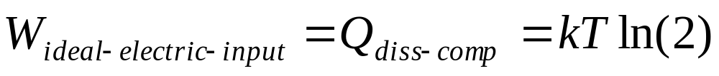
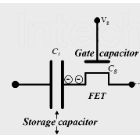
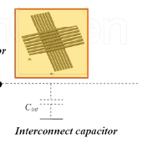
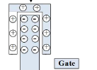

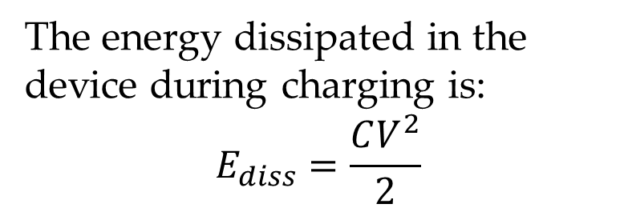
Fabrication of An Ideal Electronic Device
Ideal electrical work to be consumed for a bit of computation is:
Every thermodynamic process occurs in a material (Device).
Microelectronic devices used as Logic and memory devices
The energy dissipated in the device during charging is:
$$E_{diss}=\frac{CV^{2}}{2}$$
Capacitance is related to a linear dimension, L.

Slide 10
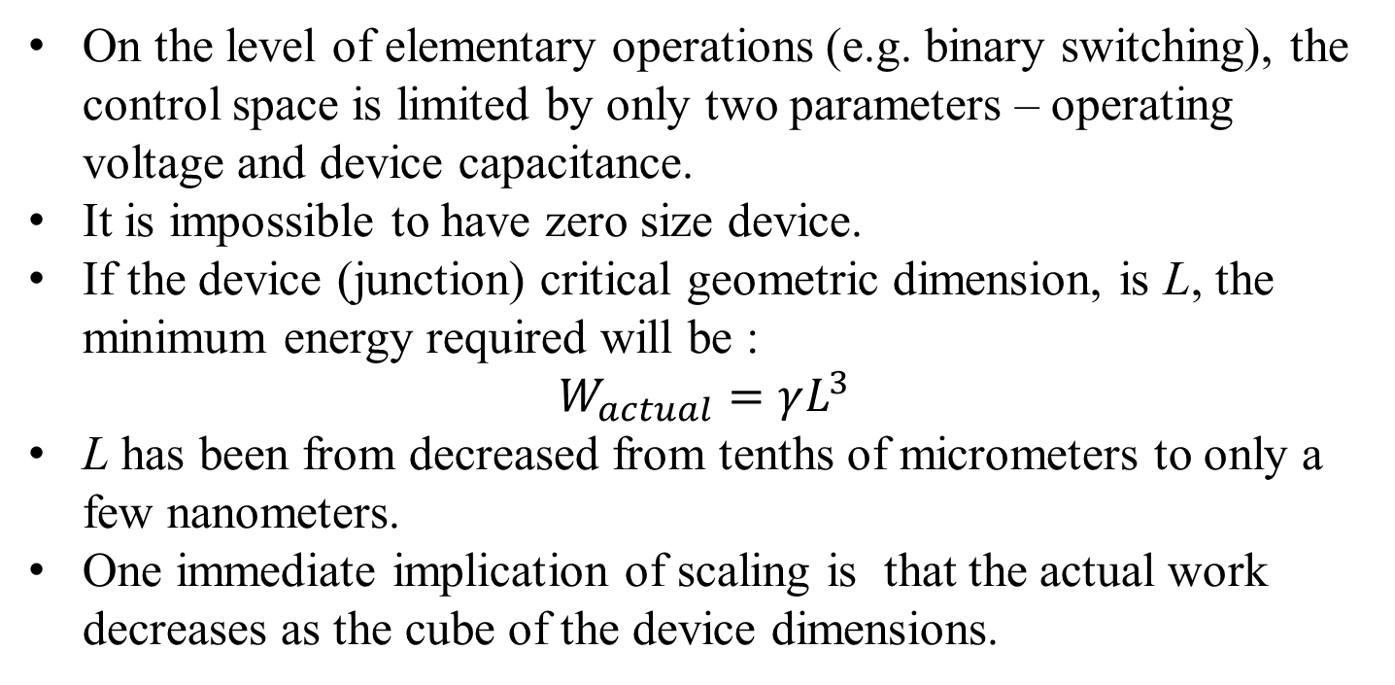
Fabrication of An Ideal Electronic Device
Ideal electrical work to be consumed for a bit of computation is:
On the level of elementary operations (e.g. binary switching), the control space is limited by only two parameters – operating voltage and device capacitance.
It is impossible to have zero size device.
If the device (junction) critical geometric dimension, is L, the minimum energy required will be :
$$W_{actual}=γL^{3}$$
L has been from decreased from tenths of micrometers to only a few nanometers.
One immediate implication of scaling is that the actual work decreases as the cube of the device dimensions.

Slide 11
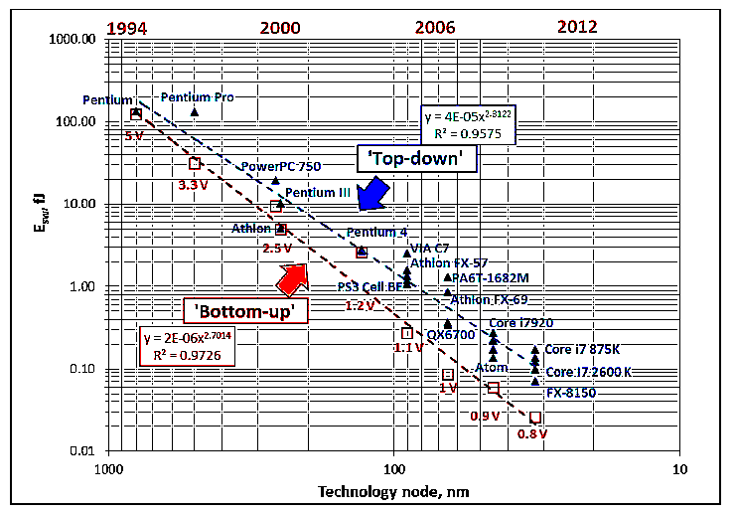
Dimension of A Junction

Slide 12
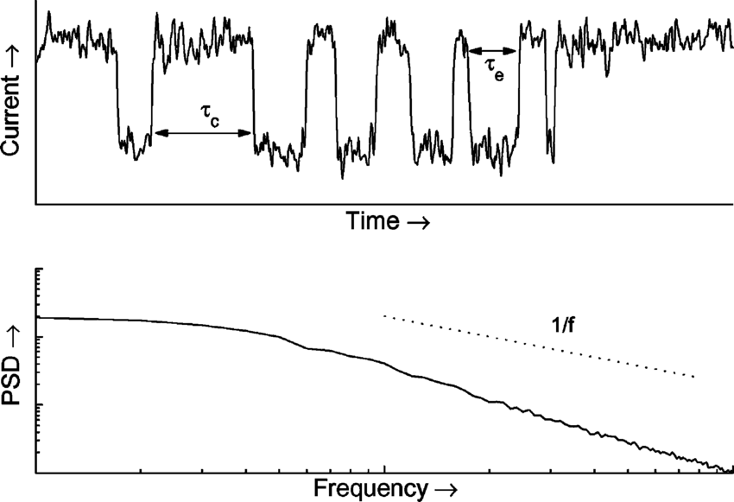
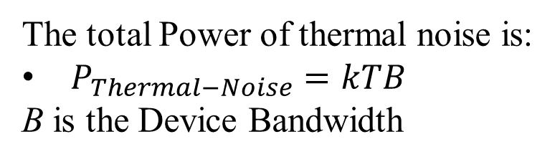
Additional Work to Compute against Thermal Noise
All materials produce noise at a power level proportional to the physical temperature of the material.
The noise is generated by random vibrations of conducting electrons and holes in the material.
This noise is often referred to as thermal noise.
Thermal noise is white and has a Gaussian amplitude distribution.
Thermal noise of a MOSFET with a 0.18-μm gate width.
The total Power of thermal noise is:
$P_{Thermal−Noise}=kTB$
B is the Device Bandwidth

Slide 13
Actual Energy consumption by An Irreversible Electronic Device
At a room temperature of 298K, W_{ideal-input} = 0.018eV.
Thermal noise on gates of minimum‐width segments of FET gates leads to channel fluctuations below ~1‐2 eV.
ITRS has minimum gate energy asymptoting to ~2 eV
Also, real logic circuits incur many further overhead factors leading to more losses:
Transistor width 10‐20× min.
Parasitic (junction, etc.) transistor capacitances (~2×)

Slide 14
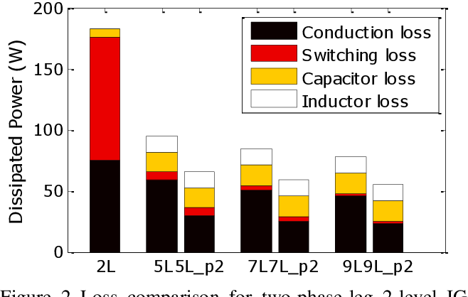
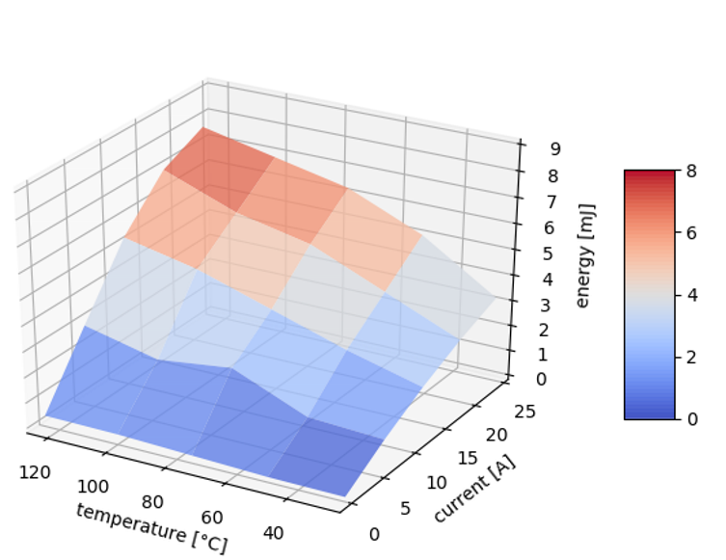
Energy consumption by An Irreversible Electronic Device
Multiple (~2) transistors fed by each input to a given logic gate
Fan‐out to a few (~3) logic gates
Parasitic wire capacitance (~2×)
Due to all these overheads, the electrical work input to each bit in real logic circuits is many times larger than the min.‐width gate energy 375‐600× (!) larger.
Practical bit energy for irreversible logic asymptotes to ~1 keV!
Practical, real‐world logic circuit designs can’t just magically cross this ~500× architectural gap!
Thermodynamic limits imply much larger practical limits!

Slide 15
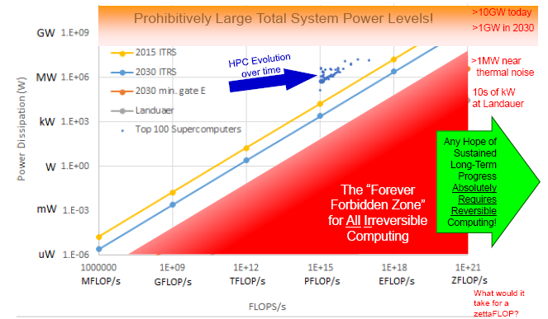
Evolution of Irreversible Computing

Slide 16
Second Law of Thermodynamics for Electronic Systems
Heat generation is an unavoidable by-product of operating electronics.
It is impossible to construct an Electric/Electronic System which produces no effect other than the consumption of Electric power from a source and the production of an equivalent amount of ICT Services
It is impossible to develop an electric/electronic device with zero heat generation.
It is difficult to operate electronics at ambient temperature.

Slide 17
Thermal Management: Designing for Reliability
Device reliability is a complex function of
the heat generated by the operation of an electronic device,
the tools used to dissipate or manage the heat,
the thermal stability of the materials used &
the environment in which the device is required to operate.
Diversity of applications & the increasing demand enjoin diverse thermal management tools.
Popular tools include gap fillers, active cooling systems, heat pipes and heat sinks.

Slide 18
Holistic Thermal Management Strategies
Reducing the Heat
Removing the Heat
Beating the Heat
Surviving the Environment

