Slide 1


Granularity of Thermal Management of Electronic Systems
P M V Subbarao
Professor & Head
Mechanical Engineering Department
Different Principles for Various Levels of Thermal Management

Slide 2

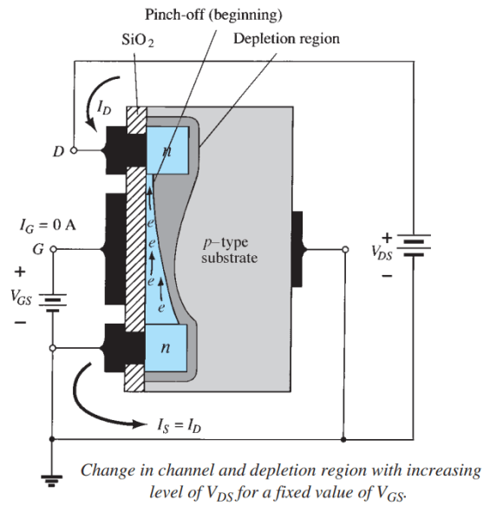
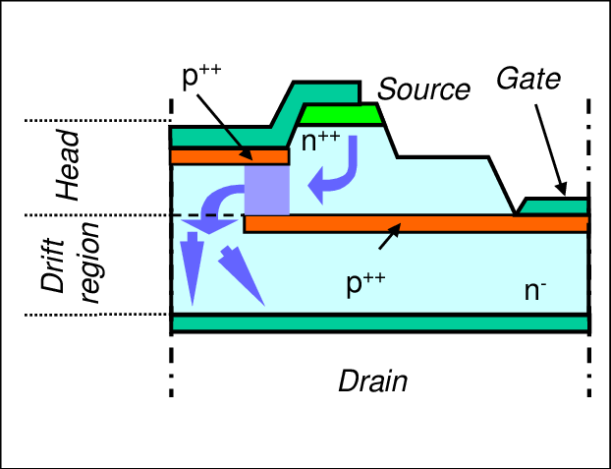
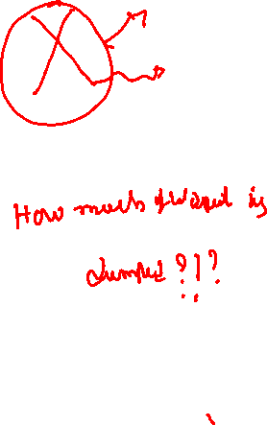
Zone of Heat Dissipation in a JFET

Slide 3
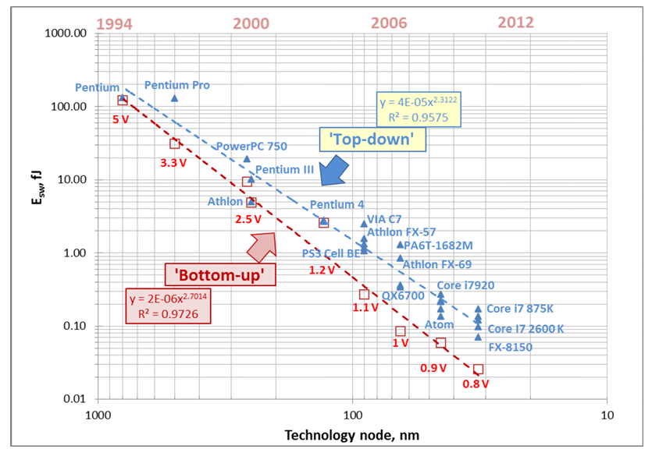
Switching Energies of Individual Transistors

Slide 4
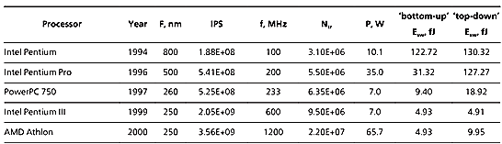
Switching Energies of Individual Transistors

Slide 5
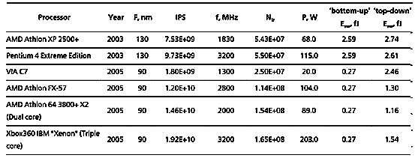
Switching Energies of Individual Transistors

Slide 6
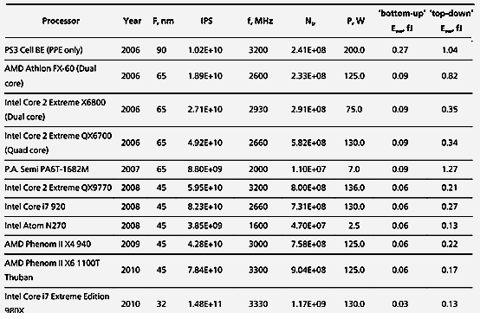
Switching Energies of Individual Transistors

Slide 7
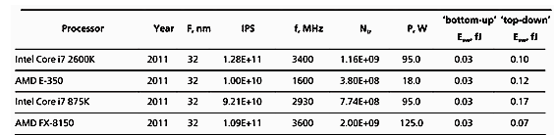
Switching Energies of Individual Transistors

Slide 8
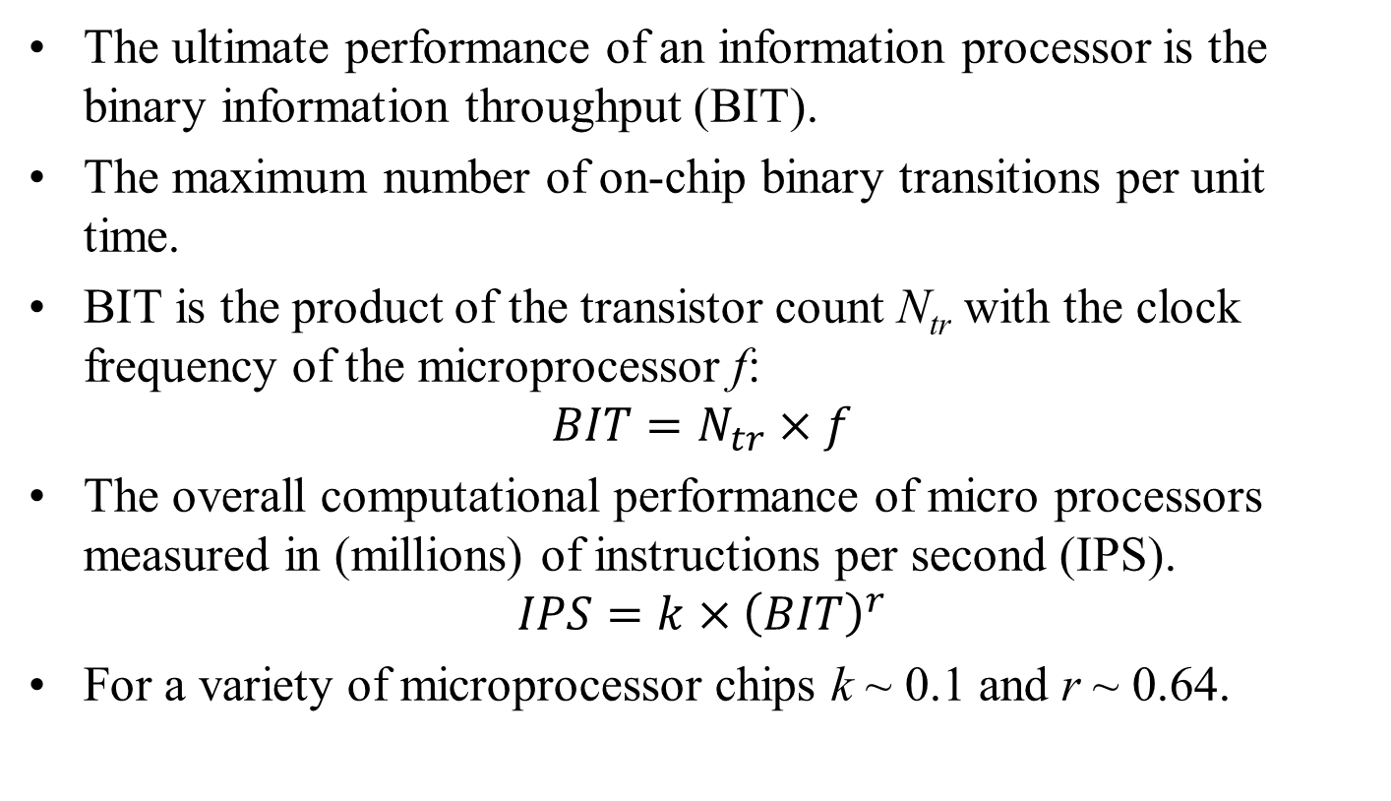
Performance Indicators of ICT Devices
The ultimate performance of an information processor is the binary information throughput (BIT).
The maximum number of on-chip binary transitions per unit time.
BIT is the product of the transistor count N_{tr} with the clock frequency of the microprocessor f:
$$BIT=N_{tr}×f$$
The overall computational performance of micro processors measured in (millions) of instructions per second (IPS).
$$IPS=k×{\left(BIT\right)}^{r}$$
For a variety of microprocessor chips k ~ 0.1 and r ~ 0.64.

Slide 9
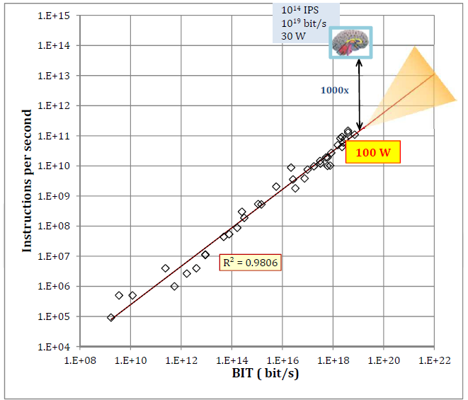
A trend for increasing computational performance through device scaling

Slide 10
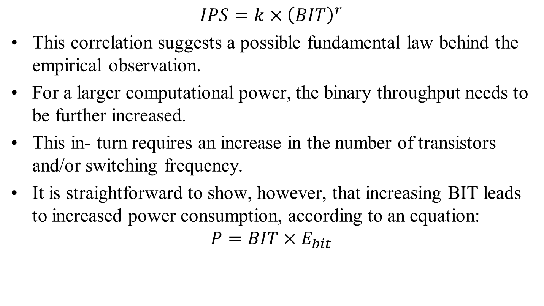
Performance Indicators of ICT Devices
$$IPS=k×{\left(BIT\right)}^{r}$$
This correlation suggests a possible fundamental law behind the empirical observation.
For a larger computational power, the binary throughput needs to be further increased.
This in- turn requires an increase in the number of transistors and/or switching frequency.
It is straightforward to show, however, that increasing BIT leads to increased power consumption, according to an equation:
$$P=BIT×E_{bit}$$

Slide 11
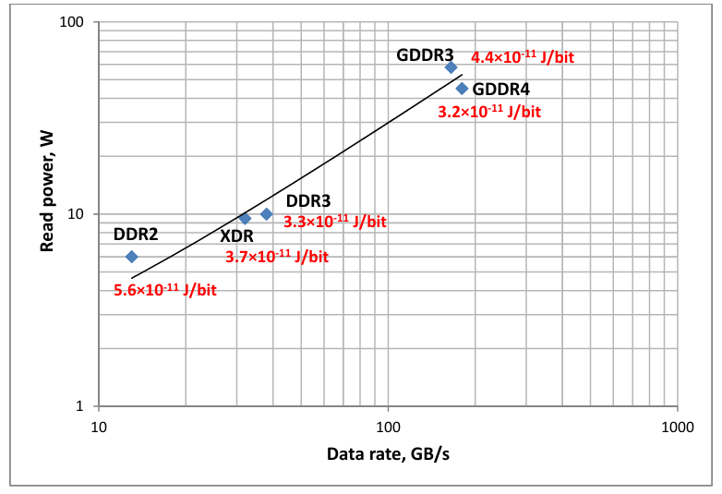
Power vs. data rate

Slide 12
Optimizing Server Hardware and Workloads
Energy-efficient hardware: Older processors and storage disks are replaced with modern, high-efficiency solid-state units designed to draw less power.
Server virtualization: Multiple software applications run on a single physical machine, lowering the total count of active servers.
Server consolidation: Idle or lightly used equipment is shut down or removed, which directly shrinks the power footprint.

Slide 13
Fundamental limits in Work of computing
Human Brain is the Least Work Demanding ICTs and architectures.
The function of brain in terms of the equivalent number of binary transitions include support language, deliberate movements, information-controlled functions of the organs, hormone system etc.,
This leads to an ‘effective’ binary throughput of the brain ~ 10¹⁹ bit/s.
An estimate of the number of equivalent instructions-per-second (IPS) was made from the analysis of brain image processing capability resulting in ~10¹⁴ IPS.
The fact is that the brain, a- biological information processor, operates at only ~30W.

Slide 14
ICT vs Brain Technology
The most recent and most impressive demonstration of an artificial intelligence computer system, the IBM Watson supercomputer.
It is capable of answering questions posed in natural language and the winner of the 2011 Jeopardy! quiz show,.
It is built from ~3000 processor cores (POWER7) each consisting of 1.2B transistors and operating at 3.5GHz.
The approximate total binary throughput about 10²² bit/s.
The machine consumes ~200kW of power.
The fact that the brain, a- biological information processor, operates at only ~30W suggests that 199.7 kW of power is dissipated as heat and responsible for generation of entropy.

Slide 15
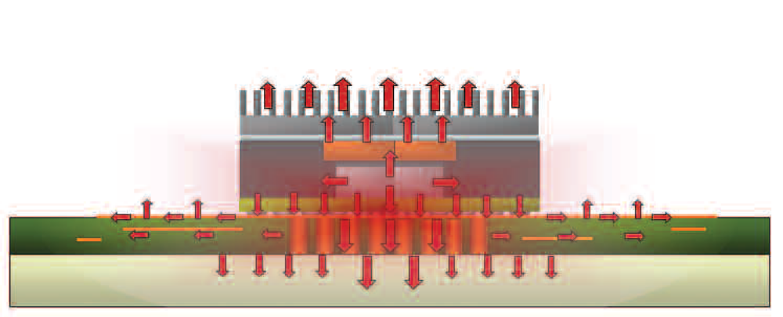
Newton (1701)
Creation of Efficient Cooling Systems
The key to improving reliability & performance is to reduce device temperature by increasing the rate at which heat is removed from the device and from the working area adjacent to the device.
Heat transfer Analysis then becomes the next step.
Challenge 1: How to facilitate removal of heat from Die or in particular the performing junction.
Challenge 2: Chip Packaging Technologies lower the opportunities of efficient heat removal techniques.

Slide 16
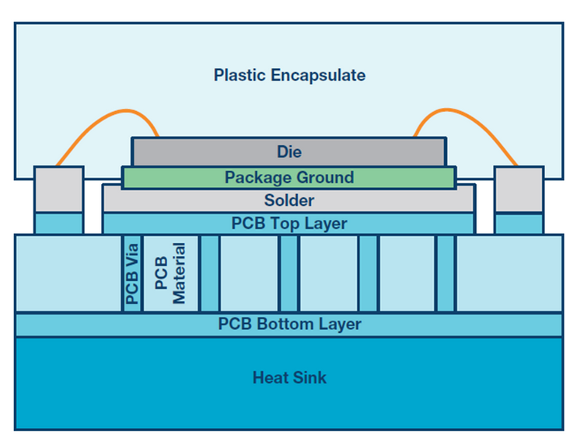
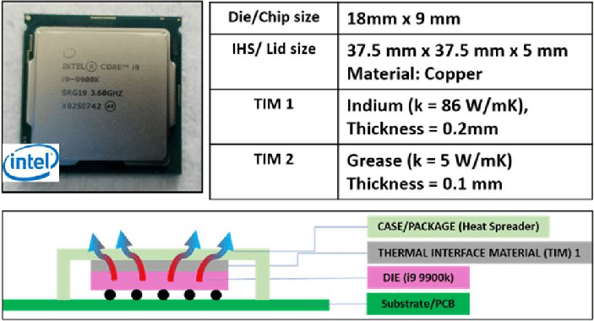
Thermal Model of Processor Package (Internal)

Slide 17
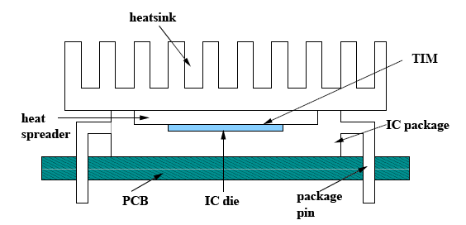
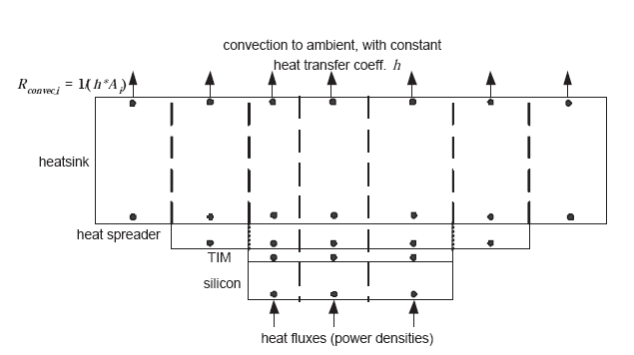
Thermal Model of Processor Package (External)

Slide 18

Chip Level (Scale -1) Thermal Management
CLTH includes:
Thermal analysis of chip packaging.
Design of new high conductive thermal adhesives.
Innovative methods for the attachment the die to the heat spreader, including the use of solder maybe considered in this scale.
Improving/Realizing the theoretical limitation of the heat removal from the chip.

Slide 19
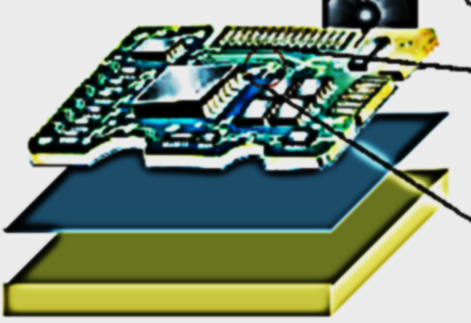
Anatomy of a General Electronic Board for Thermal Management Study
Printed Circuit Board (PCB)
Thermal Interface Material
(Optional)
Heat Sink

Slide 20
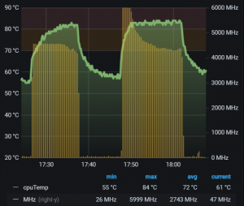
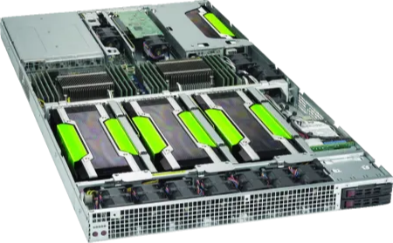
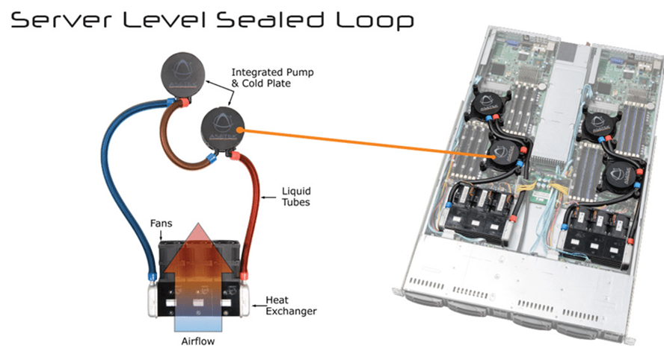
Thermal Model of A Server
Most GPU’s have thermal throttle points set at or near 80degC.

Slide 21
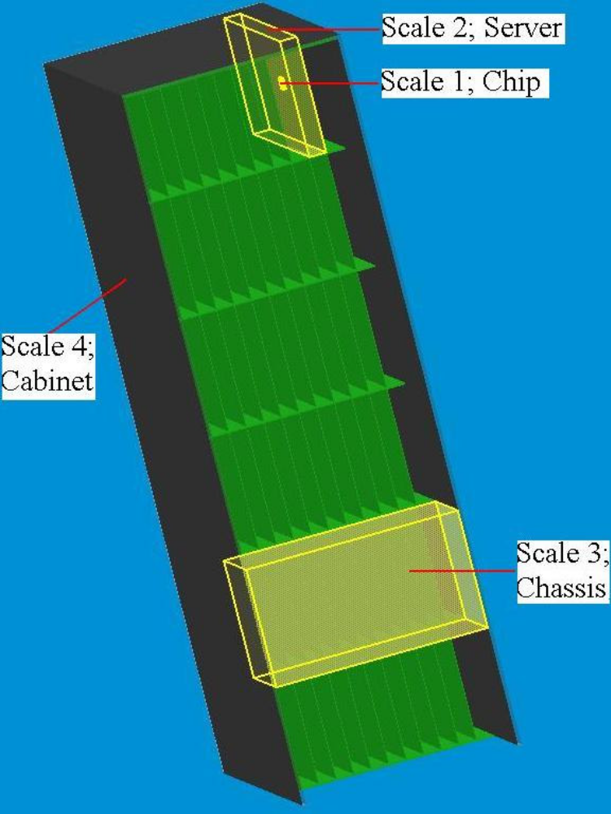
Rack Level Thermal Management

Slide 22
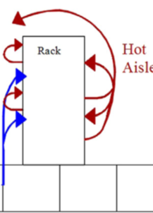
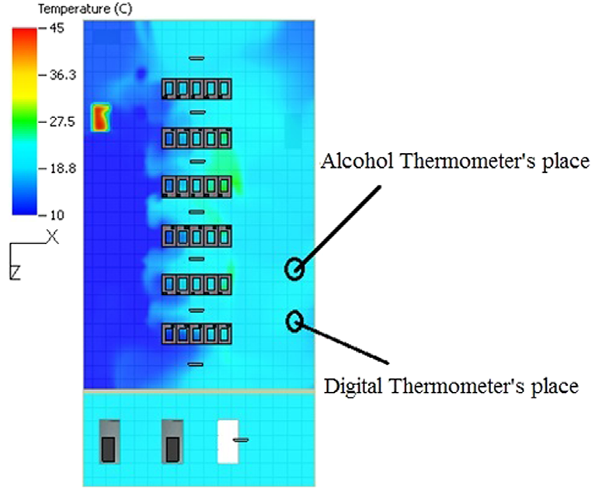
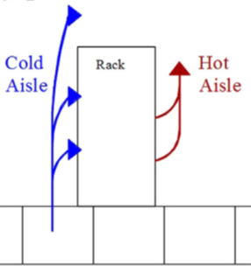


Management of Air Flow in A Rack : Second Level of Division

Slide 23
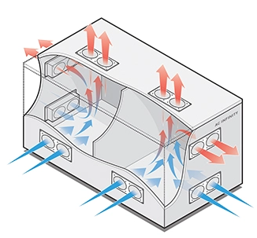
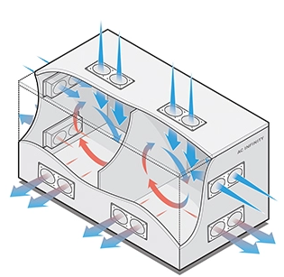
Optimal Location of Fans in A Rack/Cabinet
33% reduction in Cooling fans

Slide 24
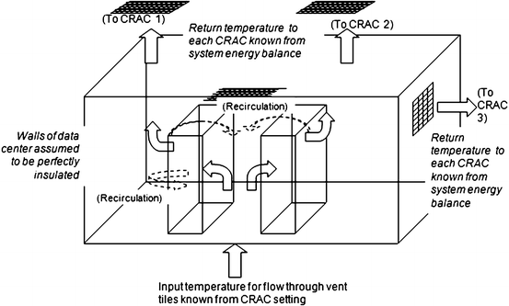
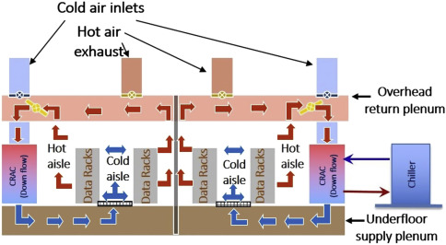
Macro-scale TM Model of A Data Center

Slide 25
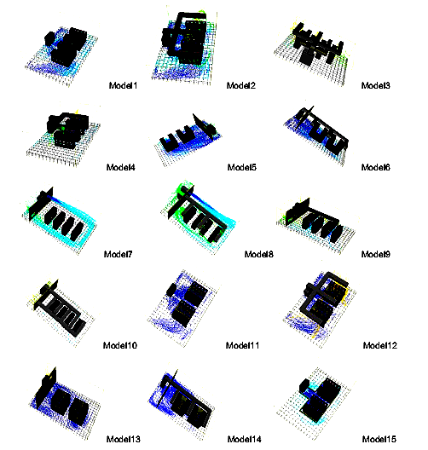
Various Models for Relative Positionng of Racks

Slide 26
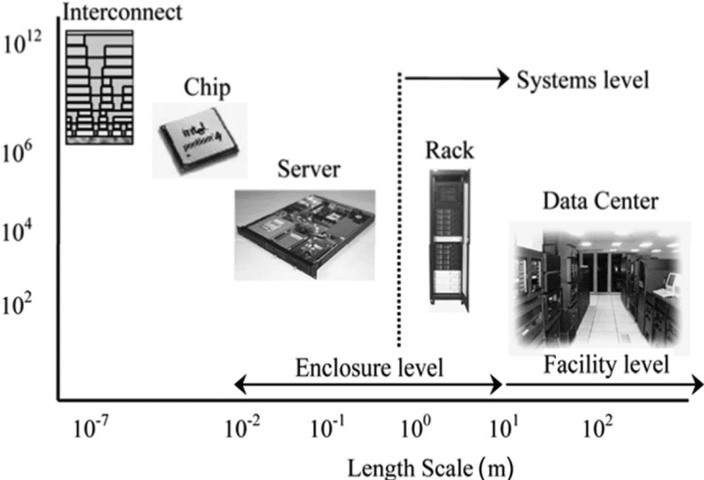
Granularity of Thermal Management of Data Centers
A successful thermal management strategy must take way heat generation at all levels!
Heat Generation Scale

