Slide 1


Machine Learning-Based Optimization:
Air-cooled Heat Sinks
P M V Subbarao
Professor
Mechanical Engineering Department
Purpose Oriented Soft Optimization…

Slide 2

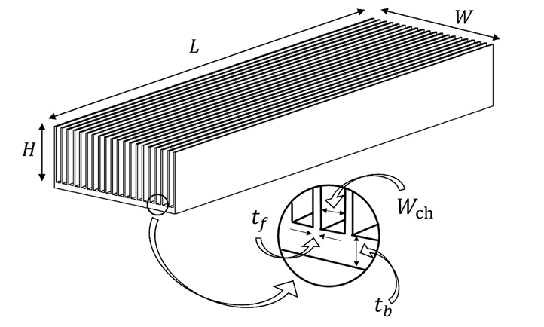
Parallel Plate Heat Sink
A parallel plate-finned heat sink (PPFHS) is the most preferred type of HS due to its excellent thermal performance and simple fabrication.
A PPFHS is fabricated from a highly thermally conductive metal, and the coolant is circulated through parallel chan nels separated via fins.

Slide 3
Parallel Plate Heat Sink
Attached to the HS are heat sources that are cooled by exchanging heat with the flowing coolant inside the channel.
Regardless of the heat transfer mechanism, the effectiveness of a PPFHS strongly depends thorough optimization during design.

Slide 4
Selection of An Optimization Method
Despite extensive research in HS optimization, there is still a lack of a generalized strategy to develop optimized HSs for practical applications.
Mainly due to unpractical objective functions and ineffectiveness of the optimization process.
Secondly, a HS should be manufacturable through economic fabrication processes, especially for mass production.
In addition to the optimization objectives, the accuracy of an optimization process is strongly affected by the effectiveness of the optimization method.
machine learning (ML) has been identified as a promising approach that is rapidly expanding to extract information from raw data to understand the underlying mechanism, solve problems, and predict patterns of systems

Slide 5
Machine Learning Methods
An ANN is a network structure formed by the interconnection of nodes called neurons.
A multi-layer ANN structure consists of an input layer, hidden layer(s), and an output layer.
Through a network training process, the information from the input layer is propagated in the network via neurons within the hidden layer(s) with a set of weights to predict the output.
The first step in training an ANN is to provide the network with a dataset of input–output patterns.

Slide 6
Machine Learning Methods
The accuracy of the ANN model is strongly dictated by the accuracy of the inputs, it is important to prepare input data as optimized HSS.
Different ANN models for different optimization objectives demand different input HSS.
Objective – 1: Maximized h/ΔP in non- dimensional heat transfer to non-dimensional form.
Objective – 2 : Maximized h.
For individual objectives, optimized HSS at several footprints are prepared as inputs within the selected conditions.

Slide 7
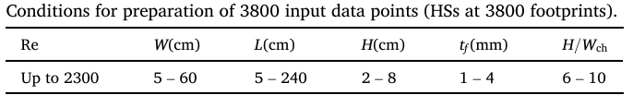
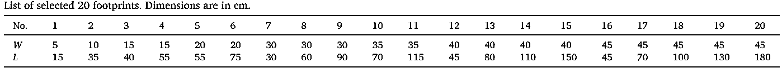
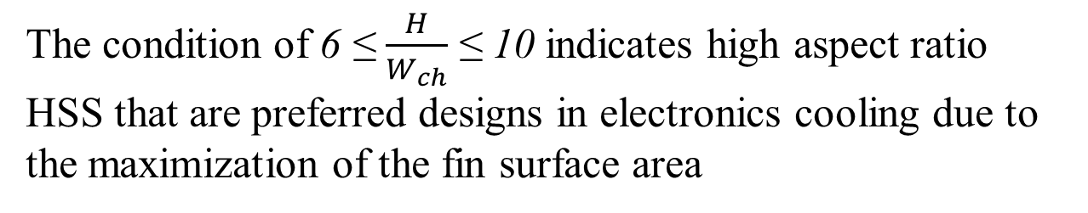
Conditions for Preparation of Input Data
The condition of 6 ≤ $\frac{H}{W_{ch}}$ ≤ 10 indicates high aspect ratio HSS that are preferred designs in electronics cooling due to the maximization of the fin surface area

Slide 8
Search Method
Grid search is used as the technique for preparing the optimized HSs as input data for the ANN models.
Grid search is a strong technique to optimize the hyperparameter values by performing a complete search against the full set of parameters and evaluating all combinations.

Slide 9
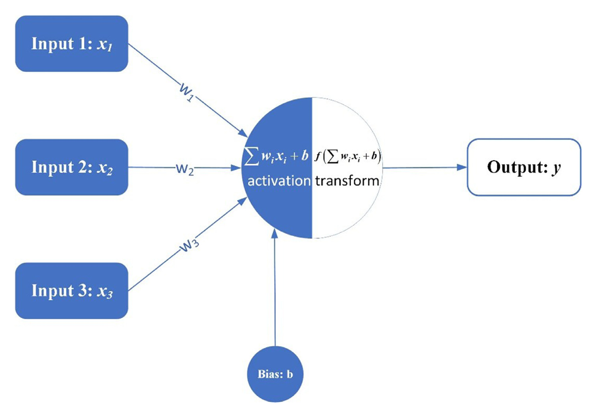
Artificial neural network basics and algorithms
An artificial neural network (ANN) always consists of many basic connected computation units called the artificial neurons.
Following figure depicts a basic artificial neuron:
In the neuron, different input variables (or features) with different weights (w) and biases (b) are summed and transferred to the activation function ( f ) of the neuron.
This sum is called the Output Signal.
Generally, different activation functions can generate different output signals.
Non-linear activation functions for neurons enhance the prediction ability of the ANN!

Slide 10
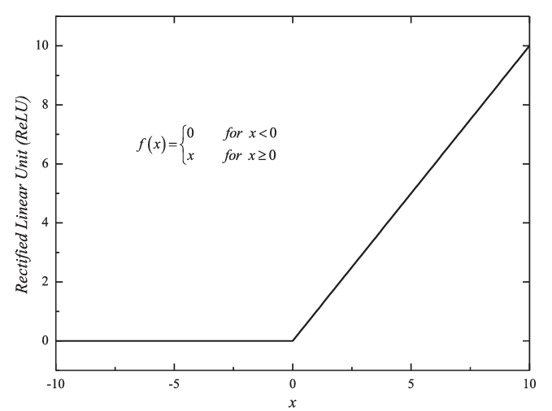
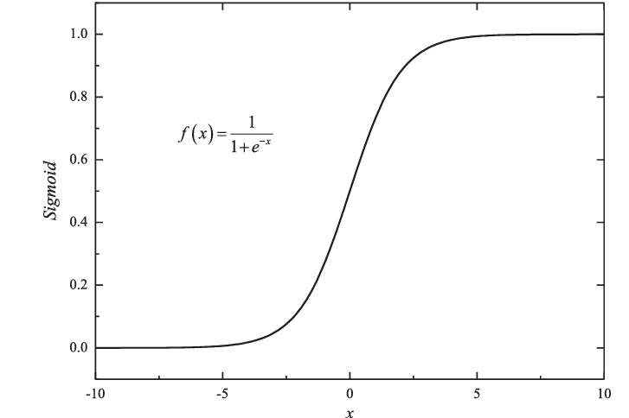
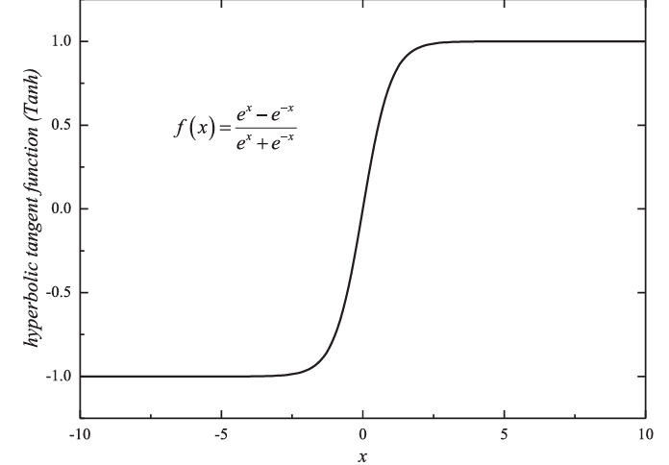
Non-Linear Neurons
These non-linear neurons, a multi-layer ANN can approximate any non-linear functions with any precision.
The commonly used activation functions include:
Rectified Linear Unit (ReLU) function
The hyperbolic tangent function (Tanh)
The Sigmoid function

Slide 11
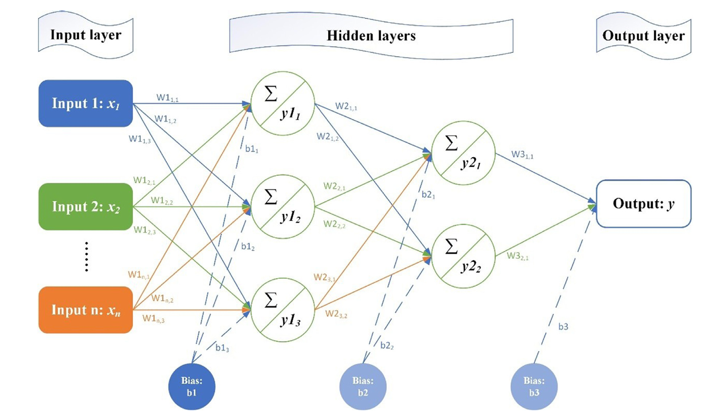
Structure of An ANN
For a typical ANN, the structure of the network is depicted as:
In HSS optimization, the input variables are fed into the network and transmitted straight forward layer by layer.
It is a kind of Feed Forward Neural Network.

Slide 12
Feed Forward Neural Network
In FFNN, the outputs of each layer can be determined according to the inputs, weights and biases layer by layer.

Slide 13

Feed Forward Neural Network
In the first hidden layer, the outputs are calculated as:

Slide 14



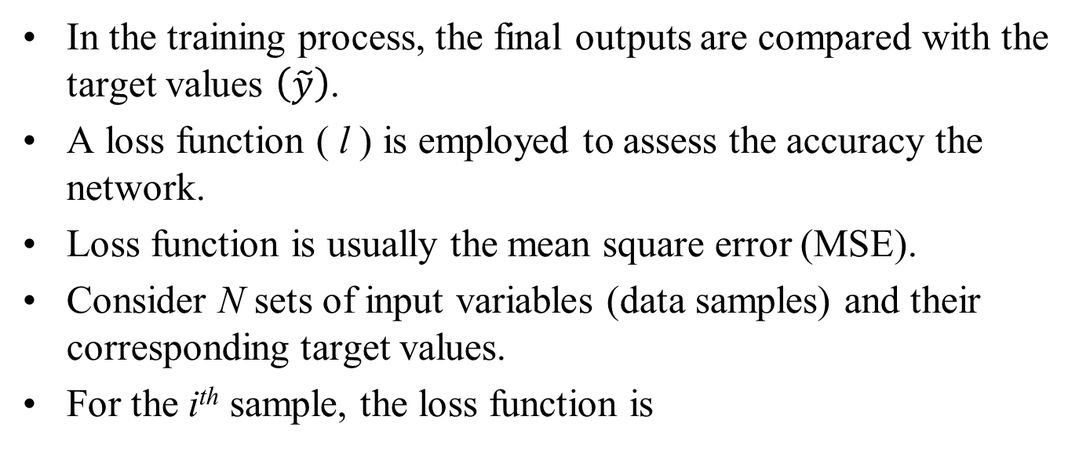
Training Process
In the training process, the final outputs are compared with the target values $\left(\tilde{y}\right)$.
A loss function ( l ) is employed to assess the accuracy the network.
Loss function is usually the mean square error (MSE).
Consider N sets of input variables (data samples) and their corresponding target values.
For the i^{th} sample, the loss function is
For all the samples, the overall loss function is

Slide 15

Appreciation of Training Process
The network training process is to find a set of parameters (w∗, b∗) to diminish the loss function as possible as low as possible (?)
In a way, the network is a kind of high dimensional data fitting.
The weights (w) and biases (b) are to be updated, to find the proper set of parameters to decrease the overall loss function and improve the prediction accuracy of the network as much as possible.
The gradient of the loss function with respect to the weights (w) and biases (b) should yield to 0 when the loss function come to its minimum value.
When these gradients are not 0, it means that the set of ( w∗, b∗) are not suitable.

Slide 16

Updating of the Weights and Biases
The weights and biases are updated using the gradient descent algorithm.
Where η is a hyperparameter in the network called the learning rate and is to be set to an appropriate value as per the physics of the problem.

Slide 17
Feed Forward Neural Network
The weights and biases (w₃, b₃) related to the final output layer are firstly updated according to the loss function.
After that, weights and biases in the hidden layers will be updated step by step.
Contrary to the flow of the input variables, which are transmitted from the input layer to the output layer.

Slide 18
Back Propagation in FFNN
This method of updating the parameters is called the backpropagation algorithm.
Most which is widely used in the training of ANNs.

Slide 19

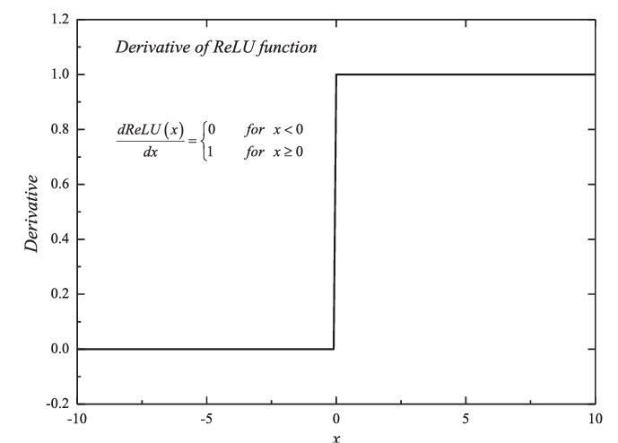
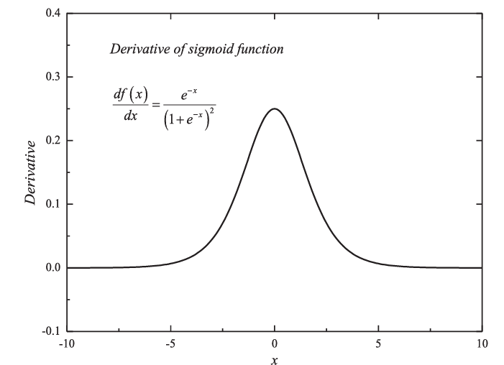
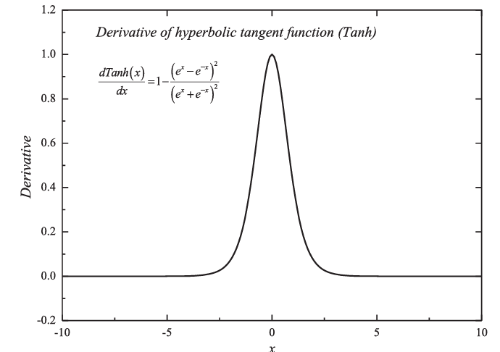
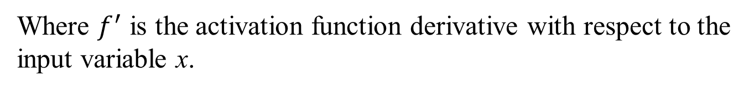
Selection of Activation Function
The loss is a function of not only the weights and biases, but also the activation function.
The gradient of the loss function with respect to the weights can be obtained and studied to select a suitable Activation Function.
Where $f^{′}$ is the activation function derivative with respect to the input variable x.

Slide 20
Selection of Activation Function

Slide 21
Selection of Activation Function
The derivative is like a hat. And the maximum derivative is only 0.25.
In the backpropagation algorithm, the gradient of the loss function for each layer is calculated recursively.
It means that in the backpropagation process, the gradient of the loss function will decrease 75% each time it passing a layer.
If a network has several layers, the loss function gradient will yield to 0.
The loss function contributes little for the updating of the weights and biases.
This phenomenon is called the gradient vanishing.

Slide 22

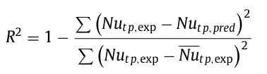
Assessment of the Neural Network
To assess the accuracy of the neural network, the mean absolute error (MAE) is to be employed.
The definition equation of the MAE is given as
The statistical index R² is used to evaluate the network predictability.

Slide 23

Assessment of the Neural Network
Generally, with the increase of input variables, the neural network tends to exhibit better predictability and higher R².
To account for the influence of additional inputs, the adjusted R² can be adopted to evaluate the network.
It is defined as follow.
Where N is the number of samples, p is the number of input variables in each sample set.

Slide 24
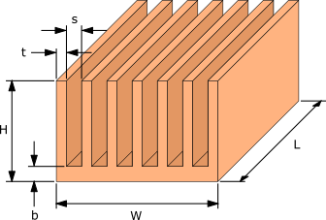

Data Generation: PPHS

Slide 25
Conjugate Model for Thermal Resistance of A Heat Sink
${Nu}_{u−c}= {\left[{\left(\frac{{Re}_{S}^{∗}Pr}{2}\right)}^{−3}+{\left(0.664\sqrt{{Re}_{S}^{∗}} {pr}^{1/3}×\sqrt{1+\frac{3.65}{\sqrt{{Re}_{S}^{∗}}}}\right)}^{−3}\right]}^{{−1}/3}$=

Slide 26
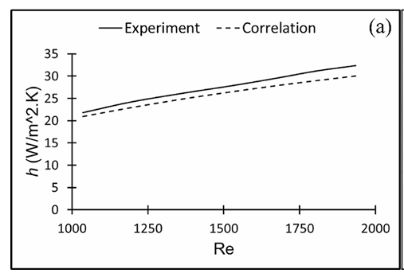
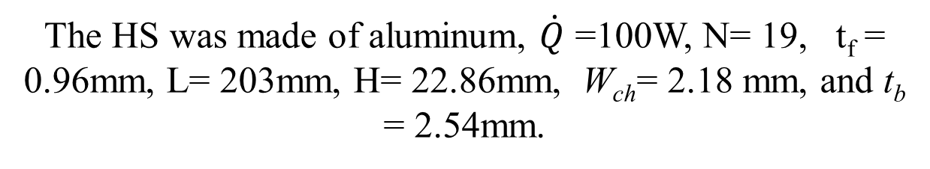
Conjugate Model for Thermal Resistance of A Heat Sink
The HS was made of aluminum, $\dot{Q}$ =100W, N= 19, t_{f} = 0.96mm, L= 203mm, H= 22.86mm, W_{ch}= 2.18 mm, and t_{b} = 2.54mm.

Slide 27
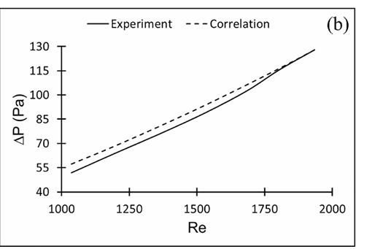
Conjugate Model for Thermal Resistance of A Heat Sink

Slide 28
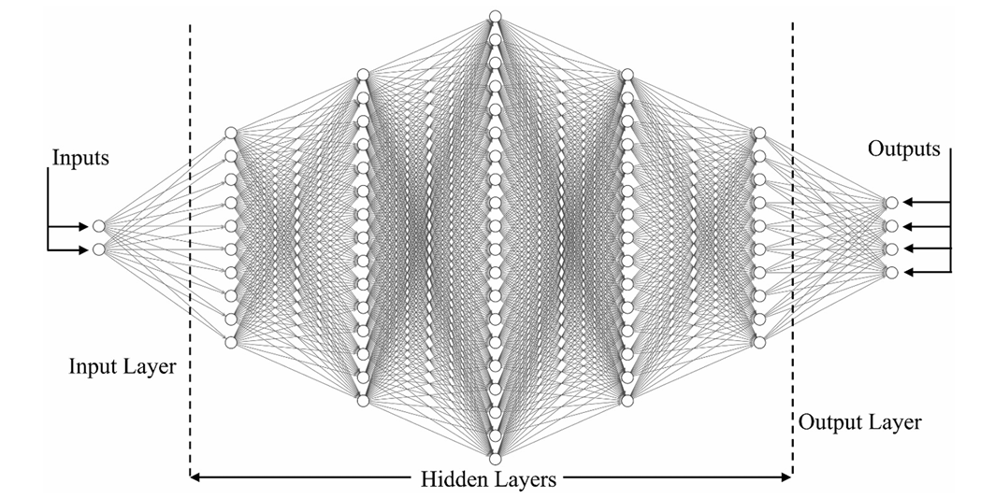
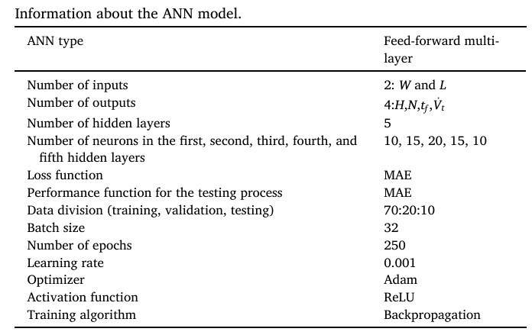
ANN architecture used for optimization of PPFHSs

Slide 29
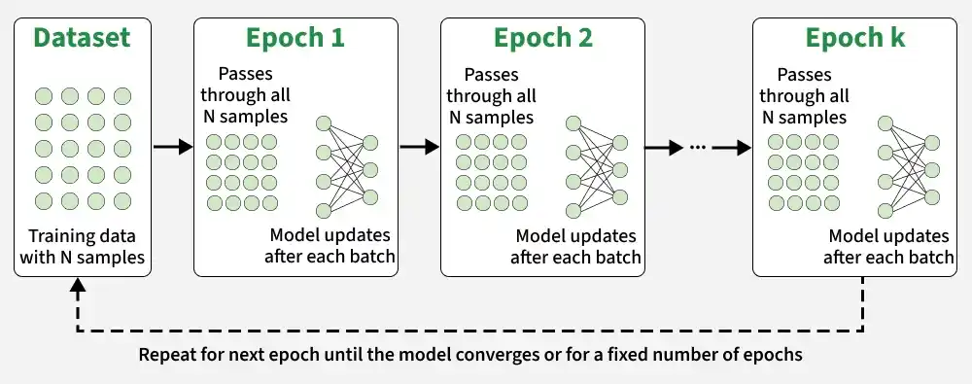
Epoch in ML

Slide 30
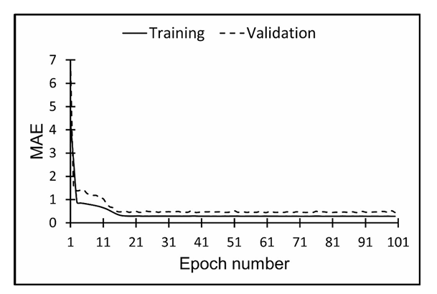
Selection of Number of Epochs

Slide 31
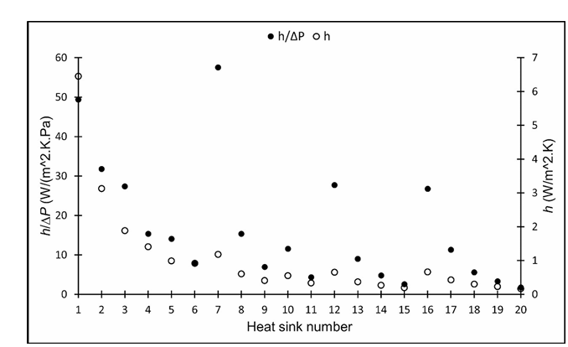
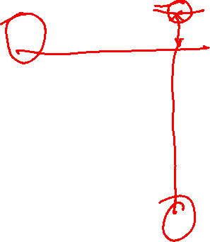
Optimal HSS using Objective 1

Slide 32
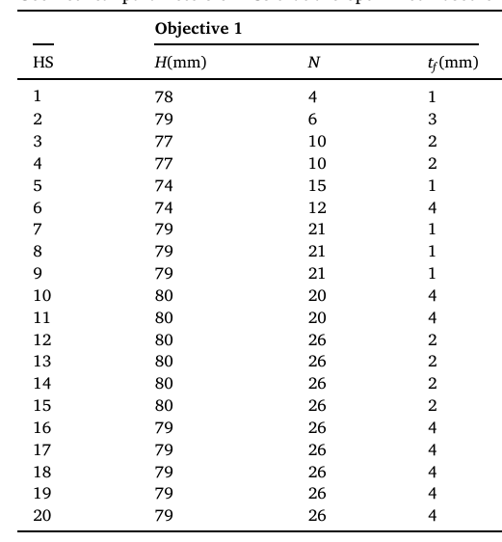

Geometrical parameters of HSs

Slide 33
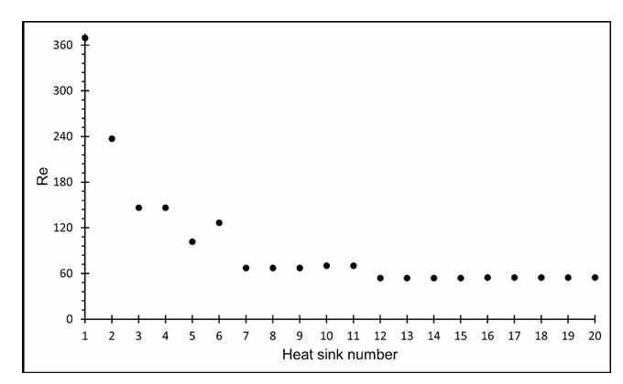
Re for optimized HSs based on objective 1

Slide 34
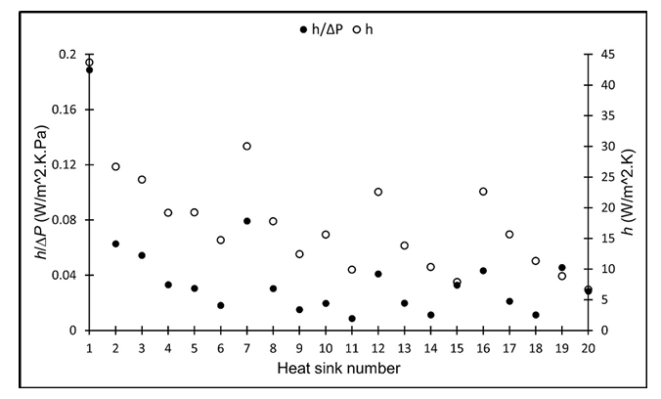

HSs Based on Objective 2

Slide 35
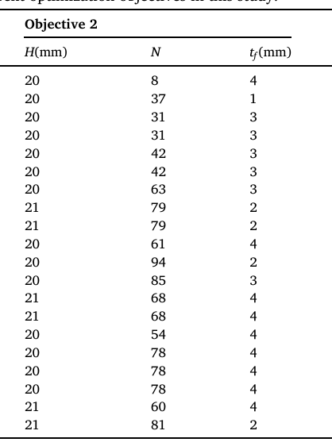
Geometrical parameters of HSs

Slide 36

Weight Sensitive Applications
In weight-sensitive applications like aerospace, reducing the weight of a thermal management system without any penalty in the thermal performance is critical.
Therefore, an optimization objective with a focus on weight reduction of the cooling system should be defined. The new objective, called objective 3, aims to find the lowest-weight HS at a given footprint that leads to the largest h within the maximum allowed velocity V_{t} .
A percentage of change in the mass, h, and ΔP of an optimized HS at a given footprint obtained by objective 3 with respect to an optimized HS obtained by objective 2 are calculated as shown below:

Slide 37
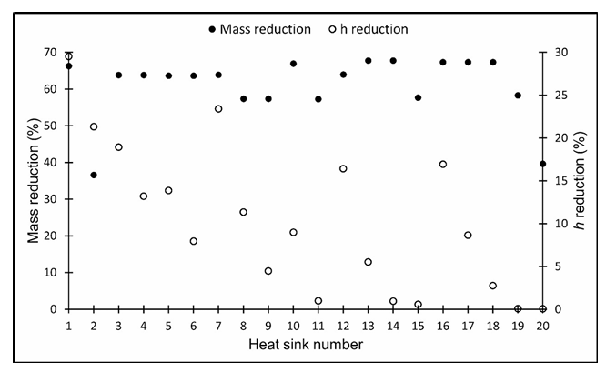
Percentage of Reduction in Mass and h

Slide 38
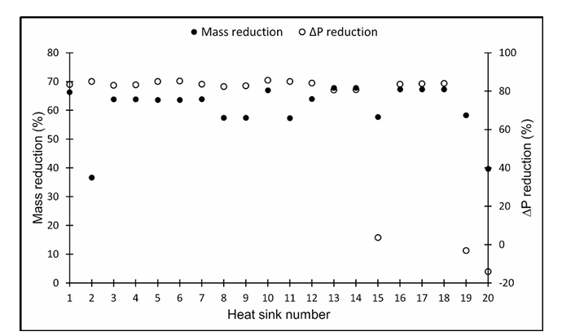
Percentage of Reduction in Mass and Δp

Slide 39
Reference
Machine learning-based optimization of air-cooled heat sinks Mohammad Reza Shaeri Ameneh Shadlo
Thermal Science and Engineering Progress : 34 (2022)

