Slide 1


Design of Fin Array Systems with Forced Convection Cooling
P M V Subbarao
Professor
Mechanical Engineering Department
Match the Least additional Material with an Energy Efficient Fan…

Slide 2

Introductory Remarks
For a number of reasons, namely, cost, simplicity, power consumption, noise, etc., Natural Convection is the preferred approach for cooling electronic systems.
However, it is often the case that natural convection is simply not sufficient to remove dissipated power.
Cooling fans are commonly used to increase cooling capacity to achieve an adequate design.
A focus on how the use of fans impacts the cooling system design is the first step in this direction.

Slide 3
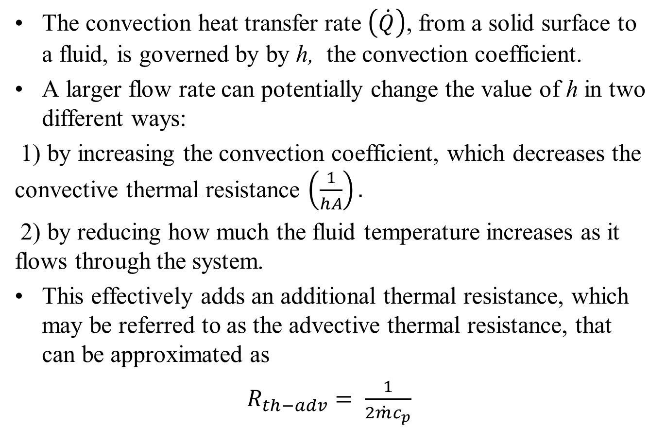
The Impact of Fan in Thermal Management
The convection heat transfer rate $\left(\dot{Q}\right)$, from a solid surface to a fluid, is governed by by h, the convection coefficient.
A larger flow rate can potentially change the value of h in two different ways:
1) by increasing the convection coefficient, which decreases the convective thermal resistance $\left(\frac{1}{hA}\right).$
2) by reducing how much the fluid temperature increases as it flows through the system.
This effectively adds an additional thermal resistance, which may be referred to as the advective thermal resistance, that can be approximated as
$R_{th−adv}= \frac{1}{2\dot{m}c_{p}}$

Slide 4
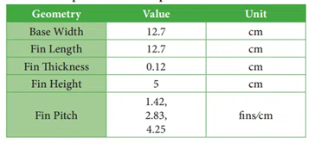
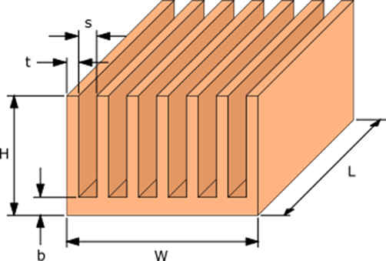
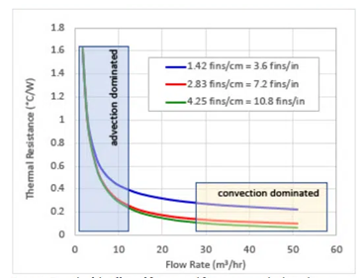
Case Study
Consider three different heat sinks with following specifications

Slide 5
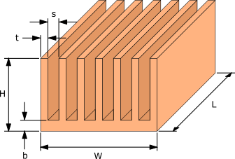
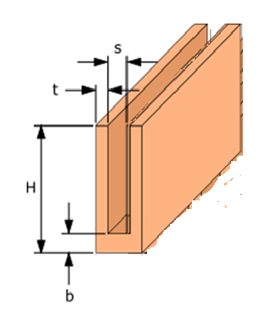
Forced Convection to Enhance the value of Convective Heat Transfer Coefficient
The velocity of the air flow between the fins (U-Channel) decides the value of heat transfer coefficient.

Slide 6
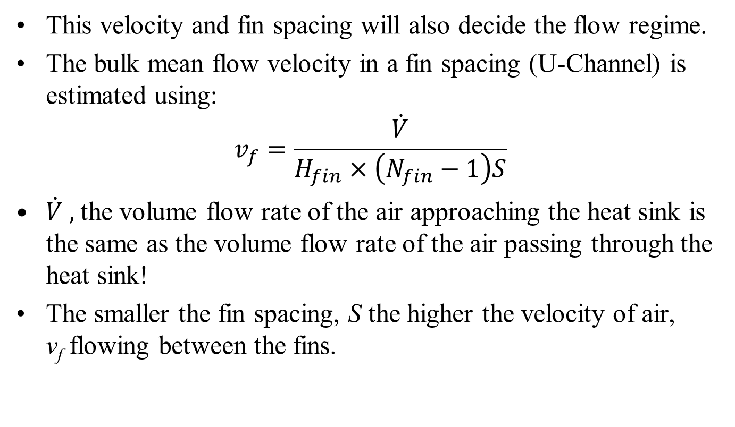
Forced Convection in A U Channel
This velocity and fin spacing will also decide the flow regime.
The bulk mean flow velocity in a fin spacing (U-Channel) is estimated using:
$$v_{f}=\frac{\dot{V}}{H_{fin}×\left(N_{fin}−1\right)S}$$
$\dot{V} ,$the volume flow rate of the air approaching the heat sink is the same as the volume flow rate of the air passing through the heat sink!
The smaller the fin spacing, S the higher the velocity of air, v_{f} flowing between the fins.

Slide 7
Constraint on Fin Spacing
The higher the air velocity the more effective the cooling of the fins.
In real world applications the flow is supplied by a fan or blower.
The actual flow rate would be limited by the increase in pressure drop across the heat sink that would occur as the spacing between the fins, S decreases.
Higher Pressure drops will lead to high power consumption by fan.
There is a need to get an Optimal heatsink-fan pair.

Slide 8
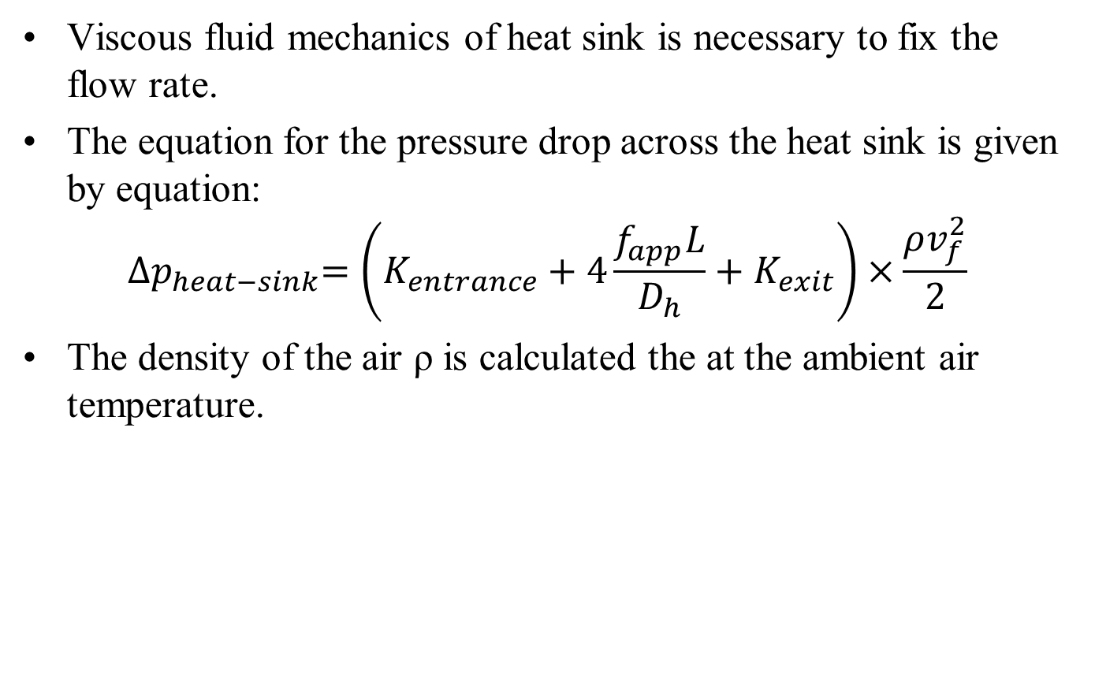
Flow Characteristics of A Heat Sink
Viscous fluid mechanics of heat sink is necessary to fix the flow rate.
The equation for the pressure drop across the heat sink is given by equation:
$${∆p}_{heat−sink}=\left(K_{entrance}+4\frac{f_{app}L}{D_{h}}+K_{exit}\right)×\frac{ρv_{f}^{2}}{2}$$
The density of the air ρ is calculated the at the ambient air temperature.

Slide 9
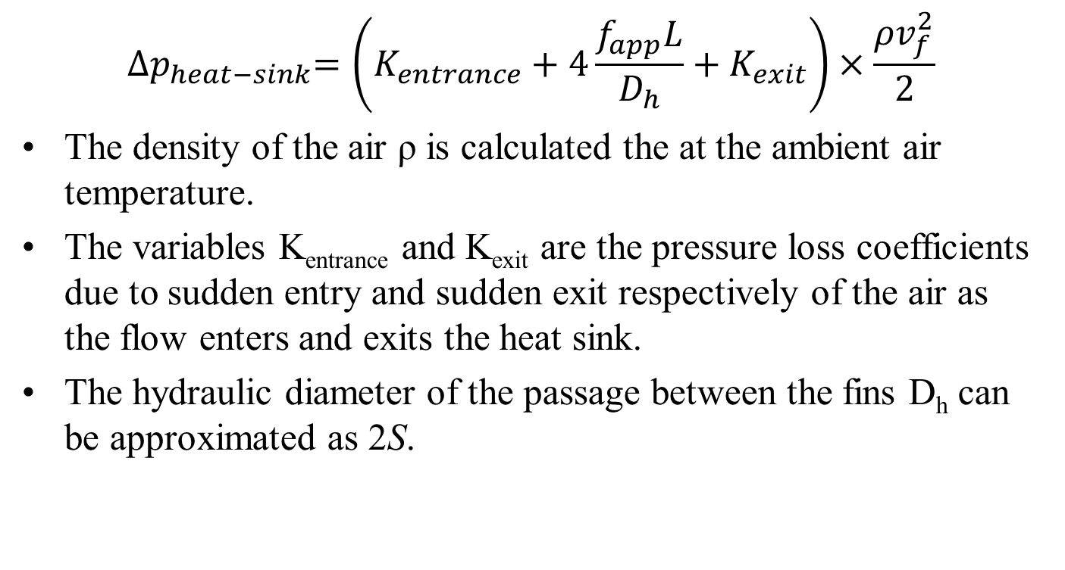
Flow Characteristics of A Heat Sink
$${∆p}_{heat−sink}=\left(K_{entrance}+4\frac{f_{app}L}{D_{h}}+K_{exit}\right)×\frac{ρv_{f}^{2}}{2}$$
The density of the air ρ is calculated the at the ambient air temperature.
The variables K_{entrance} and K_{exit} are the pressure loss coefficients due to sudden entry and sudden exit respectively of the air as the flow enters and exits the heat sink.
The hydraulic diameter of the passage between the fins D_{h} can be approximated as 2S.

Slide 10
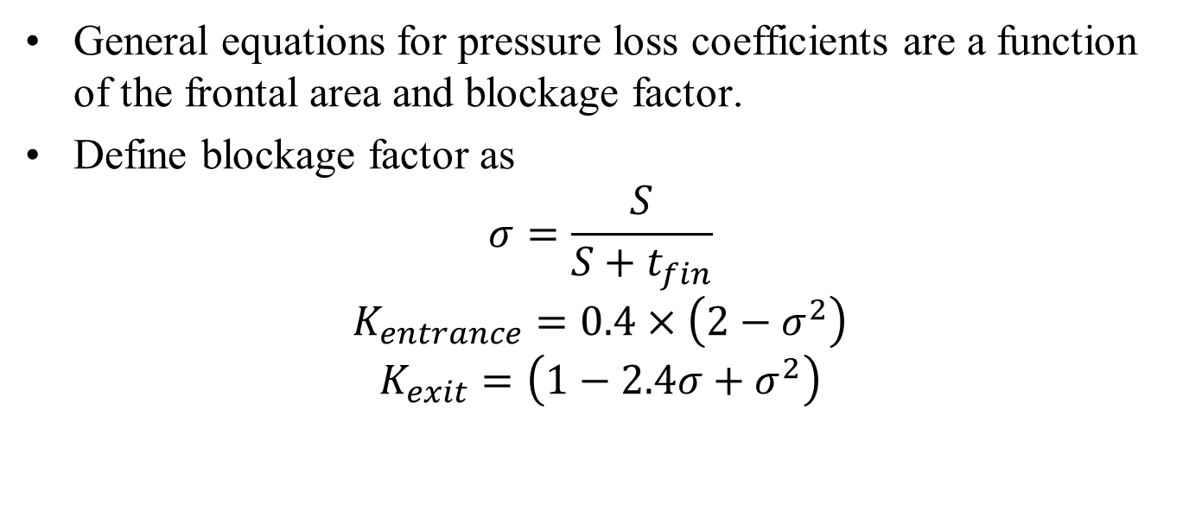
Flow resistance of A Heat Sink
General equations for pressure loss coefficients are a function of the frontal area and blockage factor.
Define blockage factor as
$$σ=\frac{S}{S+t_{fin}}$$
$$K_{entrance}=0.4×\left(2−σ^{2}\right)$$
$$K_{exit}=\left(1−{2.4σ+σ}^{2}\right)$$

Slide 11
Friction Factor for Open Channel Flows
$${∆p}_{heat−sink}=\left(K_{entrance}+4\frac{f_{app}L}{D_{h}}+K_{exit}\right)×\frac{ρv_{f}^{2}}{2}$$
Open Channel flows are very common in civil engineering applications.
Friction factor for fully developed open channel flow is:
$f{Re}_{Dh}=\frac{24}{{\left[1+\frac{S}{H_{f}}\right]}^{2}×\left[1−\frac{195S}{π^{5}H_{f}}tanh\left(\frac{πH_{f}}{2S}\right)\right]}$
${Re}_{Dh}= \frac{v_{flow}D_{h}}{ν}$

Slide 12
Apparent Friction Factor for Developing flow in U-Channel
The fully developed flow in a U-Channel i.e., fully developed fully developed flow is valid for very long Channels, where velocity profile remains constant along flow direction.
Heat sink length is generally much smaller than fully developed length.
S. Muzychka and M. M. Yovanovich (1996) developed a model to predict friction factors in non-circular ducts for developing laminar flow as:
$$f_{apparent}=\frac{\sqrt{\left[{\left(\frac{3.44}{\sqrt{L^{∗}}}\right)}^{2}+{\left(f{Re}_{Dh}\right)}^{2}\right]}}{\left(f{Re}_{Dh}\right)}$$

Slide 13
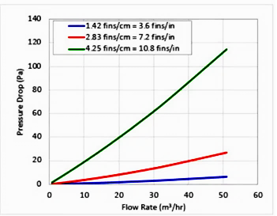
Pressure Drop: Cost to facilitate Forced Convection

Slide 14
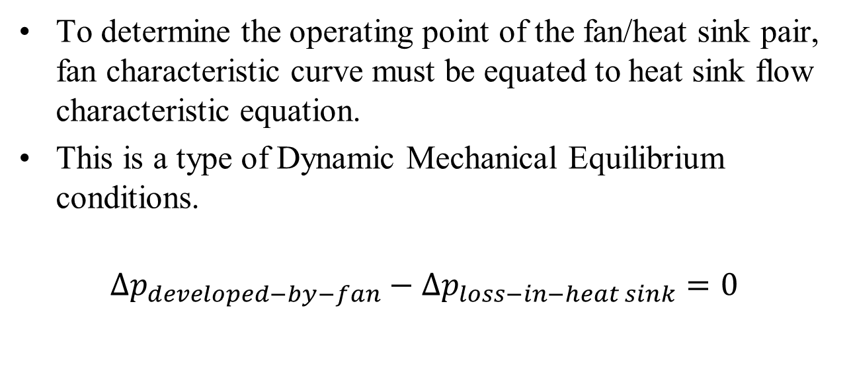
Matching of Fan & Heat Sink Pair
To determine the operating point of the fan/heat sink pair, fan characteristic curve must be equated to heat sink flow characteristic equation.
This is a type of Dynamic Mechanical Equilibrium conditions.
$$∆p_{developed−by−fan}−∆p_{loss−in−heat sink}=0$$

Slide 15
Characteristics of Fan & Heat Sink Pair
The first step in designing a heat sink is to determine the operating point of the fan and heat sink combination.
When a fan or blower is paired with a heat sink the performance of the fan will depend on the design of the heat sink.
Every fan has a unique pressure/flow rate performance curve in which the flow rate is inversely proportional to the pressure drop across the fan.
Heat sinks demand a flow rate performance curve that is the pressure drop across the heat sink is proportional to nearly square of the flow rate.
The resulting flow rate through a fan/heat sink combination is the intersection of the fan and heat sink pressure/flow rate curves.

Slide 16
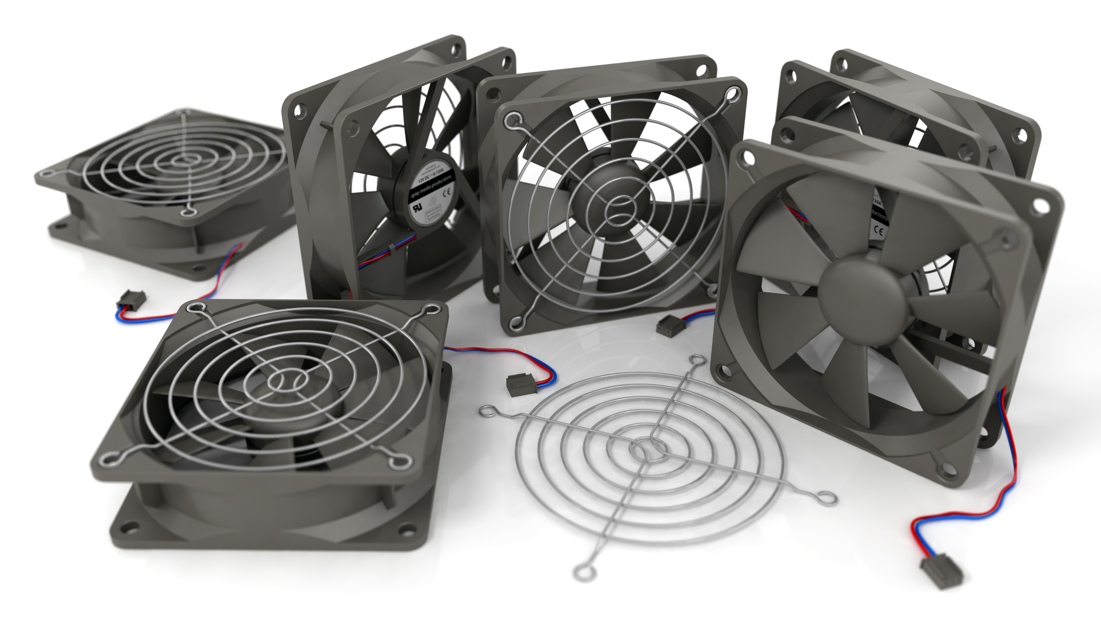
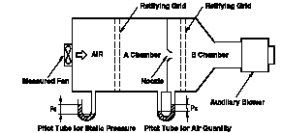
Characteristics of Fans

Slide 17
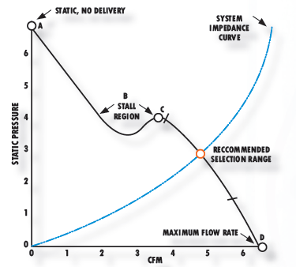


Fan Characteristic Curve
$${∆p}_{fan}$$
$$\dot{V}$$

Slide 18
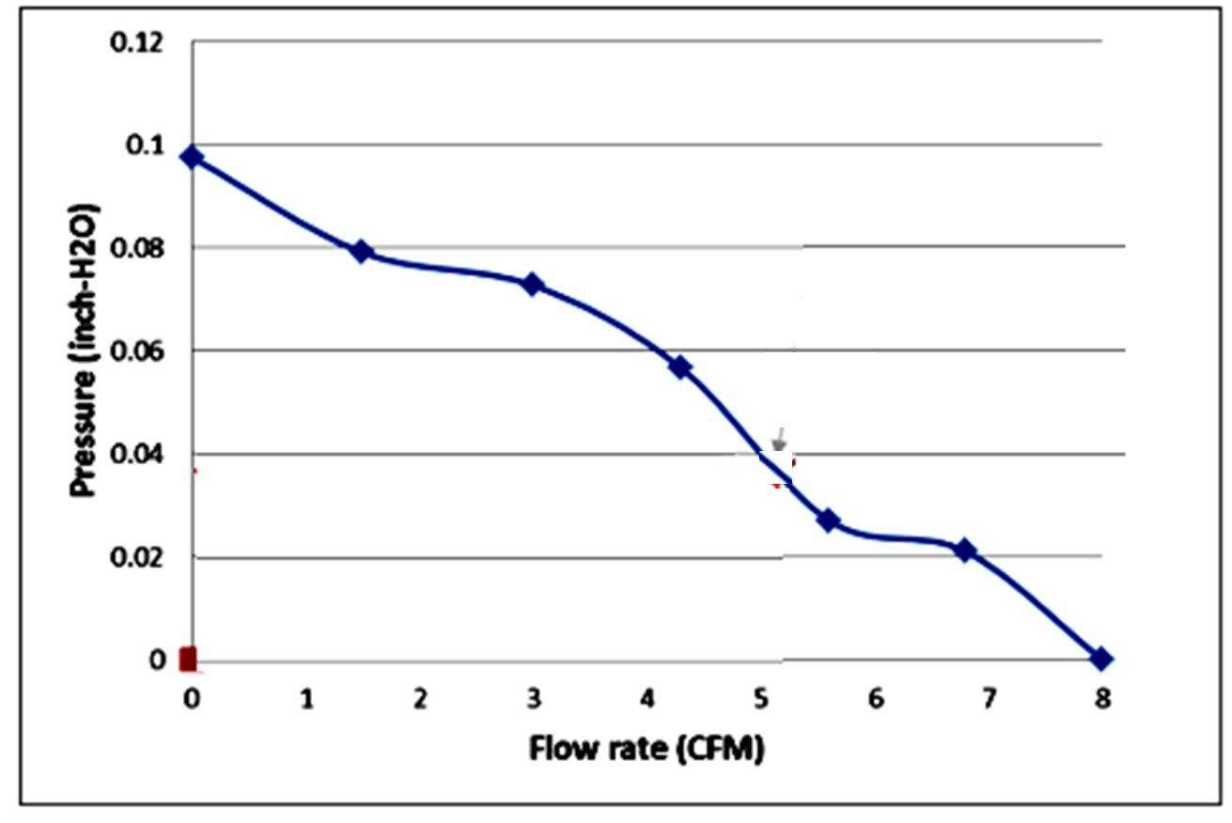
Pairing of Fan and Heat Sink
Fan Flow Curve
Heat Sink Flow Curve

Slide 19
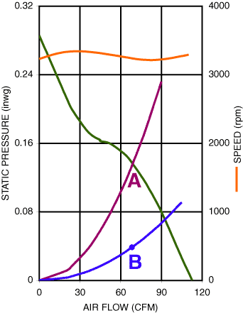
Fan and Heat Sink Pairs

Slide 20
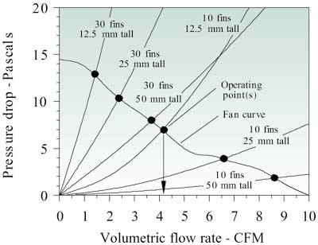
Type of fin Vs Operation Point

Slide 21
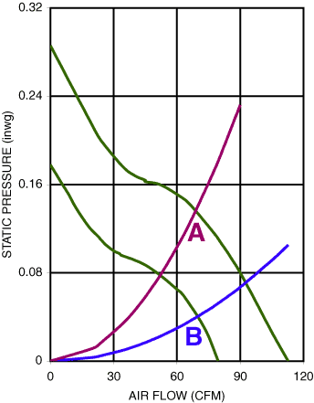
Effect of Changing A Fan

Slide 22
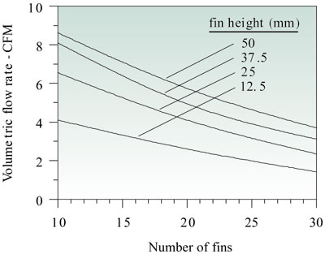
Effect of number of fins and fin height

Slide 23
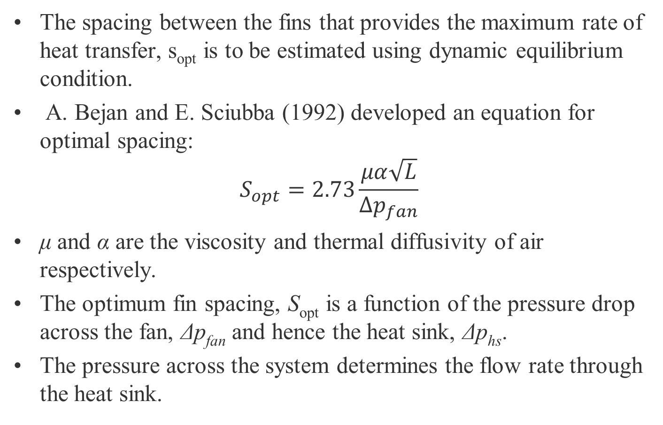
Optimizing the fin spacing
The spacing between the fins that provides the maximum rate of heat transfer, s_{opt} is to be estimated using dynamic equilibrium condition.
A. Bejan and E. Sciubba (1992) developed an equation for optimal spacing:
$$S_{opt}=2.73\frac{μα\sqrt{L}}{∆p_{fan}}$$
μ and α are the viscosity and thermal diffusivity of air respectively.
The optimum fin spacing, S_{opt} is a function of the pressure drop across the fan, Δp_{fan} and hence the heat sink, Δp_{hs}.
The pressure across the system determines the flow rate through the heat sink.

Slide 24

Conjugate Model for Thermal Resistance of A Heat Sink
P. M. Teertstra, M. M. Yovanovich, J. R. Culham, and T. F. Lemczyk (1999) developed an analytical equation for forced covenction heat transfer in plate fin heat sinks.

Slide 25
Conjugate Model for Thermal Resistance of A Heat Sink
${Nu}_{u−c}= {\left[{\left(\frac{{Re}_{S}^{∗}Pr}{2}\right)}^{−3}+{\left(0.664\sqrt{{Re}_{S}^{∗}} {pr}^{1/3}×\sqrt{1+\frac{3.65}{\sqrt{{Re}_{S}^{∗}}}}\right)}^{−3}\right]}^{{−1}/3}$=

Slide 26
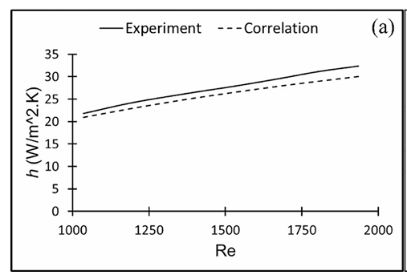
Conjugate Model for Thermal Resistance of A Heat Sink

Slide 27
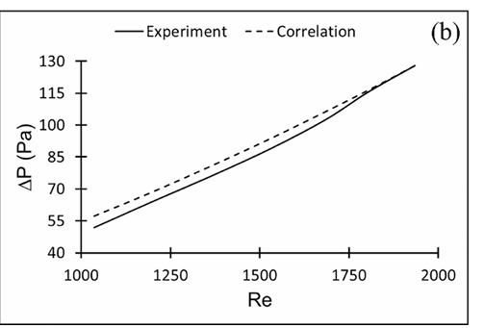
Conjugate Model for Thermal Resistance of A Heat Sink

Slide 28
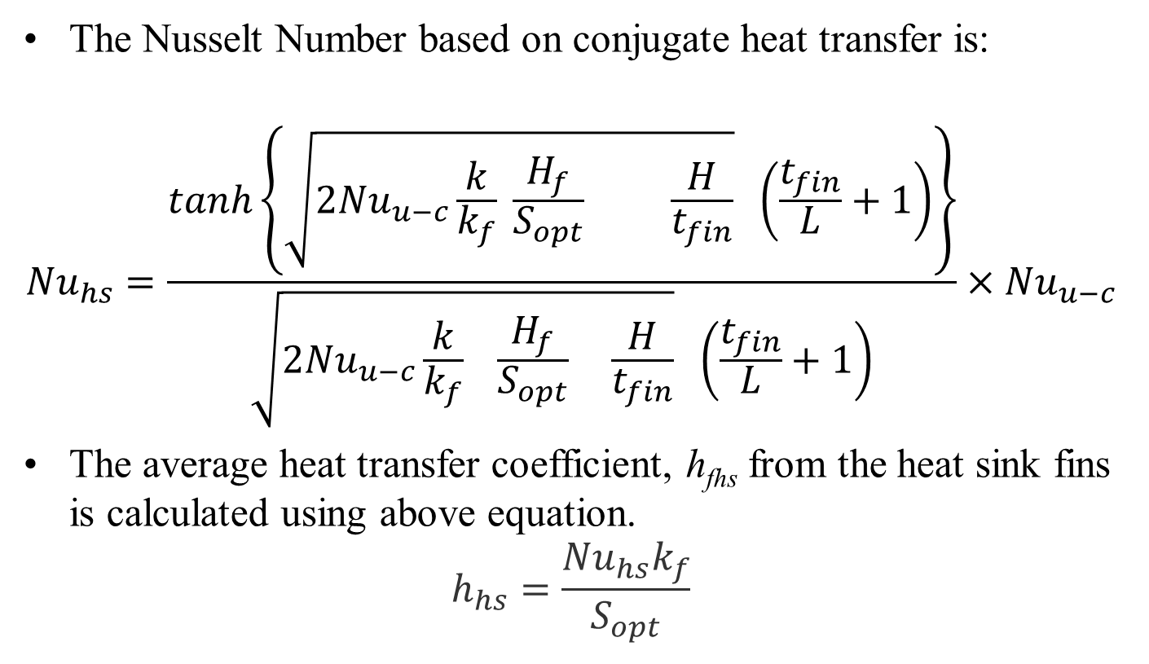
Thermal Resistance of Heat Sink under Forced Convection Cooling
The Nusselt Number based on conjugate heat transfer is:
$${Nu}_{hs}=\frac{tanh\left\{\sqrt{2{Nu}_{u−c}\frac{k}{k_{f}} \frac{H_{f}}{S_{opt}} \frac{H}{t_{fin}}} \left(\frac{t_{fin}}{L}+1\right)\right\}}{\sqrt{2{Nu}_{u−c}\frac{k}{k_{f}} \frac{H_{f}}{S_{opt}} \frac{H}{t_{fin}}} \left(\frac{t_{fin}}{L}+1\right)}×{Nu}_{u−c}$$
The average heat transfer coefficient, h_{fhs} from the heat sink fins is calculated using above equation.
$$h_{hs}=\frac{{Nu}_{hs}k_{f}}{S_{opt}}$$

Slide 29
Total Thermal Resistance of A Heat Sink including Base
$R_{hs−tot}=\frac{1}{h_{hs}A_{hs}}+\frac{b}{k_{hs}WL}$
$$A_{hs}=L\left(S_{opt}+2H_{f}\right)×\left(N_{fin}−1\right)$$

Slide 30
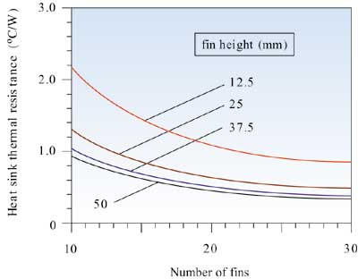
Effect of Constant air velocity on Performance of Longitudinal Fin Array

Slide 31
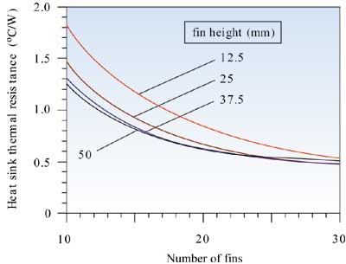
Constant Volumetric Flow Rate

Slide 32
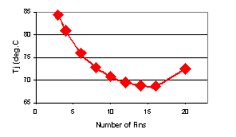
Junction Temperature Vs Number of Fins
For a selected Fan

Slide 33
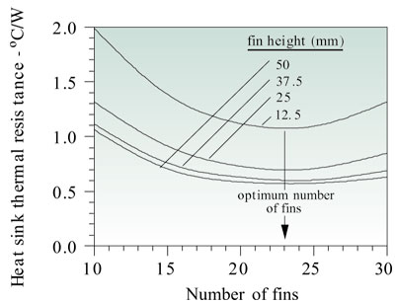
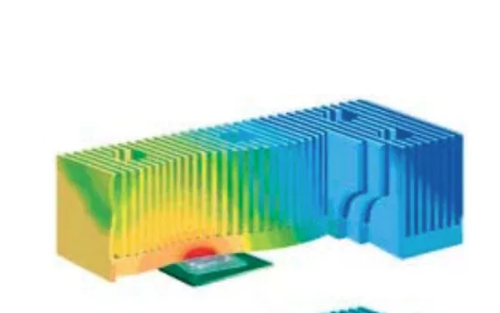
Thermal Resistance

Slide 34
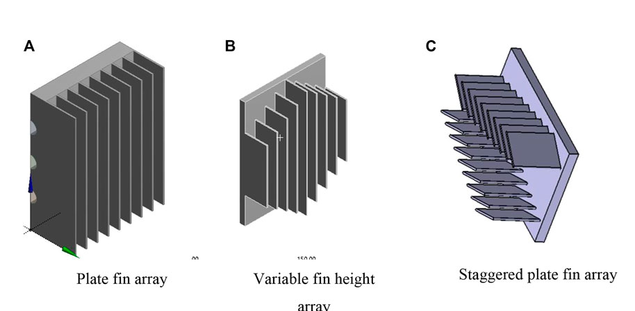
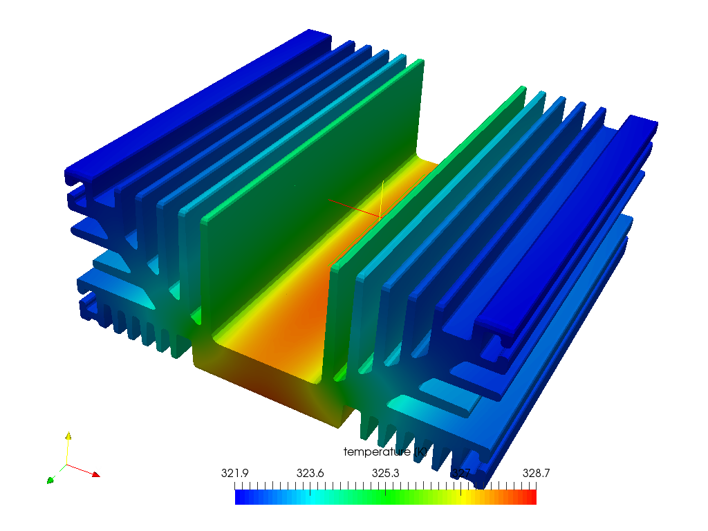
Spreading Thermal Resistance due Heat Sink

Slide 35
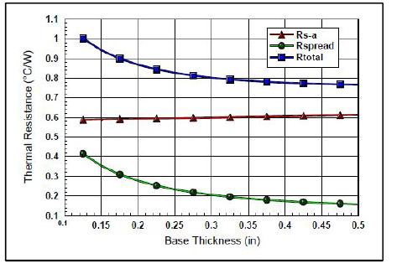
Forced Convection w/Spreading at Specific Airflow

Slide 36
Cooling Medium
Adding a fan to any heat sink changes from passive cooling, using ambient airflow, to active cooling.
Adding a fan to a typical heat sink almost always improves thermal performance.
A 50 mm square heat sink with 12 mm height, for example, has a thermal resistance of 5 °C/W with natural convection. Adding a fan drops this resistance to 1.2 °C/W.
Most demanding applications use liquid cooling in place of air cooling further improves heat sink performance.
To dissipate 1000 watts of heat with a 10 °C temperature rise would take thousands of times less volumetric water flow than airflow.
Liquid cooling can dissipate more heat with considerably less flow volume,
maintain better temperature consistency, and do it with less local acoustic noise.

Slide 37
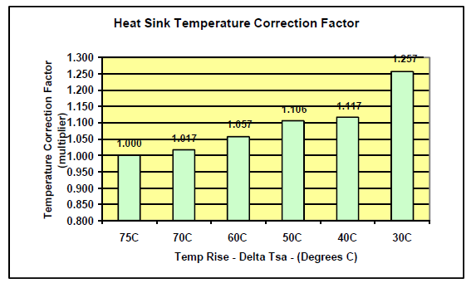
Temperature Correction Factor
As ΔT Decreases, the Heat Sink Efficiency Decreases…

Slide 38
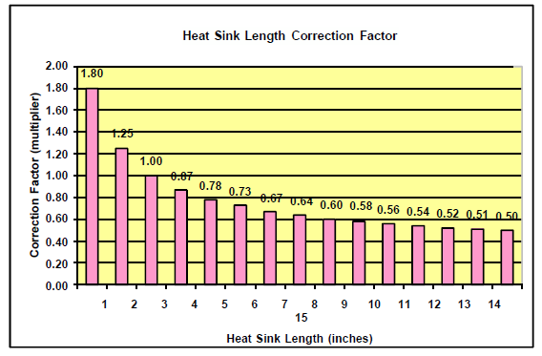
Length Correction Factor

