Slide 1


Natural Convection Heat Sinks : Single Phase Immersion Cooling (SPIC)
P M V Subbarao
Professor
Mechanical Engineering Department
A special Heat Transfer Environment for Efficient Thermal Management …

Slide 2

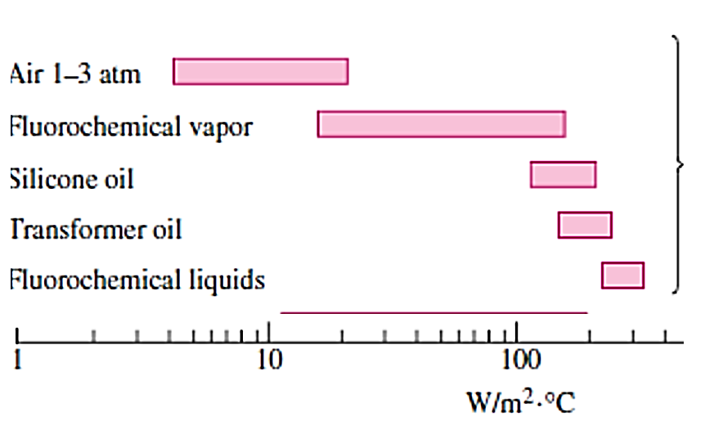
Typical heat transfer coefficients for
NC with dielectric Liquids

Slide 3
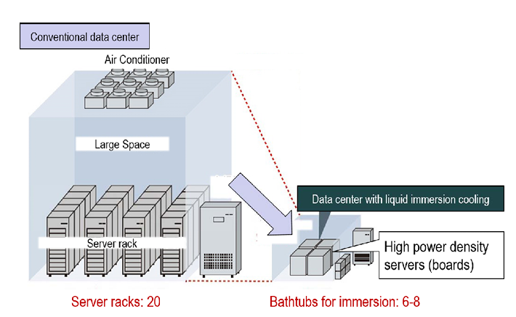
Comparison of Data Center Size
Due to superior thermophysical properties of liquids, SPIC methods exhibit higher cooling performance compared to conventional Natural air-cooling methods

Slide 4
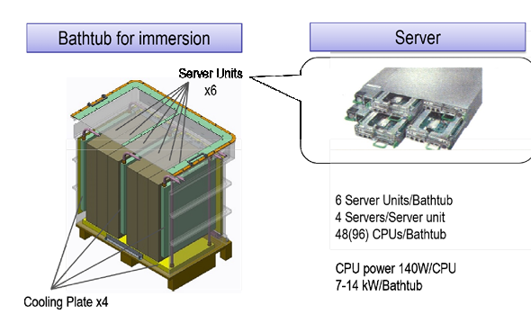
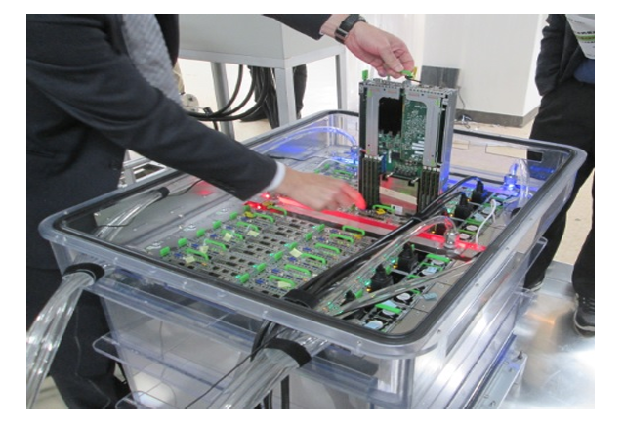
Thermal Management with NC SPIC

Slide 5
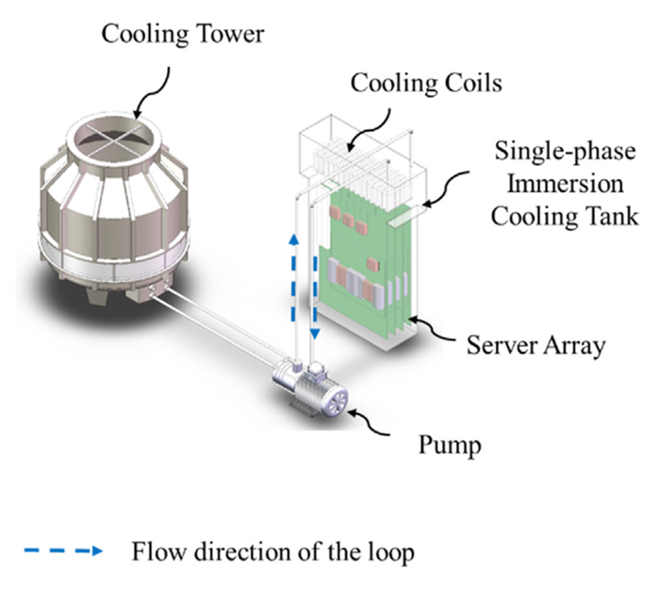
Thermal Management of A Rack with NC SPIC

Slide 6
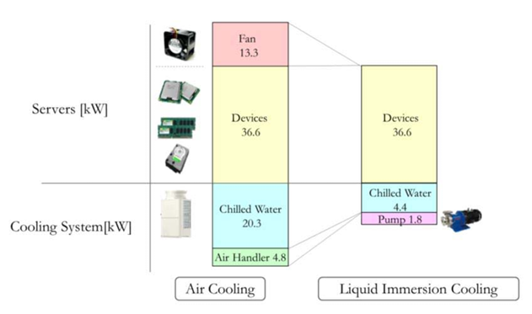
Infrastructure of A Data Center

Slide 7
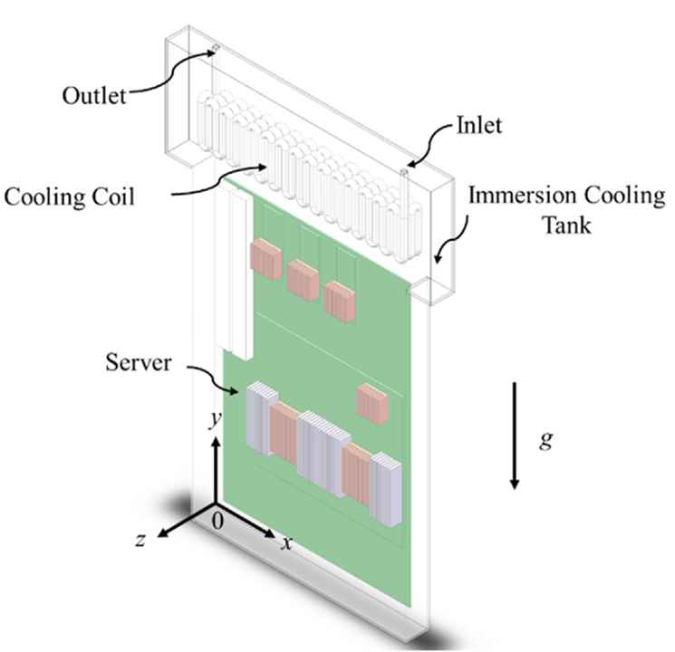
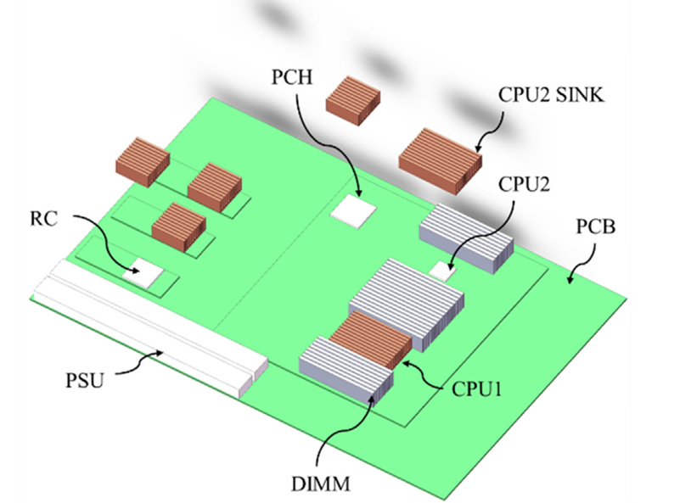
Thermal Management of A Rack with NC SPIC

Slide 8
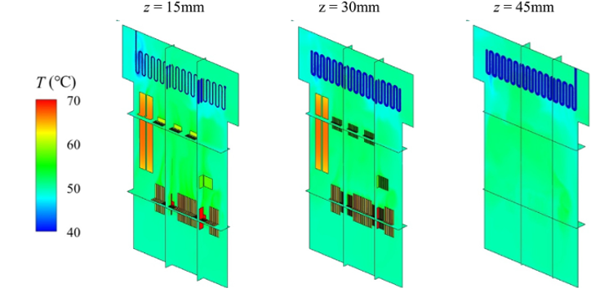
Typical Convection Pattern

Slide 9
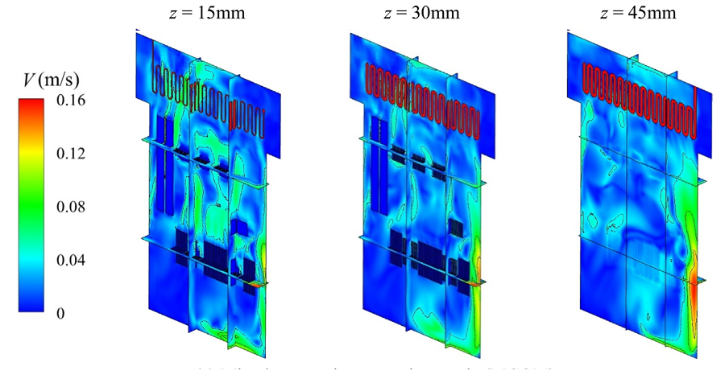
Typical Convection Pattern

Slide 10
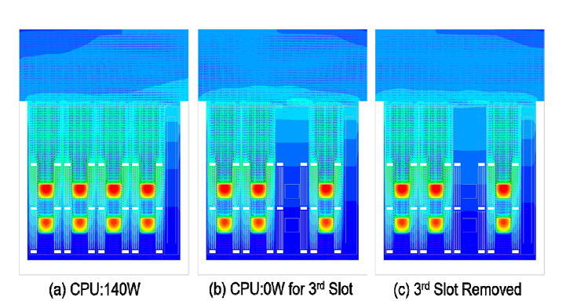
Typical Convection Pattern: Rack with Multiple Servers

Slide 11
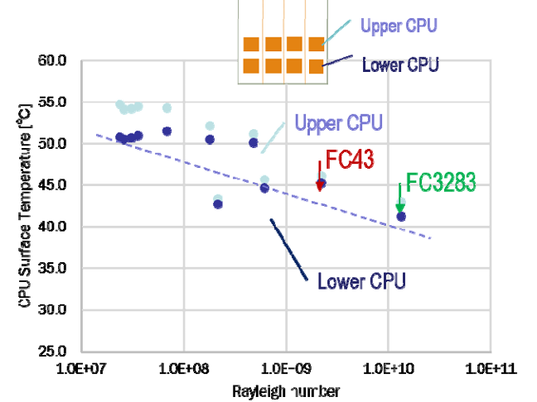
Performance of NC SPIC

Slide 12
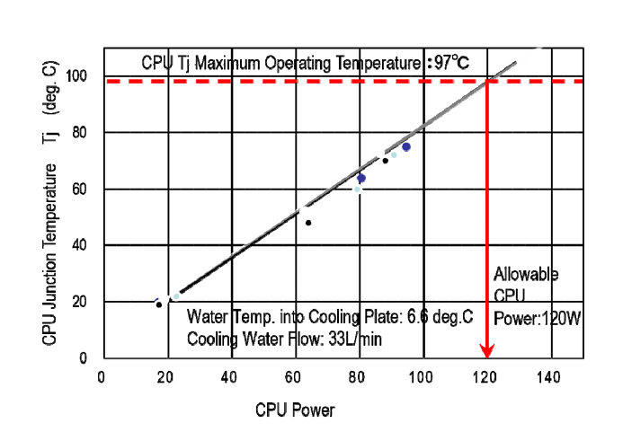

CPU Power vs CPU T_{J} : FC3283

Slide 13
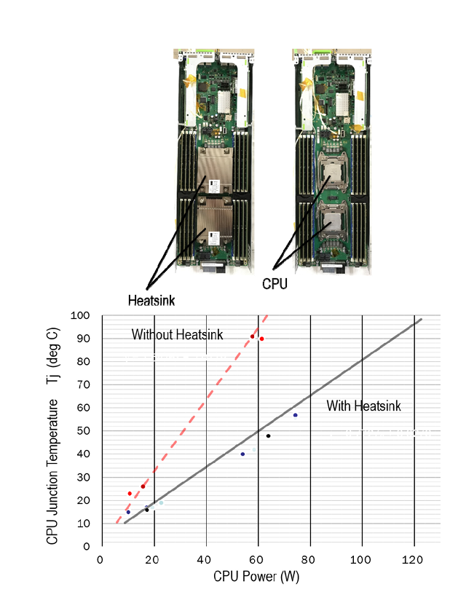
CPU Power vs CPU T_{J} : FC3283

Slide 14
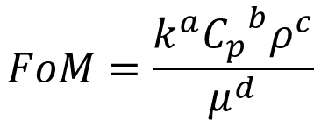
Comparison of various Single Phase Immersion Coolants
The selection of high- performance SPIC coolants is ideally guided by the following criteria:
Specific heat capacity >960 J/(kg⋅K), thermal conductivity >0.06 W/ (m⋅K), dielectric constant < 2.3, boiling point >100 °C and GWP < 250.
The concept of a Figure of Merit (FOM) was introduced to enable the quantitative optimization of the cooling liquid selection.
An ordinary FOM is typically derived from the heat transfer coefficient correlation by neglecting terms unrelated to the fluid properties.
The ordinary FOM expression applied to SPIC in current market is as follows:
$$FoM=\frac{k^{a}{C_{p}}^{b}ρ^{c}}{μ^{d}}$$

Slide 15
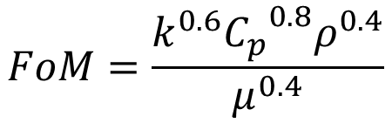
Comparison of various Single Phase Immersion Coolants
A higher FOM generally indicates superior thermal performance of the coolant.
In practical engineering applications, the coolant in pump driven SPIC cabinets typically exhibits turbulent flow.
If the classic Dittus-Boelter equation is used, the FOM can be expressed as follows:
$$FoM=\frac{k^{0.6}{C_{p}}^{0.8}ρ^{0.4}}{μ^{0.4}}$$

Slide 16

A sensitivity analysis based on FOM
A sensitivity analysis based on FOM is to be carried out to examine how the change in the independent property of a liquid immersion coolants impacts the FOM.
This is another driving factor of the cooling performance.
The variance of the FOM due to a property change can be calculated by,

Slide 17
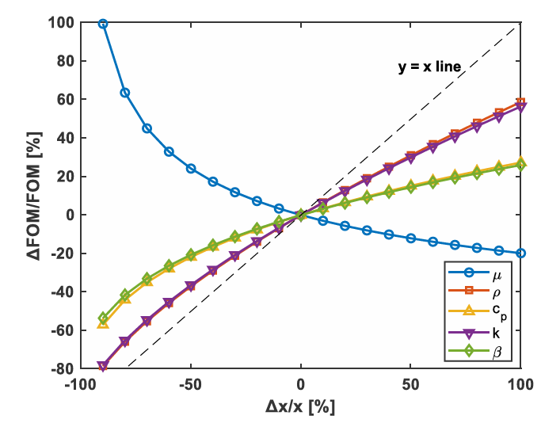
A sensitivity analysis based on FOM
A commonly used single-phase heat transfer fluid, MO 24, a high- purity white mineral oil (24cSt at 40℃), is used as an example for sensitivity analysis

Slide 18
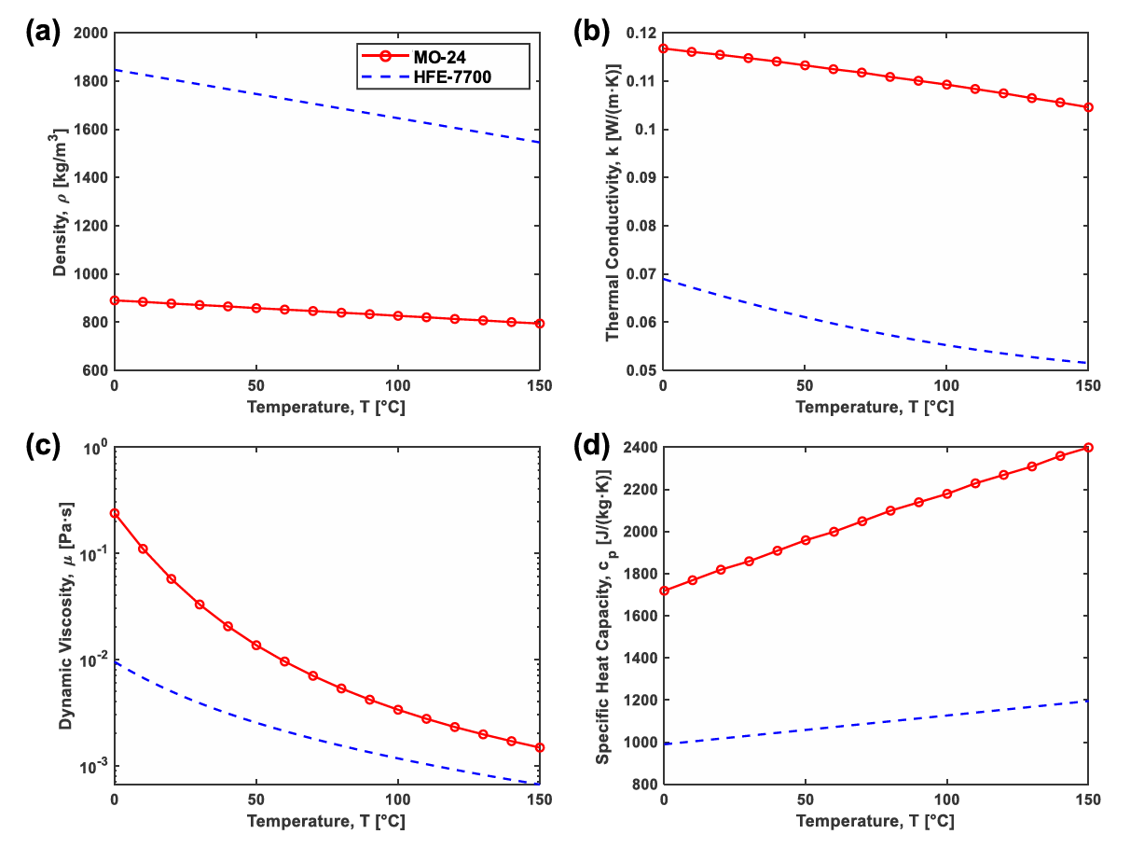
Comparative Study of Dielectric Fluids

Slide 19
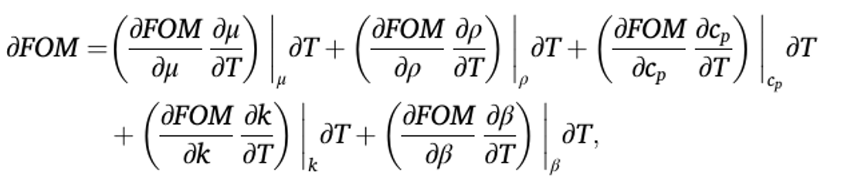
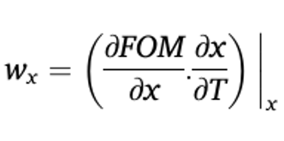
Weight Factor for A Property
Note that each property may have a different range of changes when comparing different liquids.
To further evaluate the impact of physical properties on the immersion cooling performance, a weight-factor framework is used with consideration of temperature dependence.
The weight factor for the property, x. is defined as:

Slide 20
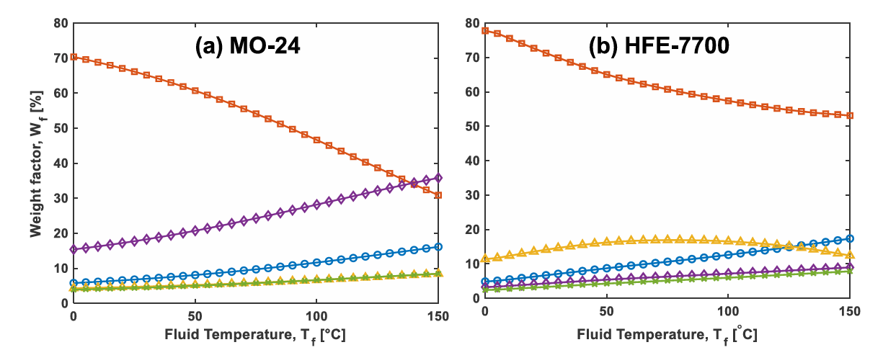
Weight Factor for A Property

Slide 21
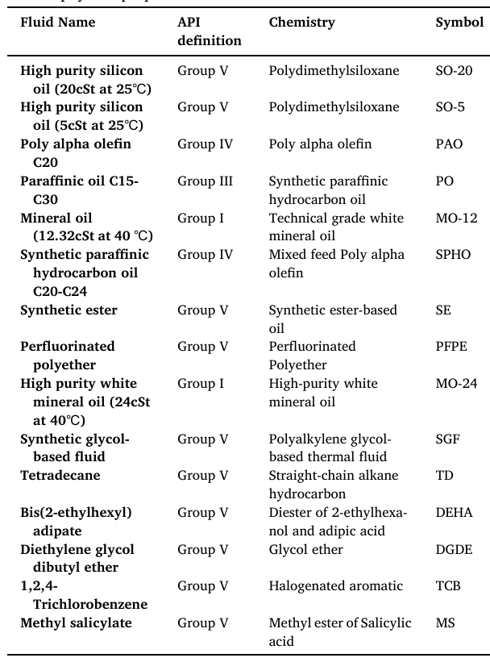
Library of Dielectric Fluids

Slide 22
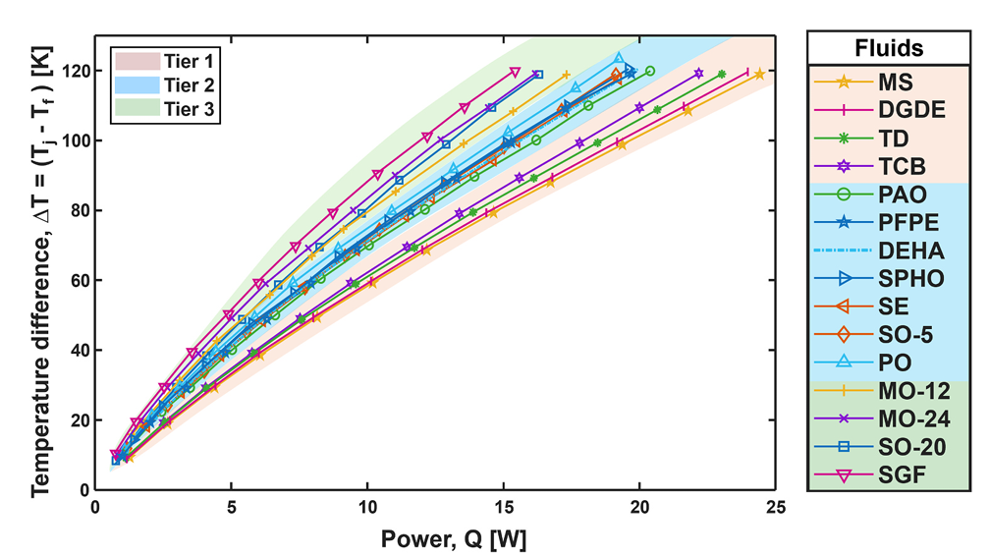
Classification of Dielectric Fluids

Slide 23
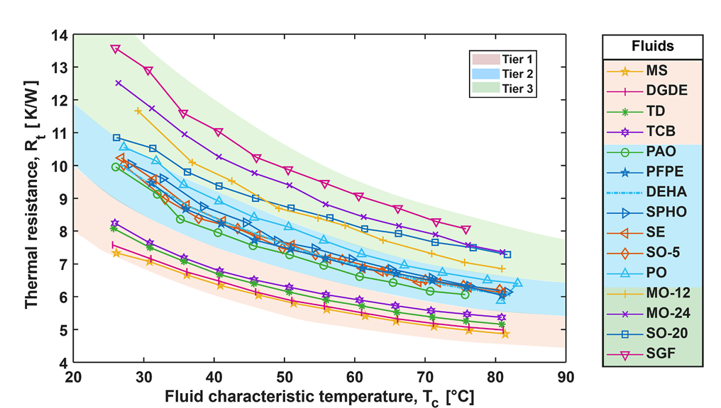
Classification of Dielectric Fluids

Slide 24
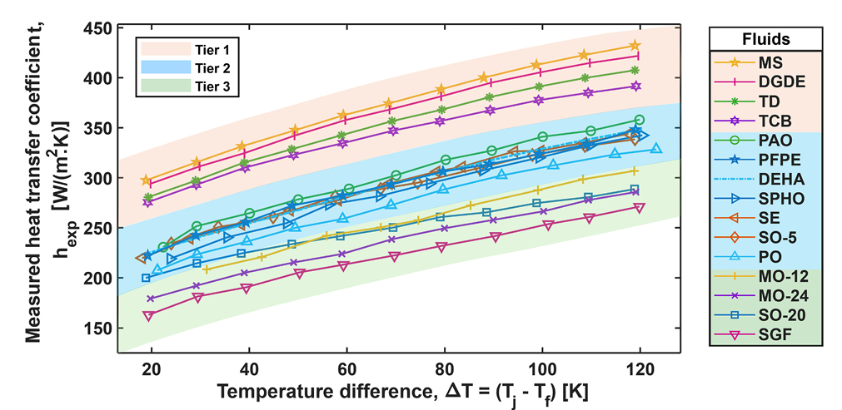
Classification of Dielectric Fluids

Slide 25
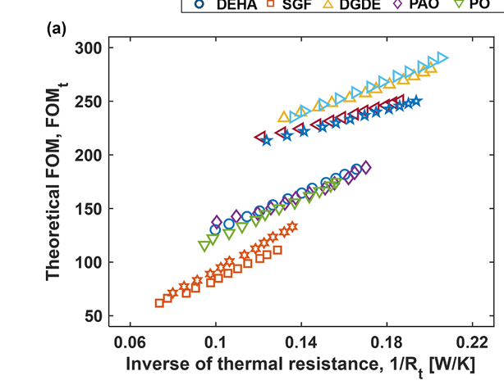
Classification of Dielectric Fluids

Slide 26
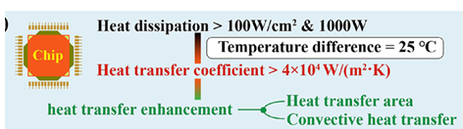
Single-phase Immersion High power Chip Cooling: Step 1
Heat dissipation requirements for chip

Slide 27
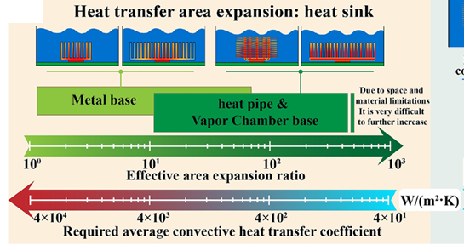
Single-phase Immersion High power Chip Cooling: Step 2
Effect of increasing the effective heat dissipation area,

Slide 28
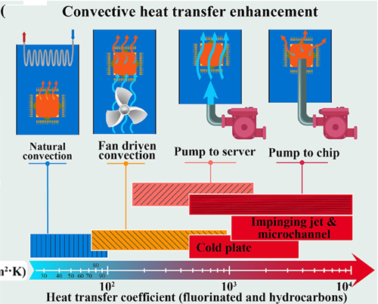

Single-phase Immersion High power Chip Cooling: Step 3
Convective heat transfer coefficients of various SPIC methods

Slide 29
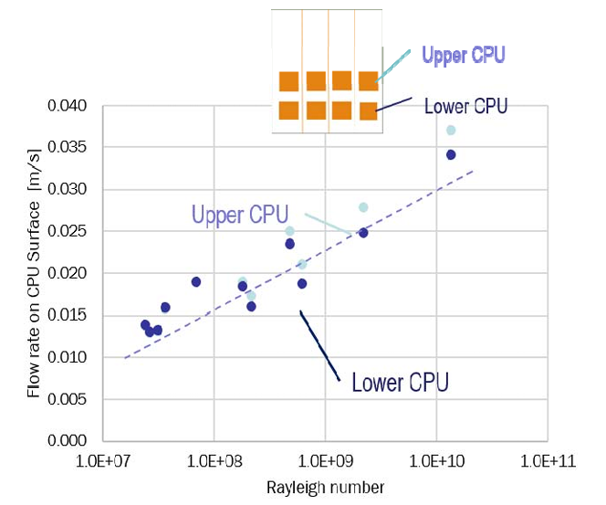
Flow Generated by NC SPIC

Slide 30
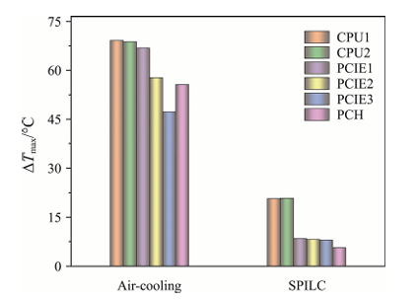
Superiority of Immersion Cooling

Slide 31
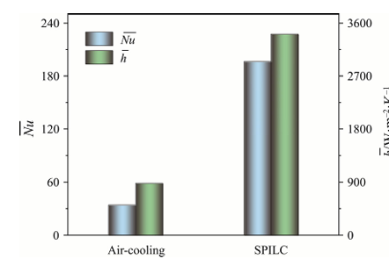
Superiority of Immersion Cooling

