Slide 1


Heatsinks for Natural Convection Cooling of Electronics
P M V Subbarao
Professor
Mechanical Engineering Department
A special Heat Transfer Device for Efficient Thermal Management …

Slide 2

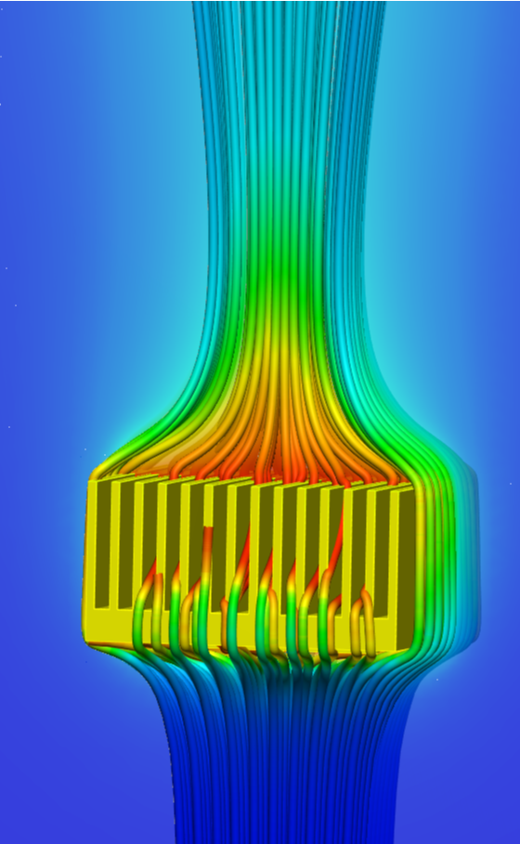
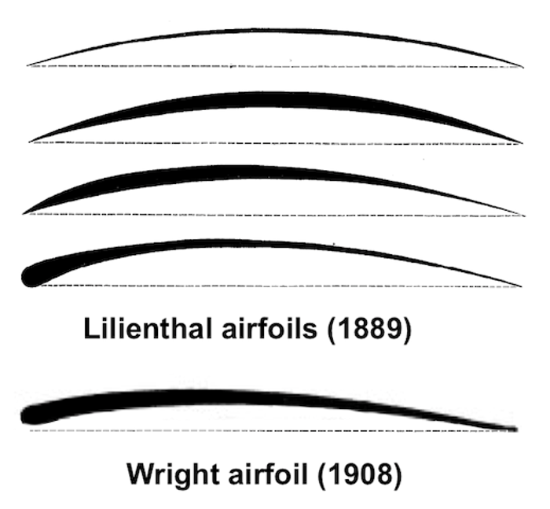
Exotic Fluid Devices

Slide 3
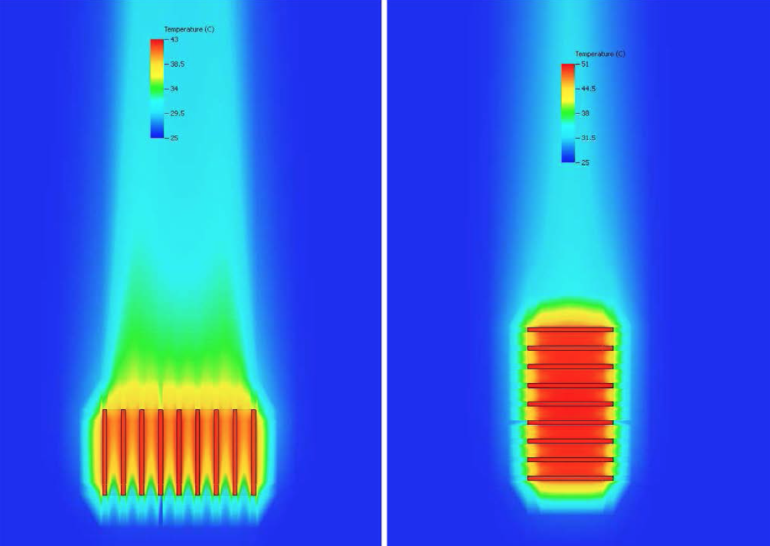
Heatsinks for Natural Convection Cooling
Communities Are Raising Noise Pollution Concerns About Data Centers | Article | EESI
Natural Convection is the preferred approach for cooling electronic systems.
For a number of reasons, namely, cost, simplicity, power consumption, noise, etc.

Slide 4
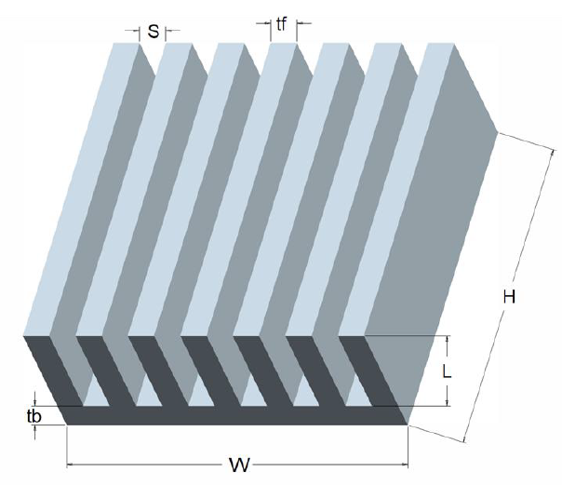
Heatsinks for Natural Convection Cooling
The arrangement of fins in a heat sink creates a Special Fluid Flow System.
This is classified as a Natural convection in rectangular U-channels with the upward flow of fluid due to buoyancy forces acting on heated surfaces.
The flow is characterized by the following principles:
Buoyancy Forces
Boundary Layer Development
Heat Transfer
Flow Stability and Transition
L
H

Slide 5



New Device: Natural Convection Analysis
Van De Pol and Tierney proposed an equation for the U-channels formed by rectangular vertical fins.

Slide 6
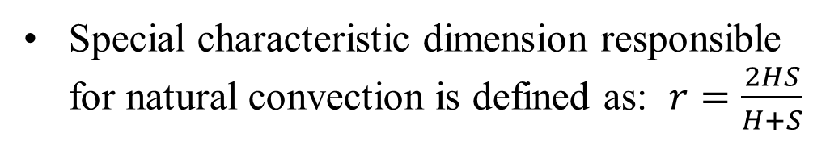
New Device: Natural Convection Analysis
Special characteristic dimension responsible for natural convection is defined as: $r=\frac{2HS}{H+S}$

Slide 7
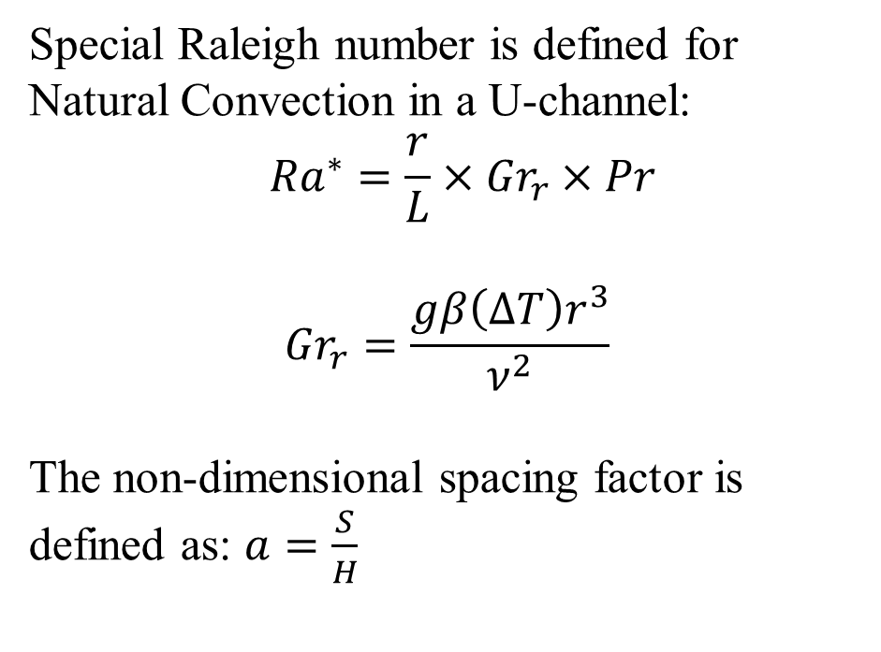
New Device: Natural Convection Analysis
Special Raleigh number is defined for Natural Convection in a U-channel:
$${Ra}^{∗}=\frac{r}{L}×{Gr}_{r}×Pr$$
$${Gr}_{r}=\frac{gβ\left(∆T\right)r^{3}}{ν^{2}}$$
The non-dimensional spacing factor is defined as: $a=\frac{S}{H}$

Slide 8
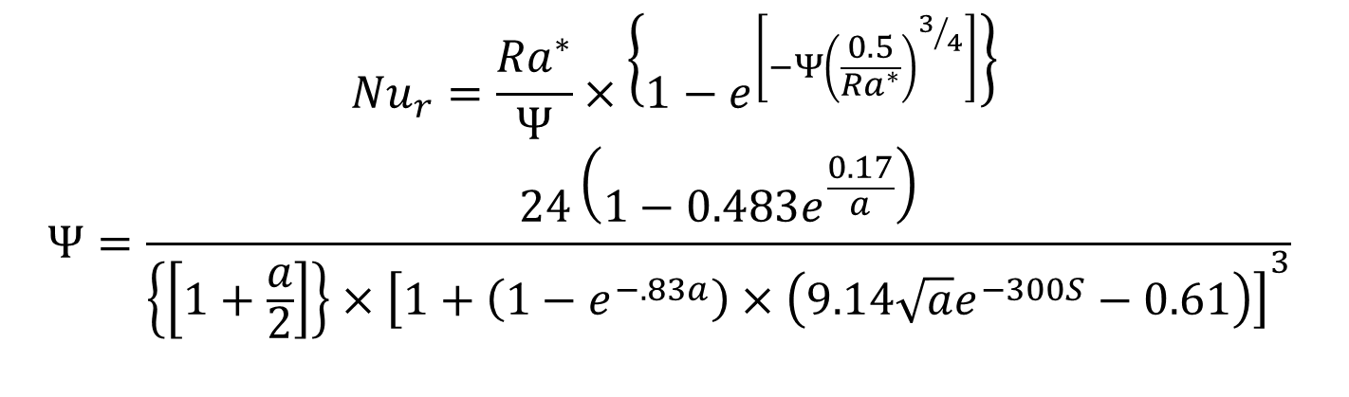
Nusselt Number Correlation for Natural Convection in a U-Channel
$${Nu}_{r}=\frac{{Ra}^{∗}}{Ψ}×\left\{1−e^{\left[−Ψ{\left(\frac{0.5}{{Ra}^{∗}}\right)}^{3/4}\right]}\right\}$$
$$Ψ=\frac{24\left(1−0.483e^{\frac{0.17}{a}}\right)}{{\left\{\left[1+\frac{a}{2}\right]\right\}×\left[1+\left(1−e^{−.83a}\right)×\left(9.14\sqrt{a}e^{−300S}−0.61\right)\right]}^{3}}$$
S in mm only!
All physical properties except β are evaluated at the surface temperature;
β is evaluated at the ambient fluid temperature.

Slide 9
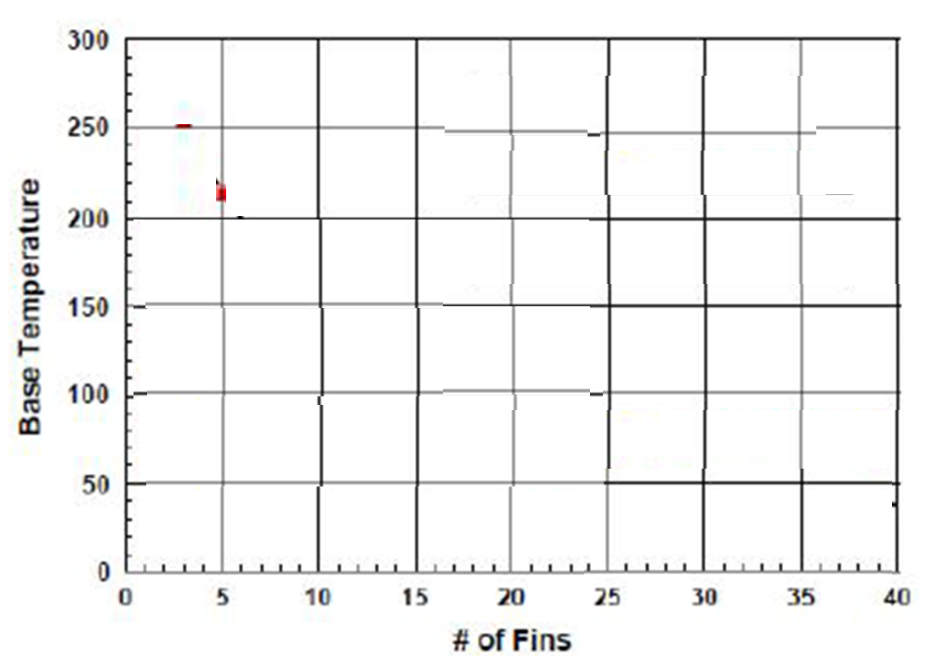

Effect of Number of Fins: Natural Convection Analysis
For a given Heat dissipation $\dot{Q} \& Base W×L$
Heat Sink Base Temperature
Bulk temperature of hot fluid at the exit
Bulk Velocity of Convected fluid

Slide 10
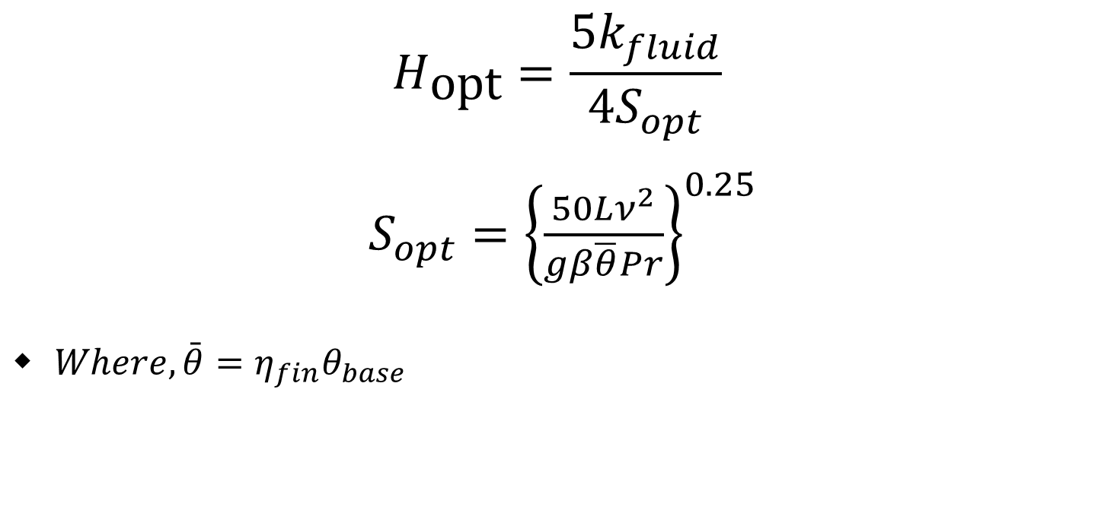
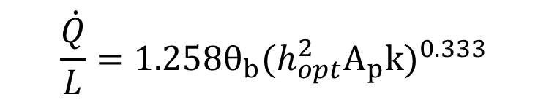
Least Material Heat Sink
$$H_{\text{opt}}=\frac{5k_{fluid}}{{4S}_{opt}}$$
$S_{opt}={\left\{\frac{50Lν^{2}}{gβ\overline{θ}Pr}\right\}}^{0.25}$
$Where, \bar{θ}=η_{fin}θ_{base}$
Heat flow from each optimum fin:
$$\frac{\dot{Q}}{L}=1.258θ_{b}(h_{opt}^{2}A_{p}k)^{0.333}$$

Slide 11
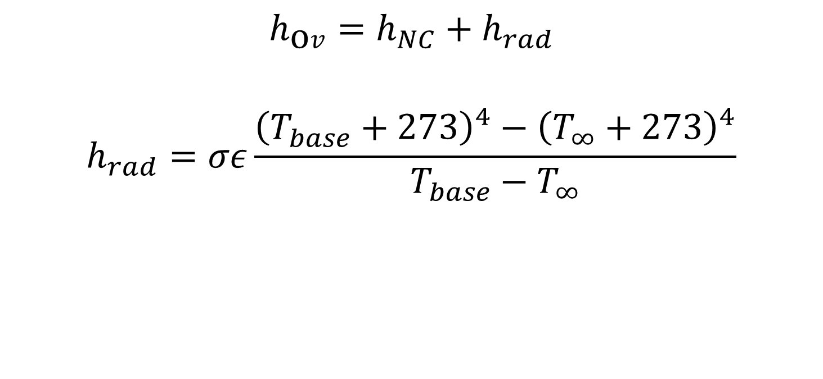
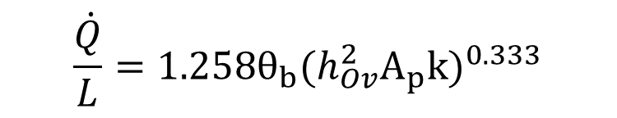
Radiation correction to Simplified Correlations
$$h_{\text{o}v}=h_{NC}+h_{rad}$$
$$h_{rad}=σε\frac{{\left(T_{base}+273\right)}^{4}−{\left(T_{∞}+273\right)}^{4}}{T_{base}−T_{∞}}$$
Heat flow from each optimum fin:
$$\frac{\dot{Q}}{L}=1.258θ_{b}(h_{Ov}^{2}A_{p}k)^{0.333}$$

Slide 12
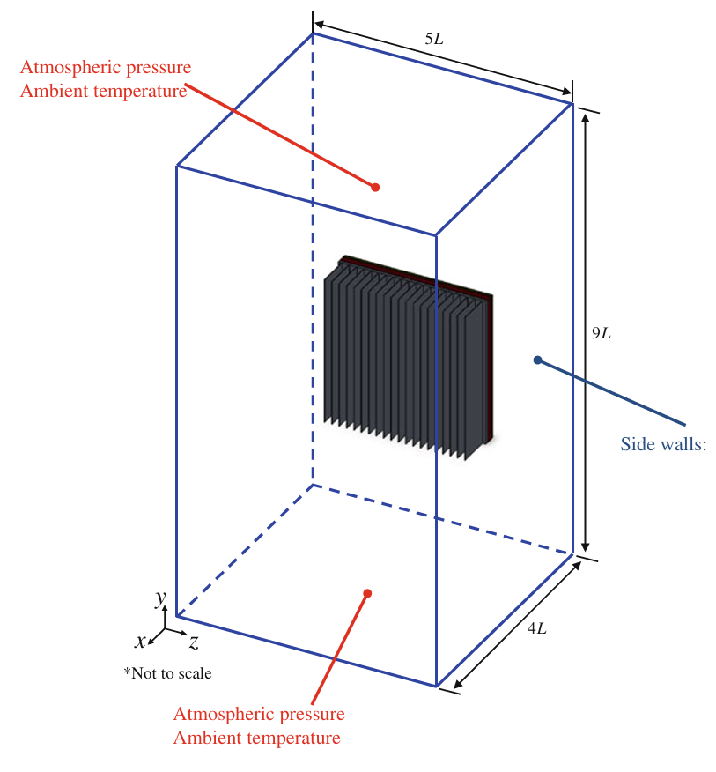
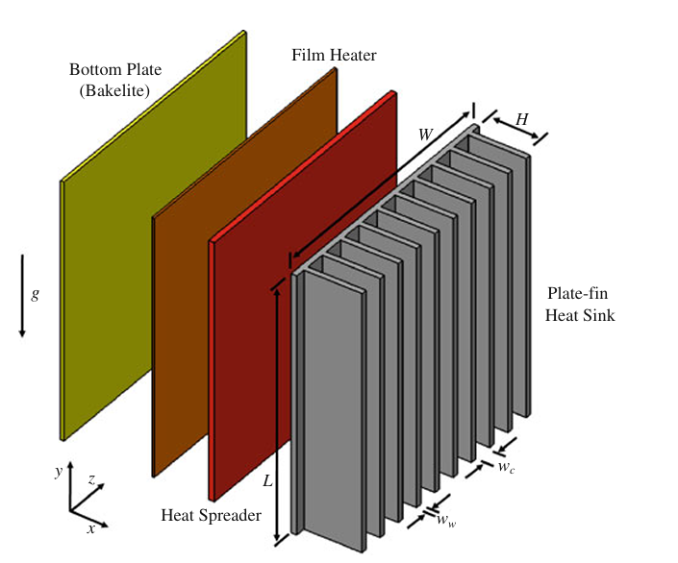
Experimental Investigation
Extensive experiments were conducted for various input powers, channel widths and heights.
Special test rigs and experimental setups were created by Industrial Research Groups.

Slide 13
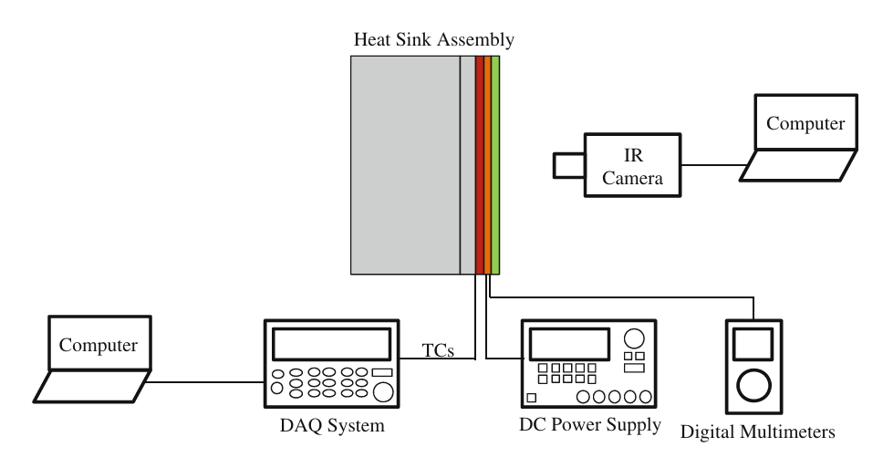
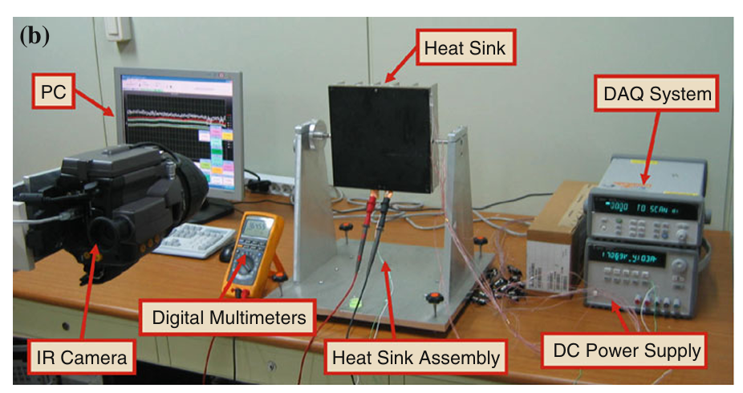
Experimental Investigation

Slide 14
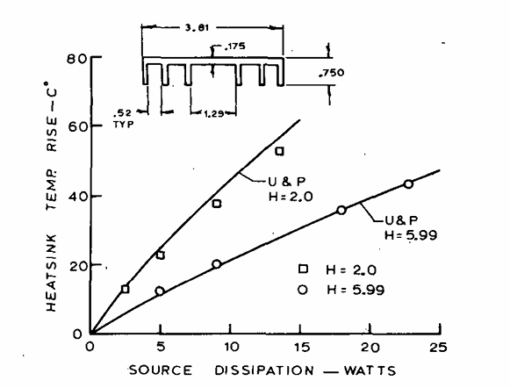
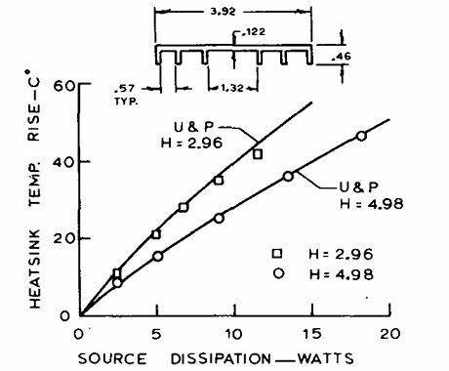
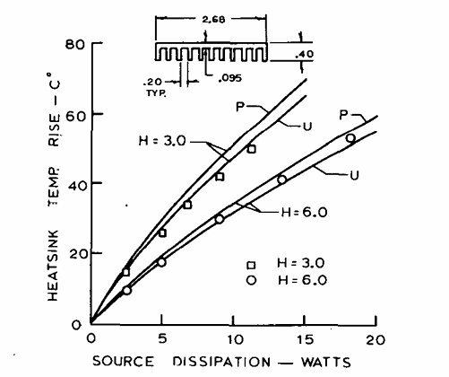
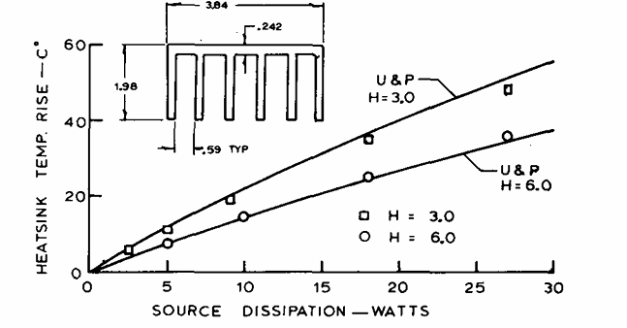
Experimental Investigations

Slide 15
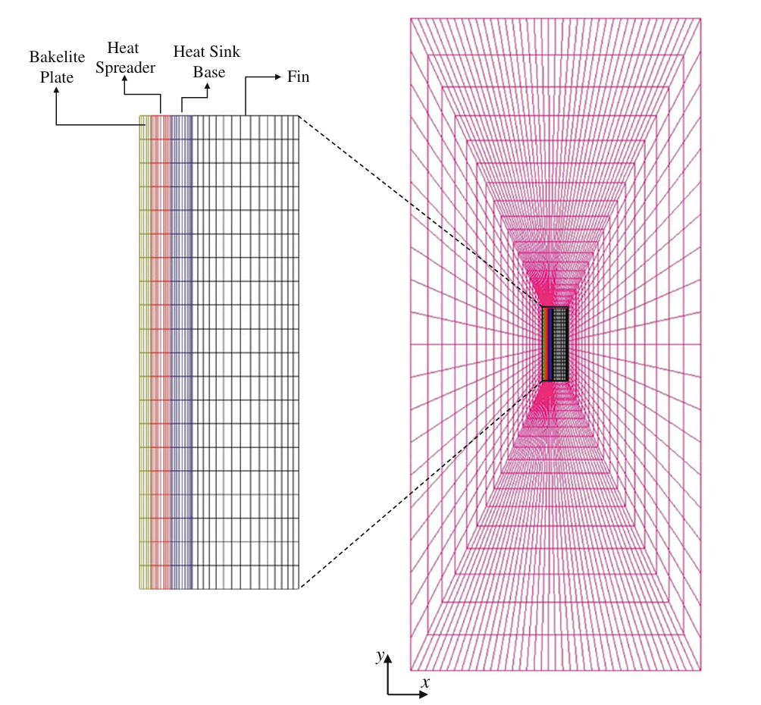
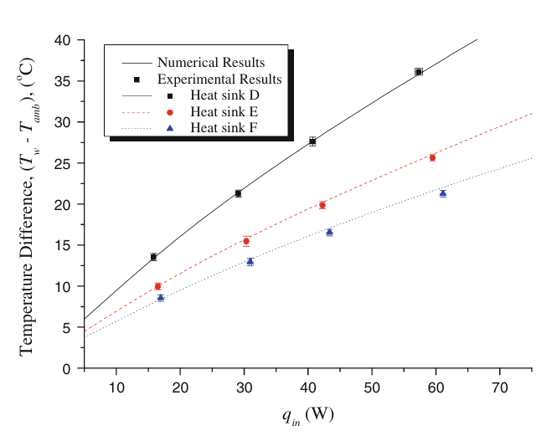
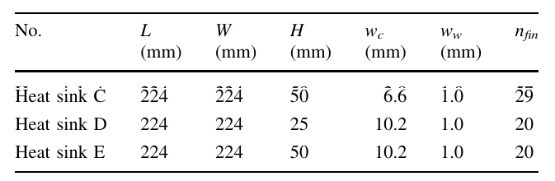
NC Heat Sinks for High Power Electronics

Slide 16
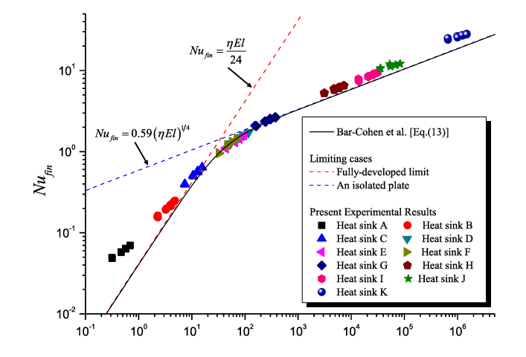
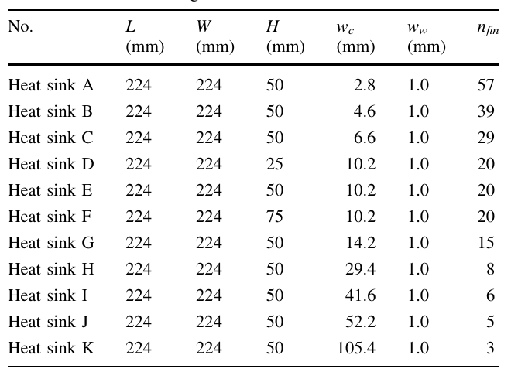

Limiting Capacity of NC Heat Sinks
$$\dot{Q}=E×I$$

Slide 17
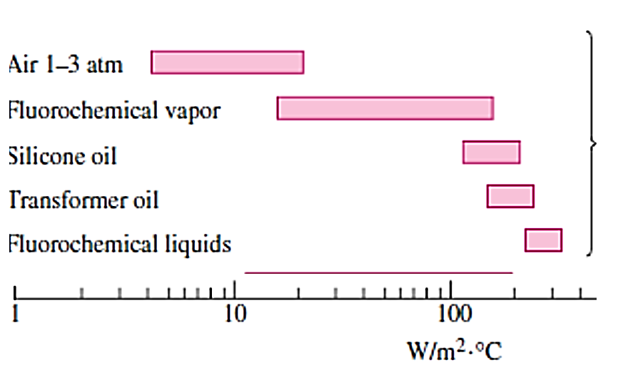
Typical heat transfer coefficients for
NC with dielectric Liquids

Slide 18
NC Heatsinks in Liquids
Immersion in dielectric Liquids can allow for greatly reduced heat transfer surface areas as the fluids are able to transfer heat much more effectively than air.
The higher heat transfer capability of the dielectric fluids compared to air means that the flowrate will be greatly reduced.
The thermal designer must balance the reduced flow rate with the required heat transfer surface area.
To properly design a heat sink for single phase immersion, a multitude of parameters should be considered for each type of dielectric fluid.
The target operational temperature may play a role in heat sink design as the fluid may show significant property changes when temperatures are changed.

Slide 19
Main Design Steps in Immersion Cooling
Material Compatibility
Thermal Design
Mechanical Design
Electronic Design
Software

Slide 20
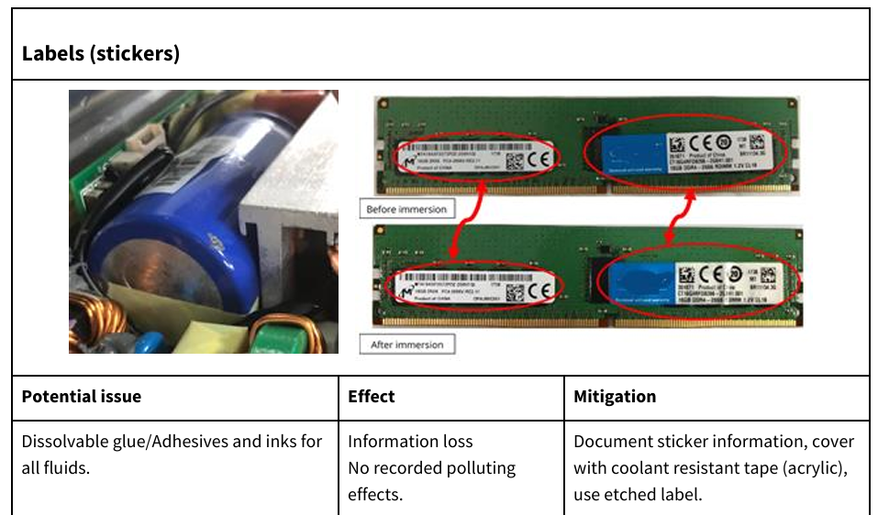
Components to Check for Compatibility & Material Source of Contaminant

Slide 21
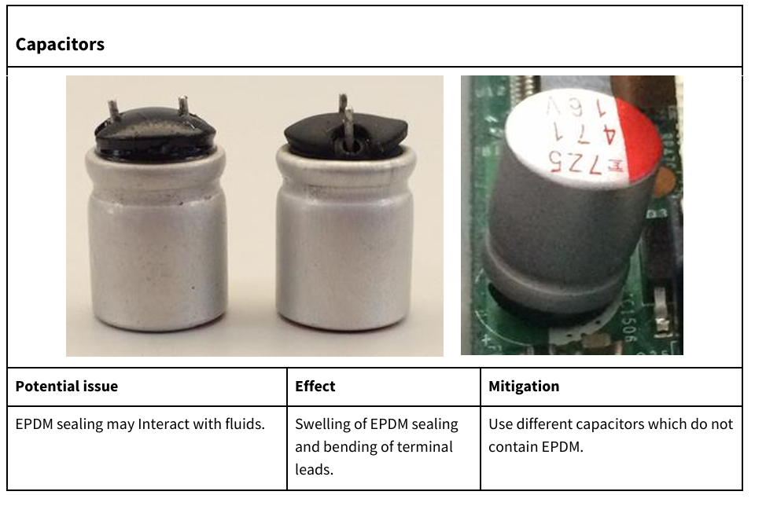
Components to Check for Compatibility & Material Source of Contaminant

Slide 22
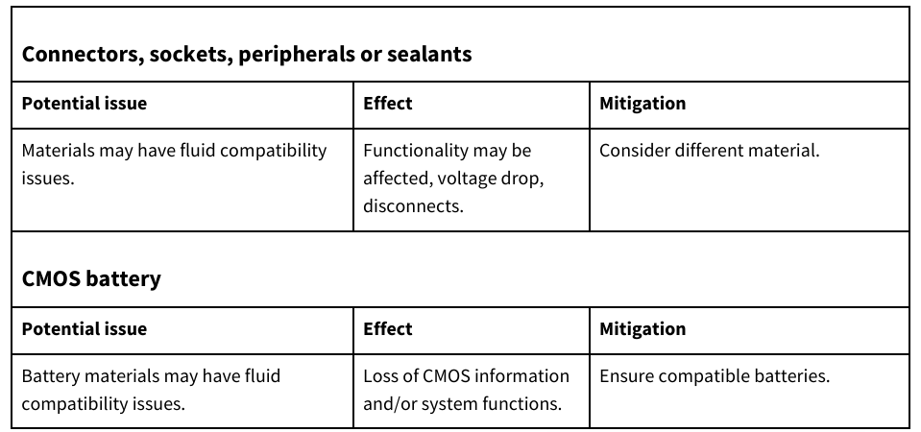
Components to Check for Compatibility & Material Source of Contaminant

Slide 23
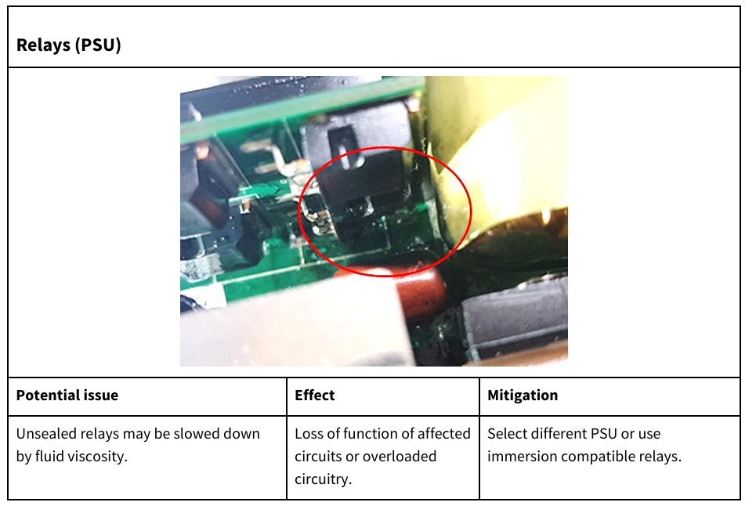
Components to Check for Compatibility & Material Source of Contaminant

Slide 24
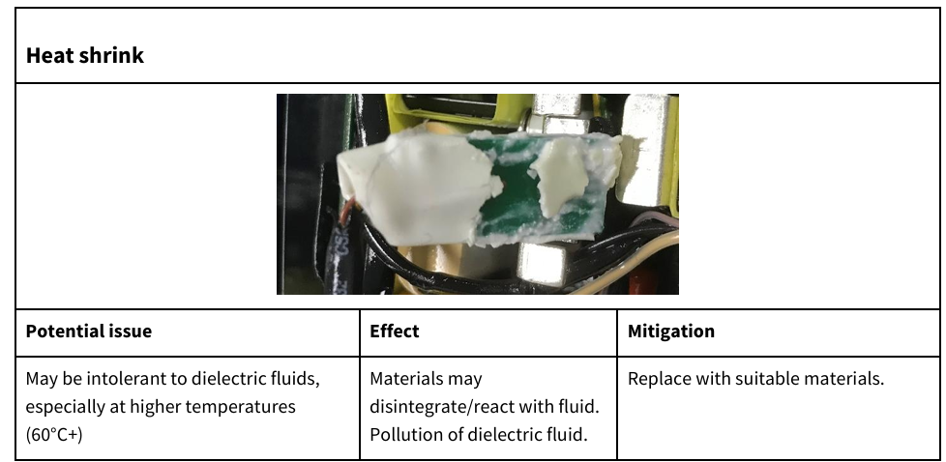
Components to Check for Compatibility & Material Source of Contaminant

Slide 25
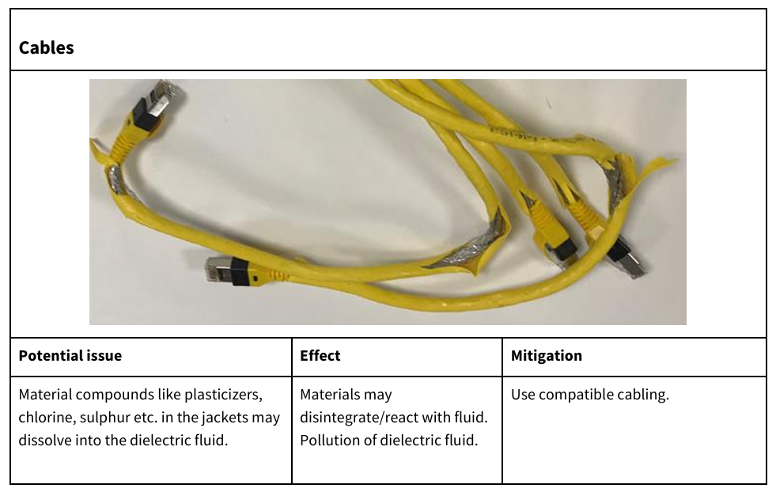
Components to Check for Compatibility & Material Source of Contaminant

Slide 26
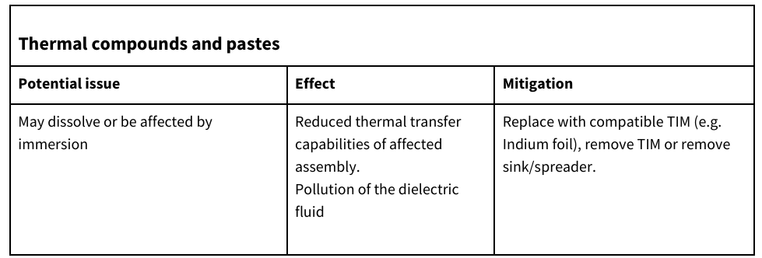
Components to Check for Compatibility & Material Source of Contaminant

Slide 27
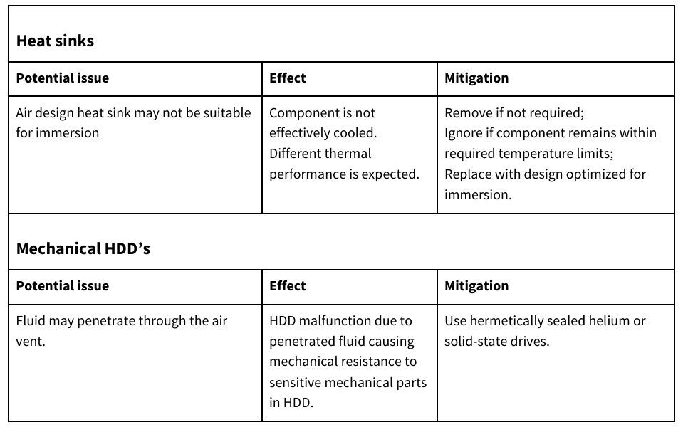
Components to Check for Compatibility & Material Source of Contaminant

Slide 28
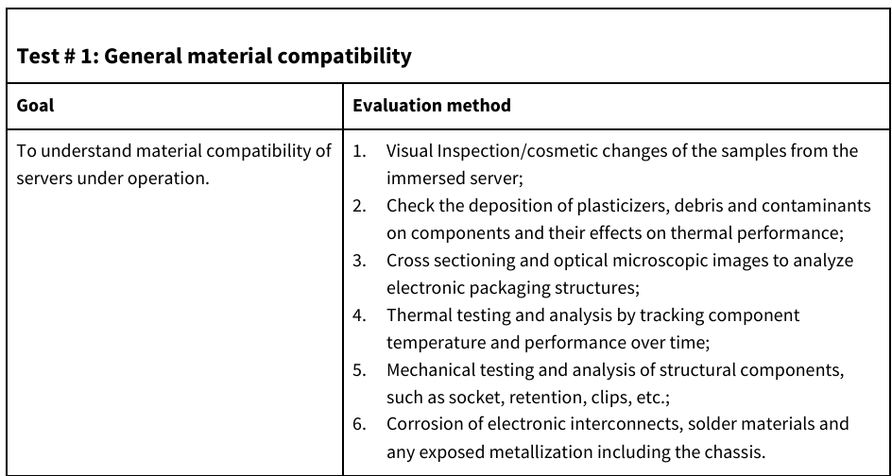
Material Compatibility: Single-Phase Immersion Cooling (Hydrocarbons)
Test conditions for material compatibility

Slide 29
Material Compatibility: Single-Phase Immersion Cooling (Fluorochemicals)
Most organic polymers used in the fabrication of modern electronics are hydrocarbons in nature.
Hydrocarbon based cooling fluid will have natural affinity or solvency of casings etc.
Fluorochemical fluids have virtually no affinity or solvency for them.
Clean fluorochemical fluids show excellent compatibility by traditional material compatibility tests.
In real world immersion cooling applications, the fluorochemicals will become contaminated with hydrocarbons such as dioctyl phthalate (DOP).

Slide 30
Material Compatibility: Single-Phase Immersion Cooling (Fluorochemicals)
Polyvinyl chloride (PVC) wire insulation or silicone oils extracted from silicone polymers, solder flux, or thermal interface materials are susceptible.
As the fluorochemical has very little solvency for these hydrocarbon contaminants, it is easily saturated with them at concentrations of only a few parts per million.
This also means that the fluorochemicals readily give up these hydrocarbon contaminants to other materials that have an affinity for them.
This may may lead to swelling of a hydrocarbon polymer as it absorbs material extracted from another hydrocarbon polymer known as “secondary incompatibility”.

Slide 31
Material Compatibility: Single-Phase Immersion Cooling (Fluorochemicals)
This due to the fact that the fluorochemical merely acts as a contaminant vector.
Effects on the performance of either the source or sink of a contaminant are rare.
Leaching out of plasticizers from CAT6 network cables will make the jacket stiffer but will not affect the functionality of the cable.
The Soxhlet extraction compatibility test is intended to quantify compatibility and certify the coolants which generate extractable materials <2% are considered as good compatibility.
Read: https://www.opencompute.org/documents/design-guidelines-for-immersion-cooled-it-equipment-revision-1-01-pdf

Slide 32
Thermal Design
In single-phase immersion, to generate optimal and efficient cooling one maximizes the flow rate through the heat sink and over hot components with the strictest cooling requirements.
The dielectric fluids are more viscous than air, which makes the generation of a turbulent flow is more challenging.
There are opportunities for enhancement by generating an unsteady versus a steady laminar flow.
The unsteady flow may assist with breaking up the thermal boundary layer and therefore enhancing the heat transfer capabilities.
Importantly, a flow is generated by natural convection in immersion, but heat still needs to be extracted from the immersion solution.

Slide 33
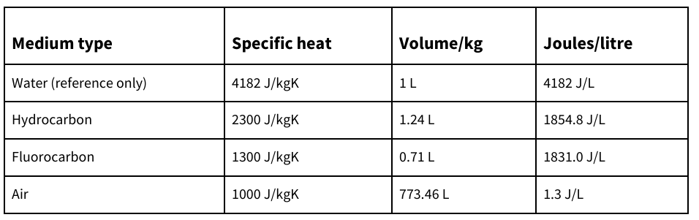
Heat transfer optimization
Central Limit Theorem:
Whatever may be the method of heat transfer, high power components such as a GPU or CPU will run much more effectively at lower component temperatures.
Heat transfer enhancement is necessary around these vital devices.

Slide 34
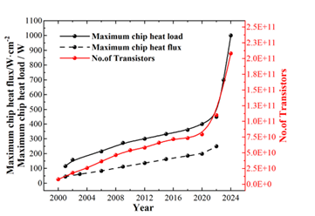
Variation in the number of transistors, maximum heat flow and heat flux of an electronic chip

Slide 35

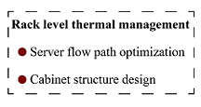
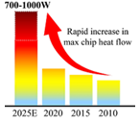
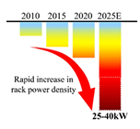

Trend of chip and High-power Rack heat Flux

Slide 36
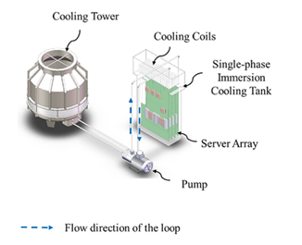
SPIC Model: Natural convection
A constrained flow mode:
The flow conditions are influenced solely by the inlets, outlets, and the internal structure of the server.

Slide 37
SPIC
Due to superior thermophysical properties of liquids, SPIC methods exhibit higher cooling performance compared to conventional Natural air-cooling methods

Slide 38
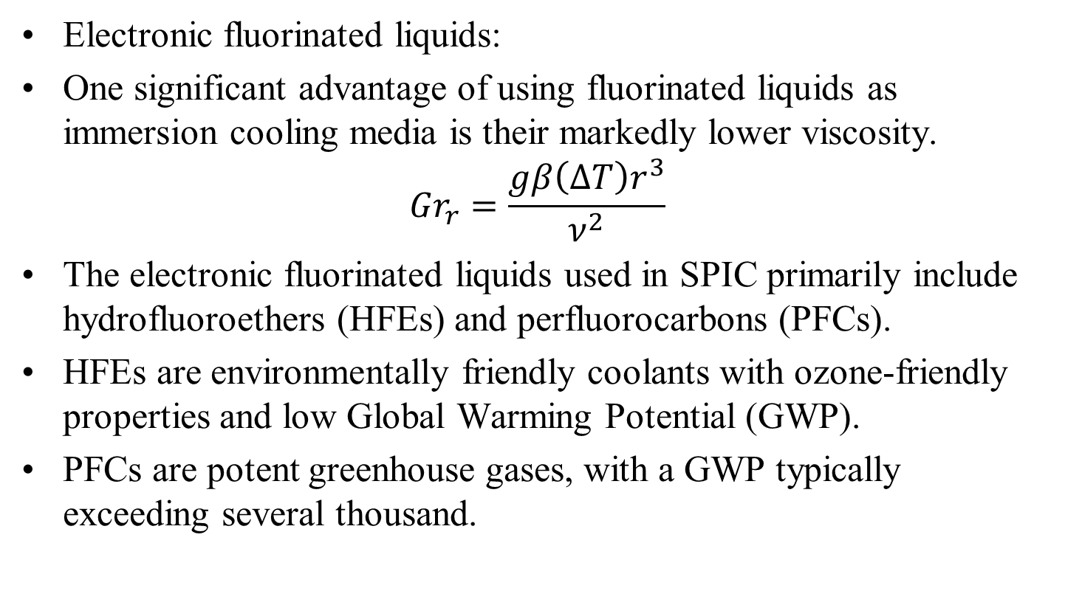
Single phase immersion cooling liquids
Electronic fluorinated liquids:
One significant advantage of using fluorinated liquids as immersion cooling media is their markedly lower viscosity.
$${Gr}_{r}=\frac{gβ\left(∆T\right)r^{3}}{ν^{2}}$$
The electronic fluorinated liquids used in SPIC primarily include hydrofluoroethers (HFEs) and perfluorocarbons (PFCs).
HFEs are environmentally friendly coolants with ozone-friendly properties and low Global Warming Potential (GWP).
PFCs are potent greenhouse gases, with a GWP typically exceeding several thousand.

Slide 39
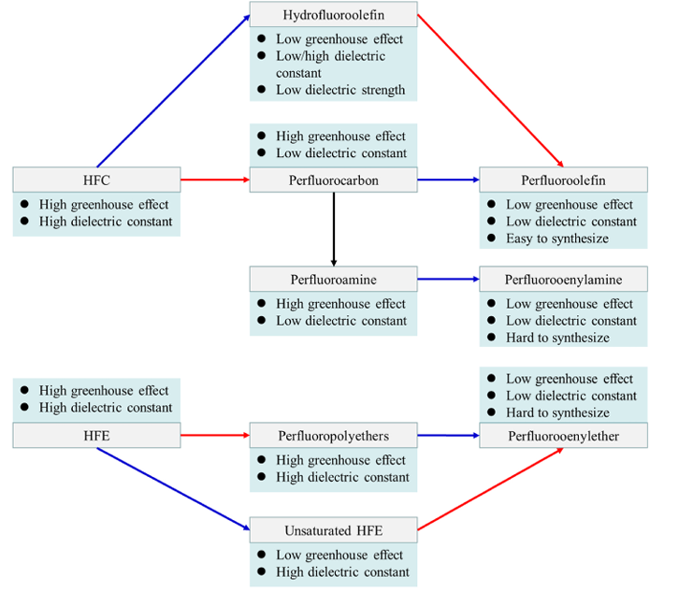
Physicochemical properties of fluorocarbon coolants
Introduction of Double bond/Ring Structure
Introduction of F atom
Introduction of N atom

