Slide 1


Methodology for Development of Least Weight Fins
P M V Subbarao
Professor
Mechanical Engineering Department
Least additional Material with Sufficient Convection Area…

Slide 2

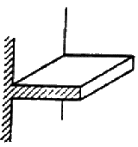

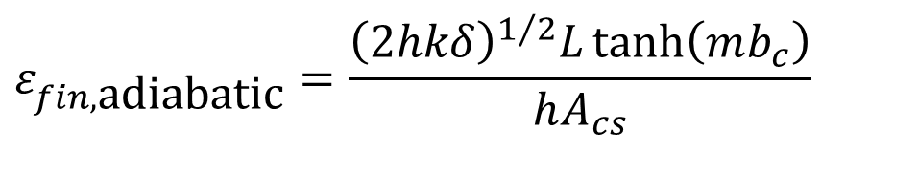
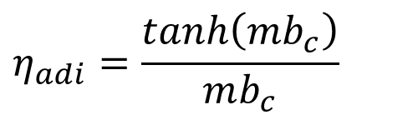
Longitudinal Fin of Rectangular Profile: Adiabatic tip
$$θ\left(x\right)=θ_{b}\frac{\cosh\left(mx\right)}{\cosh\left(mb_{c}\right)}$$
Temperature Excess Profile
Heat Dissipated = Heat Entering Base of the fin
$${\dot{Q}}_{b_{}}=kδLmθ_{b}\tanh\left(mb_{c}\right)$$
$$ε_{fin,\text{adiabatic}}=\frac{{\left(2hkδ\right)}^{1/2}L\tanh\left(mb_{c}\right)}{hA_{cs}}$$
$$η_{adi}=\frac{tanh\left(mb_{c}\right)}{mb_{c}}$$
Fin Efficiency

Slide 3
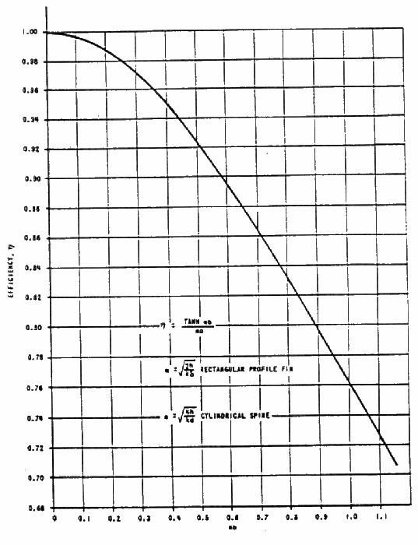


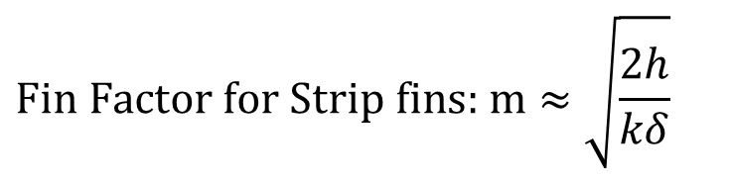
Fin Efficiency
$$\text{Fin Factor for Strip fins: }\text{m}≈\sqrt{\frac{2h}{kδ}}$$
mb_{c}

Slide 4
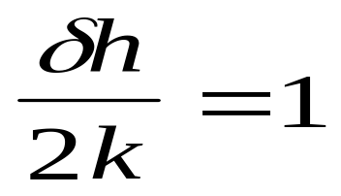
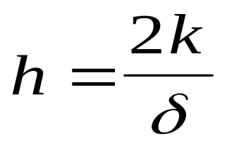



Selection of Fin thickness
The usefulness criterion:
Says that maximum cooling is facilitated by a fin, when the conductance of the fin surface conductance just equals twice the fin internal conductance.
This says that
makes the use of a fin a big win
is a borderline type of situation and
tends to make the fin act as an insulator.

Slide 5
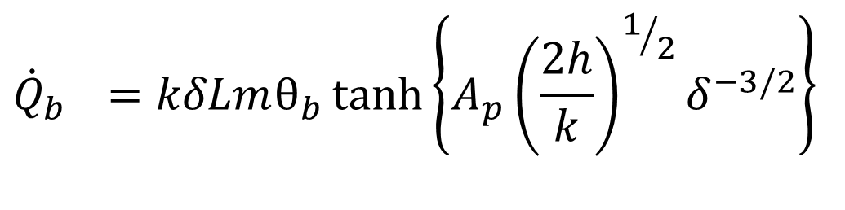
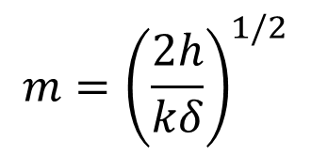
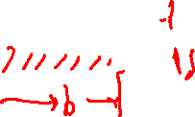
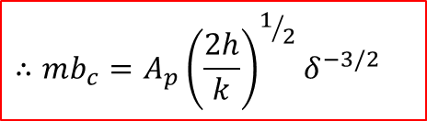
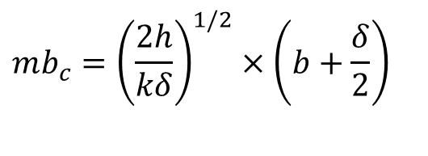
Strip Fin of Least Material
OPTIMUM SHAPES
A strip fin with least profile area will have least weight.
Least profile area for a given rate of heat transfer can be modified as maximum rate of heat transfer for a given profile area A_{p}
For a strip fin of length L :
$$m={\left(\frac{2h}{kδ}\right)}^{1/2}$$
$${\dot{Q}}_{b_{}}=kδLmθ_{b}\tanh\left(mb_{c}\right)$$
$$mb_{c}={\left(\frac{2h}{kδ}\right)}^{1/2}×\left(b+\frac{δ}{2}\right)$$
$$≈b{\left(\frac{2h}{kδ}\right)}^{1/2}$$
With
$$A_{p}=δb$$
$$∴mb_{c}=A_{p}{\left(\frac{2h}{k}\right)}^{1/2}δ^{−3/2}$$
$${\dot{Q}}_{b_{}}=kδLmθ_{b}\tanh\left\{A_{p}{\left(\frac{2h}{k}\right)}^{1/2}δ^{−3/2}\right\}$$
Hence

Slide 6
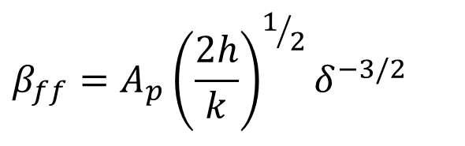
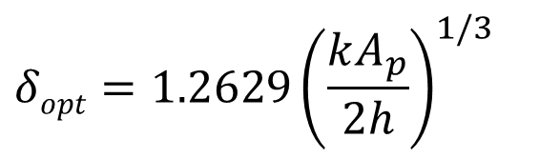
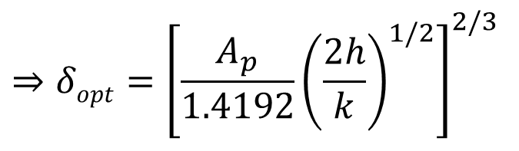
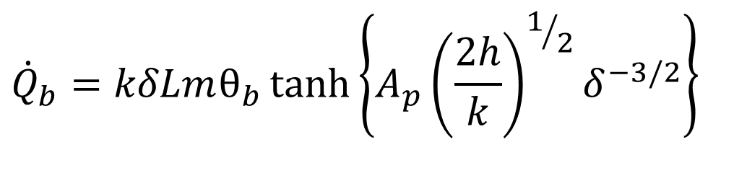
Optimum Profile Geometry
: Strip Fin
$${\dot{Q}}_{b}=kδLmθ_{b}\tanh\left\{A_{p}{\left(\frac{2h}{k}\right)}^{1/2}δ^{−3/2}\right\}$$
$$β_{ff}$$
$$\frac{d{\dot{Q}}_{b}}{dβ_{ff}}=0$$
Find the condition for
and get
$$3β_{ff}\text{sec}{\text{h}}^{2}β_{ff}=\tanh{β_{ff}}$$
Solving iteratively gives β_{ff} = 1.4192
$$β_{ff}=A_{p}{\left(\frac{2h}{k}\right)}^{1/2}δ^{−3/2}$$
$$⇒δopt={\left[\frac{A_{p}}{1.4192}{\left(\frac{2h}{k}\right)}^{1/2}\right]}^{2/3}$$
$$δopt=1.2629{\left(\frac{kA_{p}}{2h}\right)}^{1/3}$$
Optimum fin thickness

Slide 7
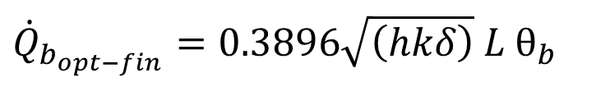
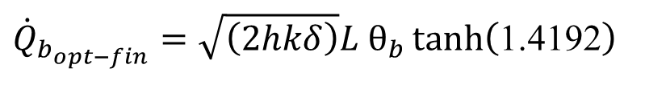
Performance of Optimum Profiles :
STRIP FINS
Heat dissipated by an optimal strip fin
$${\dot{Q}}_{b_{opt−fin}}=kδLmθ_{b}\tanh\left(β_{ff−opt}\right)$$
$${\dot{Q}}_{b_{opt−fin}}={\sqrt{\left(2hkδ\right)}L θ}_{b}\tanh\left(\text{1.4192}\right)$$
tanh (1.4192) = 0.8894
$${\dot{Q}}_{b_{opt−fin}}={0.3896\sqrt{\left(hkδ\right)} L θ}_{b}$$

Slide 8
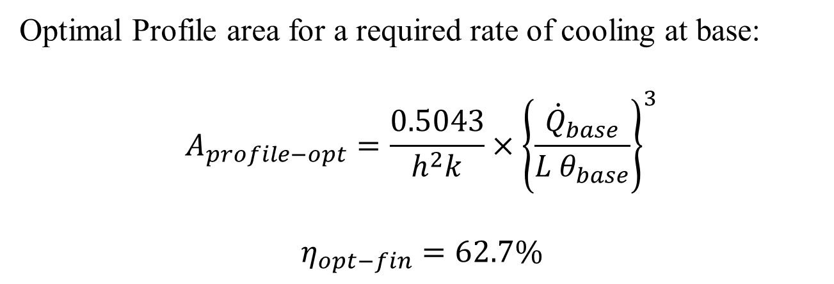
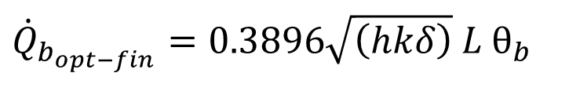
Performance of Optimum Profiles
Rate of base cooling by the optimal fins
$${\dot{Q}}_{b_{opt−fin}}={0.3896\sqrt{\left(hkδ\right)} L θ}_{b}$$
Optimal Profile area for a required rate of cooling at base:
$$A_{profile−opt}=\frac{0.5043}{h^{2}k}×{\left\{\frac{{\dot{Q}}_{base}}{{L θ}_{base}}\right\}}^{3}$$
$$η_{opt−fin}=62.7\%$$

Slide 9
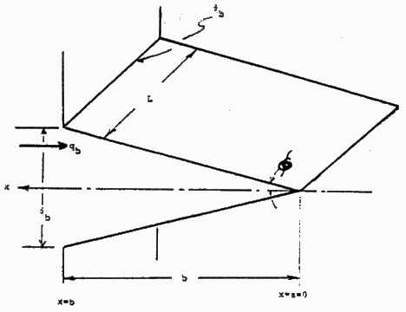
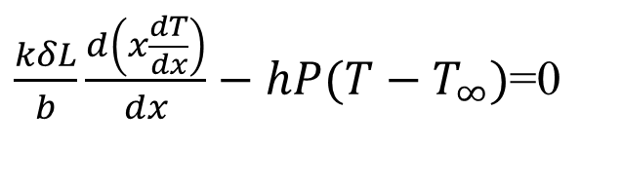
Longitudinal Fin of Triangular Profile
$$\frac{d\left(kA_{c}\frac{dT}{dx}\right)}{dx}−hP(T−T_{∞})=0$$
$$θ_{b}$$
L
x
q_{b}
$$φ$$
$$δ_{b}$$
$$A_{c}(x)=δL\frac{x}{b}$$
x=b
b
x=0
$$\frac{d\left(kδL\frac{x}{b}\frac{dT}{dx}\right)}{dx}−hP(T−T_{∞})=0$$
$\frac{kδL}{b}\frac{d\left(x\frac{dT}{dx}\right)}{dx}−hP(T−T_{∞})$=0
$$\frac{kδL}{b}\left\{x\frac{d^{2}T}{dx^{2}}+\frac{dT}{dx}\right\}−hP\left(T−T_{∞}\right)=0$$

Slide 10
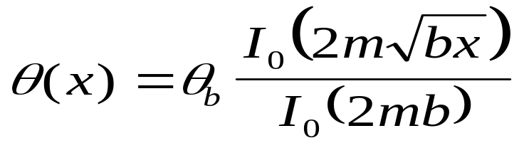
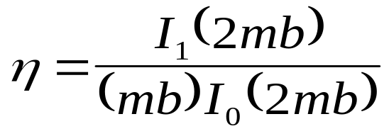
Longitudinal Fin of Triangular Profile
$$\frac{kδL}{b}\left\{x\frac{d^{2}T}{dx^{2}}+\frac{dT}{dx}\right\}−hP\left(T−T_{∞}\right)=0$$
$$θ_{b}$$
L
The particular solution
x
q_{b}
$$φ$$
$$δ_{b}$$
x=b
b
x=a=0
The fin heat dissipation is:
$${\dot{Q}}_{b}=\left(2hθ_{b}\frac{L}{m}\right)\frac{I_{1}\left(2mb\right)}{I_{0}\left(2mb\right)}$$
The fin efficiency is:

Slide 11
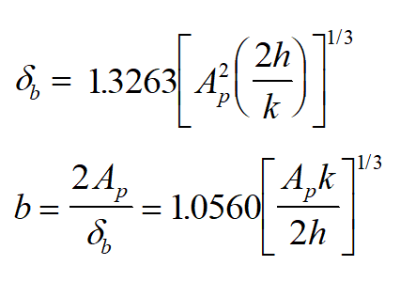
Optimum Geometry of
Longitudinal Fin of Triangular Profile

Slide 12
Comparison of Longitudinal Fin Profiles
$$A_{profile−opt}=\frac{0.5043}{h^{2}k}×{\left\{\frac{{\dot{Q}}_{base}}{{L θ}_{base}}\right\}}^{3}$$
Rectangular Profile:
$$A_{profile−opt}=\frac{0.3471}{h^{2}k}×{\left\{\frac{{\dot{Q}}_{base}}{{L θ}_{base}}\right\}}^{3}$$
Triangular Profile:
For the same material, surrounding conditions and $\frac{{\dot{Q}}_{base}}{{L θ}_{base}}$, which is basically the user’s design requirement.
Triangular profile requires only about 68.8%
as much metal as rectangular profile.

Slide 13
n^{th} order Longitudinal Fins
$${ x}^{n}\frac{d^{2}θ}{dx^{2}}+nx^{n−1}\frac{dθ}{dx}−m^{2}b^{n}θ=0$$
$$m={\left(\frac{2h}{kδ_{b}}\right)}^{1/2}$$

Slide 14
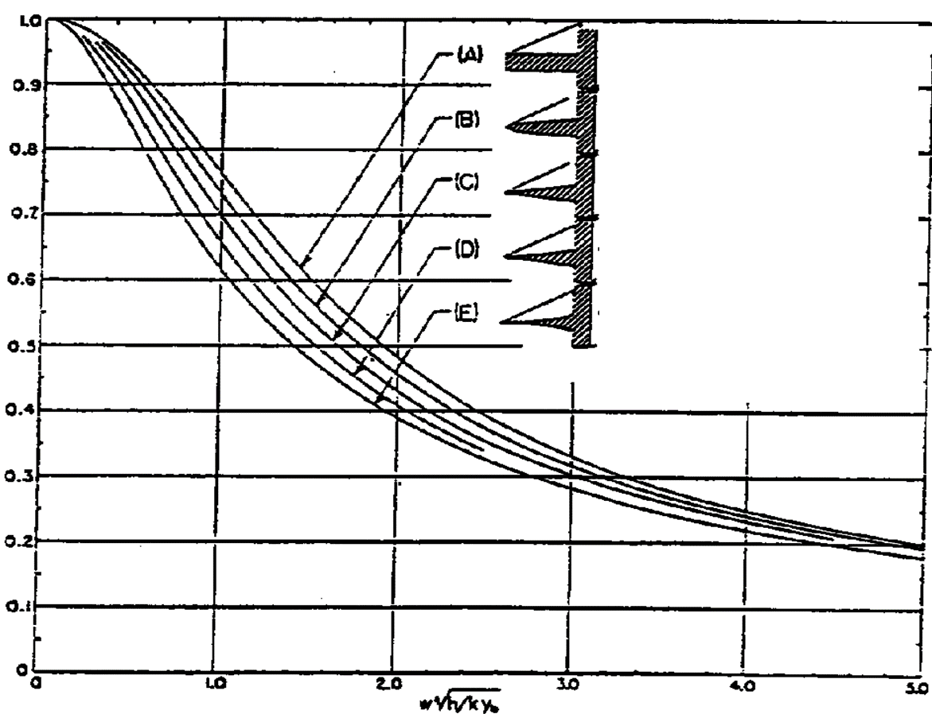
Performance of n^{th} order Longitudinal Fins
$$η_{fin}$$

Slide 15
Selection of Material for Longitudinal Fins
$$A_{profile−opt}=\frac{0.5043}{h^{2}k}×{\left\{\frac{{\dot{Q}}_{base}}{{L θ}_{base}}\right\}}^{3}$$
Rectangular Profile:
$$A_{profile−opt}=\frac{0.3471}{h^{2}k}×{\left\{\frac{{\dot{Q}}_{base}}{{L θ}_{base}}\right\}}^{3}$$
Triangular Profile:
Consider three materials:
$$ρ \left[{\text{kg}}/{m^{3}}\right]$$
$$k \left[W/{\text{mK}}\right]$$
Steel
Aluminum
Copper
7249
2704
8895
43.3
202.5
389.4

Slide 16
Selection of Material for Longitudinal Fins
Fin mass is proportional to A_{p}.
A_{p} is inversely proportional to thermal conductivity.
$$\frac{m_{material2}}{m_{material1}}∝\frac{\frac{ρ_{material2}}{k_{material2}}}{\frac{ρ_{material1}}{k_{material1}}}$$
$$m∝\frac{ρ_{material}}{k_{material}}$$
For given h, θ_{b}, and Q_{b}:
$$\frac{\text{ALUMINUM}}{\text{STEEL}}=\frac{\left(2704\right)\left(43.3\right)}{\left(7249\right)\left(202.5\right)}=0.080$$
$$\frac{\text{COPPER}}{\text{STEEL}}=\frac{\left(8895\right)\left(43.3\right)}{\left(7249\right)\left(389.4\right)}=0.136$$
$$\frac{\text{ALUMINUM}}{\text{COPPER}}=\frac{\left(2704\right)\left(389.4\right)}{\left(8895\right)\left(202.5\right)}=0.585$$

Slide 17
Comparison of Longitudinal Fin
In both fins, profile area varies as the cube of ${\left\{\frac{{\dot{Q}}_{base}}{{L θ}_{base}}\right\}}^{3}$
To double the heat flow, you use two fins
or make one fin eight times as large.
There is a virtue in using short stubby fins.

Slide 18

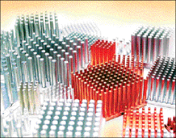
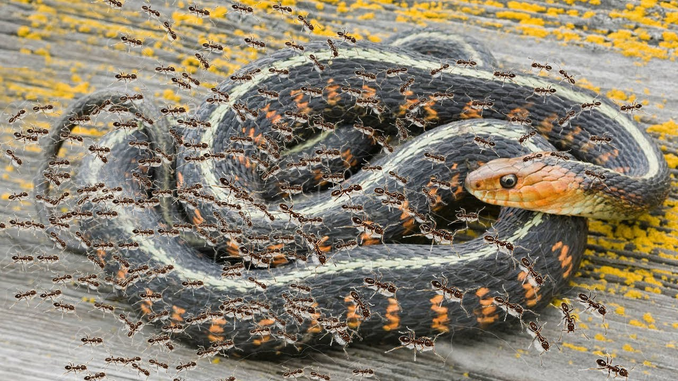
Heat Generation in A Processor is A Cobra
Several Ants can kill A Powerful Cobra……

Slide 19
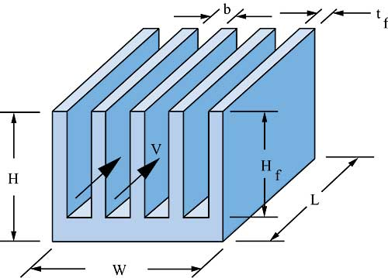
Fin Arrays & Additional Thermal Resistance

Slide 20
Basics of Fin Arrays
Natural Convection
  Plate-Fin Arrays
  Pins and Triangles
Forced Convection Plate
  Fin Heat Sinks
  analytical modeling and optimization
  numerical modeling
Heat Sink Prototyping/manufacturing

Slide 21
Prototyping of Heat Sinks
Thermal conductivity and cooling surface area must always be weighed against material and manufacturing costs.
Most heat sinks are made from aluminum, because of its low thermal resistance, light weight, and low cost.
Copper is also used for heat sinks; although lower in thermal resistance than aluminum, its cost and greater weight make it less desirable for many applications.
Stamped heat sinks made from a single sheet of metal, which is cut and bent to give the desired thermal properties.
Extruded heat sinks are very cost effective and provide good thermal performance.
Many basic shapes can be provided off-the-shelf.
Heat Sink Castings provide a cost-effective solution for high-volume, stable applications.

Slide 22
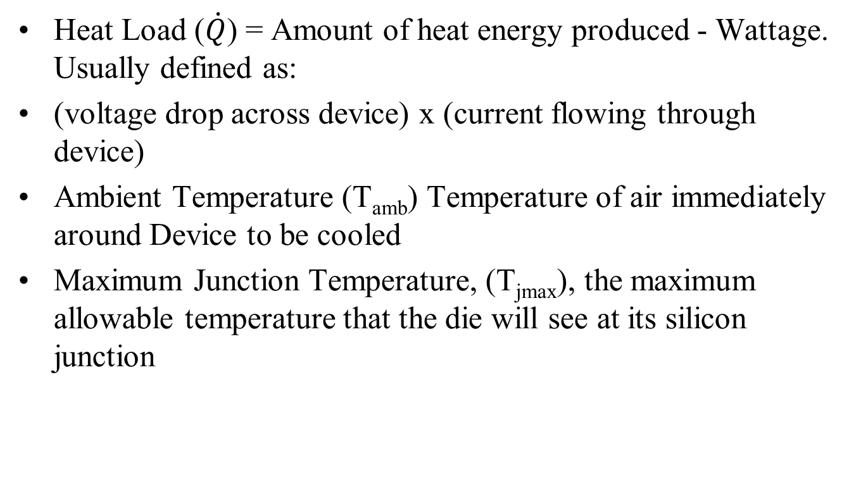
Heat Sinks: Special Terms and Definitions
Heat Load ($\dot{Q}$) = Amount of heat energy produced - Wattage. Usually defined as:
(voltage drop across device) x (current flowing through device)
Ambient Temperature (T_{amb}) Temperature of air immediately around Device to be cooled
Maximum Junction Temperature, (T_{jmax}), the maximum allowable temperature that the die will see at its silicon junction

Slide 23
Division of Heat Sink Thermal Resistance
Thermal Resistance (R_{Θ}) (°C/W) – (Sometimes written as R_{th})
The resistance that the Heat Energy meets as its flows from hot, (Device) to cold, (Ambient).
Junction to the case of the package (supplied by manufacturer). R_{ΘJC}
Thermal Resistance of the Thermal Interface Material, (TIM), used between Device and Heat Sink, R_{ΘTIM}
R_{Θsa} = Thermal Resistance of the Heat Sink to the Ambient (surrounding air).

Slide 24
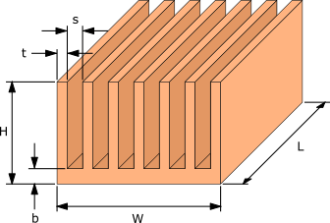
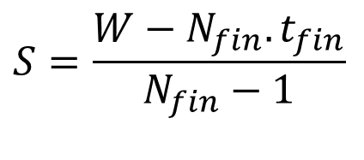

Geometrical Specifications of Fin Arrays
$$H_{fin}=H−b$$
The gap, S, between the fins may be determined from
$$S=\frac{W−N_{fin}.t_{fin}}{N_{fin}−1}$$
T_{base}
R_{TIM}
T_{case}

Slide 25
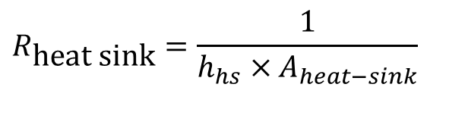
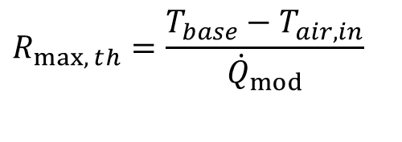
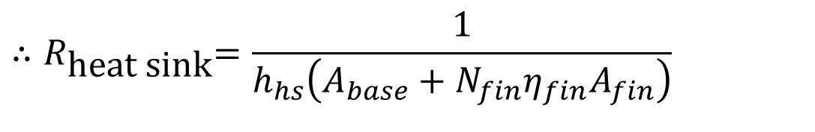
Design Calculations for Fin Arrays – Thermal Resistance
The maximum allowable heat sink resistance, R_{max}, is then given by
$$R_{max,{t}h}=\frac{T_{base}−T_{air,in}}{{\dot{Q}}_{mod}}$$
The design thermal resistance of the heat sink is given by
$$R_{\text{heat sink}}=\frac{1}{h_{hs}×A_{heat−sink}}$$
$$A_{heat−sink}≅\left(A_{base}+N_{fin}η_{fin}A_{fin}\right)$$
$${∴R}_{\text{heat sink}}=\frac{1}{h_{hs}\left(A_{base}+N_{fin}η_{fin}A_{fin}\right)}$$

Slide 26
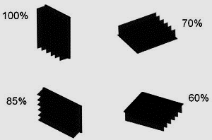
Orientation of Fins & Quantity of Natural Convection Fluid Flow rate

