Slide 1


Extended Surfaces for Better Thermal Management of Chip on Board
P M V Subbarao
Professor
Mechanical Engineering Department
Shape Evolution of Heat Exchanging Surfaces…

Slide 2

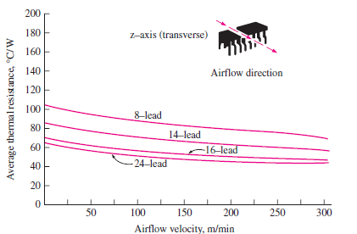
Forced Convection Cooling of Chips Using Air
High Power Chips have low surface to volume ratio w.r.t. ideal requirement!?!?!?

Slide 3
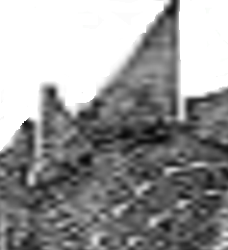
Clues from Nature: Bio-inspired Thermal Management
Continuous Convection or Radiation heat transfer to/from fin surface
Extended surface
Higher ratio of Convection area to Conduction area.
Conduction heat transfer to /from body.
Body to gain or loose heat
Conduction through the fin is strengthened or weakened by continuous convection or radiation from/to fin surface.

Slide 4
Mathematical Ideas are More Natural
Reptiles, mammals and birds like high steady body temperatures.
They have sophisticated ways to manage flows of heat between their bodies and the environment.
Body shape enters the physics of body cooling.
It also helps to explain the odd appendages like crests and sails that decorated extinct reptiles like Stegosaurus or mammal-like reptiles like Dimetrodon.
Theoretical Biologists did Calculations to show these structures could act as very effective heat exchange fins.
These fins are allowing animals with crests to heat their bodies up to high temperatures much faster than animals without them.

Slide 5
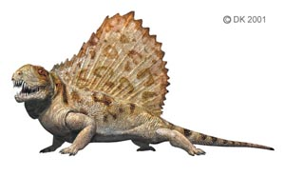
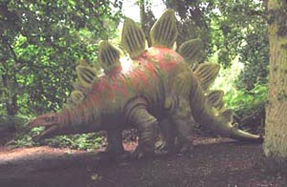
Natural Geometries for Convection Cooling
An optimum body size is essential for the ability to regulate body temperature by blood-borne heat exchange.
For animals in air, this optimum size is a little over 5 kg.
For animals living in water, the optimum size is much larger, on the order of 100 kg or so.
This may explain why large reptiles today are largely aquatic and terrestrial reptiles are smaller.

Slide 6
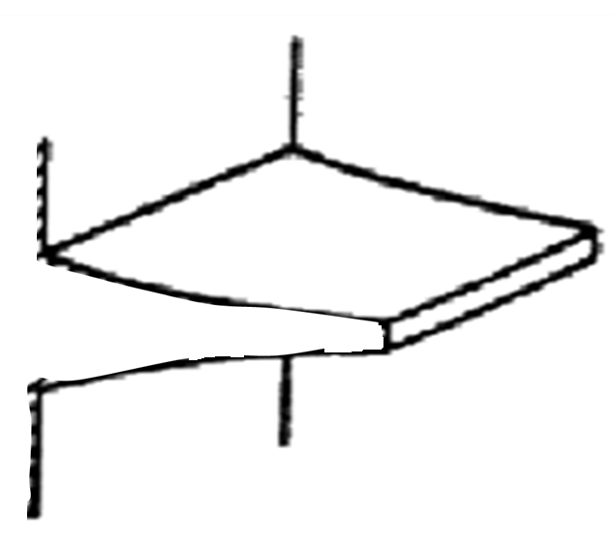
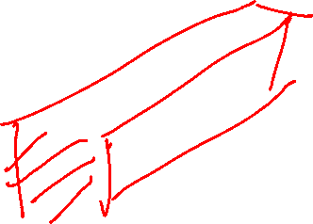

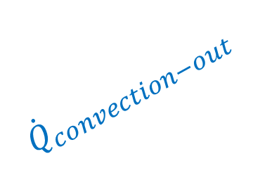

Timing of Conduction and Convection
$${\dot{Q}}_{convection−out}$$
Flow Direction
$${\dot{Q}}_{conduction−in}$$
$${\dot{Q}}_{conduction−out}$$

Slide 7
Basic Geometric Features of Fins
profile
PROFILE AREA
cross-section
CROSS-SECTION AREA

Slide 8
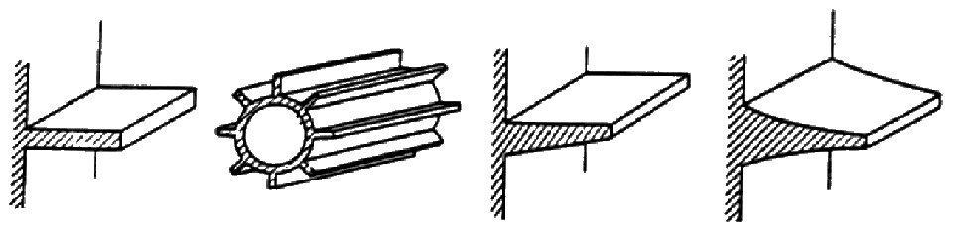
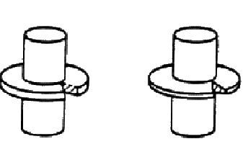
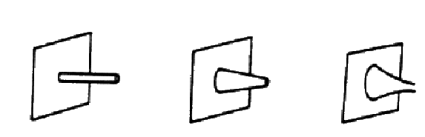
Single Fins :Shapes
Longitudinal or strip
Radial
Pins

Slide 9
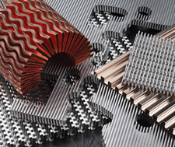
Innovative Fin Designs

Slide 10
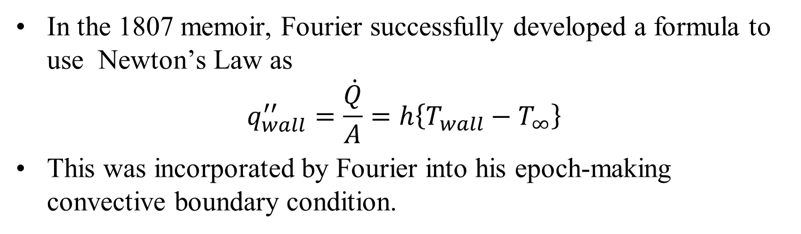
Analytical Heat Transfer for More Convective Area
In the 1807 memoir, Fourier successfully developed a formula to use Newton’s Law as
$$q_{wall}^{′′}=\frac{\dot{Q}}{A}=h\left\{T_{wall}−T_{∞}\right\}$$
This was incorporated by Fourier into his epoch-making convective boundary condition.
In 1915 Nusselt cut the Gordian knot.
Boundary layer conduction was used to define Nu or h.
Blending of Convection & Conduction into a single GDE was an essential need for survival of high energy dissipating systems.
1945 - GARDNER-MURRAY Ideas.

Slide 11
GARDNER-MURRAY ANALYSIS : ASSUMPTIONS
Steady state one-dimensional conduction Model.
No Heat sources or sinks within the fin .
Thermal conductivity constant and uniform in all directions.
Heat transfer coefficient constant and uniform over fin faces.
Surrounding temperature constant and uniform.
Base temperature constant and uniform over fin base.
Fin width much smaller than fin height.
No bond resistance between fin base and prime surface.
Heat flow off fin proportional to temperature excess.

Slide 12
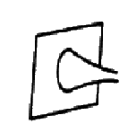
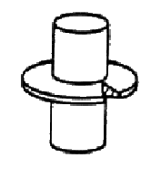
Slender Fins

Slide 13
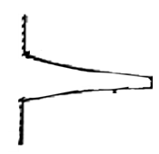
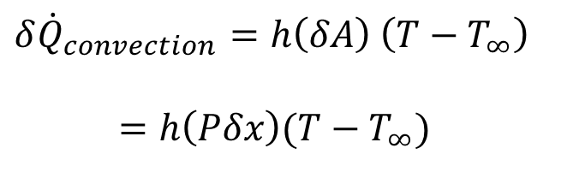

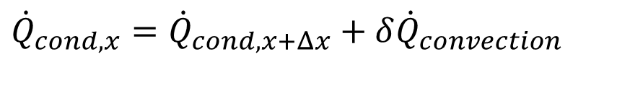


Steady One-dimensional Conduction through Strip Fins
$${\dot{δQ}}_{convection}$$
$${\dot{Q}}_{cond, x}$$
$${\dot{Q}}_{cond, x+dx}$$
Conservation of Energy:
$${\dot{Q}}_{cond,x}={\dot{Q}}_{cond,x+Δx}+δ{\dot{Q}}_{convection}$$
$${δ\dot{Q}}_{convection}=h\left(δA\right) \left(T−T_{∞}\right)$$
$$=h\left(Pδx\right)(T−T_{∞})$$

Slide 14
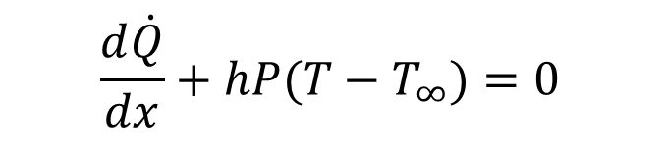
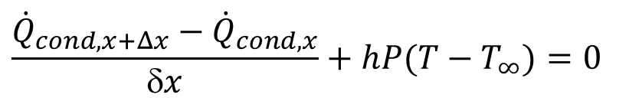
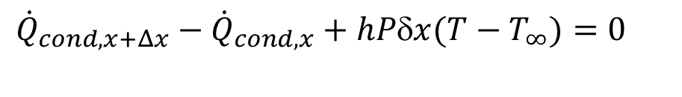
Governing Differential Equation for Conjugate Heat Transfer : Strip Fins
$${\dot{δQ}}_{convection}$$
$${\dot{Q}}_{cond, x}$$
$${\dot{Q}}_{cond, x+dx}$$
Energy Conservation Equation for differential element of the fin :
$${\dot{Q}}_{cond,x+Δx}−{\dot{Q}}_{cond,x}+hPδx(T−T_{∞})=0$$
$$\frac{{\dot{Q}}_{cond,x+Δx}−{\dot{Q}}_{cond,x}}{δx}+hP(T−T_{∞})=0$$
Taking limit δx tends to zero and using the definition of derivative:
$$\frac{d\dot{Q}}{dx}+hP(T−T_{∞})=0$$

Slide 15
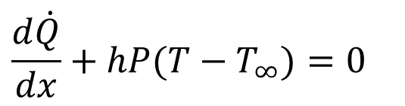
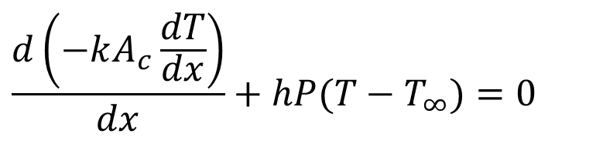
Governing Differential Equation for Conjugate Heat Transfer in Strip Fin
$${\dot{δQ}}_{convection}$$
$${\dot{Q}}_{cond, x}$$
$${\dot{Q}}_{cond, x+dx}$$
$$\frac{d\dot{Q}}{dx}+hP(T−T_{∞})=0$$
Substitute Fourier’s Law of Conduction:
$$\frac{d\left(−kA_{c}\frac{dT}{dx}\right)}{dx}+hP(T−T_{∞})=0$$

Slide 16
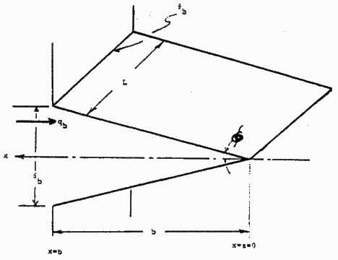
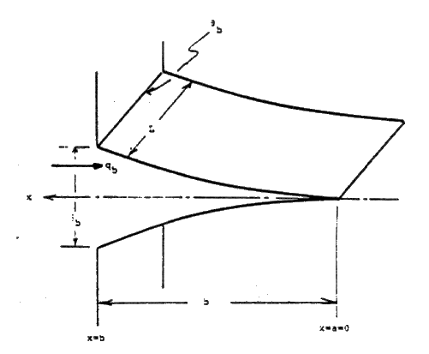
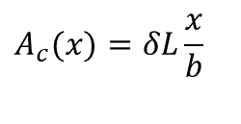
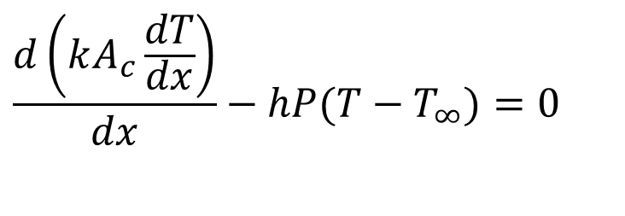

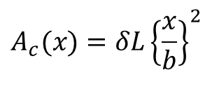


Types of Strip Fins
$$\frac{d\left(kA_{c}\frac{dT}{dx}\right)}{dx}−hP(T−T_{∞})=0$$
$$θ_{b}$$
L
x
q_{b}
$$φ$$
Straight fin of triangular profile rectangular C.S.
$$δ_{b}$$
$$A_{c}(x)=δL\frac{x}{b}$$
x=b
b
x=0
$$θ_{b}$$
Straight fin of parabolic profile rectangular C.S.
L
x
q_{b}
$$A_{c}(x)=δL{\left\{\frac{x}{b}\right\}}^{2}$$
$$δ_{b}$$
x=b
b
x=0

Slide 17
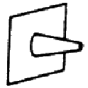
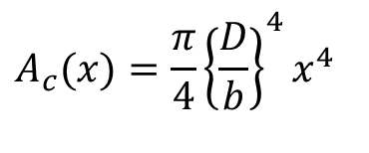
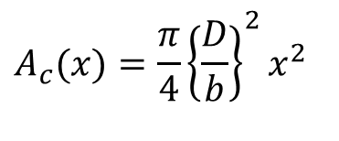
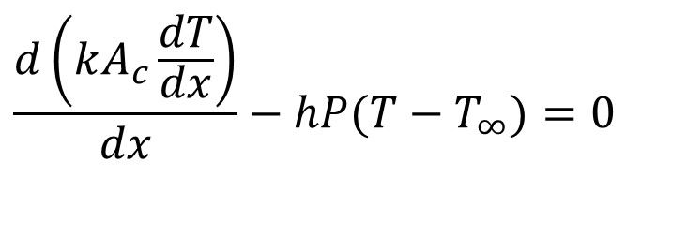
Types of Pin Fins
$$\frac{d\left(kA_{c}\frac{dT}{dx}\right)}{dx}−hP(T−T_{∞})=0$$
Straight fin of triangular profile Circular C.S.
$$A_{c}(x)=\frac{π}{4}{\left\{\frac{D}{b}\right\}}^{2}x^{2}$$
Straight fin of parabolic profile rectangular C.S.
$$A_{c}(x)=\frac{π}{4}{\left\{\frac{D}{b}\right\}}^{4}x^{4}$$

Slide 18
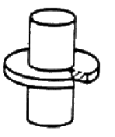
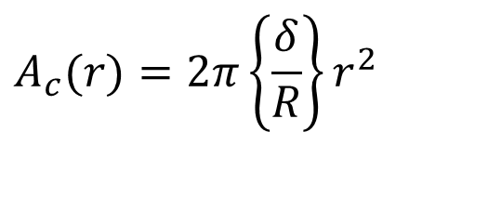
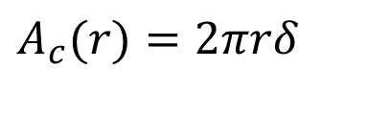
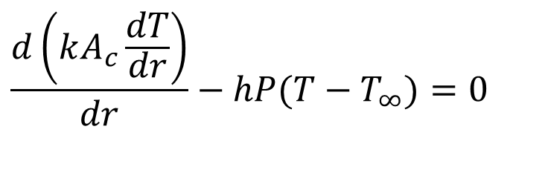
Types of Radial (Axi-symmetric) Fins
$$\frac{d\left(kA_{c}\frac{dT}{dr}\right)}{dr}−hP(T−T_{∞})=0$$
Circumferential fin of rectangular profile
$$A_{c}(r)=2πrδ$$
Straight fin of triangular profile
$$A_{c}(r)=2π\left\{\frac{δ}{R}\right\}r^{2}$$

Slide 19
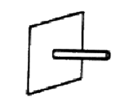
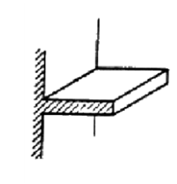
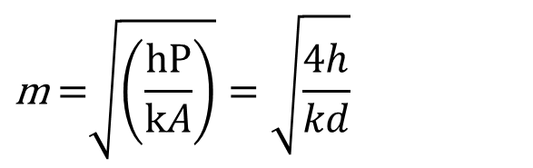
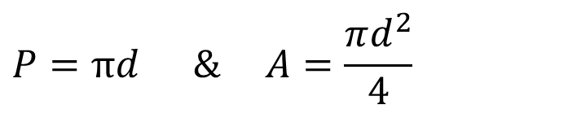
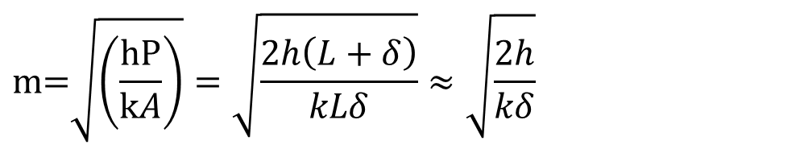
The Fin Factor
$$P=πd\text{ \& }A=\frac{πd^{2}}{4}$$
Fin factor for pin Fin:
$$\text{m} \text{=}\sqrt{\left(\frac{\text{hP}}{kA}\right)}=\sqrt{\frac{4h}{kd}}$$
Fin factor for strip Fin:
$$P=2\left(L+δ\right)\text{ \& }A=L×δ$$
$$\text{m=}\sqrt{\left(\frac{\text{hP}}{kA}\right)}=\sqrt{\frac{2h\left(L+δ\right)}{kLδ}}≈\sqrt{\frac{2h}{kδ}}$$

Slide 20
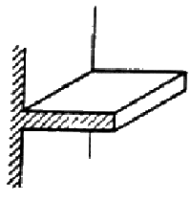
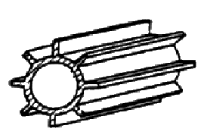
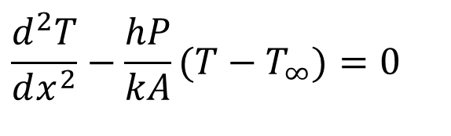
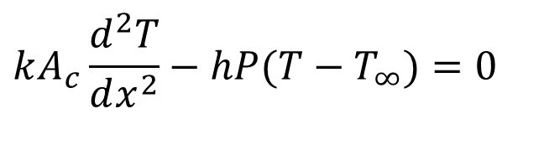
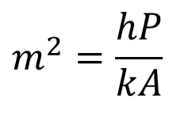
Strip Fin with constant cross section area
$$kA_{c}\frac{d^{2}T}{dx^{2}}−hP(T−T_{∞})=0$$
$$\frac{d^{2}T}{dx^{2}}−\frac{hP}{kA}(T−T_{∞})=0$$
$$m^{2}=\frac{hP}{kA}$$

Slide 21
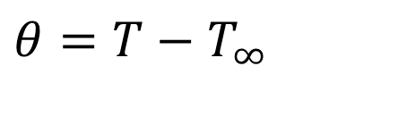
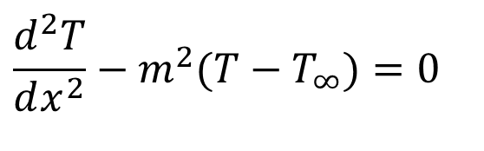
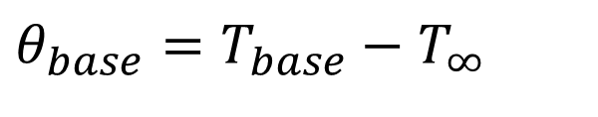
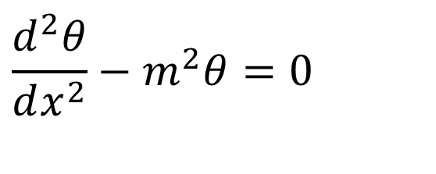
GDE for Constant CS Area Fins
$$\frac{d^{2}T}{dx^{2}}−m^{2}(T−T_{∞})=0$$
Define:
$$θ=T−T_{∞}$$
$$\frac{d^{2}θ}{dx^{2}}−m^{2}θ=0$$
At the base of the fin:
$$θ_{base}=T_{base}−T_{∞}$$

Slide 22
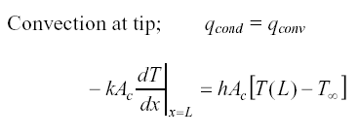


True Conditions at the Tip of A Fin

Slide 23


Linear Second order ODE with Constant Coefficients
$$\frac{d^{2}θ}{d^{2}x}−m^{2}θ=0$$
This equation has two linearly independent solutions.
The general solution is the linear combination of those two independent solutions.
Each solution function θ_{ι}(x) and its second derivative must be constant multiple of each other.
Therefore, the general solution function of the differential equation above is:
$$θ\left(x\right)=C_{1}e^{mx}+C_{2}e^{−mx}$$

Slide 24


Most Suitable Tip Boundary Condition
Convection cooling at the tip: ${\left.\dot{Q}\right|}_{conduction−tip=}={\left.\dot{Q}\right|}_{convection−tip=}$
$$−kA_{c}{\left.\frac{dT}{dx}\right|}_{x=b}=hA_{c}\left[T_{tip}−T_{∞}\right]$$
Corrected condition length for adiabatic tip:
$$b_{corr−adi}=b+\frac{δ}{2}$$

Slide 25



Linear Second order ODE with Constant Coefficients: Constant Thickness Strip Fin
$$\frac{d^{2}θ}{d^{2}x}−m^{2}θ=0$$
Δx
This equation has two linearly independent solutions a m is constant.
Δx
thickness
The general solution is the linear combination of those two independent solutions.
Each solution function θ_{ι}(x) and its second derivative must be constant multiple of each other.
Therefore, the general solution function of the differential equation above is:
x
thickness
$$θ\left(x\right)=C_{1}e^{mx}+C_{2}e^{−mx}$$
x

Slide 26
Longitudinal Fin : Adiabatic Tip
Shift the origin x=0 to the tip:
Δx
The boundary condition are:
$$θ(\text{x=}b_{c})=θ_{\begin{aligned}&b_{c} \\ &\end{aligned}}$$
thickness
$$\dot{Q}(\text{x=0})\text{=0}$$
x
Use the boundary conditions s to get
$$θ\left(x=b_{c}\right)=θ_{b_{c}}=C_{1}e^{mb_{c}}+C_{2}e^{−mb_{c}}$$
and
$$\dot{Q}\left(x=0\right)=kA_{c}{\left.\frac{dθ}{dx}\right|}_{x=0}=0$$
$$kLδ\left\{C_{1}−C_{2}\right\}=0$$

Slide 27
Longitudinal Fin : Adiabatic Tip
Insulated tip condition shows that:
Δx
$$C_{1}=C_{2}=C \\ θ_{b}=C\left\{e^{mb_{c}}+e^{−mb_{c}}\right\}$$
thickness
x
Base condition shows that:
$$θ_{b}=C\left\{e^{mb_{c}}+e^{−mb_{c}}\right\}⇒C=\frac{θ_{b_{c}}}{\left\{e^{mb_{c}}+e^{−mb_{c}}\right\}}$$
$$θ\left(x\right)=\frac{θ_{b}}{\left\{e^{mb_{c}}+e^{−mb_{c}}\right\}}\left\{e^{mx}+e^{−mx}\right\}$$
$$=θ_{b}\frac{\cosh\left(mx\right)}{\cosh\left(mb_{c}\right)}$$

Slide 28





Rate of Heat Removed by the Fin
The heat flow through the fin at any location x is:
$$\dot{Q}\left(x\right)=kδL\frac{dθ}{dx}=kδL\frac{d}{dx}\left(θ_{b}\frac{\cosh\left(mx\right)}{\cosh\left(mb_{c}\right)}\right)$$
$$\dot{Q}\left(x\right)=kδLmθ_{b}\frac{\sinh\left(mx\right)}{\cosh\left(mb_{c}\right)}$$
And at x= $b_{c}$ (heat entering fin base) :
$${\dot{Q}}_{b_{c}}=kδLmθ_{b}\tanh\left(mb_{c}\right)$$
Rate of Heat Removed from the base with the Fin:
$${\dot{Q}}_{b_{c}}={\left(2hkδ\right)}^{1/2}Lθ_{b_{c}}\tanh\left(mb_{c}\right)$$
Rate of Heat Removed from the base without the Fin:
$${\dot{Q}}_{b_{c}−w/ofin}=hLδθ_{b_{c}}$$

Slide 29



Additional Cooling of Base due to Added Fin
Additional cooling of Base due to fin:
$$∆\dot{Q}= {\dot{Q}}_{{base}_{}}−{\dot{Q}}_{{base−w/ofin}_{}}$$
$={\left(2hkδ\right)}^{1/2}Lθ_{b_{c}}\tanh\left(mb_{c}\right)−$ $hLδθ_{b_{c}}$
$$=Lθ_{b_{c}}\left\{{\left(2hkδ\right)}^{1/2}\tanh\left(mb_{c}\right)− hδ \right\}$$
Additional material volume:
$V_{fin}=Lbδ$

Slide 30
Cost – Benefit Analysis of Fins
The benefit of a fin is defined as effectiveness of a fin.
An ideal fin will have highest value of effectiveness.
An ideal fin is the one whose temperature is equal to temperature of the surface.
This is possible only if the thermal conductivity of fin material is infinitely high.
The effectiveness of an actual fin material is always lower than an ideal fin.
The relative performance of a given fin is defined as efficiency of a fin.

Slide 31
Cost – Benefit Analysis of Fins
Provision of fins on a surface requires more material and hence more capital cost.
A judicial decision is necessary to select correct factors of fin design.
Best fin design should have higher benefits with a lower amount of material.

Slide 32
Effectiveness of A Fin : Strip Fin
The fin effectiveness, ε_{fin} , is defined as the ratio of the heat dissipation with fin to the heat dissipation without a fin.
$$ε_{fin}=\frac{{\dot{Q}}_{base−withfin}}{{\dot{Q}}_{base−withoutfin}}$$
$$ε_{fin,\text{adiabatic}}=\frac{{\left(2hkδ\right)}^{1/2}L\tanh\left(mb_{c}\right)\left(T_{base}−T_{∞}\right)}{hA_{cs}\left(T_{base}−T_{∞}\right)}$$

Slide 33
Ideal Fin & Efficiency of Strip Fin
An ideal fin is made of a material with infinite thermal conductivity and hence the entire fin will operate at the base temperature excess
$${\dot{Q}}_{\text{ideal}}=h\overset{2\left(L+δ\right)b}{\overbrace{\left(\text{SURFACE}\right)}}θ_{b_{}}≈2hLbθ_{b_{}}$$
The fin efficiency, η, is defined as the ratio of the actual heat dissipation to the ideal heat dissipation if the entire fin were to operate at the base temperature excess
$$η=\frac{{\dot{Q}}_{actual}}{{\dot{Q}}_{\text{ideal}}}$$
For Adiabatic strip fin:
$${\dot{Q}}_{act−adi}=\sqrt{hPkA_{cs}}\left(T_{base}−T_{∞}\right)\tanh\left(mb_{c}\right)$$
$$η_{adi}=\frac{\sqrt{hPkA_{cs}}θ_{b_{}}\tanh{m}b_{c}}{2hLbθ_{b_{}}}$$
$$η_{adi}=\frac{\tanh{m}b_{c}}{mb_{c}}$$

Slide 34

Longitudinal Fin of Rectangular Profile: Adiabatic tip
$$θ\left(x\right)=θ_{b}\frac{\cosh\left(mx\right)}{\cosh\left(mb_{c}\right)}$$
Temperature Excess Profile
Heat Dissipated = Heat Entering Base of the fin
$${\dot{Q}}_{b_{}}=kδLmθ_{b}\tanh\left(mb_{c}\right)$$
$$ε_{fin,\text{adiabatic}}=\frac{{\left(2hkδ\right)}^{1/2}L\tanh\left(mb_{c}\right)\left(T_{base}−T_{∞}\right)}{hA_{cs}\left(T_{base}−T_{∞}\right)}$$
$$η_{adi}=\frac{tanh\left(mb_{c}\right)}{mb_{c}}$$
Fin Efficiency

Slide 35



Fin Efficiency
mb_{c}

