Slide 1



Optimum Stacking of Printed Circuit Boards
P M V Subbarao
Professor
Mechanical Engineering Department
Clues to Design Optimal Racks for A Data Center!?!?

Slide 2

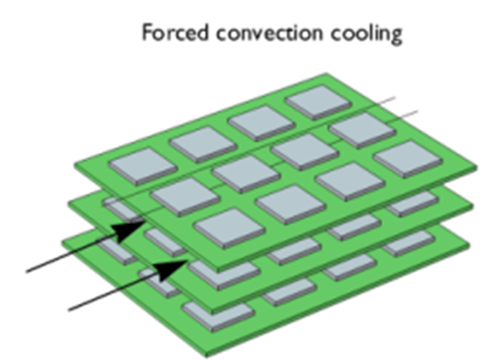

Stack of PCBs
$$\dot{m}\& ∆p$$

Slide 3

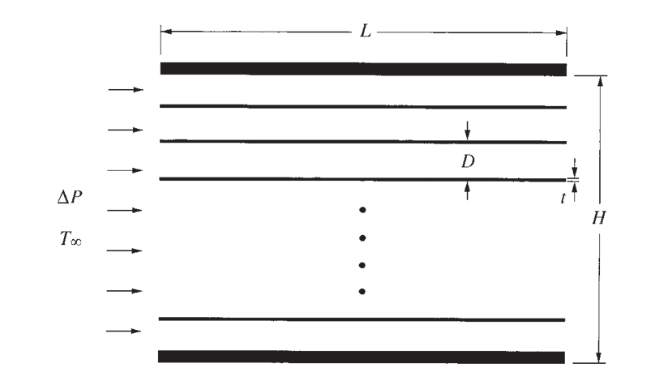
STACK OF PCBs
Determination of the spacing for maximum heat transfer density in a package (stack) of parallel plates that are cooled by forced convection was an important industrial requirement.
In 21st century application of this arrangement is the forced-air cooling of a stack of electronic circuit boards.
Of principal interest is the maximum heat transfer, rate, that is,
the maximum density of heat-generating electronics that can be fitted in a package of specified volume.

Slide 4
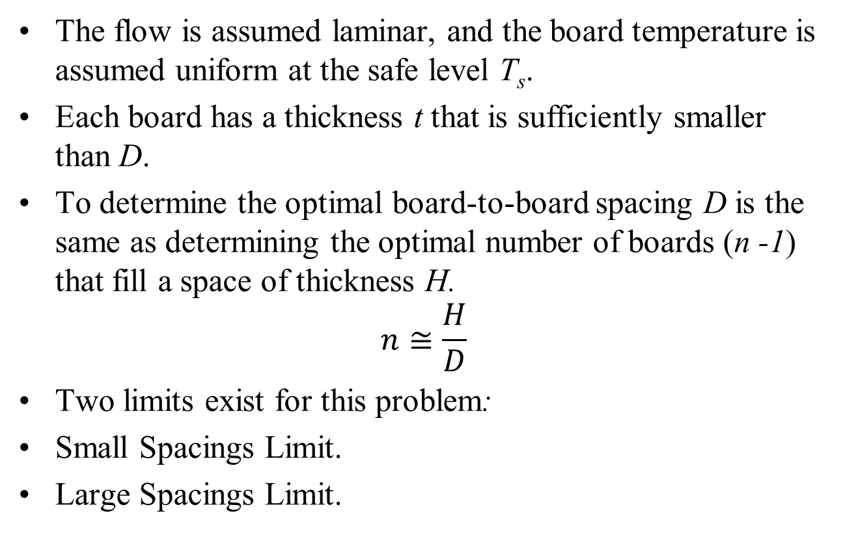
Method of Solution
The flow is assumed laminar, and the board temperature is assumed uniform at the safe level T_{s}.
Each board has a thickness t that is sufficiently smaller than D.
To determine the optimal board-to-board spacing D is the same as determining the optimal number of boards (n -1) that fill a space of thickness H.
$$n≅\frac{H}{D}$$
Two limits exist for this problem:
Small Spacings Limit.
Large Spacings Limit.

Slide 5
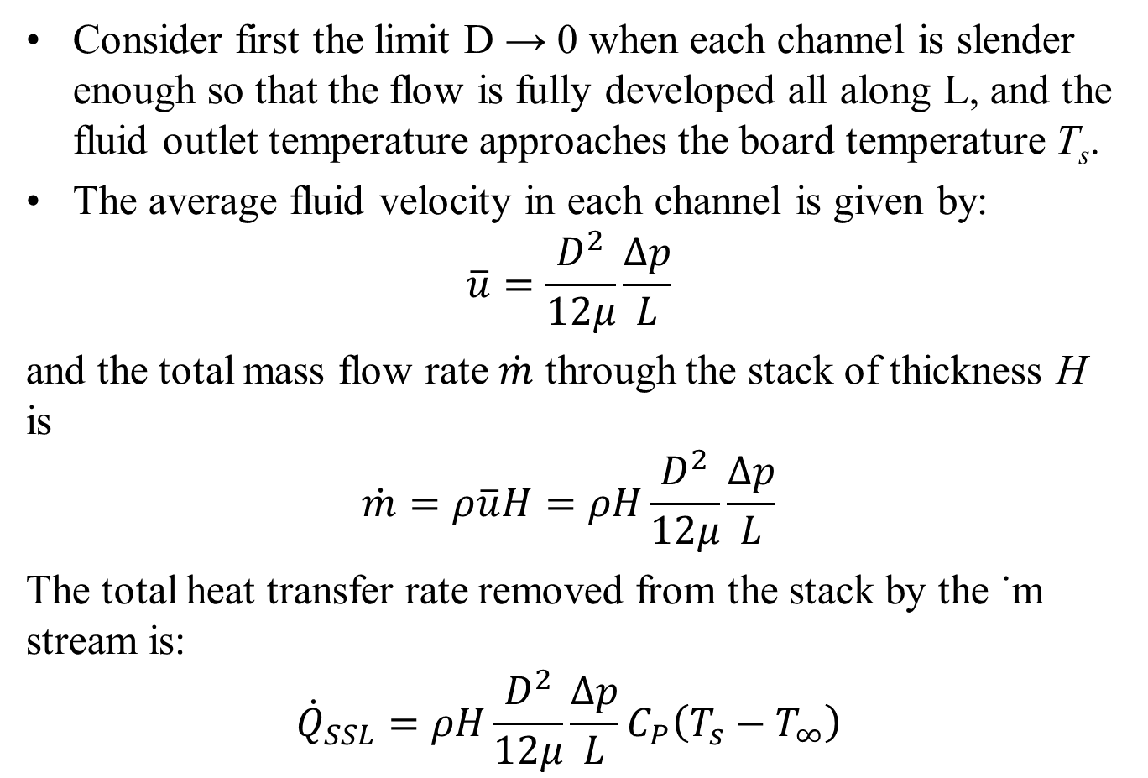
Small Spacing Limit
Consider first the limit D → 0 when each channel is slender enough so that the flow is fully developed all along L, and the fluid outlet temperature approaches the board temperature T_{s}.
The average fluid velocity in each channel is given by:
$$\overline{u}=\frac{D^{2}}{12μ}\frac{∆p}{L}$$
and the total mass flow rate $\dot{m}$ through the stack of thickness H is
$$\dot{m}=ρ\overline{u}H=ρH\frac{D^{2}}{12μ}\frac{∆p}{L}$$
The total heat transfer rate removed from the stack by the ˙m stream is:
$${\dot{Q}}_{SSL}=ρH\frac{D^{2}}{12μ}\frac{∆p}{L}C_{P}\left(T_{s}−T_{∞}\right)$$

Slide 6
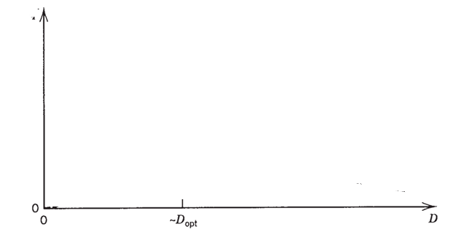

Small Spacing Limit
As a conclusion, in the limit D → 0, the total cooling rate (or total rate of allowable Joule heating in the package) decreases as D^{2.}
This trend is illustrated qualitatively as curve .
$$q^{"}\sim D^{2}−Small Space Limit$$
$$q^{"}$$
The direction toward small D values is not good for design performance.

Slide 7
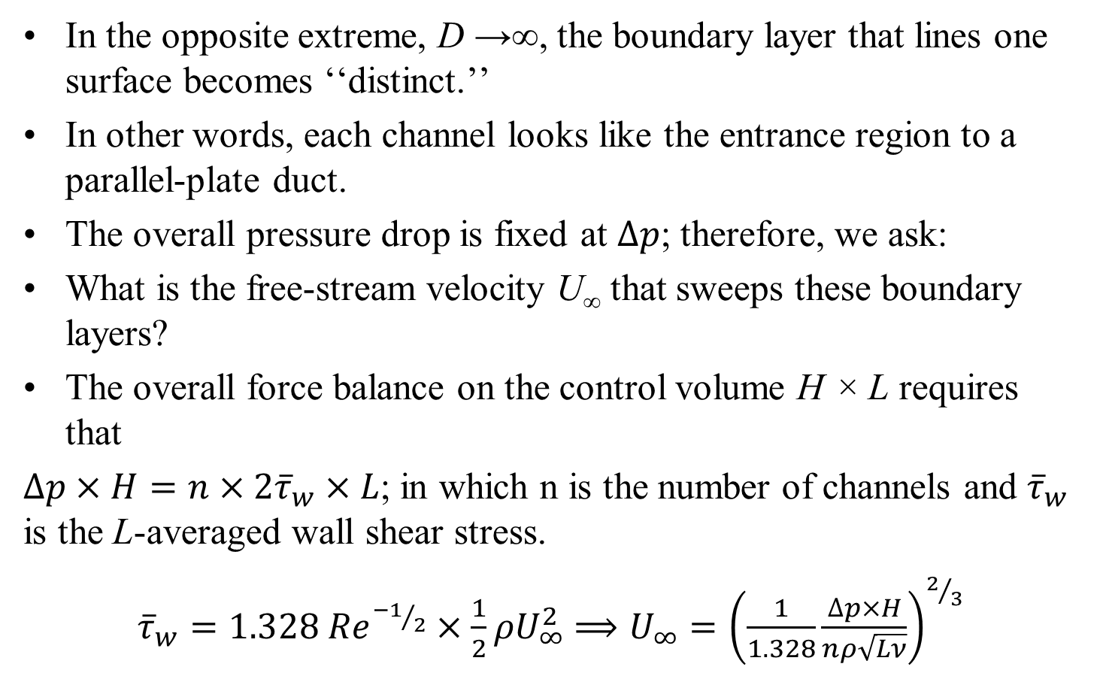
Large Spacings Limit
In the opposite extreme, D →∞, the boundary layer that lines one surface becomes ‘‘distinct.’’
In other words, each channel looks like the entrance region to a parallel-plate duct.
The overall pressure drop is fixed at $∆p$; therefore, we ask:
What is the free-stream velocity U∞ that sweeps these boundary layers?
The overall force balance on the control volume H × L requires that
$∆p×H=n×2{\overline{τ}}_{w}×L$; in which n is the number of channels and ${\overline{τ}}_{w}$ is the L-averaged wall shear stress.
${\overline{τ}}_{w}=1.328 {Re}^{{−1}/2}×\frac{1}{2}ρU_{∞}^{2}$ $⟹U_{∞}={\left(\frac{1}{1.328}\frac{∆p×H}{nρ\sqrt{Lν}}\right)}^{2/3}$

Slide 8
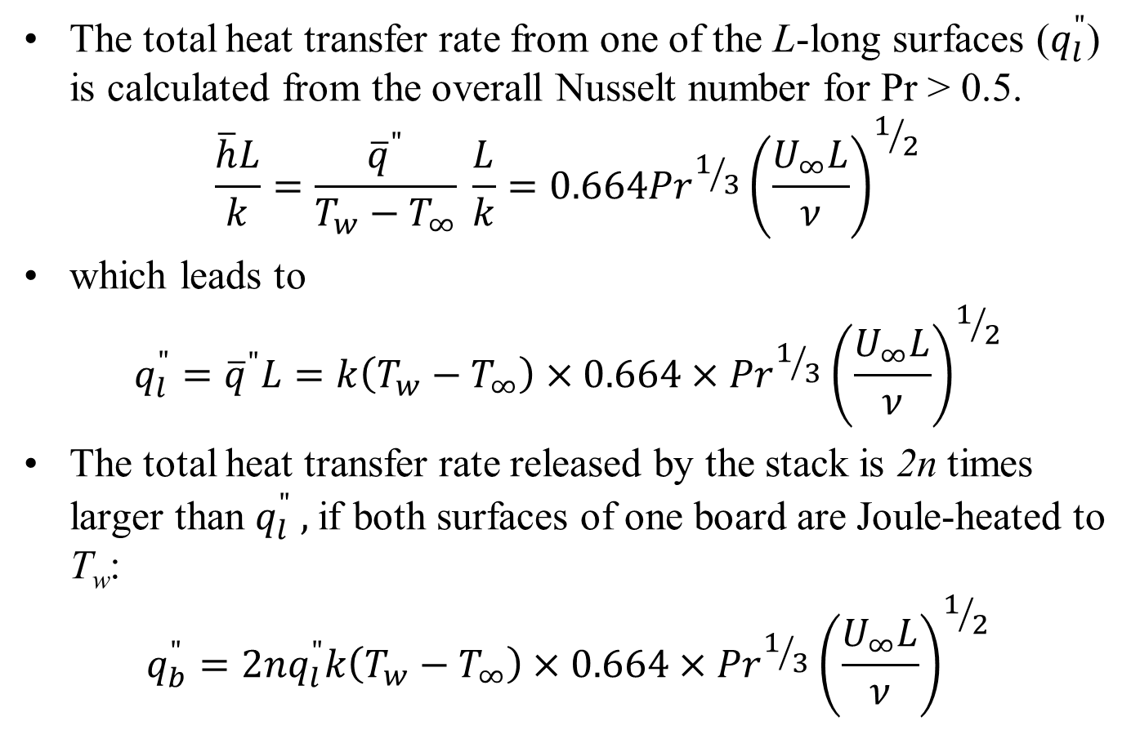
Large Spacings Limit
The total heat transfer rate from one of the L-long surfaces ($q_{l}^{"}$) is calculated from the overall Nusselt number for Pr > 0.5.
$$\frac{\overline{h}L}{k}=\frac{{\overline{q}}^{"}}{T_{w}−T_{∞}} \frac{L}{k}=0.664{Pr}^{1/3}{\left(\frac{U_{∞}L}{ν}\right)}^{1/2}$$
which leads to
$$q_{l}^{"}={\overline{q}}^{"}L=k\left(T_{w}−T_{∞}\right)×0.664×{Pr}^{1/3}{\left(\frac{U_{∞}L}{ν}\right)}^{1/2}$$
The total heat transfer rate released by the stack is 2n times larger than $q_{l}^{"} ,$if both surfaces of one board are Joule-heated to T_{w}:
$${q_{b}^{"}=2nq}_{l}^{"}k\left(T_{w}−T_{∞}\right)×0.664×{Pr}^{1/3}{\left(\frac{U_{∞}L}{ν}\right)}^{1/2}$$

Slide 9
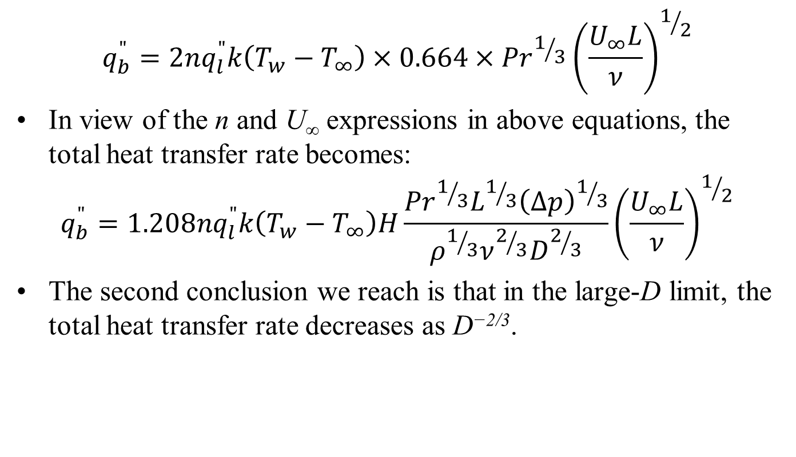
Large Spacings Limit
$${q_{b}^{"}=2nq}_{l}^{"}k\left(T_{w}−T_{∞}\right)×0.664×{Pr}^{1/3}{\left(\frac{U_{∞}L}{ν}\right)}^{1/2}$$
In view of the n and U∞ expressions in above equations, the total heat transfer rate becomes:
$${q_{b}^{"}=1.208nq}_{l}^{"}k\left(T_{w}−T_{∞}\right)H\frac{{Pr}^{1/3}L^{1/3}{\left(∆p\right)}^{1/3}}{ρ^{1/3}ν^{2/3}D^{2/3}}{\left(\frac{U_{∞}L}{ν}\right)}^{1/2}$$
The second conclusion we reach is that in the large-D limit, the total heat transfer rate decreases as D^{−2/3}.

Slide 10


Intersection of Small & Large Spacing Limits
$$q^{"}\sim D^{2}−Small Space Limit$$
$$q^{"}$$
$$q^{"}\sim D^{{−2}/3}−Large Space Limit$$
This comparison suggests that the maximum of the actual (unknown) curve q”(D) can occur only at a spacing D_{opt}
That is of the same order as the D value obtained by intersecting the asymptotes.

Slide 11
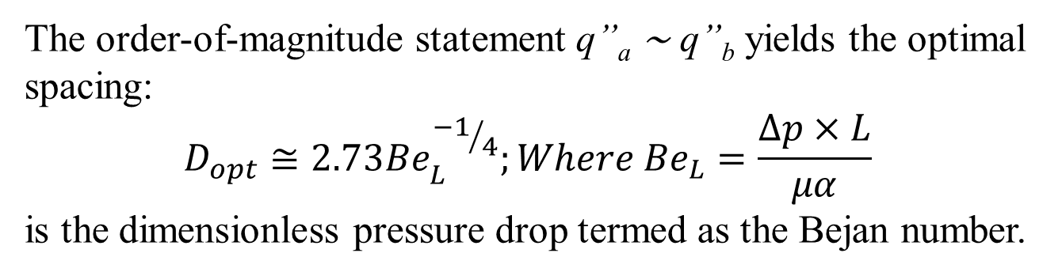
Intersection of Small & Large Spacing Limits
$$q^{"}\sim D^{2}−Small Space Limit$$
$$q^{"}$$
$$q^{"}\sim D^{{−2}/3}−Large Space Limit$$
The order-of-magnitude statement q”_{a} ∼ q”_{b} yields the optimal spacing:
$$D_{opt}≅2.73{Be}_{L}^{{−1}/4};Where {Be}_{L}=\frac{∆p×L}{μα}$$
is the dimensionless pressure drop termed as the Bejan number.

Slide 12
Optimal Spacing
The role of this dimensionless group in forced convection is discussed agrees very well with the more exact result obtained by locating the maximum of the actual q”(D).
Showed numerically that in the Pr range 0.7–103, the optimal spacing is correlated by an expression in which the coefficient 2.73 is replaced by 3.05.
The existence of the optimal spacing was also confirmed by experiments with microchannels.
The numerical maximization of the actual q”(D) relation demonstrated that in the entire range 0.7 < Pr < 103, the dimensionless length x* = (L/Dh)/(UDh/α) was consistently equal to 0.04 when D = D_{opt}.

Slide 13
Optimal Spacing
This means that the optimal board-to-board spacing must be such that the board length is of the same order of magnitude as the thermal entrance length of the parallel-plate channel.
This feature is the key to the design of compact heat exchanger structures with maximal heat transfer rate density.
This idea has been taken to higher performance levels in two ways,
by optimally shaping the channel with optimized spacing (i.e., by fitting the duct to the convective flow ) and
by packing a series of smaller plates and channels in the entrance regions of the stack.
The latter is a generally valid strategy for achieving maximal heat transfer density by constructing a flow structure with multiple length scales.

Slide 14
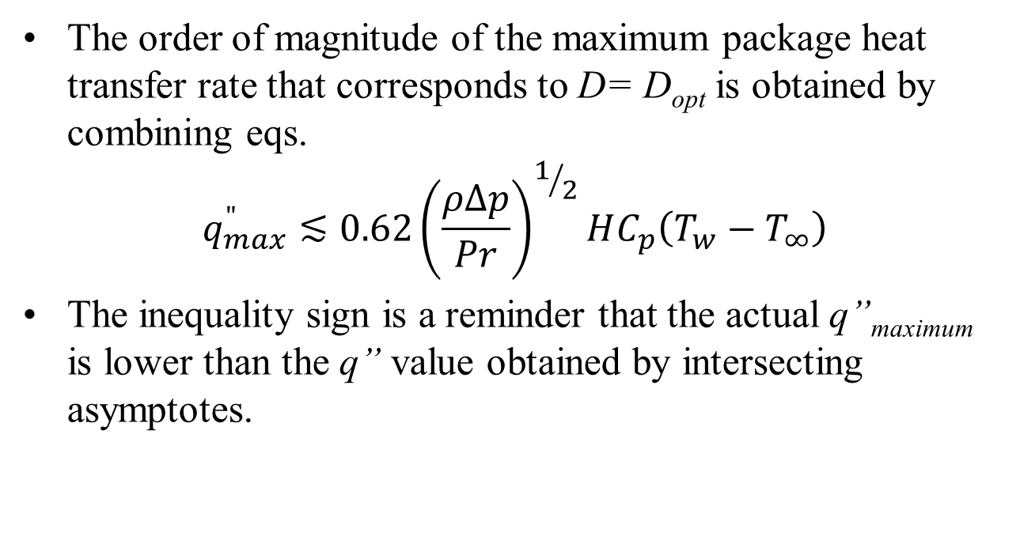
Optimal Spacing
The order of magnitude of the maximum package heat transfer rate that corresponds to D= D_{opt} is obtained by combining eqs.
$$q_{max}^{"}≲0.62{\left(\frac{ρ∆p}{Pr}\right)}^{1/2}HC_{p}\left(T_{w}−T_{∞}\right)$$
The inequality sign is a reminder that the actual q”_{maximum} is lower than the q” value obtained by intersecting asymptotes.

Slide 15
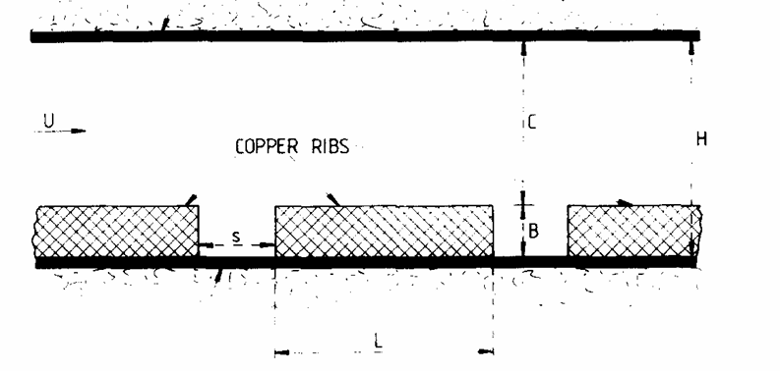
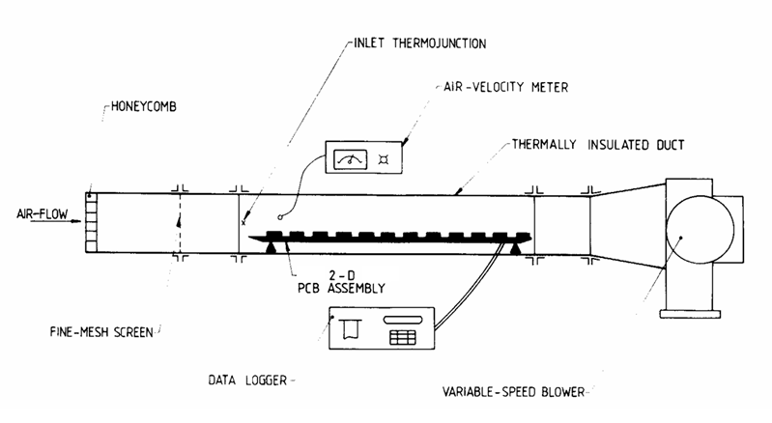
Forced Convection Cooling System of PCB Array : Test Rig

Slide 16
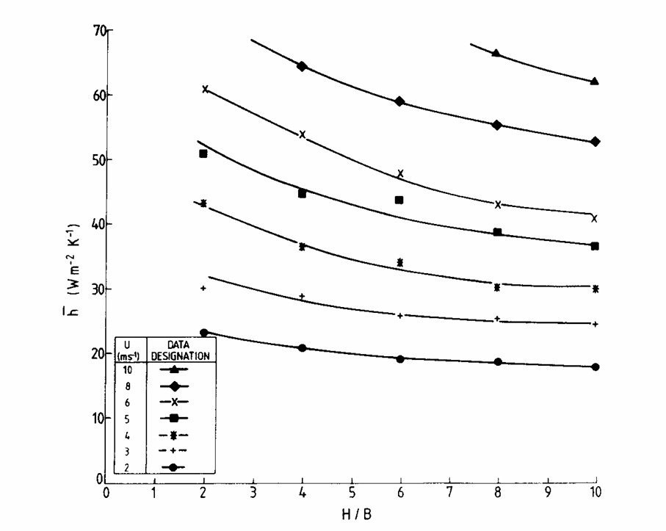
Forced Convection Cooling System of PCB Array : Test Results

Slide 17
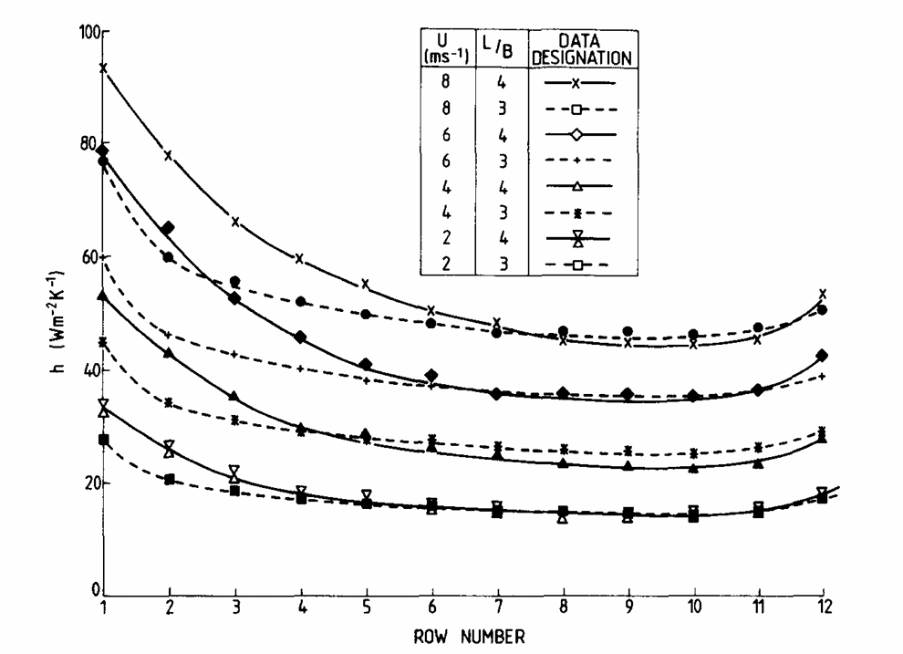
Forced Convection Cooling System of PCB Array : Test Results

Slide 18
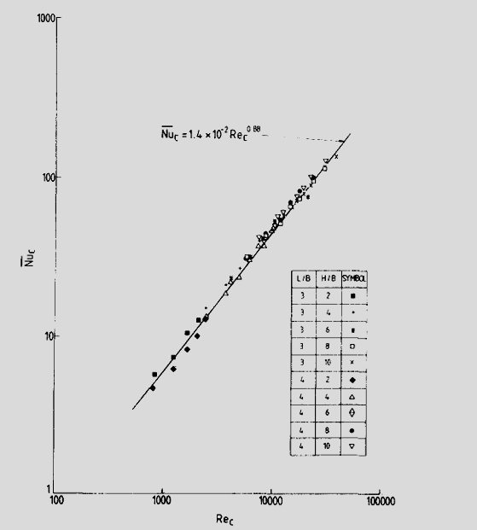
Principle of Similarity for PCB Araay

Slide 19
Closure
Analytical studies are tricky because of lack of geometric similarity (have to depend on experimental and numerical input)
Entrance effects are substantial and cannot be neglected
Need to be careful in interpreting data and using the appropriate heat transfer coefficient
Package length scale is the most representative dimension
Substrate conduction plays an important part
Several enhancement techniques can be successfully applied

Slide 20
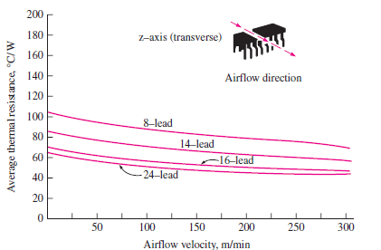
Forced Convection Cooling of Chips Using Air
High Power Chips have low surface to volume ratio w.r.t. ideal requirement!?!?!?

