Slide 1



Thermal Management thru Forced Convection Cooling of Printed Circuit Boards
P M V Subbarao
Professor
Mechanical Engineering Department
Additional Infrastructure and Energy to Achieve Controlled Thermal Management!?!?

Slide 2

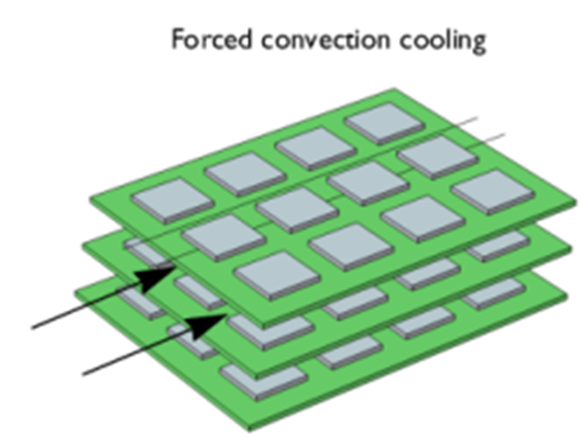

Strategic Realization of Newton’s Cooling of PCBs
$$\dot{m}\& ∆p$$

Slide 3
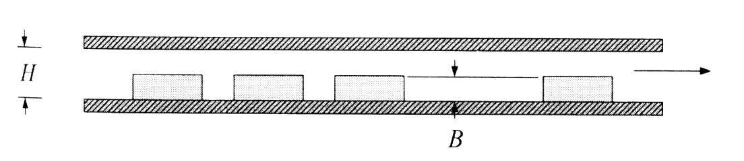
Forced Convection Cooling of PCBs
Forced air cooling: Well Known Theory and Models
Several different length scales are involved:
  Electronic System level length-scale ~ 100 cm (Re ~ 100,000)
  Printed Circuit Board level ~ 10 cm (Re ~ 10,000)
  Chip level ~ 1 cm (Re ~ 1000)

Slide 4
Flow and Heat Transfer Characteristics
System level flow
  Laminar or transitional
  Recirculation regions
  Swirl
PCB-level and chip-level flows
  Local roughness,
  Elevated free-stream turbulence, and
  Substrate conduction effects

Slide 5
Usability of Available Knowledge Framework:
Scaling Laws
Generalized relationships are difficult to obtain for electronics cooling geometries
Geometries have two attributes: size and shape
Reynolds number scaling requires identical shapes (only size may change)
Changing chip protrusion height leads to a new shape
Changing chip spacing leads to a new geometry
Same problem occurs when board spacing is varied
Even the hydraulic diameter does not account for different shapes, because of flow bypass

Slide 6
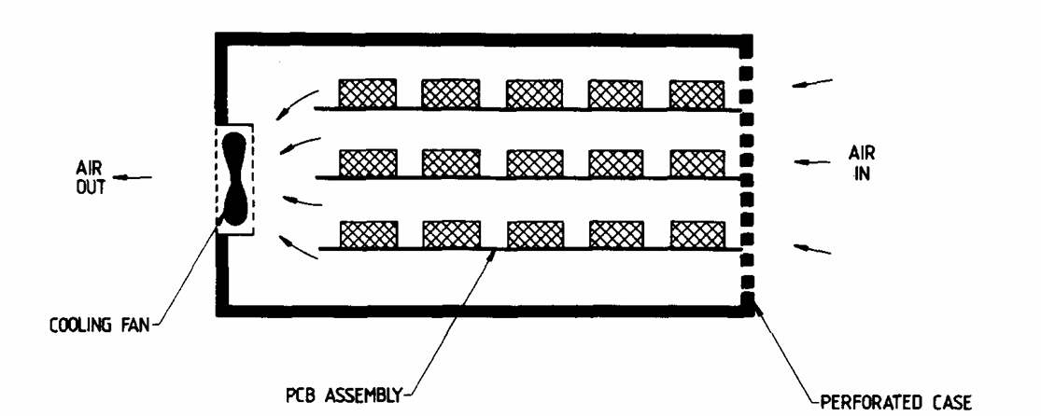
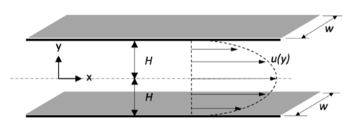
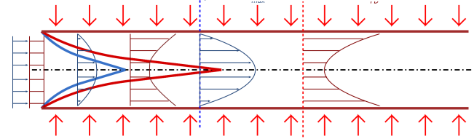
Forced Convection Cooling System of PCB Array
How to Develop Simplified Analysis ????
R
Z

Slide 7
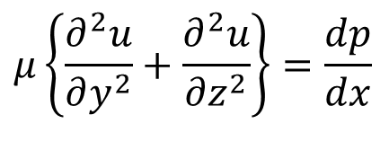
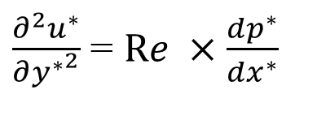
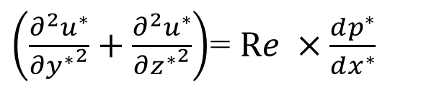
Forced Convection Cooling of Cards and Board
1
T∝
l
S
b
in
2
t
L
Fully developed Steady Laminar Channel flow analogy:
$$μ\left\{\frac{∂^{2}u}{∂y^{2}}+\frac{∂^{2}u}{∂z^{2}}\right\}=\frac{dp}{dx}$$
Simplifications
2 -D Channel
S << W
$\left(\frac{∂^{2}u^{∗}}{∂{y^{∗}}^{2}}+\frac{∂^{2}u^{∗}}{∂{z^{∗}}^{2}}\right)$= $Re ×\frac{dp^{∗}}{dx^{∗}}$
$\frac{∂^{2}u^{∗}}{∂{y^{∗}}^{2}}$ = $Re ×\frac{dp^{∗}}{dx^{∗}}$

Slide 8

Forced Convection Cooling of Cards and Board
1
T∞
in
y=0
2
L
Fully Developed Laminar flow between parallel Plates:
$$u\left(y\right)=−\frac{1}{2μ}\frac{dp}{dx}\left(y_{o}^{2}−y^{2}\right)$$

Slide 9
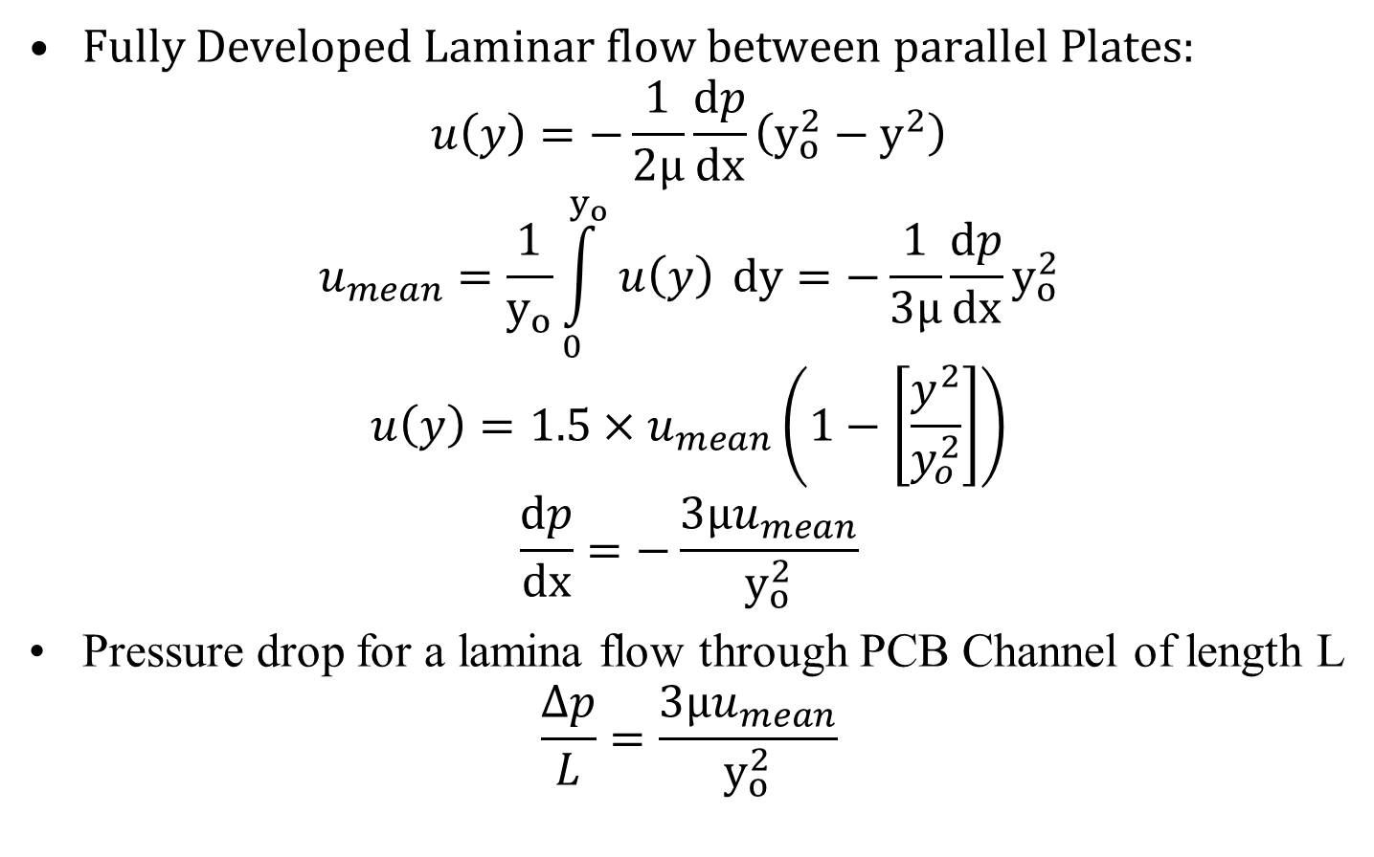
Simple Modeling of Forced Convection Laminar Flow in PCB arrays
Fully Developed Laminar flow between parallel Plates:
$$u\left(y\right)=−\frac{1}{2μ}\frac{dp}{dx}\left(y_{o}^{2}−y^{2}\right)$$
$$u_{mean}=\frac{1}{y_{o}}\int_{0}^{y_{o}}{u\left(y\right) }dy=−\frac{1}{3μ}\frac{dp}{dx}y_{o}^{2}$$
$$u\left(y\right)=1.5×u_{mean}\left(1−\left[\frac{y^{2}}{y_{o}^{2}}\right]\right)$$
$$\frac{dp}{dx}=−\frac{3μu_{mean}}{y_{o}^{2}}$$
Pressure drop for a lamina flow through PCB Channel of length L
$$\frac{∆p}{L}=\frac{3μu_{mean}}{y_{o}^{2}}$$

Slide 10
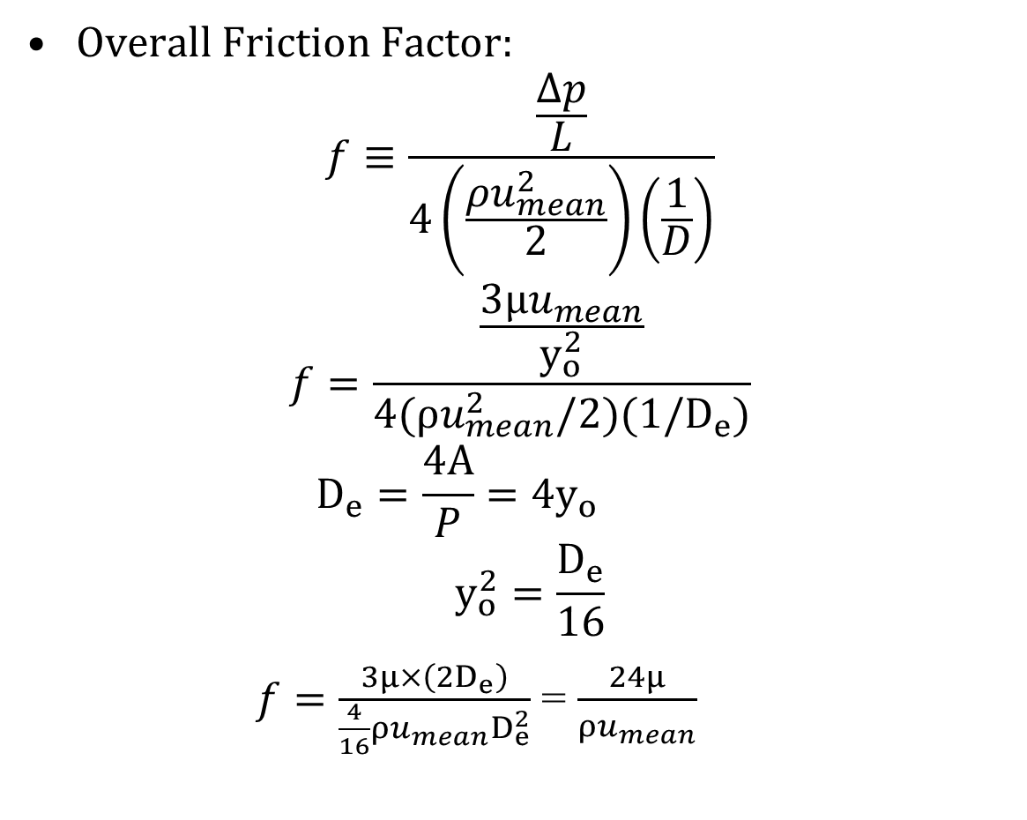
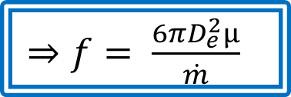
Friction Factor for a Laminar Flow in A
PCB Channel
Overall Friction Factor:
$$f≡\frac{\frac{Δp}{L}}{4\left(\frac{ρu_{mean}^{2}}{2}\right)\left(\frac{1}{D}\right)}$$
$$f=\frac{\frac{3μu_{mean}}{y_{o}^{2}}}{4(ρu_{mean}^{2}/2)(1/D_{e})}$$
$$D_{e}=\frac{4A}{P}=4y_{o}$$
$$y_{o}^{2}=\frac{D_{e}}{16}$$
$f=\frac{3μ×\left(2D_{e}\right)}{\frac{4}{16}ρu_{mean}^{}D_{e}^{2}}$ = $\frac{24μ}{ρu_{mean}^{}}$
$⇒f=$ $\frac{6πD_{e}^{2}μ}{\dot{m}}$

Slide 11
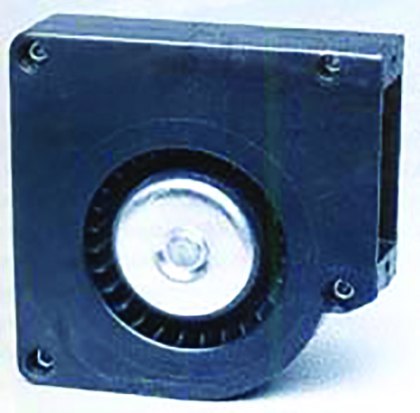
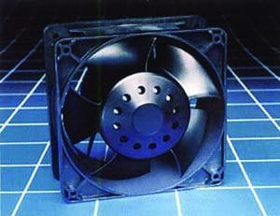
Fans to Facilitate Forced Convection Cooling
Axial flow Fan
Radial flow (centrifugal) Blower

Slide 12
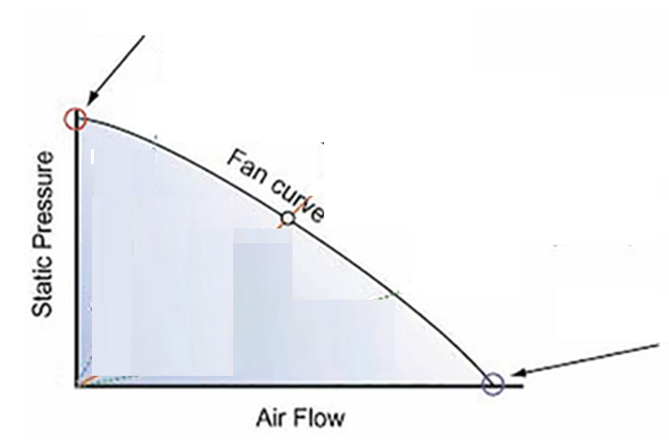
General Fan Curve
Shutoff point
Free Delivery point

Slide 13
General Fan Curve: Energy Viewpoint
Maximum potential energy Fluid
Potential Energy + Kinetic energy Fluid
Maximum Kinetic energy Fluid

Slide 14
Fan/PCB Array interaction.
The governing principle in fan selection is that any given fan can only deliver one flow at one pressure in a particular PCB array.
This “operating point” is determined by the intersection of the fan static pressure curve and the PCB array pressure curve.
PCB array pressure curve

Slide 15
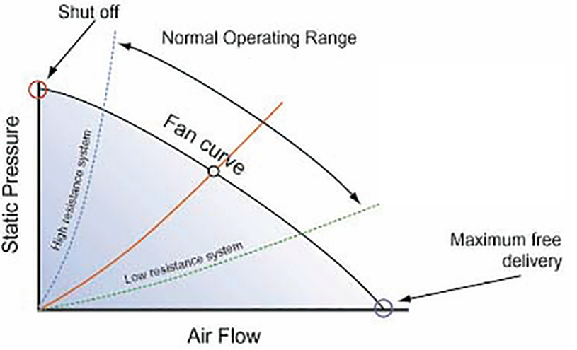
Fan/PCB Array interaction.
The operating points of both high and low resistance PCB Arrays.

Slide 16
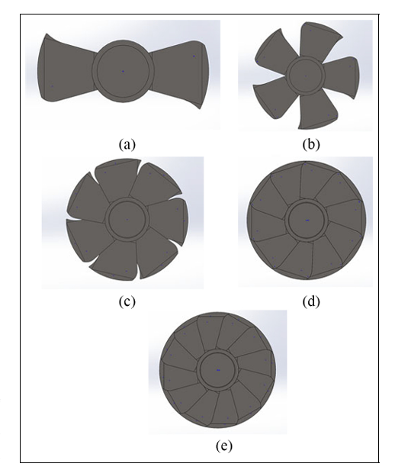
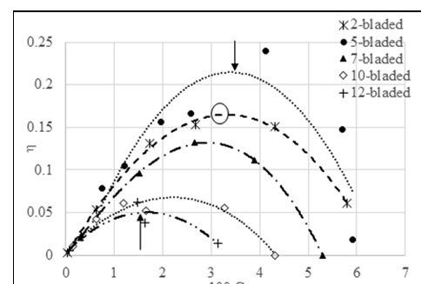

Selection of An Axial Flow Fan
$$For a given ∆p$$

Slide 17
Fan/PCB Array Operation Point
It is best to select a fan that will give an operating point being toward the high flow, low pressure end of the performance curve.
This leads to minimum power consumption by fan motor with minimum irreversiblities.
Each PCB array should be analyzed for possible reduction in the overall resistance to airflow.
Other considerations, such as available space and power, noise, reliability, and operating environment should also be brought to bear on fan choice.

Slide 18
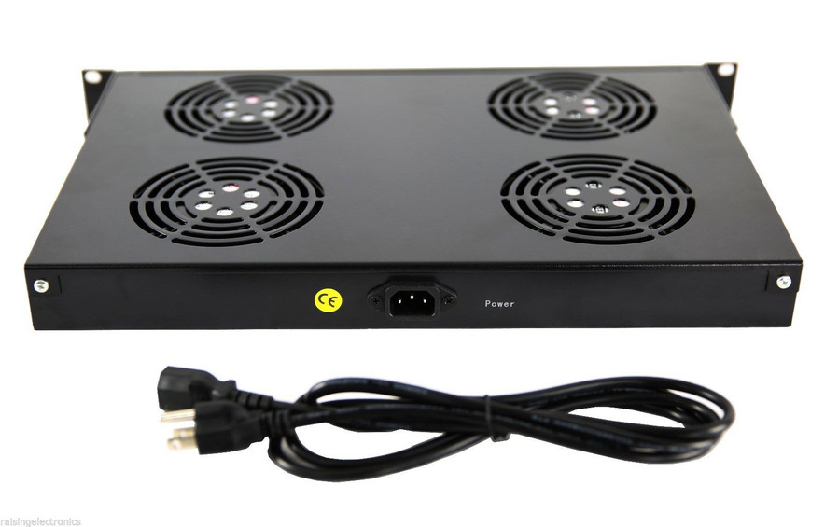
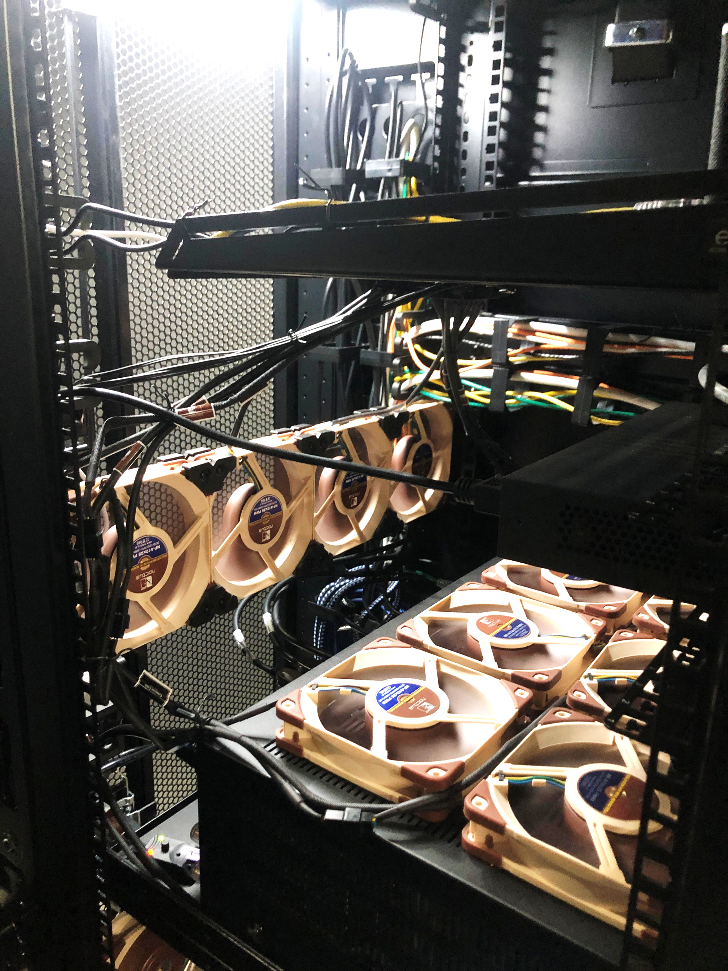
General Desing of A Package of Fans
How to develop combined fans characteristics curve?

Slide 19

Fluid Temperature Profile in FULLY DEVELOPED DUCT FLOW
$$u\frac{∂T}{∂x}=α\frac{∂^{2}T}{∂y^{2}}$$
$$u\left(y\right)=1.5×u_{mean}\left(1−\left[\frac{y^{2}}{y_{o}^{2}}\right]\right)$$
$$1.5×u_{mean}\left(1−\left[\frac{y^{2}}{y_{o}^{2}}\right]\right)×\frac{∂T}{∂x}=α\frac{∂^{2}T}{∂y^{2}}$$
The boundary conditions are:
$\frac{∂T}{∂y}=0 at y=0$ & $k\frac{∂T}{∂y}=q^{′′} at y= y_{0}$

Slide 20

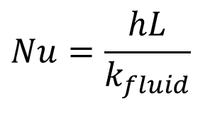
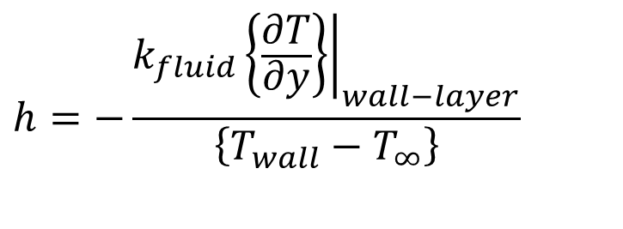
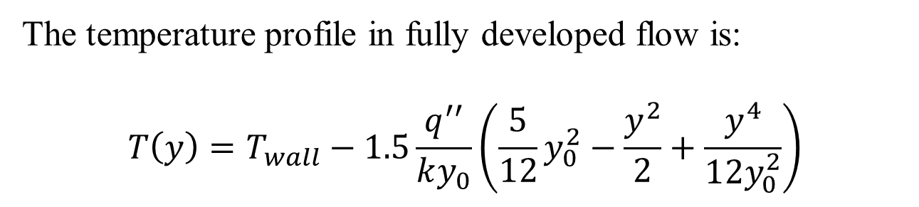
Fluid Temperature Profile in FULLY DEVELOPED DUCT FLOW
The temperature profile in fully developed flow is:
$$T\left(y\right)=T_{wall}−1.5\frac{q^{′′}}{ky_{0}}\left(\frac{5}{12}y_{0}^{2}−\frac{y^{2}}{2}+\frac{y^{4}}{{12y}_{0}^{2}}\right)$$
$$h=−\frac{k_{fluid}{\left.\left\{\frac{∂T}{∂y}\right\}\right|}_{wall−layer}}{\left\{T_{wall}−T_{∞}\right\}}$$
$$Nu=\frac{hL}{k_{fluid}}$$

Slide 21
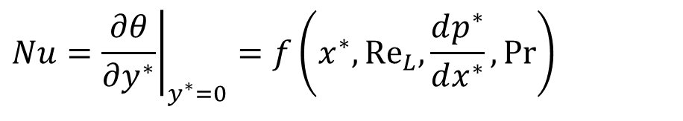
Forced Convection Cooling in a PCB Array
$$Nu={\left.\frac{∂θ}{∂y^{∗}}\right|}_{y^{∗}=0}=f\left(x^{∗},{Re}_{L}{,}\frac{dp^{∗}}{dx^{∗}},Pr\right)$$
Nusselt Number is constant in thermally Developed flow:
$$Nu≡\frac{hD_{e}}{k}=−\frac{D_{e}{\left(\frac{∂T}{∂y}\right)}_{o}}{T_{o}−T_{m}}$$
$$Nu=7.6$$
Isothermal Walls
Iso-heat flux Walls
Nu = 8.23

Slide 22
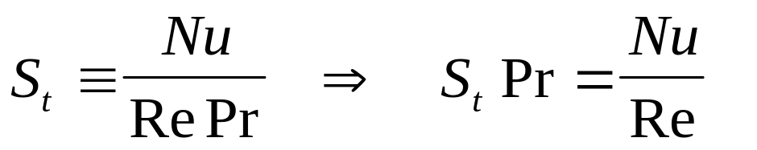
Fluid Flow /Convection Heat Transfer Analogy
Thomas Stanton (engineer) (1865–1931) invented Transport Analogy.
He used to characterize heat transfer in forced convection flows using fluid flow field and developed a dimensionless number.
This number is titled as Stanton number.
Stanton Number
Applying to Channel with Isothermal walls:
$S_{t}×Pr=\frac{7.6}{Re}$
$f=\frac{24}{Re}$

Slide 23
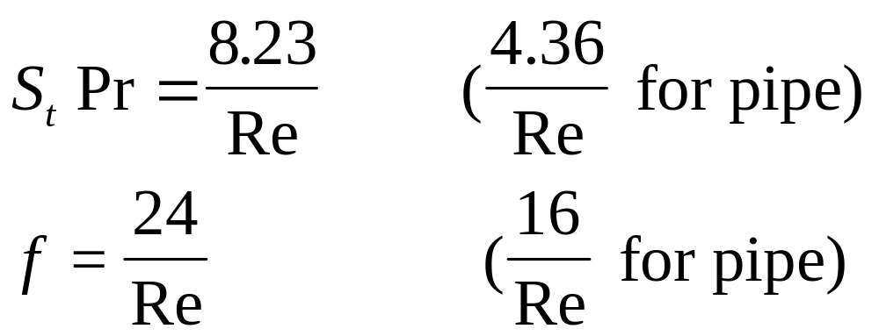
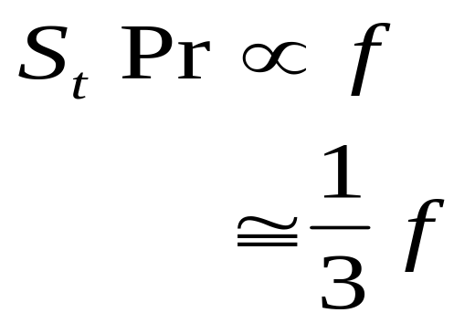
Fluid Flow/Heat Transfer Analogy
Applying to Channel with Isoflux walls
Laminar, fully-developed, channel

Slide 24

Turbulent, Fully-Developed Channel
Development of Correlations for Nu Variation using Transport Similarity:
$$f=0.046{Re}^{−0.2}$$
Transport Analogy using Laminar flows
$$S_{t}Pr=\frac{f}{3}$$
$$S_{t}Pr=\frac{0.046{Re}^{−0.2}}{3}$$
$$\frac{Nu}{Re}=\frac{0.046{Re}^{−0.2}}{3}$$
$$Nu=0.0153{ Re}^{0.8}$$

Slide 25
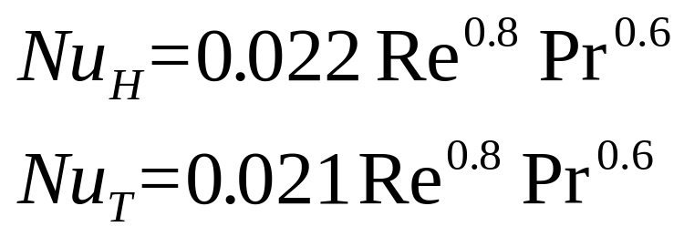
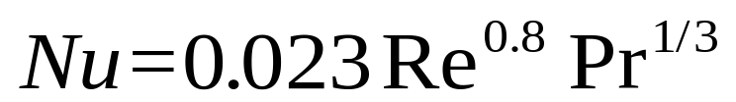
Turbulent, Fully-Developed Channel
Experimental Correlations for Nu
(Kays)
(Colburn)

Slide 26
Turbulent, Fully-Developed Channel
Development General Transport Analogy:
(Colburn)
$$S_{t}Pr=\frac{0.023{Re}^{0.8}{Pr}^{1/3}}{Re}$$
$$S_{t}{Pr}^{2/3}=\frac{0.023}{{Re}^{0.2}}$$
$$f=0.046{Re}^{−0.2}$$
$$S_{t}{Pr}^{2/3}=2f$$

Slide 27
Asymmetric Heating PCB Channels
Parallel Plate Channel : Laminar Flow
$${Nu}_{i}=\frac{5.385}{1−0.346×\left\{\frac{q_{o}^{′′}}{q_{i}^{′′}}\right\}}$$
$${Nu}_{o}=\frac{5.385}{1−0.346×\left\{\frac{q_{i}^{′′}}{q_{o}^{′′}}\right\}}$$
$$q_{o}^{′′}=q_{i}^{′′} ⇒{Nu}_{o}={Nu}_{i}=8.23$$

Slide 28
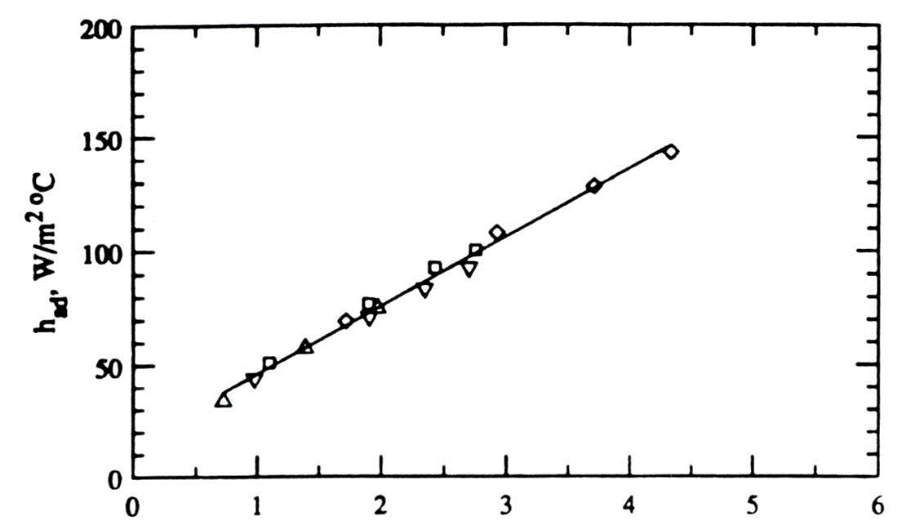
Effect of Turbulence Intensity on Heat Transfer Coefficient
$$u_{rms}=\sqrt{\int_{0}^{T}{{\left\{u\left(t\right)−\overline{U}\right\}}^{2}dt}, m/s}$$

Slide 29
Enhancement of Forced Convection from PCBs
Inherent enhancement
  Protrusions
  Vibrations
  Electrical fields
Enhancement by control of geometric layout
  Staggering chips on the board
  Optimal streamwise spacing
Displaced promoters and flow modulation
  Wires, rods attached to the opposite wall of the channel
  Modulate flow at an appropriate frequency

Slide 30
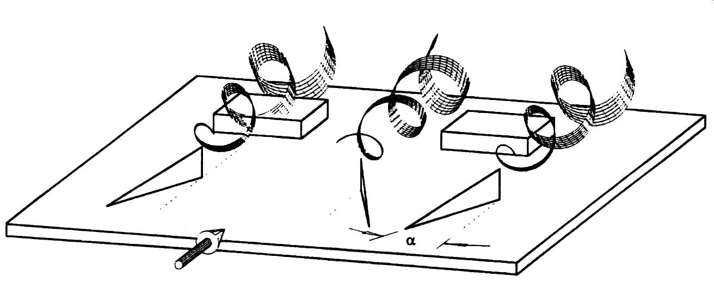
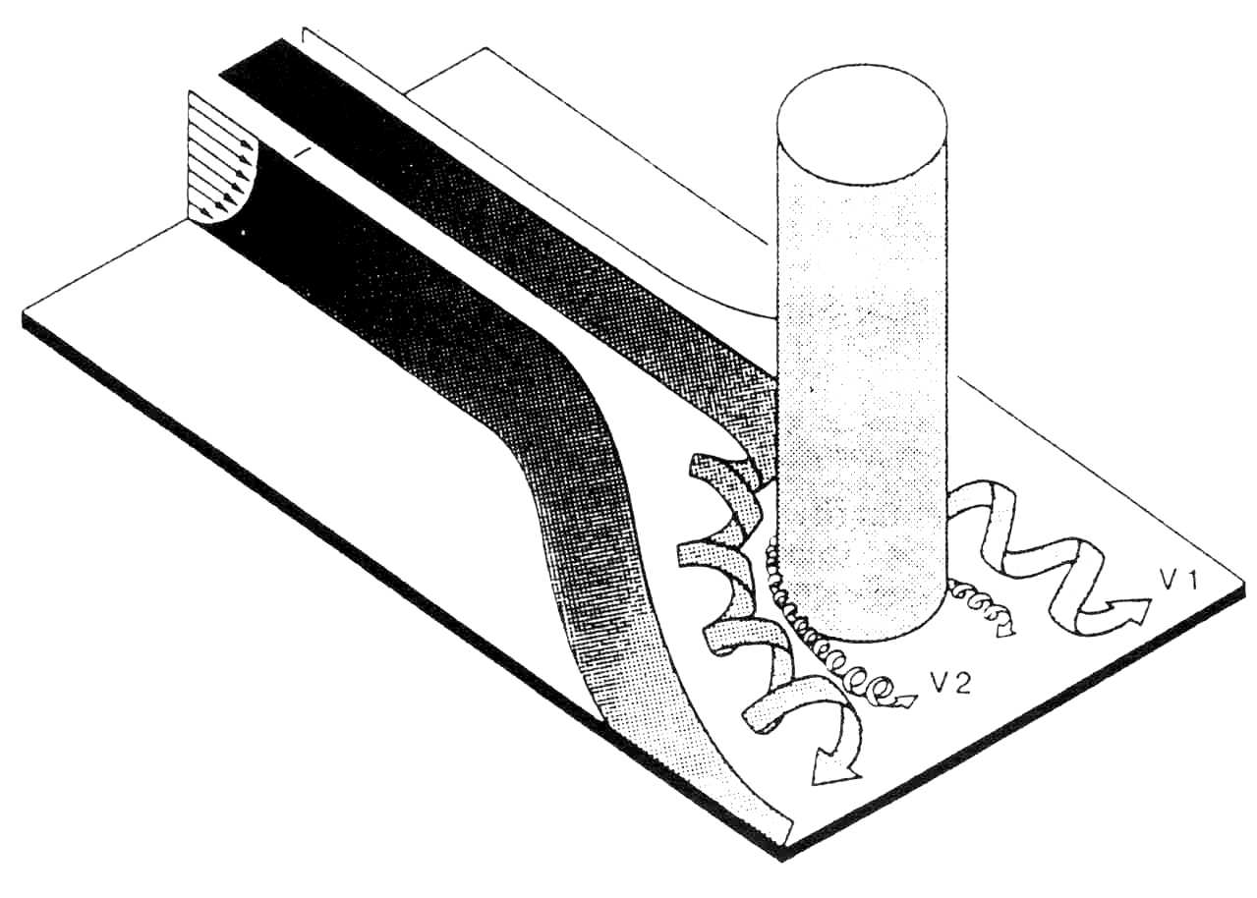
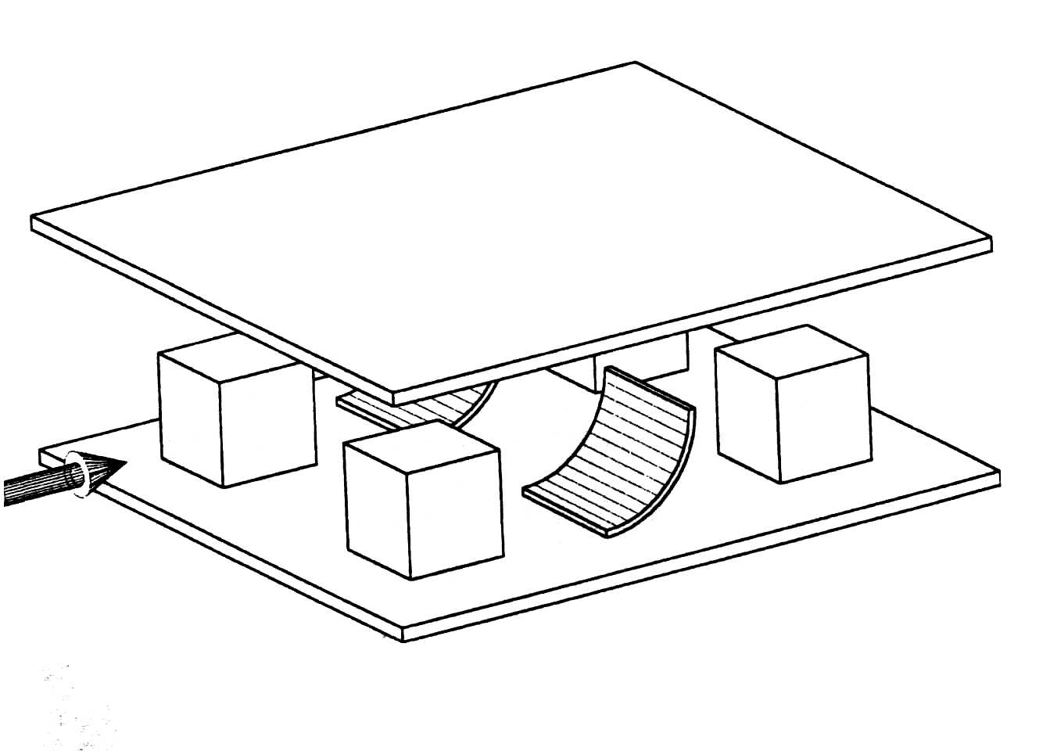
Enhancement of Forced Convection from PCBs
Vortex generators and barriers
  Delta-wing vortex generators
  Scoops
  Wall-mounted cylinders

Slide 31
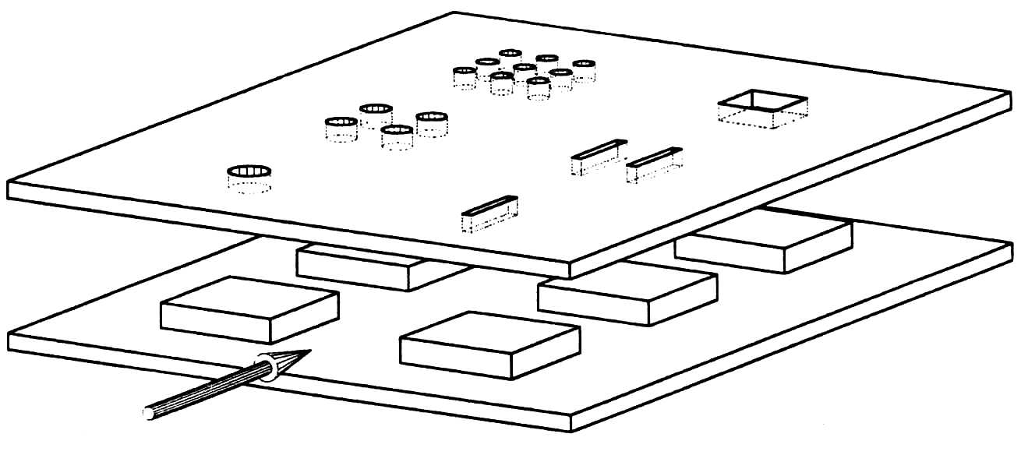
Enhancement of Forced Convection from PCBs
Impinging jets
  Free Jets
  Submerged jets
Compact heat sinks
  Microchannel heat sinks
  Porous metallic matrices
Hybrid techniques

Slide 32
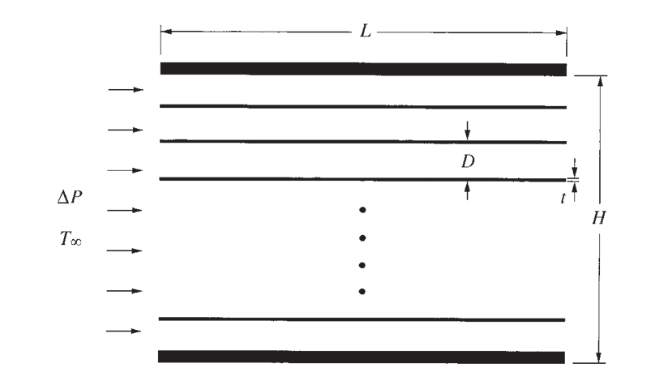
STACKOFHEAT-GENERATING PLATES
Determination of the spacing for maximum heat transfer density in a package (stack) of parallel plates that are cooled by forced convection was an important industrial requirement.
In 21st century application of this arrangement is the forced-air cooling of a stack of electronic circuit boards.
Of principal interest is the maximum heat transfer, rate, that is,
the maximum density of heat-generating electronics that can be fitted in a package of specified volume.

Slide 33
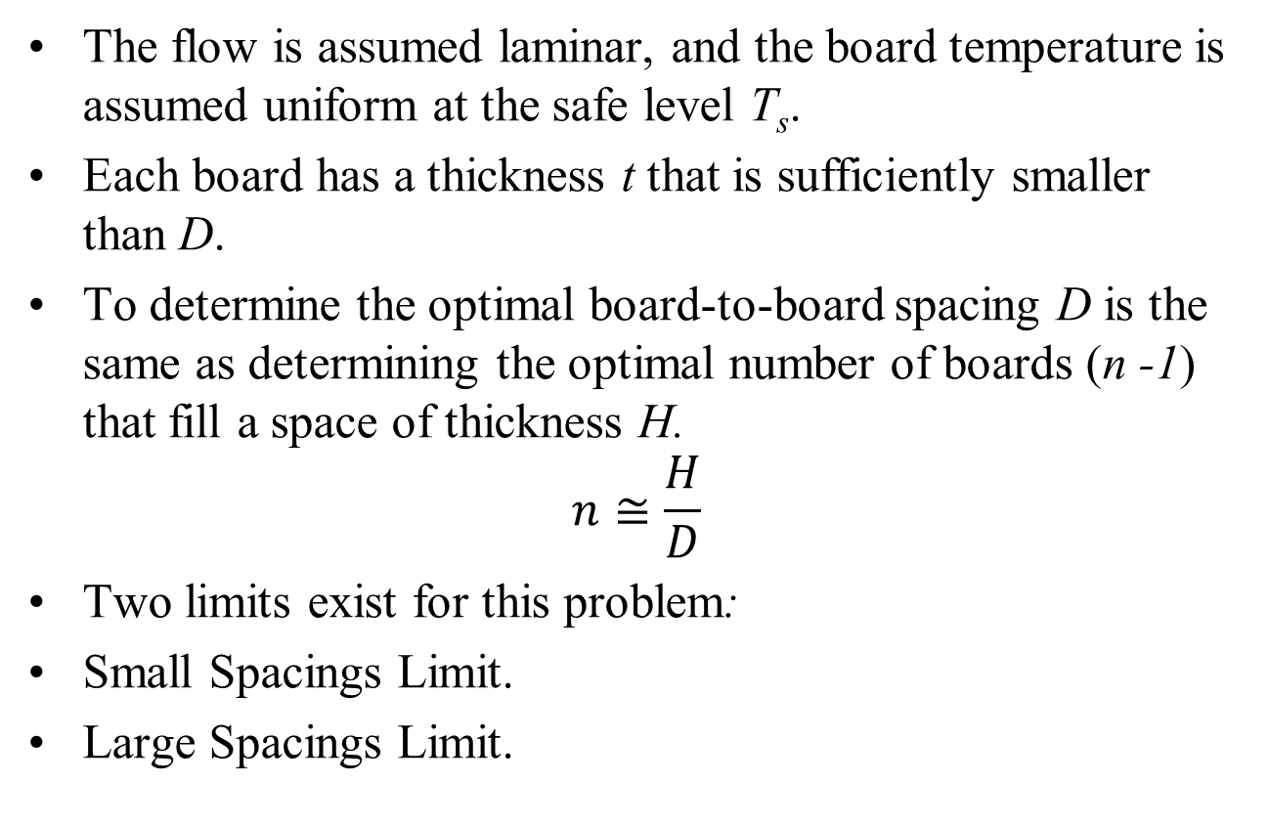
Method of Solution
The flow is assumed laminar, and the board temperature is assumed uniform at the safe level T_{s}.
Each board has a thickness t that is sufficiently smaller than D.
To determine the optimal board-to-board spacing D is the same as determining the optimal number of boards (n -1) that fill a space of thickness H.
$$n≅\frac{H}{D}$$
Two limits exist for this problem:
Small Spacings Limit.
Large Spacings Limit.

Slide 34
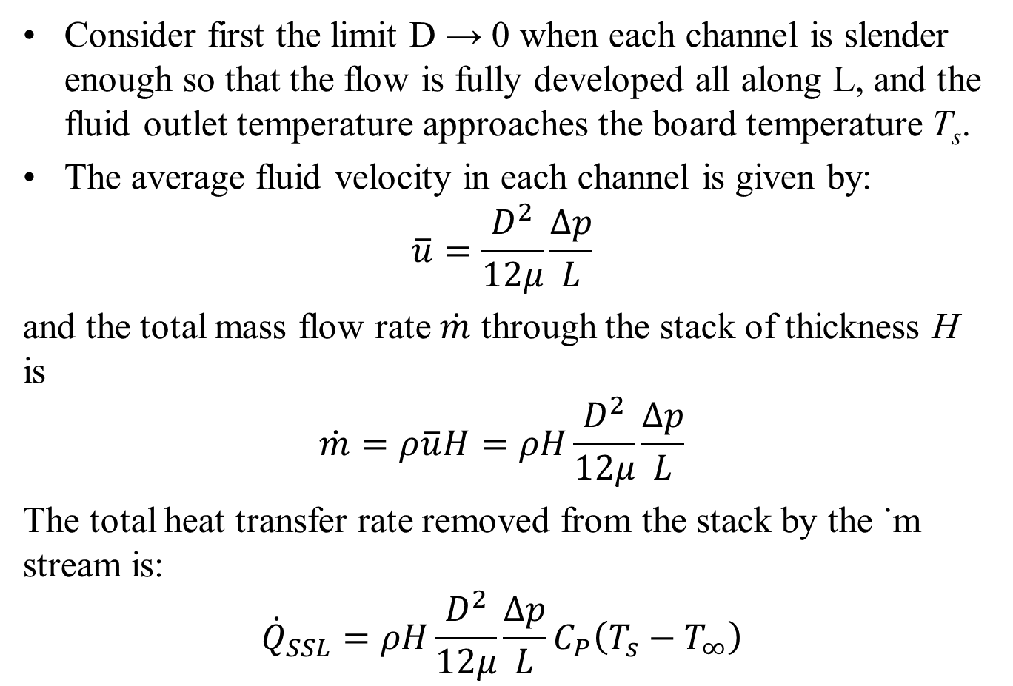
Small Spacing Limit
Consider first the limit D → 0 when each channel is slender enough so that the flow is fully developed all along L, and the fluid outlet temperature approaches the board temperature T_{s}.
The average fluid velocity in each channel is given by:
$$\overline{u}=\frac{D^{2}}{12μ}\frac{∆p}{L}$$
and the total mass flow rate $\dot{m}$ through the stack of thickness H is
$$\dot{m}=ρ\overline{u}H=ρH\frac{D^{2}}{12μ}\frac{∆p}{L}$$
The total heat transfer rate removed from the stack by the ˙m stream is:
$${\dot{Q}}_{SSL}=ρH\frac{D^{2}}{12μ}\frac{∆p}{L}C_{P}\left(T_{s}−T_{∞}\right)$$

Slide 35
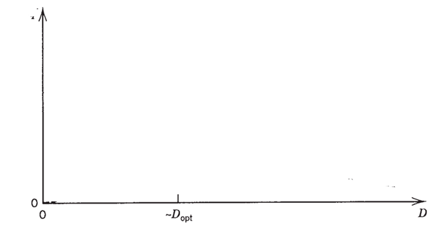

Small Spacing Limit
As a conclusion, in the limit D → 0, the total cooling rate (or total rate of allowable Joule heating in the package) decreases as D^{2.}
This trend is illustrated qualitatively as curve .
$$q^{"}\sim D^{2}−Small Space Limit$$
$$q^{"}$$
The direction toward small D values is not good for design performance.

Slide 36
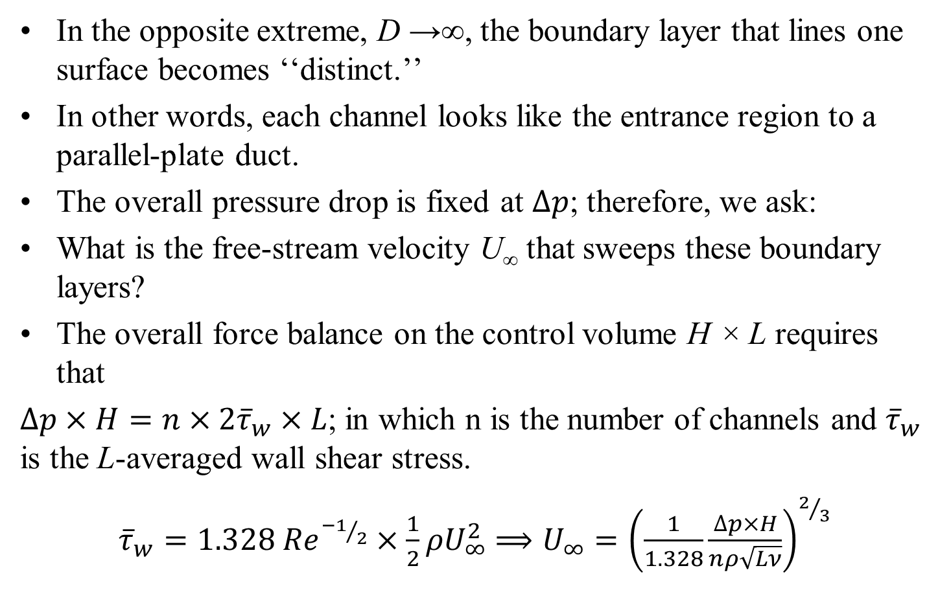
Large Spacings Limit
In the opposite extreme, D →∞, the boundary layer that lines one surface becomes ‘‘distinct.’’
In other words, each channel looks like the entrance region to a parallel-plate duct.
The overall pressure drop is fixed at $∆p$; therefore, we ask:
What is the free-stream velocity U∞ that sweeps these boundary layers?
The overall force balance on the control volume H × L requires that
$∆p×H=n×2{\overline{τ}}_{w}×L$; in which n is the number of channels and ${\overline{τ}}_{w}$ is the L-averaged wall shear stress.
${\overline{τ}}_{w}=1.328 {Re}^{{−1}/2}×\frac{1}{2}ρU_{∞}^{2}$ $⟹U_{∞}={\left(\frac{1}{1.328}\frac{∆p×H}{nρ\sqrt{Lν}}\right)}^{2/3}$

Slide 37
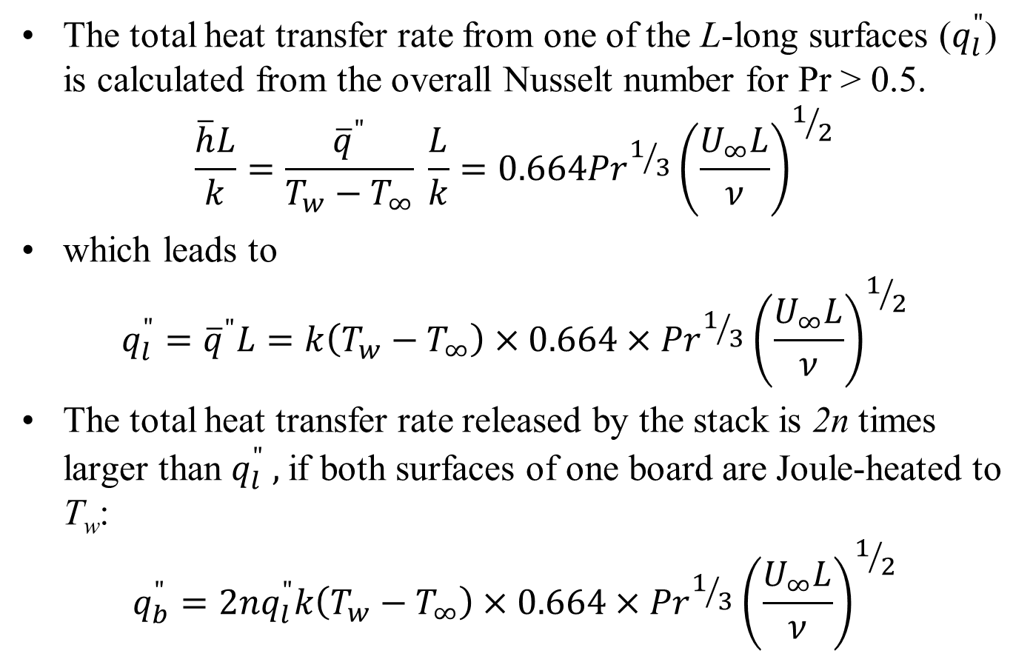
Large Spacings Limit
The total heat transfer rate from one of the L-long surfaces ($q_{l}^{"}$) is calculated from the overall Nusselt number for Pr > 0.5.
$$\frac{\overline{h}L}{k}=\frac{{\overline{q}}^{"}}{T_{w}−T_{∞}} \frac{L}{k}=0.664{Pr}^{1/3}{\left(\frac{U_{∞}L}{ν}\right)}^{1/2}$$
which leads to
$$q_{l}^{"}={\overline{q}}^{"}L=k\left(T_{w}−T_{∞}\right)×0.664×{Pr}^{1/3}{\left(\frac{U_{∞}L}{ν}\right)}^{1/2}$$
The total heat transfer rate released by the stack is 2n times larger than $q_{l}^{"} ,$if both surfaces of one board are Joule-heated to T_{w}:
$${q_{b}^{"}=2nq}_{l}^{"}k\left(T_{w}−T_{∞}\right)×0.664×{Pr}^{1/3}{\left(\frac{U_{∞}L}{ν}\right)}^{1/2}$$

Slide 38
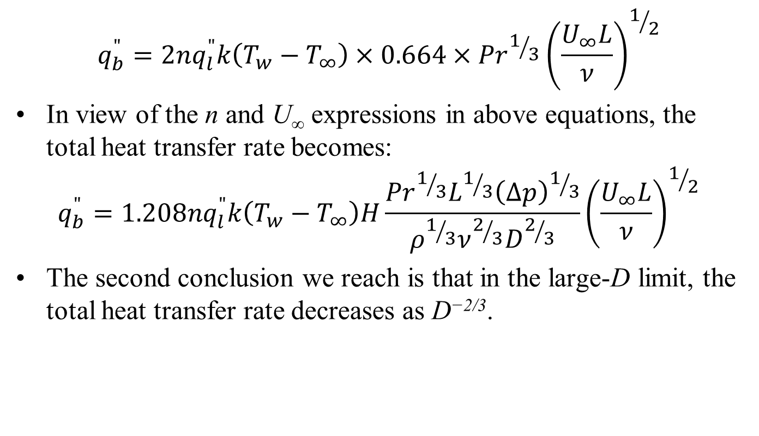
Large Spacings Limit
$${q_{b}^{"}=2nq}_{l}^{"}k\left(T_{w}−T_{∞}\right)×0.664×{Pr}^{1/3}{\left(\frac{U_{∞}L}{ν}\right)}^{1/2}$$
In view of the n and U∞ expressions in above equations, the total heat transfer rate becomes:
$${q_{b}^{"}=1.208nq}_{l}^{"}k\left(T_{w}−T_{∞}\right)H\frac{{Pr}^{1/3}L^{1/3}{\left(∆p\right)}^{1/3}}{ρ^{1/3}ν^{2/3}D^{2/3}}{\left(\frac{U_{∞}L}{ν}\right)}^{1/2}$$
The second conclusion we reach is that in the large-D limit, the total heat transfer rate decreases as D^{−2/3}.

Slide 39


Intersection of Small & Large Spacing Limits
$$q^{"}\sim D^{2}−Small Space Limit$$
$$q^{"}$$
$$q^{"}\sim D^{{−2}/3}−Large Space Limit$$
This comparison suggests that the maximum of the actual (unknown) curve q”(D) can occur only at a spacing D_{opt}
That is of the same order as the D value obtained by intersecting the asymptotes.

Slide 40
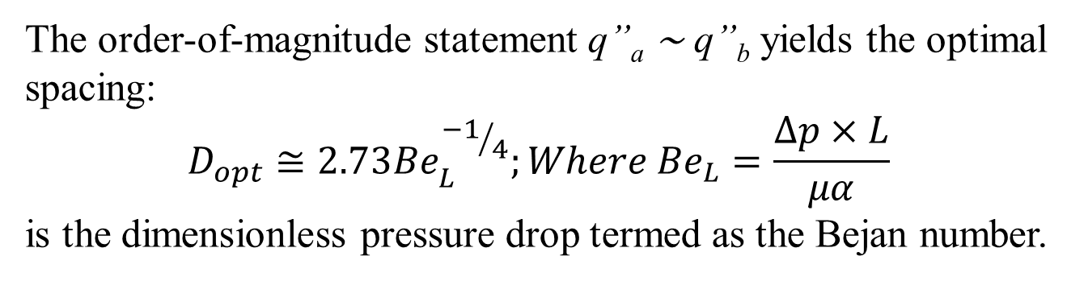
Intersection of Small & Large Spacing Limits
$$q^{"}\sim D^{2}−Small Space Limit$$
$$q^{"}$$
$$q^{"}\sim D^{{−2}/3}−Large Space Limit$$
The order-of-magnitude statement q”_{a} ∼ q”_{b} yields the optimal spacing:
$$D_{opt}≅2.73{Be}_{L}^{{−1}/4};Where {Be}_{L}=\frac{∆p×L}{μα}$$
is the dimensionless pressure drop termed as the Bejan number.

Slide 41
Optimal Spacing
The role of this dimensionless group in forced convection is discussed agrees very well with the more exact result obtained by locating the maximum of the actual q”(D).
Showed numerically that in the Pr range 0.7–103, the optimal spacing is correlated by an expression in which the coefficient 2.73 is replaced by 3.05.
The existence of the optimal spacing was also confirmed by experiments with microchannels.
The numerical maximization of the actual q”(D) relation demonstrated that in the entire range 0.7 < Pr < 103, the dimensionless length x* = (L/Dh)/(UDh/α) was consistently equal to 0.04 when D = D_{opt}.

Slide 42
Optimal Spacing
This means that the optimal board-to-board spacing must be such that the board length is of the same order of magnitude as the thermal entrance length of the parallel-plate channel.
This feature is the key to the design of compact heat exchanger structures with maximal heat transfer rate density.
This idea has been taken to higher performance levels in two ways,
by optimally shaping the channel with optimized spacing (i.e., by fitting the duct to the convective flow ) and
by packing a series of smaller plates and channels in the entrance regions of the stack.
The latter is a generally valid strategy for achieving maximal heat transfer density by constructing a flow structure with multiple length scales.

Slide 43
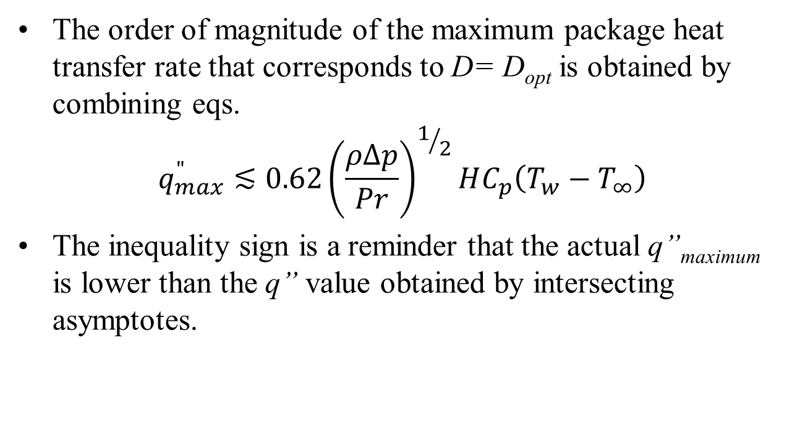
Optimal Spacing
The order of magnitude of the maximum package heat transfer rate that corresponds to D= D_{opt} is obtained by combining eqs.
$$q_{max}^{"}≲0.62{\left(\frac{ρ∆p}{Pr}\right)}^{1/2}HC_{p}\left(T_{w}−T_{∞}\right)$$
The inequality sign is a reminder that the actual q”_{maximum} is lower than the q” value obtained by intersecting asymptotes.

Slide 44
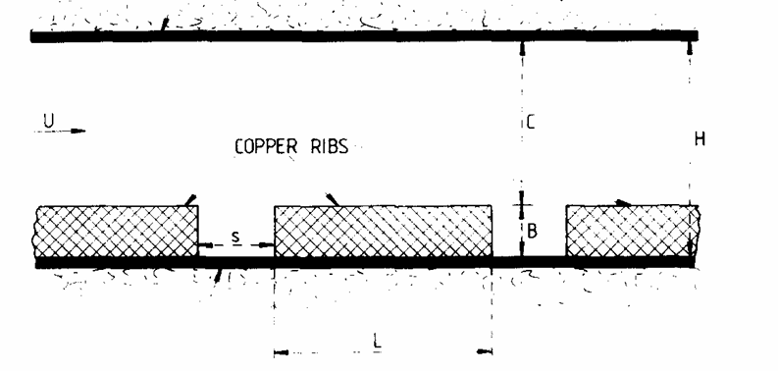
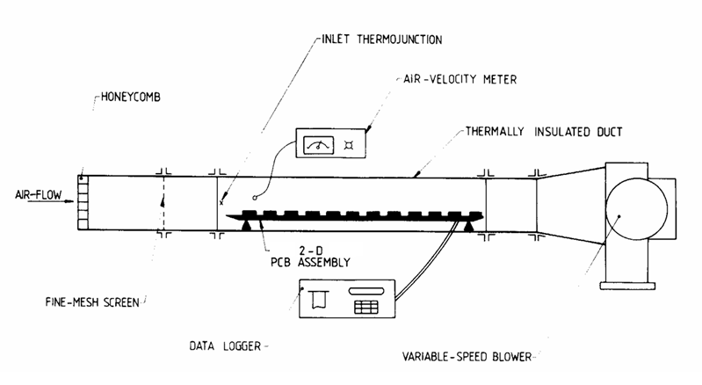
Forced Convection Cooling System of PCB Array : Test Rig

Slide 45
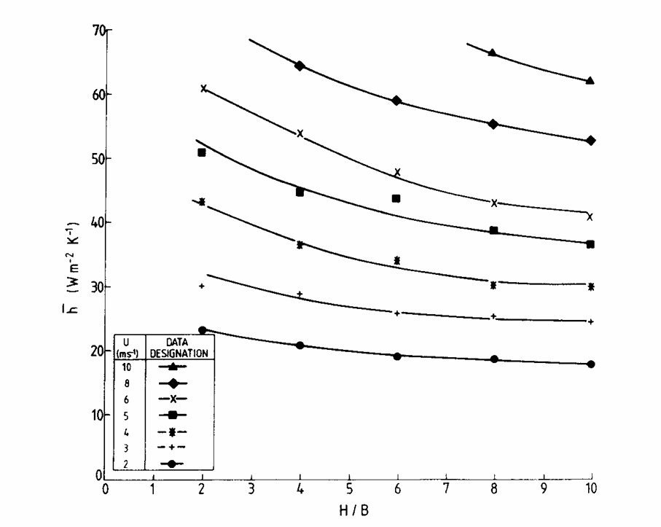
Forced Convection Cooling System of PCB Array : Test Results

Slide 46
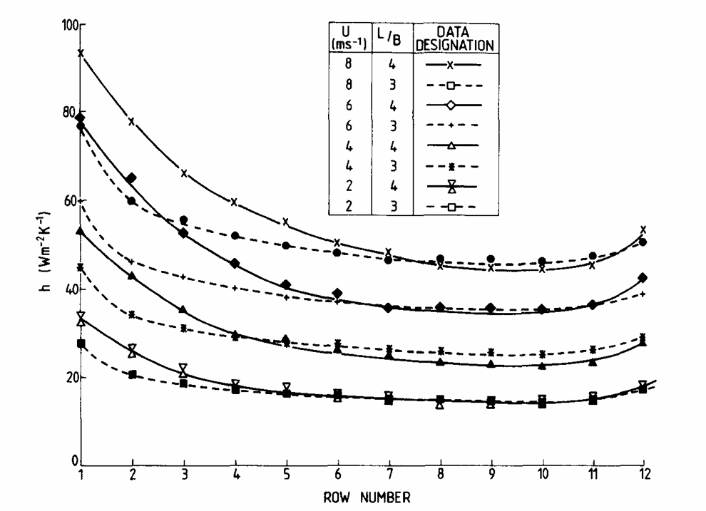
Forced Convection Cooling System of PCB Array : Test Results

Slide 47
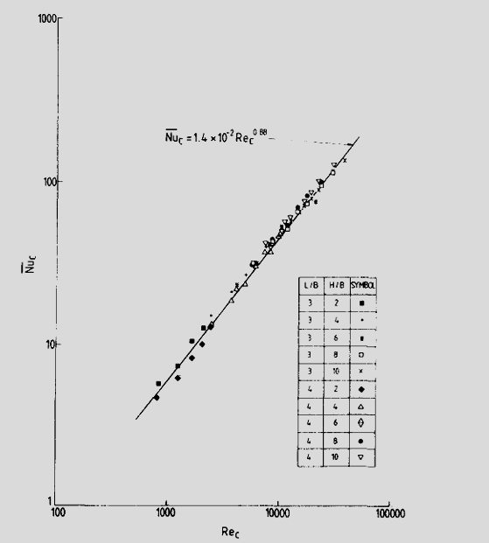
Principle of Similarity for PCB Araay

Slide 48
Closure
Analytical studies are tricky because of lack of geometric similarity (have to depend on experimental and numerical input)
Entrance effects are substantial and cannot be neglected
Need to be careful in interpreting data and using the appropriate heat transfer coefficient
Package length scale is the most representative dimension
Substrate conduction plays an important part
Several enhancement techniques can be successfully applied

Slide 49
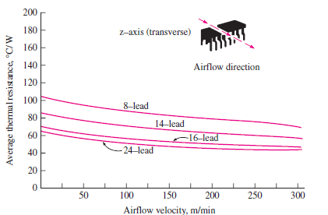
Forced Convection Cooling of Chips Using Air
High Power Chips have low surface to volume ratio w.r.t. ideal requirement!?!?!?

