Slide 1


Thermal Management thru Natural Convection Cooling of Vertical PCBs
P M V Subbarao
Professor
Mechanical Engineering Department
Onset of Powerful Desktops..

Slide 2


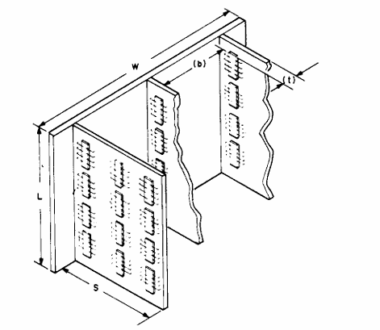
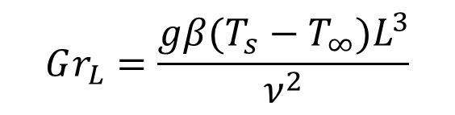
Natural Convection
Measure for Cooling Potential thru Natural Convection
$$Gr_{L}=\frac{gβ(T_{s}−T_{∞})L^{3}}{ν^{2}}$$

Slide 3
Vertical Array of PCBs : Natural Convection
Natural convection flow in vertical channels are formed by the component-carrying printed circuit boards.
Heat dissipation profiles along the channel walls depends on packaging constraints and partitioning considerations, as well as system operating modes.
Oftentimes, the assumption of a uniform heat-flux boundary condition along one or both of the channel walls can be shown to approximate the thermal driving force present in this configuration.
The maximum component surface temperature attained on a natural convection; air-cooled PCB can be predicted by analytical expressions associated with the isoflux wall condition.

Slide 4
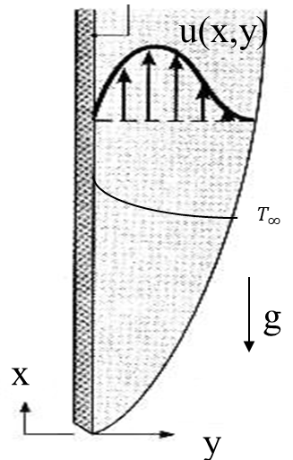
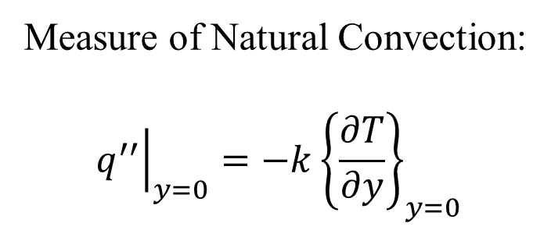
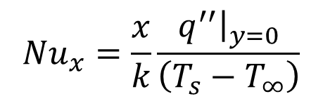
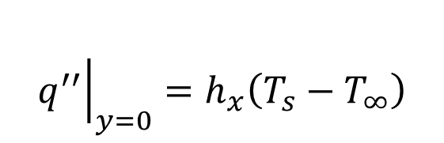
Natural Convection on A VFP : Constant Heat Flux
Measure of Natural Convection:
$${\left.q^{′′}\right|}_{y=0}=−k{\left\{\frac{∂T}{∂y}\right\}}_{y=0}$$
$$q_{s}^{′′}$$
$${\left.q^{′′}\right|}_{y=0}=h_{x}\left(T_{s}−T_{∞}\right)$$
$${Nu}_{x}=\frac{x}{k}\frac{{\left.q^{′′}\right|}_{y=0}}{\left(T_{s}−T_{∞}\right)}$$

Slide 5
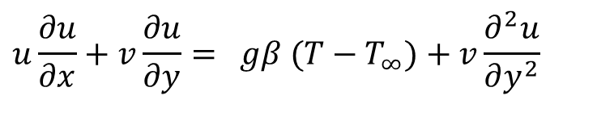


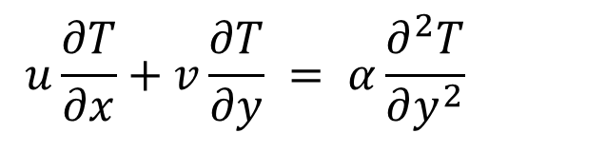


Natural Convection on A VFP : Constant Heat Flux
Simplified NS equations for Natural Convection Boundary Layer Flow:
$$u\frac{∂u}{∂x}+v\frac{∂u}{∂y}= gβ (T−T_{∞})+v\frac{∂^{2}u}{∂y^{2}}$$
$$u\frac{∂T}{∂x}+v\frac{∂T}{∂y} = α\frac{∂^{2}T}{∂y^{2}}$$
$$q_{s}^{′′}$$
The boundary conditions will be
$$u=0 at x=0$$
$$u=0 \& y=0 at y =0$$
$$q_{s}^{′′}=−k{\left.\frac{∂T}{∂y}\right|}_{y=0}=constant$$
$$u=0 \& T=T_{∞} at y →∞$$

Slide 6
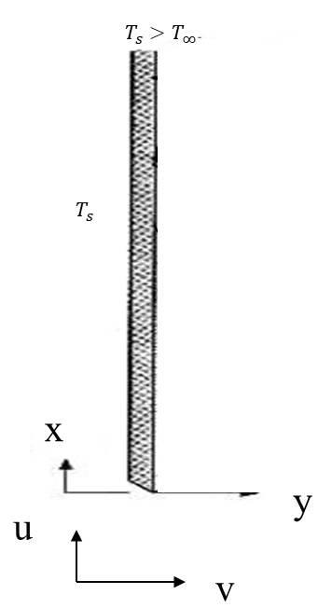

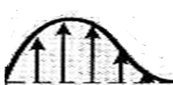

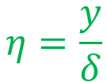



A Heated Vertical Plate: Prandtl’s Intuition
Focus on free convection flows bounded by a vertical surface.
$$δ\left(x\right)$$
T(x₄,y)
u(x₅,y)
$$η=\frac{y}{δ}$$
Quiescent fluid
T(x₃,y)
u(x₄,y)
u(x₃,y)
T(x₂,y)
u(x₂,y)
T(x₁,y)
For air
u(x₁,y)
$$\tilde{u}=φ_{0}\left(η^{3}−2η^{2}+η\right)$$
$$θ=φ_{0}\left(η^{2}−2η+1\right)$$

Slide 7
Velocity and Length Scales
Scale for master Velocity
$$φ_{0}=F\left({\dot{q}}_{s}^{′′},k,ν,g,β,L\right)$$
Scale for length
$$δ_{0}=G\left(q_{s}^{′′},k,ν,g,β,L\right)$$
Using dimensional analysis:
$$φ_{0}=\sqrt[4]{\frac{gβ{\dot{q}}_{s}^{′′}ν^{2}L^{2}}{k}}$$
$$δ_{0}=\frac{1}{\sqrt[4]{\frac{gβ{\dot{q}}_{s}^{′′}L^{2}}{kν^{2}}}}$$
$${Gr}_{L}^{∗}=\frac{gβ{\dot{q}}_{s}^{′′}L^{4}}{kν^{2}}$$
Define Global flux Grashof Number as
Define Local flux Grashof Number as
$${Gr}_{x}^{∗}=\frac{gβ{\dot{q}}_{s}^{′′}x^{4}}{kν^{2}}$$
Local Grashof Number: Measure of local ratio of driving force to Viscous resistance force.

Slide 8
Natural Convection : Constant Heat Flux
In 1956, Sparrow and Gregg, derived a similarity solution for this system by defining novel similarity variables:
$$η=\sqrt[5]{\frac{gβq_{s}^{′′}}{5kν^{2}x}} ×y$$
$$q_{s}^{′′}$$
$$θ\left(η\right)=\left(T_{∞}−T\right)\sqrt[5]{\frac{gβq_{s}^{′′}}{5kν^{2}}} ×\left[\frac{k}{q_{s}^{′′}\sqrt[5]{x}}\right]$$
$$ψ=\sqrt[5]{\frac{125gβq_{s}^{′′}ν^{3}}{k}} ×x^{4/5}×F\left(η\right)$$

Slide 9
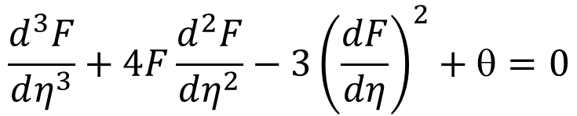

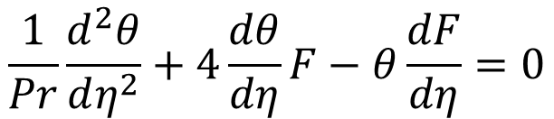
Governing ODEs Natural Convection on Vertical Plate with Constant Heat Flux
ODE equivalent of NS equations for Natural Convection on a vertical plate:
$$\frac{d^{3}F}{dη^{3}}+4F\frac{d^{2}F}{dη^{2}}−3{\left(\frac{dF}{dη}\right)}^{2}+θ=0$$
$$q_{s}^{′′}$$
$$\frac{1}{Pr}\frac{d^{2}θ}{dη^{2}}+4\frac{dθ}{dη}F−θ\frac{dF}{dη}=0$$
The modified Grashof number is defined as
$${Gr}_{x}^{∗}=\frac{gβq_{s}^{′′}x^{4}}{kν^{2}}$$

Slide 10
Natural Convection : Constant Heat Flux
The modified Grashof number is defined as
$${Gr}_{x}^{∗}=\frac{gβq_{s}^{′′}x^{4}}{kν^{2}}$$
Constant wall heat flux leads to a wall with (T_{s} − T∞) ∼ x^{1/5} .
Finally, the local Nusselt number is defined as:
$${Nu}_{x}=−\frac{1}{\sqrt[5]{5}}\frac{\sqrt[5]{{Gr}_{x}^{∗}}}{θ′\left(0\right)}$$
$${Nu}_{x}=\frac{2}{\sqrt[5]{360}} \sqrt[5]{\left\{\frac{{Pr}^{2}{×{Gr}_{x}^{∗}}}{\frac{4}{5}+Pr}\right\}}$$
$$q_{s}^{′′}$$

Slide 11
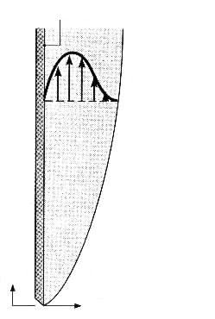
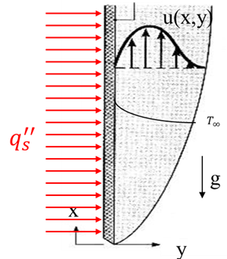
Natural Convection on A Vertical Flat Plate
Isothermal Hot Plate
Constant Heat-flux Hot Plate
$$\frac{d^{3}F}{dη^{3}}+3F\frac{d^{2}F}{dη^{2}}−2{\left(\frac{dF}{dη}\right)}^{2}+θ=0$$
$$\frac{d^{3}F}{dη^{3}}+4F\frac{d^{2}F}{dη^{2}}−3{\left(\frac{dF}{dη}\right)}^{2}+θ=0$$
$$T_{s}>T_{∞}$$
$$\frac{1}{Pr}\frac{d^{2}θ}{dη^{2}}+3F\frac{dθ}{dη}=0$$
u(x,y)
$$\frac{1}{Pr}\frac{d^{2}θ}{dη^{2}}+4\frac{dθ}{dη}F−θ\frac{dF}{dη}=0$$
$$T_{s}$$
$$Gr_{x}= \frac{gβ(T_{s}−T_{∞})x^{3}}{ν^{2}}$$
$$T_{∞}$$
$${Gr}_{x}^{∗}=\frac{gβq_{s}^{′′}x^{4}}{kν^{2}}$$
g
x
u
y
v
$${Nu}_{x}=\frac{0.75 \sqrt{Pr}}{\sqrt[4]{4×\left[0.609+1.221\sqrt{Pr}+1.238Pr\right] }}×{\left(\frac{{Gr}_{x}}{4}\right)}^{1/4}$$
$${Nu}_{x}=\frac{2}{\sqrt[5]{360}} \sqrt[5]{\left\{\frac{{Pr}^{2}{×{Gr}_{x}^{∗}}}{\frac{4}{5}+Pr}\right\}}$$

Slide 12
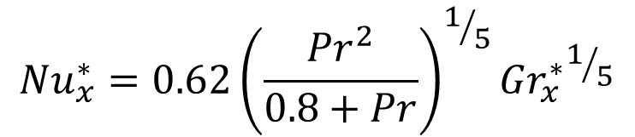
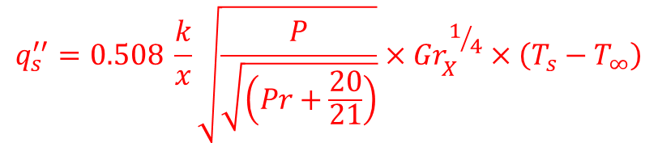
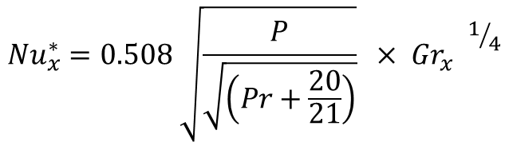
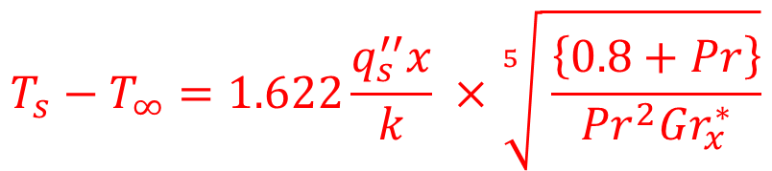
Natural Convection Profiles for a Vertical Wall
Constant Heat Flux VW
Constant Temperature VW
$${Nu}_{x}^{∗}=0.62{\left(\frac{{Pr}^{2}}{0.8+Pr}\right)}^{1/5}{{Gr}_{x}^{∗}}^{1/5}$$
$${Nu}_{x}^{∗}=0.508 \sqrt{\frac{P}{\sqrt{\left(Pr+\frac{20}{21}\right)}}}{ × {Gr}_{x}^{}}^{1/4}$$
Variation of Wall Temperature for CHF :
$$T_{s}−T_{∞}=1.622\frac{q_{s}^{′′}x}{k} ×\sqrt[5]{ \frac{\left\{0.8+Pr\right\}}{{Pr}^{2}{Gr}_{x}^{∗}}}$$
Variation of Wall Heat Flux for CT :
$$q_{s}^{′′}=0.508 \frac{k}{x}\sqrt{\frac{P}{\sqrt{\left(Pr+\frac{20}{21}\right)}}}×{Gr}_{X}^{1/4}×\left(T_{s}−T_{∞}\right)$$

Slide 13
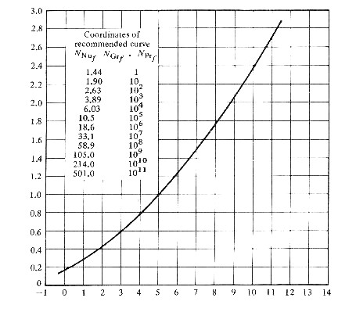

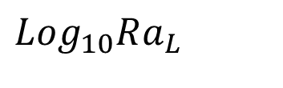
Experimental Results on
Vertical Plate at constant T_{s}
$$Log_{10}Nu_{L}$$
$$Log_{10}Ra_{L}$$

Slide 14

Array of Vertical PCBs.
Natural convection in vertical channels with asymmetric heating is a correct model for an array of PCBs.
Heat flux distribution is not uniform.
Few modifications to conventional correlations are required for thermal management of PCB arrays with Natural Convection cooling

Slide 15
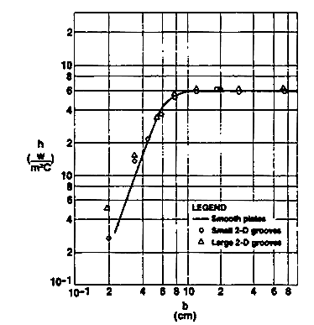
Validity of Smooth Plate Correlations
Analysis of NC on Vertical Smooth plates serves as a convenient idealization for component-carrying PCBs.
These packaging configurations are better represented by plates with both vertical and horizontal grooves machined in the surface.
The natural convection thermal performance of such a grooved, isothermal, parallel-plate channel is shown as

Slide 16

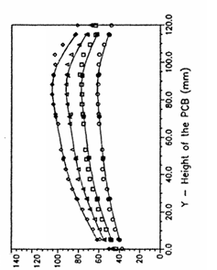
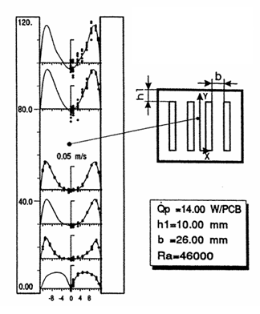
TWO-DIMENSIONAL CHANNEL MODEL for PBC array

Slide 17
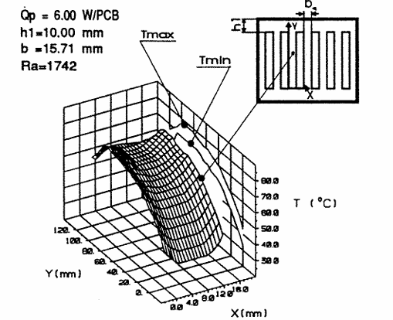
Temperature Profile on A PCB

Slide 18
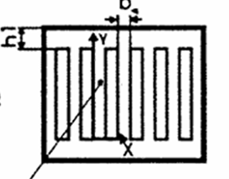
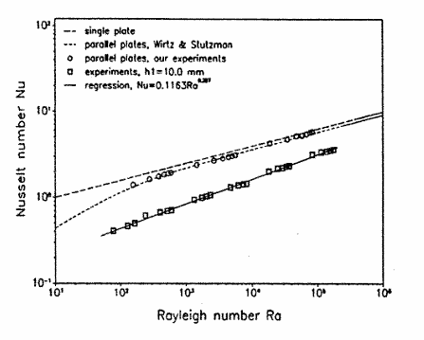
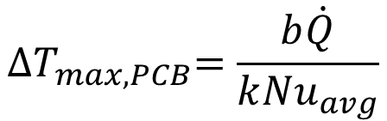

Average Nusselt Number of A PCB
$${Nu}_{avg}=0.1163{Ra}^{0.287}$$
$${∆T}_{max,PCB}=\frac{b\dot{Q}}{k{Nu}_{avg}}$$

Slide 19
Selection of Spacing for PCB Array
Air circulation plays an important role in the cooling of PCBs array in a closed casing.
The air goes up form the PCBs array when it is warmed up by the dissipation of heat of chips on the PCBS.
The frictional force acting at the walls of PCBs will control the quantity of air flow.
Optimum spacing is important to maximize the cooling effect for a given amount of heat dissipation rate per PCB.
An optimization of Spacing is to be carried out for best thermal management of PCB arrays.

Slide 20
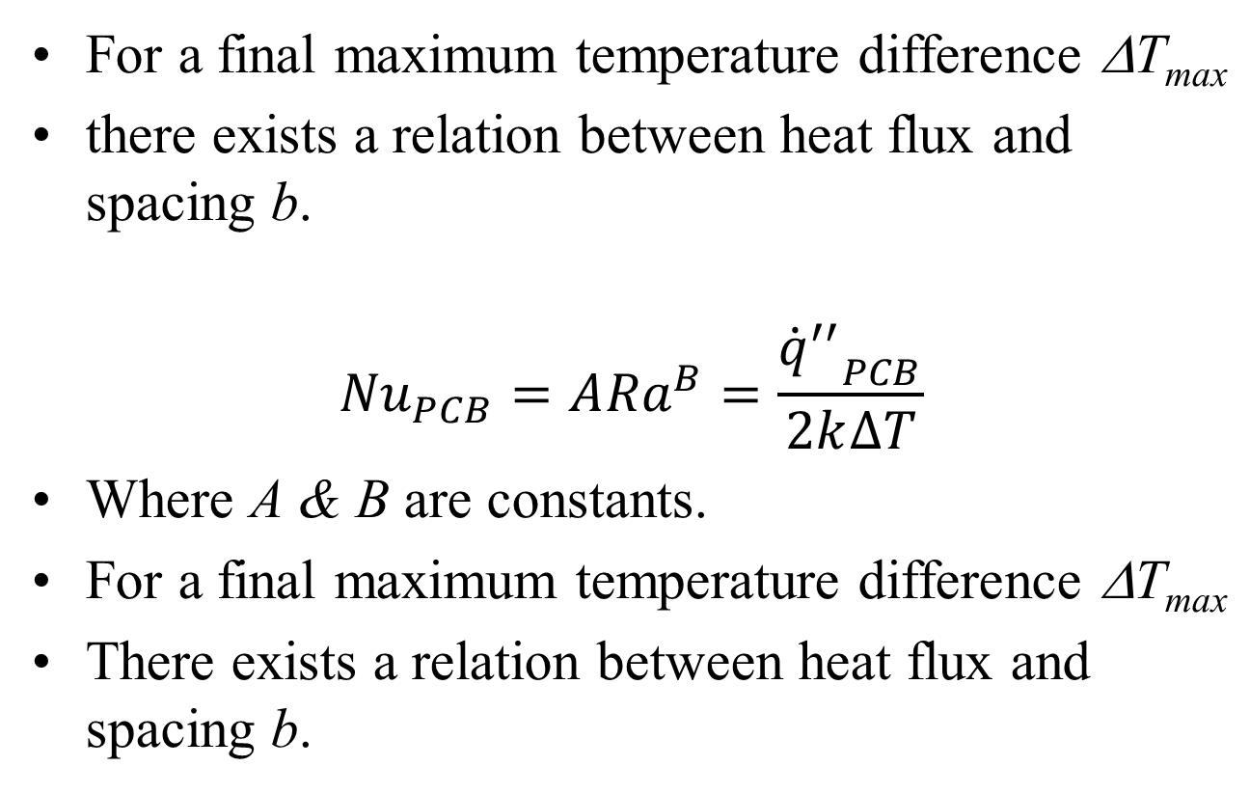
Heat Flux vs Spacing for Reliable thermal management of A PCB Array
For a final maximum temperature difference ΔT_{max}
there exists a relation between heat flux and spacing b.
$${Nu}_{PCB}=A{Ra}^{B}=\frac{{{\dot{q}}^{′′}}_{PCB}}{2k∆T}$$
Where A & B are constants.
For a final maximum temperature difference ΔT_{max}
There exists a relation between heat flux and spacing b.

Slide 21
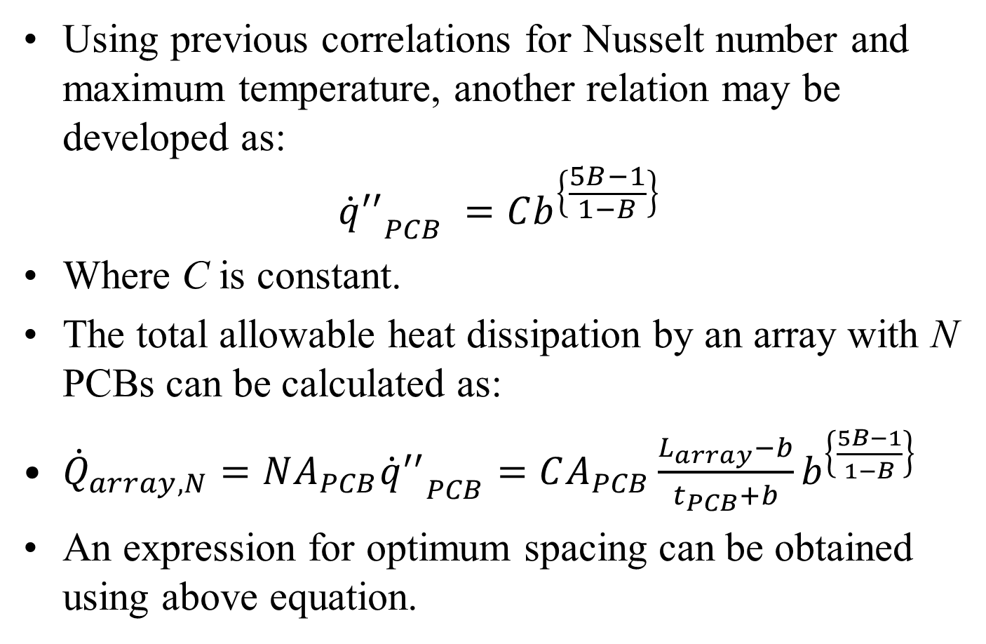
Optimal Spacing for A PCB Array
Using previous correlations for Nusselt number and maximum temperature, another relation may be developed as:
$${{\dot{q}}^{′′}}_{PCB} =Cb^{\left\{\frac{5B−1}{1−B}\right\}}$$
Where C is constant.
The total allowable heat dissipation by an array with N PCBs can be calculated as:
${\dot{Q}}_{array,N}=NA_{PCB}{{\dot{q}}^{′′}}_{PCB}=CA_{PCB}\frac{L_{array}−b}{t_{PCB}+b}b^{\left\{\frac{5B−1}{1−B}\right\}}$
An expression for optimum spacing can be obtained using above equation.

Slide 22
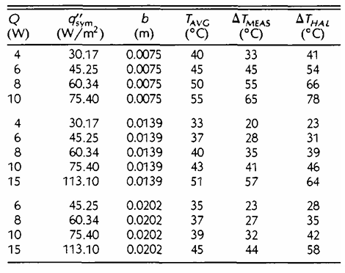
Theoretical Bounds on PCB Maximum Temperatures

Slide 23
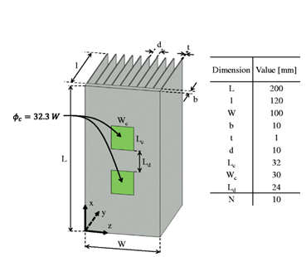
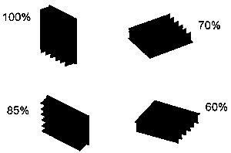
Art of Thermal Management of Electronics

Slide 24
The Shift to Active CPU Cooling
Intel 80486: As processors grew faster, passive heat sinks were no longer enough, prompting the introduction of active cooling fans directly on the CPU with the arrival of the Intel 80486.
Standardization: By 1997, dedicated fan-and-heatsink units became standard equipment on all desktop computer processors.
Chassis and Case Fans
Pentium 4 Era: The launch of the high-wattage Pentium 4 in late 2000 made single-component cooling insufficient for the entire system.
Airflow Design: Manufacturers introduced dedicated case fans—typically a rear exhaust fan paired with an optional front intake fan—to establish steady internal airflow across the entire motherboard

Slide 25
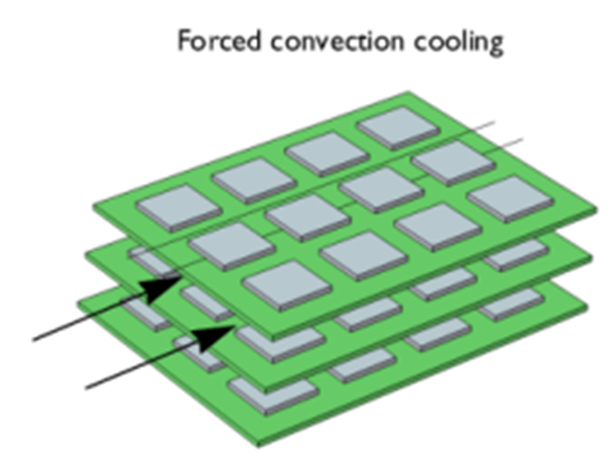
Strategic Realization of Newton’s Cooling of PCBs

