Slide 1

Basic Thermodynamics of An Electronic System
P M V Subbarao
Professor
Mechanical Engineering Department
Clues for Thermal Management of Electronic Systems !!!

Slide 2

ICT Device
ICT : Information, Communications Technologgy
ICT is an umbrella term that includes any communication device, encompassing radio, television, cell phones, computer and network hardware, satellite systems and so on ….
Also includes various epistemological services and appliances with them such as video conferencing and distance learning.

Slide 3

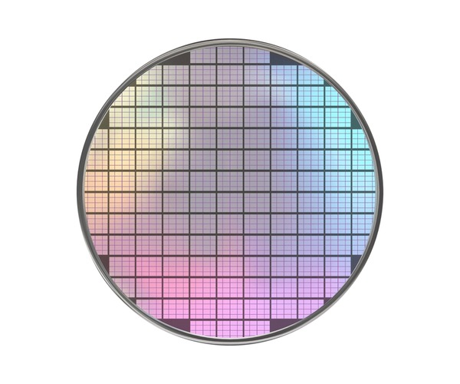

Photos of the Silicon Wafor for making a Processor Die

Slide 4

First Law Analysis of A Piece of Raw Silicong Wafor

Slide 5
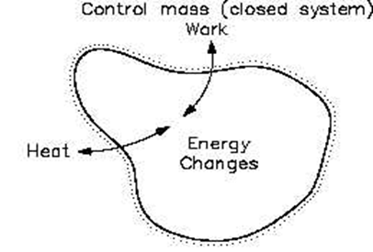
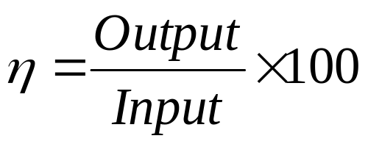
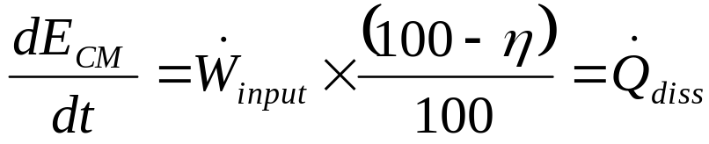
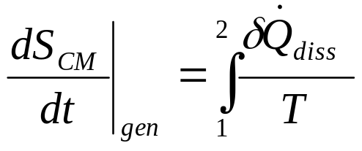
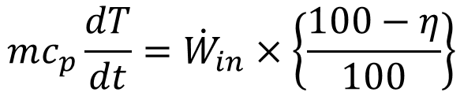
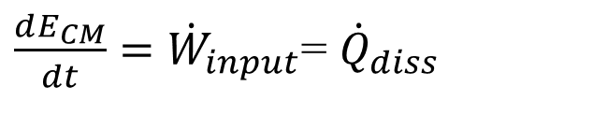
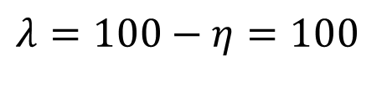
An Adiabatic Silicon Wafor
Efficiency of An E-Device:
Loss percentage of An E- Device:
$$λ=100−η=100$$
$\frac{dE_{CM}}{dt}={\dot{W}}_{input}$= ${\dot{Q}}_{diss}$
This Loss is dissipated as heat:

Slide 6
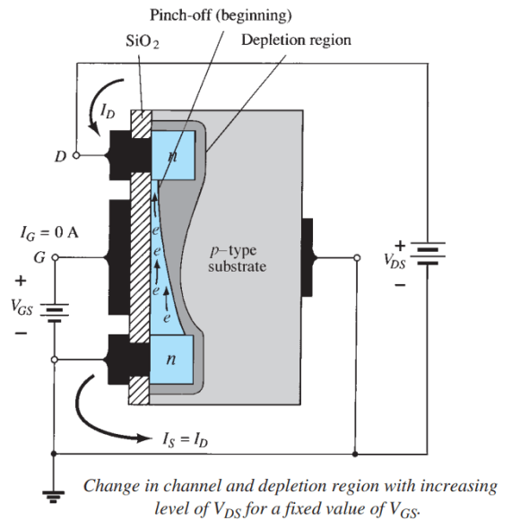
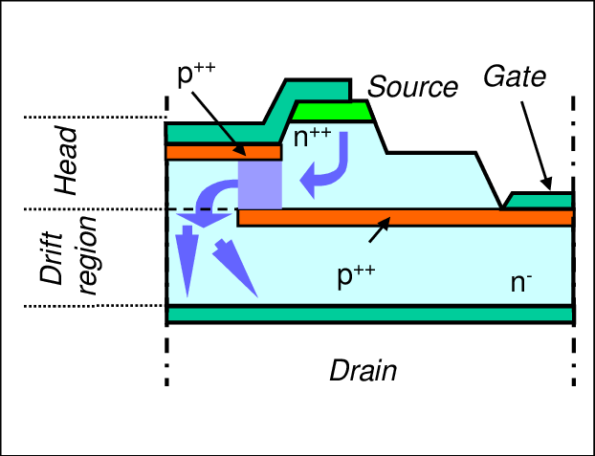
Silicon Wafor as a JFET

Slide 7
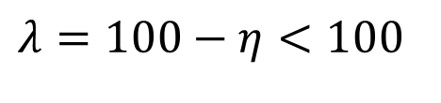
An Adiabatic Silicon Wafor
Efficiency of An E-Device:
Loss percentage of An E- Device:
$$λ=100−η<100$$
$\frac{dE_{CM}}{dt}={\dot{W}}_{input}$= ${\dot{Q}}_{diss}$
This Loss is dissipated as heat:

Slide 8
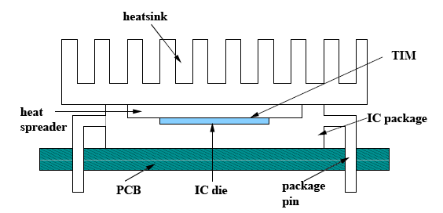
Structure of A Simple ICT Processor

Slide 9
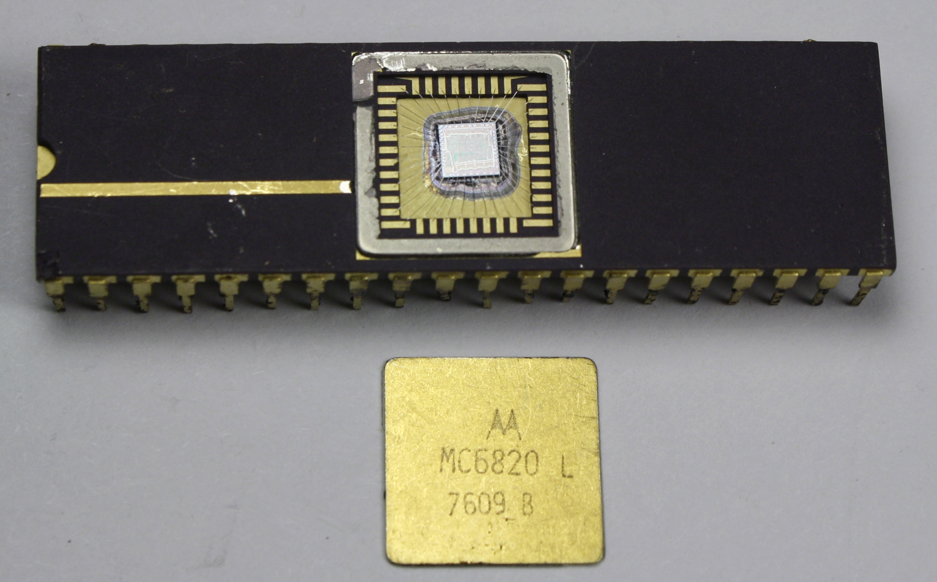
Structure of A Processor Die

Slide 10
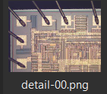
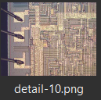
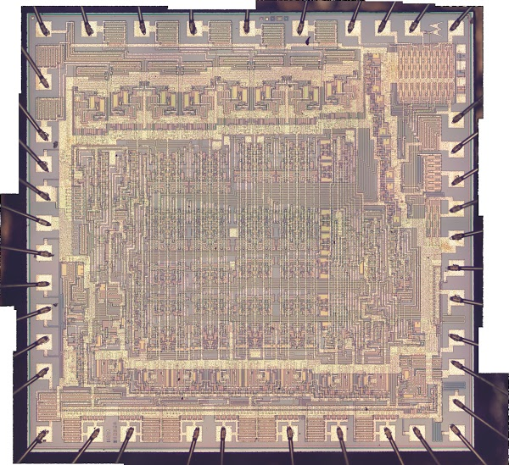
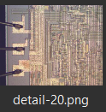
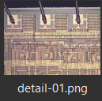
Photos of the Die through a Microscope

Slide 11
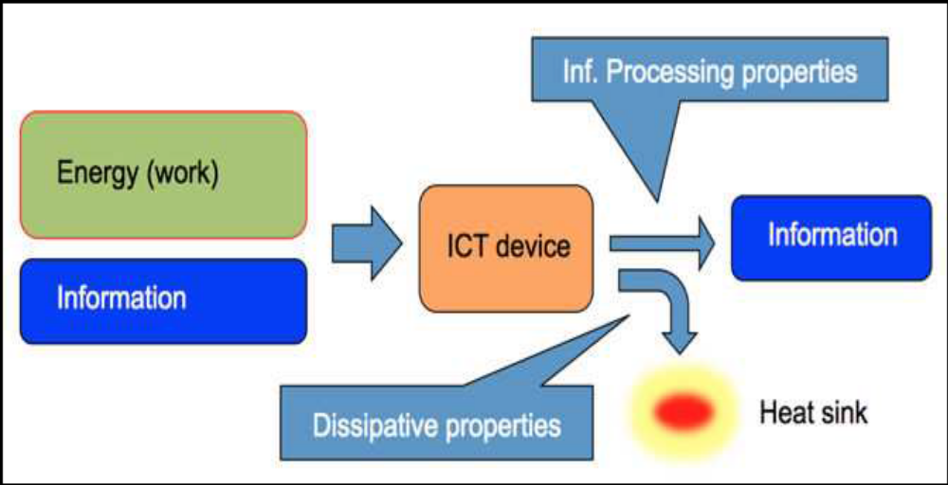
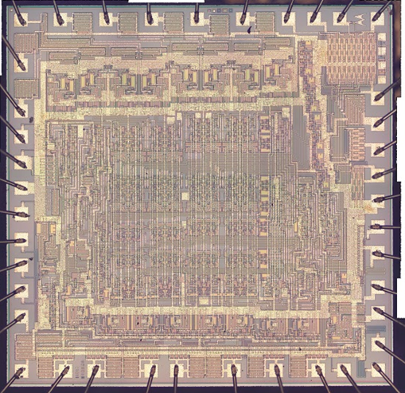
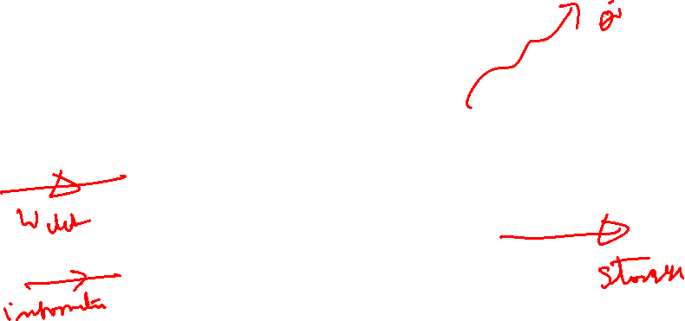
First Law Analysis of ICT die

Slide 12
ICT vs Brain Technology
The most recent and most impressive demonstration of an artificial intelligence computer system, the IBM Watson supercomputer.
It is capable of answering questions posed in natural language and the winner of the 2011 Jeopardy! quiz show,.
It is built from ~3000 processor cores (POWER7) each consisting of 1.2B transistors and operating at 3.5GHz.
The approximate total binary throughput about 10²² bit/s.
The machine consumes ~200kW of power.
The fact that the brain, a- biological information processor, operates at only ~30W suggests that 199.7 kW of power is dissipated as heat and responsible for generation of entropy.

Slide 13
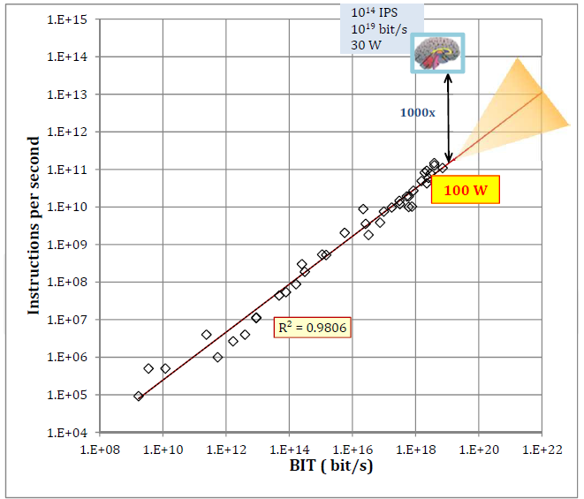
Trend in Energy Efficiency of ICTs
Energy dissipation in present computers

Slide 14
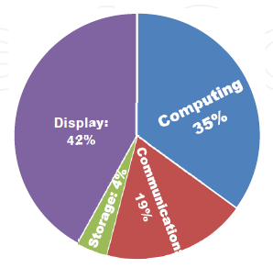
Energy consumption by four primary information processing functions
In modern electronic ICT systems

Slide 15
Energetic Issues of ICTs
The energetics issues of current and future computation raises a question of the ultimate energy efficiency of ICTs
Energy Efficiency is a reminiscent of the Carnot limit for the efficiency for heat engines.
The entire discipline of thermodynamics emerged from the practical need to increase the efficiency of utility heat engines.
Innovations in steam engines and internal combustion engines have been driven by the need to more closely approach the ideal limit of a Carnot engine.
An information processor must be viewed as a computing engine that transforms incoming energy flow into useful work and also produces some heat.

Slide 16
Energetic Issues of ICTs
Interesting insights on the energy efficiency of binary elements were obtained in pioneering studies by John von Neumann and subsequently by Charles H. Bennet and Ralph Landauer in the 20th century.
It is known that information processing is intimately related to energy management (“information is physical”).
Bennet and Landauer have shown that there exists a minimum amount of energy required to perform any irreversible computation.
The ultimate limit on the minimum energy per switching is set at k_{B}T ln2.
It is approximately 10⁻²¹J at room temperature, called as the Shannon-von Neumann-Landauer (SNL) limit .

Slide 17
Energetic Issues of ICTs
Landauer argued that this minimum amount cannot be reduced to zero if some information is discarded (erased) during the computation process.
The reason is directly linked to thermodynamics:
erasing information decreases the overall entropy of the system and this cannot be done without dissipating heat of at least k_{B}T ln2 Joule per bit erased.
Therefore, ideal computation is also thermodynamically irreversible!

Slide 18
Energetic Issues of ICTs
Interesting insights on the energy efficiency of binary elements were obtained in pioneering studies by John von Neumann and subsequently by Charles H. Bennet and Ralph Landauer in the 20th century.
It is known that information processing is intimately related to energy management (“information is physical”).
Bennet and Landauer have shown that there exists a minimum amount of energy required to perform any irreversible computation.
The ultimate limit on the minimum energy per switching is set at k_{B}T ln2.
It is approximately 10⁻²¹J at room temperature, called as the Shannon-von Neumann-Landauer (SNL) limit .

Slide 19
Energetic Issues of ICTs
Landauer argued that this minimum amount cannot be reduced to zero if some information is discarded (erased) during the computation process.
The reason is directly linked to thermodynamics:
erasing information decreases the overall entropy of the system and this cannot be done without dissipating heat of at least k_{B}T ln2 Joule per bit erased.
Therefore, ideal computation is also thermodynamically irreversible!

Slide 20
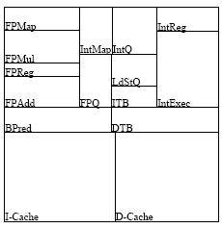
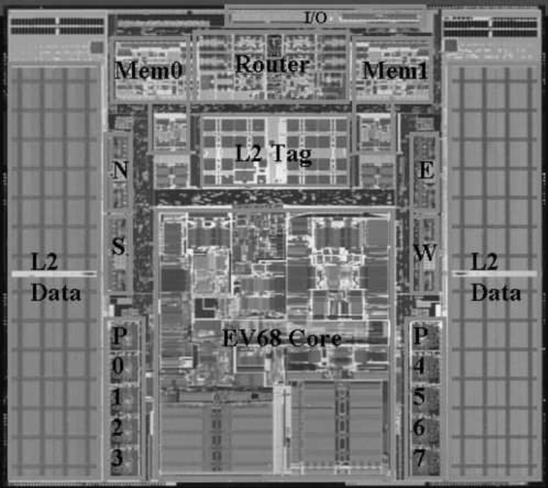
Architecture-Level Thermal Model
21364 die photo
Architecture of CPU Die

Slide 21
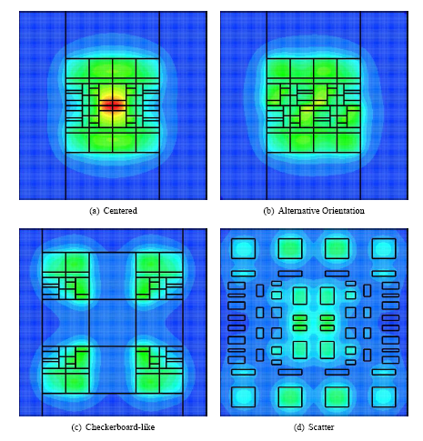
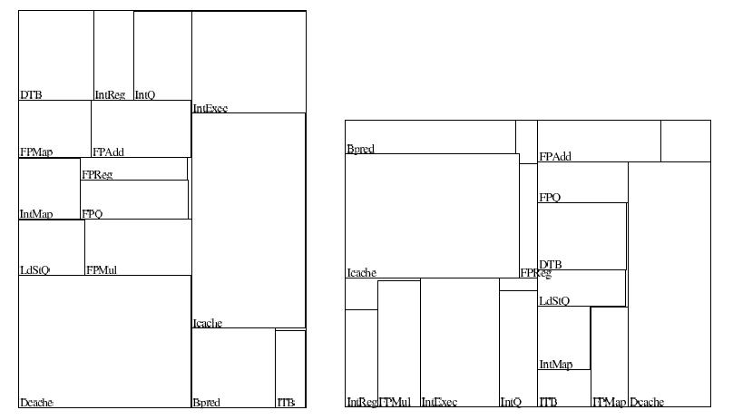
Alternate floorplans for Architecture Level Thermal Analysis

Slide 22
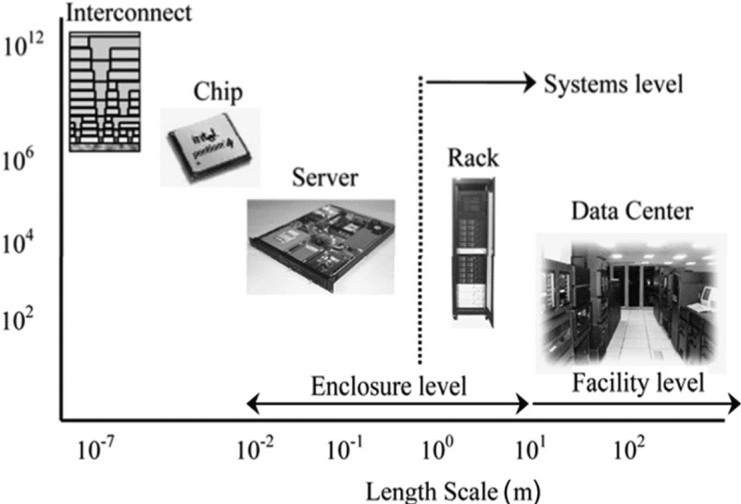
Holistic View of Thermal Management of Data Centers
A successful thermal management strategy must take way heat generation at all levels!
Heat Generation Scale

