Slide 1



Thermal Management thru Natural Convection Cooling
P M V Subbarao
Professor
Mechanical Engineering Department
Cooling/Heating with Zero Operating Cost….

Slide 2
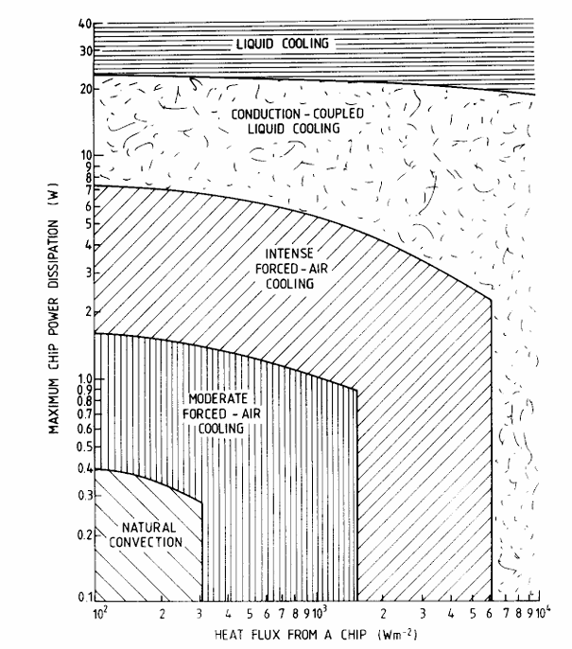
Classification of the Zones of Appropriate Cooling Techniques

Slide 3
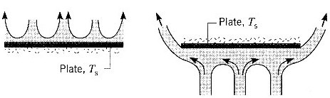
Natural Convection from Horizontal Plate
Hot Plate (Ts > T∞)

Slide 4
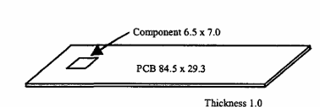



Simple Electronic System with Natural Convection Cooling
Temperature Field is the Cornerstone of Convection Heat Transfer…
$${mm}^{2}$$
$${mm}^{2}$$
$$mm$$

Slide 5
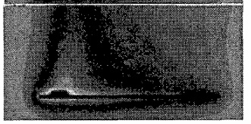
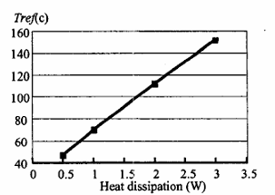
Steady State Temperature Distribution & Natural Convection Plume

Slide 6
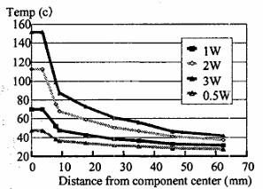
Steady State Temperature Distribution & Natural Convection Plume

Slide 7

Body Forces in A General Convection
In 1879, Anton Oberbeck had earlier applied the same concept in his description of heat conduction in liquids accounting for currents driven by thermal gradients.
The model for body force due to NC is now commonly referred to as the Oberbeck—Boussinesq (OB) approximation in recognition of their respective contributions.
The OB approximation is established based on the following assumptions:

Slide 8
Nusslets Idea to Solve Convection Systems
The central ideal of Nusselt is the development of dimensional analysis for these four cases of conductive heat transfer.
Buckingham and Lord Rayleigh worked on that same idea at the same time based on their dimensional analysis on a given set of variables chosen from experience.
Nusselt created an open-minded method of using the partial differential equations of fluid flow and heat transfer to derive the set of dimensionless numbers.
Nusselt simply denoted by the capital letters A, B, C, D, E, F, the same symbols were used in his final equation.

Slide 9
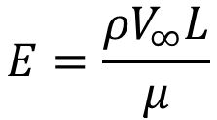

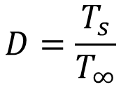
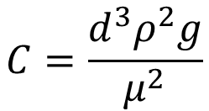
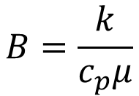
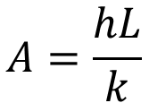
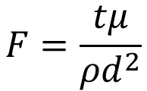
Nusslets Idea to Solve Convection Systems
Nusselt's A, B, C, D, E, F:
$$A=\frac{hL}{k}$$
$$B=\frac{k}{c_{p}μ}$$
$$C=\frac{d^{3}ρ^{2}g}{μ^{2}}$$
$$D=\frac{T_{s}}{T_{∞}}$$
$$E=\frac{{ρV}_{∞}L}{μ}$$
$$F=\frac{tμ}{ρd^{2}}$$
Nusselt’s Final Equation:
$$\text{A= }Φ \text{(B, C, D, E, F)}$$

Slide 10
The OB scheme
The OB approximation can be formulated as an asymptotic theory based on five physical assumptions:
1. The fluid density depends only on the local temperature or, equivalently, pressure changes yield negligible density changes;
2. The local difference between the temperature,𝑇, and its reference constant value,𝑇₀, is very small;
3. The acceleration experienced by the fluid elements in the flow domain is very small;
4. The viscous stress is very small;
5. The local difference between the pressure gradient and the hydro-static pressure gradient is very small.

Slide 11
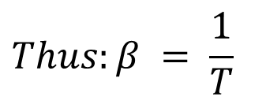
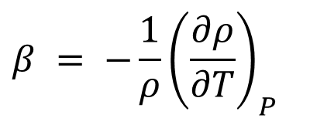
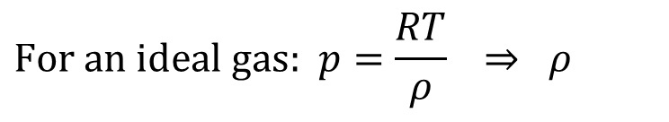

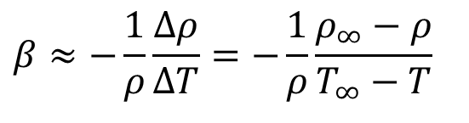
Thermodynamics of Buoyancy Force
Define β, the volumetric thermal expansion coefficient.
$$β = −\frac{1}{ρ}{\left(\frac{∂ρ}{∂T}\right)}_{P}$$
$$\text{For an ideal gas: }p=\frac{RT}{ρ} ⇒ ρ$$
$$Thus:β = \frac{1}{T}$$
Not valid for liquids and non-ideal gases
$$β≈−\frac{1}{ρ}\frac{Δρ}{ΔT}=−\frac{1}{ρ}\frac{ρ_{∞}−ρ}{T_{∞}−T}$$
Valid for any general fluid
$$ρ_{∞}−ρ≈ρβ(T−T_{∞})$$
Density gradient is due to the temperature gradient
${\vec{f}}_{b}=f_{b,x}\hat{i}$+ $f_{b,x}\hat{j}$+ $f_{b,z}\hat{k}=0 \hat{i}\text{+ }0 \hat{j}\text{+ }\left\{ρ_{0}gβ\left(T−T_{0}\right)\right\}\hat{k}$

Slide 12
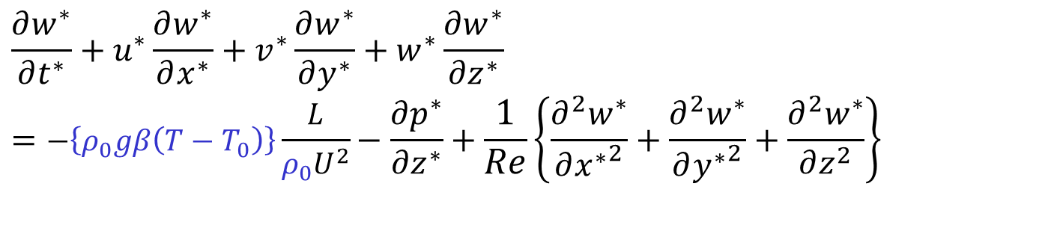
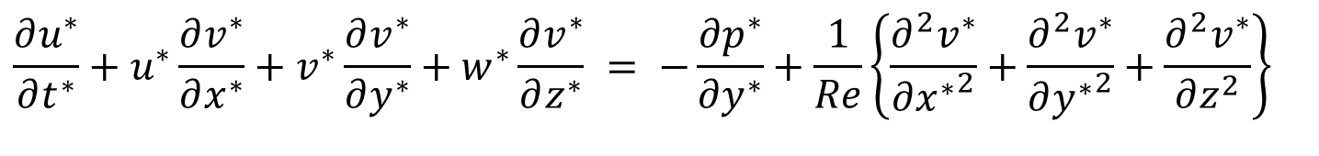
Non-dimensional form of NS Equation
Non-dimensional x-momentum equation for an incompressible flow:
$$\frac{∂u^{∗}}{∂t^{∗}}+u^{∗}\frac{∂u^{∗}}{∂x^{∗}}+v^{∗}\frac{∂u^{∗}}{∂y^{∗}}+w^{∗}\frac{∂u^{∗}}{∂z^{∗}} = −\frac{∂p^{∗}}{∂x^{∗}}+\frac{1}{Re}\left\{\frac{∂^{2}u^{∗}}{∂{x^{∗}}^{2}}+\frac{∂^{2}u^{∗}}{∂{y^{∗}}^{2}}+\frac{∂^{2}u^{∗}}{∂z^{2}}\right\}$$
Non-dimensional y-momentum equation for an incompressible flow:
$$\frac{∂u^{∗}}{∂t^{∗}}+u^{∗}\frac{∂v^{∗}}{∂x^{∗}}+v^{∗}\frac{∂v^{∗}}{∂y^{∗}}+w^{∗}\frac{∂v^{∗}}{∂z^{∗}} = −\frac{∂p^{∗}}{∂y^{∗}}+\frac{1}{Re}\left\{\frac{∂^{2}v^{∗}}{∂{x^{∗}}^{2}}+\frac{∂^{2}v^{∗}}{∂{y^{∗}}^{2}}+\frac{∂^{2}v^{∗}}{∂z^{2}}\right\}$$
Non-dimensional z-momentum equation for an incompressible flow:
$$\frac{∂w^{∗}}{∂t^{∗}}+u^{∗}\frac{∂w^{∗}}{∂x^{∗}}+v^{∗}\frac{∂w^{∗}}{∂y^{∗}}+w^{∗}\frac{∂w^{∗}}{∂z^{∗}}=−\left\{ρ_{0}gβ\left(T−T_{0}\right)\right\}\frac{L}{ρ_{0}U^{2}}−\frac{∂p^{∗}}{∂z^{∗}}+\frac{1}{Re}\left\{\frac{∂^{2}w^{∗}}{∂{x^{∗}}^{2}}+\frac{∂^{2}w^{∗}}{∂{y^{∗}}^{2}}+\frac{∂^{2}w^{∗}}{∂z^{2}}\right\}$$

Slide 13
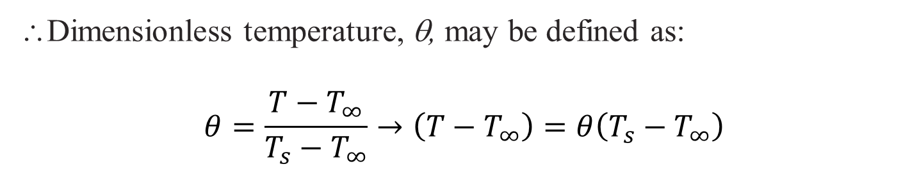



Non-dimensional form of NS Equation for Convection System
Non-dimensional z-momentum equation for an incompressible flow:
$$\frac{∂w^{∗}}{∂t^{∗}}+u^{∗}\frac{∂w^{∗}}{∂x^{∗}}+v^{∗}\frac{∂w^{∗}}{∂y^{∗}}+w^{∗}\frac{∂w^{∗}}{∂z^{∗}}=−\left\{ρ_{0}gβ\left(T−T_{0}\right)\right\}\frac{L}{ρ_{0}U^{2}}−\frac{∂p^{∗}}{∂z^{∗}}+\frac{1}{Re}\left\{\frac{∂^{2}w^{∗}}{∂{x^{∗}}^{2}}+\frac{∂^{2}w^{∗}}{∂{y^{∗}}^{2}}+\frac{∂^{2}w^{∗}}{∂z^{2}}\right\}$$
Maximum possible temperature difference in any convection system is
$${{∆T}_{max}=T}_{s}−T_{∞}$$
∴Dimensionless temperature, θ, may be defined as:
$$θ=\frac{T−T_{∞}}{T_{s}−T_{∞}}→\left(T−T_{∞}\right)=θ\left(T_{s}−T_{∞}\right)$$
$$\frac{\left\{ρ_{0}gβ\left(T_{s}−T_{∞}\right) \right\}L}{ρ_{0}U^{2}}θ$$

Slide 14
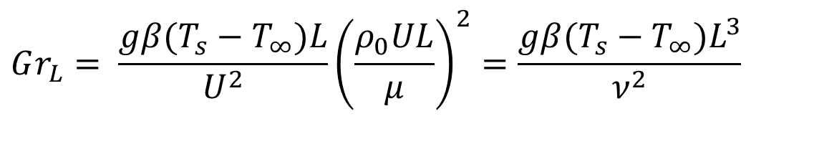
Dimensionless Similarity Parameter
Define new dimensionless parameter,
$$Gr_{L}= \frac{gβ(T_{s}−T_{∞})L}{U^{2}}{\left(\frac{ρ_{0}UL}{μ}\right)}^{2}=\frac{gβ(T_{s}−T_{∞})L^{3}}{ν^{2}}$$
The Grashof number (Gr_{L}) is named after Franz Grashof, a German engineer and professor of machine science.
Grashof made significant contributions to understanding free convection.
However, the Grashof number was named after him after his death in 1893.

Slide 15
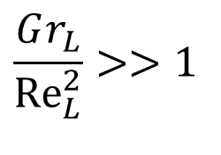
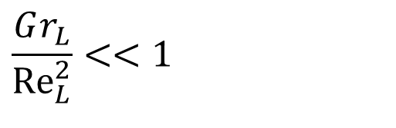
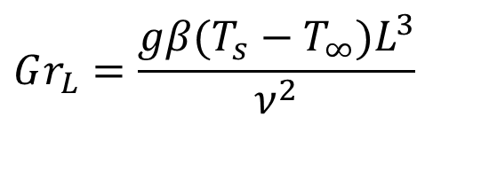
Dimensionless Similarity Parameter
$$Gr_{L}=\frac{gβ(T_{s}−T_{∞})L^{3}}{ν^{2}}$$
Grashof number in natural convection is analogous to the Reynolds number in forced convection.
Grashof number indicates the ratio of the buoyancy force to the viscous force.
Higher Gr number means increased natural convection flow
$$\frac{Gr_{L}}{{Re}_{L}^{2}}<<1$$
Forced Convection
$$\frac{Gr_{L}}{{Re}_{L}^{2}}>>1$$
Natural Convection

Slide 16
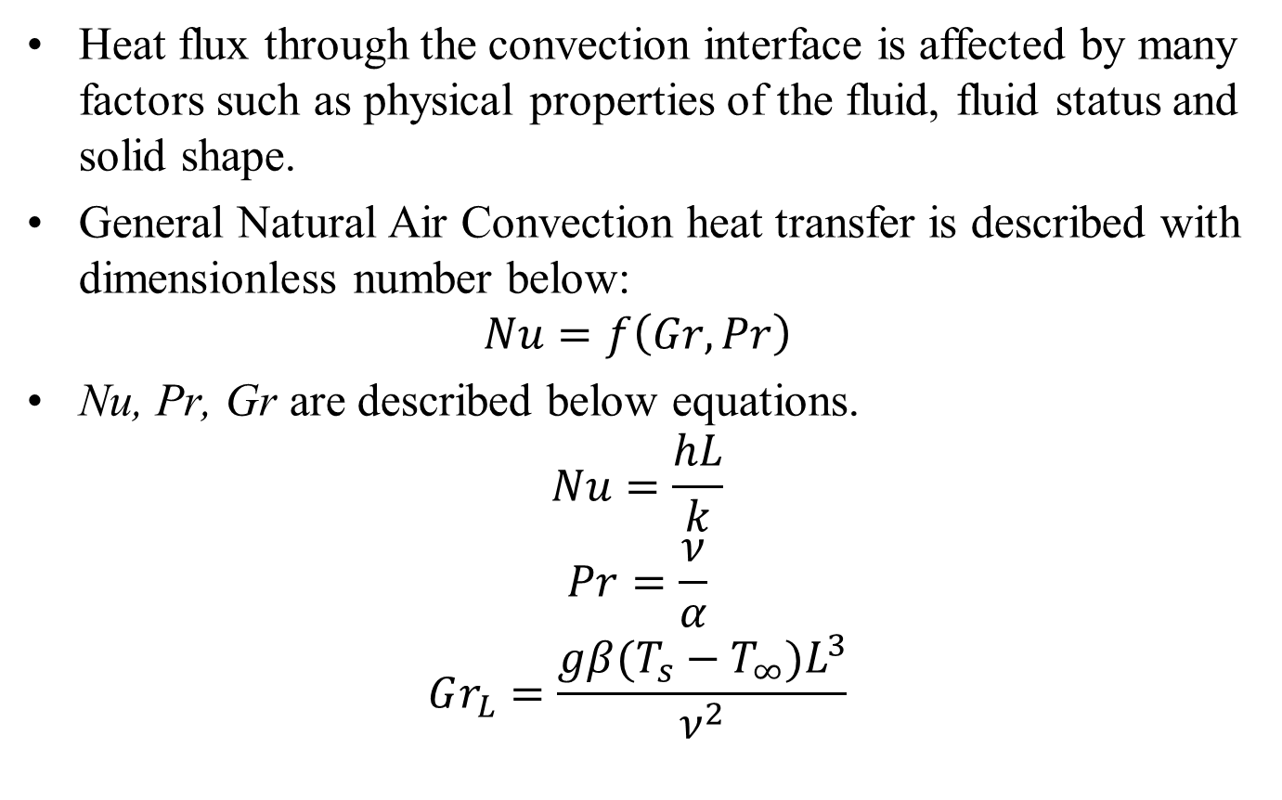
Dimensional Analysis
Heat flux through the convection interface is affected by many factors such as physical properties of the fluid, fluid status and solid shape.
General Natural Air Convection heat transfer is described with dimensionless number below:
$$Nu=f\left(Gr, Pr\right)$$
Nu, Pr, Gr are described below equations.
$$Nu=\frac{hL}{k}$$
$$Pr=\frac{ν}{α}$$
$$Gr_{L}=\frac{gβ(T_{s}−T_{∞})L^{3}}{ν^{2}}$$

Slide 17
Derivation of non-dimensional number in PCB cooling
To apply dimensional analysis to PCB cooling system, some unique ideas are required to derivate non-dimensional numbers.
The following four ideas enable to derive dimensionless numbers that represent the PCB properties and cooling system.
1)The temperature difference in Gr is the difference of ambient temperature and component temperature. circle
2)The reference length L in Nu and Gr is a radius length of the area where the non-dimensionalized temperature is above 0.5.

Slide 18
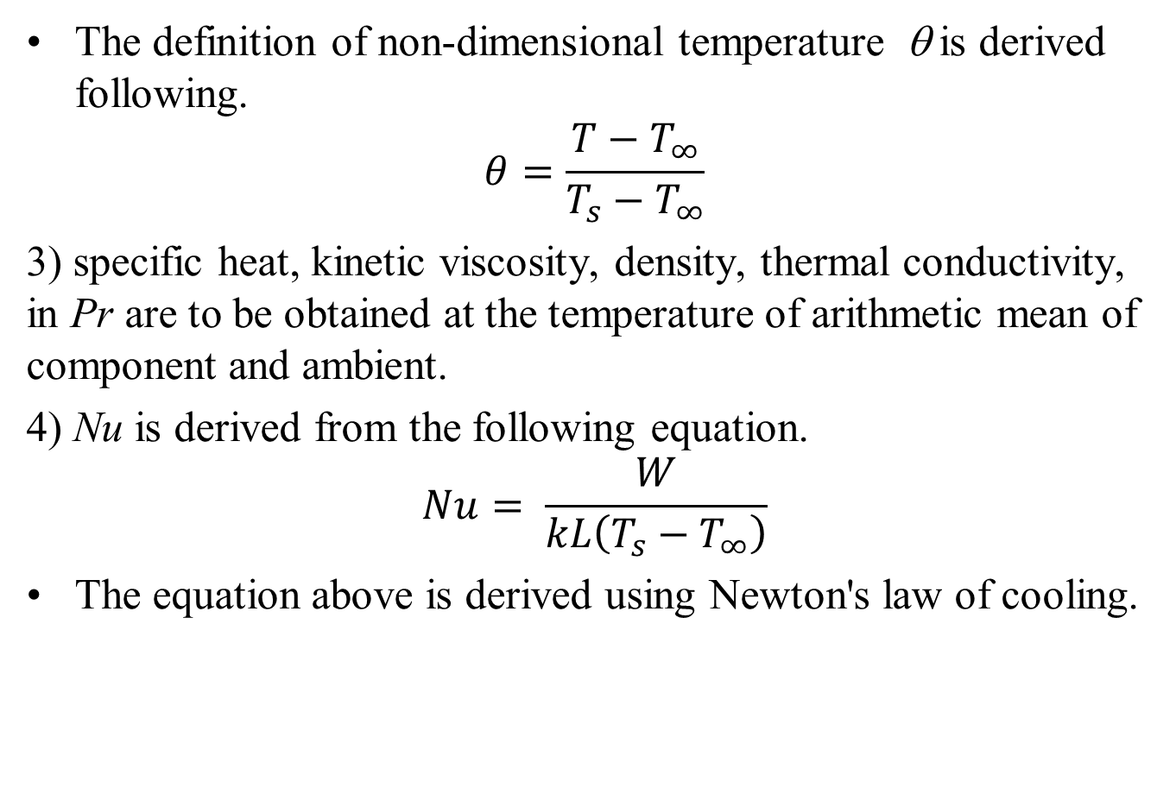
Derivation of non-dimensional number in PCB cooling
The definition of non-dimensional temperature θ is derived following.
$$θ=\frac{T−T_{∞}}{T_{s}−T_{∞}}$$
3) specific heat, kinetic viscosity, density, thermal conductivity, in Pr are to be obtained at the temperature of arithmetic mean of component and ambient.
4) Nu is derived from the following equation.
$$Nu= \frac{W}{kL\left(T_{s}−T_{∞}\right)}$$
The equation above is derived using Newton's law of cooling.

Slide 19
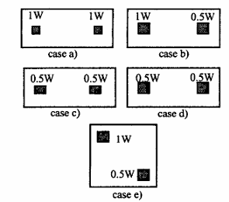
More Experiments

Slide 20
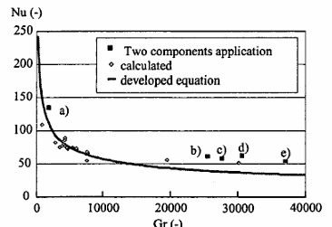

Universal Characteristics of Natural Convection
$$Nu=80000×{\left(Gr×Pr\right)}^{2/5}$$

Slide 21

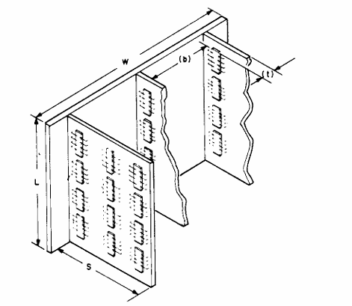

Natural Convection
$$Gr_{L}=\frac{gβ(T_{s}−T_{∞})L^{3}}{ν^{2}}$$

