Slide 1



Thermal Management thru Natural Convection Cooling
P M V Subbarao
Professor
Mechanical Engineering Department
Sizing and Analysis of Final Heat Carrier!?!?

Slide 2

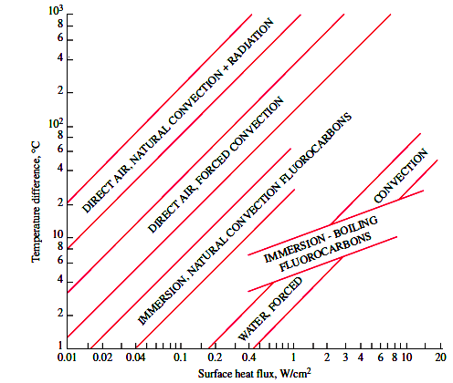
Options for Removal of Heat from Electronic System

Slide 3

Natural Philosophy by Newton
Newtons Laws of Motion ~1686
Newtons Law of Viscosity ~ 1687
Newtons Law of Cooling ~ 1692-1693

Slide 4
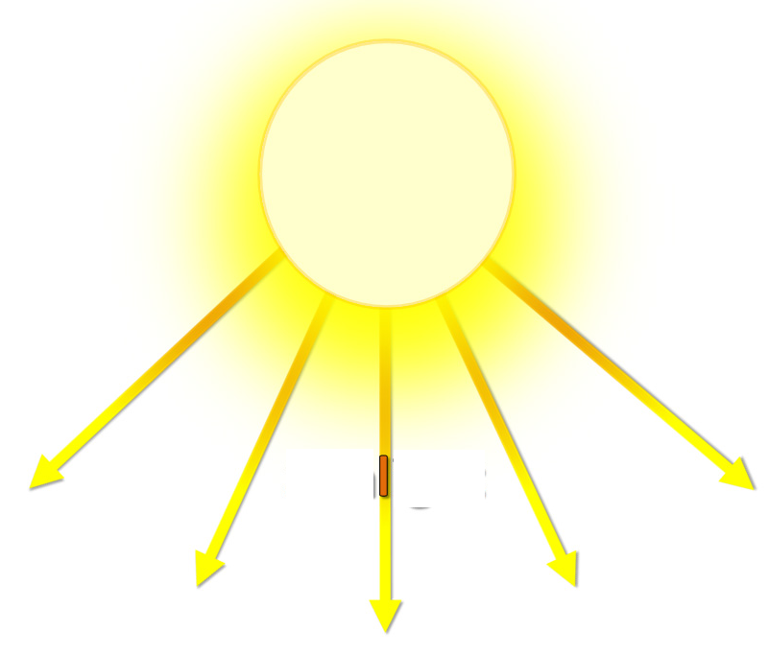
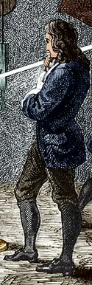

Another Newton’s Experience
Natural Philosophy!

Slide 5
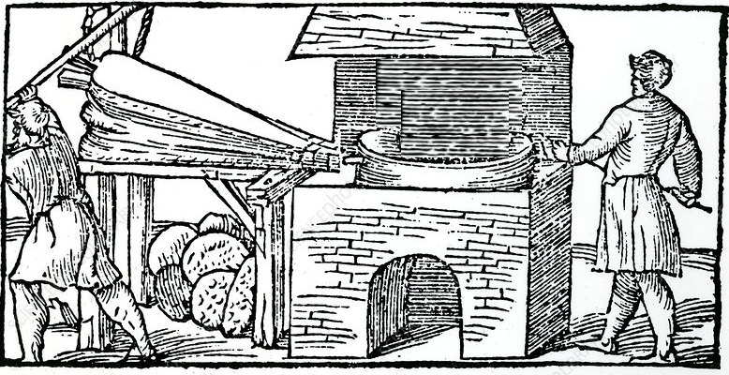
Further Experimentation of Experience
Air Velocity vs Cooling Time
State 1
State 2

Slide 6
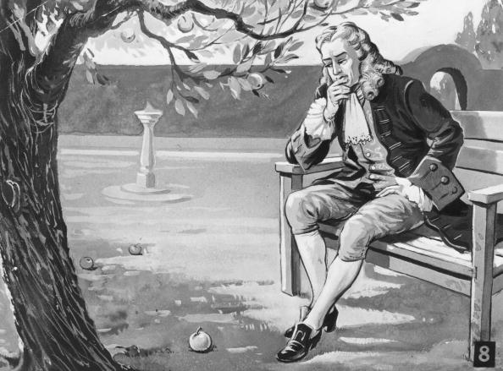
A Natural Engineering for the Existence, Growth and Performance of Energetic Systems.
Latent Engineering in Nature
A True Design Reason behind Existence of Natural Systems…..
A Strong Design Modification for the Performance of Artificial Systems….

Slide 7

Why I Am Different ?
?

Slide 8
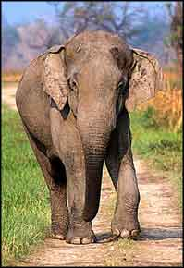
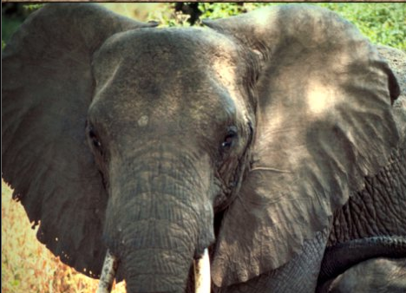
Geometrical Variations of Elephants
African Elephant
Indian Elephant

Slide 9
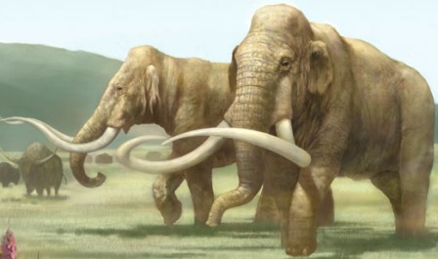
Mammoths, living in a cold tundra region, have fur coats and small hairy ears.

Slide 10
An Exotic & Artificial Device……
The basic invention is due to other sciences…
The final and reliable existence is governed by design for Heat Iteractions…

Slide 11

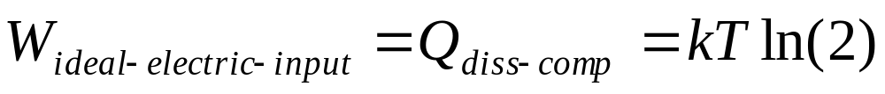
The Pentium 4 Processor
At a room temperature of 298K, W_{ideal-elec-input} = 0.018eV.
Best real‐world logic circuit designs can’t just magically cross this ~500× minimum power.

Slide 12
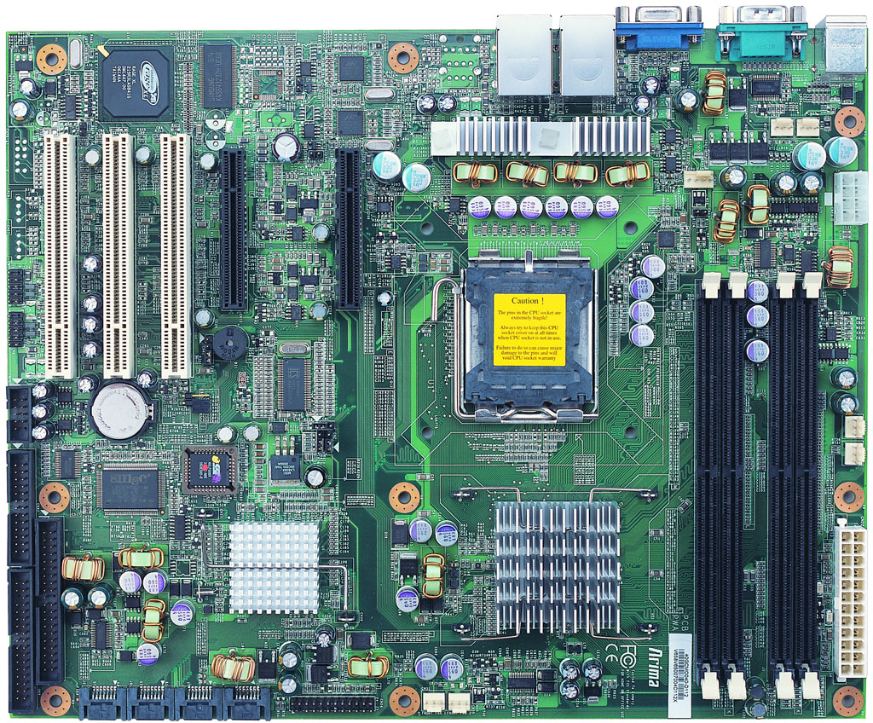
Basic Location on A Mother Board

Slide 13
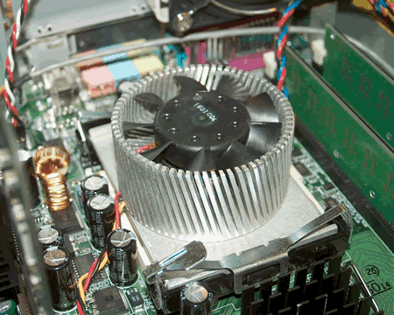
Reliable and Guaranteed Location in A Desktop

Slide 14
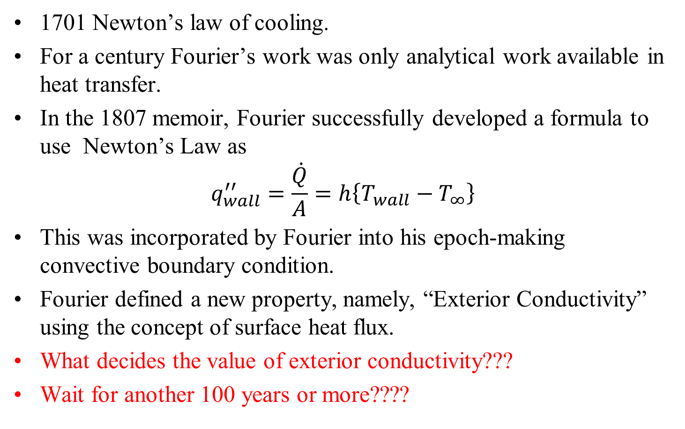
From Newton (1701) to Fourier (1807)
1701 Newton’s law of cooling.
For a century Fourier’s work was only analytical work available in heat transfer.
In the 1807 memoir, Fourier successfully developed a formula to use Newton’s Law as
$$q_{wall}^{′′}=\frac{\dot{Q}}{A}=h\left\{T_{wall}−T_{∞}\right\}$$
This was incorporated by Fourier into his epoch-making convective boundary condition.
Fourier defined a new property, namely, “Exterior Conductivity” using the concept of surface heat flux.
What decides the value of exterior conductivity???
Wait for another 100 years or more????

Slide 15
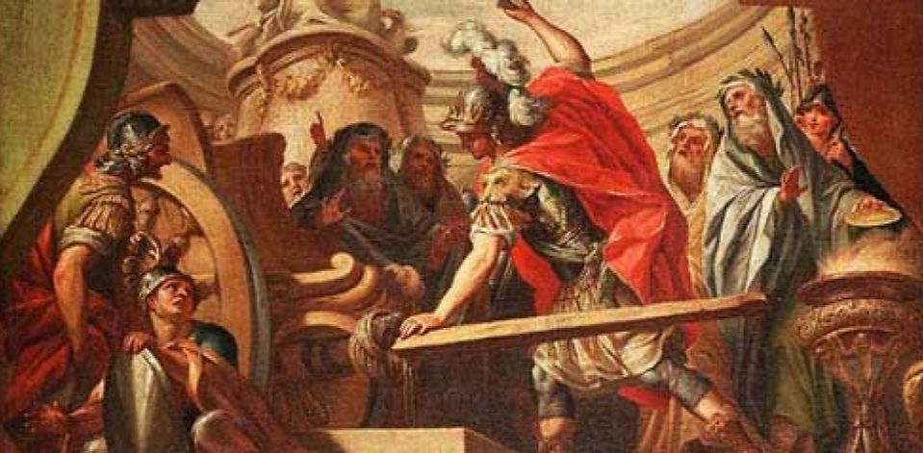
Who will open This Gordian Know
20th Century Alexander of Heat Transfer….

Slide 16
How to Create a Convection Heat Transfer Coefficient
Ernst Kraft Wilhelm Nußelt (Nusselt) is the first contributor to analytical convection heat transfer.
In 1915 Nusselt cut the Gordian knot.
In a single stroke, Nusselt used Dimensional Analysis to prove that there exist a functional form essential for all analytical/experimental works in convection heat transfer.

Slide 17
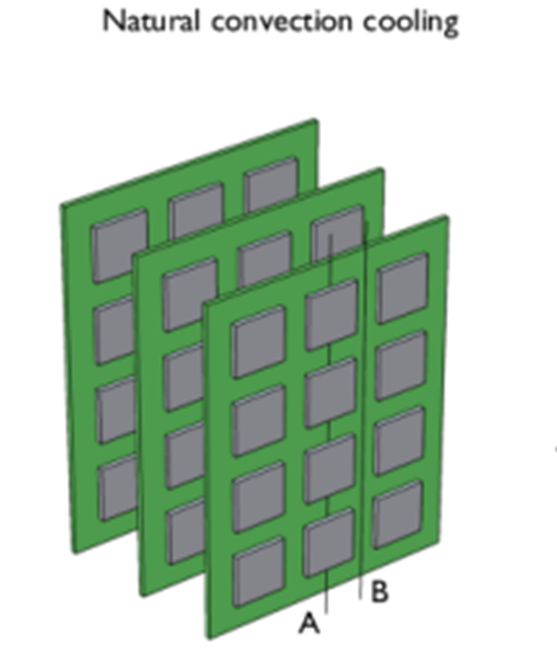
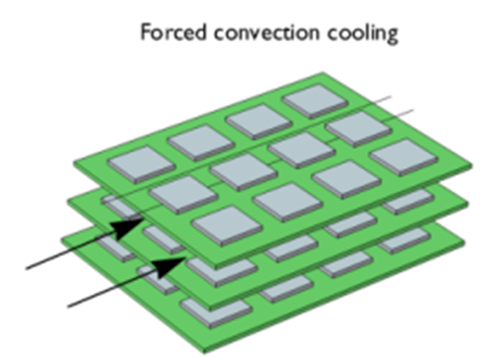
Newton’s Cooling of PCBs
Zero Running cost.
No fans/pumps..
Added Running cost.
Need for fans/pumps..

Slide 18
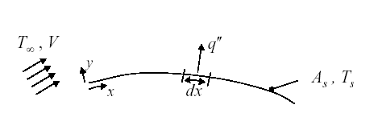
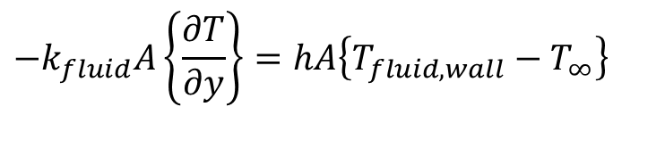

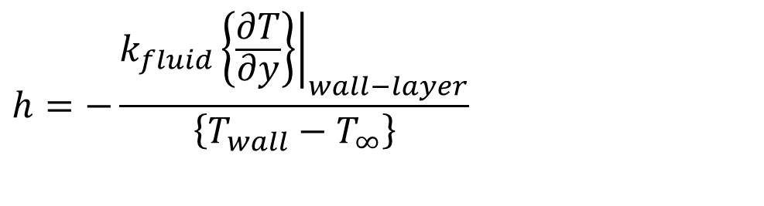
Analysis of Heat Transfer in Equilibrium Layer
At Thermodynamic equilibrium
$$T_{fluid,wall}=T_{wall}$$
At the wall for fluid layer :
$$−k_{fluid}A\left\{\frac{∂T}{∂y}\right\}=hA\left\{T_{fluid,wall}−T_{∞}\right\}$$
$$h=−\frac{k_{fluid}{\left.\left\{\frac{∂T}{∂y}\right\}\right|}_{wall−layer}}{\left\{T_{wall}−T_{∞}\right\}}$$

Slide 19
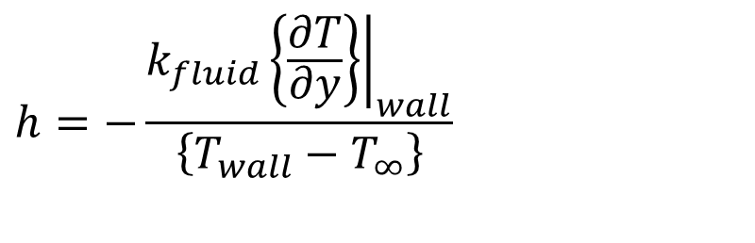
Estimation of Heat Transfer Coefficient
$$h=−\frac{k_{fluid}{\left.\left\{\frac{∂T}{∂y}\right\}\right|}_{wall}}{\left\{T_{wall}−T_{∞}\right\}}$$
Estimation of heat transfer coefficient is basically computation of temperature profile in equilibrium fluid layer.
Provoked a general theoretical and experimental study to understand how the equilibrium layer is developed.
The global geometry of the solid wall and flow conditions will decide the structure of stagnant layer.

Slide 20
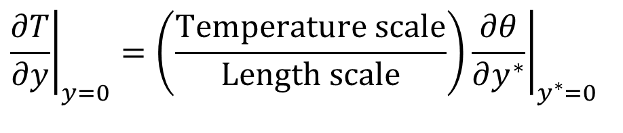
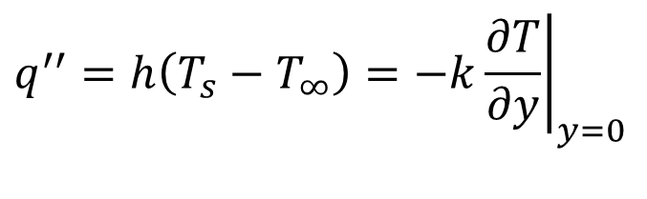
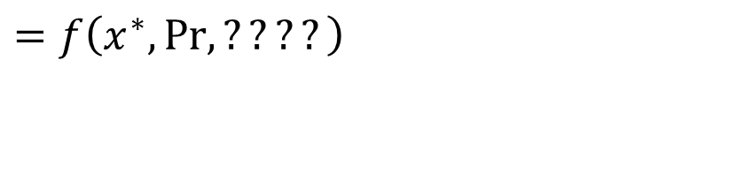
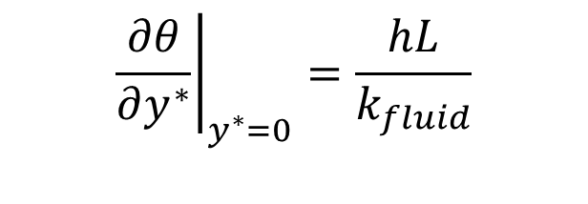
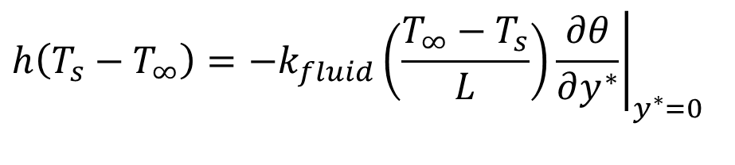
In search of A Dimensionless Parameter for Convection
$$q^{′′}=h\left(T_{s}−T_{∞}\right)=−k{\left.\frac{∂T}{∂y}\right|}_{y=0}$$
$${\left.\frac{∂T}{∂y}\right|}_{y=0}=\left(\frac{\text{Temperature scale}}{\text{Length scale}}\right){\left.\frac{∂θ}{∂y^{∗}}\right|}_{y^{∗}=0}$$
$$h\left(T_{s}−T_{∞}\right)=−k_{fluid}{\left.\left(\frac{T_{∞}−T_{s}}{L}\right)\frac{∂θ}{∂y^{∗}}\right|}_{y^{∗}=0}$$
$${\left.\frac{∂θ}{∂y^{∗}}\right|}_{y^{∗}=0}=\frac{hL}{k_{fluid}}$$
$$=f\left(x^{∗}, Pr, ????\right)$$

Slide 21
Natural Convection in Electronic Devices
Natural convection in vertical channels with asymmetric heating of this nature is found in communication equipment.
In such equipment, vertical circuit cards containing heat generating electronic devices are arrayed to form vertical channels and are cooled by free convection.
Natural or free convection occurs due to the change in density of the fluid caused by heating process.
In a gravity field, the fluid, which has a lower density, is lighter and therefore rises, creating a movement in the fluid which is called convection.
This movement permits the fluid to pick up heat and carry it away.
The natural convection is the common method used in electronics cooling.
A large class of equipment that lends itself to natural convection .

Slide 22

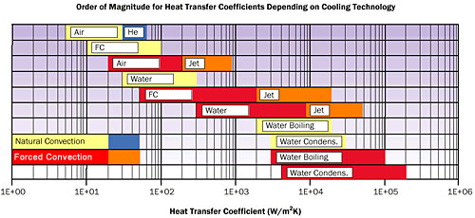

Natural Convection HT on A Flat Plate
P M V Subbarao
Professor & Head
Mechanical Engineering Department
Cooling/Heating with Zero Operating Cost….

Slide 23
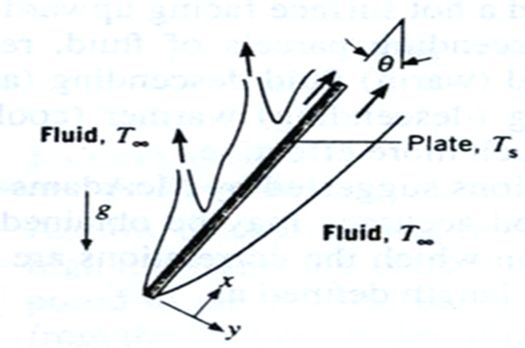
Natural Convection on Inclined Hot Flat Surface

Slide 24
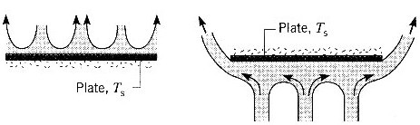
Natural Convection from Horizontal Plate
Hot Plate (Ts > T∞)

