Slide 1



Advanced Method for Estimation fo EFFECTIVE THERMAL CONDUCTIVITY OF A PCB
P M V Subbarao
Professor
Mechanical Engineering Department
Creation of Fast and Accurate Models

Slide 2

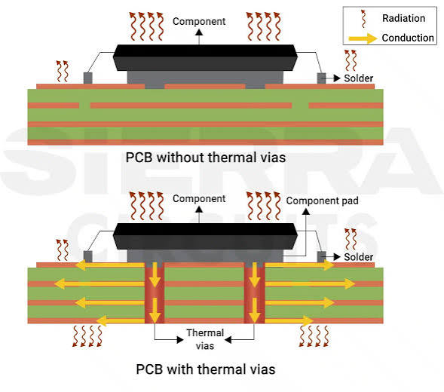
Fraction of Heat Transferred to/thru PCB

Slide 3
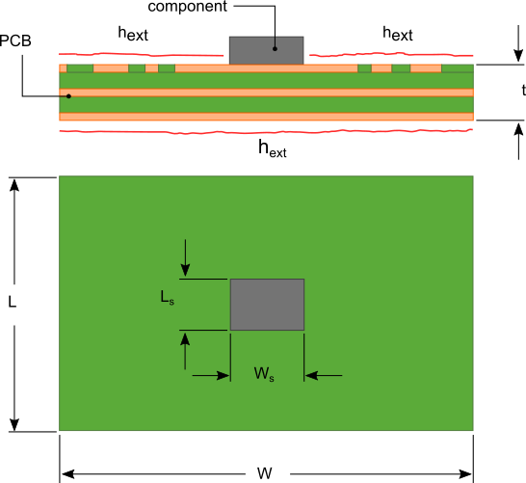
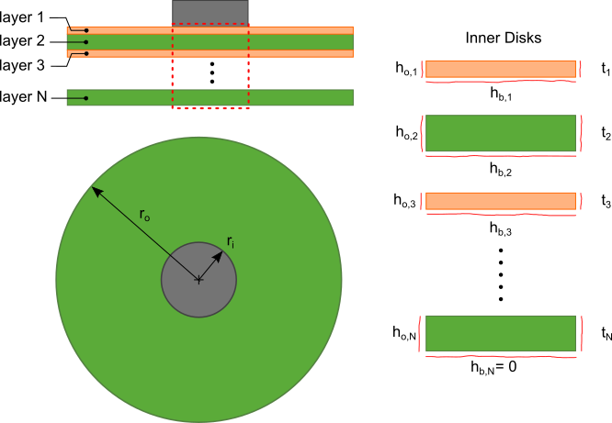
Transformation of PCB
https://www.heatsinkcalculator.com/blog/how-to-calculate-the-thermal-resistance-of-a-pcb/

Slide 4
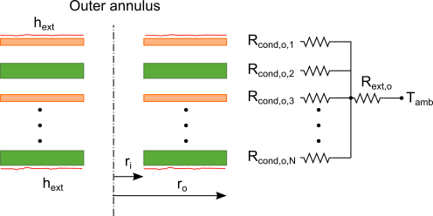
Thermal Resistance Network
The outer portion of each layer is an annulus (referred to as the “outer annulus”) with inner and outer radii r_{inner} and r_{outer} respectively.
The calculation for h_{o,n} is developed with the approximation that the temperature difference between the layers of the PCB is small.
In reality, the flow of heat is predominantly radial in the outer annulus.
The resistance to heat flow in the outer annulus can then be approximated by the thermal resistance network shown

Slide 5
Thermal Resistance Network
R_{cond,o,i} in the thermal resistance network shown in figure represents the conduction thermal resistance of each layer.
R_{ext} is the thermal resistance due to the convection/radiative cooling h_{ext} on the exposed upper and lower surfaces of the PCB.

Slide 6
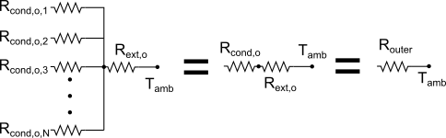

Simplified thermal resistance network for the outer annulus layers
The total equivalent thermal resistance of the thermal resistance network is determined by combining the parallel and series resistances as illustrated
To determine R_{outer} R_{cond,o,i} for each layer is first calculated by determining k_{eff}, the average in-plane thermal conductivity of the PCB.
k_{eff} is an average of the effective thermal conductivity of each layer, k_{eff,i}.

Slide 7
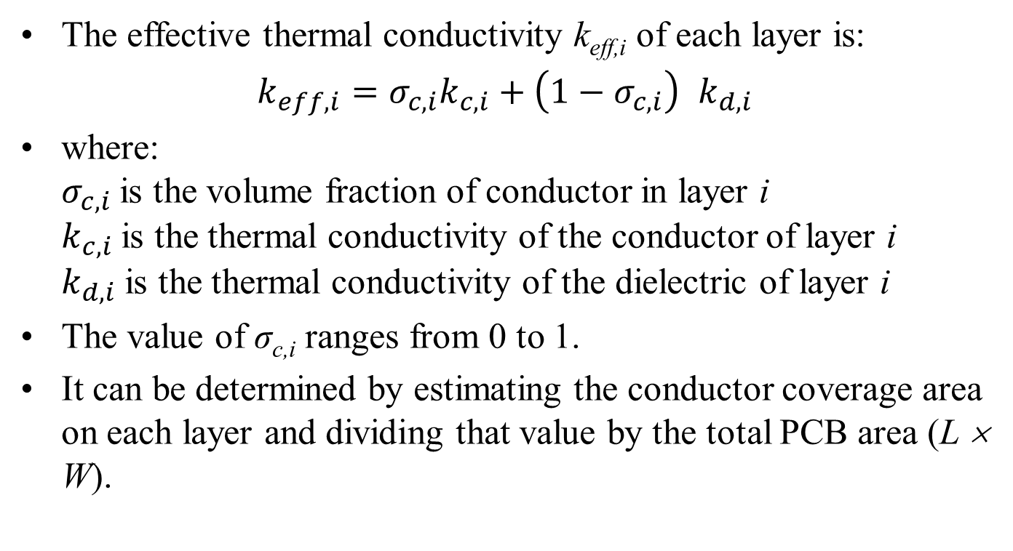
Effective Thermal conductivity k_{eff,i} of Each Layer
The effective thermal conductivity k_{eff,i} of each layer is:
$k_{eff,i}=σ_{c,i}k_{c,i}+\left(1−σ_{c,i}\right)$ $k_{d,i}$
where:
$σ_{c,i}$is the volume fraction of conductor in layer i
$k_{c,i}$is the thermal conductivity of the conductor of layer i
$k_{d,i}$is the thermal conductivity of the dielectric of layer i
The value of σ_{c,i} ranges from 0 to 1.
It can be determined by estimating the conductor coverage area on each layer and dividing that value by the total PCB area (L × W).

Slide 8
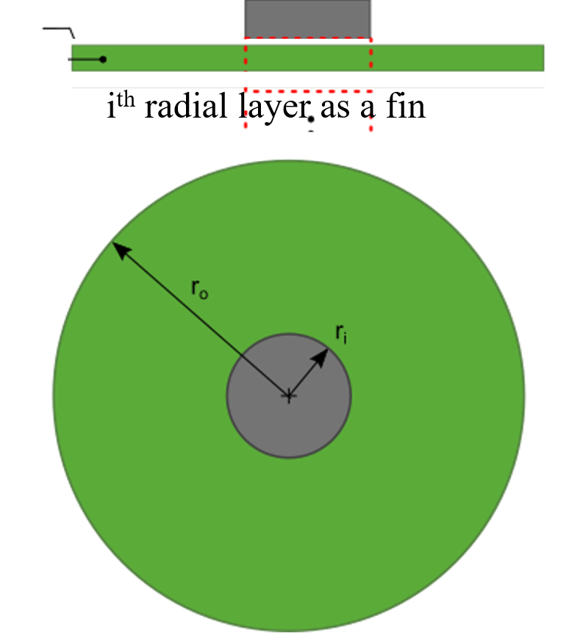
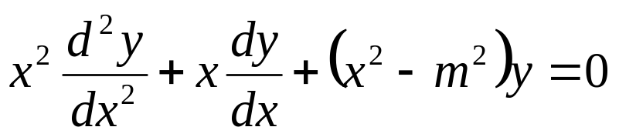
Temperature in i^{th} layer as A Radial Fin
The Bessel equation appears when the Laplace equation is solved in cylindrical coordinates.
The Bessel equation appears for the radial variable in the cylindrical coordinate system.
The equation is named after Friedrich Bessel, a German astronomer.
Bessel first obtained the equation when he was studying star motions.
But the equation first appeared in Daniel Bernoulli's studies of oscillations of a hanging chain.

Slide 9
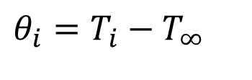
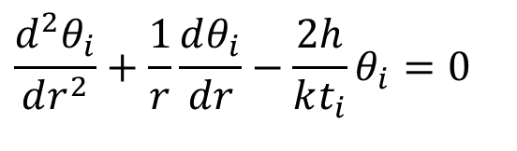
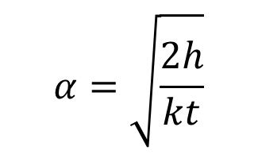
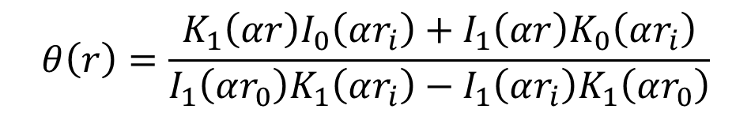
Radial Conduction Equation for Each Plane
Define
$$θ_{i}=T_{i}−T_{∞}$$
Radial conduction equation in each plane :
$$\frac{d^{2}θ_{i}}{dr^{2}}+\frac{1}{r}\frac{dθ_{i}}{dr}−\frac{2h}{kt_{i}}θ_{i}=0$$
The appropriate boundary conditions:
$$at\text{ r}=r_{inner} θ=θ_{inner}\text{ and insulated fin tip}$$
The equation for the temperature excess becomes
$$θ\left(r\right)=\frac{K_{1}\left(αr\right)I_{0}\left(αr_{i}\right)+I_{1}\left(αr\right)K_{0}\left(αr_{i}\right)}{I_{1}\left(αr_{0}\right)K_{1}\left(αr_{i}\right)−I_{1}\left(αr_{i}\right)K_{1}\left(αr_{0}\right)}$$
$$α=\sqrt{\frac{2h}{kt}}$$

Slide 10
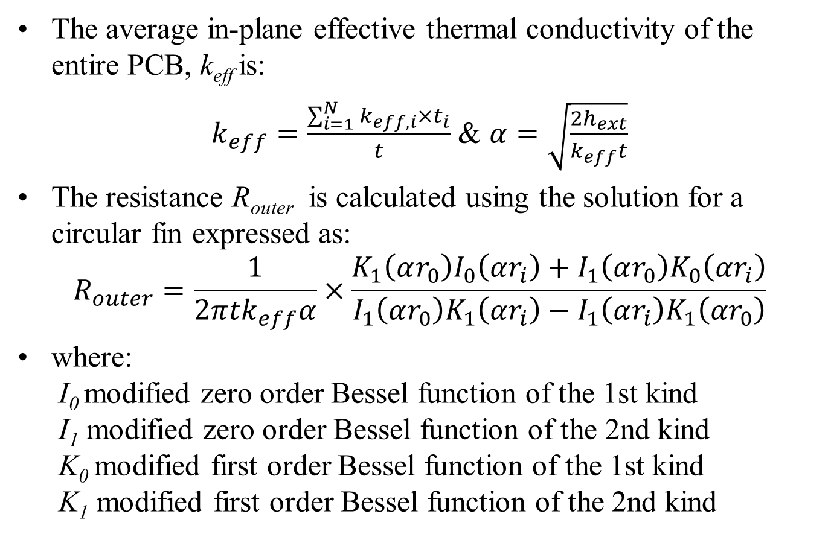
In-plane Effective Thermal Conductivity
The average in-plane effective thermal conductivity of the entire PCB, k_{eff} is:
$k_{eff}=\frac{\sum_{i=1}^{N}{k_{eff,i}{×t}_{i}}}{t}$ & $α=\sqrt{\frac{2h_{ext}}{k_{eff}t}}$
The resistance R_{outer} is calculated using the solution for a circular fin expressed as:
$$R_{outer}=\frac{1}{2πtk_{eff}α}×\frac{K_{1}\left(αr_{0}\right)I_{0}\left(αr_{i}\right)+I_{1}\left(αr_{0}\right)K_{0}\left(αr_{i}\right)}{I_{1}\left(αr_{0}\right)K_{1}\left(αr_{i}\right)−I_{1}\left(αr_{i}\right)K_{1}\left(αr_{0}\right)}$$
where:
I₀ modified zero order Bessel function of the 1st kind
I₁ modified zero order Bessel function of the 2nd kind
K₀ modified first order Bessel function of the 1st kind
K₁ modified first order Bessel function of the 2nd kind

Slide 11
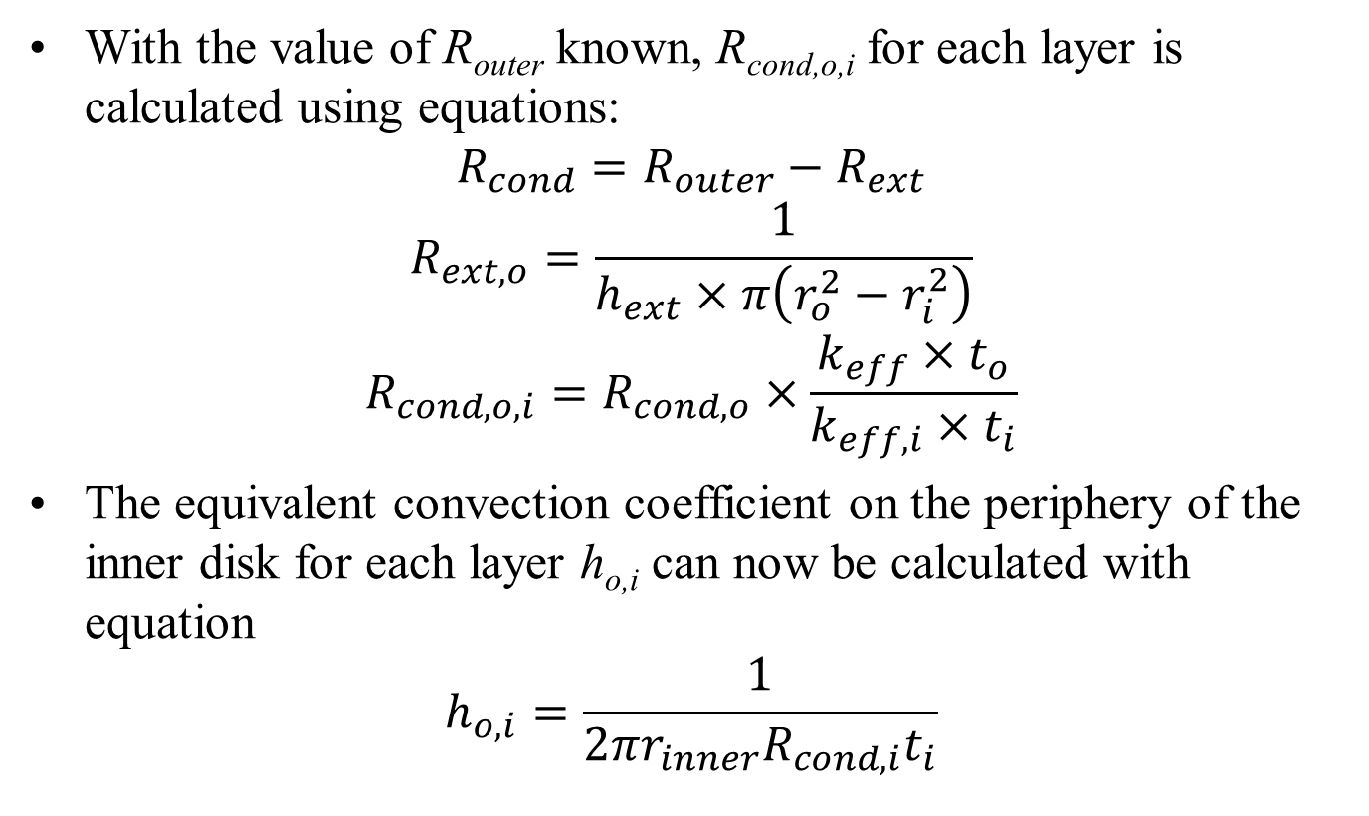
Conduction Resistance of Each Outer Layer
With the value of R_{outer} known, R_{cond,o,i} for each layer is calculated using equations:
$$R_{cond}=R_{outer}−R_{ext}$$
$$R_{ext,o}=\frac{1}{h_{ext}×π\left(r_{o}^{2}−r_{i}^{2}\right)}$$
$$R_{cond,o,i}=R_{cond,o}×\frac{k_{eff}×t_{o}}{k_{eff,i}×t_{i}}$$
The equivalent convection coefficient on the periphery of the inner disk for each layer h_{o,i} can now be calculated with equation
$$h_{o,i}=\frac{1}{2πr_{inner}R_{cond,i}t_{i}}$$

Slide 12
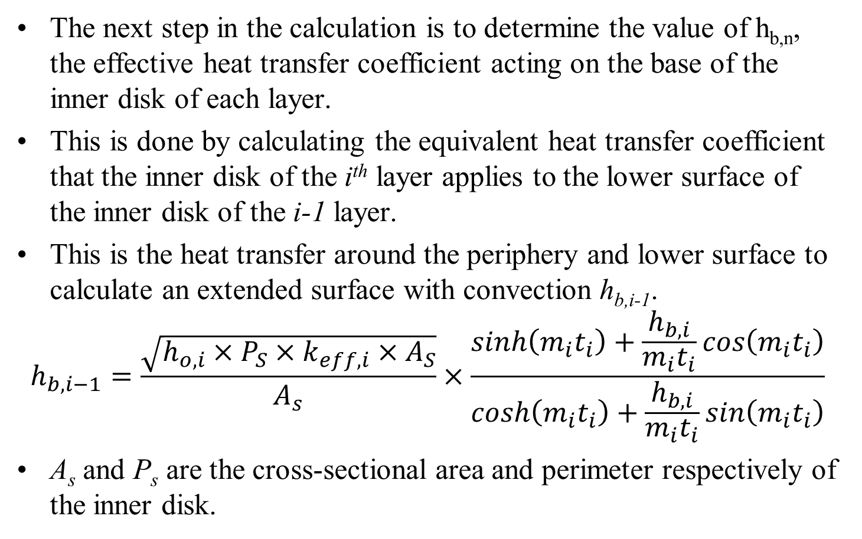
Combining the PCB layer thermal resistances
The next step in the calculation is to determine the value of h_{b,n}, the effective heat transfer coefficient acting on the base of the inner disk of each layer.
This is done by calculating the equivalent heat transfer coefficient that the inner disk of the i^{th} layer applies to the lower surface of the inner disk of the i-1 layer.
This is the heat transfer around the periphery and lower surface to calculate an extended surface with convection h_{b,i-1}.
$$h_{b,i−1}=\frac{\sqrt{h_{o,i}×P_{S}×k_{eff,i}×A_{S}}}{A_{s}}×\frac{sinh\left(m_{i}t_{i}\right)+\frac{h_{b,i}}{m_{i}t_{i}}cos\left(m_{i}t_{i}\right)}{cosh\left(m_{i}t_{i}\right)+\frac{h_{b,i}}{m_{i}t_{i}}sin\left(m_{i}t_{i}\right)}$$
A_{s} and P_{s} are the cross-sectional area and perimeter respectively of the inner disk.

Slide 13
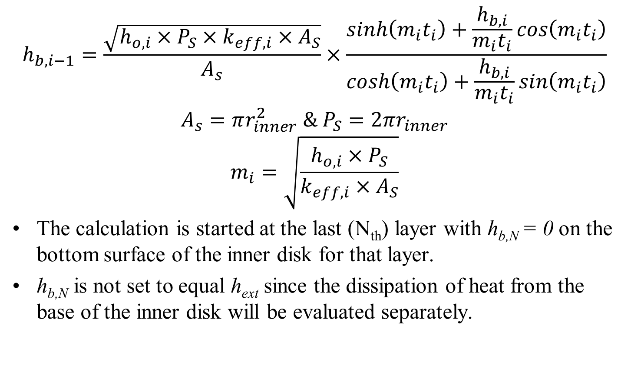
Combining the PCB layer thermal resistances
$$h_{b,i−1}=\frac{\sqrt{h_{o,i}×P_{S}×k_{eff,i}×A_{S}}}{A_{s}}×\frac{sinh\left(m_{i}t_{i}\right)+\frac{h_{b,i}}{m_{i}t_{i}}cos\left(m_{i}t_{i}\right)}{cosh\left(m_{i}t_{i}\right)+\frac{h_{b,i}}{m_{i}t_{i}}sin\left(m_{i}t_{i}\right)}$$
$$A_{s}=πr_{inner}^{2} \& P_{S}=2πr_{inner}$$
$$m_{i}=\sqrt{\frac{h_{o,i}×P_{S}}{k_{eff,i}×A_{S}}}$$
The calculation is started at the last (N_{th}) layer with h_{b,N} = 0 on the bottom surface of the inner disk for that layer.
h_{b,N} is not set to equal h_{ext} since the dissipation of heat from the base of the inner disk will be evaluated separately.

Slide 14
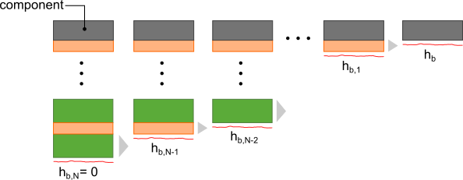
Iterative Calculation for h_{b}
Using fin equation, h_{b,N-1} is calculated.
This process is repeated N times for all the layers resulting in an equivalent heat transfer coefficient h_{b}.
This process is illustrated as:
The heat transfer coefficient h_{b} is the equivalent heat transfer coefficient of the conduction resistance due to flow of heat through the inner disk and into the outer annulus of the PCB acting on the heat generating component.

Slide 15
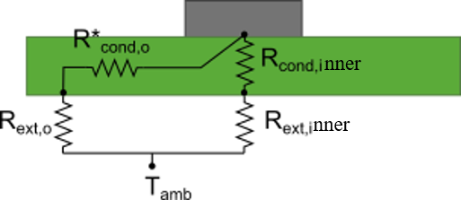
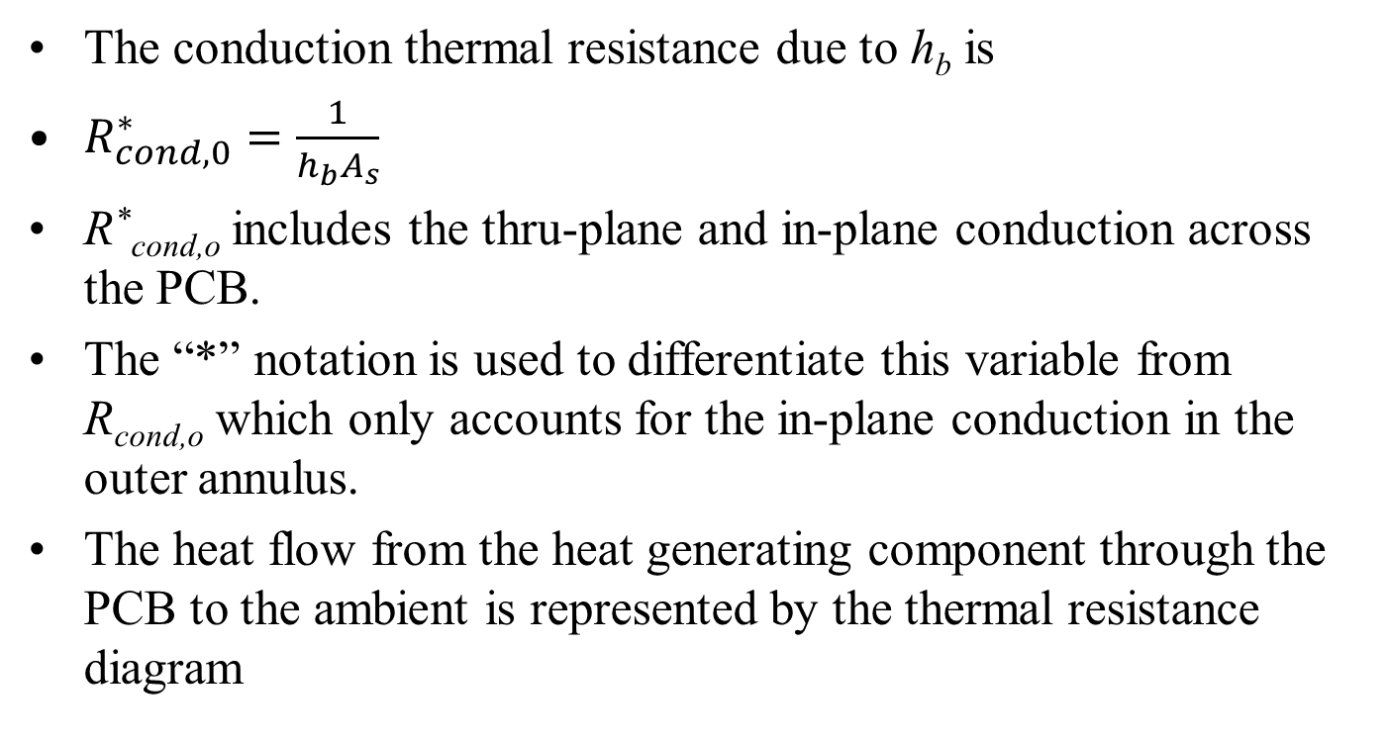
Thermal resistance network for heat flow through the PCB to the ambient
The conduction thermal resistance due to h_{b} is
$R_{cond,0}^{∗}=\frac{1}{h_{b}A_{s}}$
R*_{cond,o} includes the thru-plane and in-plane conduction across the PCB.
The “*” notation is used to differentiate this variable from R_{cond,o} which only accounts for the in-plane conduction in the outer annulus.
The heat flow from the heat generating component through the PCB to the ambient is represented by the thermal resistance diagram

Slide 16
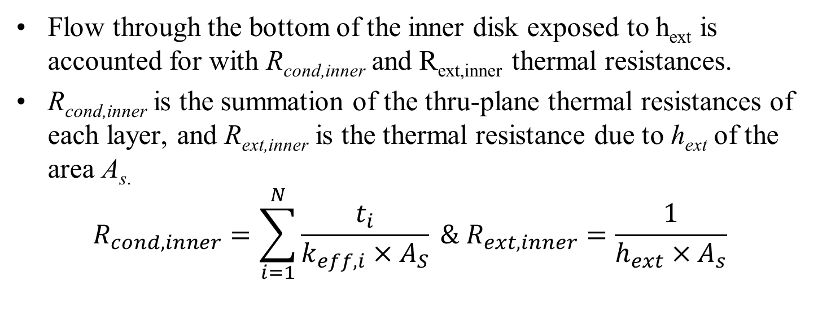
Thermal resistance network for heat flow through the PCB to the ambient
Flow through the bottom of the inner disk exposed to h_{ext} is accounted for with R_{cond,inner} and R_{ext,inner} thermal resistances.
R_{cond,inner} is the summation of the thru-plane thermal resistances of each layer, and R_{ext,inner} is the thermal resistance due to h_{ext} of the area A_{s.}
$$R_{cond,inner}=\sum_{i=1}^{N}{\frac{t_{i}}{k_{eff,i}×A_{S}}} \& R_{ext,inner}=\frac{1}{h_{ext}×A_{s}}$$

Slide 17
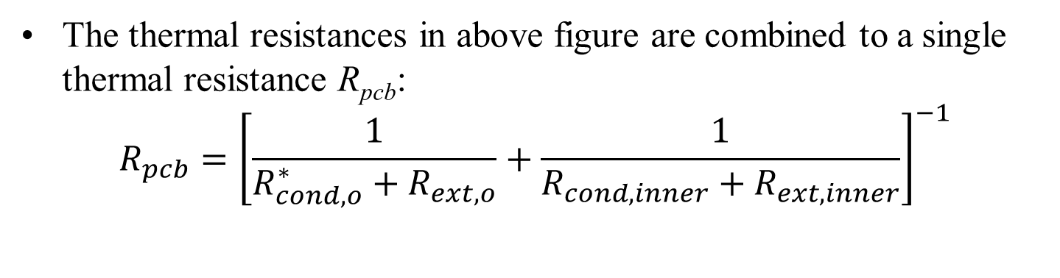
Thermal resistance network for heat flow through the PCB to the ambient
The thermal resistances in above figure are combined to a single thermal resistance R_{pcb}:
$$R_{pcb}={\left[\frac{1}{R_{cond,o}^{∗}+R_{ext,o}}+\frac{1}{R_{cond,inner}+R_{ext,inner}}\right]}^{−1}$$

Slide 18
Fraction of Heat Transferred to/thru PCB

Slide 19
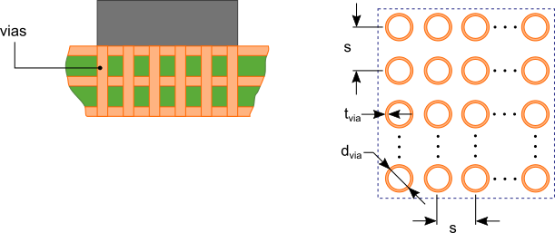
PCB with Thermal Vias
Thermal vias placed under the heat generating component provide a path to more efficiently transfer heat from the heat generating component to the inner layers and base layer of the PCB.
This then allows to the heat to be spread across these layers reducing the thermal resistance of the PCB.

Slide 20
PCB with Thermal Vias
The analysis of the effect of imbedded thermal vias as shown in above figure requires the calculation of an equivalent through-plane thermal conductivity, k_{via,n} for the inner disk of each layer.
This is calculated by evaluating the flow of heat through the inner disk of each layer through three parallel thermal resistances

Slide 21
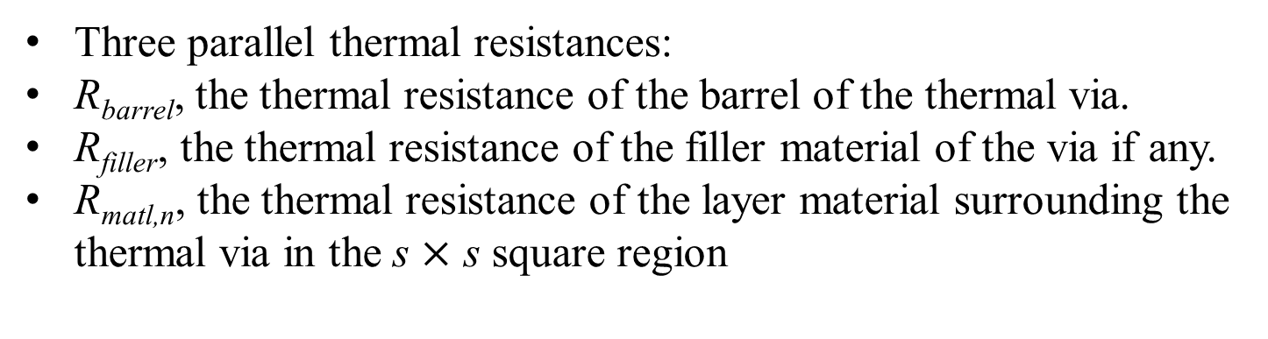
PCB with Thermal Vias
Three parallel thermal resistances:
R_{barrel}, the thermal resistance of the barrel of the thermal via.
R_{filler}, the thermal resistance of the filler material of the via if any.
R_{matl,n}, the thermal resistance of the layer material surrounding the thermal via in the s $×$ s square region

Slide 22
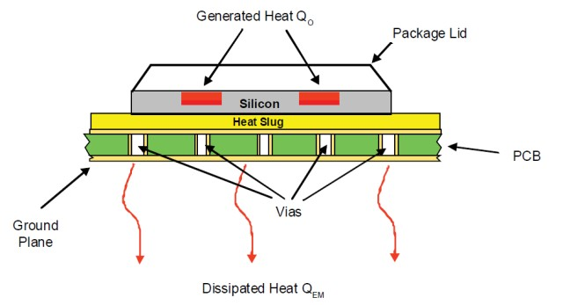
Case Study : Temperature Estimation POINTS
A cross-section of the power IC mounted to a PCB

Slide 23
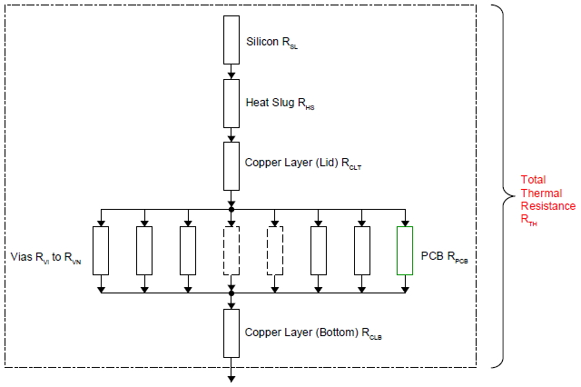
Case Study : Resistance Network

Slide 24

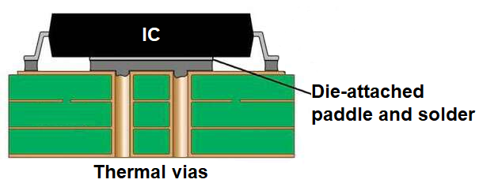
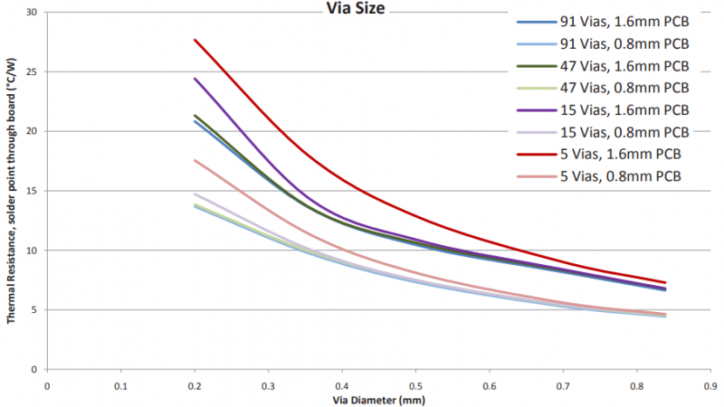
PCB Thermal Management –Design of Thermal via
Device-to-board edge thermal resistance of a PCB ∼ 20 to 60°C/W)
Thermal vias should just be part of a larger thermal management strategy for superior thermal management of a PCB.
Placement of thermal vias in a PCB board to aid heat transfer, you should check your placement against your design rules and constraints.

Slide 25
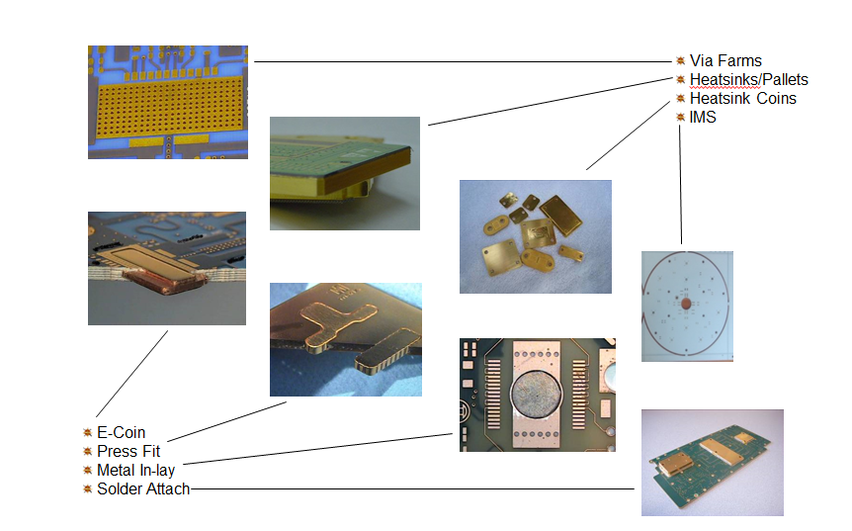
PCB Thermal Management – Metal Coins
https://emsxchange.com/pcb-thermal-management-metal-coins/

Slide 26
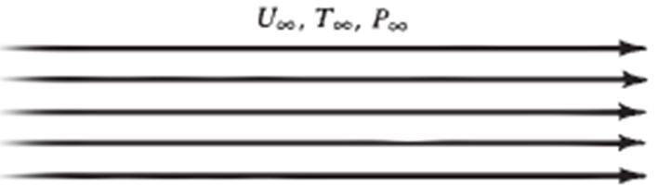
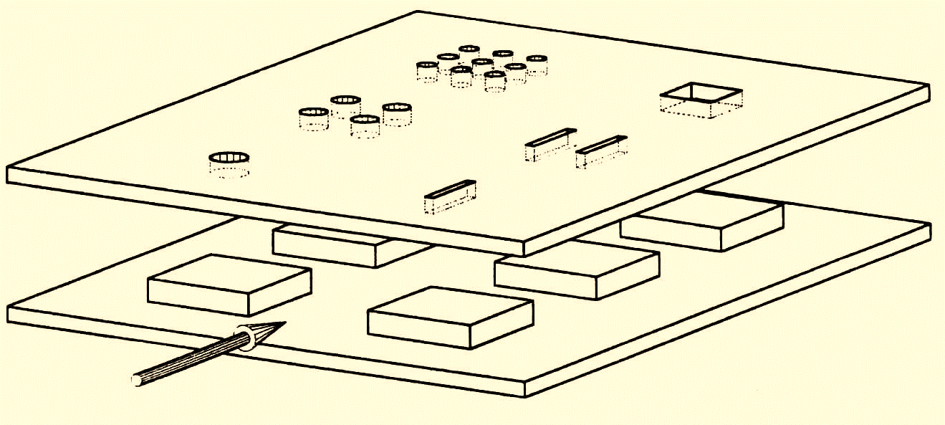
Heat Transfer is an Action: Path Function
Cold Surroundings
PCB as a Hot Thermodynamic System

