Slide 1



EFFECTIVE THERMAL CONDUCTIVITY OF A PCB
P M V Subbarao
Professor
Mechanical Engineering Department
Creation of Precision & Smarter Thermal Paths

Slide 2

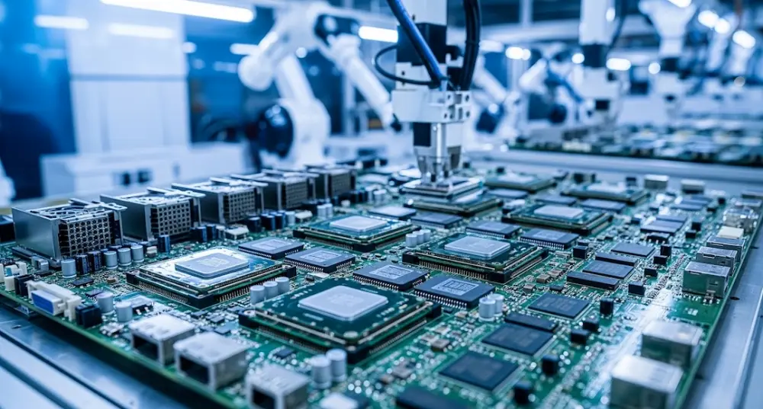
The PCB
Printed Circuit Boards (PCBs) are the physical foundation of modern servers, but they are part of a larger ecosystem of innovations.

Slide 3
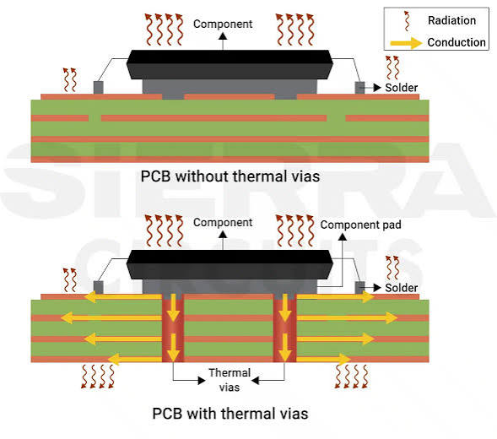
Fraction of Heat Transferred to/thru PCB

Slide 4
Printed Circuit Board (PCB)
The amount of heat that is dissipated through the printed circuit board (PCB) becomes an important fraction of the total heat dissipated by microelectronic devices.
This fraction is of more concern due to the increase in power density and the reduction in space available for heat sinking them.
The heat generated in these devices is transferred through their leads or cases to the PCB.
The thermal conductivity of the PCB, is strongly anisotropic due to the large difference between the thermal conductivities of copper and glass-epoxy.

Slide 5
Effective Thermal Conductivity
Detailed representation of the individual layers of PCBs in a thermal-fluid model of an electronic system makes the model too big, and the solution process too slow.
The placement of the various layers, source size and placement, and the convective boundary conditions have significant effects on the effective thermal conductivity of a PCB.
Effects of the component size on the lateral and normal effective thermal conductivities is to be studied.

Slide 6
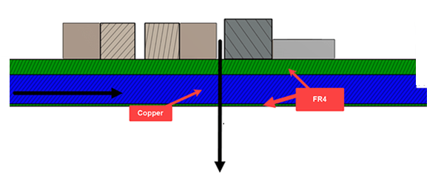
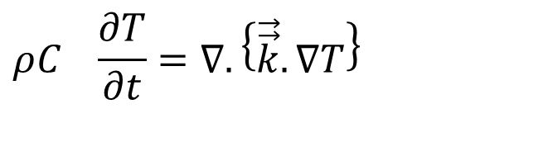
Anisotropy of A PCB
In plane or
Lateral Direction
Through plane or Perpendicular Direction
The Fourier Conduction Equation
$$ρC_{}\frac{∂T}{∂t}=∇.\left\{\vec{\vec{k}}.∇T\right\}$$

Slide 7
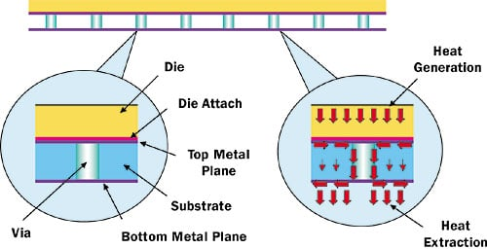
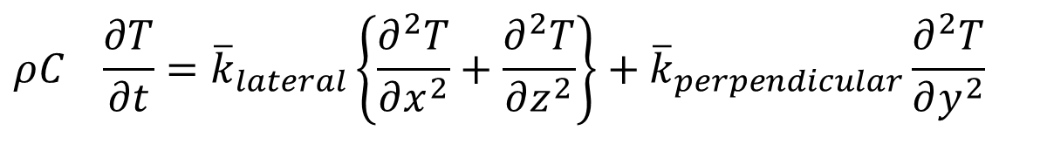
Homogeneous Model for A PCB
$$ρC_{}\frac{∂T}{∂t}={\overline{k}}_{lateral}\left\{\frac{∂^{2}T}{∂x^{2}}+\frac{∂^{2}T}{∂z^{2}}\right\}+{\overline{k}}_{perpendicular}\frac{∂^{2}T}{∂y^{2}}$$
Effective PCB Thermal Conductivity
  Volumetric averaged Lateral Conductivity
  Volumetric averaged Perpendicular Conductivity

Slide 8
The Daunting Task
A common feature of the thermal analysis of electronic equipment is the complexity of the heat flow paths in the hardware.
Nowhere is this more evident than the printed circuit board.
The multiple layers of complex trace patterns present a daunting thermal modeling task.
Clearly, computing temperatures for a PCB model that resolves the details of the trace patterns stretches the capabilities of some PCB’s.
The traces are important heat transfer paths and cannot be ignored in the thermal design.

Slide 9
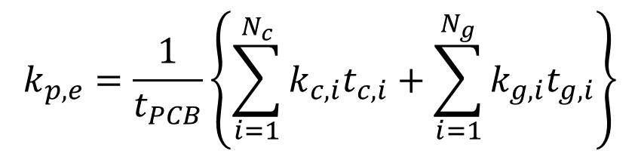
Modelling
PCBs are usually modeled as single objects with parallel (in the plane of the board) and normal (perpendicular to the board) effective thermal conductivities.
The effective parallel (lateral) and normal (perpendicular) thermal conductivities, k_{p,e} and k_{n,e}, are typically calculated assuming one-dimensional heat conduction through a composite layer.
The thermal contact resistance between the copper and glass-epoxy layers is neglected.
For a PCB with N_{c} number of copper layers and N_{g} number of glass-epoxy layers
$$k_{p,e}=\frac{1}{t_{PCB}}\left\{\sum_{i=1}^{N_{c}}{k_{c,i}t_{c,i}}+\sum_{i=1}^{N_{g}}{k_{g,i}t_{g,i}}\right\}$$

Slide 10
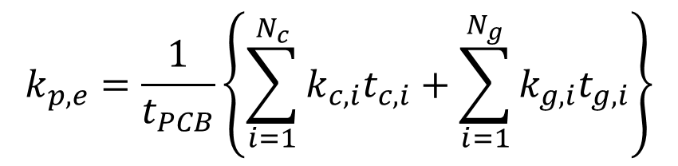
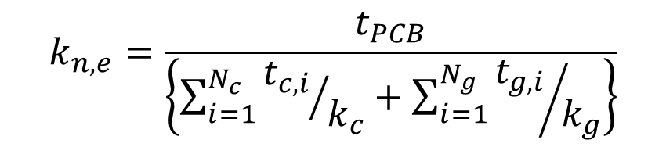
Modelling
$$k_{p,e}=\frac{1}{t_{PCB}}\left\{\sum_{i=1}^{N_{c}}{k_{c,i}t_{c,i}}+\sum_{i=1}^{N_{g}}{k_{g,i}t_{g,i}}\right\}$$
$$k_{n,e}=\frac{t_{PCB}}{\left\{\sum_{i=1}^{N_{c}}{{t_{c,i}}/{k_{c}}}+\sum_{i=1}^{N_{g}}{{t_{g,i}}/{k_{g}}}\right\}}$$
where t is the total thickness of PCB, t_{c,i} and t_{g,i} are the thicknesses of the ith copper and glass-epoxy layers,
k_{c} and k_{g} are thermal conductivities of copper and glass epoxy.
This model here is called the “one-dimensional effective thermal conductivity” model (1DM).

Slide 11
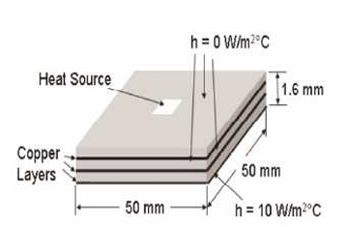
Case Study: Six Layer PCB
Consider a 50 mm x 50 mm x 1.6 mm PCB with two (35 μm thick) internal copper layers and a copper layer on the solder (bottom) side (17 μm thick) as shown
The internal copper layers are positioned uniformly in the PCB thickness.
The top and sides of this PCB are insulated and the convection heat transfer coefficient and air temperature on the bottom side are 10 W/mC and 200C.
The top layer of this PCB, on which the components are mounted, is a glass epoxy layer.

Slide 12
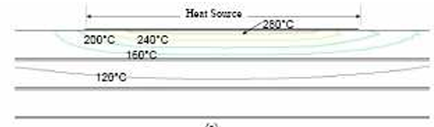
Case Study: Two Layer PCB
As the thermal conductivity of glass-epoxy is very low, this layer creates a large conduction thermal resistance against the heat flow into and through the PCB.
Place a centrally located 5 mm x 5 mm heat source (2W) on this PCB.
The computed temperature contours in this PCB are:
No copper layer on top surface
A large temperature gradient is seen near the heat source as a result of high conduction resistance.

Slide 13
Case Study: Two Layer PCB
If the thermal conductivities of copper and glass epoxy are 390 W/mC and 0,25 W/mC respectively.
The parallel and normal thermal conductivities k_{p,e} = 21,56 W/mC and k_{n,e} = 0,264 W/mC for the 1DM model of this PCB.
It is seen that the parallel thermal conductivity of the PCB is too high compared to the thermal conductivity of glass-epoxy.

Slide 14
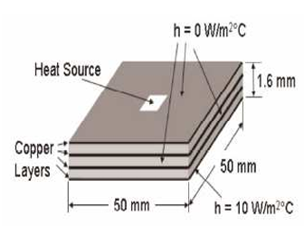
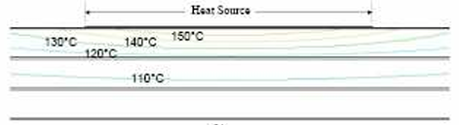
Case Study: Seven Layer PCB
There are also situations in which the component (top) side of a PCB, or at least part of it, is covered with a layer of copper.
This copper layer helps to spread the heat over a larger area.
The computed temperature contours in are:
Copper layer on top surface
The high thermal conductivity of copper, the top copper layer offers a low resistance path against the heat conduction into the board.

Slide 15
Case Study: Seven Layer PCB
Copper layer on top surface
The 1DM model does not replicate this behavior.
The effective parallel and normal thermal conductivities of such a model for this PCB are k_{p,e} = 25,83 W/mC and k_{n,e} = 0,268 W/mC.
It is seen that the parallel thermal conductivity of the PCB model is much smaller than the thermal conductivity of copper.

Slide 16
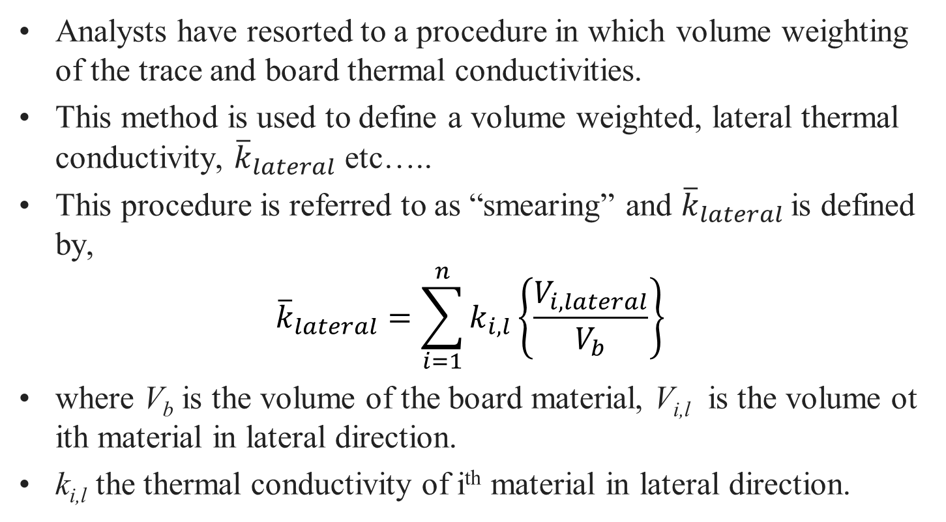
Detailed Resistance Model
Analysts have resorted to a procedure in which volume weighting of the trace and board thermal conductivities.
This method is used to define a volume weighted, lateral thermal conductivity, ${\overline{k}}_{lateral}$ etc…..
This procedure is referred to as “smearing” and ${\overline{k}}_{lateral}$is defined by,
$${\overline{k}}_{lateral}=\sum_{i=1}^{n}{k_{i,l}\left\{\frac{V_{i,lateral}}{V_{b}}\right\}}$$
where V_{b} is the volume of the board material, V_{i,l} is the volume ot ith material in lateral direction.
k_{i,l} the thermal conductivity of i^{th} material in lateral direction.

Slide 17
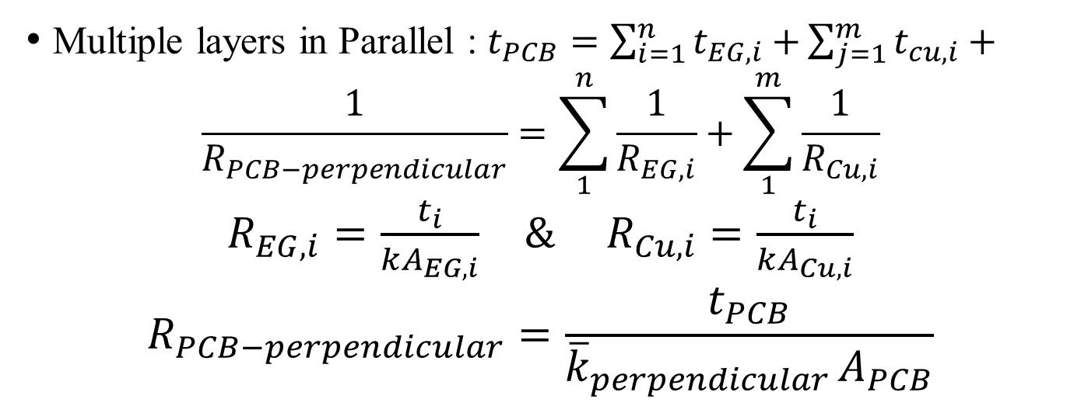

Effective Thermal Conductivity of A PCB
Lateral Conductivity
w
L
A_{EG}
$$t_{PCB}$$
A_{Cu}
Multiple layers in Parallel : $t_{PCB}=\sum_{i=1}^{n}{t_{EG,i}+}\sum_{j=1}^{m}{t_{cu,i}+}$
$$\frac{1}{R_{PCB−perpendicular}}=\sum_{1}^{n}{\frac{1}{R_{EG,i}}}+\sum_{1}^{m}{\frac{1}{R_{Cu,i}}}$$
$R_{EG,i}=\frac{t_{i}}{kA_{EG,i}}$ $\& R_{Cu,i}=\frac{t_{i}}{kA_{Cu,i}}$
$$R_{PCB−perpendicular}=\frac{t_{PCB}}{{\overline{k}}_{perpendicular }A_{PCB}}$$

Slide 18
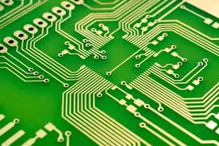
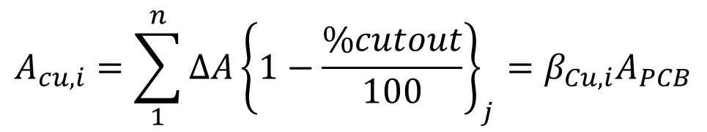
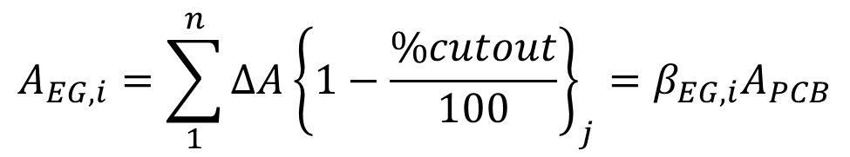
True Areas of Layers in A PCB
$$A_{cu,i}=\sum_{1}^{n}{∆A{\left\{1−\frac{\%cutout}{100}\right\}}_{j}=β_{Cu,i}A_{PCB}}$$
$$A_{EG,i}=\sum_{1}^{n}{∆A{\left\{1−\frac{\%cutout}{100}\right\}}_{j}=β_{EG,i}A_{PCB}}$$

Slide 19
Smart Methods of 21st Century…
Save time and Accuracy….

Slide 20
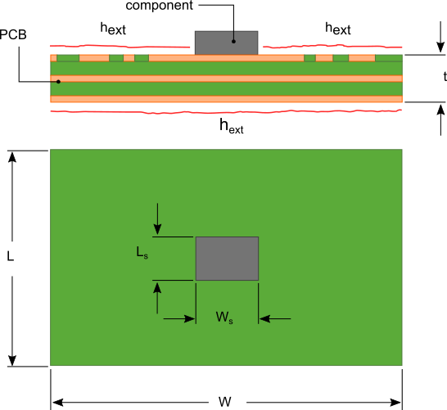
21st Century Industrial Practice
The industrial technical article will provide a detailed explanation of the formulas and method used to calculate the thermal resistance of a PCB.
The calculation methodology will take into account the PCB insulation (FR4)/copper layer thicknesses, percent copper coverage in each layer, location of these layers with respect to the heat generating component and usage of thermal vias.
https://www.heatsinkcalculator.com/blog/how-to-calculate-the-thermal-resistance-of-a-pcb/

Slide 21
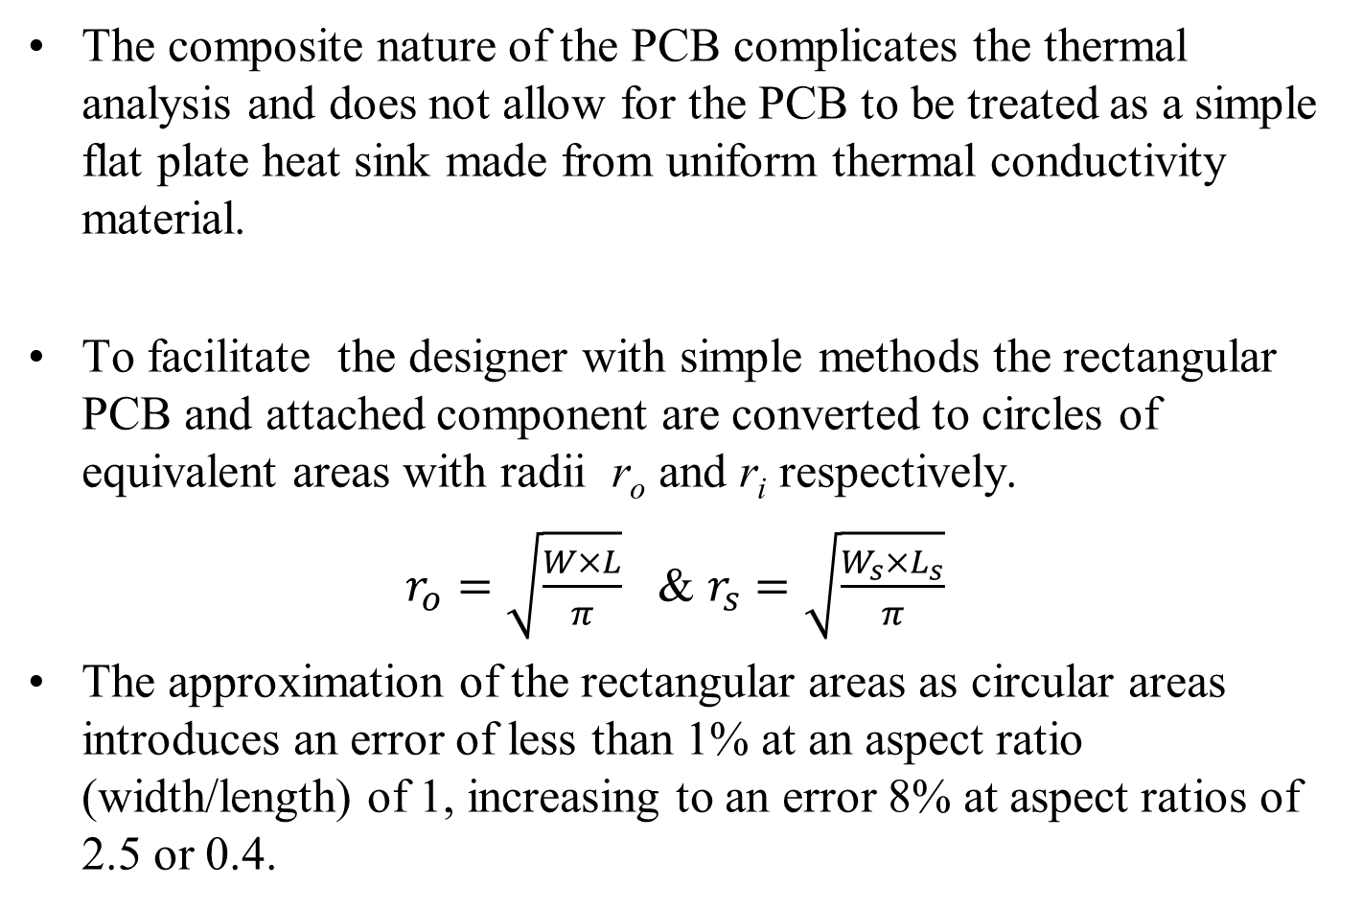
Equivalent Radius of PCB
The composite nature of the PCB complicates the thermal analysis and does not allow for the PCB to be treated as a simple flat plate heat sink made from uniform thermal conductivity material.
To facilitate the designer with simple methods the rectangular PCB and attached component are converted to circles of equivalent areas with radii r_{o} and r_{i} respectively.
$r_{o}=\sqrt{\frac{W×L}{π}}$ & $r_{s}=\sqrt{\frac{W_{s}×L_{s}}{π}}$
The approximation of the rectangular areas as circular areas introduces an error of less than 1% at an aspect ratio (width/length) of 1, increasing to an error 8% at aspect ratios of 2.5 or 0.4.

Slide 22
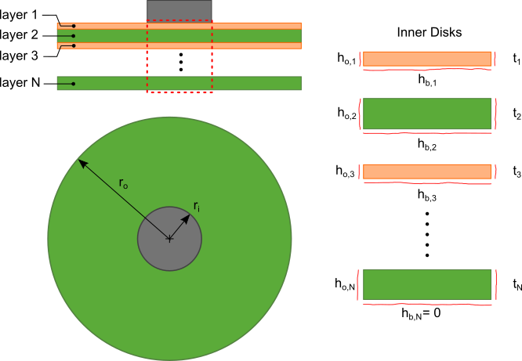
Axi-Symmetric Model

Slide 23
Industrial Methodology: Step 1
The thermal resistance calculation is conducted layer by layer to account for the non-uniform thermal conductivity of the PCB.
The section of each layer directly under the component is a disk with radius r_{i} and thickness t_{n}.
This disk will be referred to as the “inner disk”.
The periphery of the disk has an equivalent convection coefficient h_{o,n} that represents the effective cooling of the outer portion of the layer as shown in

Slide 24
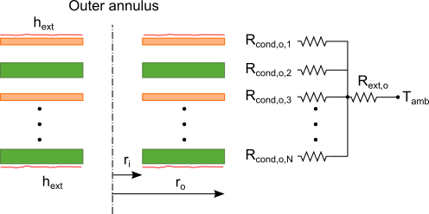
Thermal Resistance Network
The outer portion of each layer is an annulus (referred to as the “outer annulus”) with inner and outer radii r_{i} and r_{o} respectively.
The calculation for h_{o,n} is developed with the approximation that the temperature difference between the layers of the PCB is small.
In reality, the flow of heat is predominantly radial in the outer annulus.
The resistance to heat flow in the outer annulus can then be approximated by the thermal resistance network shown

Slide 25
Thermal Resistance Network
R_{cond,o,n} in the thermal resistance network shown in previous figure represents the conduction thermal resistance of each layer.
R_{ext} is the thermal resistance due to the convection/radiative cooling h_{ext} on the exposed upper and lower surfaces of the PCB.

