Slide 1



Thermal Management of Printed Circuit Boards
P M V Subbarao
Professor
Mechanical Engineering Department
Material View of PCB for Thermal Management…..

Slide 2

Printed Circuit Board (PCB)
A printed circuit board (PCB) is a non-conductive substrate that supports and connects electronic components through conductive circuitry materials mounted on its surface and within its layers.
Each component on a PCB is interconnected by conductive tracks, known as traces, to form a complete electronic circuit or assembly.
PCBs are commonly manufactured from fiberglass-reinforced epoxy laminate or other insulating materials, with copper traces etched onto the board to create reliable electrical pathways.
Inner copper layers are precisely etched to route signals, power, and ground connections between components.

Slide 3
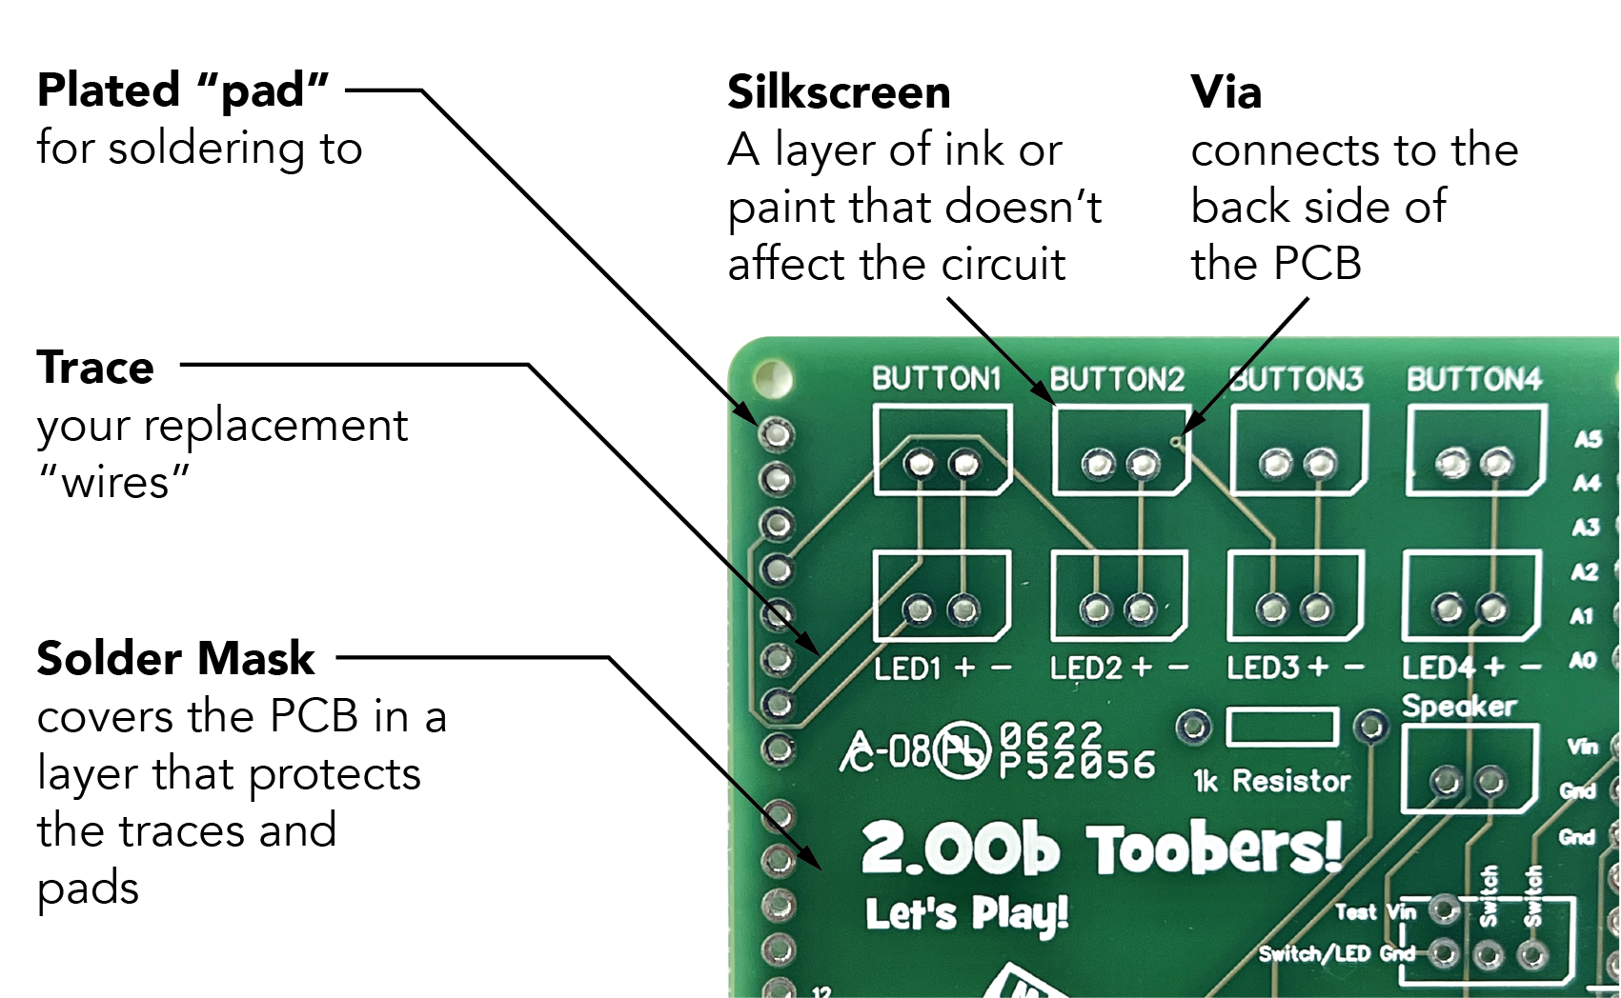
Anatomy of A PCB

Slide 4
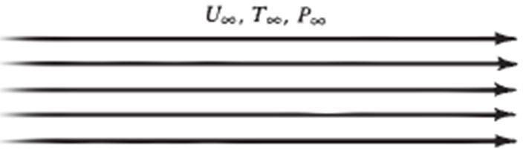
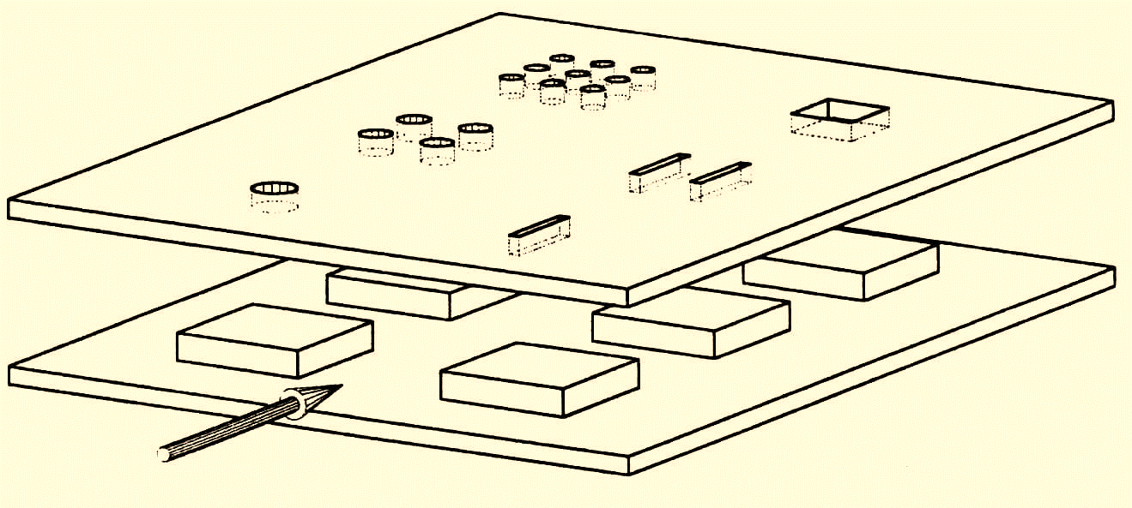
Heat Transfer is an Action: Path Function
Cold Surroundings
PCB as a Hot Thermodynamic System

Slide 5
PCB as A Heat Transfer Material
Printed circuit boards (PCBs) are the boards that are used as the base in most electronics – both as a physical support piece and as the wiring area for the surface-mounted and socketed components.
PCBs are most commonly made out of fiberglass, composite epoxy, or another composite material.
Single-layer PCB
Double-layer PCB
Multi-layer PCB

Slide 6
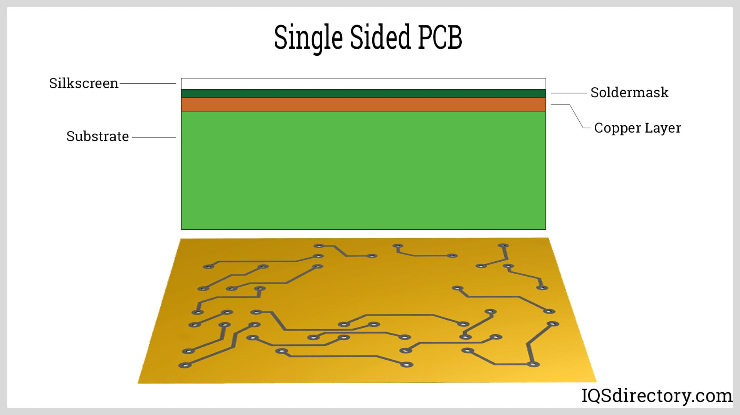
Single Layered PCBs
A Single-layer or single-sided PCB is one that is made from single layer of base material or substrate.
Applications: calculators, cameras, radio, stereo equipment, solid state drives, printers and power supplies.

Slide 7
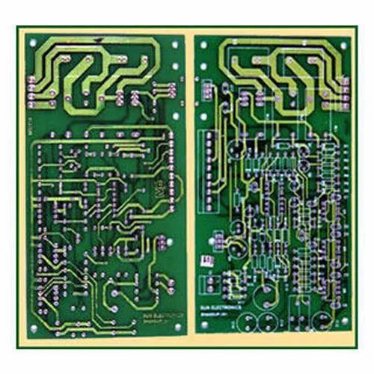
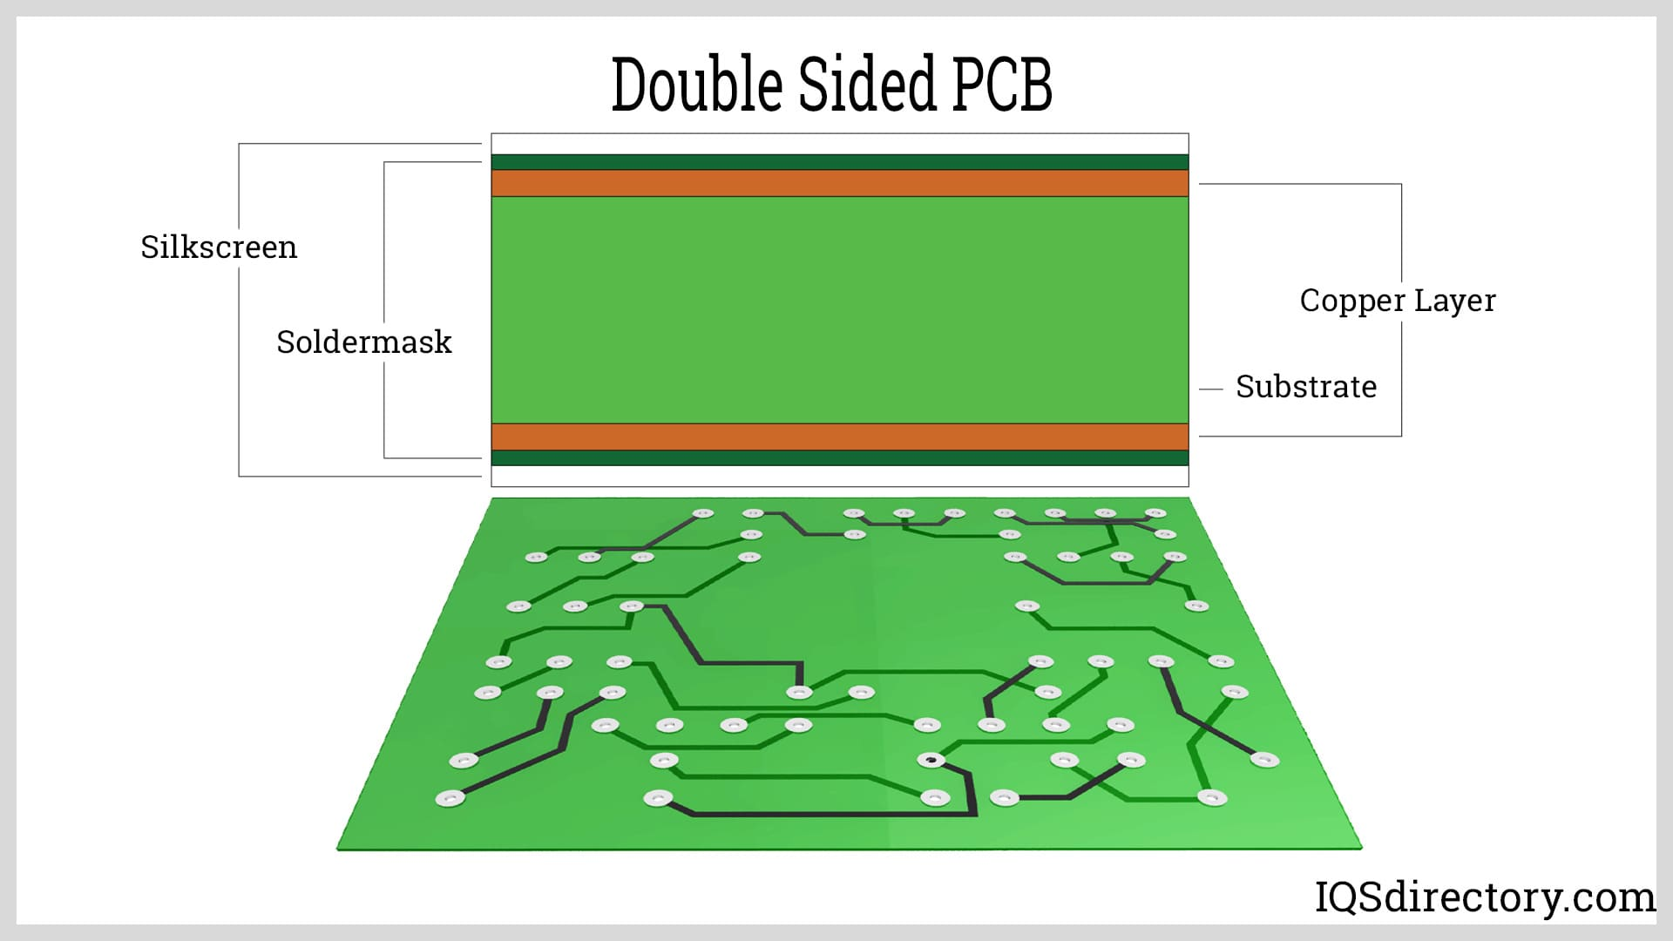
Double Layered PCBs
Top
Bottom
Double-layer or double-sided PCBs have base material with a thin layer of conductive metal, like copper, applied to both sides of the board.

Slide 8


Double Layered PCBs
Applications: Industrial controls, power supplies, instrumentation, HVAC systems, LED lighting, automotive dashboards, amplifiers and vending machines.

Slide 9
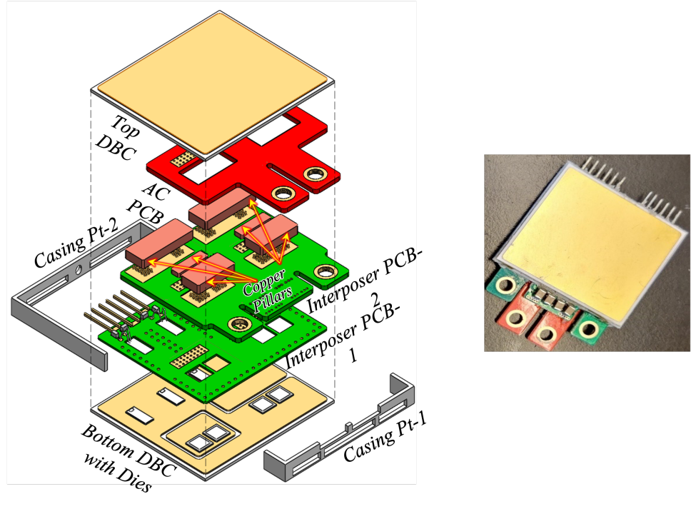

Thermal Model of an Encapsulate Double Layer PCB

Slide 10
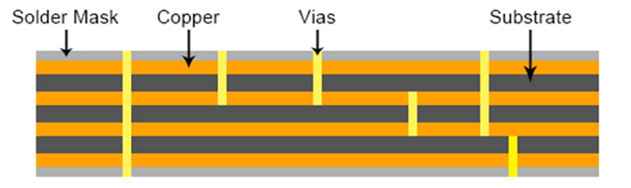
Multi Layered PCBs
A multi-layer PCBs consist of a series of three or more double layered PCBs.

Slide 11
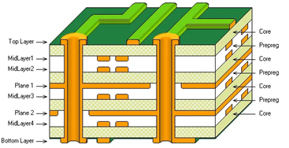
Multi Layered PCBs
Applications: File servers, Data storage, GPS technology, Satellite systems, Weather analysis and Medical equipment.:

Slide 12
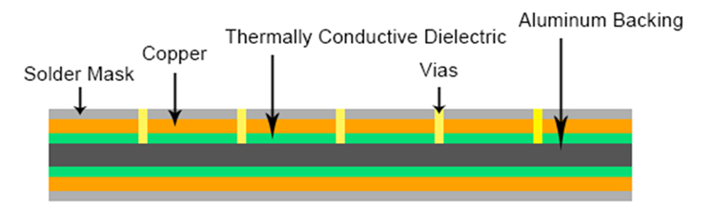
High Frequency PCBs
Instead of the usual fiberglass used in most PCBs, aluminum-baked PCBs make use of aluminum or copper substrate board.
Medical Applications : X-ray, CT-Scan, etc.

Slide 13
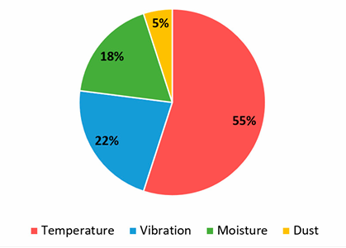
Most Frequent Causes of Electronic Failures on a PCB

Slide 14
Thermal Management on PCB
TM for PCB to the techniques and strategies used to control and dissipate heat generated by electronic components on the board.
Ensuring proper functionality by preventing excessive temperatures that could damage the components or affect signal integrity.
Key aspects include selecting appropriate PCB materials, strategically placing components, utilizing thermal vias, and incorporating heat sinks when necessary.

Slide 15
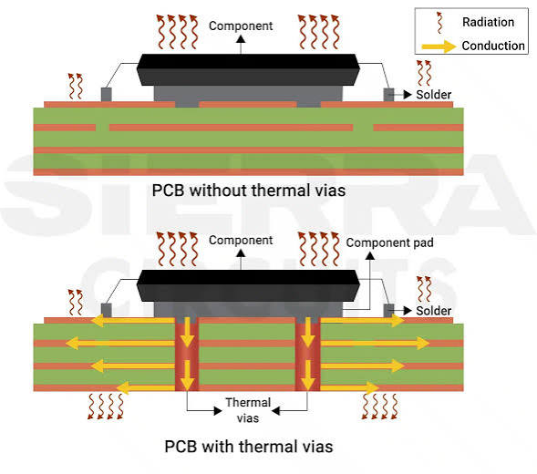
Fraction of Heat Transferred to/thru PCB

Slide 16
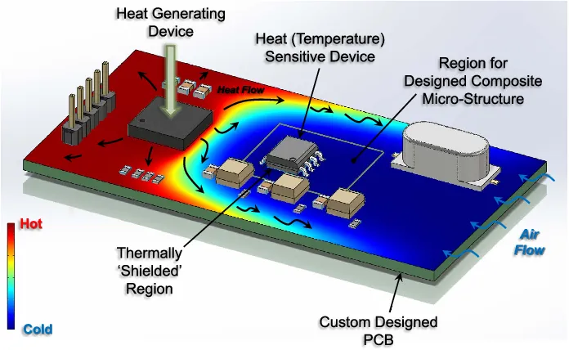
Key Elements of PCB Thermal Management
Component placement: Carefully placing high-power components away from sensitive components and strategically distributing heat sources across the board to optimize heat dissipation.

Slide 17
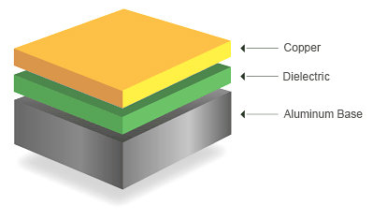
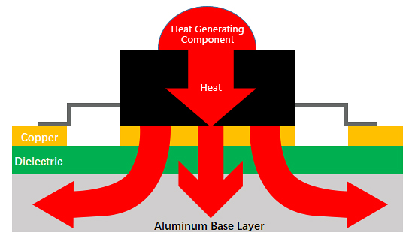
Key Elements of PCB Thermal Management
PCB material selection: Choosing a substrate material with good thermal conductivity, like a metal core PCB, to effectively transfer heat away from components.

Slide 18
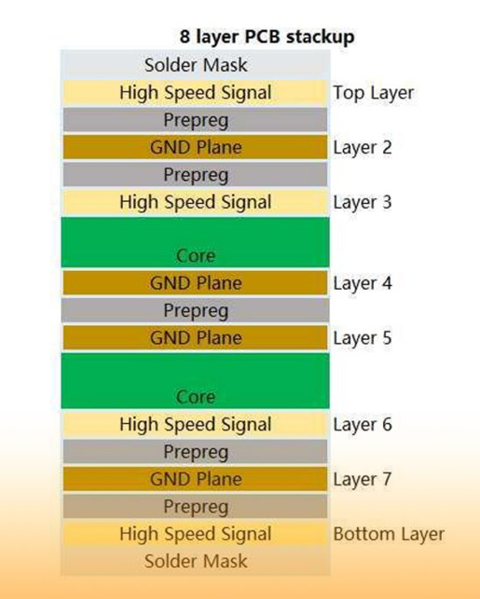
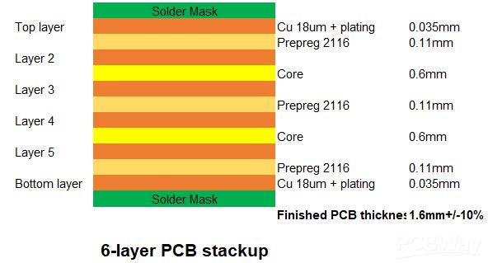
Key Elements of PCB Thermal Management
Layer stackup design: Arranging the different layers of the PCB to optimize heat flow, including the placement of copper planes for efficient heat conduction.

Slide 19
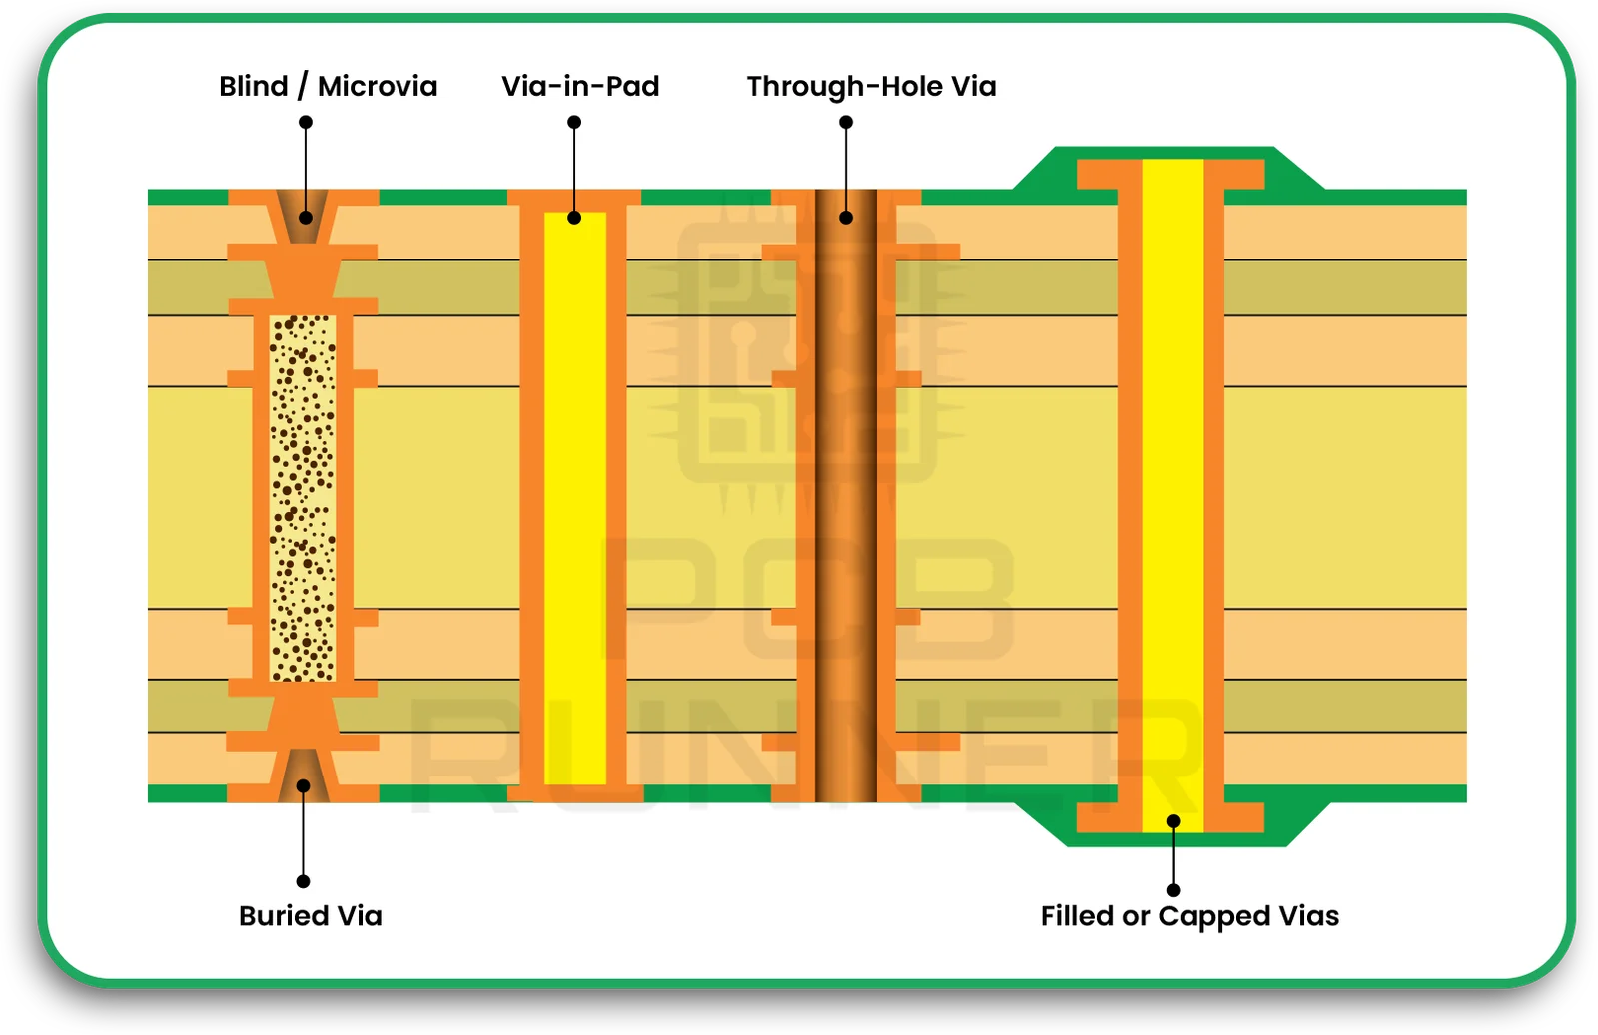
Key Elements of PCB Thermal Management
Thermal vias: Vertical connections drilled through the PCB that act like heat pipes, transferring heat from one side of the board to the other, particularly around heat-generating components.

Slide 20
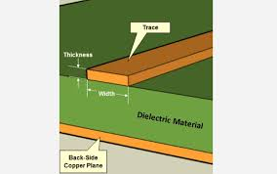

Key Elements of PCB Thermal Management
Copper weight and trace design: Adjusting the thickness and width of copper traces to manage heat dissipation on the PCB.
$$Q=∆U=mc∆T$$
A 1 oz copper trace (which is about 35 micrometers thick) with a width of 10 mils (0.254 mm) can typically carry around 0.5 amps with a 10°C temperature rise in an internal layer.
For higher currents, such as 3 amps, a width closer to 50 mils (1.27 mm) is required under similar conditions.
These values can vary depending on whether the trace is on an external or internal layer, as external traces dissipate heat more effectively.

Slide 21
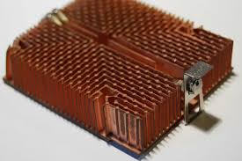
Key Elements of PCB Thermal Management
Heat sinks: Passive cooling mechanisms attached to high-power components to increase their surface area for heat dissipation.

Slide 22
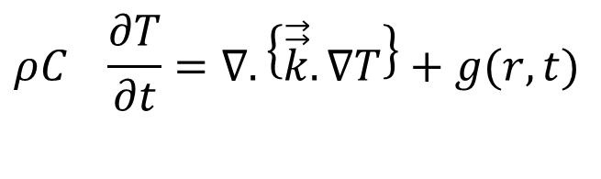
Conduction Heat Transfer for Printed Circuit Boards
$$ρC_{}\frac{∂T}{∂t}=∇.\left\{\vec{\vec{k}}.∇T\right\}+g(r,t)$$
A common feature of the thermal analysis of A PCB is the complexity of the heat flow paths.
The multiple layers of complex trace patterns present a daunting thermal modeling task.

Slide 23
The Daunting Task
Consider a 6 layer, 100 x 100 mm, circuit board, with some traces as small as 0.25 mm (0.010 in) in width.
A thermal model, either finite difference (FDM) or finite element (FEM), would require a mesh of 400 (100/.25) nodes or elements on a side or nearly 160,000 nodes per layer, resulting in almost 1,000,000 nodes for the board.
This is a relatively small PCB.
A large board, say 250 x 250 mm, with 10 layers would generate a model with more than 10,000,000 nodes.
Clearly, computing temperatures for a PCB model that resolves the details of the trace patterns stretches the capabilities of some PC’s.

Slide 24
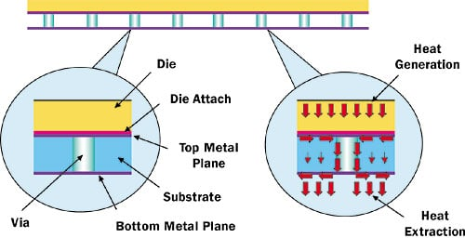
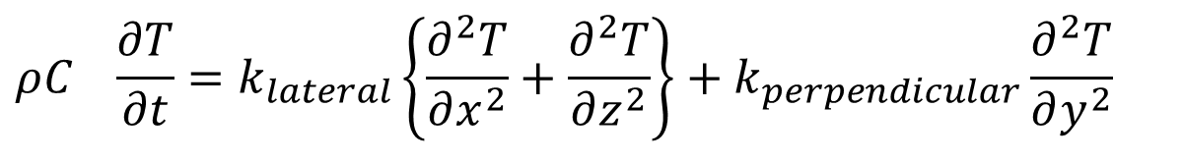
Thermal Conductivity of A PCB
$$ρC_{}\frac{∂T}{∂t}=k_{lateral}\left\{\frac{∂^{2}T}{∂x^{2}}+\frac{∂^{2}T}{∂z^{2}}\right\}+k_{perpendicular}\frac{∂^{2}T}{∂y^{2}}$$
Effective PCB Thermal Conductivity
  Lateral Conductivity
  Perpendicular Conductivity

