Slide 1



Oriented Structural Design of Thermal Interface Materials
P M V Subbarao
Professor
Mechanical Engineering Department
Vector TIMS to Control Heat Flux Vector!!!

Slide 2

Advanced Manufacturing for future AI
With the rapid development of artificial intelligence (AI) and bigdata technologies, electronic devices are evolving toward higher integration and power density.
Posing severe challenges for thermal dissipation.
More than 50% of the thermal resistance is attributed to the interfaces.
High-performance thermal interface materials (TIMs) are key to achieving efficient thermal management of electronic devices.
New manufacturing methods for development of advanced low thermal resistance TIMs, are critical for achieving efficient thermal management.

Slide 3
The Interface Conflict
When two rigid solids come into contact, surfaces that appear smooth at the macroscopic scale still exhibit roughness at the microscopic scale.
This results in imperfect contact.
Even under a pressure of approximately 400 kPa, the effective contact area between solids is only 1–2%.
98 to 99% of the gap is filled by air, whose thermal conductivity is only 0.026 Wm⁻¹K⁻¹.
It is impossible to completely fill the micron level gaps using rigid solids.
Try Soft Polymers…

Slide 4
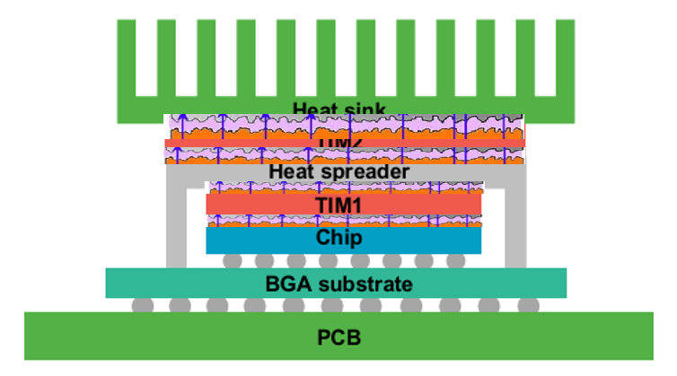
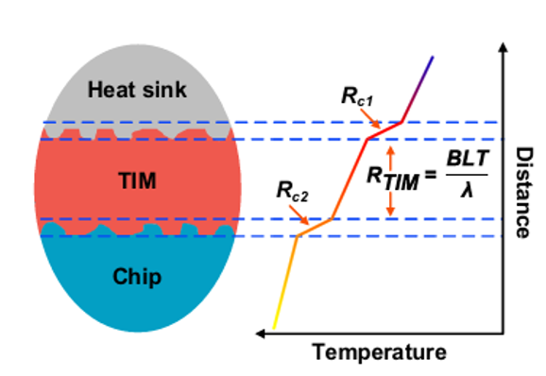
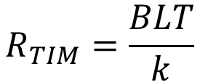
Unconventional Conduction Heat Transfer in Interfaces with TIM
$$R_{tot−interface}=R_{TIM}+R_{c1}+R_{c2}$$
$$R_{TIM}=\frac{BLT}{k}$$

Slide 5
The Interface Conflict
Polymers are soft but not crystalline.
But polymers exhibit lower k, typically ranging from 0.1 to 0.5 Wm⁻¹K⁻¹.
This is due to the disordered arrangement of molecular chains, which causes frequent scattering of phonons.
Molecular disorder of polymers make them soft with poor thermal conductivity.
However, better than air.
Should we compromise???
Fourier’s law of conduction is a constitutive relation.
Consult a Constitutional Reformer !!!

Slide 6
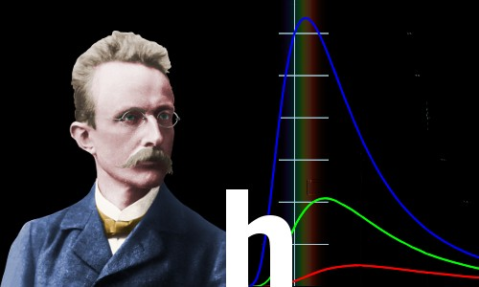
Max Karl Ernst Ludwig Planck:
A Free Thinker
Followed logic past accepted norms: Introduced energy quanta in 1900 as an "act of despair" to solve black-body radiation, dismantling classical physics.
Challenged dogmatic resistance: Famously noted that new scientific truths triumph not by convincing opponents, but because opponents eventually die off.
There is no matter as such.
All matter originates and exists only by virtue of a force which brings the particle of an atom to vibration and holds this most minute solar system of the atom together.
We must assume behind this force the existence of a conscious and intelligent Mind. This Mind is the matrix of all matter.
Max Planck changed physics and our cognizance of the world forever
Hermann Müller taught his receptive young student how to visualize the laws of physics in his mind – a vital weapon in the armory of the great physicists

Slide 7
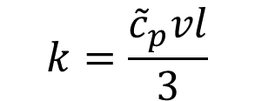
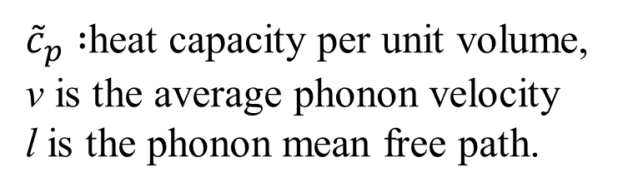
Microscopic View of Thermal Conductivity
The thermal conductivity (k) can be categorized into in-plane and through-plane thermal conductivity based on the transfer direction of heat flow.
For TIM, high through-plane k is particularly critical, as it enables rapid transfer of waste heat from the bottom to the top of the TIM.
This transfer facilitates heat dissipation.
High in-plane k helps prevent the generation of hot spots.
In solid materials, heat transfer is typically conducted through either electrons or atomic vibrations known as phonons.
Thermal conductivity of solids can be described by the Debye equation:
${\tilde{c}}_{p} :$heat capacity per unit volume,
v is the average phonon velocity
l is the phonon mean free path.
$$k=\frac{{\tilde{c}}_{p}vl}{3}$$

Slide 8
Microscopic View of A TIM
The phonon mean free path is relatively long in the regular lattice structure in crystalline materials.
Long MFP results in high k.
In contrast, polymers exhibit lower k, typically ranging from 0.1 to 0.5 Wm⁻¹K⁻¹, due to the disordered arrangement of molecular chains, which causes frequent scattering of phonons.
Molecular disorder significantly shortens their mean free path.
Enhancement the k of polymer TIMs primarily depends on incorporating thermally conductive fillers and maximizing filler loading.

Slide 9
Microscopic View of A TIM
Phonon scattering at the filler-matrix interface severely limits the improvement in thermal conductivity.
The intrinsic k of polymer-based TIM is mainly determined by
the thermal conductivity of the polymer matrix and filler,
the loading of the filler,
the distribution of the filler, and
the ITR between the filler and the matrix.
To improve the k of TIMs, the key is to minimize the inefficient heat transfer paths within the polymer matrix and reduce the filler-matrix interface.
Demands New manufacturing methods to filler Orientation at microscopic level.

Slide 10
Compliant Composites as TIMs
Compliant composites with high thermal conductivity can be soft with decent thermal conductivity.
They are best to fill the gaps, as TIMs.
The TIM between the chip and the heat spreader is referred to as TIM1, while the TIM between the heat spreader and the heat sink is referred to as TIM 2.
TIM 1 is in direct contact with the chip and hence it requires not only a high k but also excellent electrical insulation properties.
Advancements in compliant composite TIM are fundamentally contingent upon optimizing R_{TIM} and R_{c.}
Manufacturing processes for production of Compliant composites with high thermal conductivity to fill the gaps is the challenge for next two decades.

Slide 11
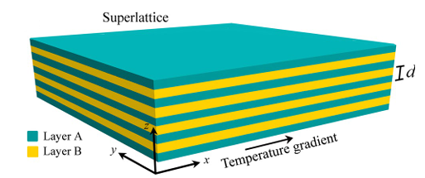
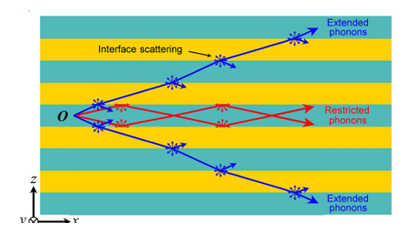
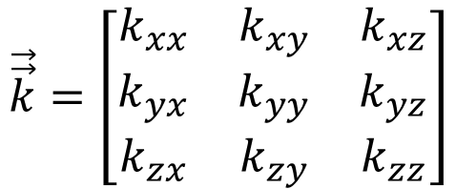


Schematic Representation of Phonon Transport
The in-plane thermal conductivity of superlattices is calculated by using the well-established Fourier’s law of heat conduction, which is given by
$$\vec{q^{′′}}=−k∇T$$
Kinematics of Phonons & thermal conductivity
$$\vec{q^{′′}}=−\vec{\vec{k}}∙∇T$$
$$\vec{\vec{k}}=\left[\begin{matrix}k_{xx} & k_{xy} & k_{xz} \\ k_{yx} & k_{yy} & k_{yz} \\ k_{zx} & k_{zy} & k_{zz}\end{matrix}\right]$$

Slide 12
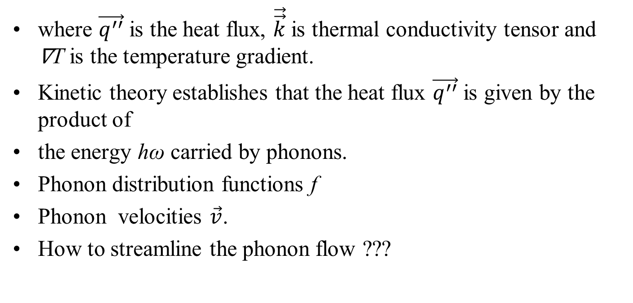

Phonons & Thermal Conductivity
$$\vec{q^{′′}}=−\vec{\vec{k}}∙∇T$$
where $\vec{q^{′′}}$ is the heat flux, $\vec{\vec{k}}$is thermal conductivity tensor and ∇T is the temperature gradient.
Kinetic theory establishes that the heat flux $\vec{q^{′′}}$ is given by the product of
the energy hω carried by phonons.
Phonon distribution functions f
Phonon velocities $\vec{v}$.
How to streamline the phonon flow ???

Slide 13
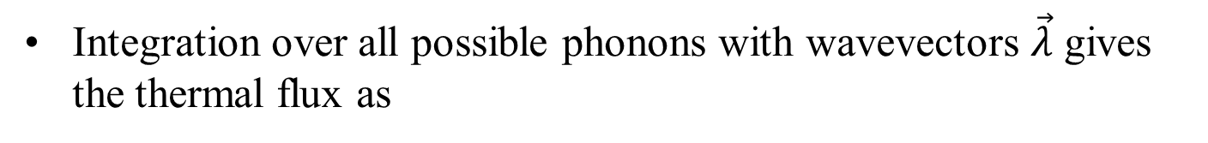
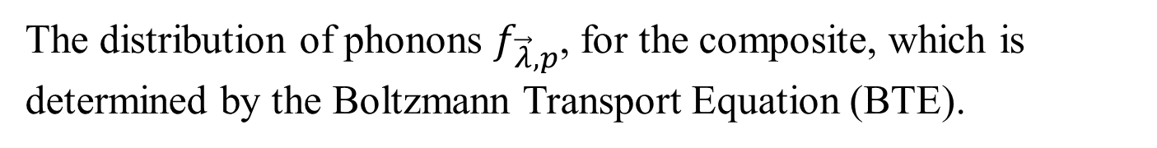
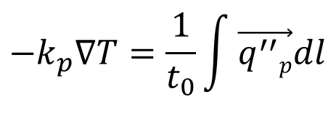
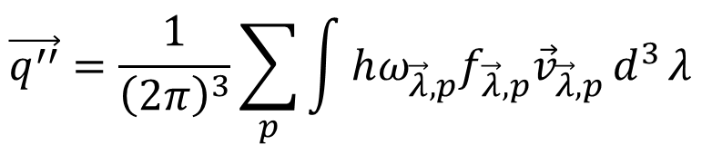
Phonons & Thermal Conductivity
$$\vec{q^{′′}}=−\vec{\vec{k}}∙∇T$$
Integration over all possible phonons with wavevectors $\vec{λ}$ gives the thermal flux as
$$\vec{q^{′′}}=\frac{1}{{\left(2π\right)}^{3}}\sum_{p}{\int{hω_{\vec{λ},p}f_{\vec{λ},p}{\vec{v}}_{\vec{λ},p}}d^{3}}λ$$
where the subscript p denotes the different polarizations of phonons (i.e. longitudinal and transverse).
The thermal conductivity κ_{p} of the superlattice is calculated by combining above equations and integrating the flux along the p over a period t₀ as
$$−k_{p}∇T=\frac{1}{t_{0}}\int{\vec{q^{′′}p}dl}$$
The distribution of phonons $f_{\vec{λ},p}$, for the composite, which is determined by the Boltzmann Transport Equation (BTE).

Slide 14
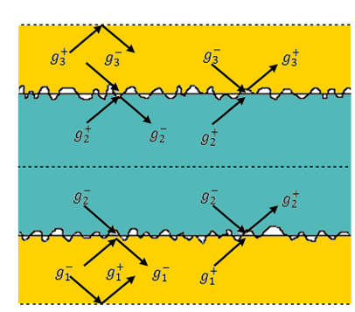
Phonon scattering at rough surfaces
For infinitely periodic interfaces between filler particles and polymer, the boundary conditions are given by an energy balance upon scattering of phonons at the rough interfaces.
A rigorous statistical analysis is required to study the scattering of thermal phonons from rough surfaces and finally corresponding macroscopic variables are obtained.
Boundary Line Matrix (BLT) is one such macro variable.

Slide 15
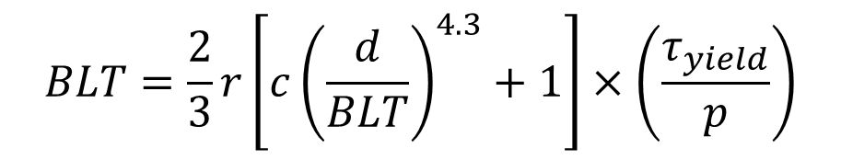
BLT: A macroscopic equivalent of Phonon Kinematics
The BLT of TIMs should be as thin as possible.
In practical applications, too thin a TIM is prone to gaps during thermal cycling, reducing its reliability.
A suitable BLT not only effectively fills the gaps between a rigid component but also relieves the stress caused by the thermal expansion mismatch and absorbs vibrations.
BLT based on rheological models, known as the scaling–bulk (S–B) model, expressed as follows:
$$BLT=\frac{2}{3}r\left[c{\left(\frac{d}{BLT}\right)}^{4.3}+1\right]×\left(\frac{τ_{yield}}{p}\right)$$

Slide 16
Contact Resistance due to TIM
TIMs can effectively fill these gaps, under limited packaging pressure.
However, the TIM itself cannot perfectly conform to the roughness of rigid components.
Some tiny gaps inevitably remain.
Heat flow is conducted not only through the actual contact areas between the solids but also through the gaps in the noncontact regions of the interface.
This contraction of heat flow leads to the formation of Rc, related to the roughness and hardness of the material and contact pressure.

Slide 17
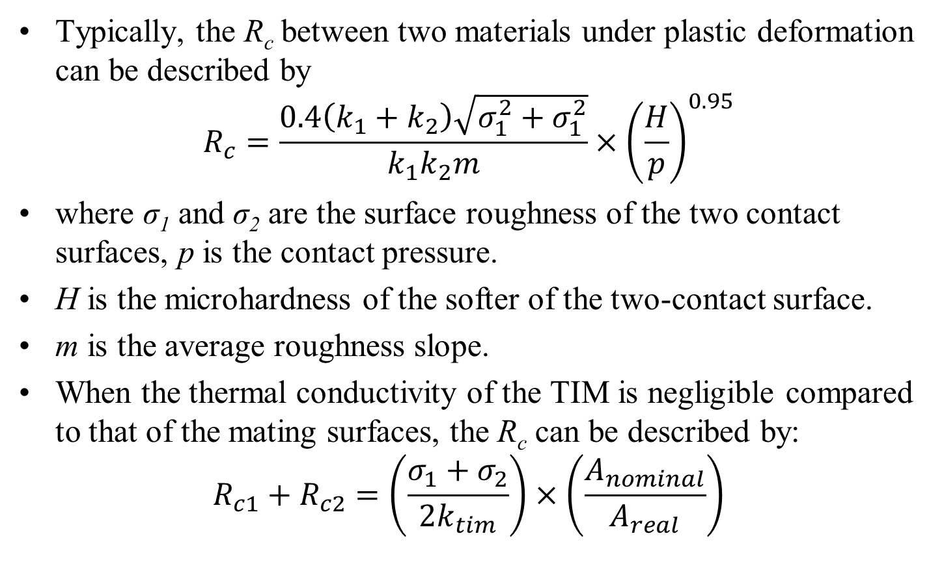
Contact Resistance due to TIM
Typically, the R_{c} between two materials under plastic deformation can be described by
$$R_{c}=\frac{0.4\left(k_{1}+k_{2}\right)\sqrt{σ_{1}^{2}+σ_{1}^{2}}}{k_{1}k_{2}m}×{\left(\frac{H}{p}\right)}^{0.95}$$
where σ₁ and σ₂ are the surface roughness of the two contact surfaces, p is the contact pressure.
H is the microhardness of the softer of the two-contact surface.
m is the average roughness slope.
When the thermal conductivity of the TIM is negligible compared to that of the mating surfaces, the R_{c} can be described by:
$$R_{c1}+R_{c2}=\left(\frac{σ_{1}+σ_{2}}{2k_{tim}}\right)×\left(\frac{A_{nominal}}{A_{real}}\right)$$

Slide 18
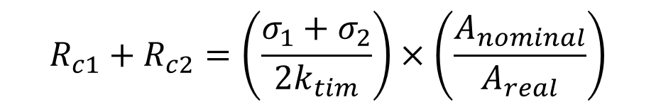
Contact Resistance due to TIM
$$R_{c1}+R_{c2}=\left(\frac{σ_{1}+σ_{2}}{2k_{tim}}\right)×\left(\frac{A_{nominal}}{A_{real}}\right)$$
where A_{nominal} and A_{real} represent the nominal and actual microscopic contact areas of the two contact surfaces.
Traditional polymer-based TIMs, even with an excessively high loading of thermally conductive fillers, show limited improvement in k.
This is primarily attributed to the weak phonon transport in the disordered polymer chains, the lack of continuous and efficient heat transfer pathways, and the strong phonon scattering at the interface between the fillers and the polymer matrix.

Slide 19
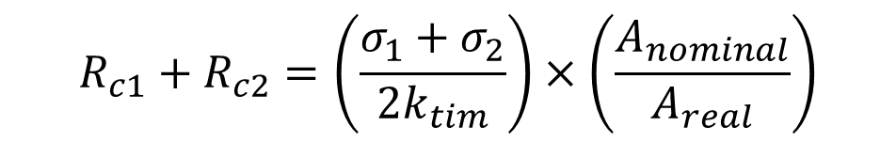
Contact Resistance due to TIM
$$R_{c1}+R_{c2}=\left(\frac{σ_{1}+σ_{2}}{2k_{tim}}\right)×\left(\frac{A_{nominal}}{A_{real}}\right)$$
There fore, the key to improving k of TIMs is to prevent fillers from being separated by the polymer matrix, thereby reducing inefficient filler-matrix-filler thermal pathways.
Advanced manufacturing methods for enhancing k based on oriented structure design is future TIM development.

Slide 20
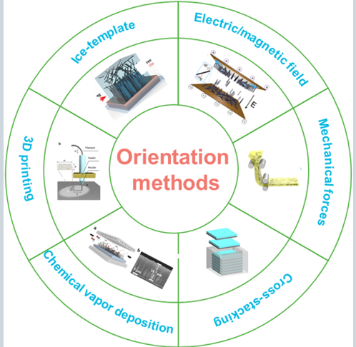
Macro Manufacturing Methods to control Microscopic Filler Orientation

Slide 21
Ice-template Assisted Orientation
Ice-templated orientation utilizes ice crystals as templates to align fillers in an aqueous solution along the direction of ice crystal growth.
Also known as directional freeze-casting.
In this process, a cold metal finger, whose temperature is controlled by a liquid nitrogen bath, is used to create a temperature gradient.
The aqueous slurry containing fillers is placed onto the cold metal finger, driving the growth of ice crystals in a specific direction.
Simultaneously, the fillers are confined within the ice crystal gaps and align along the ice growth direction.

Slide 22
Ice-template Assisted Orientation
After freeze-casting, the ice crystals are removed through vacuum freeze-drying at low temperatures, resulting in an oriented filler skeleton.
Generally, directional freeze-casting is suitable for 1D or 2D thermally conductive fillers to design oriented structures.

Slide 23
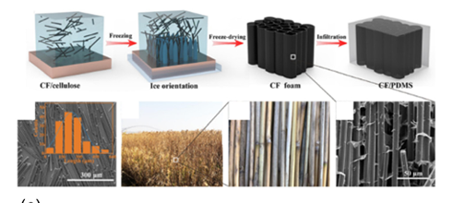
CFs Oriented Skeleton
Construction of the CFs oriented skeleton using the ice template method.
The fabricated TIM exhibited a through-plane λ of 6.04 Wm⁻¹ K⁻¹ at a CF loading of 12.8 vol % in polydimethylsiloxane (PDMS).

Slide 24
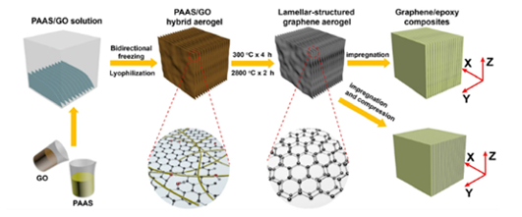
Lamellar-structured Graphene Aerogels
Preparation of lamellar-structured graphene aerogels with oriented and closely stacked graphene lamellae by bidirectional freezing, imidization, and graphitization treatments.
The resulting epoxy composite exhibits a through plane λ of up to 20.0 Wm−1 K−1 with 2% graphene loading in epoxy.

Slide 25
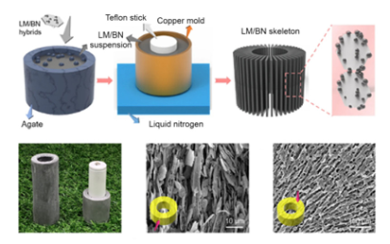
Oriented LM-modified BN skeleton
Construction of oriented LM-modified BN skeleton using the ice template method.

Slide 26
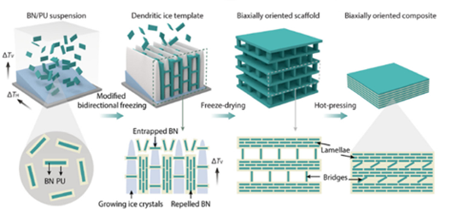
Biaxially oriented BN skeleton by modified bidirectional freeze-casting.
Construction of biaxially oriented BN skeleton by modified bidirectional freeze-casting.

Slide 27
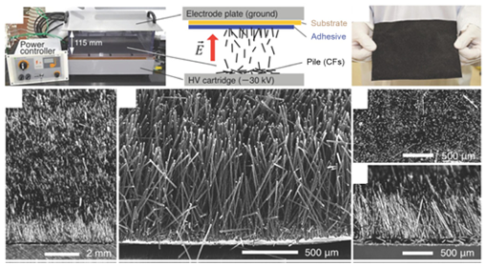
vertically aligned and high-density CF arrays

Slide 28
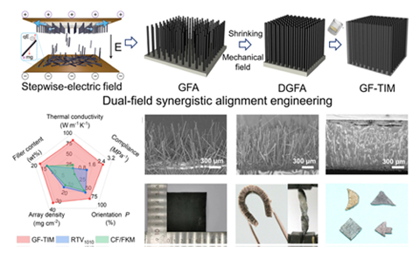
Vertically aligned GFs scaffold

Slide 29
Closure on TIMS
Two modern problems of thermal transport of micro- and nanostructures:
1) heat transfer through the contact surfaces between two solids (through interfaces).
A quantitative measure of the rate of heat transfer through interfaces is the Kapitza conductance (the reciprocal is the thermal boundary resistance (TBR).
2) Scattering of heat carriers (phonons) at the free boundary of a sample during the propagation of heat along the films (tubes).
Quantitatively, this process is characterized by the effective longitudinal thermal conductivity (ETC).

