Slide 1



Thermal Interfacing Materials for Electronic Packaging
P M V Subbarao
Professor
Mechanical Engineering Department
More layers for less Total Thermal Resistance!?!?

Slide 2

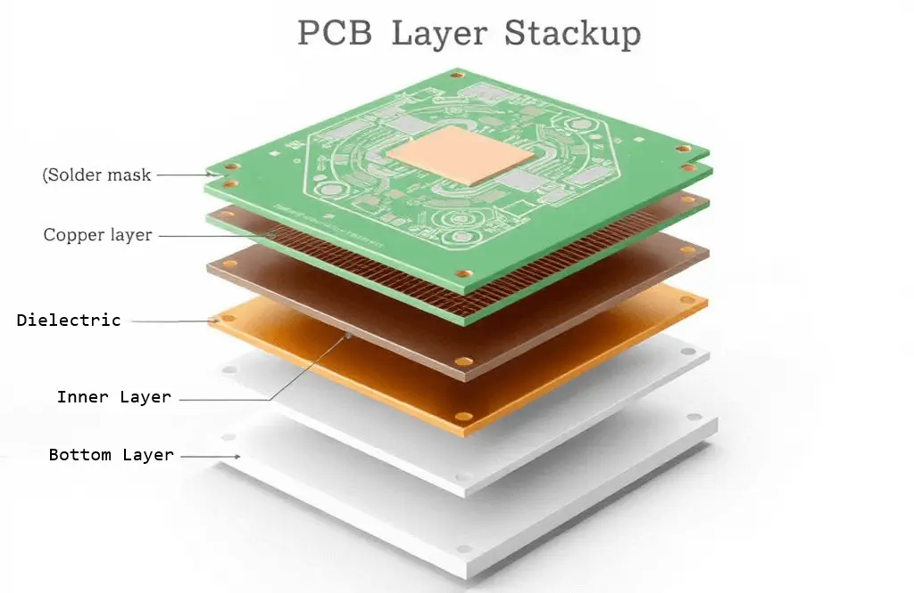
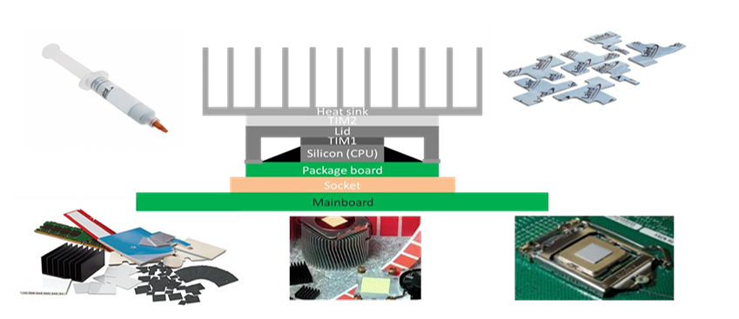
An Electronic System is अन्तर्बहिश्च तत् सर्वं व्याप्य Interfaces

Slide 3
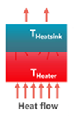
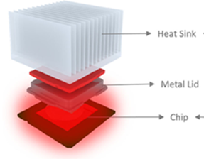
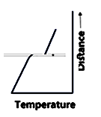

Deviation from Conventional Heat Conduction at Interface
$$\frac{A × ∆T_{jump}}{\dot{Q}}= ????$$

Slide 4
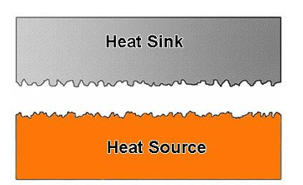
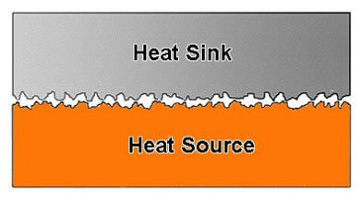
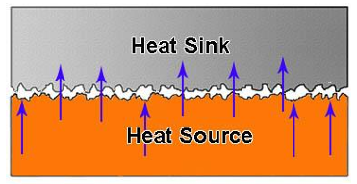
Primary Physics behind Temperature Jump
A view of the two surfaces of a heat sink and a heat source shows the rough machined surface.
Machined surfaces can lead to few contact points between surfaces of the heat sink and the heat source.
Typically, less than 2% of the overall area interacts with each other when two surfaces, metallic or semiconductor, are placed in contact
The remaining area is occupied by air, which has a low thermal conductivity of 0.026 Wm−1 K−1 at room temperature (RT)

Slide 5
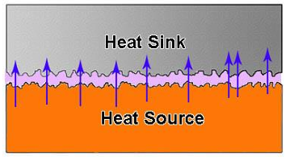
Primary Physics behind Temperature Jump
A view of the two surfaces of a heat sink and a heat source shows the rough machined surface.
Machined surfaces can lead to few contact points between surfaces of the heat sink and the heat source.

Slide 6
Interfacial thermal resistance
Even assuming perfect contact at the atomic level, the boundary between two solid phases is resistive to heat flow.
This is due to differences in vibrational and electronic properties in different materials.
The heat carrier (phonon or electron) arriving at the interface will undergo scattering.
The probability of transmission after scattering will depend on available energy states on both sides of the interface
The transfer of thermal energy at interfaces involves complex interactions and scattering processes.
Electron–phonon interactions.
Phonon–phonon interactions.
Phonon-interface scattering.

Slide 7
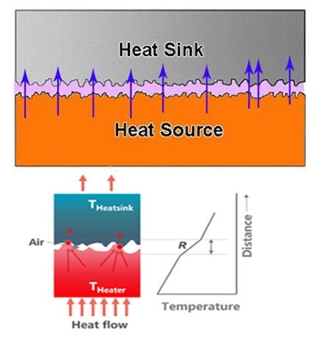
Filling Materials for Interfaces and ITR
From a materials perspective, thermal interface materials (TIMs) play a crucial role in electronic devices.
These materials are specifically engineered to fill microgaps and address surface irregularities that emerge when electronic devices interface with heat dissipation elements.

Slide 8
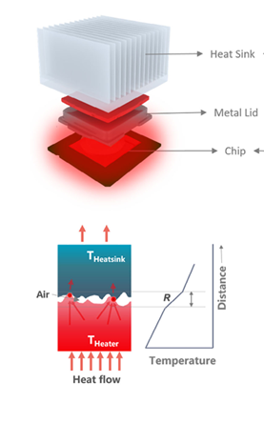
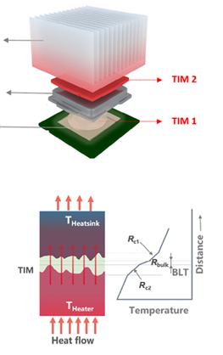
More Interfaces due to TIM
The primary objective is to reduce the overall contact thermal resistance that impedes heat transfer at the interface,

Slide 9
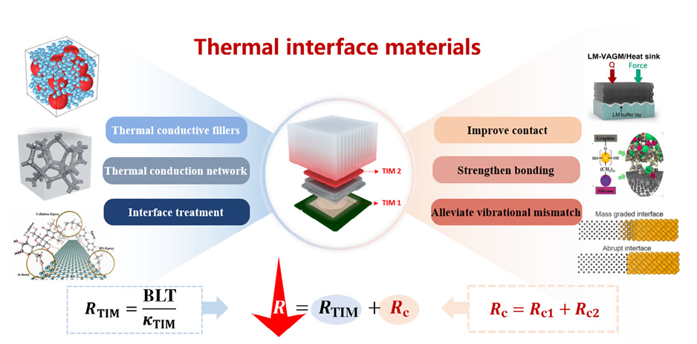
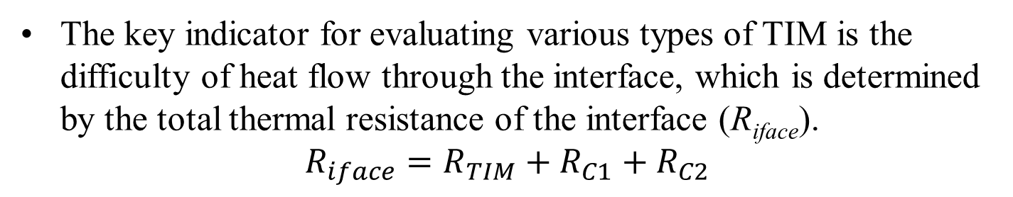
Interfacial thermal resistance with TIM
The key indicator for evaluating various types of TIM is the difficulty of heat flow through the interface, which is determined by the total thermal resistance of the interface (R_{iface}).
$$R_{iface}=R_{TIM}+R_{C1}+R_{C2}$$

Slide 10
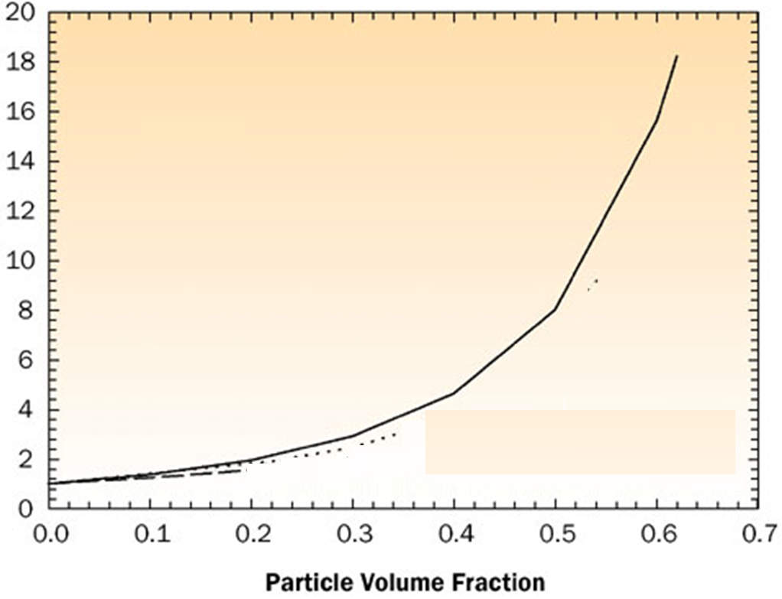
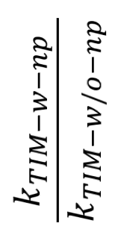
Thermal Interface Materials & Thermal Conductivity
The TIM serves to conduct heat through its thickness.
The thermal conductivity of a TIM is typically enhanced by loading a soft, sometimes liquid-like polymeric material matrix with conducting solid particles, such as aluminum, alumina and boron nitride.
If the design requirement is that the TIM should be thermally conducting but electrically insulating, then the ceramic based filler particles are more typically chosen.
$$\frac{k_{TIM−w−np}}{k_{TIM−w/o−np}}$$

Slide 11
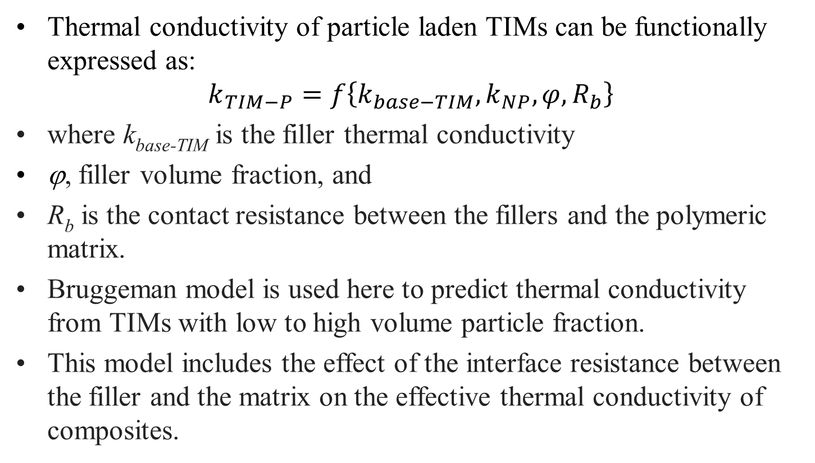
Thermal Interface Materials & Thermal Conductivity
Thermal conductivity of particle laden TIMs can be functionally expressed as:
$$k_{TIM−P}=f\left\{k_{base−TIM},k_{NP},φ,R_{b}\right\}$$
where k_{base-TIM} is the filler thermal conductivity
ϕ, filler volume fraction, and
R_{b} is the contact resistance between the fillers and the polymeric matrix.
Bruggeman model is used here to predict thermal conductivity from TIMs with low to high volume particle fraction.
This model includes the effect of the interface resistance between the filler and the matrix on the effective thermal conductivity of composites.

Slide 12
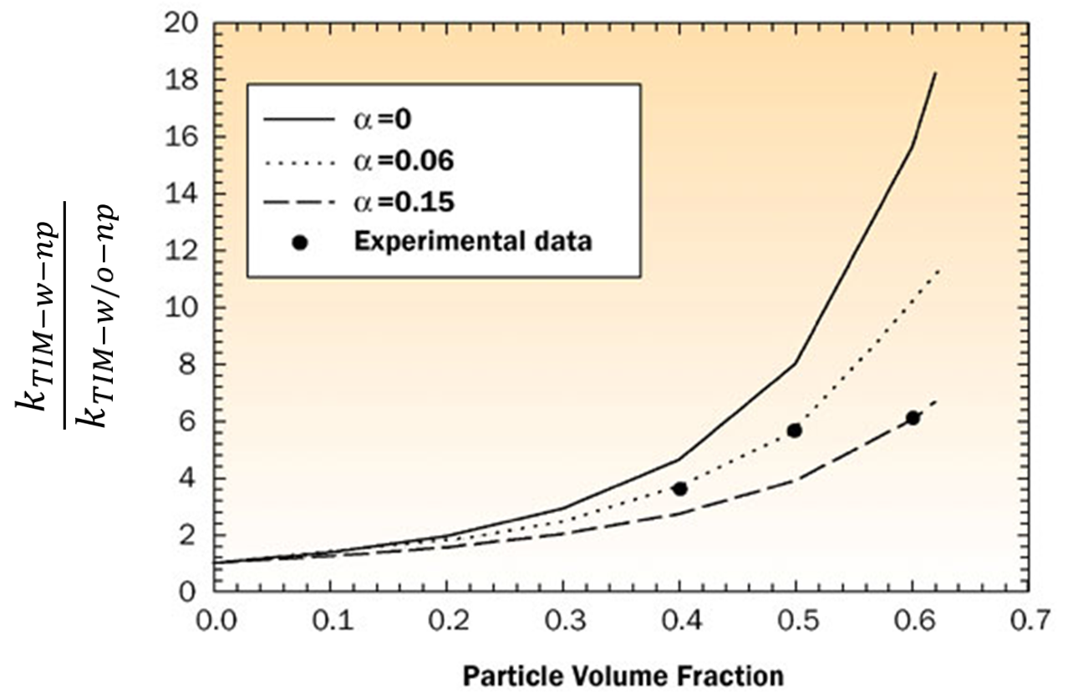
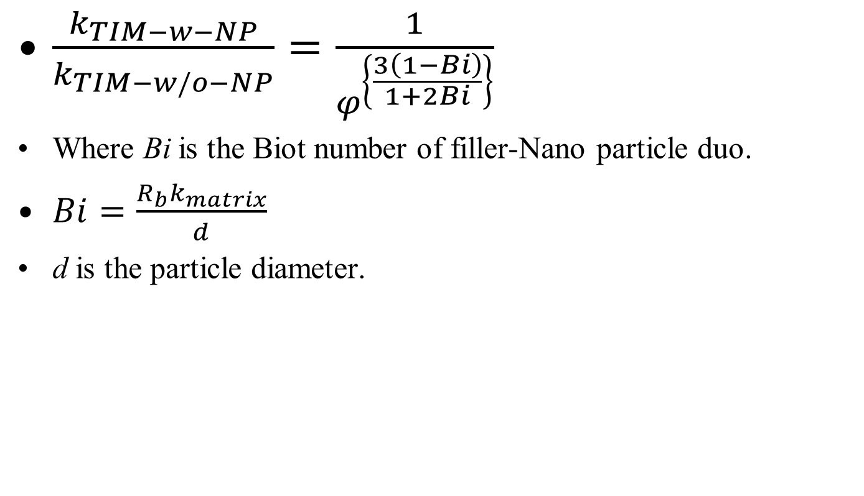
Bruggeman model and Biot Number
$\frac{k_{TIM−w−NP}}{k_{TIM−w/o−NP}}=\frac{1}{φ^{\left\{\frac{3\left(1−Bi\right)}{1+2Bi}\right\}}}$
Where Bi is the Biot number of filler-Nano particle duo.
$Bi=\frac{R_{b}k_{matrix}}{d}$
d is the particle diameter.
Bi
Bi
Bi

Slide 13
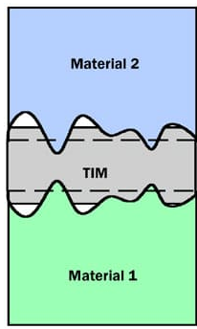
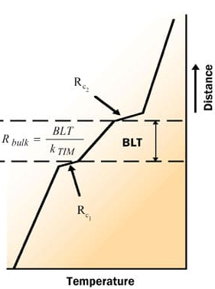
Characteristics of a TIM Layer
Achieving low ITR not only necessitates a high intrinsic k to enhance heat conduction but also demands the reduction of the heat path between the gaps, known as the Bond Line Thichkness.

Slide 14
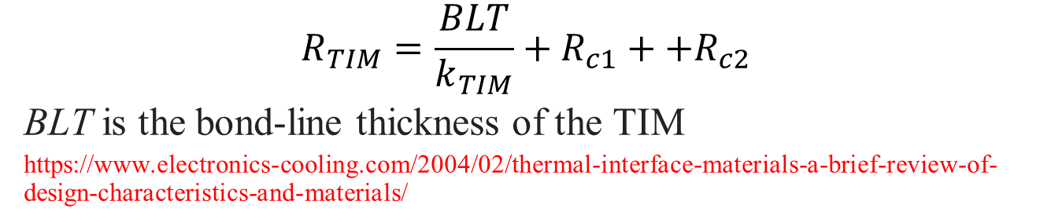
Characteristics of a TIM Layer
$$R_{TIM}=\frac{BLT}{k_{TIM}}+R_{c1}++R_{c2}$$
BLT is the bond-line thickness of the TIM
https://www.electronics-cooling.com/2004/02/thermal-interface-materials-a-brief-review-of-design-characteristics-and-materials/

Slide 15

Desired Characteristics of a TIM Layer
$$R_{TIM}=\frac{BLT}{k_{TIM}}+R_{c1}+R_{c2}$$
R_{c1} and R_{c2} are the contact resistances of the TIM with the two adjoining surfaces.
R_{TIM}, R_{c1}, and R_{c2} are area-normalized thermal resistances (k-m²/W).
One of the goals of thermal design is to reduce R_{TIM}.
Accomplished by reducing the BLT, increasing the thermal conductivity and reducing the contact resistances R_{c1} and R_{c2}.

Slide 16
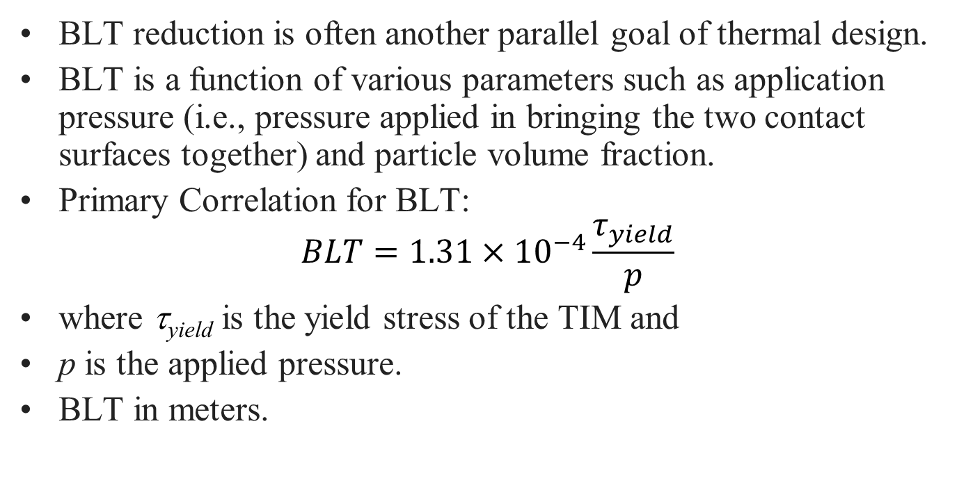
Bond-Line Thickness (BLT)
BLT reduction is often another parallel goal of thermal design.
BLT is a function of various parameters such as application pressure (i.e., pressure applied in bringing the two contact surfaces together) and particle volume fraction.
Primary Correlation for BLT:
$$BLT=1.31×{10}^{−4}\frac{τ_{yield}}{p}$$
where τ_{yield} is the yield stress of the TIM and
p is the applied pressure.
BLT in meters.

Slide 17
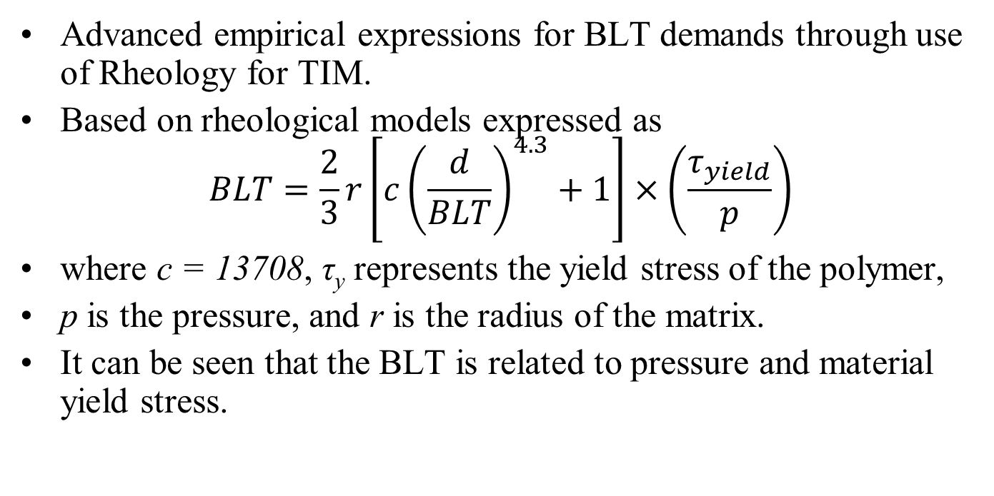
Advanced Correlations for
Bond-Line Thickness (BLT)
Advanced empirical expressions for BLT demands through use of Rheology for TIM.
Based on rheological models expressed as
$$BLT=\frac{2}{3}r\left[c{\left(\frac{d}{BLT}\right)}^{4.3}+1\right]×\left(\frac{τ_{yield}}{p}\right)$$
where c = 13708, τ_{y} represents the yield stress of the polymer,
p is the pressure, and r is the radius of the matrix.
It can be seen that the BLT is related to pressure and material yield stress.

Slide 18
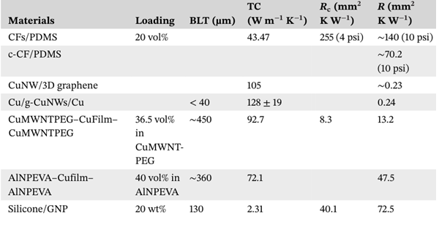
Recent TIMs

Slide 19
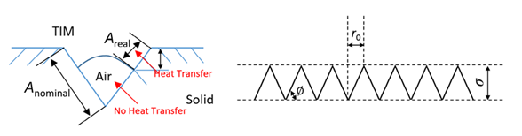
Contact Resistance
Contact thermal resistance, R_{c1} and R_{c2}, are related to interface surface roughness, material TC , hardness, Young’s modulus, wettability, and other properties.
For fluid TIMs, the wetting characteristics of liquid materials on solid surfaces depend on surface chemistry.
It is assumed that the solid surface roughness profile consists of a series of V-shaped grooves of equal height, and the half-width lengths of all V-shaped grooves are equal and equal to a parameter, as shown below

Slide 20
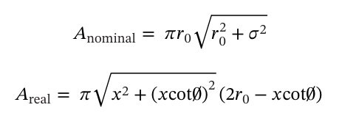

Contact Resistance
$$R_{c}=R_{c1}+R_{c2}=\left\{\frac{σ_{1}+σ_{2}}{2k_{TIM}}\right\}\left\{\frac{A_{nominal}}{A_{real}}\right\}$$

Slide 21
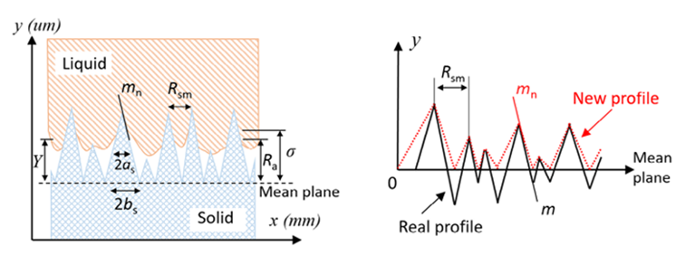
New Models for TIM–solid interface profile
The “Gaussian distribution assumption” is more widely adopted for solid surface roughness.
More standardized roughness parameters, such as the mean asperity peak spacing (R_{sm}) need to implemented in R_{c} model.

Slide 22

New Models for TIM–solid interface profile
Where 𝜅_{s}=2𝜅₁𝜅₂/(𝜅₁+𝜅₂) is the effective TC of the contacting materials.
Y is mean trapped air thickness, which has great influence on the R_{c}.

Slide 23
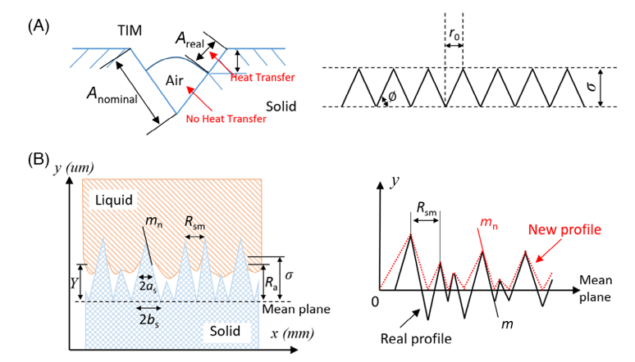
New Models for TIM–solid interface profile

Slide 24
Challenges and opportunities Manufacture of TIMs
The rapid growth of consumer electronics is the main driving force for widespread utilization of TIMs.
The thermal resistance generated between different fillers at the interface (RF-F) becomes key factors limiting the TC improvement of composite materials.
Most modern manufacturing techniques are used to adjust and enhance the TIM interface structure to reduce R_{F-F}.
The manufacturing processes optimize filler distribution.
Advanced manufacturing of composite materials focused on enhancing the dispersion of fillers to augment κ.

