Slide 1

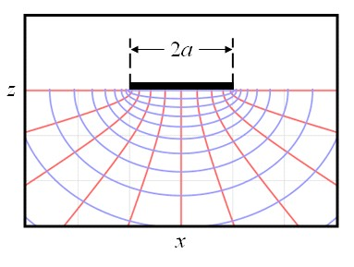
Spreading/Constriction Resistance
P M V Subbarao
Professor
Mechanical Engineering Department
A High-Power Density Processor Needs Larger Convective Cooling Area …

Slide 2

Constriction/Spreading Resistance
Constriction/spreading resistance exists whenever heat flows from one region to another of different cross-sectional area.
The term constriction is used describe the situation where heat flows into a narrower region.
The term spreading is used to describe the case where heat flows out of a narrow region into a larger cross-sectional area.
Phenomenologically the constriction resistance and spreading resistance are different.
However, quantitative analysis of thermal rectification due to the direction of heat flow, the constriction and spreading resistances are assumed to be identical in magnitude.

Slide 3
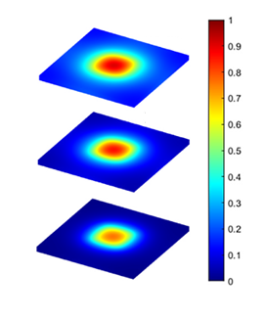



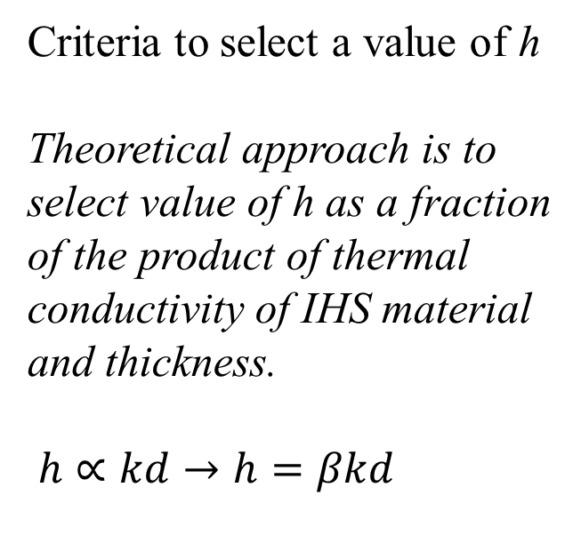
Temperature distribution in IHS
$$h=0.05kd$$
Criteria to select a value of h
Theoretical approach is to select value of h as a fraction of the product of thermal conductivity of IHS material and thickness.
$h∝kd→h=βkd$
h, Increasing
$$h=0.1kd$$
$$h=0.25kd$$
Temperature Profile in IHS

Slide 4
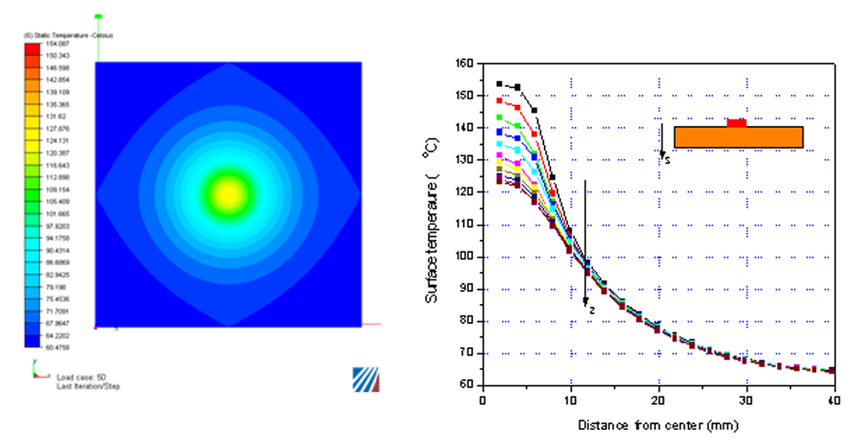
Temperature distribution in IHS

Slide 5
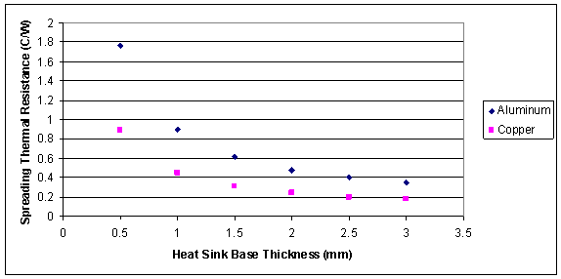
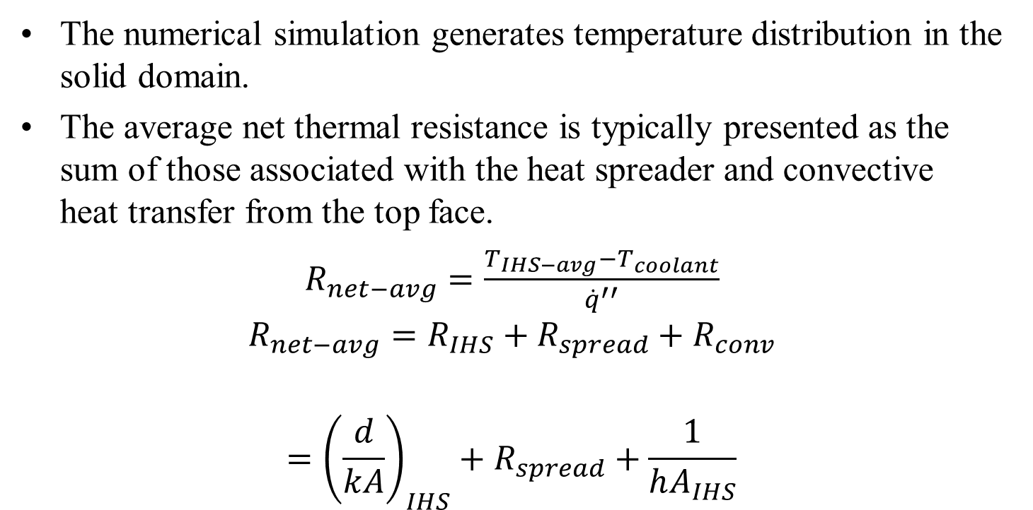
Spreading Resistance of an IHS
The numerical simulation generates temperature distribution in the solid domain.
The average net thermal resistance is typically presented as the sum of those associated with the heat spreader and convective heat transfer from the top face.
$R_{net−avg}=\frac{T_{IHS−avg}−T_{coolant}}{{\dot{q}}^{′′}}$
$$R_{net−avg}=R_{IHS}+R_{spread}+R_{conv}$$
$$={{\left(\frac{d}{kA}\right)}_{IHS}+R}_{spread}+\frac{1}{hA_{IHS}}$$
where T_{IHS-avg} is the average temperature of the heat source area.
R_{IHS} is the conductive thermal resistance of HIS.
R_{spread} Spreading Resistance

Slide 6
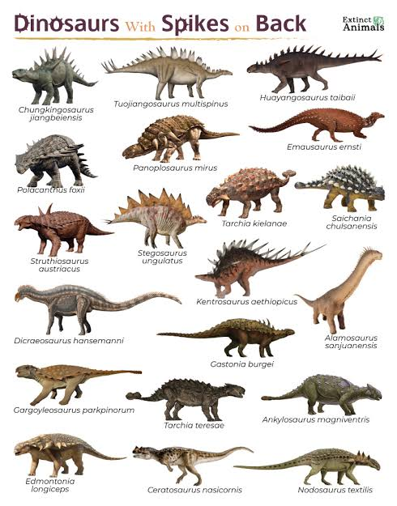
Nature of IHS
Heat spreaders are, in principle, lateral fins since they are intended to increase the heat transfer surface area.
It is like the function of traditional fins, though in a different orientation in relation to the heat source.
Fins themselves are a classical scenario of conjugate heat transfer, where the solid phase conductive heat transfer is strongly dependant on the convective heat transfer that acts on the solid boundaries.
This is also the case for heat spreaders and is an important consideration since, like fins, a heat spreader’s purpose is to increase the surface area for convection to act.

Slide 7
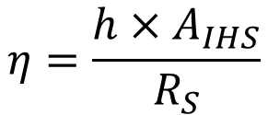
Efficiency of IHS
Therefore, considering the heat spreader as a fin can provide a more effective means to describe the conjugate heat transfer problem being considered.
The efficiency of the heat spreader can be defined as the thermal resistance to one of an infinite thermal conductivity.
$$η=\frac{h×A_{IHS}}{R_{S}}$$
where A_{IHS} is the surface area of the convective surface on the spreader.
The spreader efficiency, η_{IHS}, thus provides a representation of the heat spreading performance.
η_{IHS} closer to unity, the more effective area of the spreader’s top surface is active for convection to act.

Slide 8
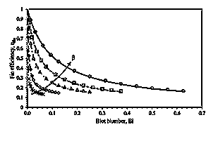

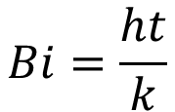
Efficiency of IHS
$$Bi=\frac{ht}{k}$$
$$h=βkd$$

Slide 9
Variables Effecting the Value of Spreading Thermal Resistance
Spreading (constriction) resistance depends on several factors such as
(1) geometry (2) domain, (3) boundary condition and (4) time (steady-state, transient).
The analytical solutions may be expressed in the form of infinite series.
Integrals can be computed quickly and accurately by means of computer algebra systems.

Slide 10
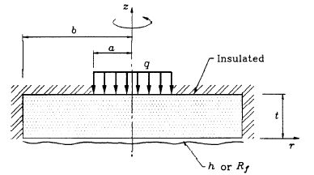
Role of Domain on Spreading Resistance Model

Slide 11
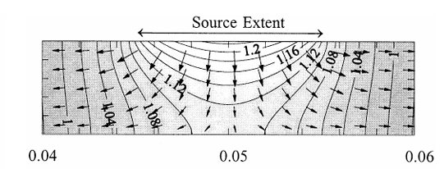
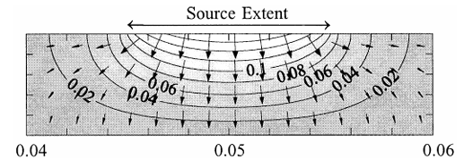
Role of Domain on Constriction Resistance Model

Slide 12
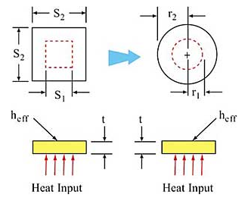
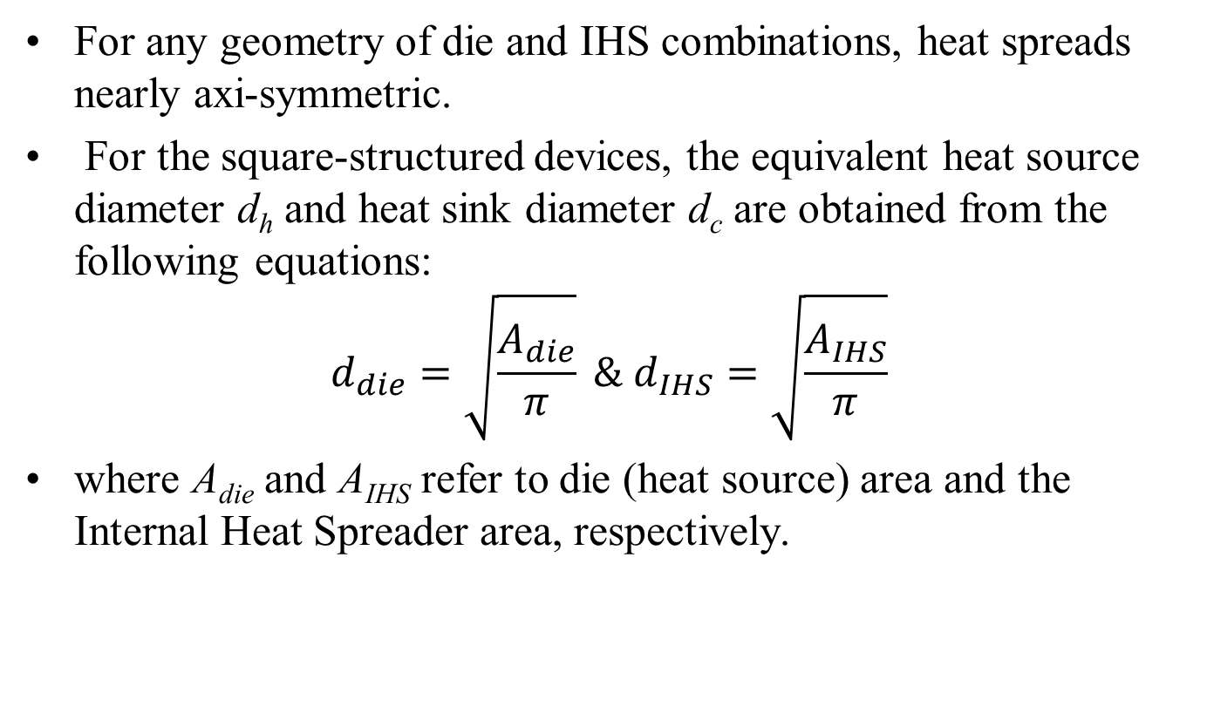
Spreading Resistances in Electronics Packaging
For any geometry of die and IHS combinations, heat spreads nearly axi-symmetric.
For the square-structured devices, the equivalent heat source diameter d_{h} and heat sink diameter d_{c} are obtained from the following equations:
$$d_{die}=\sqrt{\frac{A_{die}}{π}} \& d_{IHS}=\sqrt{\frac{A_{IHS}}{π}}$$
where A_{die} and A_{IHS} refer to die (heat source) area and the Internal Heat Spreader area, respectively.

Slide 13
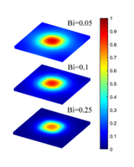

Radial Symmetry of Spread
Define Non-dimensional die diameter, ε
$$ε=\frac{d_{die}}{d_{IHS}}$$

Slide 14

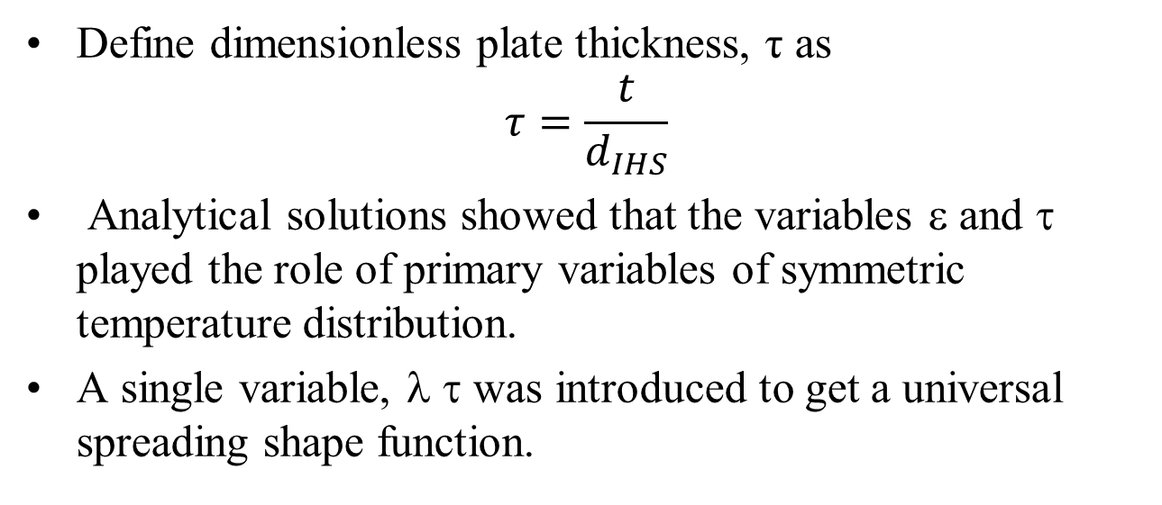
Semi-Analytical Models for Temperature Spreading Function
Define dimensionless plate thickness, τ as
$$τ=\frac{t}{d_{IHS}}$$
Analytical solutions showed that the variables ε and τ played the role of primary variables of symmetric temperature distribution.
A single variable, λ τ was introduced to get a universal spreading shape function.
$λ=π+\frac{1}{\sqrt{πε}}$

Slide 15
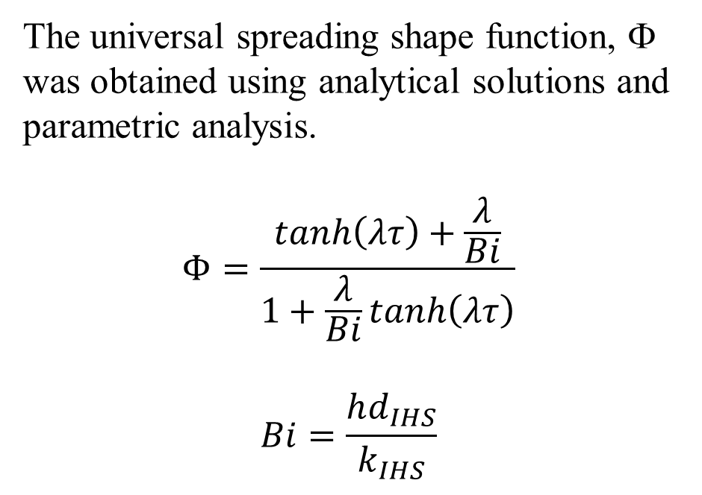
Semi-Analytical Models for Temperature Spreading Function
The universal spreading shape function, Φ was obtained using analytical solutions and parametric analysis.
$$Φ=\frac{tanh\left(λτ\right)+\frac{λ}{Bi}}{1+\frac{λ}{Bi}tanh\left(λτ\right)}$$
$$Bi=\frac{hd_{IHS}}{k_{IHS}}$$

Slide 16
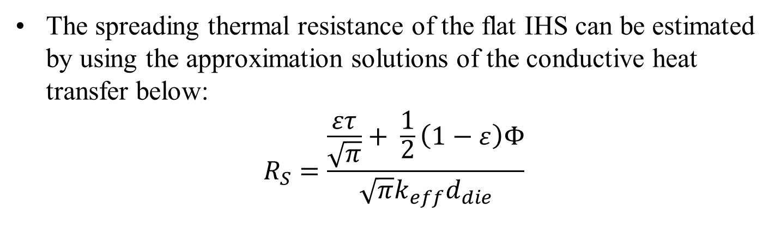
Correlations for the Value of Spreading Thermal Resistance
The spreading thermal resistance of the flat IHS can be estimated by using the approximation solutions of the conductive heat transfer below:
$$R_{S}=\frac{\frac{ετ}{\sqrt{π}}+ \frac{1}{2}\left(1−ε\right)Φ}{\sqrt{π}k_{eff}d_{die}}$$

Slide 17

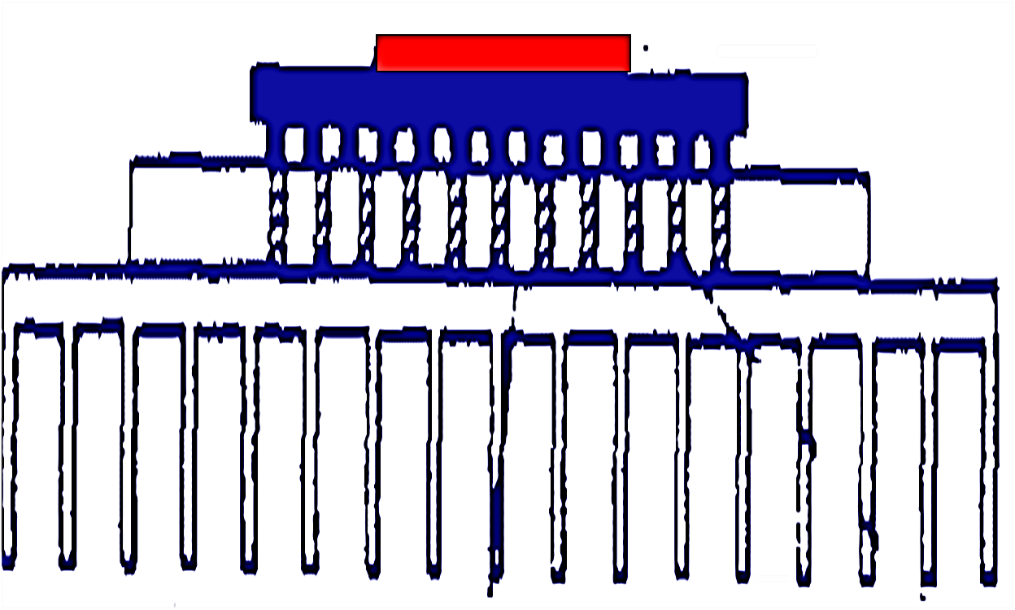
Constriction & Spreading Resistances in Electronics Boards
Consider a case of chip package on PCB & Heat Sink:

Slide 18
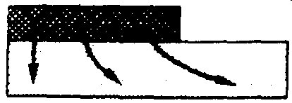
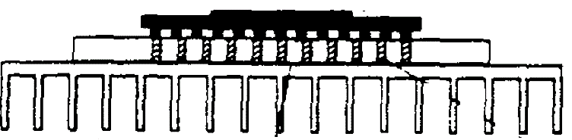
Constriction & Spreading Resistances in Electronics Boards
Consider a chip package on PCB:
Chip to Substrate Spread

Slide 19

Constriction & Spreading Resistances in Electronics Packaging
Consider a chip package on PCB:
Chip to Substrate Spread
Constriction & Spread across Solder Balls

Slide 20
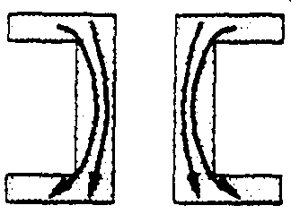
Constriction & Spreading Resistances in Electronics Packaging
Consider a chip package on PCB:
Chip to Substrate Spread
Constriction & Spread across Solder Balls
Constriction & Spread Through Thermal Vias

Slide 21
Constriction & Spreading Resistances in Electronics Packaging
Consider a chip package on PCB:
Chip to Substrate Spread
Constriction & Spread across Solder Balls
Constriction & Spread Through Thermal Vias
PCB to Heat Sink

Slide 22
In many instances,
the constriction and spreading resistances may become greater than one-dimensional material resistances in a system and represent an essential part of the total thermal resistance in predicting the overall thermal performance of the device.
Many studies have been carried out to determine the constriction/spreading resistances since 1960.!!!

Slide 23
Theory of Constriction Resistance
Models for Steady-state and Transient constriction (spreading) resistances for a range of geometries for isothermal and iso-flux boundary conditions are essential for chip level thermal management.
Analytical/Numerical solutions will help in obtaining simple models for constriction resistance.
Elastoconstriction resistance and gap and joint resistances for line and point contacts are also equally important.

Slide 24
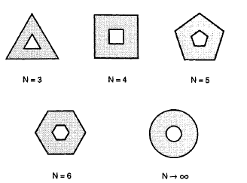
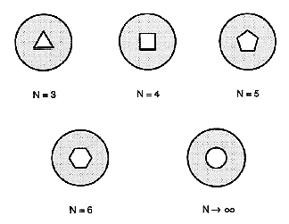
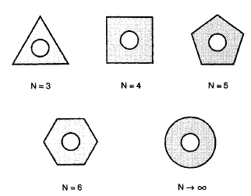
Geometrical Models for Generalized Constriction Resistance
Dissimilar Constrictions
Similar Constrictions

Slide 25
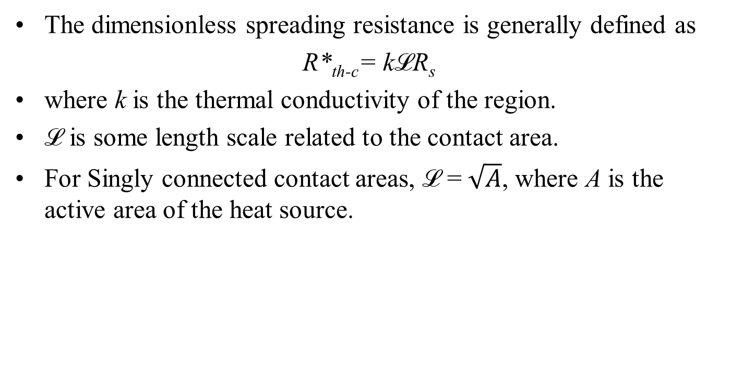
Spreading Resistance.
The dimensionless spreading resistance is generally defined as
R*_{th-c}= kℒR_{s}
where k is the thermal conductivity of the region.
ℒ is some length scale related to the contact area.
For Singly connected contact areas, ℒ = $\sqrt{A}$, where A is the active area of the heat source.

Slide 26
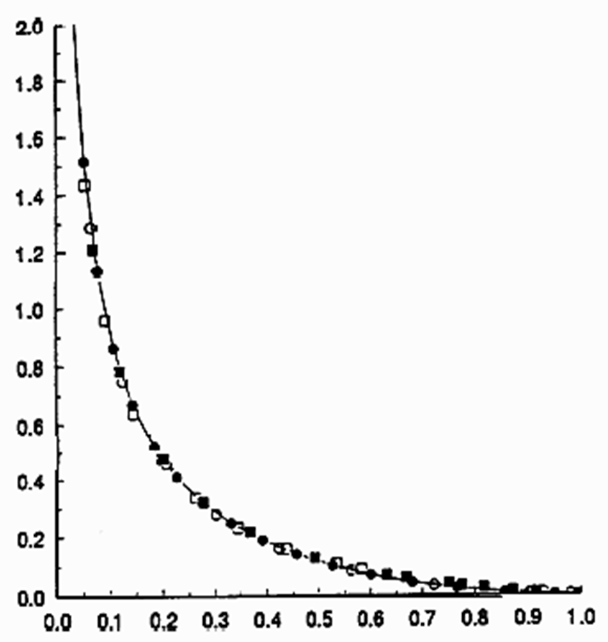
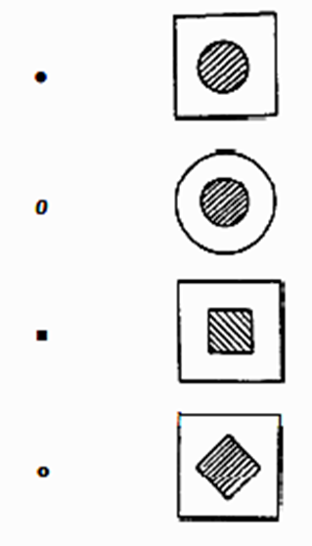

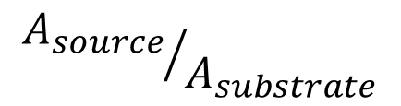
Generalized Models for Dimensionless Constriction Resistance
$$R_{th−c−dimensionless}=k\sqrt{A_{source}}R_{th−c}$$
$${A_{source}}/{A_{substrate}}$$

Slide 27
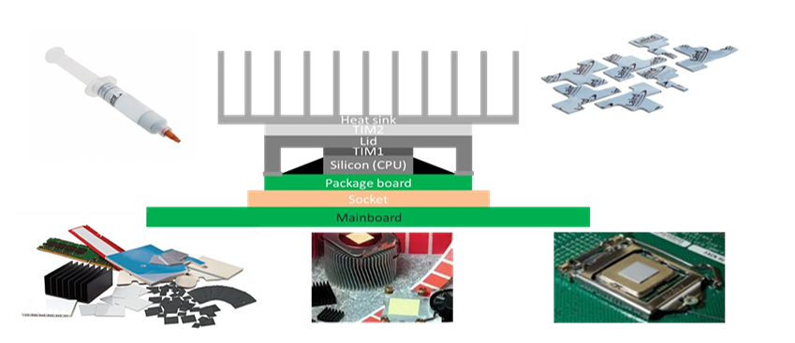
Interfaces in Chip Packaging
In any microelectronic device, interfaces play a pivotal role.
Interfaces can broadly be categorized into two types.
First, within the intricate structures of the main devices,
different materials may be employed for various components, resulting in numerous interfaces.
Second, during the packaging process, additional components such as heat dissipation elements are encapsulated alongside the main device.
Interfaces emerge at the connections between the primary device and these supplementary components.

Slide 28
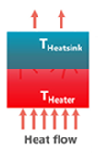
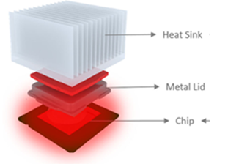
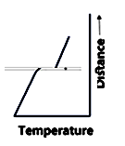

Deviation from Conventional Heat Conduction at Interface
$$\frac{A × ∆T_{jump}}{\dot{Q}}= ????$$

Slide 29
Interfacial thermal resistance
When heat flows through an interface between the constituents of a composite, a temperature drop occurs at the interface.
This disturbance of heat flow can be described by means of thermal resistance.
It is known as interfacial thermal resistance (ITR) and refers to the combined effect of two thermal resistances.
The first is referred to as thermal contact resistance (TCR) and is caused by poor mechanical and chemical bonding between constituent phases.
The second is thermal boundary resistance (TBR), which occurs due to differences in the physical properties of constituent materials.

Slide 30
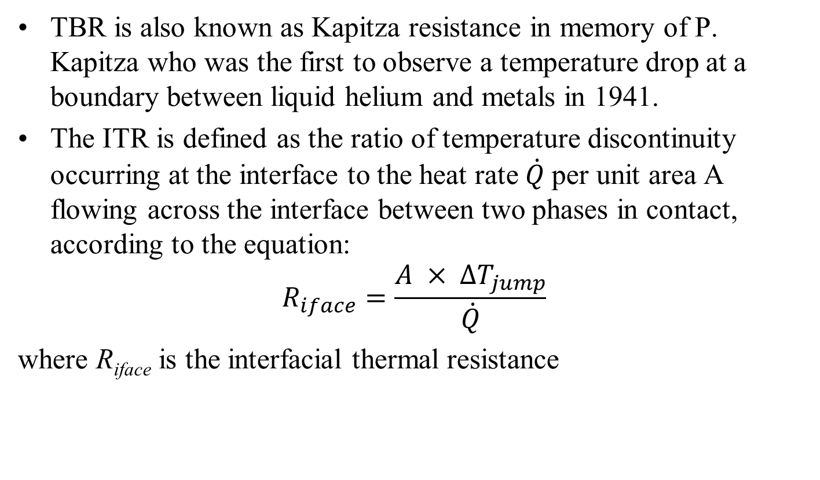
Interfacial thermal resistance
TBR is also known as Kapitza resistance in memory of P. Kapitza who was the first to observe a temperature drop at a boundary between liquid helium and metals in 1941.
The ITR is defined as the ratio of temperature discontinuity occurring at the interface to the heat rate $\dot{Q}$per unit area A flowing across the interface between two phases in contact, according to the equation:
$$R_{iface}=\frac{A × ∆T_{jump}}{\dot{Q}}$$
where R_{iface} is the interfacial thermal resistance

Slide 31
Interfacial thermal resistance
Even assuming perfect contact at the atomic level, the boundary between two solid phases is resistive to heat flow.
This is due to differences in vibrational and electronic properties in different materials.
The heat carrier (phonon or electron) arriving at the interface will undergo scattering.
The probability of transmission after scattering will depend on available energy states on both sides of the interface
The transfer of thermal energy at interfaces involves complex interactions and scattering processes.
Electron–phonon interactions.
Phonon–phonon interactions.
Phonon-interface scattering.

Slide 32
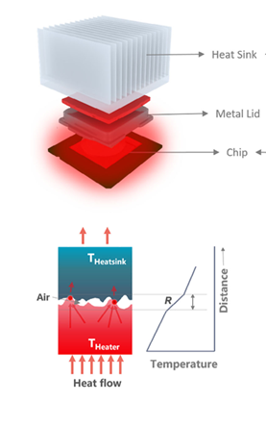
Real Interfaces and ITR
Typically, less than 2% of the overall area interacts with each other when two surfaces, metallic or semiconductor, are placed in contact.
The remaining area is occupied by air, which has a low thermal conductivity of 0.026 W/m.K at room temperature.

Slide 33
Filling Materials for Interfaces and ITR
From a materials perspective, thermal interface materi als (TIMs) play a crucial role in electronic devices.
These materials are specifically engineered to fill microgaps and address surface irregularities that emerge when electronic devices interface with heat dissipation elements.

Slide 34
Interfacial thermal resistance
ITR was first revealed in 1936 in the study of heat transfer at solid–liquid interfaces.
Historically, ITR is Kapitza resistance for solid–liquid interfaces.
ITR is Boundary thermal resistance for solid–solid interfaces.
It measures the difficulty of heat go through the junction between two different materials.
Due to the differences in material composition and structure on both sides of the interface, hot carriers will be scattered when passing through the interface.
This causes a temperature discontinuity (jump) at both sides of the interface at the micro–nano scale.

Slide 35
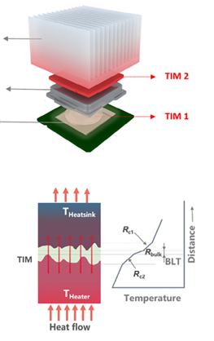
Interfaces and ITR
The primary objective is to reduce the thermal resistance that impedes heat transfer at the interface,

Slide 36
Interfaces and ITR
TIMs play a pivotal role in modern thermal management strategies.

Slide 37
Interfaces and ITR
TIMs profoundly influences the performance and reliability of electronic devices

