Slide 1

Internal Heat Spreaders in Chip Packaging
P M V Subbarao
Professor
Mechanical Engineering Department
Thermal Management Needs are Opposite to the needs of High-Power Chips
A High-Power Density Processor Needs Larger Convective Cooling Area …

Slide 2

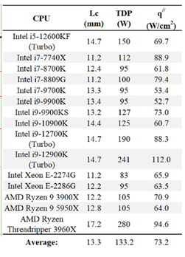
A Die can Generate Heat but Cannot Eject
Successful thermal management of the electronic component requires maximization of convection cooling area.
The convection cooling area available with modern die is not sufficient to achieve acceptable thermal management.

Slide 3
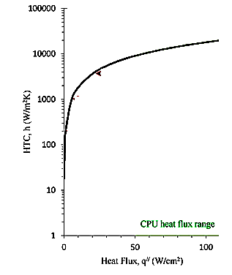
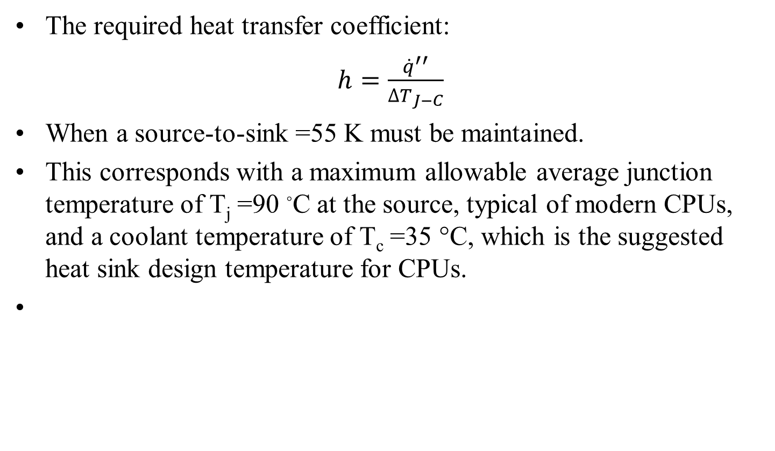
Convective Incapability of A Die
The required heat transfer coefficient:
$h=\frac{{\dot{q}}^{′′}}{{∆T}_{J−C}}$
When a source-to-sink =55 K must be maintained.
This corresponds with a maximum allowable average junction temperature of T_{j} =90 ◦C at the source, typical of modern CPUs, and a coolant temperature of T_{c} =35 °C, which is the suggested heat sink design temperature for CPUs.

Slide 4
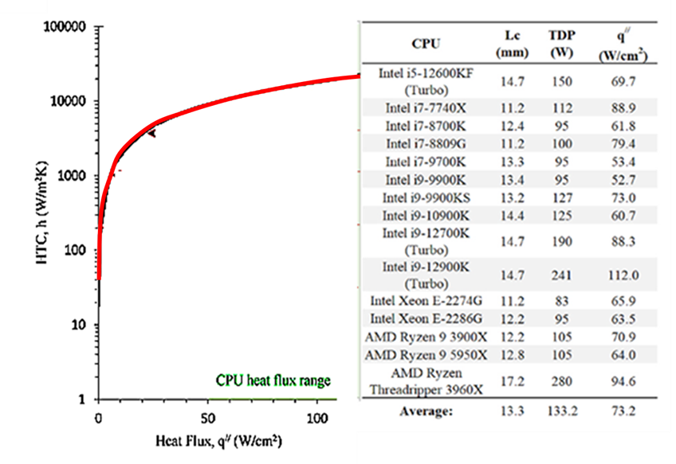
Convective Incapability of A Die

Slide 5
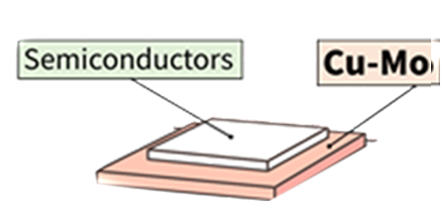
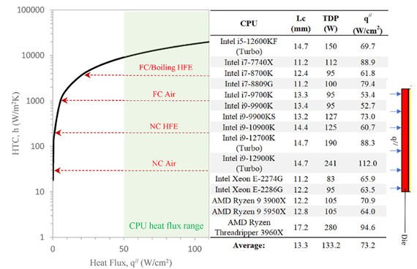
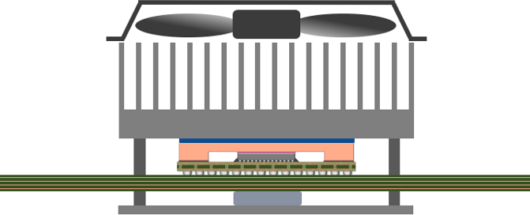






Convective Modes for A Die
$$T_{coolant}$$
IHS heat Flux
$$R_{conv}$$
$$R_{Die}$$
$$T_{coolant}$$
$$T_{Die}$$

Slide 6
Heat Spreaders
Successful thermal management of the electronic component requires maximization of convection cooling area.
This is achieved using Internal Heat Spreaders attached to the active die in a package.
IHS will lower convective resistance due to larger area but adds additional thermal resistance in the package of chips.
Two additional resistances, namely the critical thermal contact and spreading thermal resistances are generated between die and IHS.
Spreading or constriction thermal resistances exist when heat flows from one region to another in different cross-sectional area.

Slide 7
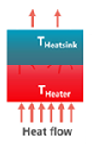
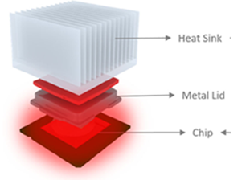
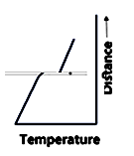

Deviation from Conventional Heat Conduction at Interface
TIM
$$\frac{A × ∆T_{jump}}{\dot{Q}}= ????$$

Slide 8
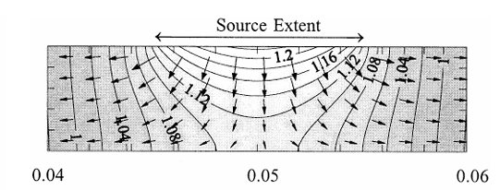
Deviation from Conventional Heat Conduction due to Spreading

Slide 9
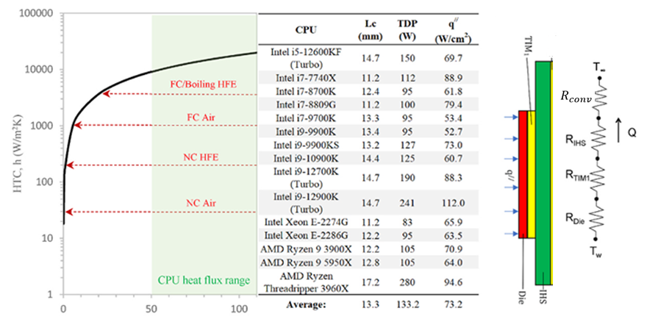
Two-Way Challenge
IHS is must in most of the chip packages.
IHS adds both physical conduction resistance and Spreading Resistance to the thermal network.
However, it lowers the convective resistance with cost effective/zero cost convection systems.
Spreading Resistance is defined as the temperature difference between the average junction surface temperature and some reference temperature, divided by the total heat receiving from the heat source.

Slide 10
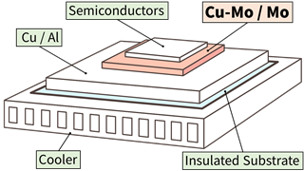
Series of Spreading resistances in Chips
The chip package can be regarded as a stack of plates with different cross-sectional areas.
The simple thermal models are valid if heat transfer areas of each plate in a stack are equal.
High power chips need larger area plates as heat spreaders:

Slide 11
Varying Area Layers in a Chip Packaging
Insulated Gate Bipolar Transistors are used to control current for motor drives.
They handle high voltage and current.
To dissipate heat from IGBT modules, cooling method involves embedding a metallic plate (Cu/Al) or a cooler.
This introduces another problem known as Thermal Coupling.
Cu-Mo or Mo is placed between the semiconductor chip and the metallic plate, which helps promote heat dissipation and serves as a thermal buffer.

Slide 12
Simple (Compact) Thermal Models for Chips
Thermal spreading process on the plate surface needs to be considered, when two successive plates are not equal in a stack.
The thermal resistance of a flat plate with a small area heat source must be obtained using more comprehensive thermal analysis.

Slide 13
Art of Thermal Coupling in Chip Package
Insertion of an IHS into the package has the potential to facilitate a wide range of cooling options.
A question then arises around how large R_{IHS} is in proportion to the thermal resistances that can be achieved by different practical heat sinks for various Dies/CPUs.
Thermal spreading process on the plate surface needs to be considered, when two successive plates are not equal in a stack.
The thermal resistance of a flat plate with a small area heat source must be obtained using more comprehensive thermal analysis.

Slide 14
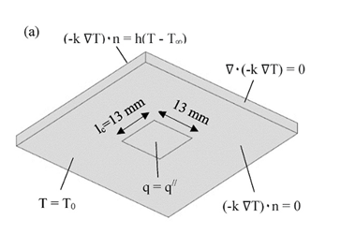
Integrated Heat Spreader Thermal Resistance
A case study is considered to address this question.
Copper Molybdenum alloy is best choice as the material, with a thermal conductivity of k = 160 – 270 W/m K.
IHS thickness between 1.0 mm ≤ d ≤ 5.0 mm.
The convective heat transfer coefficient is assumed to be uniform.

Slide 15

Integrated Heat Spreader Thermal Resistance
The thermal model used to simulate the case study is based upon the steady state three-dimensional heat conduction equation, which assumes a constant thermal conductivity in the solid domain.
GDE in cartesian Coordinate system:
$$\frac{∂^{2}T}{∂x^{2}}+\frac{∂^{2}T}{∂y^{2}}+\frac{∂^{2}T}{∂z^{2}}=0$$

Slide 16
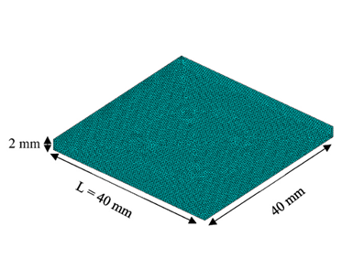
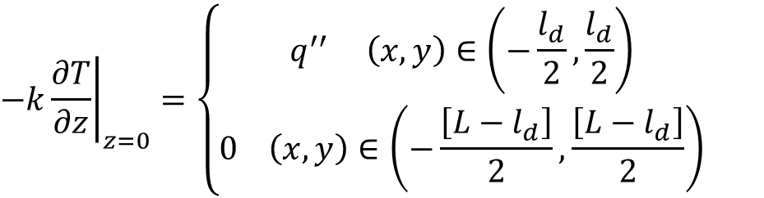
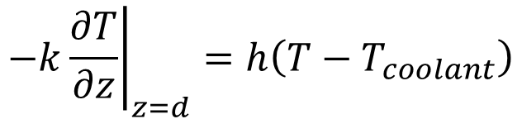
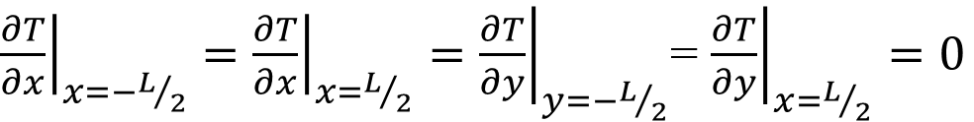
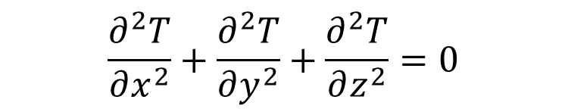
Analysis of Integrated Heat Spreader Thermal Resistance
$$\frac{∂^{2}T}{∂x^{2}}+\frac{∂^{2}T}{∂y^{2}}+\frac{∂^{2}T}{∂z^{2}}=0$$
Boundary Conditions:
${\left.\frac{∂T}{∂x}\right|}_{x=−L/2}={\left.\frac{∂T}{∂x}\right|}_{x=L/2}={\left.\frac{∂T}{∂y}\right|}_{y=−L/2}$= ${\left.\frac{∂T}{∂y}\right|}_{x=L/2}=0$
$${\left.−k\frac{∂T}{∂z}\right|}_{z=d}=h\left(T−T_{coolant}\right)$$
$${\left.−k\frac{∂T}{∂z}\right|}_{z=0}=\left\{\begin{matrix}q^{′′} \left(x,y\right)∈\left(−\frac{l_{d}}{2},\frac{l_{d}}{2}\right) \\ 0 \left(x,y\right)∈\left(−\frac{\left[L−l_{d}\right]}{2},\frac{\left[L−l_{d}\right]}{2}\right)\end{matrix}\right.$$

Slide 17
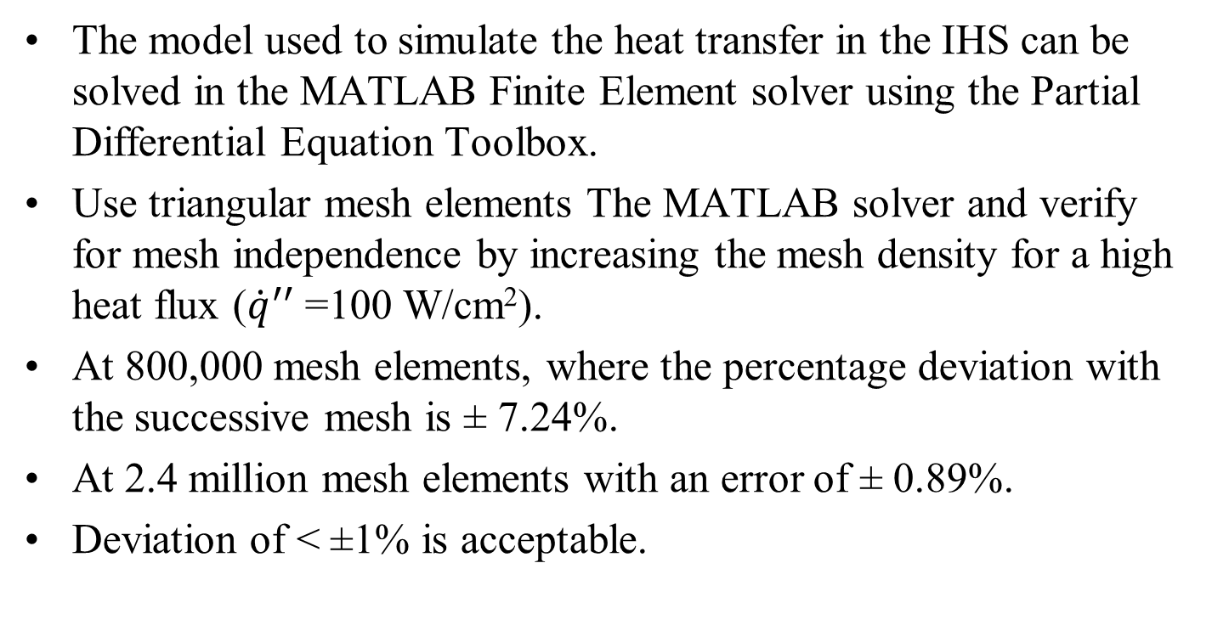
The Solver
The model used to simulate the heat transfer in the IHS can be solved in the MATLAB Finite Element solver using the Partial Differential Equation Toolbox.
Use triangular mesh elements The MATLAB solver and verify for mesh independence by increasing the mesh density for a high heat flux (${\dot{q}}^{′′}$ =100 W/cm²).
At 800,000 mesh elements, where the percentage deviation with the successive mesh is ± 7.24%.
At 2.4 million mesh elements with an error of ± 0.89%.
Deviation of < ±1% is acceptable.

Slide 18
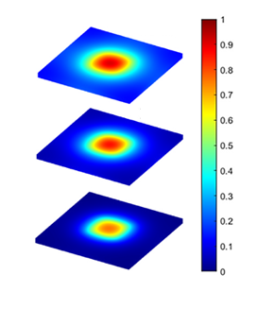



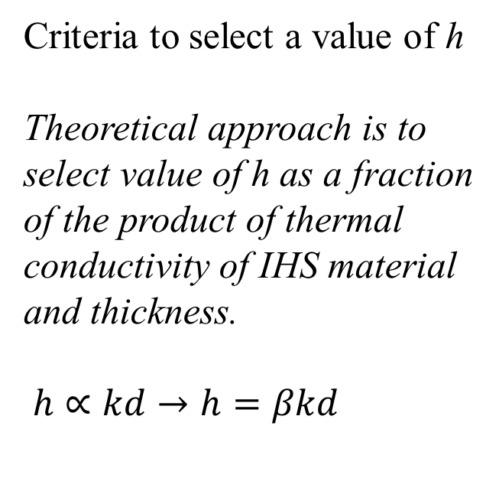
The Solutions
$$h=0.05kd$$
Criteria to select a value of h
Theoretical approach is to select value of h as a fraction of the product of thermal conductivity of IHS material and thickness.
$h∝kd→h=βkd$
h, Increasing
$$h=0.1kd$$
$$h=0.25kd$$
Temperature Profile in IHS

Slide 19
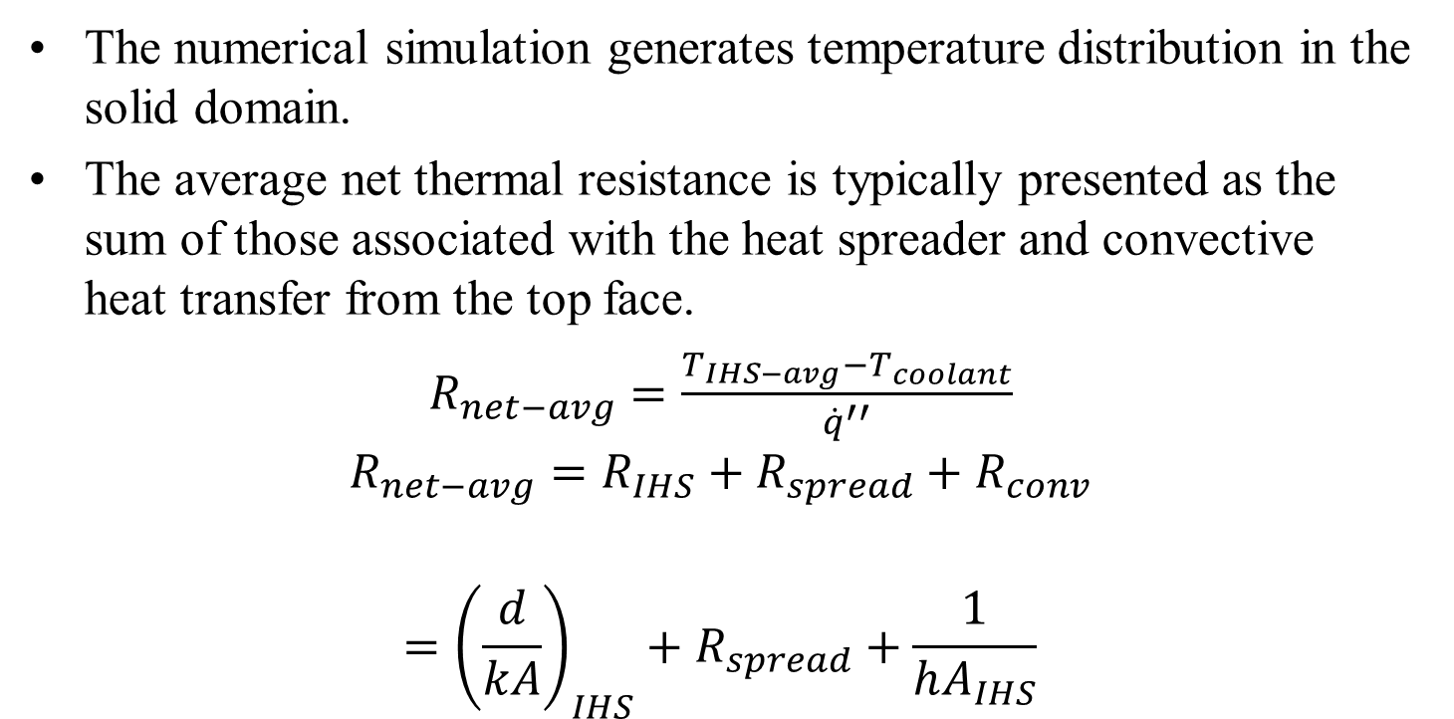
Figure of Merit for IHS
The numerical simulation generates temperature distribution in the solid domain.
The average net thermal resistance is typically presented as the sum of those associated with the heat spreader and convective heat transfer from the top face.
$R_{net−avg}=\frac{T_{IHS−avg}−T_{coolant}}{{\dot{q}}^{′′}}$
$$R_{net−avg}=R_{IHS}+R_{spread}+R_{conv}$$
$$={{\left(\frac{d}{kA}\right)}_{IHS}+R}_{spread}+\frac{1}{hA_{IHS}}$$
where T_{IHS-avg} is the average temperature of the heat source area.
R_{IHS} is the conductive thermal resistance of HIS.
R_{spread} Spreading Resistance

Slide 20
Constriction/Spreading Resistance
Constriction/spreading resistance exists whenever heat flows from one region to another of different cross-sectional area.
The term constriction is used describe the situation where heat flows into a narrower region.
The term spreading is used to describe the case where heat flows out of a narrow region into a larger cross-sectional area.
Phenomenologically the constriction resistance and spreading resistance are different.
However, quantitative analysis of thermal rectification due to the direction of heat flow, the constriction and spreading resistances are assumed to be identical in magnitude.

