Slide 1

Fourier’s Solutions to Detailed Thermal Modeling of Chip Packages
P M V Subbarao
Professor & Head
Mechanical Engineering Department
A Forerunner Version of Digital Analysis….

Slide 2

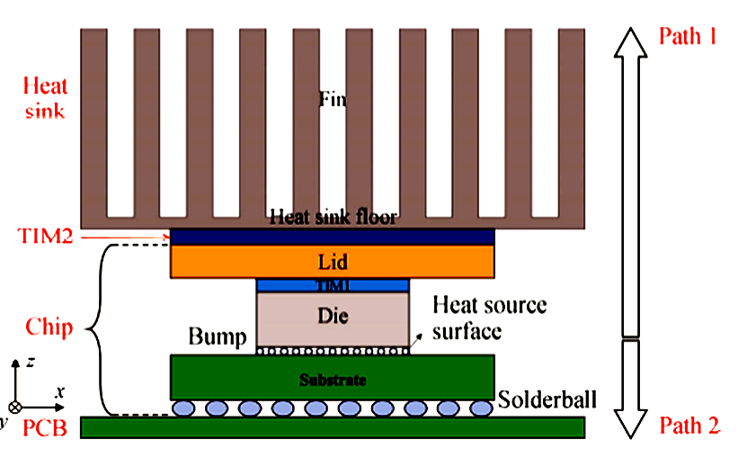
Compact Thermal Model for FCBGA
The heat source of chip is 23.09 W.

Slide 3
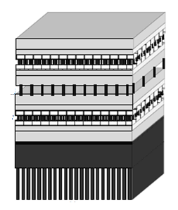
Thermal Model for FCBGA

Slide 4
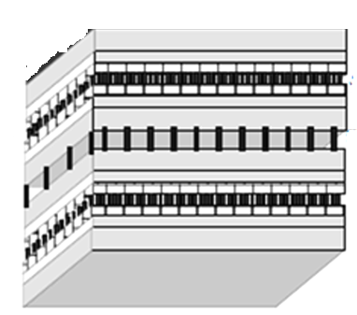
Thermal Model for Conduction Analysis
Convection Condition
Layer N is the heatsink base layer
z
x
y
z
x
Layer 1 is the silicon layer
y

Slide 5
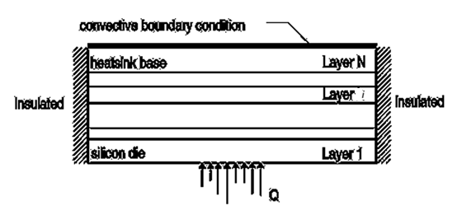
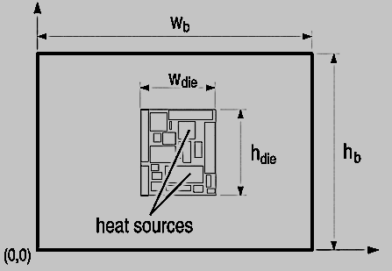
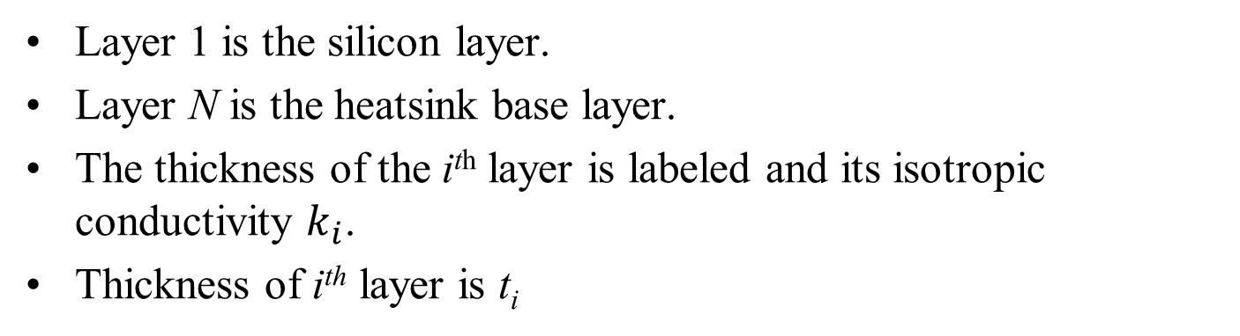
The Model for Conduction Heat Transfer
Layer 1 is the silicon layer.
Layer N is the heatsink base layer.
The thickness of the i^{th} layer is labeled and its isotropic conductivity $k_{i}$.
Thickness of i^{th} layer is t_{i}
Reference Paper: IEEE TRANSACTIONS ON COMPONENTS AND PACKAGINGTECHNOLOGIES,VOL.31,NO.2,JUNE2008 461 A Fourier Series-Based Analytical Solution for Three-Dimensional Conjugate Heat Transfer Problems in Microprocessor Cooling Sai Ankireddi and Stanley Pecavar.

Slide 6
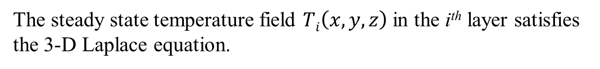

The Model for Conduction Heat Transfer
The steady state temperature field $Ti\left(x,y,z\right)$in the i^{th} layer satisfies the 3-D Laplace equation.
$$\frac{∂^{2}T_{i}}{∂x^{2}}+\frac{∂^{2}T_{i}}{∂y^{2}}+\frac{∂^{2}T_{i}}{∂z^{2}}=0$$

Slide 7
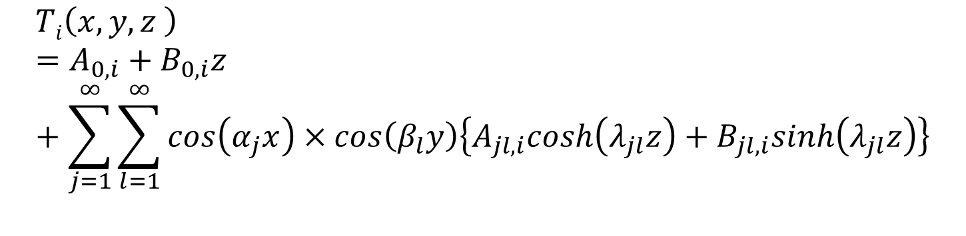
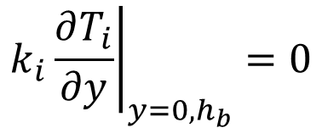
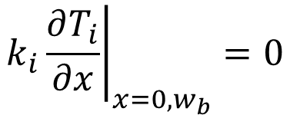


General Solution of A Steady State 3D Conduction Model without Heat generation
$$\frac{∂^{2}T}{∂x^{2}}+\frac{∂^{2}T}{∂y^{2}}+\frac{∂^{2}T}{∂z^{2}}=0$$
$$Ti\left(x,y,z \right)=A_{0,i}+B_{0,i}z+\sum_{j=1}^{∞}{\sum_{l=1}^{∞}{cos\left(α_{j}x\right)}×cos\left(β_{l}y\right)\left\{A_{jl,i}cosh\left(λ_{jl}z\right)+B_{jl,i}sinh\left(λ_{jl}z\right)\right\}}$$
Temperature distribution in i^{th} layer
It is noted an identical condition satisfied as:
$$λ_{jl}^{2}=α_{j}^{2}+β_{l}^{2}$$
Edge Boundary Conditions:
$$k_{i}{\left.\frac{∂T_{i}}{∂x}\right|}_{x=0,w_{b}}=0$$
It is assumed that the ends of the layer are insulated, i.e.
$$k_{i}{\left.\frac{∂T_{i}}{∂y}\right|}_{y=0,h_{b}}=0$$

Slide 8
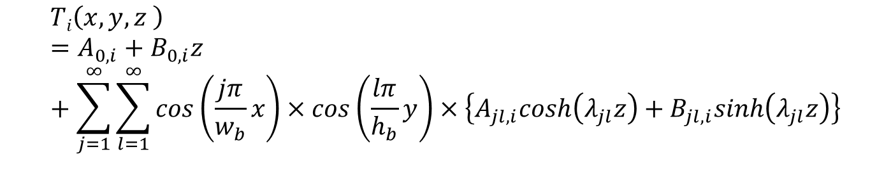
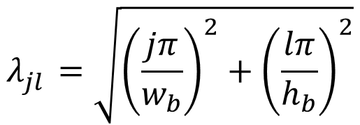

General Solution with Insulated Sides
$$Ti\left(x,y,z \right)=A_{0,i}+B_{0,i}z+\sum_{j=1}^{∞}{\sum_{l=1}^{∞}{cos\left(\frac{jπ}{w_{b}}x\right)}×cos\left(\frac{lπ}{h_{b}}y\right)×\left\{A_{jl,i}cosh\left(λ_{jl}z\right)+B_{jl,i}sinh\left(λ_{jl}z\right)\right\}}$$
$$λ_{jl}^{}=\sqrt{{\left(\frac{jπ}{w_{b}}\right)}^{2}+{\left(\frac{lπ}{h_{b}}\right)}^{2}}$$
$$j,l=0,1,2,3…..∞$$

Slide 9
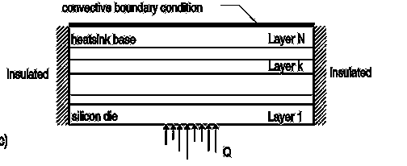
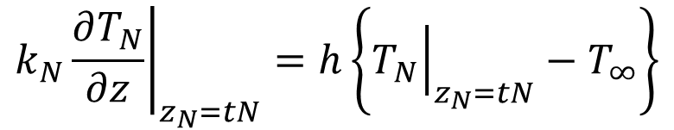
Heat Sink Boundary Conditions
At the upper end of the heatsink base, at it is assumed that the heat transfer is manifest via a uniform convective film coefficient.
The appropriate boundary condition at that location is
$$k_{N}{\left.\frac{∂T_{N}}{∂z}\right|}_{z_{N}=tN}=h\left\{{\left.T_{N}\right|}_{z_{N}=tN}−T_{∞}\right\}$$

Slide 10
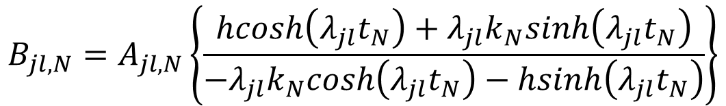
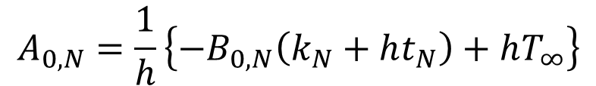
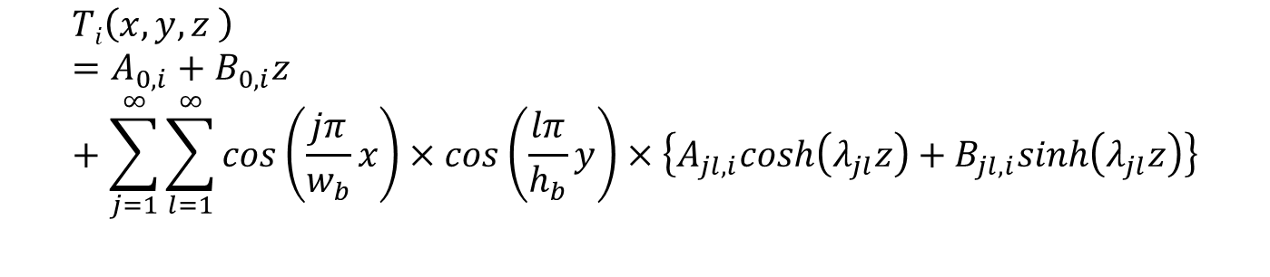
Heat Sink Boundary Conditions
$$Ti\left(x,y,z \right)=A_{0,i}+B_{0,i}z+\sum_{j=1}^{∞}{\sum_{l=1}^{∞}{cos\left(\frac{jπ}{w_{b}}x\right)}×cos\left(\frac{lπ}{h_{b}}y\right)×\left\{A_{jl,i}cosh\left(λ_{jl}z\right)+B_{jl,i}sinh\left(λ_{jl}z\right)\right\}}$$
Applying heat sink boundary condition gives relationships between the characteristic constants for the N^{th} layer as:
$$A_{0,N}=\frac{1}{h}\left\{−B_{0,N}\left(k_{N}+ht_{N}\right)+hT_{∞}\right\}$$
$$B_{jl,N}=A_{jl,N}\left\{\frac{hcosh\left(λ_{jl}t_{N}\right)+λ_{jl}k_{N}sinh\left(λ_{jl}t_{N}\right)}{−λ_{jl}k_{N}cosh\left(λ_{jl}t_{N}\right)−hsinh\left(λ_{jl}t_{N}\right)}\right\}$$

Slide 11
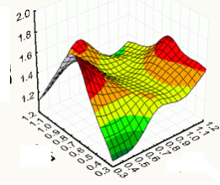
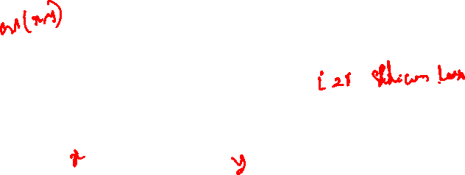
Heat Source Boundary Condition
A functional description of the heat flux associated with this source is

Slide 12
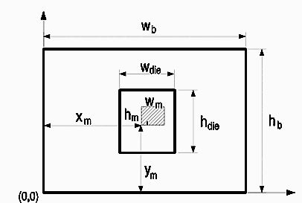

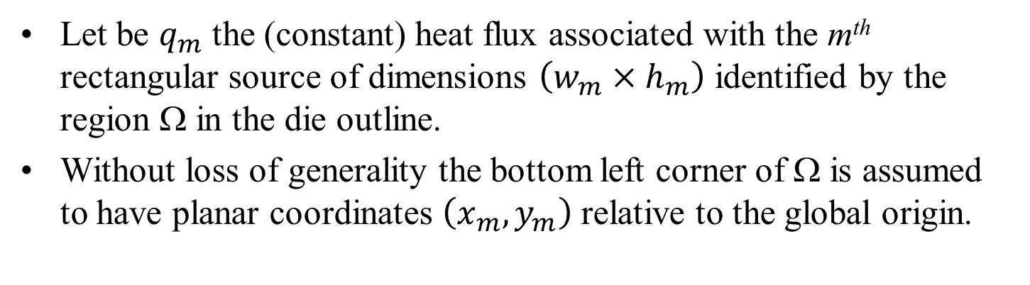
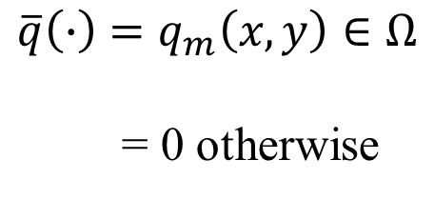
Heat Source Boundary Condition
Let be $q_{m}$ the (constant) heat flux associated with the m^{th} rectangular source of dimensions $\left(w_{m}×h_{m}\right)$ identified by the region Ω in the die outline.
Without loss of generality the bottom left corner of Ω is assumed to have planar coordinates $\left(x_{m},y_{m}\right)$ relative to the global origin.
A functional description of the heat flux associated with this source is
$$\overline{q}\left(∙\right)=q_{m}\left(x,y\right)∈Ω$$
= 0 otherwise

Slide 13
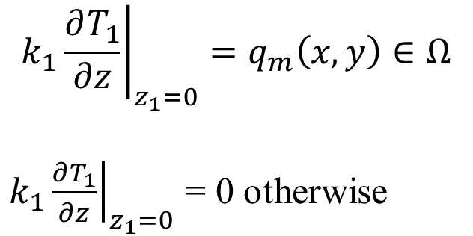
Heat Source Boundary Condition
A functional description of the heat flux associated with this source is
$$k_{1}{\left.\frac{∂T_{1}}{∂z}\right|}_{z_{1}=0}=q_{m}\left(x,y\right)∈Ω$$
$k_{1}{\left.\frac{∂T_{1}}{∂z}\right|}_{z_{1}=0}$ = 0 otherwise

Slide 14
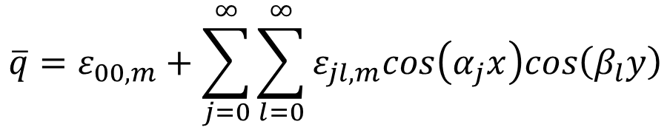
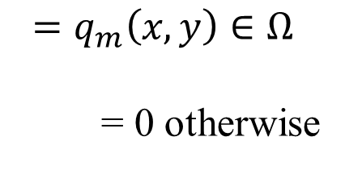
Heat Source Boundary Condition
A functional description of the heat flux associated with this source is
$$=q_{m}\left(x,y\right)∈Ω$$
= 0 otherwise
The Fourier series decomposition for this areal source is
$$\overline{q}=ε_{00,m}+\sum_{j=0}^{∞}{\sum_{l=0}^{∞}{ε_{jl,m}cos\left(α_{j}x\right)cos\left(β_{l}y\right)}}$$
Where the running indices are not simultaneously zero.
Using standard decomposition techniques, the Fourier coefficients and may be determined.

Slide 15
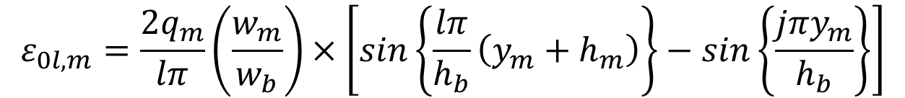
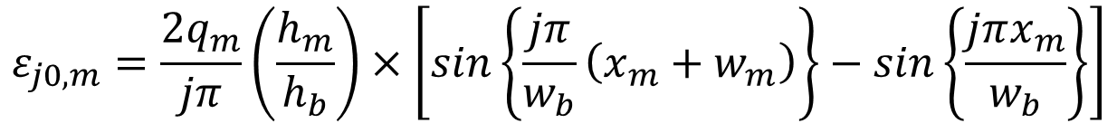
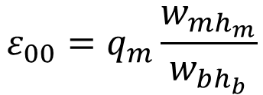
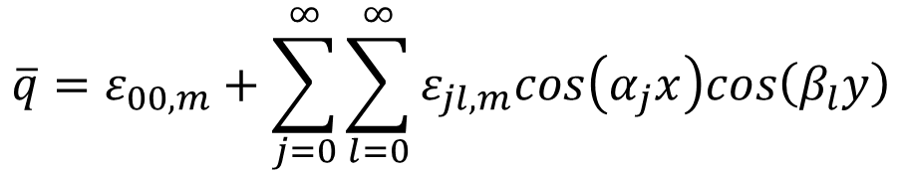
Heat Source Boundary Condition
$$\overline{q}=ε_{00,m}+\sum_{j=0}^{∞}{\sum_{l=0}^{∞}{ε_{jl,m}cos\left(α_{j}x\right)cos\left(β_{l}y\right)}}$$
The Fourier coefficients:
$$ε_{00}=q_{m}\frac{w_{mh_{m}}}{w_{bh_{b}}}$$
$$ε_{j0,m}=\frac{2q_{m}}{jπ}\left(\frac{h_{m}}{h_{b}}\right)×\left[sin\left\{\frac{jπ}{w_{b}}\left(x_{m}+w_{m}\right)\right\}−sin\left\{\frac{jπx_{m}}{w_{b}}\right\}\right]$$
$$ε_{0l,m}=\frac{2q_{m}}{lπ}\left(\frac{w_{m}}{w_{b}}\right)×\left[sin\left\{\frac{lπ}{h_{b}}\left(y_{m}+h_{m}\right)\right\}−sin\left\{\frac{jπy_{m}}{h_{b}}\right\}\right]$$

Slide 16
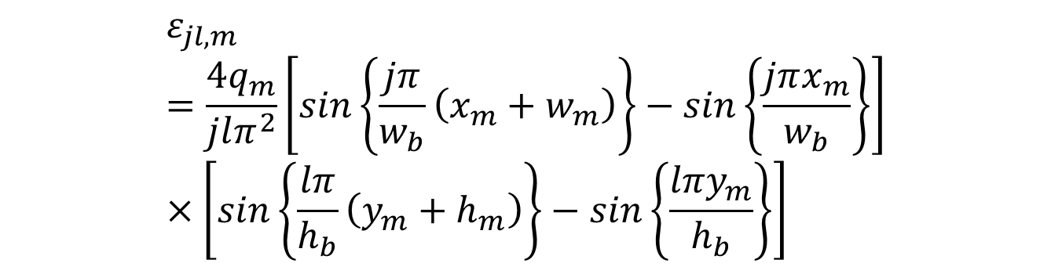
Heat Source Boundary Condition
$$\overline{q}=ε_{00,m}+\sum_{j=0}^{∞}{\sum_{l=0}^{∞}{ε_{jl,m}cos\left(α_{j}x\right)cos\left(β_{l}y\right)}}$$
The Fourier coefficients:
$$ε_{jl,m}=\frac{4q_{m}}{jlπ^{2}}\left[sin\left\{\frac{jπ}{w_{b}}\left(x_{m}+w_{m}\right)\right\}−sin\left\{\frac{jπx_{m}}{w_{b}}\right\}\right]×\left[sin\left\{\frac{lπ}{h_{b}}\left(y_{m}+h_{m}\right)\right\}−sin\left\{\frac{lπy_{m}}{h_{b}}\right\}\right]$$
Where j=1,2,…..∞;and l=1,2,…..∞, respectively.

Slide 17
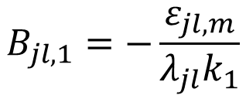
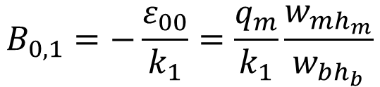
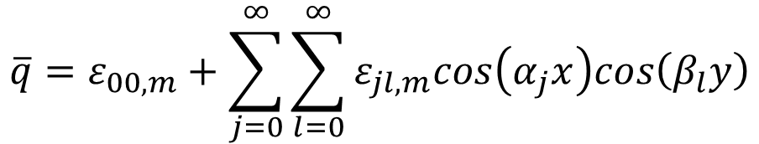
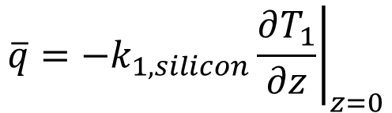
Heat Source Boundary Condition
The appropriate boundary condition at z=0 in the silicon layer (Layer1) is
$$\overline{q}=−k_{1,silicon}{\left.\frac{∂T_{1}}{∂z}\right|}_{z=0}$$
Applying above condition and using
$$\overline{q}=ε_{00,m}+\sum_{j=0}^{∞}{\sum_{l=0}^{∞}{ε_{jl,m}cos\left(α_{j}x\right)cos\left(β_{l}y\right)}}$$
The following relationships are obtained for the characteristic constants in Layer
$$B_{0,1}=−\frac{ε_{00}}{k_{1}}=\frac{q_{m}}{k_{1}}\frac{w_{mh_{m}}}{w_{bh_{b}}}$$
$$B_{jl,1}=−\frac{ε_{jl,m}}{λ_{jl}k_{1}}$$

Slide 18
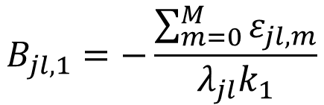
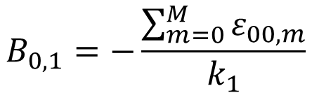
Heat Source Boundary Condition
The appropriate boundary condition at z=0 in the silicon layer (Layer1) is
$$\overline{q}=−k_{1,silicon}{\left.\frac{∂T_{1}}{∂z}\right|}_{z=0}$$
With M independent areal heat sources simultaneously active, the preceding analysis can be readily extended to show that
$$B_{0,1}=−\frac{\sum_{m=0}^{M}{ε_{00,m}}}{k_{1}}$$
$$B_{jl,1}=−\frac{\sum_{m=0}^{M}{ε_{jl,m}}}{λ_{jl}k_{1}}$$

Slide 19
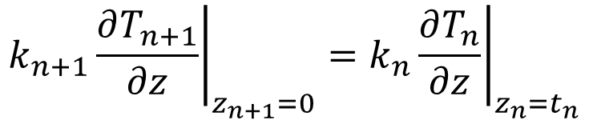
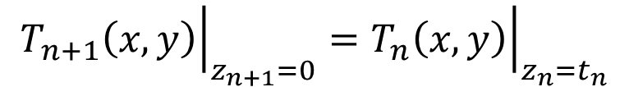
Inter Layer Temperature and Flux Continuity Conditions
Inter Layer Continuity Conditions
Physically, both temperature and flux fields must be continuous at the interface between any two successive layers in the stackup.
Stated mathematically, this means that for any given i^{th} Layer and its neighbor Layer i+1
$${\left.T_{n+1}\left(x,y\right)\right|}_{z_{n+1}=0}={\left.T_{n}\left(x,y\right)\right|}_{z_{n}=t_{n}}$$
$${\left.k_{n+1}\frac{∂T_{n+1}}{∂z}\right|}_{z_{n+1}=0}={\left.k_{n}\frac{∂T_{n}}{∂z}\right|}_{z_{n}=t_{n}}$$

Slide 20
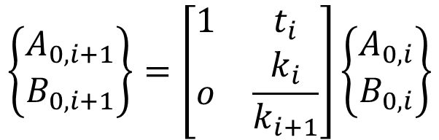
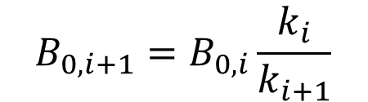

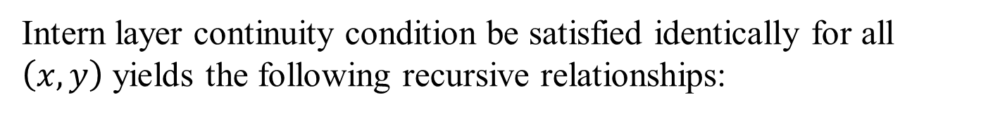
Inter Layer Temperature Continuity Conditions
Inter Layer Continuity Conditions
Intern layer continuity condition be satisfied identically for all $\left(x,y\right)$ yields the following recursive relationships:
$$B_{0,i+1}=B_{0,i}\frac{k_{i}}{k_{i+1}}$$
$$A_{0,i+1}=A_{0,i}+B_{0,i}t_{i}$$
$$\left\{\begin{matrix}A_{0,i+1} \\ B_{0,i+1}\end{matrix}\right\}=\left[\begin{matrix}1 & t_{i} \\ o & \frac{k_{i}}{k_{i+1}}\end{matrix}\right]\left\{\begin{matrix}A_{0,i} \\ B_{0,i}\end{matrix}\right\}$$

Slide 21
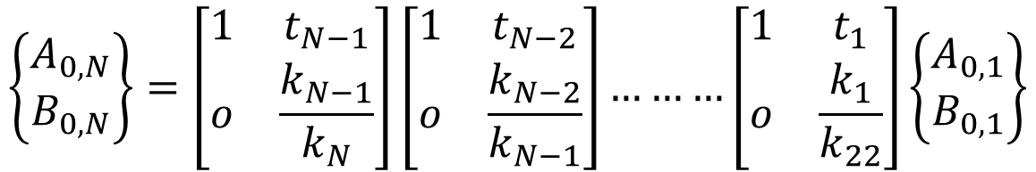
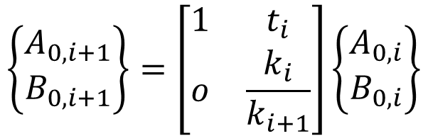
Inter Layer Temperature Continuity Conditions
Inter Layer Continuity Conditions
$$\left\{\begin{matrix}A_{0,i+1} \\ B_{0,i+1}\end{matrix}\right\}=\left[\begin{matrix}1 & t_{i} \\ o & \frac{k_{i}}{k_{i+1}}\end{matrix}\right]\left\{\begin{matrix}A_{0,i} \\ B_{0,i}\end{matrix}\right\}$$
Now applying above condition repeatedly to all layers from 1 to N
$$\left\{\begin{matrix}A_{0,N} \\ B_{0,N}\end{matrix}\right\}=\left[\begin{matrix}1 & t_{N−1} \\ o & \frac{k_{N−1}}{k_{N}}\end{matrix}\right]\left[\begin{matrix}1 & t_{N−2} \\ o & \frac{k_{N−2}}{k_{N−1}}\end{matrix}\right]………\left[\begin{matrix}1 & t_{1} \\ o & \frac{k_{1}}{k_{22}}\end{matrix}\right]\left\{\begin{matrix}A_{0,1} \\ B_{0,1}\end{matrix}\right\}$$

Slide 22
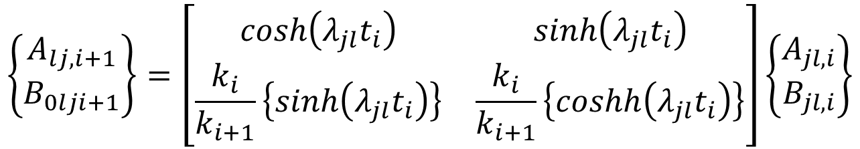
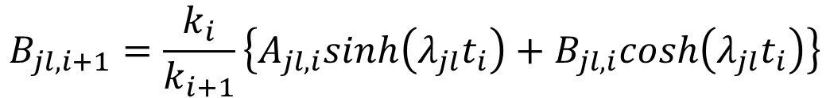
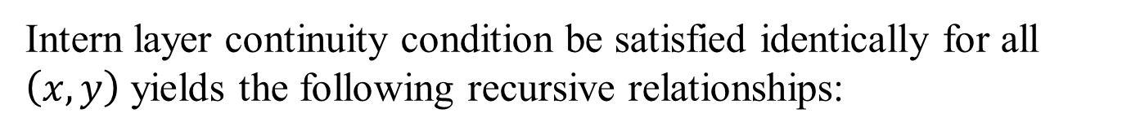
Inter Layer Continuity Conditions
Inter Layer Continuity Conditions
Intern layer continuity condition be satisfied identically for all $\left(x,y\right)$ yields the following recursive relationships:
$$A_{jl,i+1}=A_{jl,i}cosh\left(λ_{jl}t_{i}\right)+B_{jl,i}sinh\left(λ_{jl}t_{i}\right)$$
$$B_{jl,i+1}=\frac{k_{i}}{k_{i+1}}\left\{A_{jl,i}sinh\left(λ_{jl}t_{i}\right)+B_{jl,i}cosh\left(λ_{jl}t_{i}\right)\right\}$$
$$\left\{\begin{matrix}A_{lj,i+1} \\ B_{0lji+1}\end{matrix}\right\}=\left[\begin{matrix}cosh\left(λ_{jl}t_{i}\right) & sinh\left(λ_{jl}t_{i}\right) \\ \frac{k_{i}}{k_{i+1}}\left\{sinh\left(λ_{jl}t_{i}\right)\right\} & \frac{k_{i}}{k_{i+1}}\left\{coshh\left(λ_{jl}t_{i}\right)\right\}\end{matrix}\right]\left\{\begin{matrix}A_{jl,i} \\ B_{jl,i}\end{matrix}\right\}$$

Slide 23
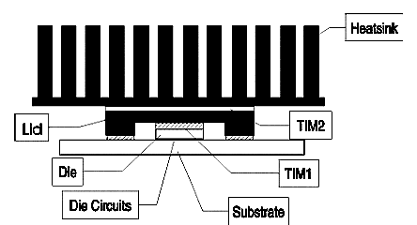
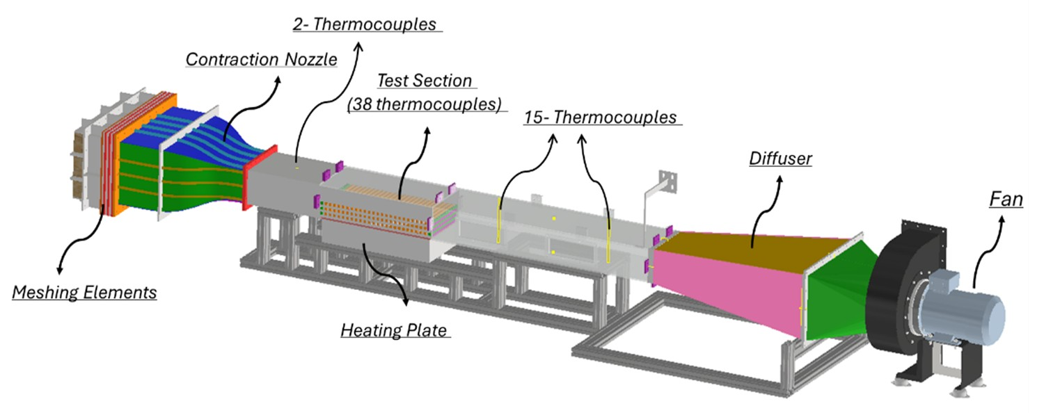
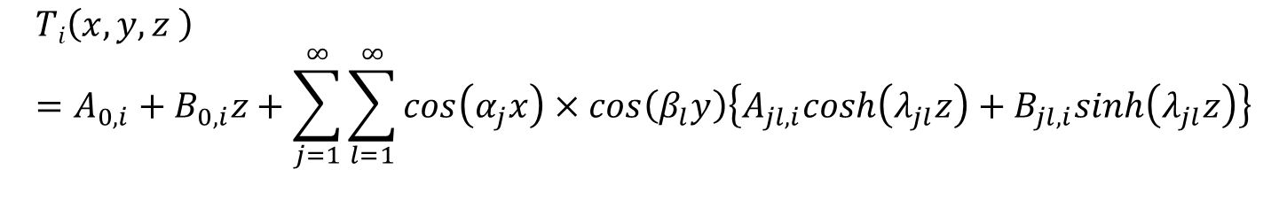
Thermal Management Wind Tunnel
$$Ti\left(x,y,z \right)=A_{0,i}+B_{0,i}z+\sum_{j=1}^{∞}{\sum_{l=1}^{∞}{cos\left(α_{j}x\right)}×cos\left(β_{l}y\right)\left\{A_{jl,i}cosh\left(λ_{jl}z\right)+B_{jl,i}sinh\left(λ_{jl}z\right)\right\}}$$

Slide 24
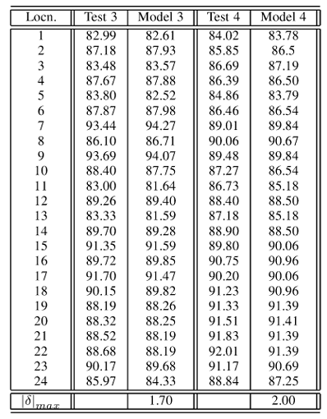

Experimental Verification
This package had a 400 mm² die with multiple cells which could be powered independently.
It was assembled onto a test board with a heatsink and mounted in the neck section of a wind tunnel.
A leading grease thermal interface material was used as TIM2.
The wind tunnel was turned on and the ducted flow was adjusted to 12.7 m/s.
Under such conditions the heatsink chosen had a thermal resistance of 0.20 °C/W.
Four separate test were conducted on a flip-chip LGA thermal test package to validate the Fourier series-based solution

Slide 25


Experimental Verification
Die thermal map
Lid thermal map

Slide 26

FCBGA Package
Flip Chip Ball Grid Array is a surface mounting Package

Slide 27
Compact Thermal Model for FCBGA
The heat source of chip is 23.09 W.

Slide 28

Detailed dimensions and physical parameters of the model

Slide 29

Temperature Distribution Contours at the Die

Slide 30


Compact Thermal Model for FCBGA
${\dot{Q}}_{1}$=18.33 W
${\dot{Q}}_{2}$=4.76 W
The heat source of chip is 23.09 W.

Slide 31


Average Temperatures of Each Surface

Slide 32



Compact Thermal Resistance Model
${\dot{Q}}_{1}$=18.33 W
${\dot{Q}}_{2}$=4.76 W

Slide 33

Pie chart of internal thermal resistance of the chip along path

Slide 34

Effect of Chip Power vs Spreading Resistance

