Slide 1

MCL348 : THERMAL MANAGEMENT OF ELECTRONICS: Introduction
P M V Subbarao
Professor
Mechanical Engineering Department
Data Centers on Track to Suck Up a Fifth of US Power Use by 2035: By Bloomberg
Jul 21, 2026
An Essential Support to Epistemological Evolution Responsible for Digital 21st Century!!!

Slide 2

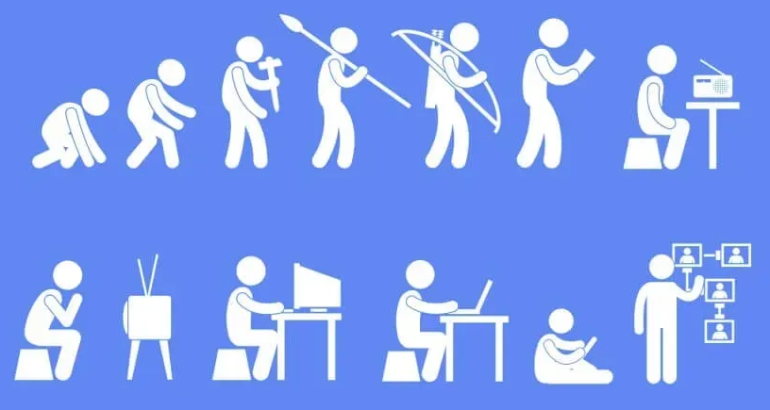
Epistemological Evolution

Slide 3
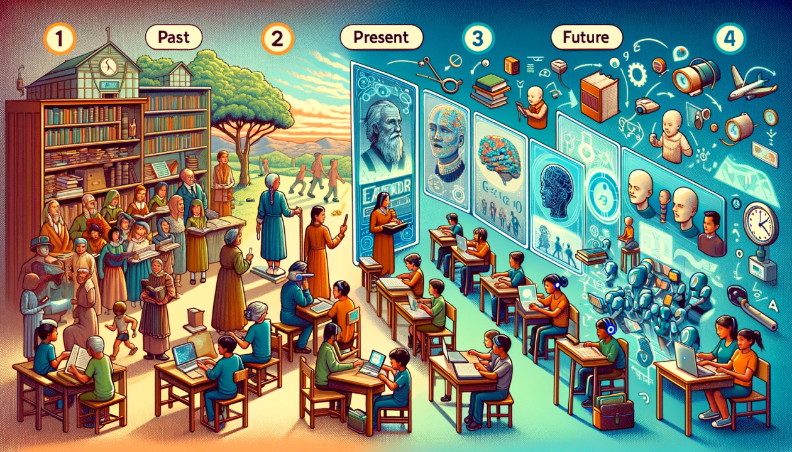
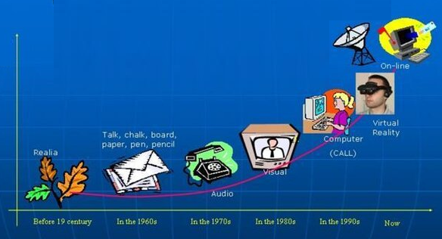
Evolution of Didactical Epistemology

Slide 4
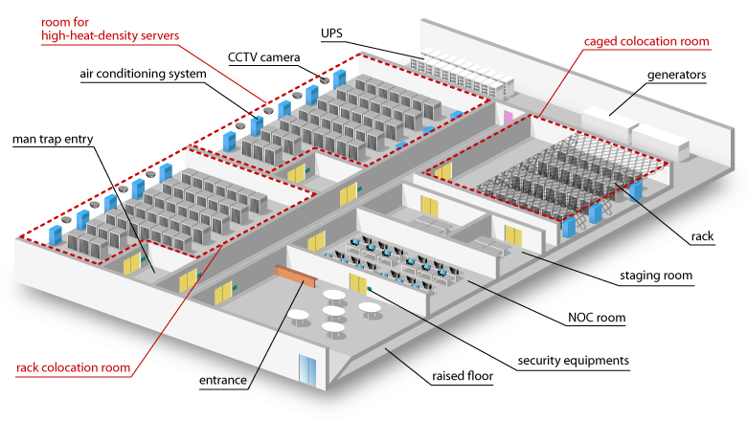
Backbone of 21st Century’s Digital World
A global Village continuously connected thru Data Centers.

Slide 5
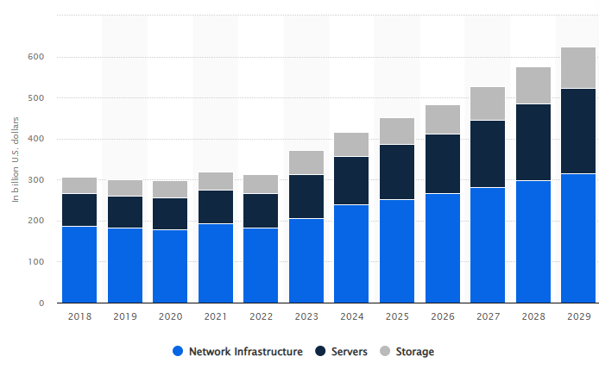
Revenue by Segment of A DC

Slide 6
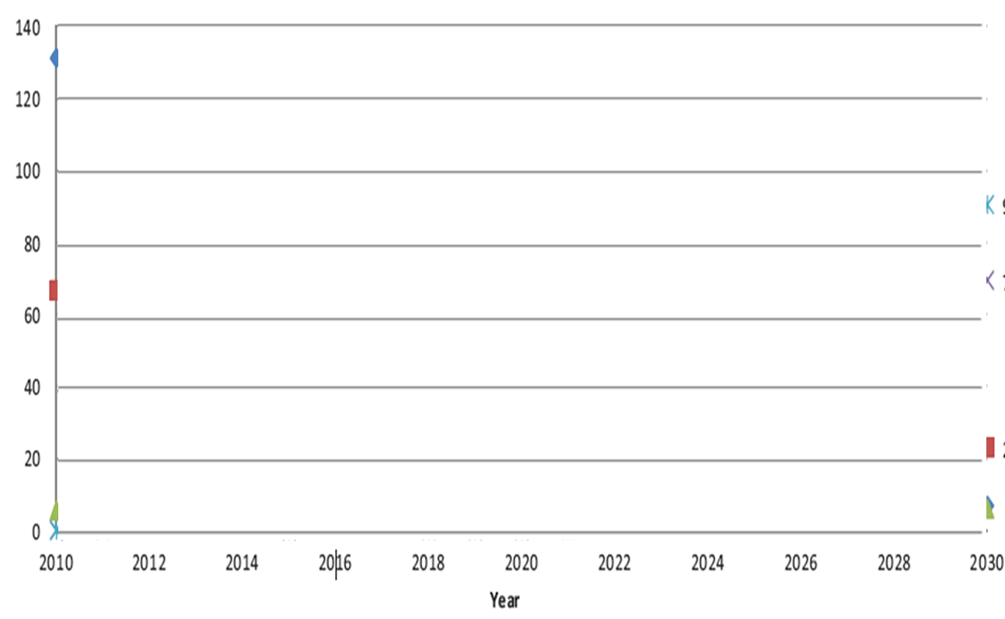
Expected Case Electricity Usage of Wireless Access Networks
2G/3G voice
4G Data
(TWh)
2G Data
5G Data
3G Data

Slide 7
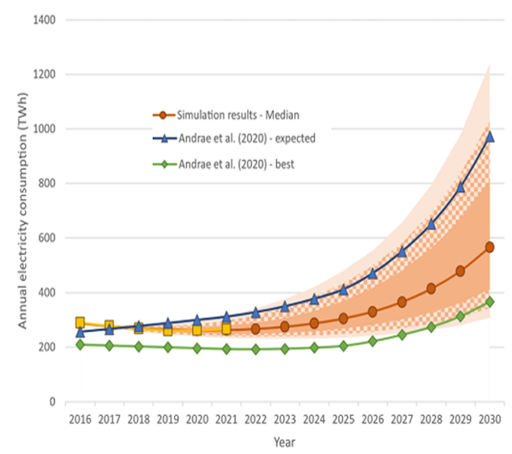
Evolution of Electricity Usage by Data Centres

Slide 8
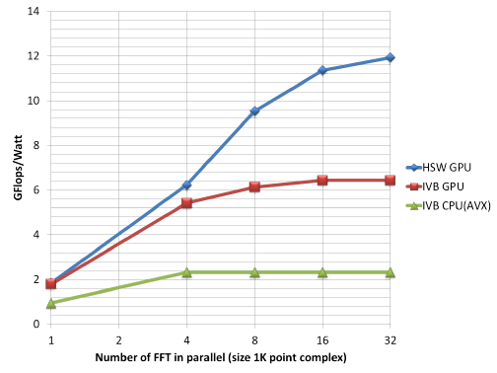
Breakdown of Energy End-use of Processors – Level 1

Slide 9
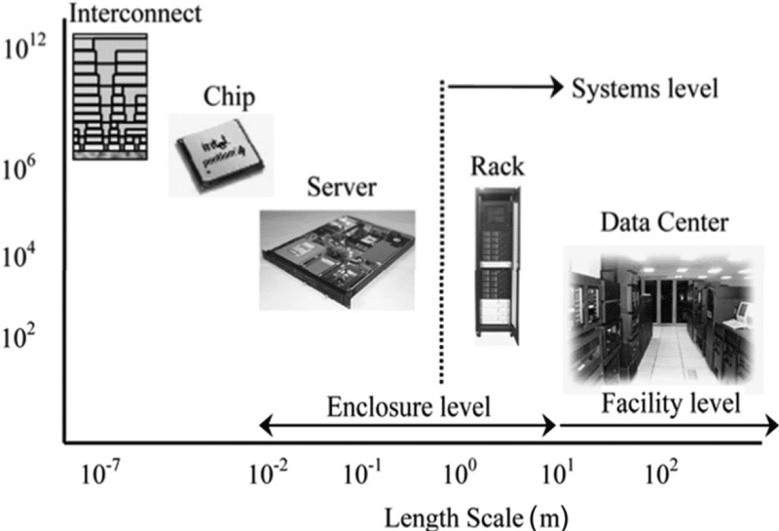
Irreversible Nature of An Electronic System
Heat Generation Scale

Slide 10
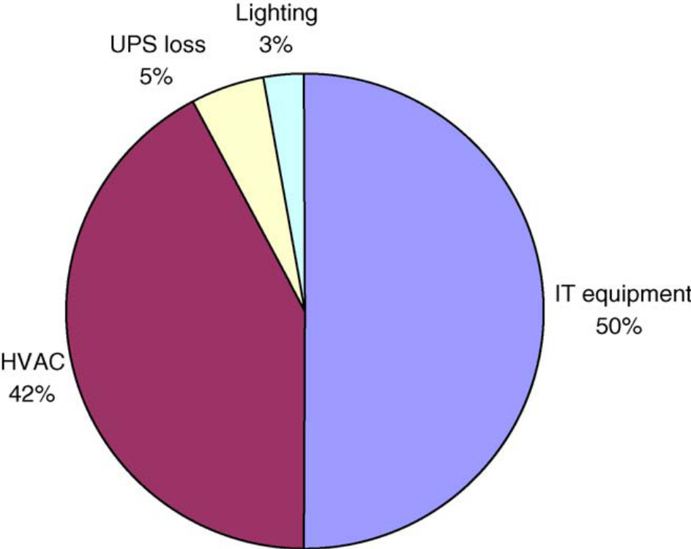
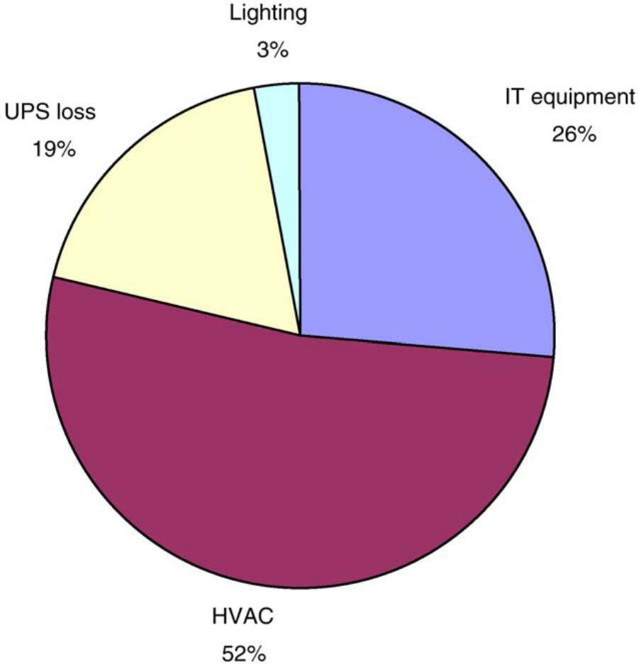
Breakdown of Energy End-use of Selected Data Centers Level -2

Slide 11
Essential Skills Required for A 21st Century
An Energy perspective of Digital world.
Energetic understanding of every electrical / electronics / communication device.
Theories for Ideal Energy Consumption.
Thermal Control of Electrical, Communication & Digital Systems.
New Algorithms and systems for development of Efficient digital/consumer world.

Slide 12
Pedagogy of Thermal Sciences
A System based approach for Balancing and Accounting….
Learning/revision of Laws and theories …
Related to System, State and interactions….
Conversion of Natural sources of energy to Usable energy source (Electrical/Mechanical)….
Thermal Management of Electrical and Electronics systems…
Enhancement of Energy Utilization Effectiveness of Systems…..

Slide 13
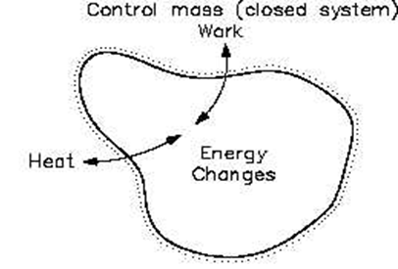
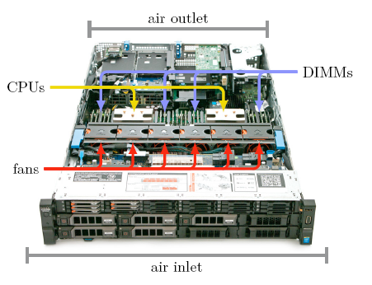
An Electronic System
The major functional requirements of an electronic system is solid as a working substance will work as a control mass.
Dell R730xd Power-Edge server

Slide 14
A Dell R730xd Power Edge server : An Assembly of Solid Working Substances
This plat form is a cuboid shaped thermodynamic control mass.
Dimensions: 44.40cm wide ×68.40cm long and 8.73cm hight.
Basic Hardware: 2 Central Processing Units (CPUs)
16 banks of Dual In-line Memory Modules (DIMMs) organized in four groups.
Companion chips and connectivity support electronics, a power supply unit and upto 12 mass storage docks.
For simplicity we assume that ensuring safe operating temperatures for these components guarantees also the safe operating temperature for the other electronic components.

Slide 15
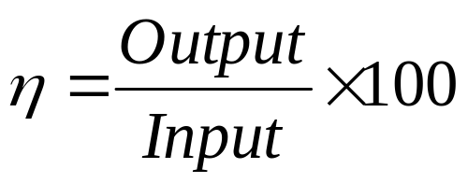
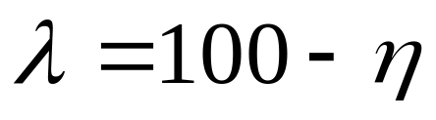
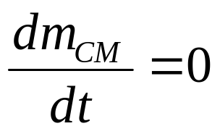
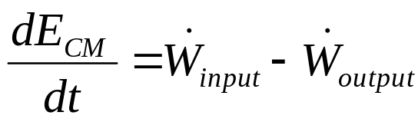
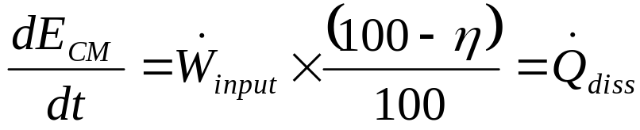
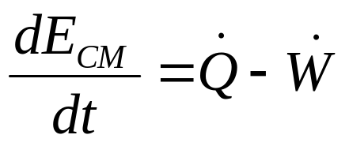
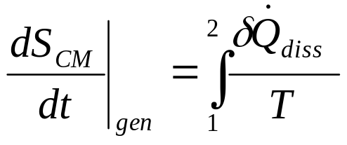
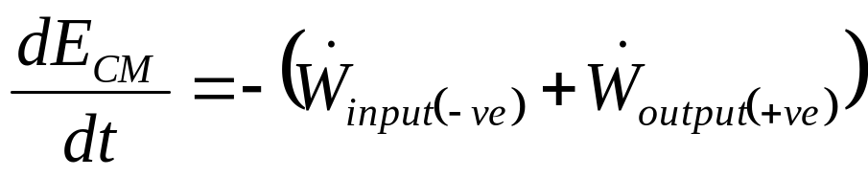
An Adiabatic E-Device
Efficiency of An E-Device:
Loss percentage of An E- Device:
This Loss is dissipated as heat:
Conservation of Mass :
First law of thermodynamics :

Slide 16
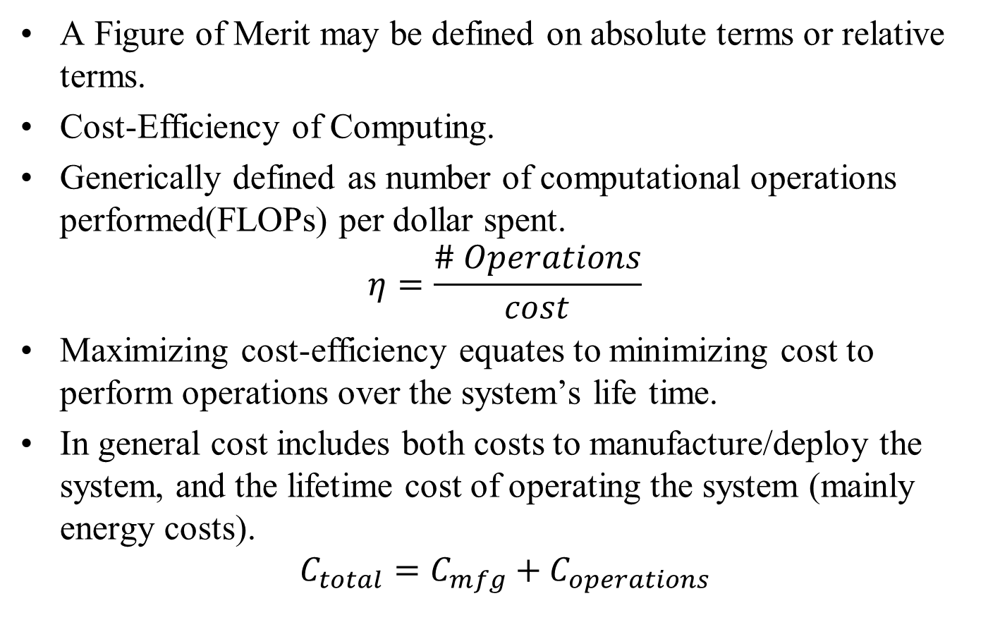
Figure of Merit for Computing

Slide 17
Figure of Merit for Computing
In typical contexts today, the practical lifetime, 𝐿 of most computing systems is relatively fixed.
There is a maximum tolerable latency, ℓ until the result of a given computational task must be obtained.
Therefore, need to care about not just maximizing cost efficiency, but also minimizing cost/op for operations within some fixed time frame.
This translates to increasing both performance per unit cost, as well as performance per unit power dissipation.

Slide 18
Course Plan
Information will be made available on My Website:
  Course contents & References.
  Electronics packaging and cooling technologies; Heat sinks: principle, types, modelling, and design; Contact resistance; Heat pipes and two-phase systems: principle, types, modelling and design; Microchannel heat exchangers: single phase and two phase; Radiative heat transfer and importance in space applications; Thermoelectric devices; Measurement and characterisation techniques; Case studies of thermal management of electronics.
  Evaluation and Attendance Policies.
  Reading material

