Slide 1

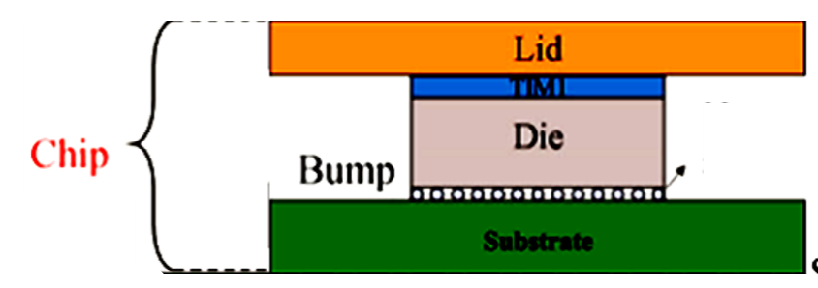
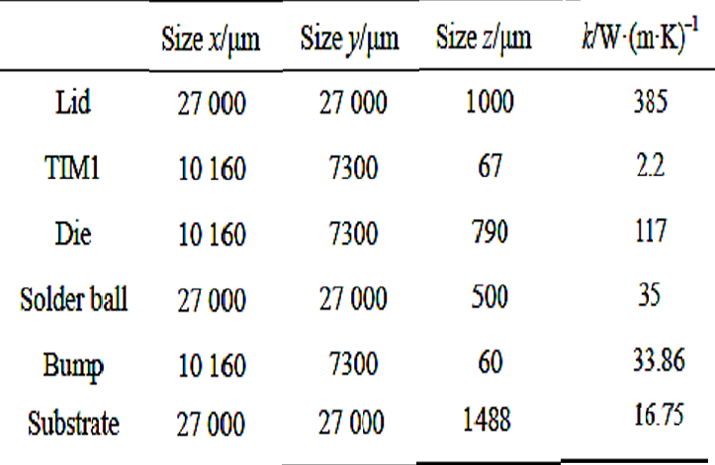
Assignment -1
The heat source of chip is 23.09 W.
Layout of a chip with all dimensions and properties are given here.
Plot temperature distribution at the midplane of each layer using Fourier’s Solutions.

Slide 2
MCL348: Assignment – 1
Write detailed derivation for each layer along with plots for temperature distribution.
Time and Date of submission: 5 pm &5 October 2026.
TA will mail you the google link for submission of pdf scanned report.
Symbols must be same as those used in lecture slides.
All copied reports will get zero marks.

Slide 3
Additional Instructions
Do not copy and paste the equations. You must use uniform symbols
through out your report.
Your assignment report must be complete with respect to all the intermediate algebraic operations and description of concepts.
Original Assignments with recent models will get highest marks.
You are free to submit scanned copies of handwritten or typed document in pdf.
Do not copy and paste the equations. You must use uniform symbols
through out your report.
Your assignment report must be complete with respect to all the intermediate algebraic operations and description of concepts.
Original Assignments with recent models will get highest marks.

