Slide 1

Stagnation Properties for Compressible Flow
P M V Subbarao
Professor
Mechanical Engineering Department
The Impact of Relative Speed!

Slide 2


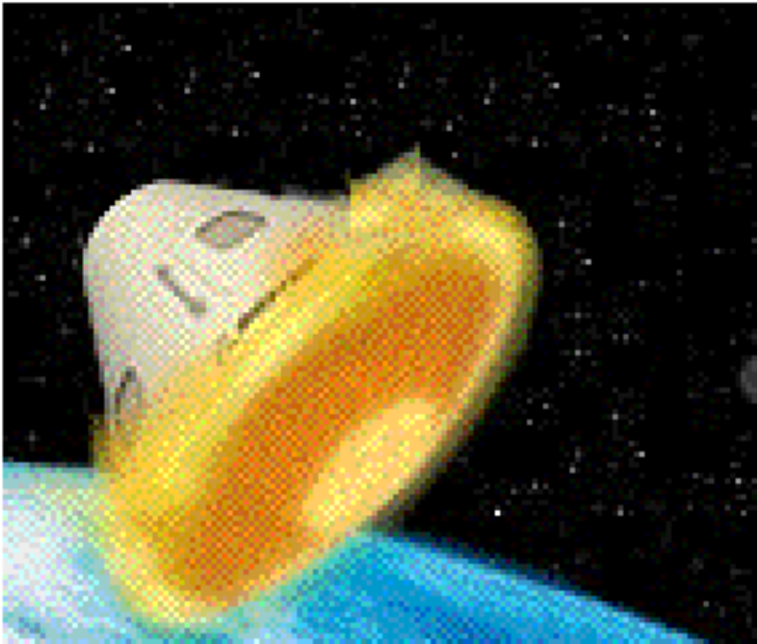
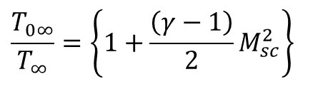
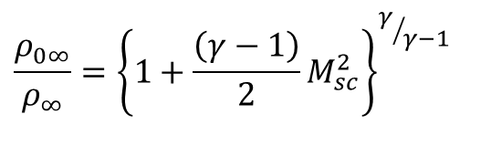
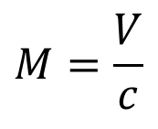
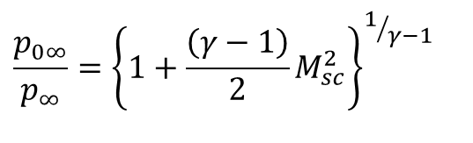
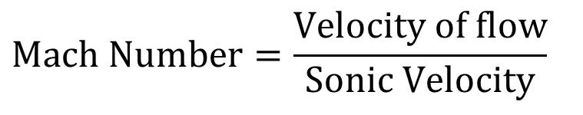
Engineering Importance of Stagnation Temperature
$$\text{Mach} \text{Number}=\frac{\text{Velocity} \text{of} \text{flow}}{\text{Sonic} \text{Velocity}}$$
$$M=\frac{V}{c}$$
• Largely responsible for the high Level of heating that occurs on reentering space Vehicles …
$$\frac{T_{0∞}}{T_{∞}}=\left\{1+\frac{\left(γ−1\right)}{2}M_{sc}^{2}\right\}$$
$$\frac{p_{0∞}}{p_{∞}}={\left\{1+\frac{\left(γ−1\right)}{2}M_{sc}^{2}\right\}}^{1/{γ−1}}$$
$$\frac{ρ_{0∞}}{ρ_{∞}}={\left\{1+\frac{\left(γ−1\right)}{2}M_{sc}^{2}\right\}}^{γ/{γ−1}}$$

Slide 3
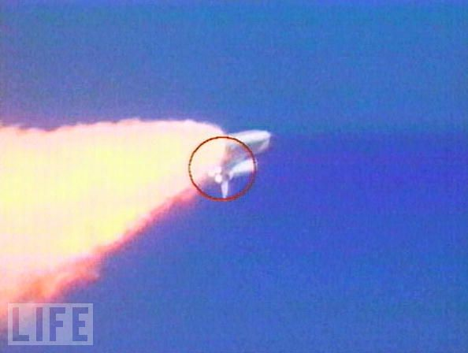
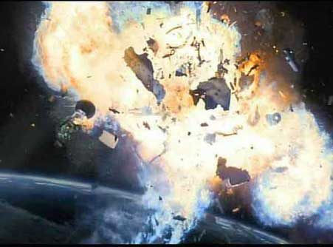
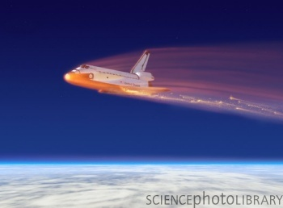
The Columbia Disaster !!!!
On Feb. 1, 2003, space shuttle Columbia broke up as it returned to Earth, killing the seven astronauts on board.
NASA suspended space shuttle flights for more than two years as it investigated the disaster

Slide 4
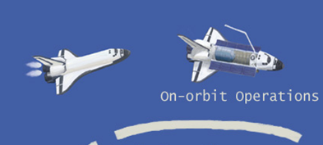
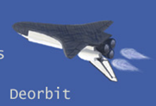
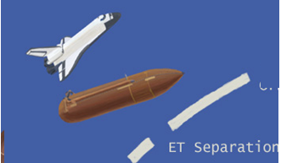
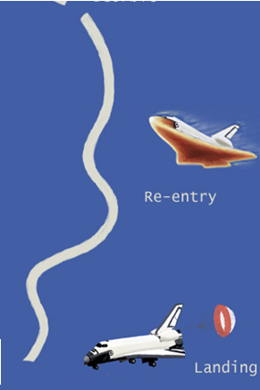
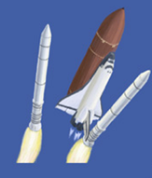
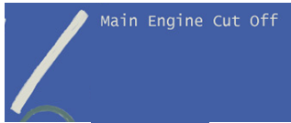
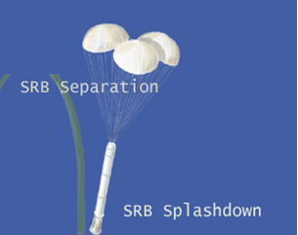
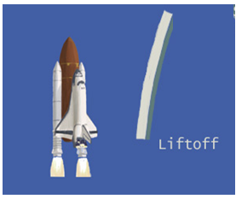
Travel Cycle for Modern Spacecrafts

Slide 5
The Cause !!!
Approximately 82 seconds after launch from Kennedy Space Center's LC-39-A, a suitcase-size piece of thermal insulation foam broke off the External Tank (ET).
This piece had hit the Columbia's left wing Reinforced Carbon-Carbon (RCC) panels while falling.
At the time of the foam strike, the orbiter was at an altitude of about 66,000 feet (20 km; 13 mi), traveling at Mach 2.46 (1,870 miles per hour or 840 m/s).
As demonstrated by ground experiments conducted by the Columbia Accident Investigation Board, this likely created a 6-to-10-inch (15 to 25 cm) diameter hole, allowing hot gases to enter the wing when Columbia later reentered the atmosphere.

Slide 6
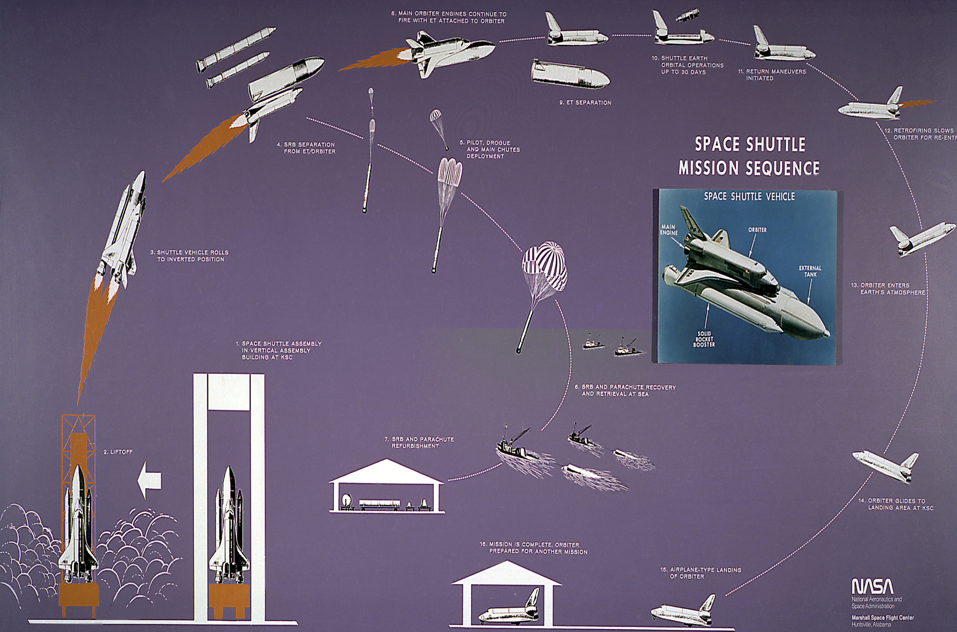
Travel Cycle for Modern Spacecrafts

Slide 7
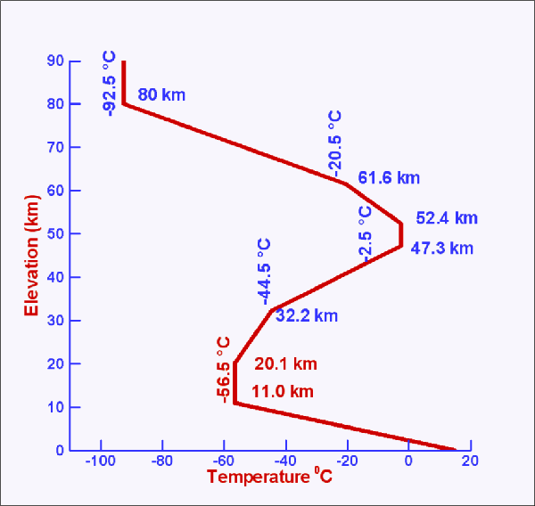
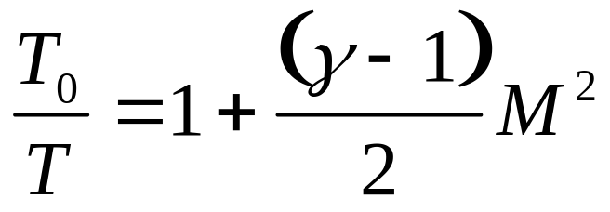
Mach’s Analysis of the Problem
Loss of Signal at 61.2 km altitude
T∞ ~ 243 K
~18.0 Mach Number

Slide 8
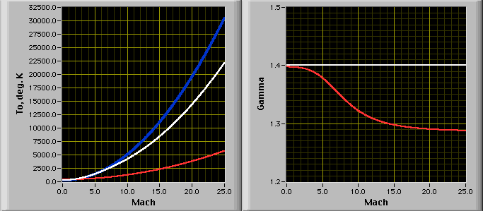
Computation of Stagnation Temperature at High Mach Numbers
Ideal gas Variable Properties Real gas

Slide 9
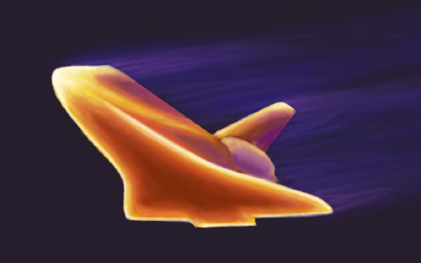
Rentering Space Craft

Slide 10
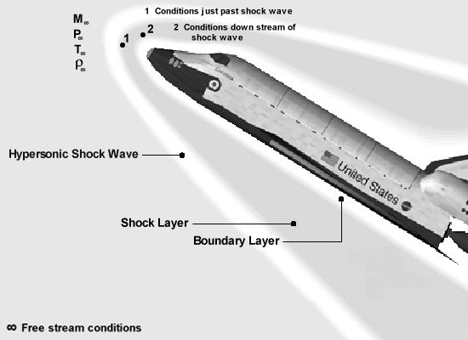
What was the Surface Temperature At Columbia Breakup?

Slide 11
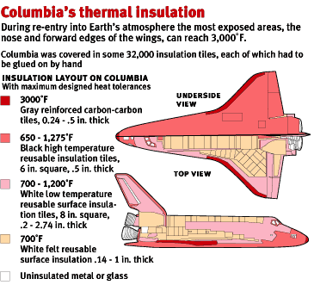

Slide 12
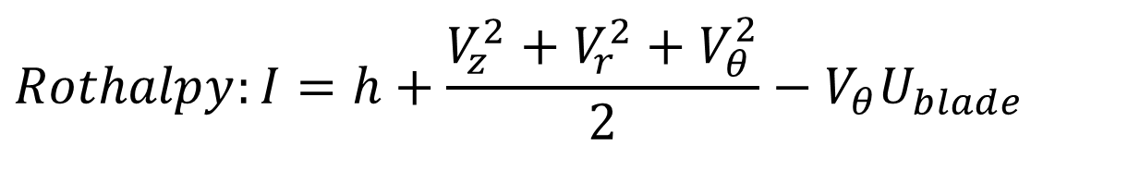
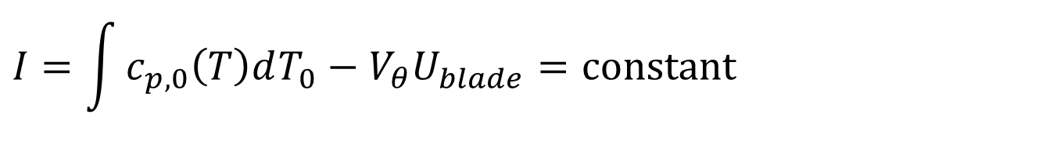
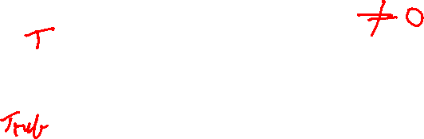
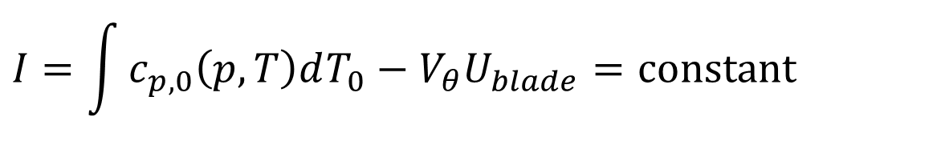

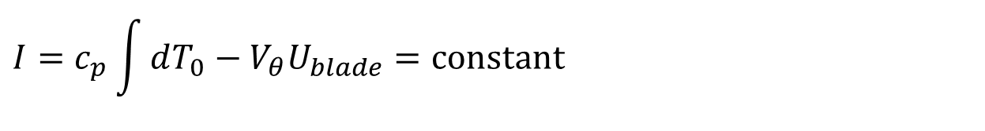
Rothalpy for Turbomachines working with Vapors/Gas
$$gz≈\text{constant}$$
$$Rothalpy:I=h+\frac{V_{z}^{2}+V_{r}^{2}+V_{θ}^{2}}{2}−V_{θ}U_{blade}$$
$$Rothalpy:I=h_{0}−V_{θ}U_{blade}$$
$$I=\int{c_{p,0}\left(p,T\right)dT_{0}}−V_{θ}U_{blade}=\text{constant}$$
For an ideal gas as a working fluid:
$$I=\int{c_{p,0}\left(T\right)dT_{0}}−V_{θ}U_{blade}=\text{constant}$$
For simple compressible fluid: Like Inert Gas
$$I=c_{p}\int{dT_{0}}−V_{θ}U_{blade}=\text{constant}$$

Slide 13
Rothalpy & Stagnation Enthalpy to Classify Ingenious Inventions (Steam Turbines)
Analysis of Innovations Aligned with Rothalpy Conservation!!

Slide 14
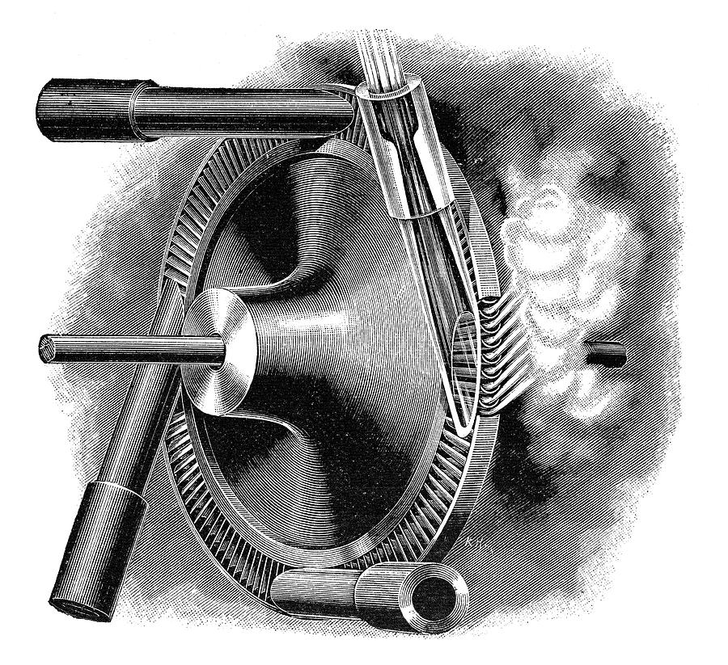
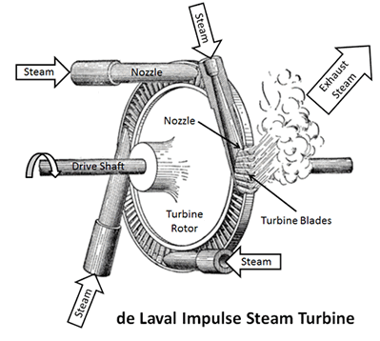
De Laval Turbine : The First Design for Steam Turbine
de Laval impact/impulse turbine for Cream Separator in 1878!
This is an impulse turbine ran at An enormous speed of 30,000 revolutions per minute in the 5 H. P. size.

Slide 15
De Laval Turbine : Rules for Maximum Power Generation
The velocity of the steam will determine the conditions under which a maximum transformation of the steam-jets' kinetic energy into useful mechanical work can be reached.
These conditions being the same as for impact water turbines.
The nozzle angle, or the angle of the steam nozzle with relation to the plane of the wheel, should be as small as possible.
A certain mathematical relation should exist between the nozzle angle, the velocity of the steam-jet, the peripheral velocity of the turbine wheel, and the inlet angle of the buckets.
The outlet angle of the buckets should be the smallest possible.

Slide 16
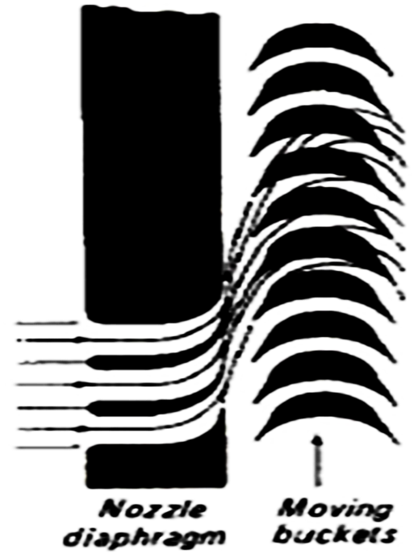
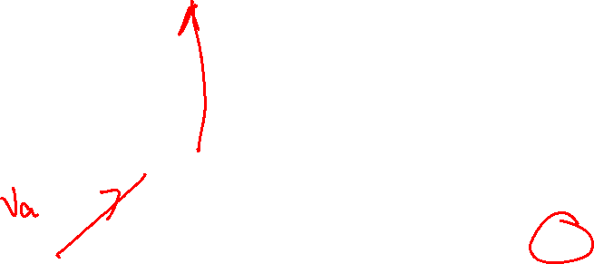
Steam Turbine Flow Path in De Laval Turbine
$$I=h+\frac{1}{2}\left(V_{rel}^{2}−U_{blade}^{2}\right)$$
In Rotor/Buckets:
De Laval tubine is classified as axial flow Impulse Turbine.
Ideally magnitude of V_{rel} is constant!
U
α_{e}
α₁
β_{e}
β_{i}
V_{ae}
V_{ai}
V_{ri}
V_{re}

Slide 17
De Laval Turbine : Rules for Maximum Power Generation
Practical considerations limit to a certain degree the attainment of proper angles for the very best efficiency.
Thus, in the De Lava1 turbine, a nozzle angle of 20° has been established for all sizes of the turbine.
The inlet and outlet angles of the buckets are made alike, and are 32 ° for smaller sizes, 36° for larger sizes.

Slide 18
Steam Turbine Flow Path in De Laval Turbine
$$I=h+\frac{1}{2}\left(V_{x}^{2}+V_{r}^{2}+{\left[V_{θ}−U_{blade}\right]}^{2}−U_{blade}^{2}\right)$$
$$I=h+\frac{1}{2}\left(V_{rel}^{2}−U_{blade}^{2}\right)$$
The velocity of the steam-jets varies considerably, owing to
change in pressure of the steam before entering the nozzles, to
varying exhaust pressure, and
to a greater or less degree of moisture
or superheat in the steam.

Slide 19
Original Observations by De Laval…
$$I=h+\frac{1}{2}\left(V_{rel}^{2}−U_{blade}^{2}\right)$$
The Lower Limit:
Steam Pressure: 310.3 kPa
Degree of superheat=0
Nozzle Exit Pressure: Ambient Pressure
Exit Steam quality: 90%
Nozzle Exit Steam Velocity:606 m/s

Slide 20
Original Observations by De Laval…
$$I=h+\frac{1}{2}\left(V_{rel}^{2}−U_{blade}^{2}\right)$$
The Upper Limit:
Steam Pressure: 1379 kPa
Degree of Superheat: 111°C
Nozzle Exit Pressure: 94 kPa
Nozzle Exit Steam Velocity: 1333 m/s

Slide 21
Steam Turbine Flow Path in De Laval Turbine
$$I=\int{c_{p}dT_{0}}−V_{θ}U_{blade}=\text{constant}$$
$$I=\int{c_{p}dT_{0}}=\text{constant}$$
In stator/Nozzle:
$$h_{si}+\frac{V_{si}^{2}}{2}=h_{se}+\frac{V_{se}^{2}}{2}=h_{ai}+\frac{V_{ai}^{2}}{2}$$
$$\frac{V_{se}^{2}}{2}={\frac{V_{si}^{2}}{2}+h}_{si}−h_{se}$$
$$\frac{V_{se}^{2}}{2}=\frac{V_{si}^{2}}{2}−\int_{T_{si}}^{T_{se}}{c_{p}dT}$$

Slide 22
Steam Turbine Flow Path in De Laval Turbine
$$\frac{V_{se}^{2}}{2}=\frac{V_{si}^{2}}{2}−\int_{T_{si}}^{T_{se}}{c_{p}dT}$$
$$\dot{m}×\frac{V_{se}^{2}}{2}=\dot{m}×\left\{\frac{V_{si}^{2}}{2}−\int_{T_{si}}^{T_{se}}{c_{p}dT}\right\}$$
How to maximize above function for a given rate of fuel consumption?

Slide 23
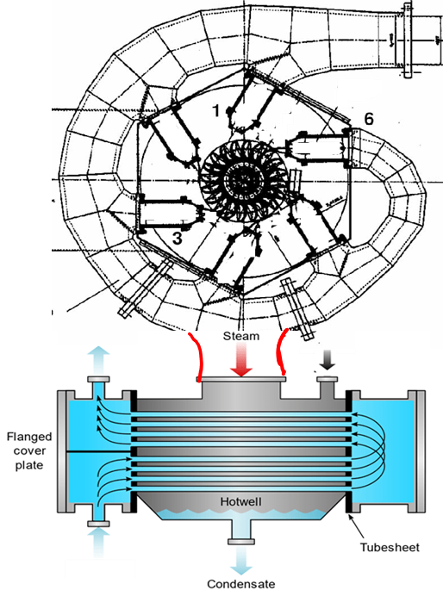
Steam Turbine Flow Path in De Laval Turbine for Maximum Benefits - 1
How to maximize above function for a given rate of fuel consumption?
$$\dot{m}×\frac{V_{se}^{2}}{2}=\dot{m}×\left\{\frac{V_{si}^{2}}{2}−\int_{T_{si}}^{T_{se}}{c_{p}dT}\right\}$$
$$\dot{m}×\frac{V_{se}^{2}}{2}=\dot{m}×\left\{\frac{V_{si}^{2}}{2}−\int_{T_{si}}^{373K}{c_{p}dT}\right\}$$
$$\dot{m}×\frac{V_{se}^{2}}{2}=\dot{m}×\left\{\frac{V_{si}^{2}}{2}−\int_{T_{si}}^{T_{amb} ?}{c_{p}dT}\right\}$$

Slide 24
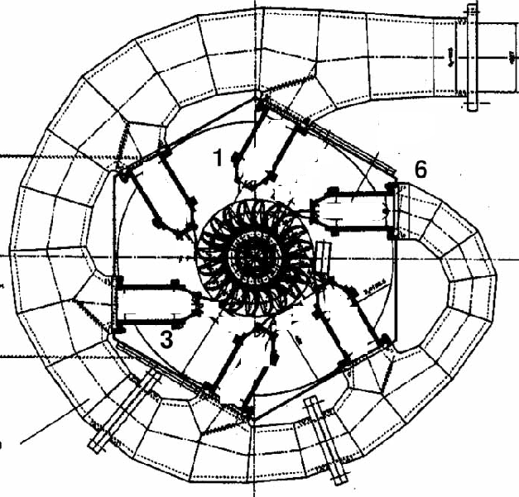
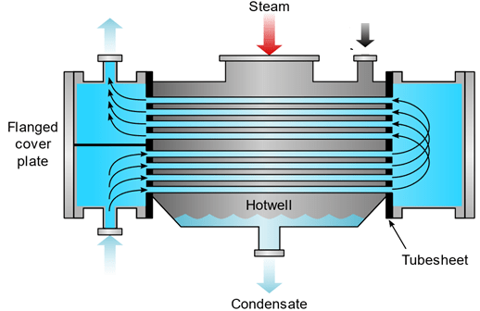
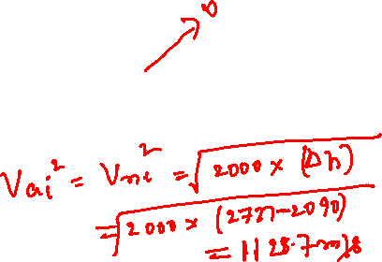
Steam Turbine Flow Path in De Laval Turbine for Maximum Benefits - 2
$$\dot{m}×\frac{V_{se}^{2}}{2}=\dot{m}×\left\{\frac{V_{si}^{2}}{2}−\int_{T_{si}}^{≳ T_{amb} }{c_{p}dT}\right\}$$
How to minimize fuel consumption for a given rise in macroscopic kinetic energy of the jet at the exit of stator/nozzle?

Slide 25
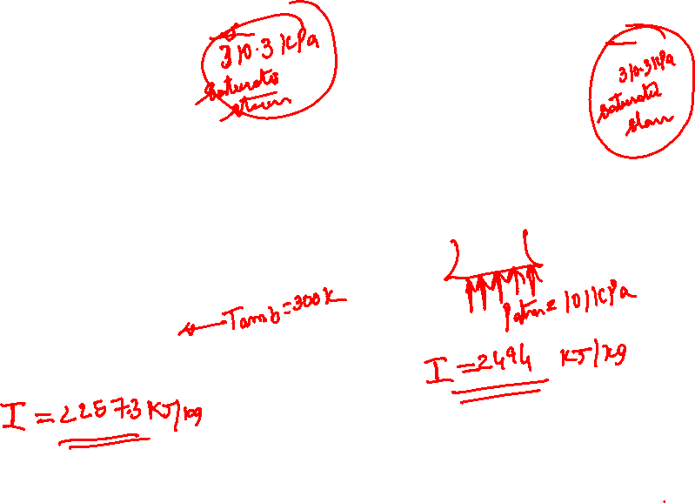
Steam Turbine Flow Path in De Laval Turbine for Maximum Benefits - 2
How to minimize fuel consumption for a given rise in macroscopic kinetic energy of the jet at the exit of stator/nozzle?

Slide 26
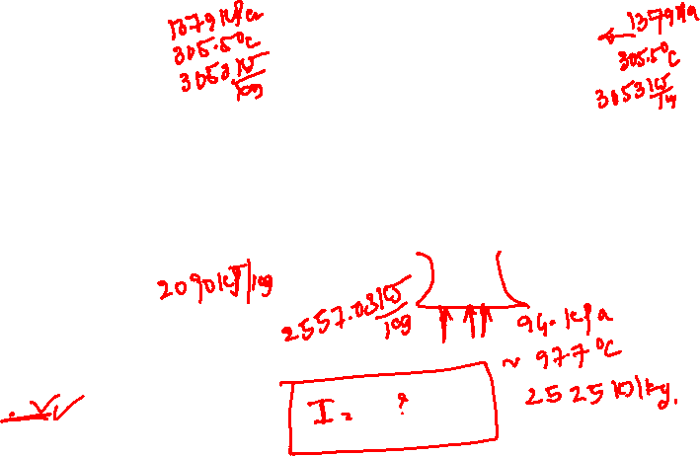
Steam Turbine Flow Path in De Laval Turbine for Maximum Benefits - 2
How to minimize fuel consumption for a given rise in macroscopic kinetic energy of the jet at the exit of stator/nozzle?

